Slide 1
1.2 – 116 GHz Demonstration System
Sander Weinreb, June 2018. sweinreb@Caltech.edu
Hamdi Mani
Status of current hardware
Modeled system performance
Revisions under consideration
Thermal test results

Slide 2
Concept for 1.2 to 116 GHz Receiver
Four dual-polarized receivers in one vacuum chamber and one low powere cryocooler
Proposed bands are 1.2-4.2, 4-15, 15-50, and 70-116 GHz
1.2-4.2 GHz feed cooled to 80K, all other feeds and all LNA’s cooled to 15K
Receiver mounted on X-Y stage for band selection and focus
Weight < 200 lbs and power consumption < 1500W

Slide 3
Current Status of Demonstration System
System with two connected dewars, one cryocooler, and feed for 1.2 to 4.2 GHz has been constructed and is under test.
Current Issues
Current models of QRFH feeds with 3.5:1 frequency range and corrugated feeds with 1.67:1 range show average efficiencies of 76% and 86% respectively. These values are both high compared to currently measured systems and need verification. Is the cost advantage and high frequency range of the wide bandwidth systems worth the lower efficiency?
Thermally-shielded copper straps from cooler to the feed are being evaluated. The use of one low power (1.5 KW AC) cooler to call all 4 feeds has yet to be demonstrated in terms of realized temperatures.
Feed highly optimized for SKA optics. Performance with other optics needs study
Spillover noise of feed in dewar is dependent upon configuration outside of dewar due to backlobe and dewar edge diffraction. Model results with a small cone around the dewar show much improvement.

Slide 4
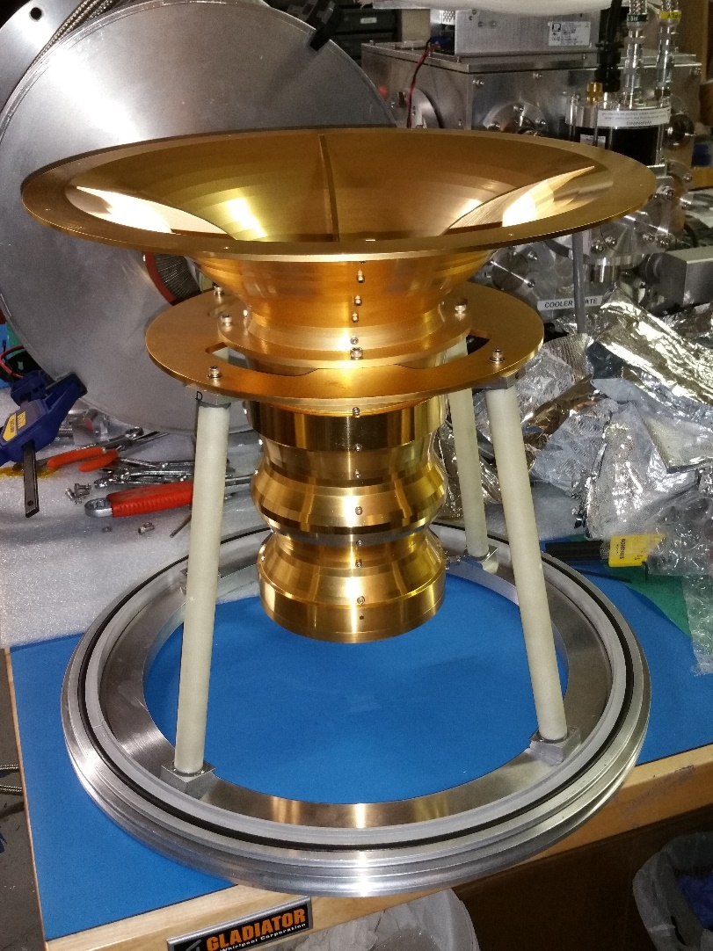
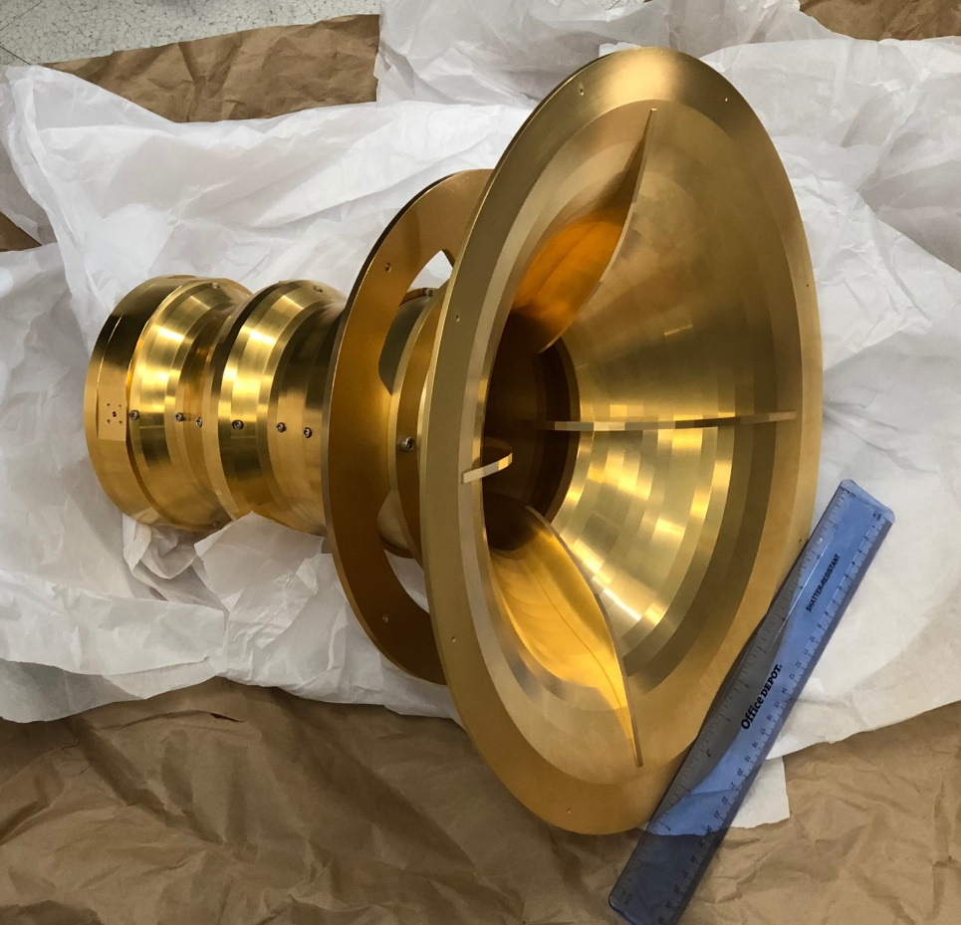
ngVLA 1.2 to 4.2 GHz QRPH Antenna Feed Received Feb 22, 2018

Slide 5
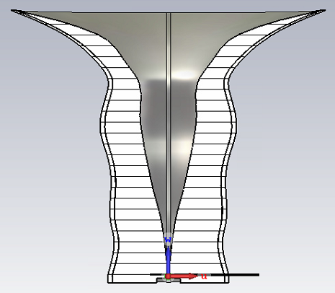
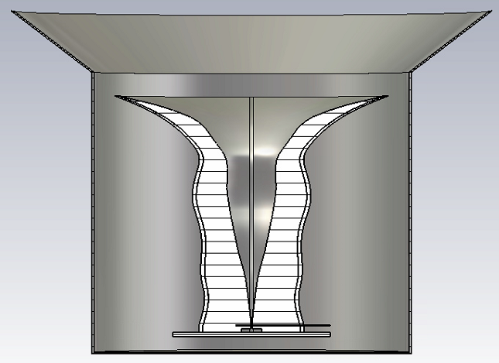
Total Feed Aperture Efficiency and Spillover Temperature
Current ngVLA demonstration design for 1.2 to 4.2 GHz with 58^{O} Half Angle
Feed Without External Feed Cone
With External Feed Cone
Average Efficiency =76%
Average Efficiency =76%
Average Spillover Noise = 11K
Average Spillover Noise = 6K
Feed cone is external to Dewar. Its main effect is on the back lobe
Spillover Noise is at zenith with conservative assumption that ½ the total spillover is at 250K

Slide 6
Currently Available LNA’s for ngVLA
June, 2018
Frequency Range, GHz | Currently Available LNA | LNA Noise, K
1.2 – 4.2 | Caltech SiGe, IHP or ST | 3 to 4.5K
4.2 - 12.3 or 15 | LNF-LNC0.3_14 | 4 to 5K to 12, 8K to 15 GHz
15 - 28 | LNF-LNC15_29B | 6 to 10K to 28 GHz, 14K at 30 GHz
30 - 50 | LNF-LNC28-52B | 8 to 14K
70 - 116 | Caltech InP, NGC, or LNF | 25 to 30K

Slide 7
Total System Noise Estimate at Center Frequencies of Primary Interest
Noise, K, due to component | Remarks | Tsys 1.4 GHz | Tsys 8 GHz | Tsys 15 GHz | Tsys 35 GHz | Tsys 80 GHz
Sky | Background + atmosphere, 45deg, 13mm | 4 | 6 | 8 | 15 | 43
Spillover & Blockage | Reduce with offset antenna And ground shield | 9 | 4 | 3 | 3 | 3
Feed loss | Computed 0.1 dB @60K for 1.4 GHz @20K for 8-116 GHz | 1 | 1 | 1 | 2 | 4
Window and IR Filter | Mylar window; multilayer polymer blanket | 2 | 3 | 3 | 3 | 3
Feed to LNA No Coupler | 0.1 dB | 1 | 1 | 2 | 2 | 2
LNA | Robust LNA measured at connector | 4 | 3 | 5 | 12 | 25
Total | Estimate, +/- 5K | 21 | 18 | 22 | 37 | 80

Slide 8
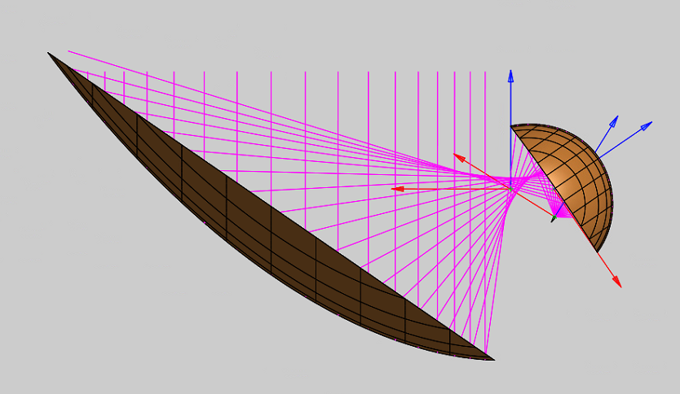
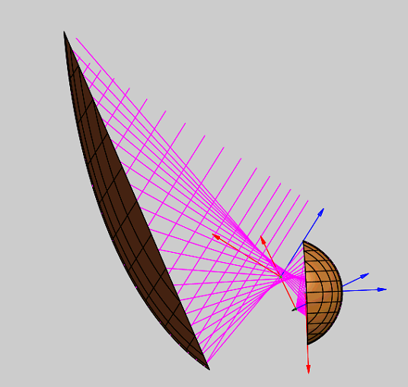
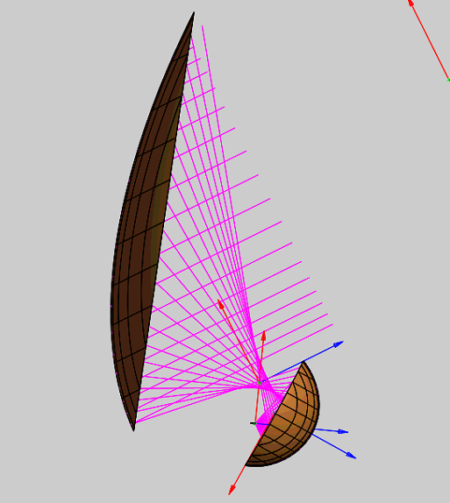
Offset Gregorian Ray Paths at El. 90º, 60º, and 15º
The receiver system requires offset Gregorian optics such as that used on the Meerkat antennas and selected for the SKA dish array.
No primary beam blockage with large subreflector and receiver platform
Spillover is in cold sky for upper half of both subreflector and main reflector for all elevation angles
El. 60°
El. 15°
El. 90°

Slide 9
Sub Reflector Extension to Reduce Spillover
Isak Theron “The design of the MeerKAT dish optics”, IEEE, 2012
Similar though larger shield used on Allen Telescope Array (ATA)
A small shield on lower edge of the subreflector lowers the spillover noise by ~4K over a wide range of zenith angle – A significant improvement to Tsys and allows the feed to be positioned near the ground for maintenance
Notes:
Trcvr values include LNA and cold losses due to feed, window, and IR filter
Tsky values are from B. Butler, NRAO, 2016 and are for VLA site at zenith, with 13mm water vapor

Slide 10
Revisions Under Consideration for ngVLA Demonstration Receiver
Change | Pro | Con
Increase receivers from 4 to 5; see frequency lineup below | Increased sensitivity in the 15 – 50 GHz range | Estimate cost increase of ~$100K per receiver, $20M total
Separate into two dewars with two coolers | Simplifies thermal design. Lower temperature for LNA’s | Forces two coolers with increased capital and operating cost
Provide demo system closer to ngVLA baseline | Provides a hardware demo to strengthen proposal and reduce risk | Requires additional development funds
Current Demonstration
Receiver
Revised ?
Demonstration
Receiver
Current ngVLA
Baseline
Band | GHz
1 | 1.2 – 3.5
2 | 3.5-12.3
3 | 12.3 – 20.5
4 | 20.5 – 34.0
5 | 30.5 – 50.5
6 | 70 - 116
Band | GHz
1 | 1.2 – 4.2
2 | 4.2 - 15
3 | 15 – 50
4 | 70 - 116
Band | GHz
1 | 1.2 – 3.5
2 | 3.5-12.3
3 | 12.3 – 30.5
4 | 30.5 – 50.5
5 | 70 - 116

Slide 11
Backup Slides

Slide 12
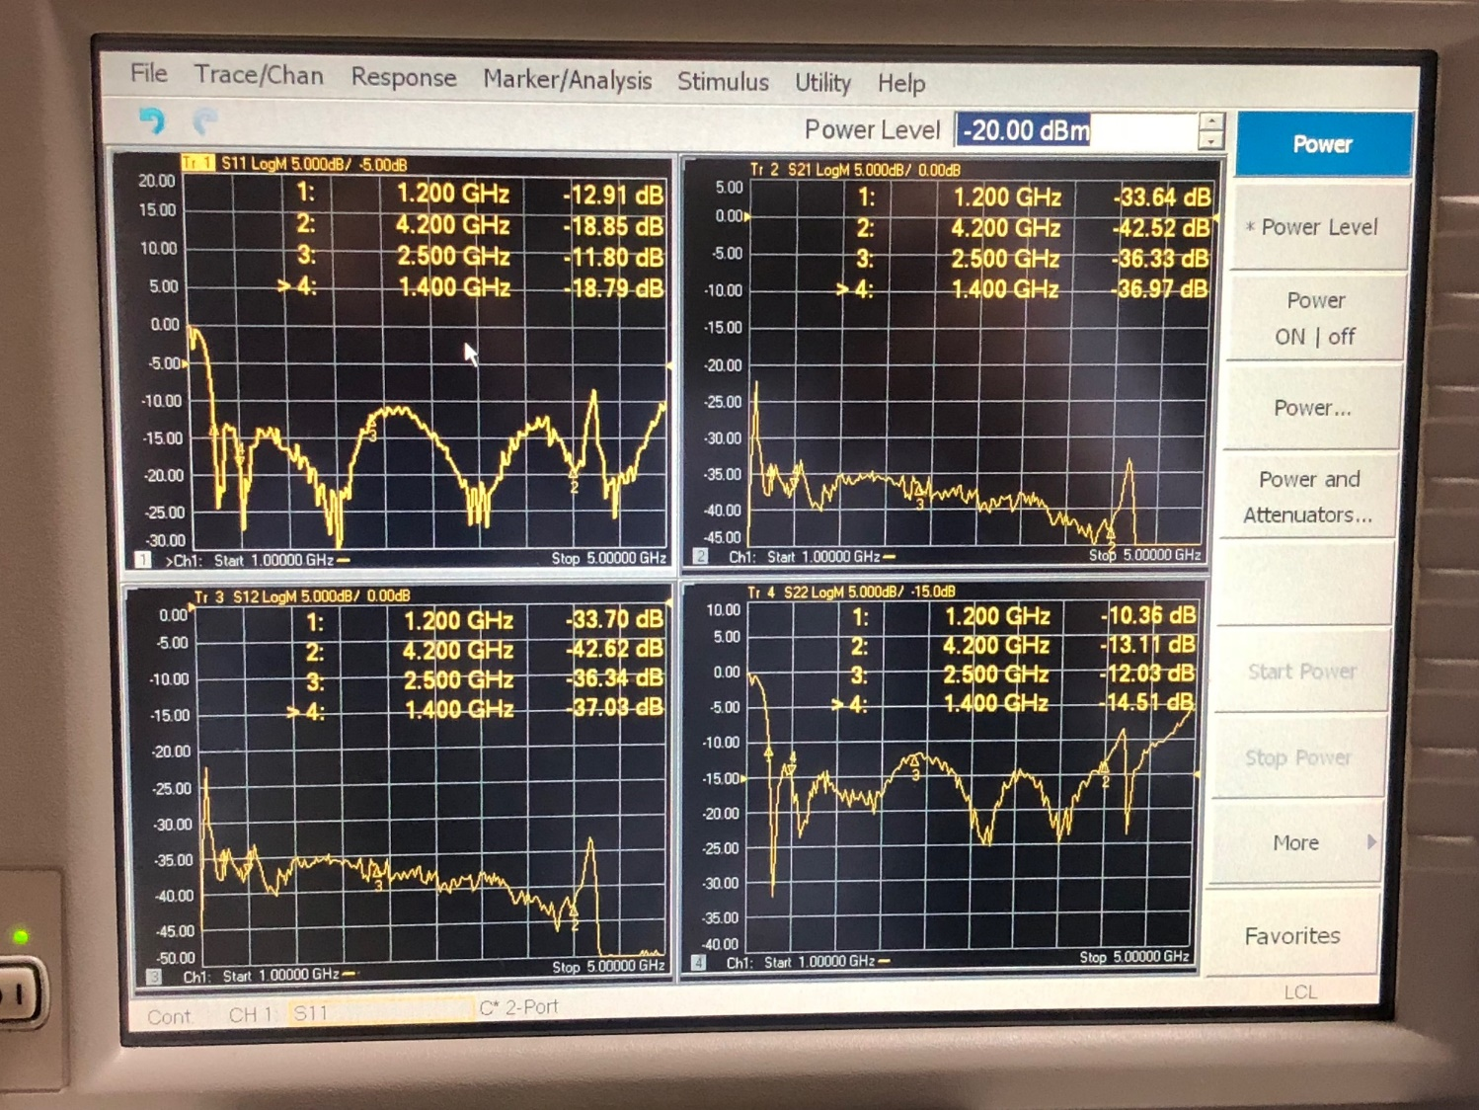
Measured S Parameters of Feed
One polarization on Port 1; other on Port 2.
Return loss of both ports averages to 15 dB form 1.2 to 4.2 GHz. This is excellent and is what what is expected.
Cross coupling is less than 34 dB which shows excellent symmetry of fins and low capacitance between coaxial probe.

Slide 13
Modeled Return Loss of Feed Output Linear Polarization Port.
Port 1 in red; port 2 in blue
Very close agreement of measured and modeled results

Slide 14
Effect of Feed Mismatch on LNA Gain and Noise Temperature
Gain (S21) in red, noise temperature in brown, and input reflection in blue
Solid lines are with no feed reflections and dashed lines are for modeled feed
Results are for port 1 including 133.9 mm of 50 ohm line between center of feed and LNA input
Data is in LNA model file, MWO IHP12BFUFeb17.emp

Slide 15
Self-Heating Limitation to Noise of Cryogenic Transistors
We will attempt to mitigate this heating by flowing LHe4 on the surface of the transistor.

Slide 16
Very Low Noise LNA at 300K for FRB Detection
J. Shi and S. Weinreb, Jan 25, 2018
Designs for 1.2 to 1.6 GHz and 1.2 to 4 GHz are shown
Both are two-stage designs with an OMMIC HEMT first stage
Wider band design needs a 3rd stage to increase and flatten gain
Calibration noise will be built into amplifier
Weatherproof case with type N connectors is planned

Slide 17
Next Generation Very Large Array - ngVLA
A radio astronomy instrument under development by National Radio Astronomy Observatory to be located in New Mexico
Science drivers are orgins of planets, life, stars, galaxies, and the universe
Complements other radio telescopes (SKA, ALMA , and JVLA) in terms of its frequency range of 1.2 to 116 GHz and array baselines to 300km
Conceptual design in process for proposed detailed design by 2024 and completion by 2030

Slide 18
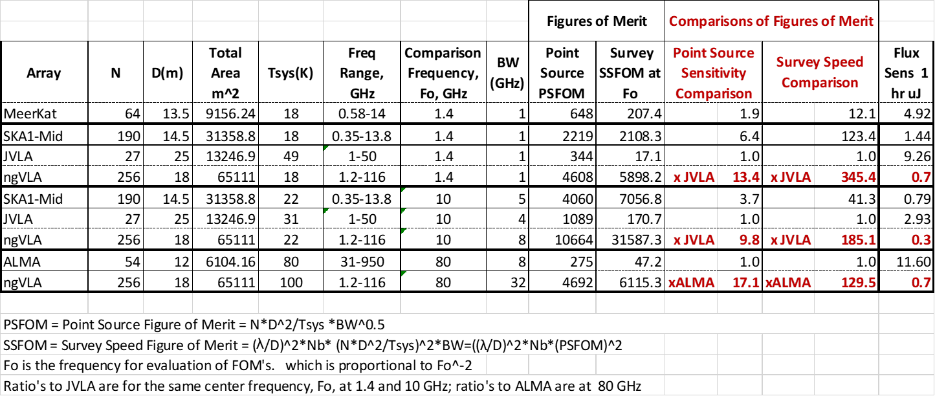
Comparison of ngVLA With Existing or Planned Radio Arrays
The ngVLA fills the gap in frequency (13 to 116 GHz) between the SKA and ALMA
The ngVLA will have an order of magnitude greater sensitivity and resolution compared with the current JVLA; survey speed is two orders greater

Slide 19
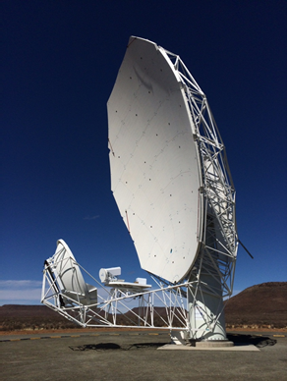
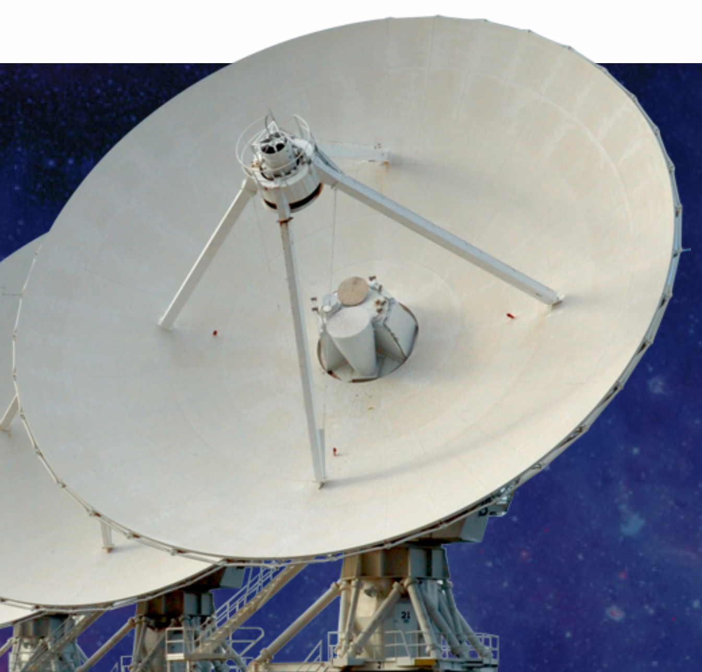
Reflector Optics Design
JVLA 25m Shaped Cassegrain
8 large feeds,< octave BW to cover 1 to 50 GHz
Each receiver has cryocooler which increases maintenance and power costs
ngVLA 18m Shaped Offset Gregorian
Clear aperature (no blockage) to decrease system noise and reduce sidelobes
1.2 to 116 GHz with 4 to 6 feeds
Easy access to receivers for maintenance

