Slide 1
ngVLA Optics Workshop
Keck Center, Caltech,Pasadena, CA, June 19-20, 2018
Agenda, Day 1, Tuesday, June 19
Time (PDT) Topic Persons
0900-0930 Workshop Objectives Sandy Weinreb
0930-1010 ngVLA Project Overview & Status Rob Selina* or Eric Murphy*
(Science, schedule, heterogeneous array, on-going tasks)
1010-1040 Optics Requirements & Reference Design Rob Selina *
(Sensitivity, critical bands, polarization, sidelobes, etc.)
1040-1100 Break
1100-1140 DVA1/DVA2/ngDVA Optics and Feed Design Lynn Baker
1140 -1220 ngVLA Baseline Receiver and Cryogenics Denis Urbain
1220-1330 Lunch
1330 -1410 SKA Reflector and Feed Design Dirk de Villiers, Robert Lehmensiek (SKA dish shape requirements, modeled efficiency and spillover noise, expected tests, octave vs wideband feed comparison)
1410-1440 Antenna and Feed Design at NRC Bruce Veidt
1440-1500 Break
1500 -1540 Octave Band Feed Design Performance Sri Srikanth
1540-1620 Performance of 1.2 to 4.2 GHz Feed Jonas Flygare
and SKA Wideband Study
1620-1700 Further Development of QRFH Feeds Ahmed Akgiray, Jun Shi
1900-2100 Dinner at Athenaeum Outdoor Facility

Slide 2
Agenda, Day 2, Wednesday, June 20, 2018
0900-0940 SKA Feed and Cryogenic Integration Mike Jones
0940-1020 1.2 – 116 GHz Demonstration System Weinreb, Mani (status and alternatives)
1020-1100 Alternative Cryogenic Systems for ngVLA Larry D’Addario
1100-1200 Open discussion and Way Forward Sandy Weinreb
Objectives and Key Issues
Reflector Shape and Sub Reflector Size
How were DVA1/2 and SKA geometries chosen?
Importance of spillover noise and shields.
Receiver Frequency Ranges
Numbers of receivers, dewars, and coolers
Sensitivity vs feed frequency range
Receiver Calibration Method
Directional couplers vs noise injection

Slide 3
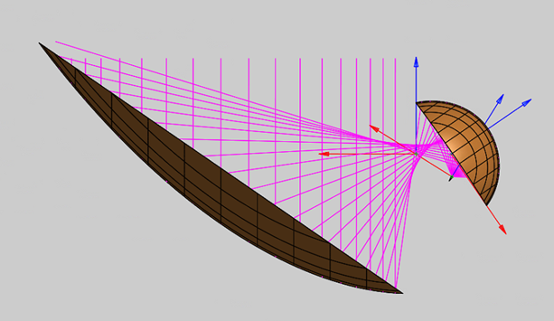
Reflector Shape and Sub Reflector Size
The 18m/3.5m is being used for mechanical design and is based on early studies of the Canadian DVA1 reflector while the 15m/5m design (scalable to 18m/6m) is being used for all SKA feed designs and construction of prototype antennas
Rationale and modeled performance of both designs will be presented at the workshop. A highly important factor is the spillover noise which may dominate the system temperature below 10 GHz.
Note that the wind loading which effects the pointing error may be dominated by the large area of the main reflector.
18m/3.5m Shape for DVA1/2
15m/5m Shape Used by SKA

Slide 4
Number of Receivers, Dewars, and Coolers for 1.2 to 116 GHz Range
Current Demonstration
Receiver
Revised ?
Demonstration
Receiver
Current ngVLA
Baseline
Band | GHz
1 | 1.2 – 3.5
2 | 3.5-12.3
3 | 12.3 – 20.5
4 | 20.5 – 34.0
5 | 30.5 – 50.5
6 | 70 - 116
Band | GHz
1 | 1.2 – 4.2
2 | 4.2 - 15
3 | 15 – 50
4 | 70 - 116
Band | GHz
1 | 1.2 – 3.5
2 | 3.5-12.3
3 | 12.3 – 30.5
4 | 30.5 – 50.5
5 | 70 - 116
Are current estimates of feed efficiency and spillover of 3.5:1 and 1.67:1 frequency range designs correct? What further design is needed?
How do these bands map into existing LNA’s, dewars, and cryocoolers?

Slide 5
Comparison of Sensitivity (Tsys/η) of 6 Receiver ngVLA Baseline Plan (black) and 4 Receiver Current Demonstration Plan (blue) – From Wes Grammer, May, 2018

Slide 6
Receiver Noise Calibration Signal
Almost all radio astronomy receivers built in the last 50 years have a noise source generator coupled into a directional coupler beteen the antenna and low noise amplifier. The calibration signal has traditionally been used to determine the flux of a radio astronomy emitter.
The primary need for this calibration signal is no longer required because so many known radio sources now have known flux (i.e. calibrator sources). These are superior to the noise source calibration because they include the effects of antenna efficiency and atmosphere which are even more variable than the receiver gain.
The directional coupler introduces loss which increases Tsys and have size which increases cooling requirements. This is especially true for wideband coaxial couplers used in the low microwave range, say < 18 GHz.
A secondary purpose of the noise calibration signal is to check that the receiver has not changed. This can be performed without the directional coupler by either weak coupling of noise into the feed or through a high value resistor, say 5000 ohms attached in parallel with the 50 ohm receiver input.

Slide 7
Best Candidate Coaxial Directional Couplers for Calibration injection
Exceptionally low loss directional coupler, .05 dB at 4 GHz. Needs to be tested at cryogenic temperatures. Minicircuits ZGDC35-93,
Length 6” with adaptors
Typical directional coupler, <.5 dB loss from 4 to 12 GHz. Krytar 120430. Length ~2”

