Slide 1
ngVLA Pathfinder system Thermal Tests
Hamdi Mani / Sandy Weinreb
06/20/2018
Tests with dummy feed and Stirling cooler
Tests with 1.2-4.2 GHz feed and small (1.5 kW) Sumitomo cooler

Slide 2
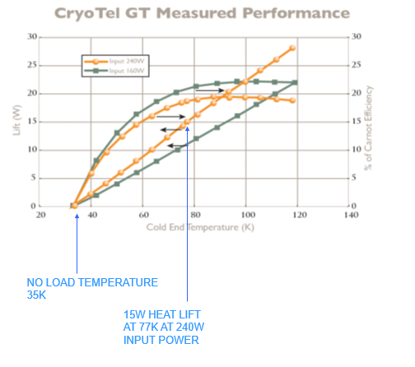
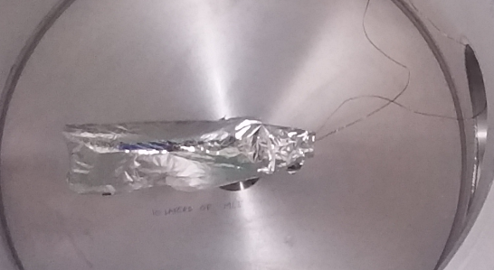
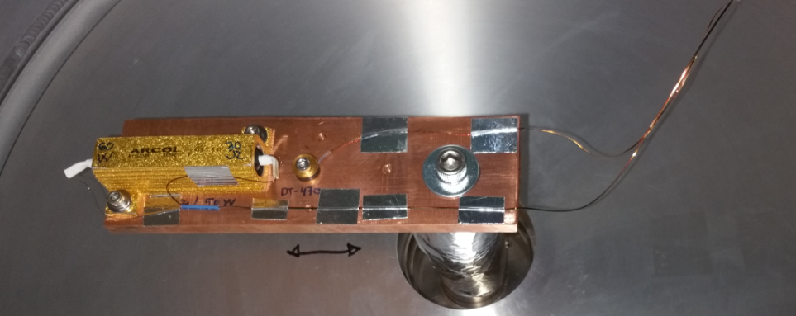
Sunpower GT Stirling Cycle Cryogenic Cooler

Slide 3
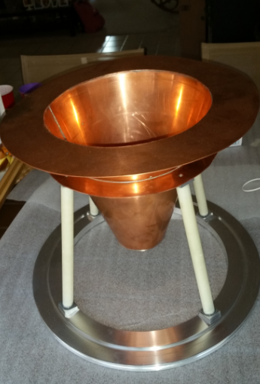
Physical Properties for Dummy_Feed
General Properties:
Material: {Copper}
Density: 8.940 g/cm^3
Mass: 4.610 lbmass
Area: 800.460 in^2 ~ 0.5m^2
Volume: 14.275 in^3

Slide 4
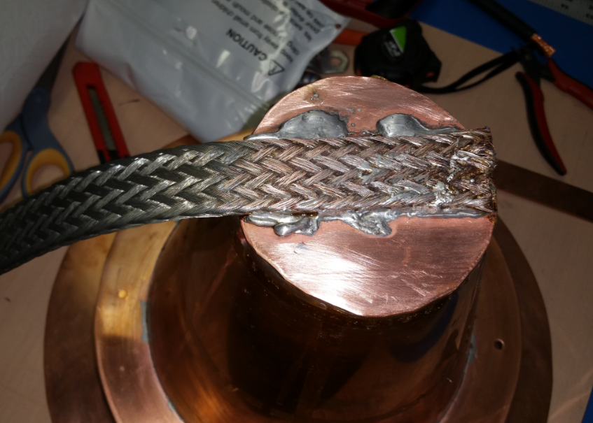
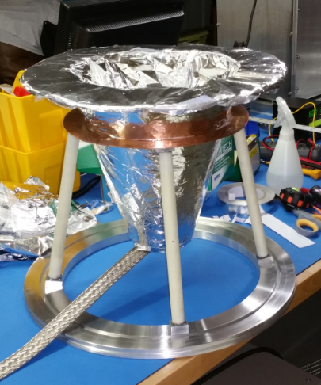

Slide 5
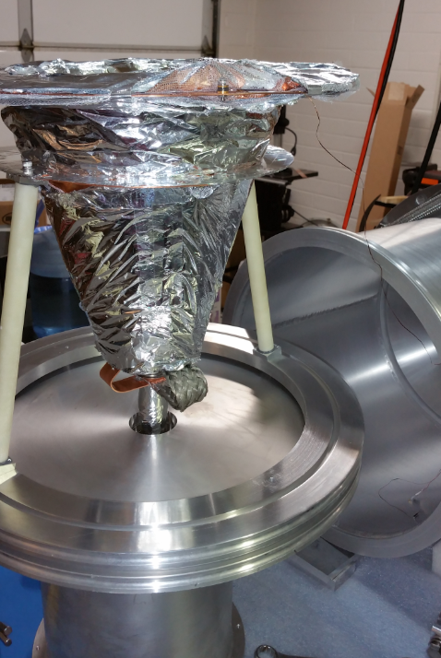
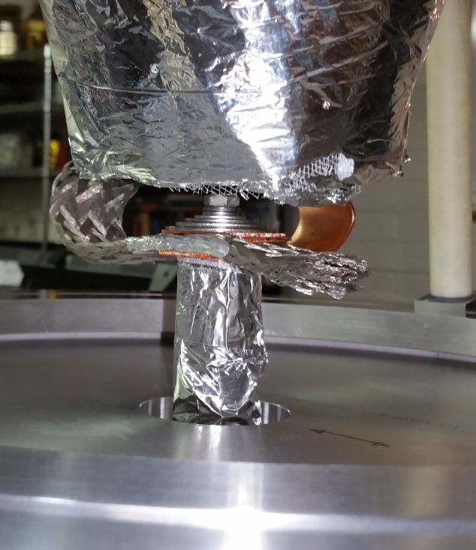
2 Heat Straps:
1in x 1/8 in x 5in
One strap made of braided copper
The other strap made of solid OFHC Copper

Slide 6
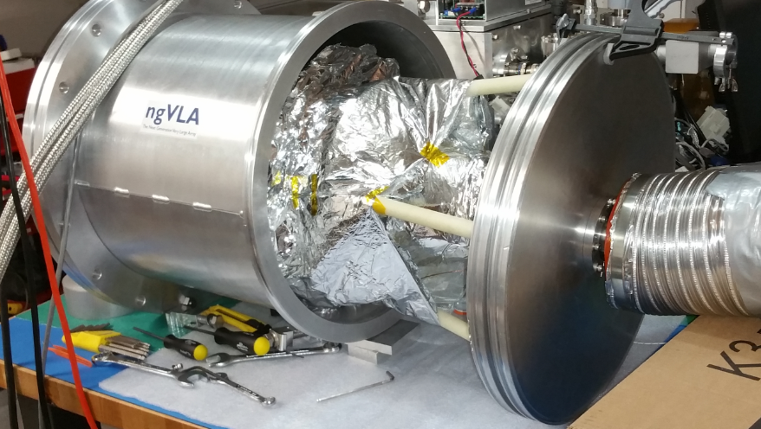

Slide 7
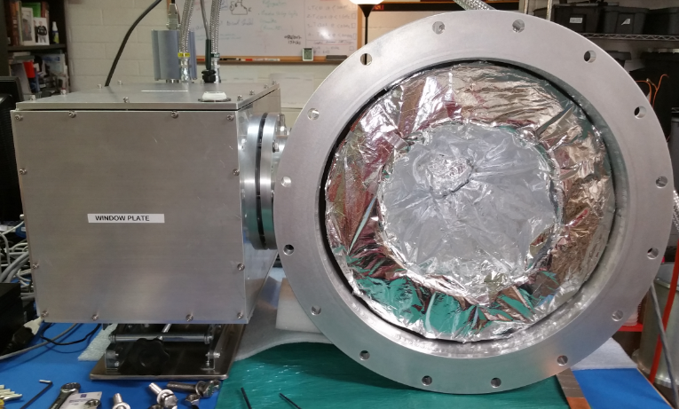

Slide 8
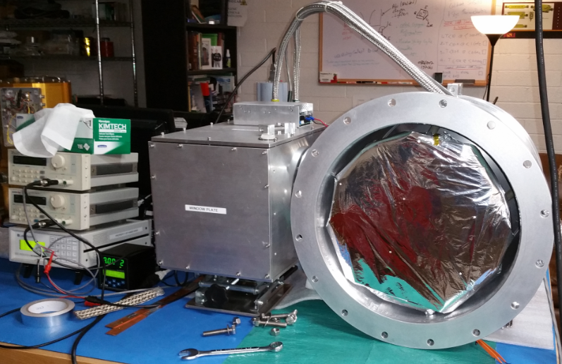
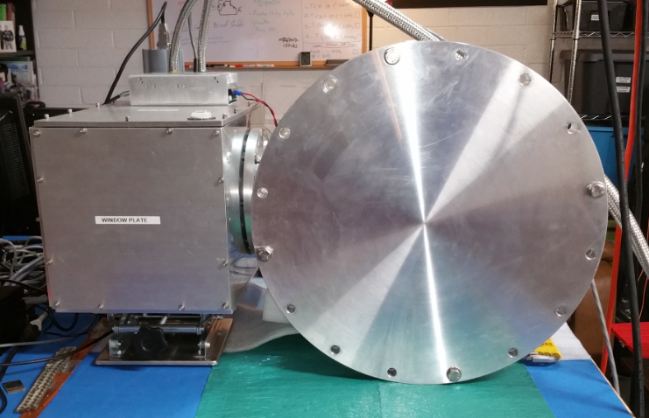
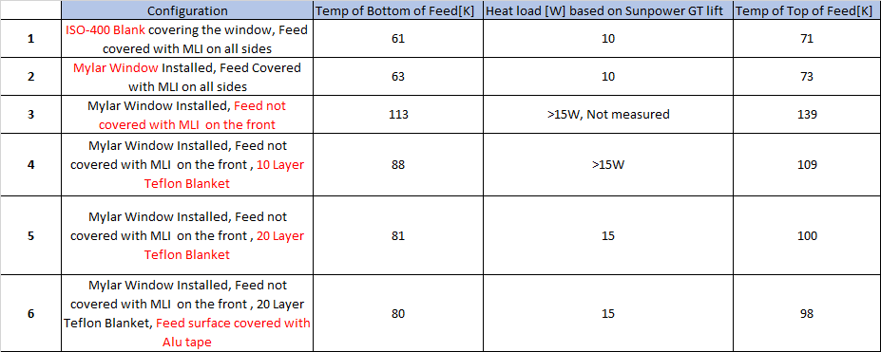
Configuration # 01

Slide 9
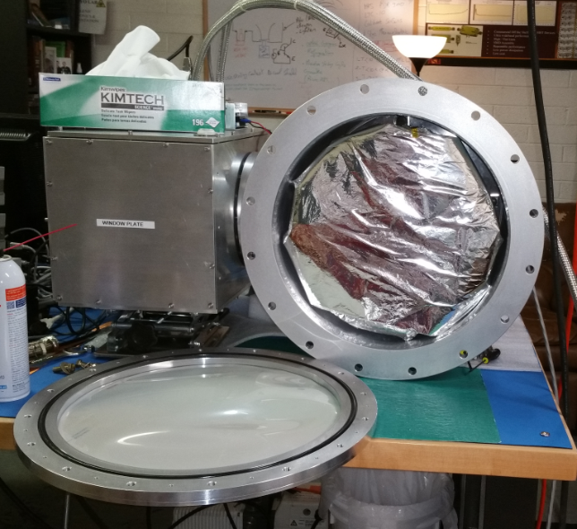
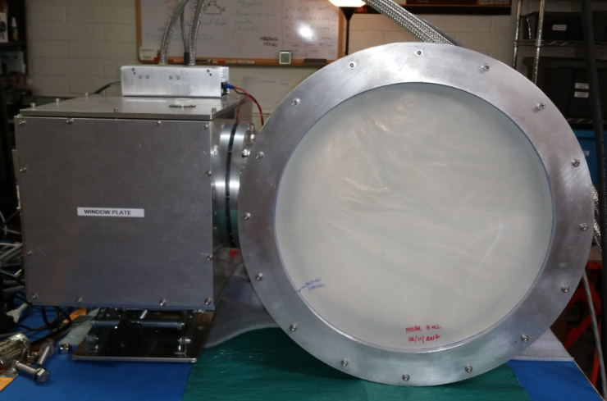
Configuration # 02

Slide 10
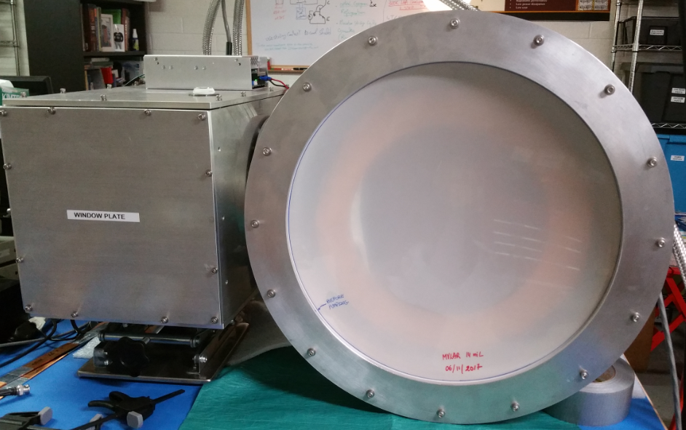
Configuration # 03

Slide 11
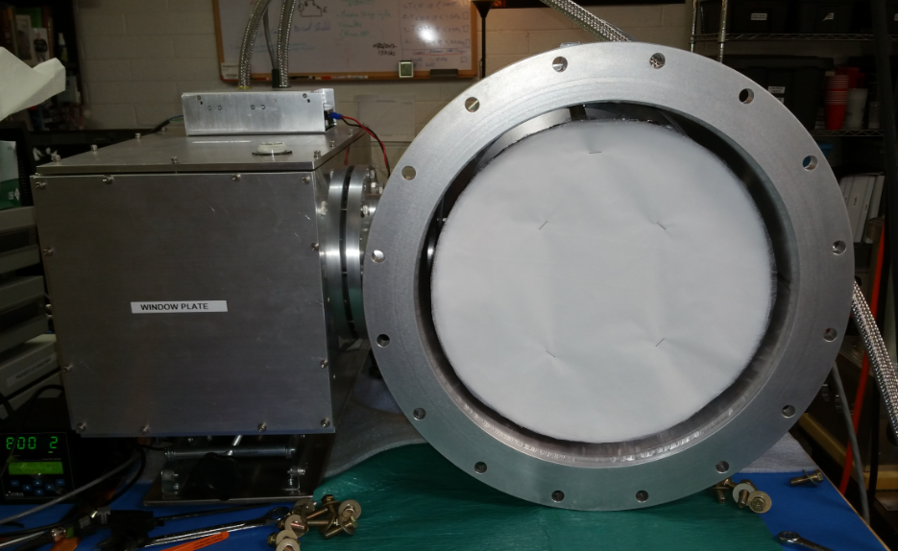
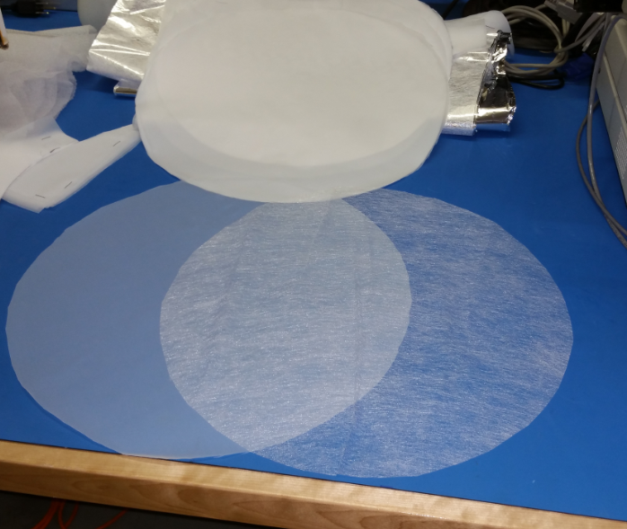
Configuration # 04

Slide 12
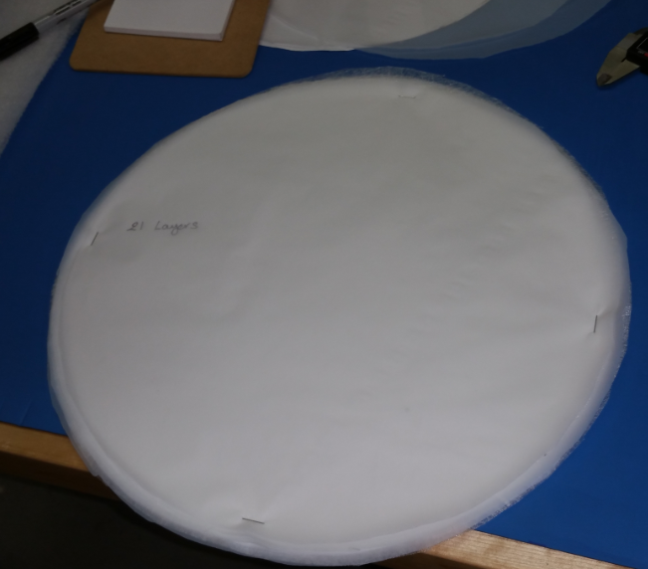
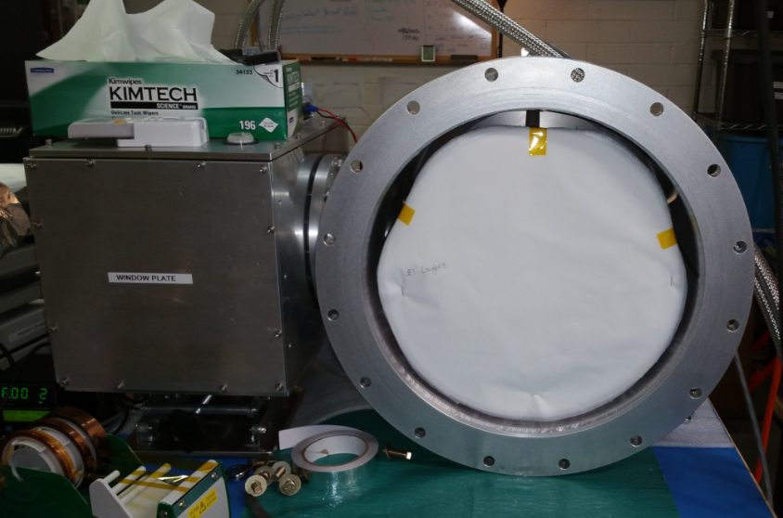
Configuration # 05

Slide 13
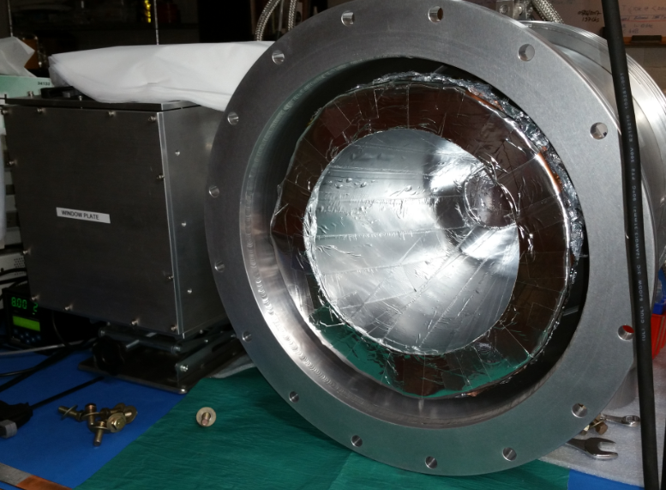
Configuration # 06

Slide 14
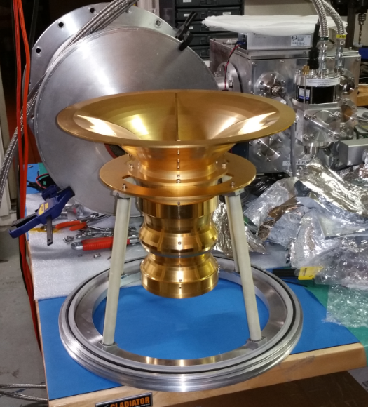
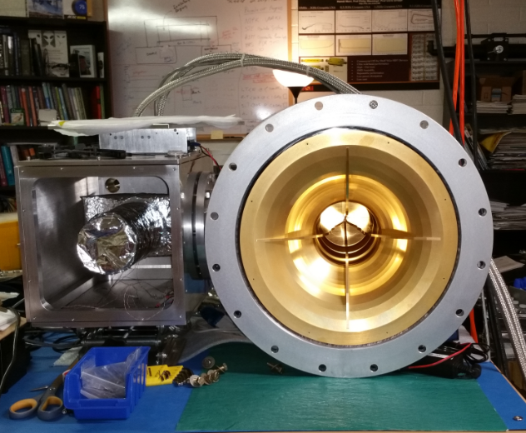

Slide 15
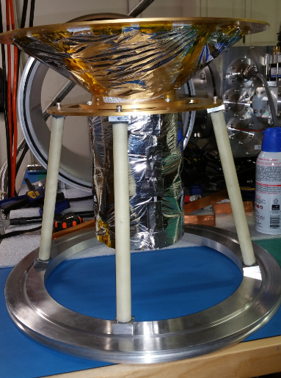
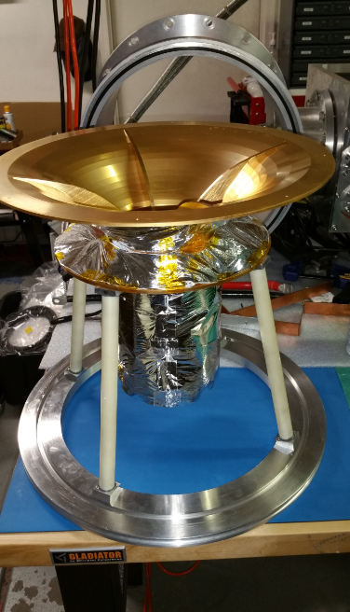
Feed covered with MLI on sides

Slide 16
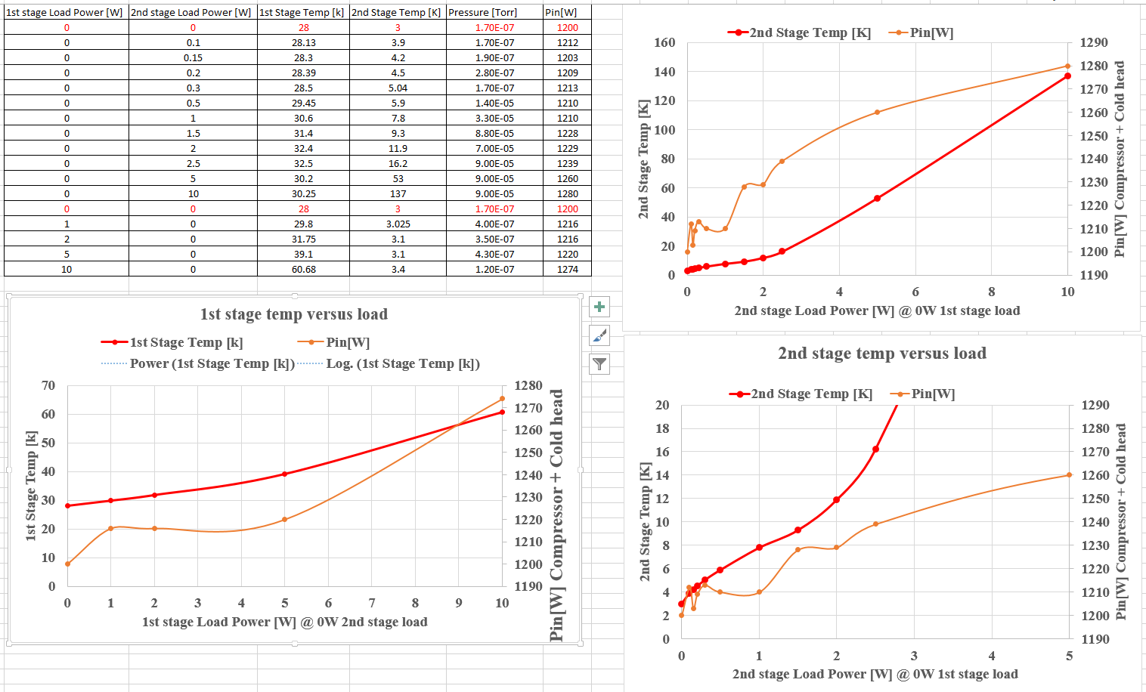

Slide 17
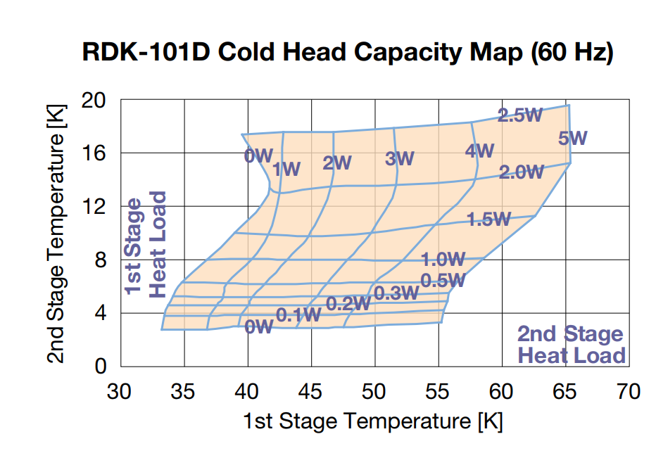

Slide 18
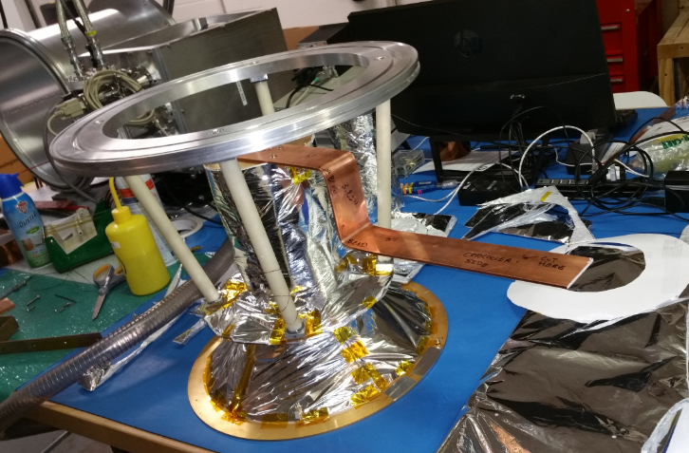
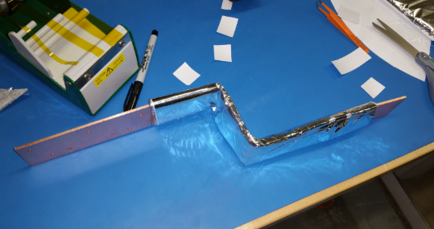
Heat strap connecting the feed to
the Sumitomo 1st stage
Heat strap dimension: 1/8” x 2 “ x 21.5”
OFHC Copper
Covered with 10 layers of MLI

Slide 19
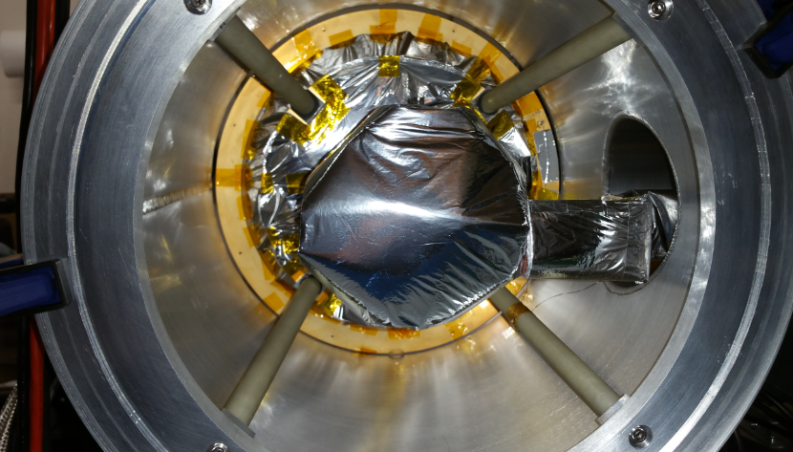
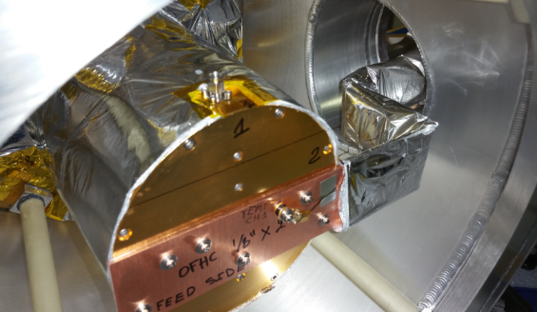
Temp Sensor mounted on top plate of feed
Temp sensor mounted on bottom plate
Of feed

Slide 20
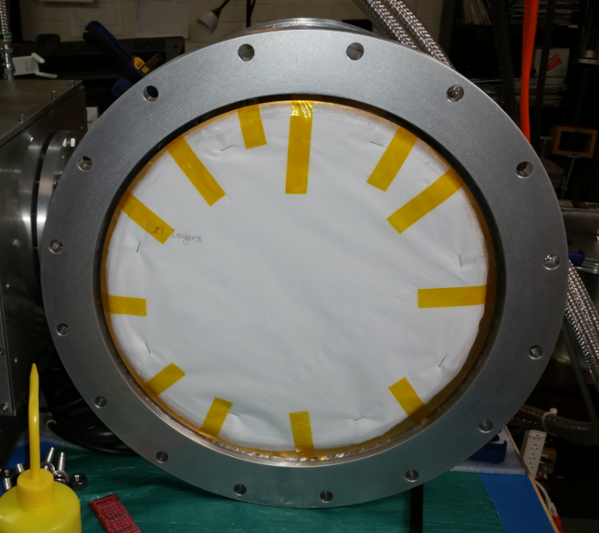
Teflon blanket made of 21 layers

Slide 21
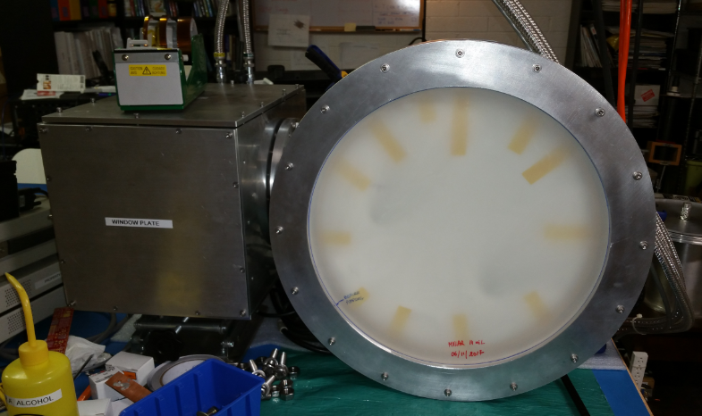
14 mil thick Mylar
Window
Temperatures after 24 Hour cooldown
Top plate of feed: 167K
Bottom plate of feed: 158K
Cooler 1st Stage: 88K
Cooler 2nd stage: 6K
More work is needed to make a better heat strap:
Low thermal resistance heat strap: use OFHC copper material and with low contact resistance

Slide 22
Low thermal resistance heat strap: use OFHC copper material and with low contact resistance

