Slide 1


Galactic Gravitational Waves and Pulsar Timing Arrays
Dusty Madison
2018 Jansky Symposium Socorro, NM

Slide 2
Overview
GW searches across the spectrum
Galactic considerations for pulsar timing
GW Bursts with Memory
Possible Galactic Memory sources
The real, non-revisionist story

Slide 3
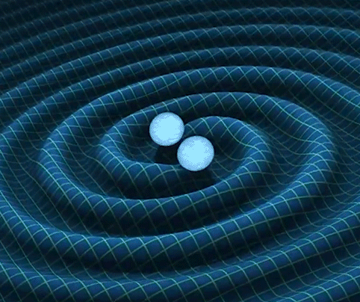
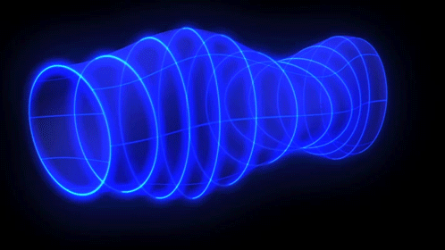
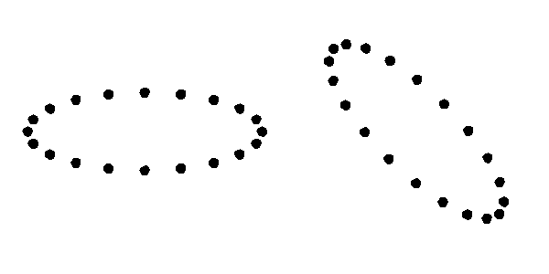
Gravitational Waves

Slide 4


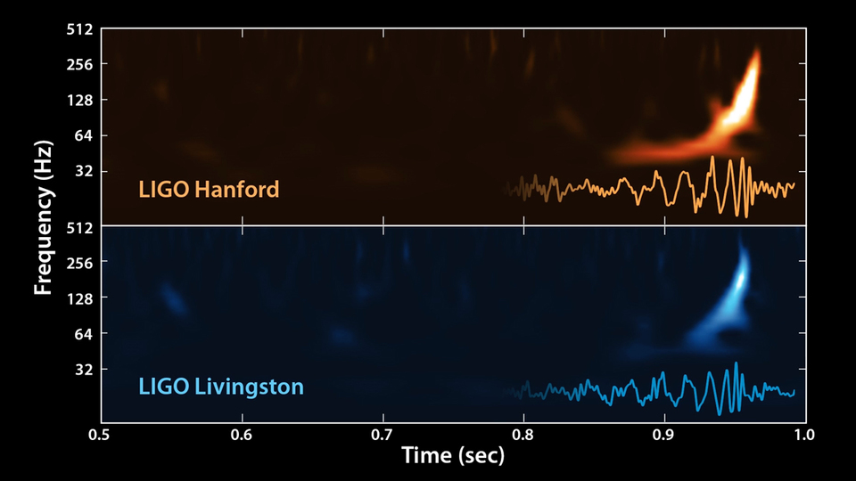

A GW Celebrity

Slide 5

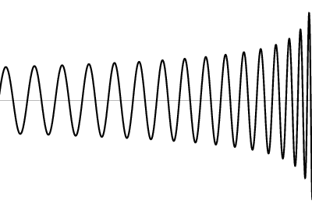
A Straightforward Measurement
…
4 km
few x 100 Mpc

Slide 6
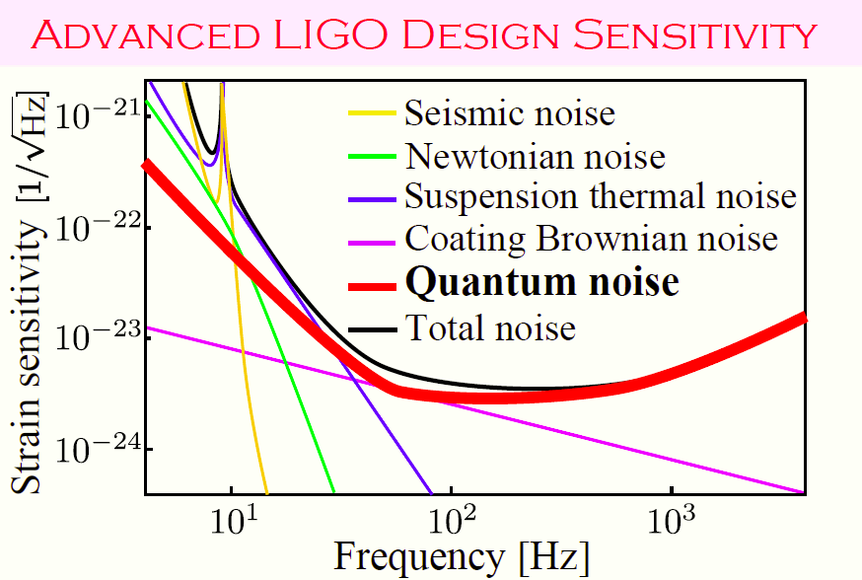
LIGO’s Noise

Slide 7

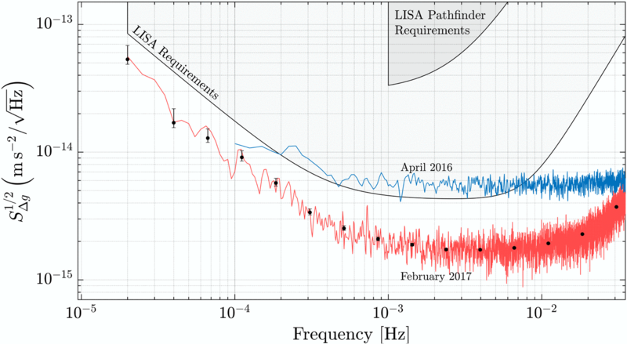
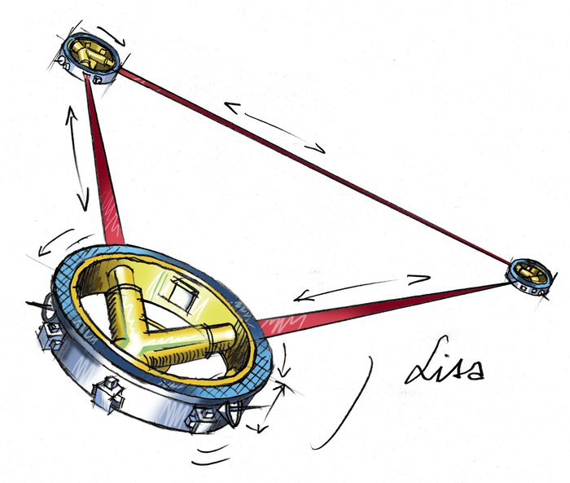
A Space Based Detector

Slide 8
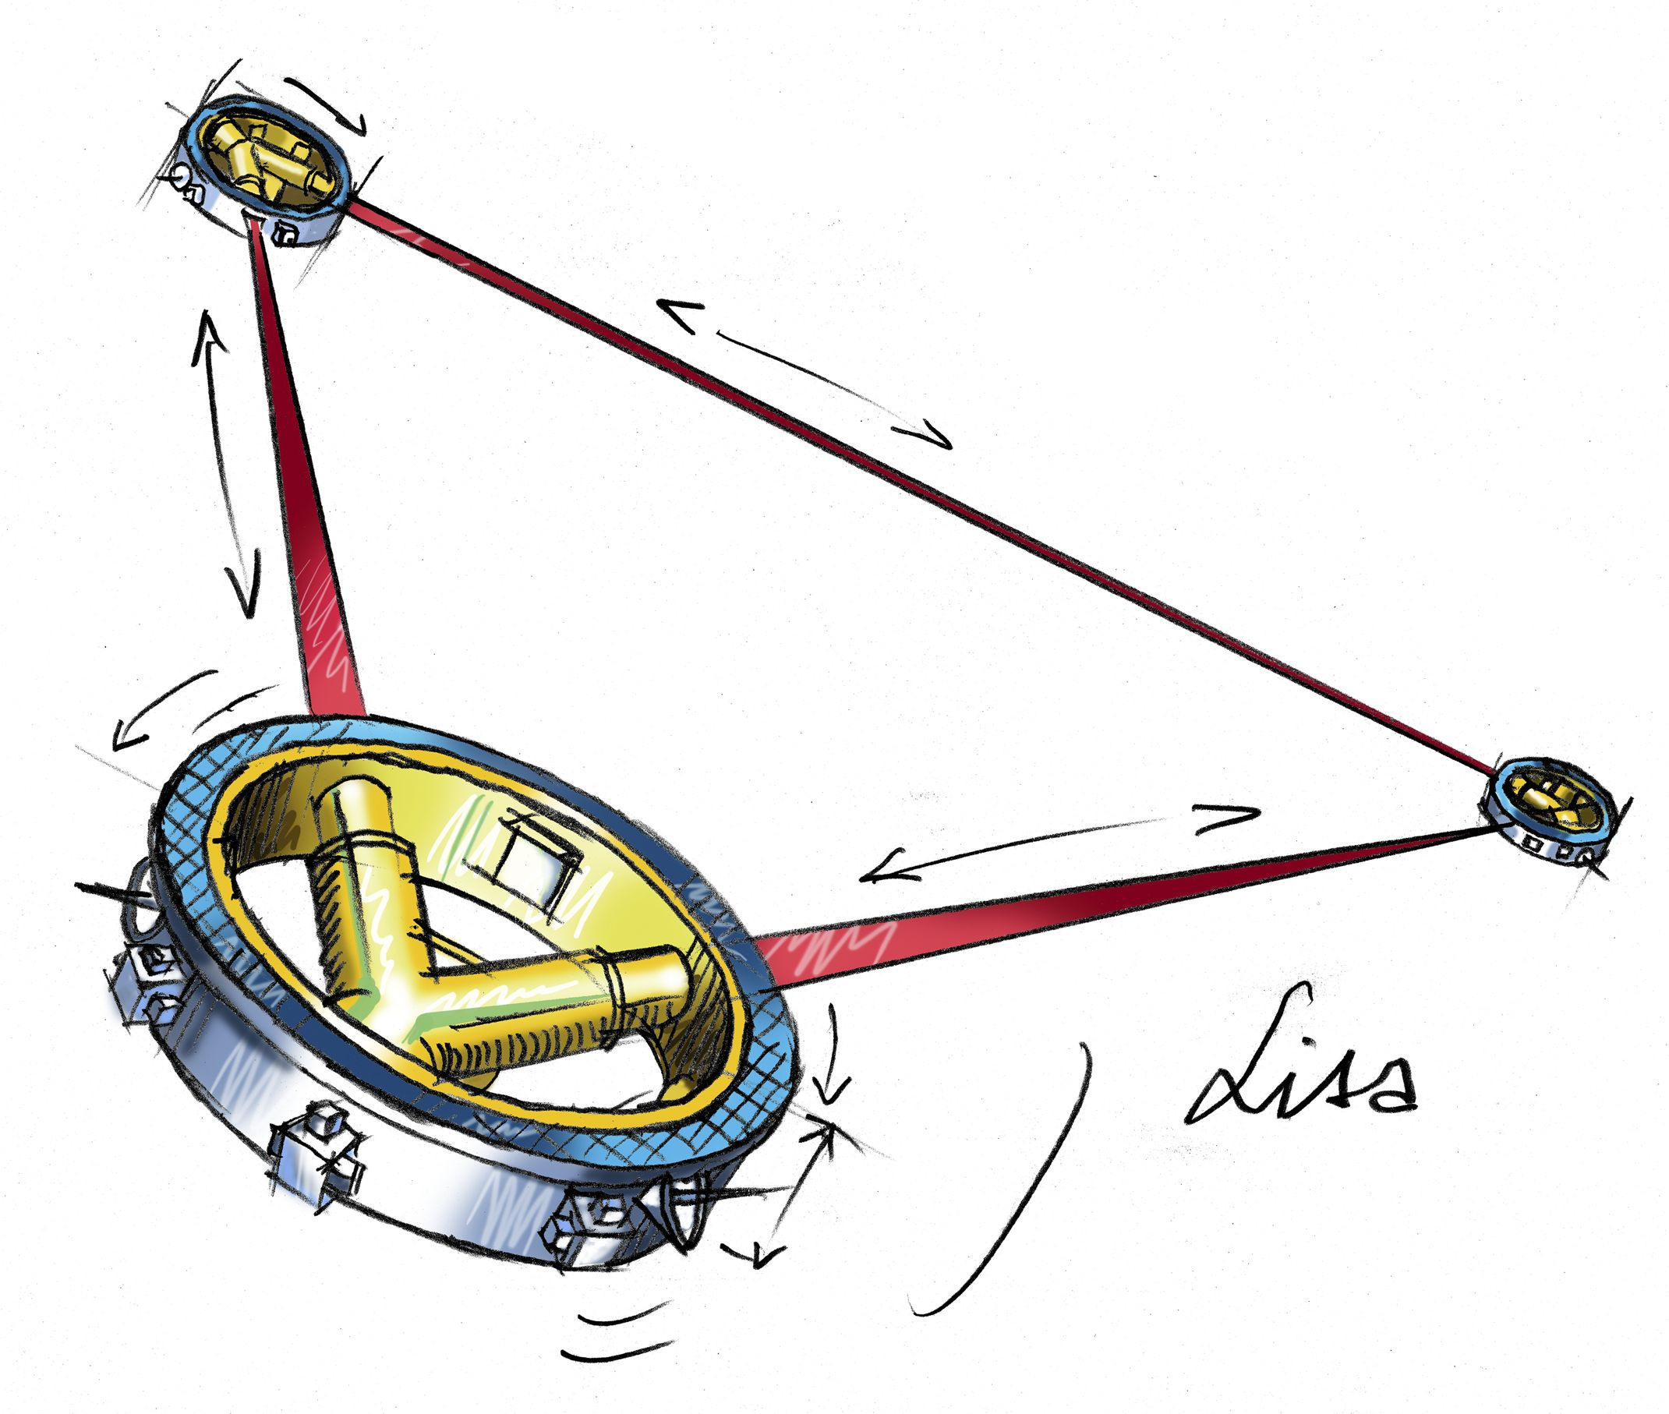
Similar Idea
…
5e6 km
few x 100 pc — few x 100 Mpc

Slide 9
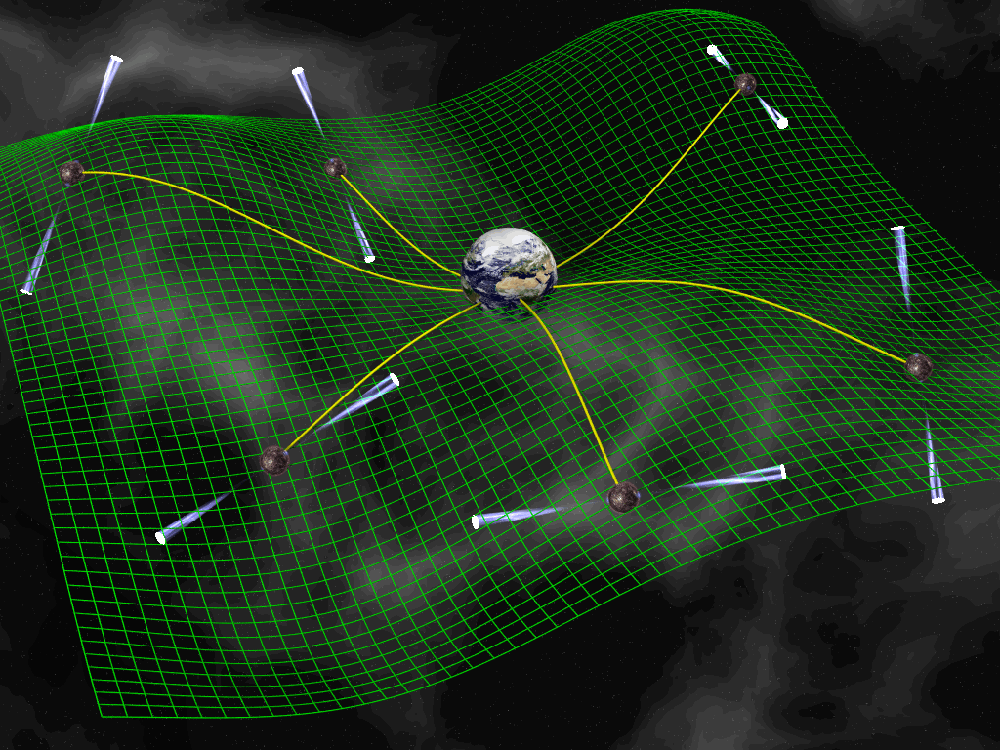



A Pulsar Timing Array
The Standard Graphic

Slide 10

Similar Idea Again
…
few kpc
few x kpc — few x 100 Mpc

Slide 11
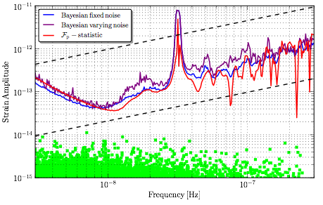
NANOGrav’s Noise
Arzoumanian et al. (2014)

Slide 12
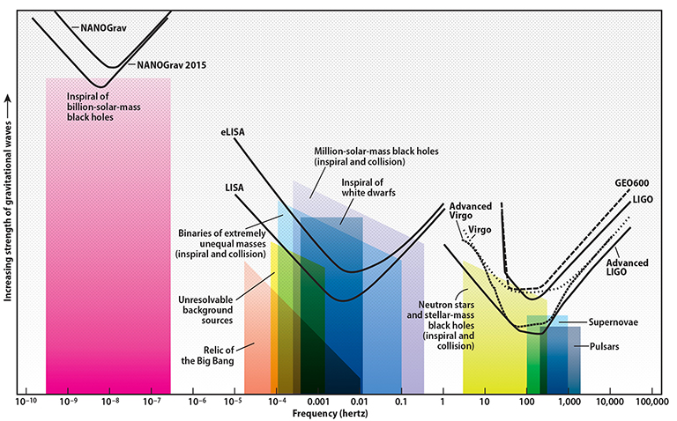
The Full Spectrum

Slide 13

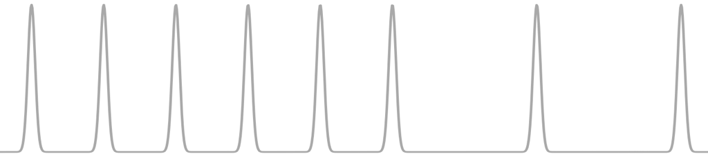

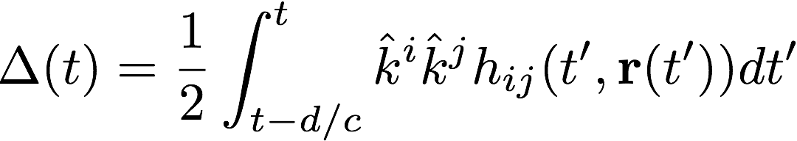


What do we Measure?

Slide 14

What do we Measure?
Earth term
Pulsar term

Slide 15
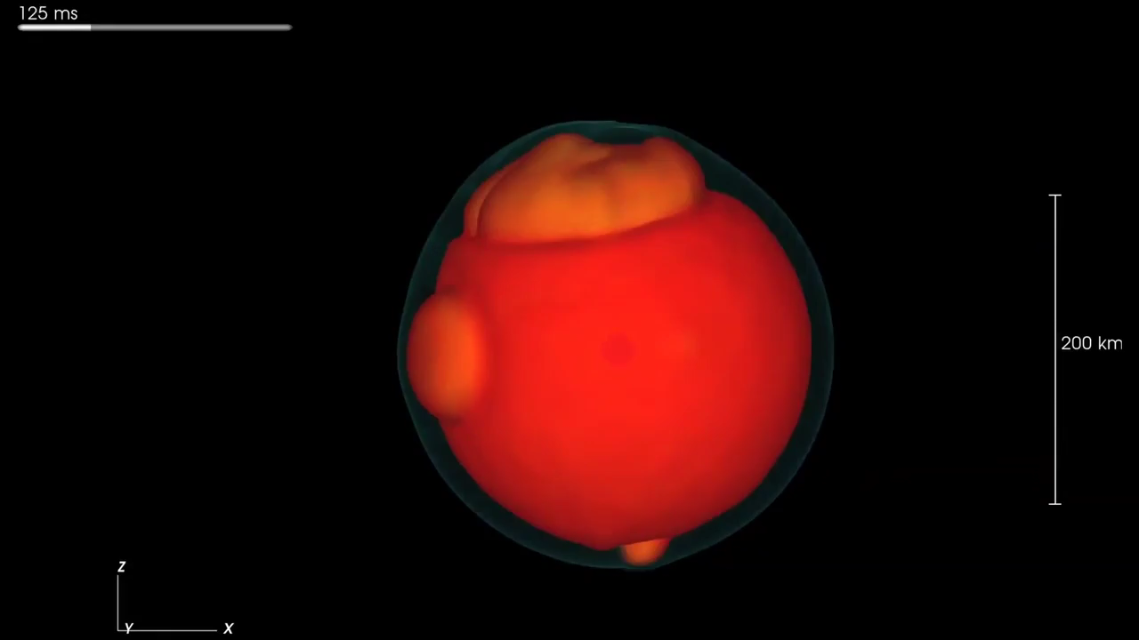
A Galactic Supernova
Max Planck Institute, Garching

Slide 16
The Full Spectrum

Slide 17
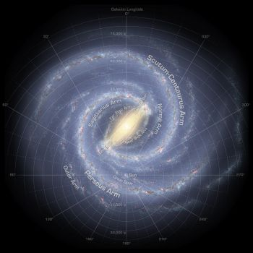

Our Detector is Big

Slide 18

Our Detector is Big

Slide 19
Our Detector is Big

Slide 20
Our Detector is Big

Slide 21
Aren’t SN High Frequency

Slide 22
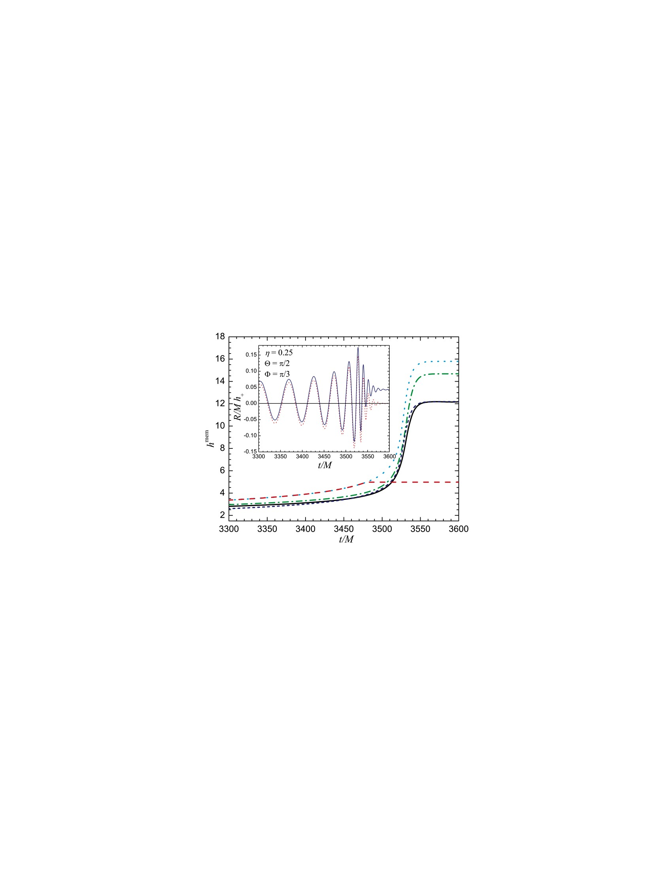

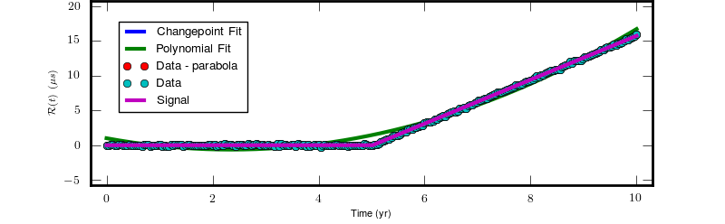
Enter GW Memory

Slide 23

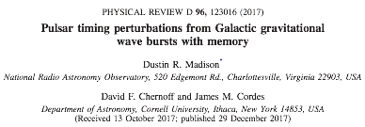


A Project is Born

Slide 24

Some Geometry

Slide 25
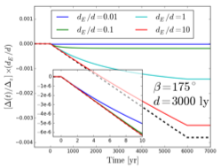
Case One

Slide 26
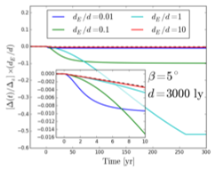
Case Two

Slide 27
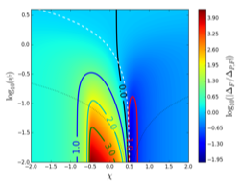
All the Cases

Slide 28
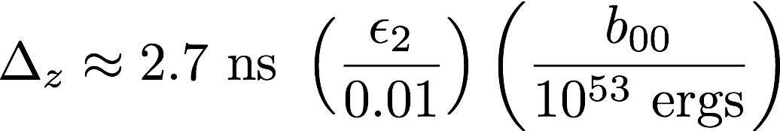
Can we Detect This?
Supernovae:

Slide 29
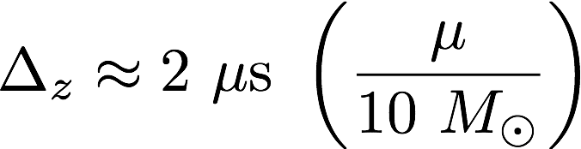
Can we Detect This?
Merger:

Slide 30
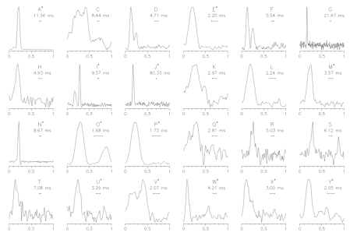

Pulsars in Clusters
Ransom et al. (2005)

Slide 31




IMBH in Clusters

Slide 32
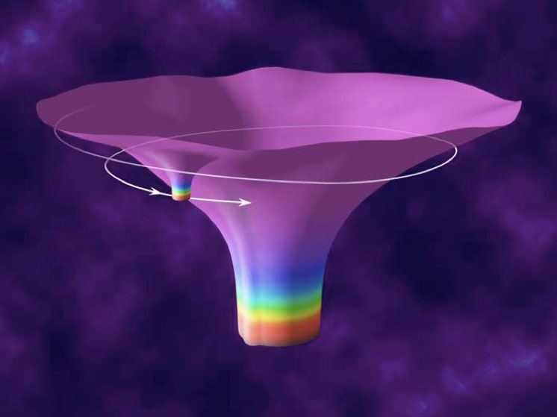
EMRIs

Slide 33
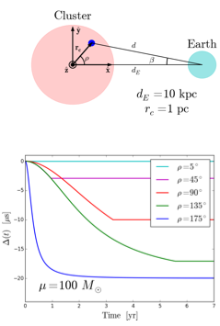
Leveraging Proximity

Slide 34
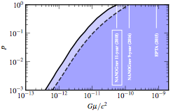
Okay, here’s how this actually started…
Arzoumanian et al. (2018)

Slide 35
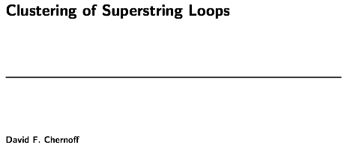
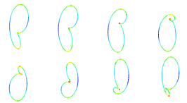
Okay, here’s how this actually started…
Bloomfield & Chernoff (2014)

Slide 36
In Summary
Among GW detectors, PTAs respond uniquely to Galactic sources due to their sheer scale.
Memory is a generic feature of GW events and causes PTA signals that grow over time.
Detection of a conventional Galactic BWM is unlikely because of low event rates and the need for fortuitous alignment.
Globular clusters and the GC are good places to look.
This is a useful first step towards considering more exotic forms of Galactic GW sources such as string loops.

