Slide 1
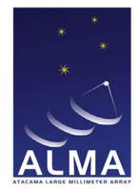

Star Formation and gas distribution in Local U/LIRGs at GMC scales
Loreto Barcos Muñoz
Joint ALMA observatory
National radio astronomy observatory
Adam Leroy (OSU), Aaron Evans (UVa/NRAO), Susanne Aalto (Chalmers), Lee Armus (IPAC), Jim Condon (NRAO), Amanda Kepley (NRAO), Sergio Martin (ESO/JAO), Joseph Mazzarella (IPAC), David Meier (NMT/NRAO), Emmanuel Momjian (NRAO), Eric Murphy (NRAO), Juergen Ott (NRAO), George Privon (UFL), David Sanders (IfA), Kazushi Sakamoto (ASIAA), Eva Schinnerer (MPIA), Sabrina Stierwalt (UVa), Jason Surace (IPAC), Todd Thompson (OSU)

Slide 2
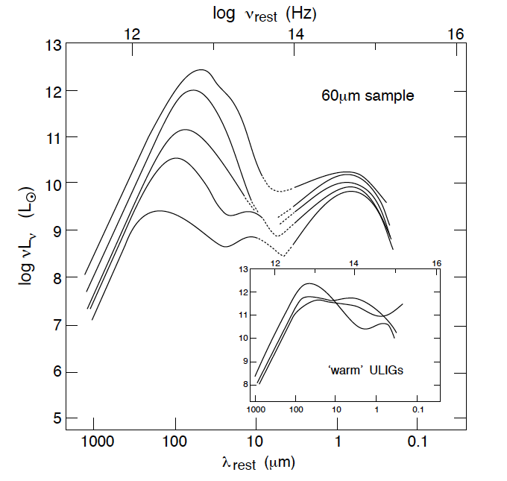
The most extreme local starburst systems
U/LIRGs: An extreme starburst population in the local universe
LIRGs: L_{IR}[8-1000 μm] ≥ 10¹¹ L
ULIRGs: L_{IR}[8-1000 μm] ≥ 10¹² L
Gas rich
Dust rich
SFR
DCF
Compact
Dust
High SFR
Stars
AGN
Sanders & Mirabel (1996)
Mergers

Slide 3
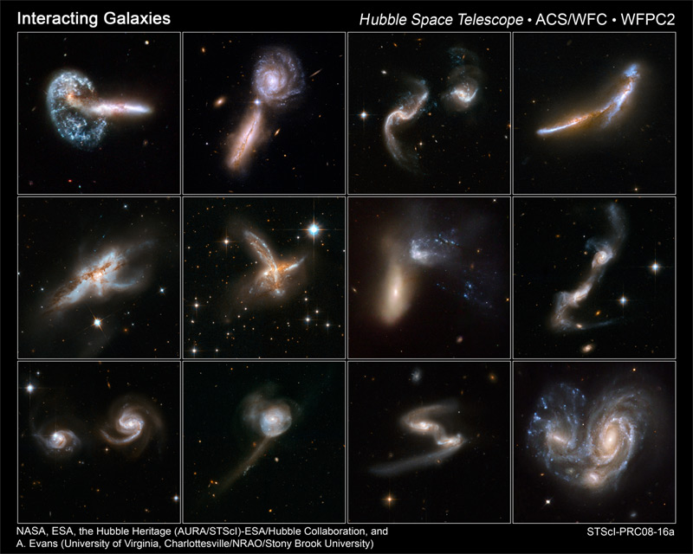

Slide 4
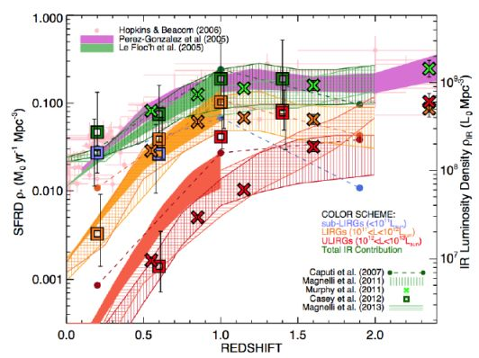
U/LIRGs: An extreme starburst population in the local universe
Casey+14 (Review)
Major contribution to IR density at z > 1.5

Slide 5
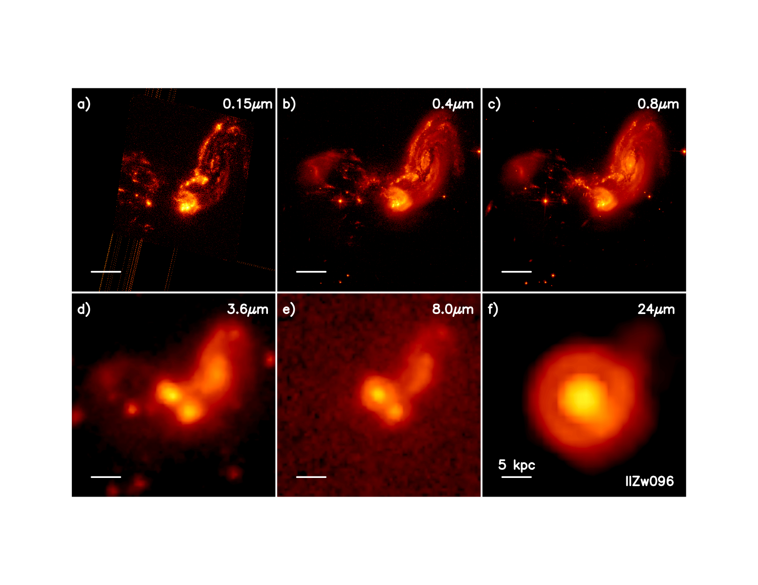
Issues: compactness and dust obscuration in U/LIRGs
UV
Optical
Dust rich
near-IR
mid-IR
Far-IR
Radio interferometry at cm/mm wavelength
Compact

Slide 6
Issues: compactness and dust obscuration in U/LIRGs
Typical SFR tracers heavily obscured.
Best hope is IR [8-1000 microns], but still may be affected by dust obscuration in extreme cases.
UV
Optical
Dust rich
near-IR
mid-IR
Far-IR
Radio interferometry at cm/mm wavelength
Compact

Slide 7
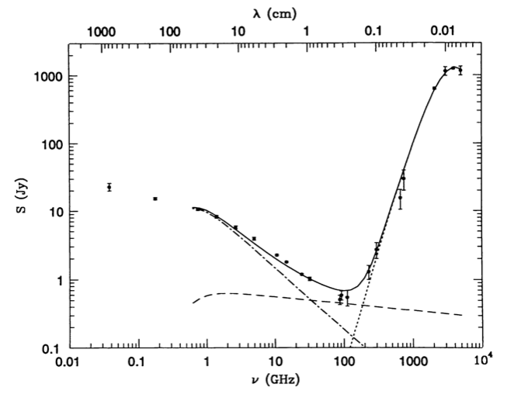
Radio continuum to the rescue
Types of radiation:
Synchrotron emission (acceleration of CR e⁻ by SNR)
Free-Free (ion-electron interaction in ionized gas, HII regions)
Thermal dust (absorption of photons heat up dust)
VLA
ALMA
M82
dust
synchrotron
free-free
Trace star formation
Spectra of M82 from Condon (1992)

Slide 8
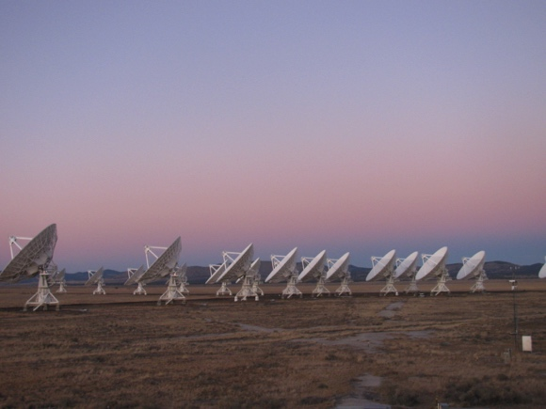
First high resolution 33 GHz survey of local U/LIRGs
22 U/LIRGs (8/14) from GOALs:
Distances span 50 – 300 Mpc (z < 0.065)
Log₁₀(L_{IR}[L])=11.6 – 12.6
JVLA (A,B,C,D configurations) – High fidelity imaging
Imaging at 4.7, 7.2, 29 and 36 GHz with 1 GHz BW
~40 min total on source.
Ka band (26.5 – 40 GHz):
Resolution ~ 0.08” (40 pc @ 100 Mpc)
Noise ~30 μJy/beam
33 GHz
C band (4 – 8 GHz):
Resolution ~ 0.4”
Noise ~10 μJy/beam
Spectra of M 82 (Condon 1992)
C
Ka

Slide 9
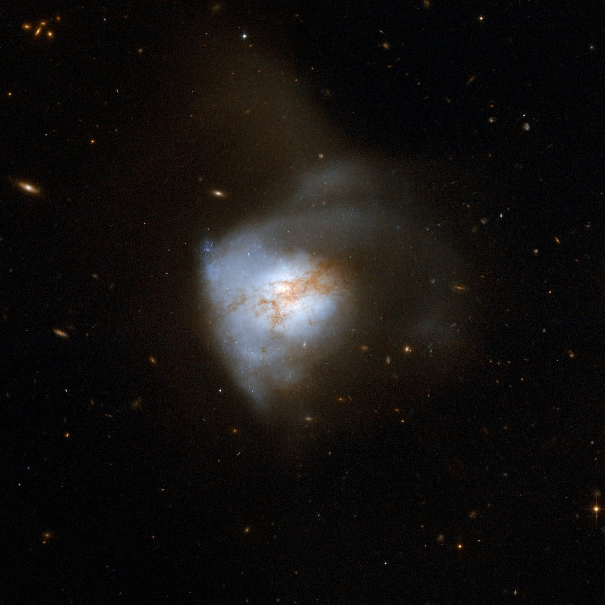
The Case of Arp 220
D_{L} = 77 Mpc (1 arcsecond ~ 370 pc)
L_{IR}[8-1000 μm] ~ 10^{12.2} L⦿, SFR~ few 100 M⦿yr ⁻¹
Av ~2000 mag towards the nuclei
Late stage merger: Most of the emission concentrated within < 1 kpc. Compact system.
Commonly used as a template for high z starbursts galaxies.
Ideal combination of proximity and extreme environment.
Able to test extreme physics of star formation, and galaxy evolution, in great detail.
Credit: NASA, ESA, the Hubble Heritage Team (STScI/AURA)-ESA/Hubble Collaboration and A. Evans (University of Virginia, Charlottesville/NRAO/Stony Brook University)
Well studied, but still mysterious in many ways

Slide 10
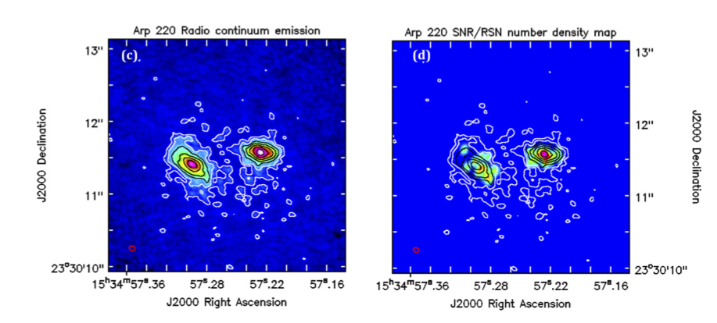
Star Formation Distribution at 30 pc Scales at a distance of 77 Mpc
JVLA 33GHz continuum
R₅₀ (E) ≈ 50pc
R₅₀ (W) ≈ 35pc
Highest values measured for any star-forming system
Σ_{SFR}(W) ~ 10^{4.1} M yr⁻¹ kpc⁻²
Σ_{gas}(W) ~ 4.5x10⁵ Mpc⁻²
Barcos-Muñoz et al. 2015

Slide 11
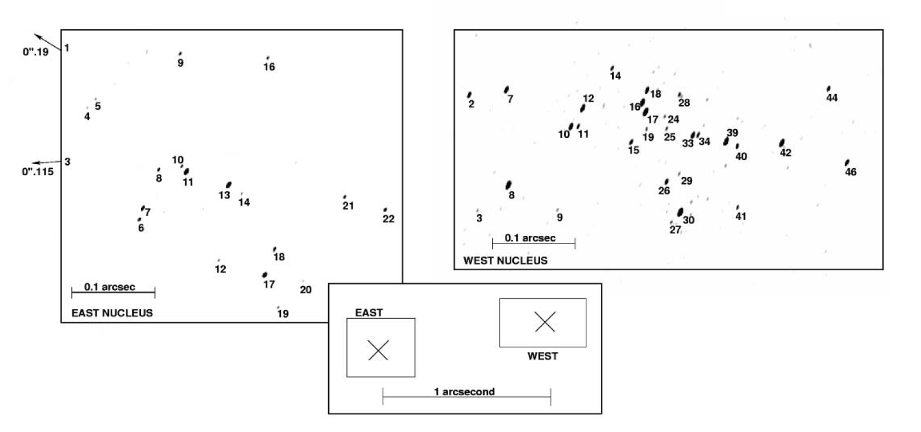
Star Formation Distribution at 30 pc Scales at a distance of 77 Mpc
JVLA 33GHz continuum
R₅₀ (E) ≈ 50pc
R₅₀ (W) ≈ 35pc
49 RSNe in the entire system with VLBI (Lonsdale+06)
See Varenius+17 arxiv for updated observations with 97 sources total.
Highest values measured for any star-forming system
Σ_{SFR}(W) ~ 10^{4.1} M yr⁻¹ kpc⁻²
Σ_{gas}(W) ~ 4.5x10⁵ Mpc⁻²
Barcos-Muñoz et al. 2015

Slide 12
Star Formation Distribution at 30 pc Scales at a distance of 77 Mpc
JVLA 33GHz continuum
R₅₀ (E) ≈ 50pc
R₅₀ (W) ≈ 35pc
SNR distribution from Lonsdale+06
Highest values measured for any star-forming system
Σ_{SFR}(W) ~ 10^{4.1} M yr⁻¹ kpc⁻²
33 GHz tracing recent SF
Σ_{gas}(W) ~ 4.5x10⁵ Mpc⁻²
Barcos-Muñoz et al. 2015

Slide 13
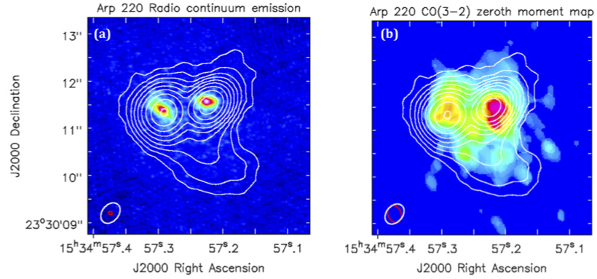
Star Formation Distribution at 30 pc Scales at a distance of 77 Mpc
VLA observations
Sakamoto+2008
6 GHz tracing molecular gas (?)
Barcos-Muñoz et al. 2015

Slide 14
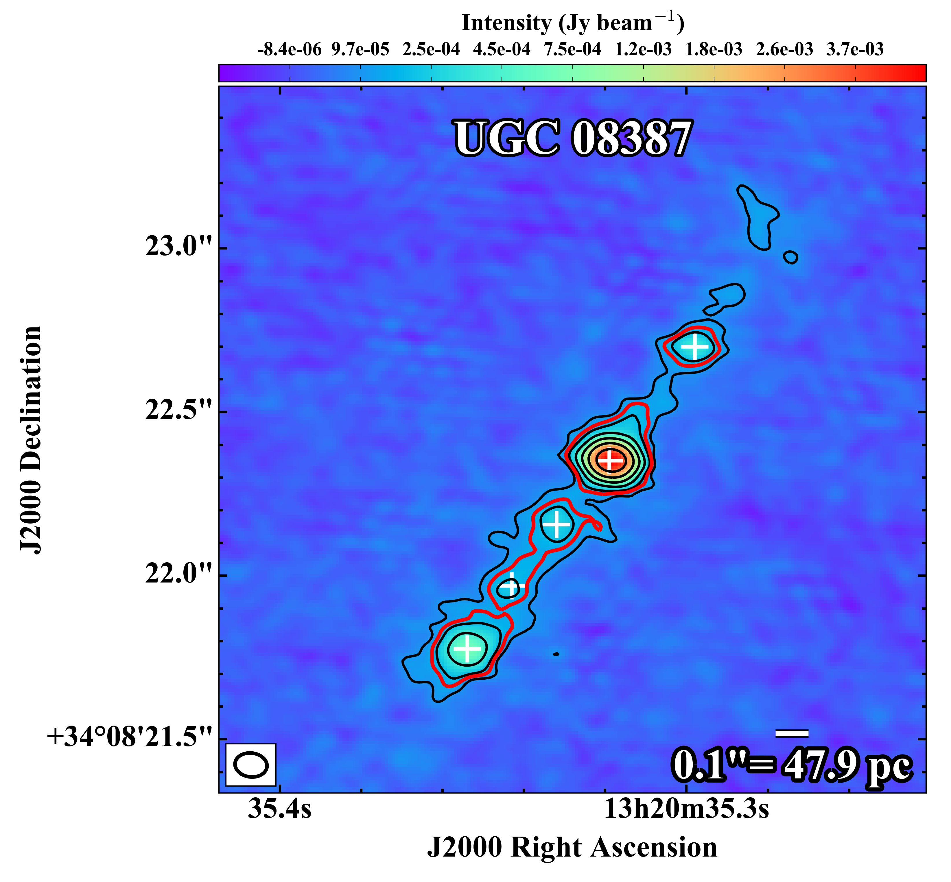
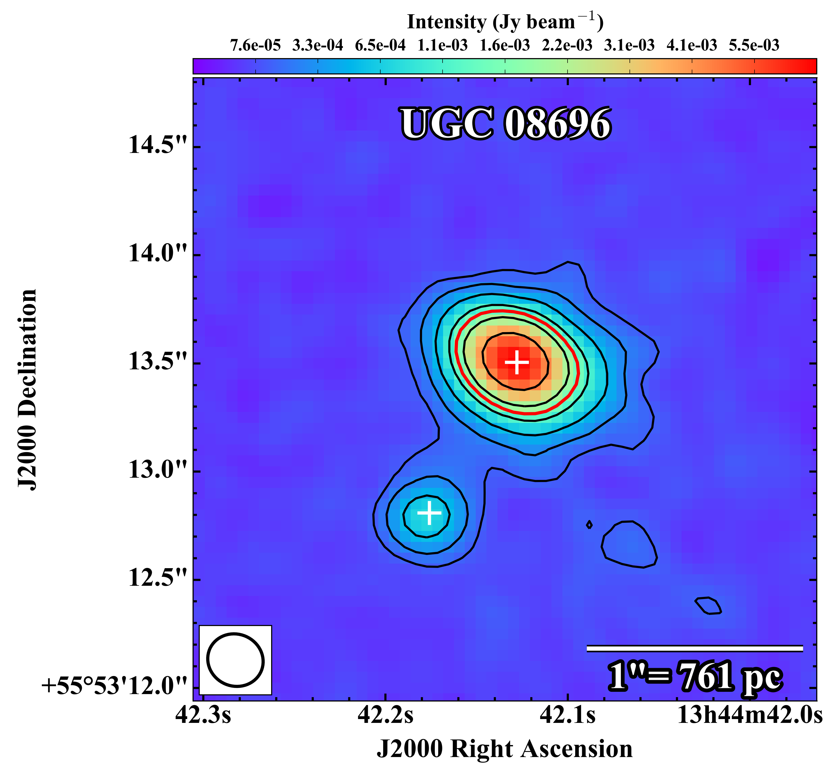
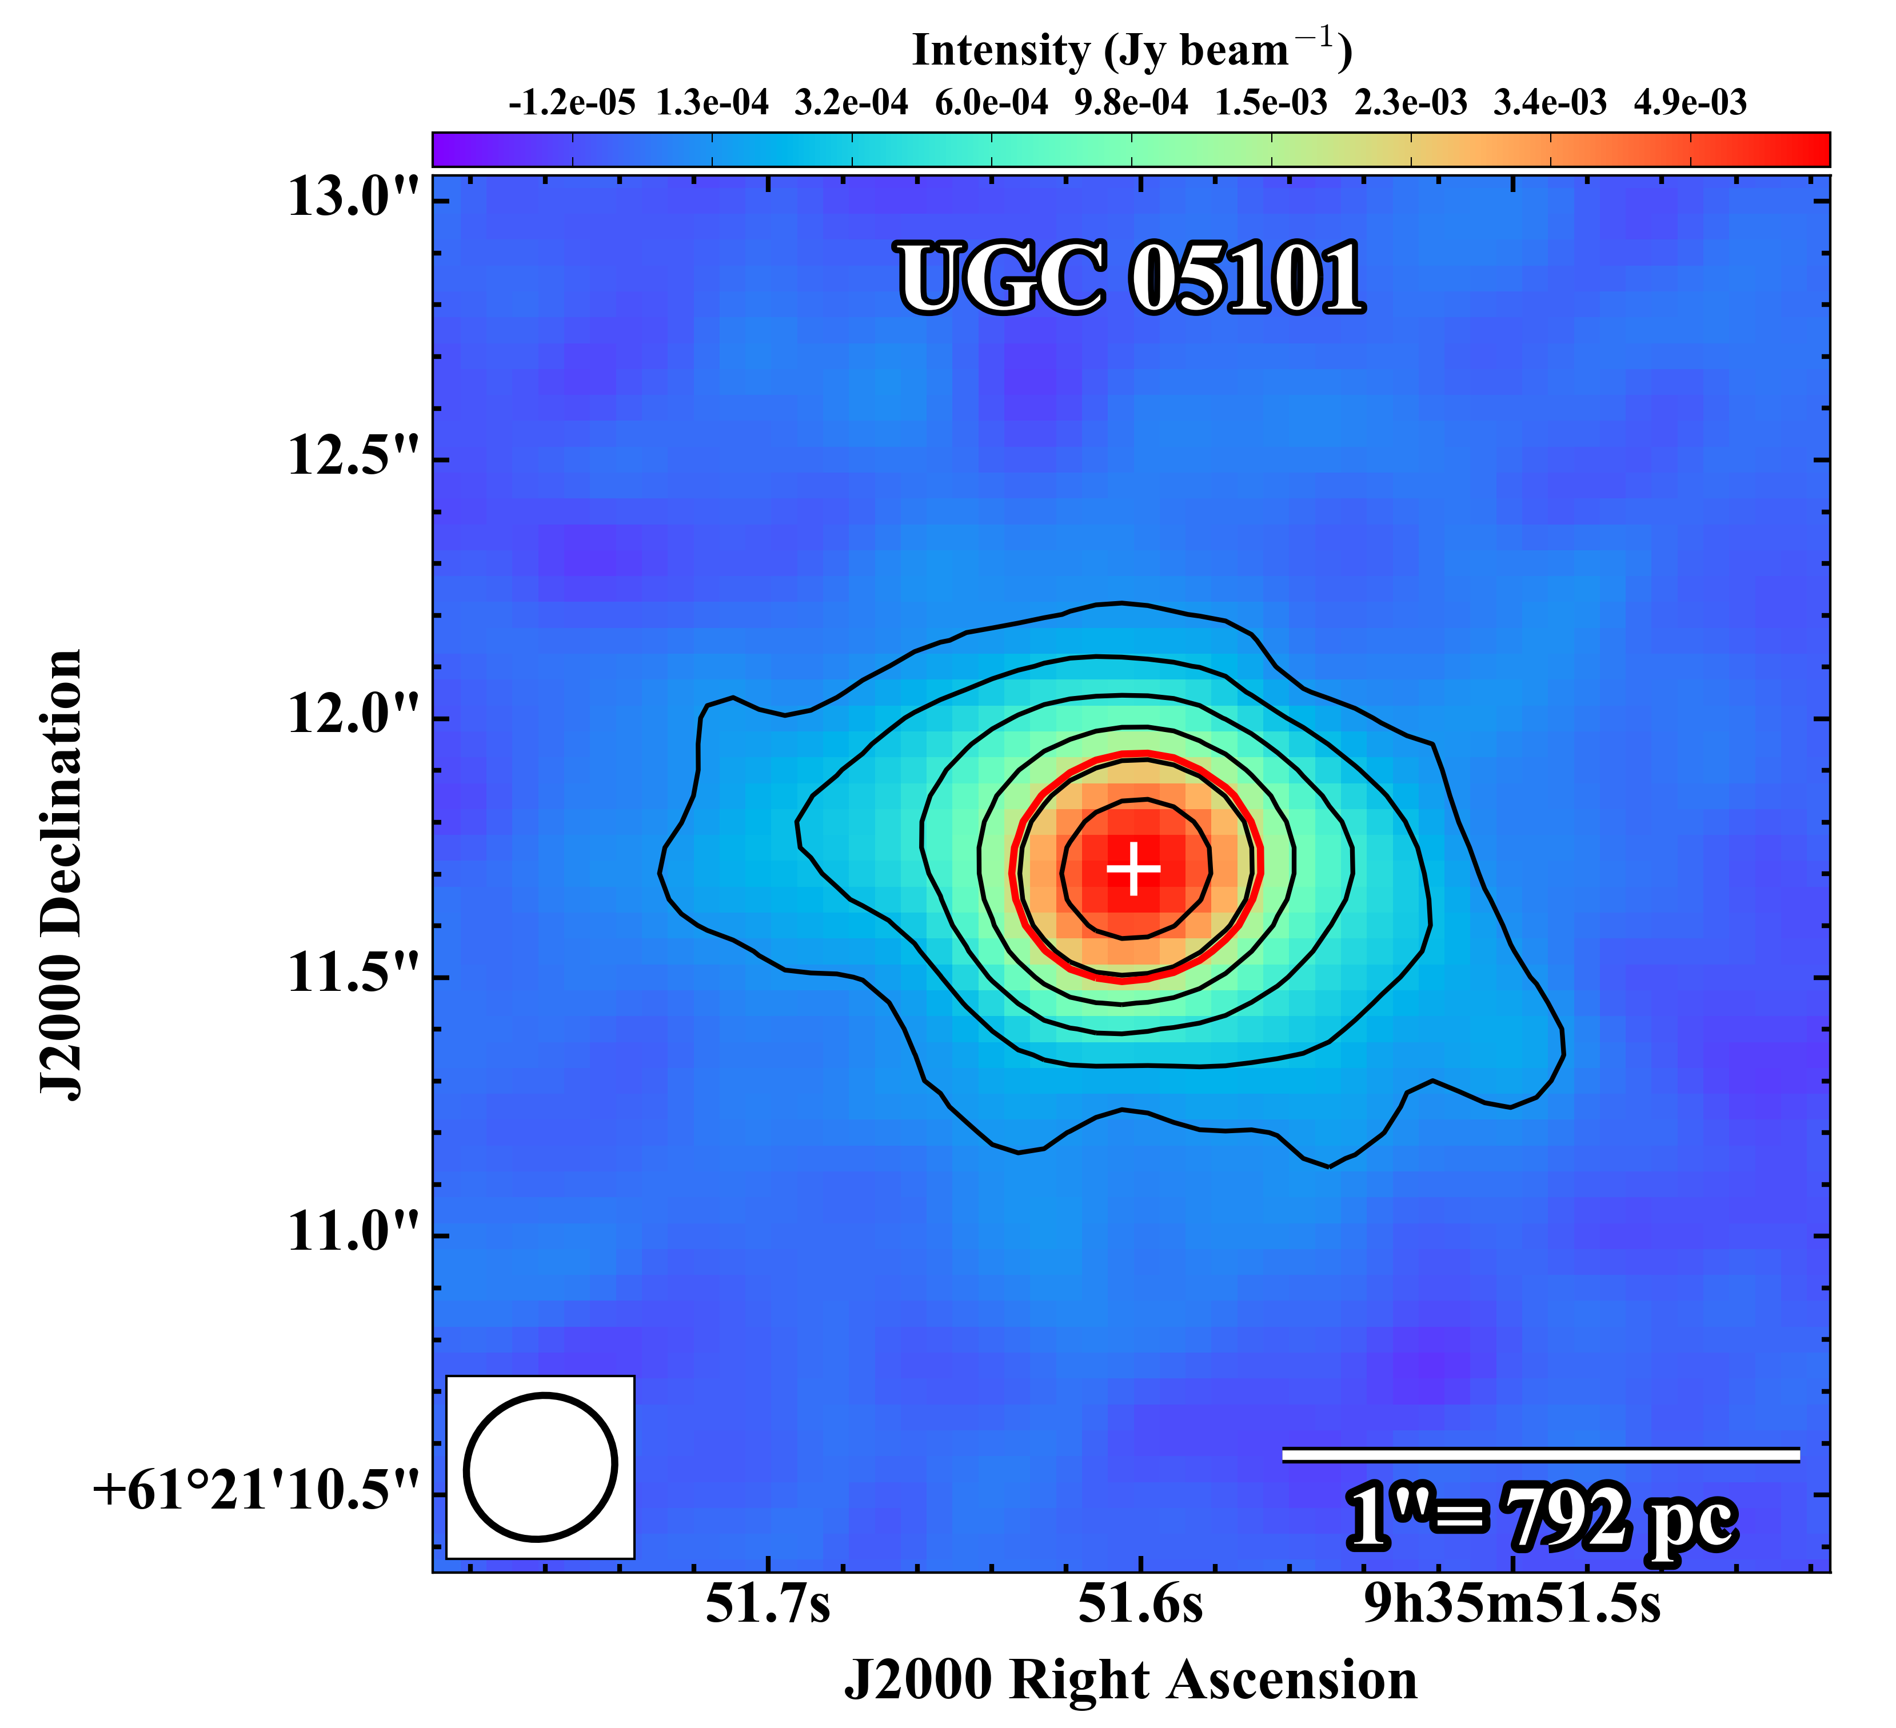
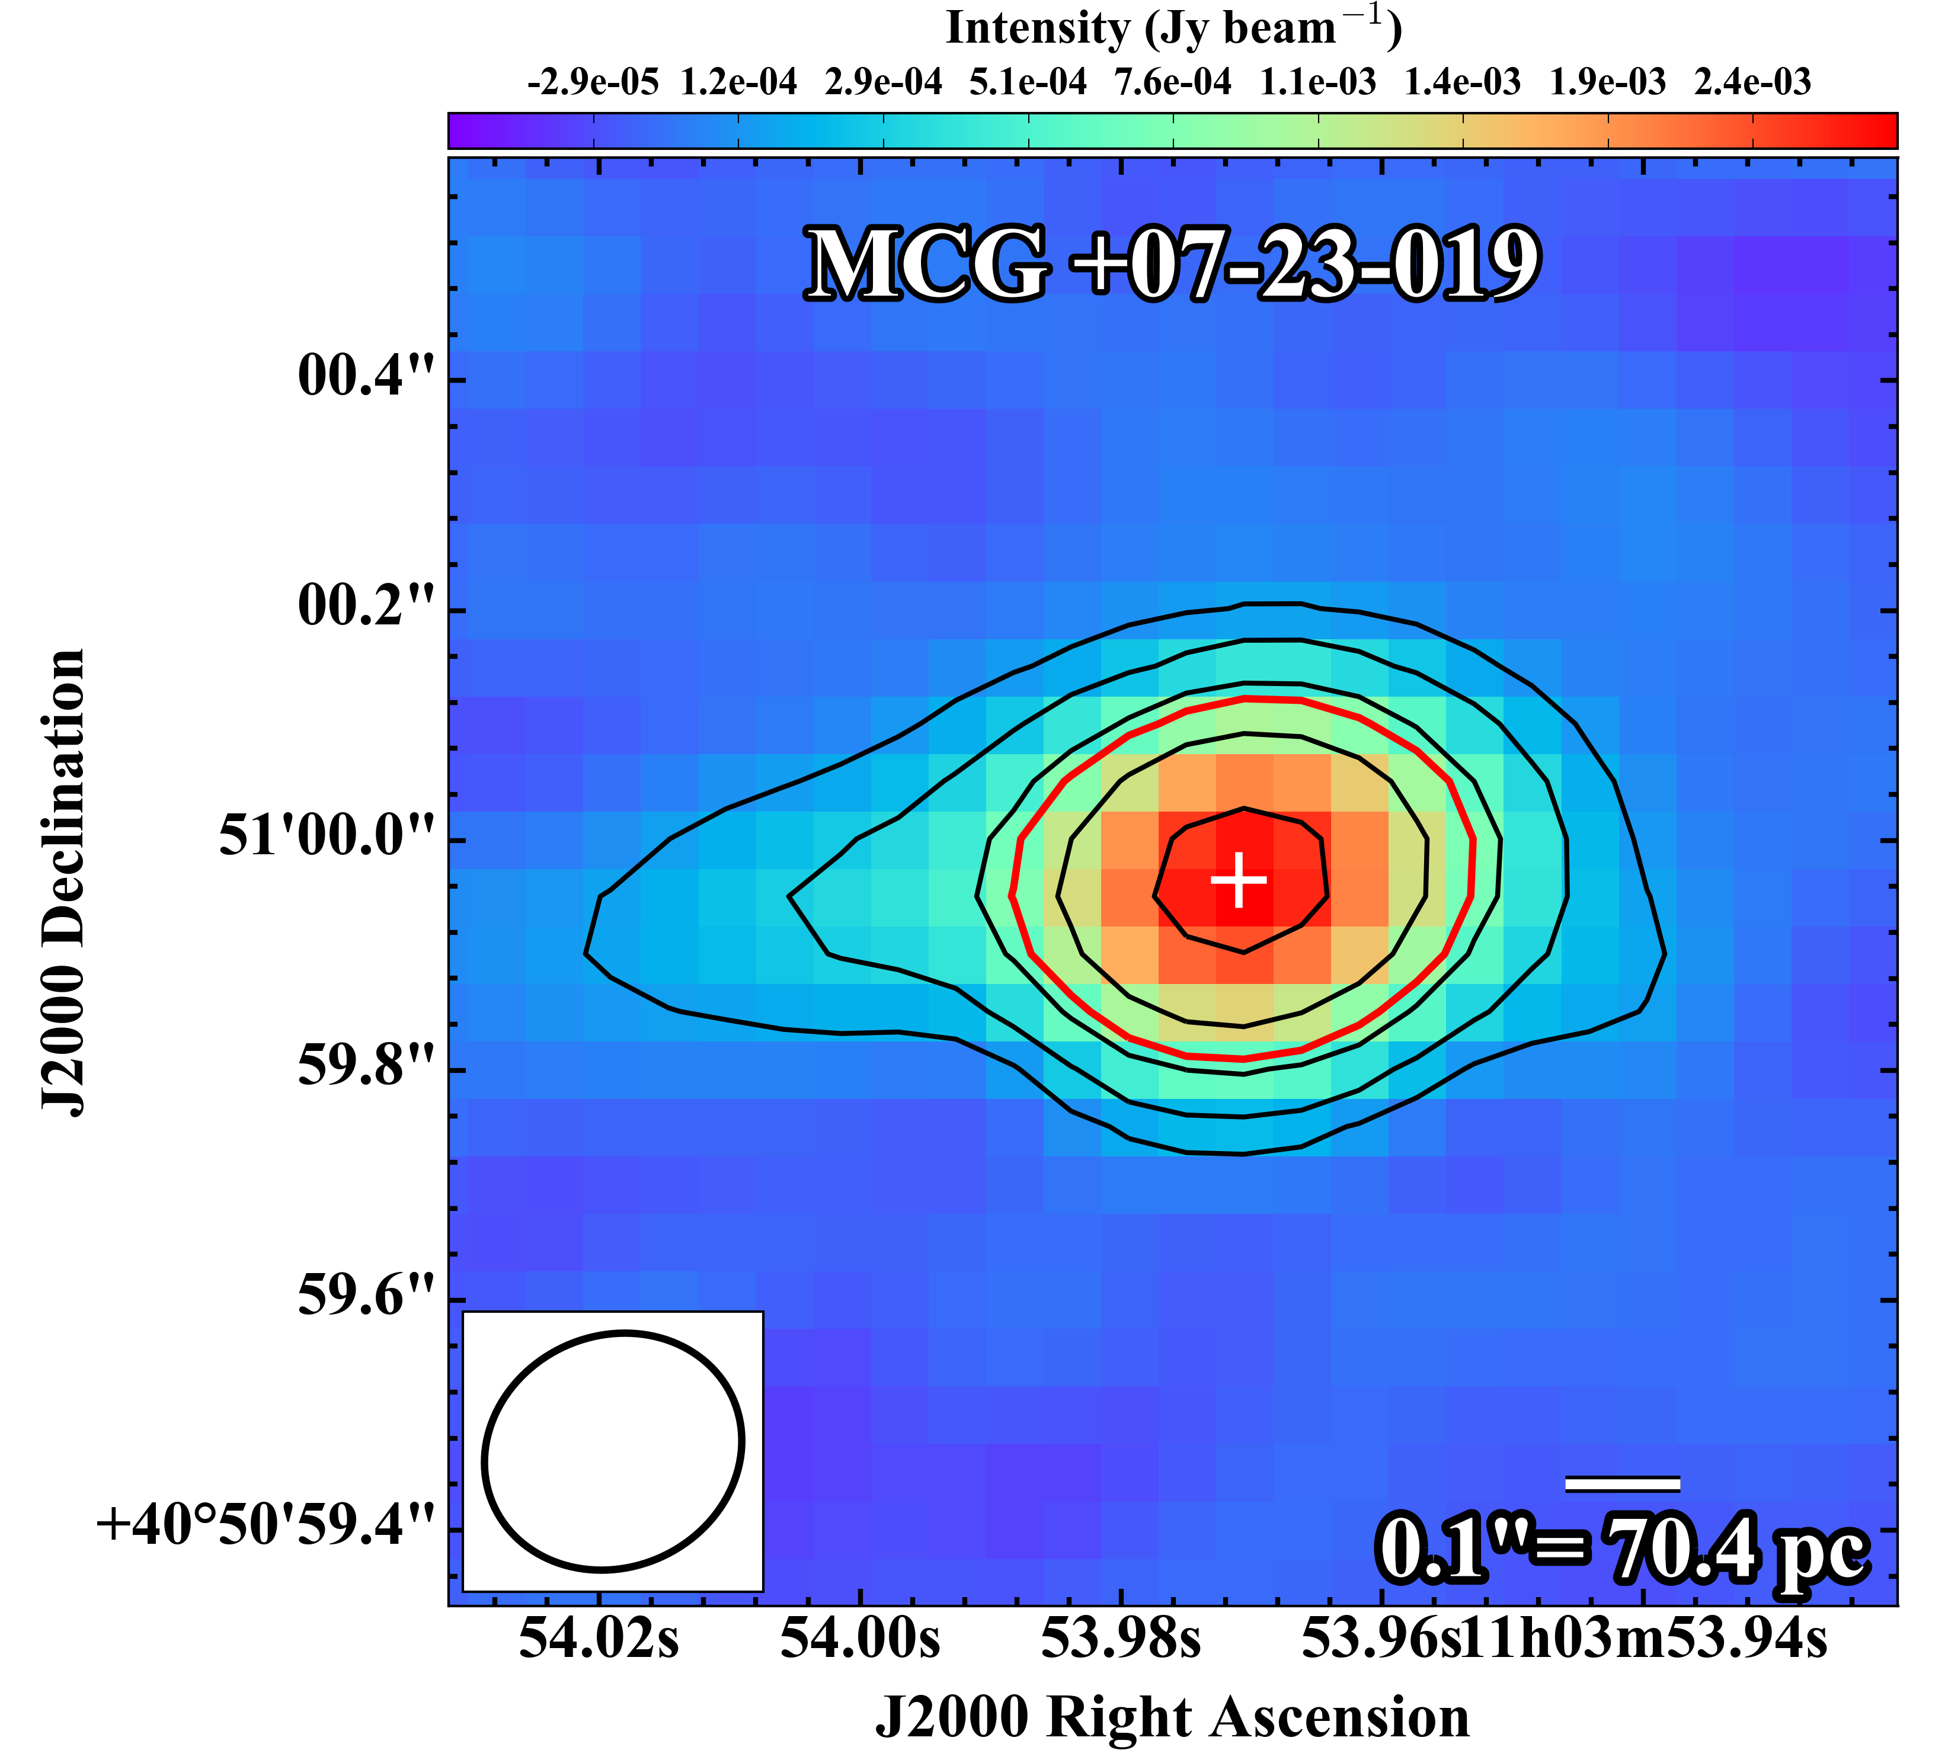
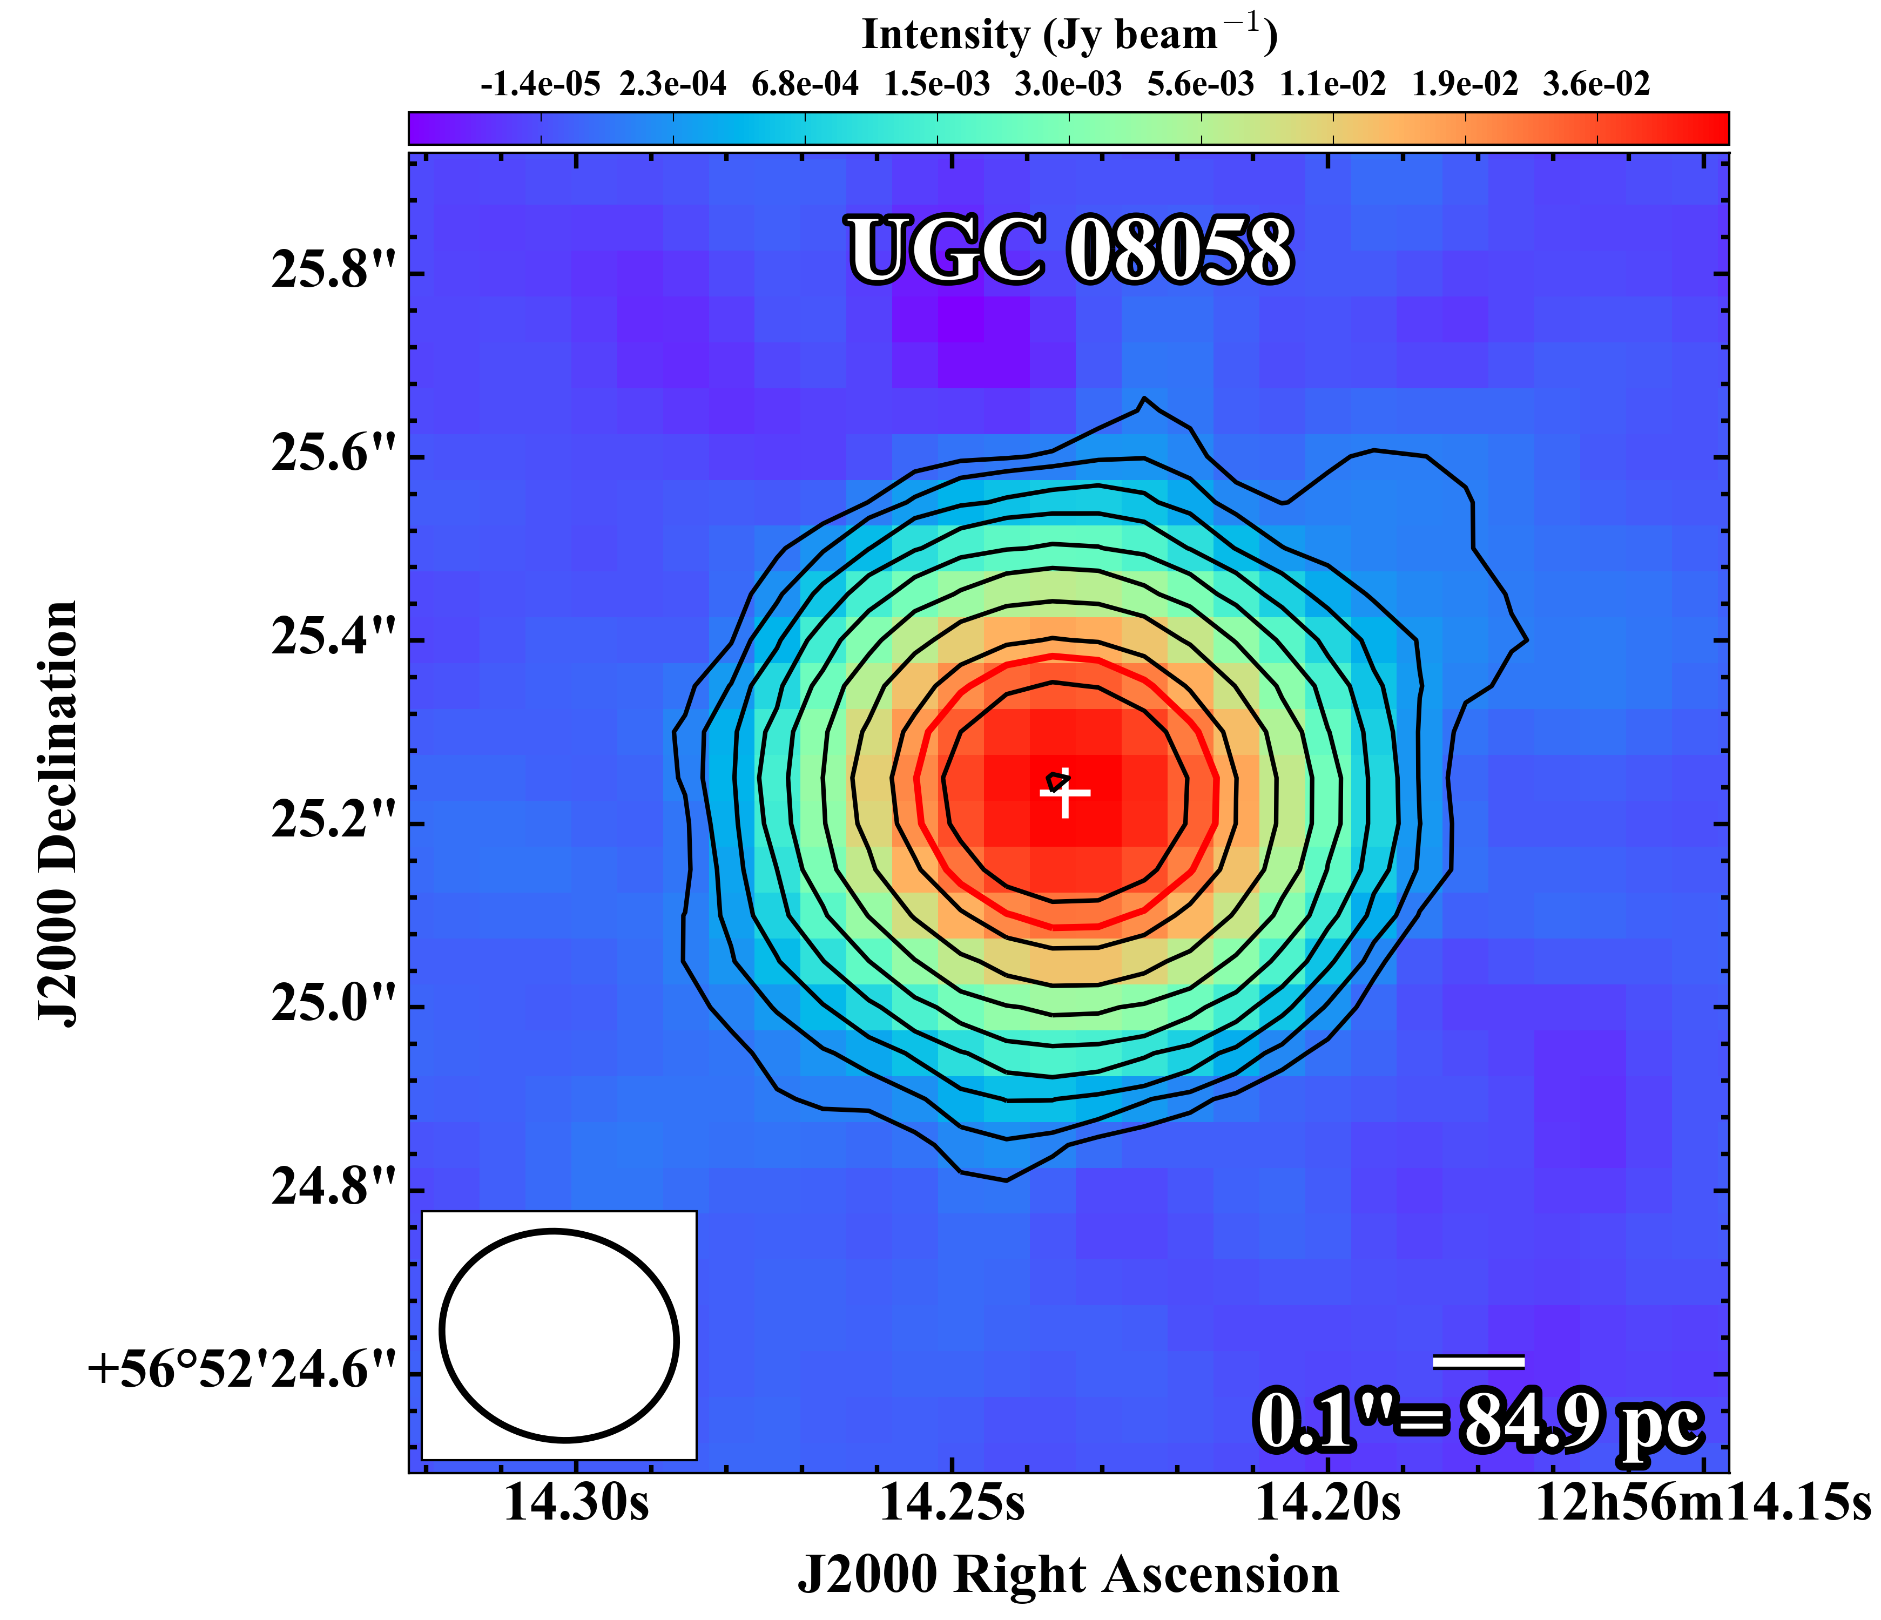
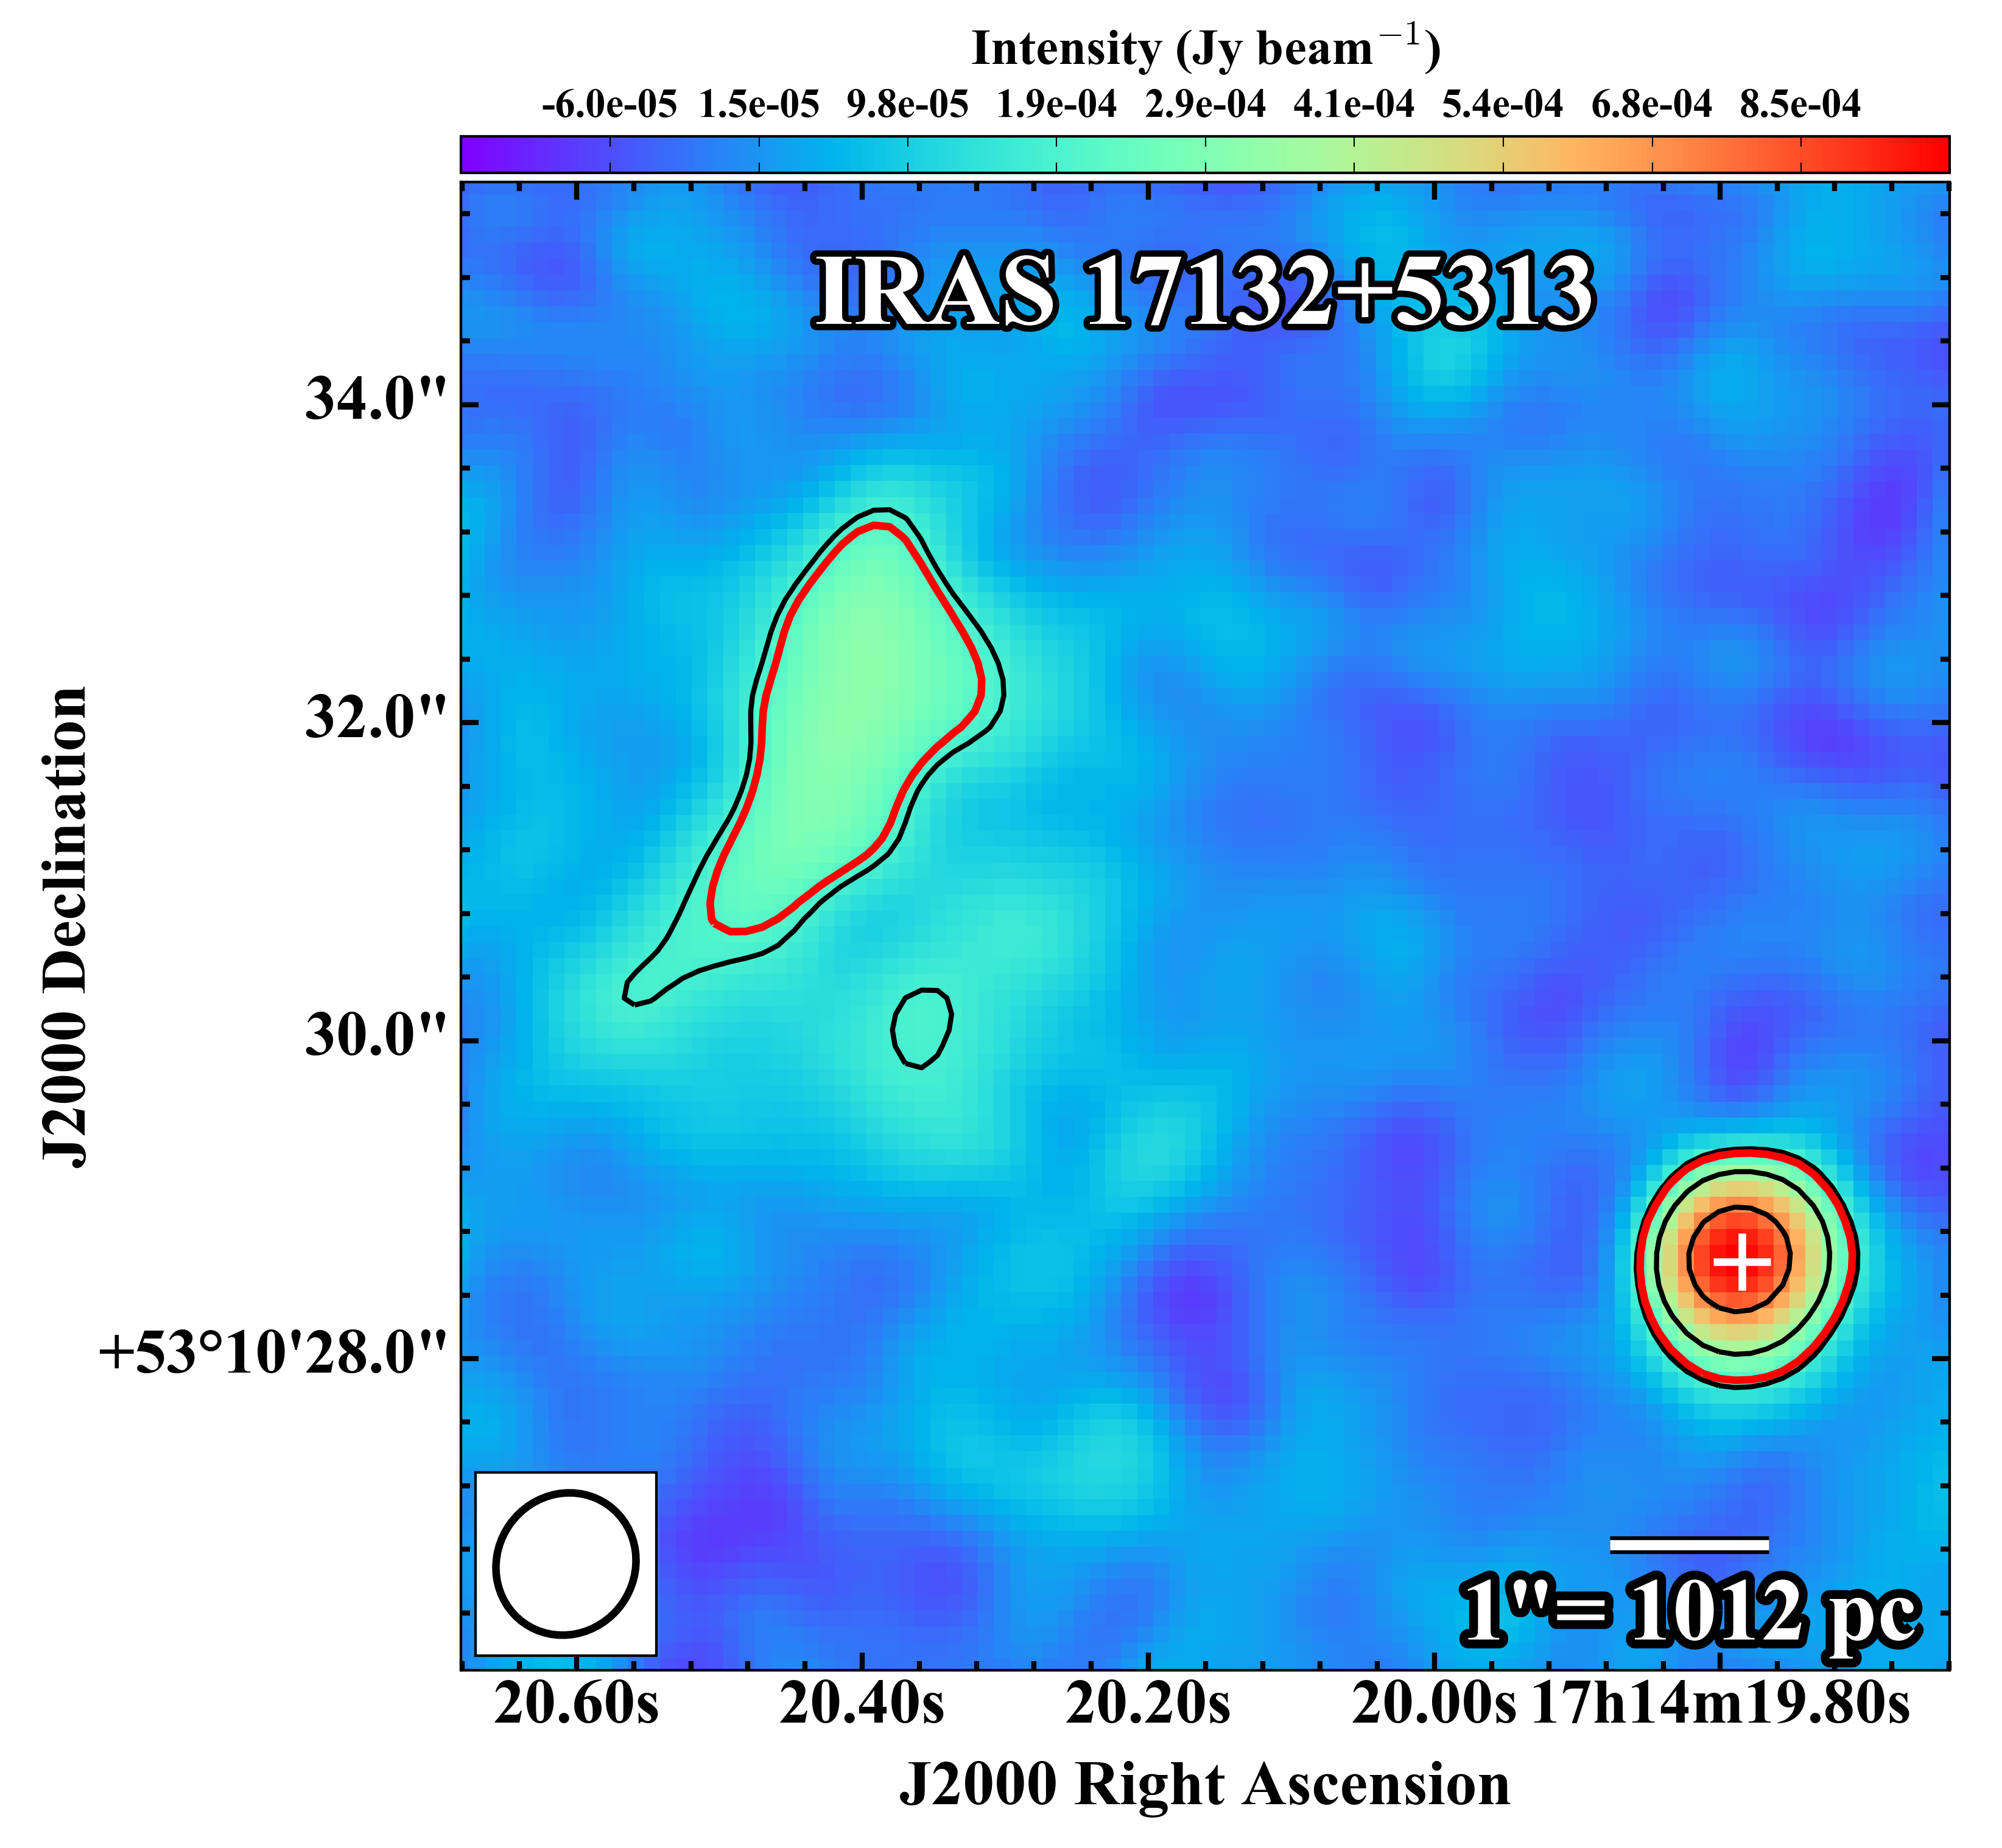
33 GHz contour maps
Barcos-Muñoz et al. 2017

Slide 15
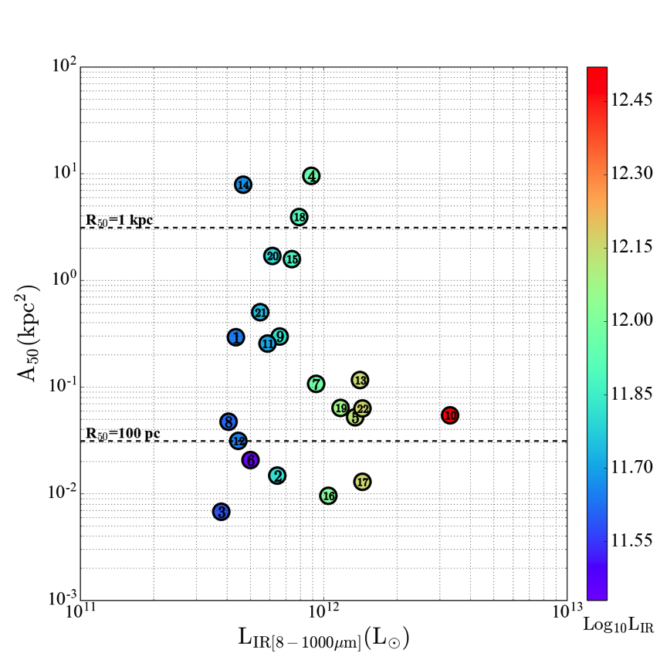
Compact sizes
Barcos-Muñoz et al. 2017

Slide 16
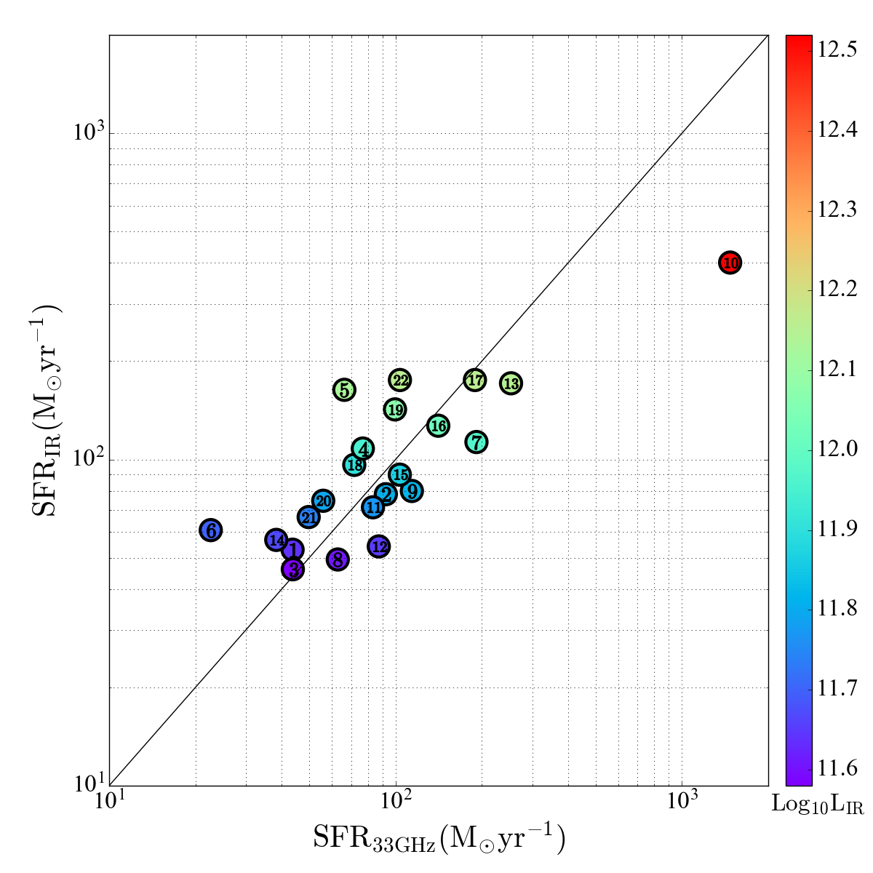
Integrated SFR (IR versus radio)
Need to account for AGN contribution at 33 GHz
Fine agreement, within the scatter
Barcos-Muñoz et al. 2017

Slide 17
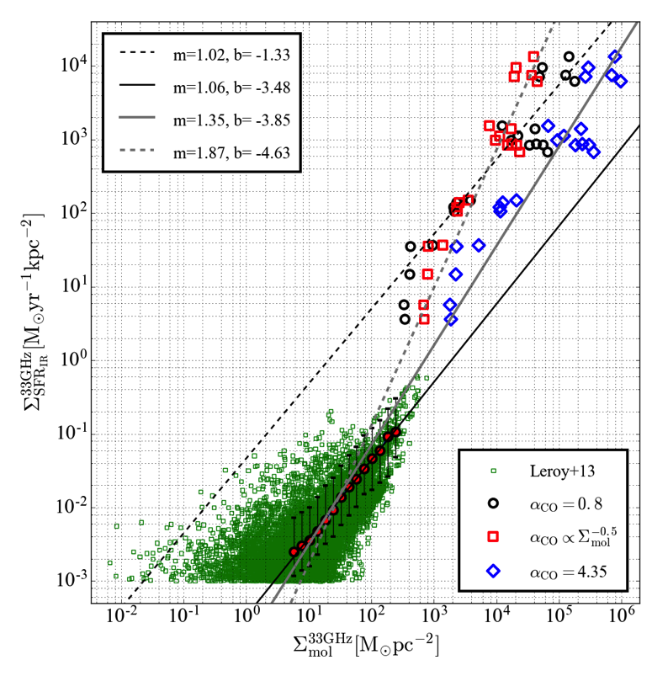
The most extreme starbursts
Barcos-Muñoz et al. 2017

Slide 18
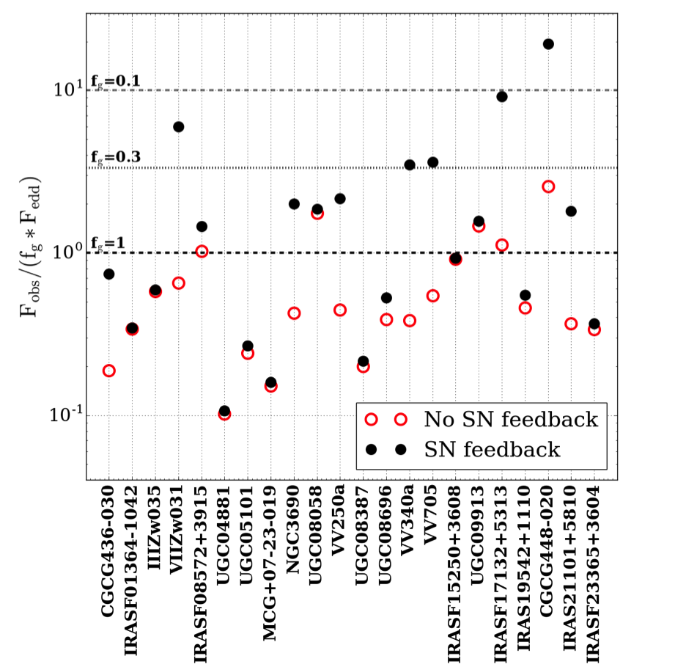
Maximal Starbursts?
Barcos-Muñoz et al. 2017

Slide 19
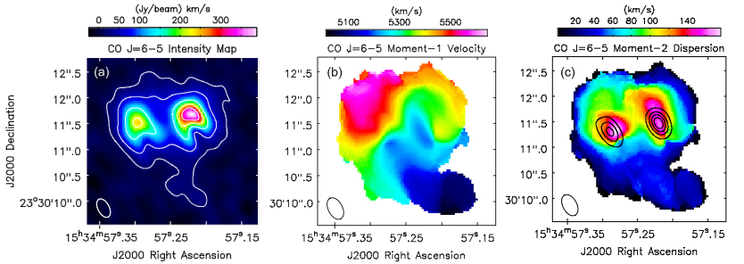
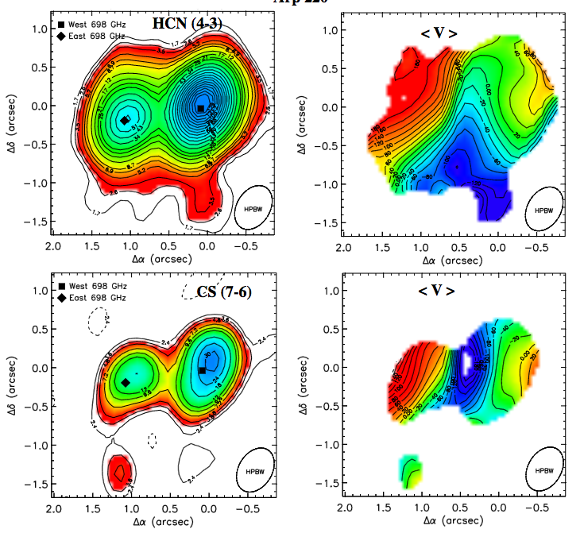
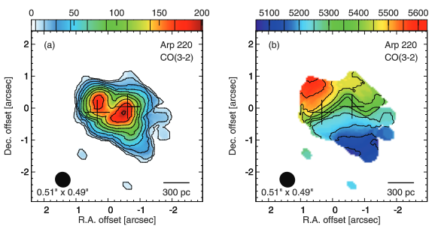
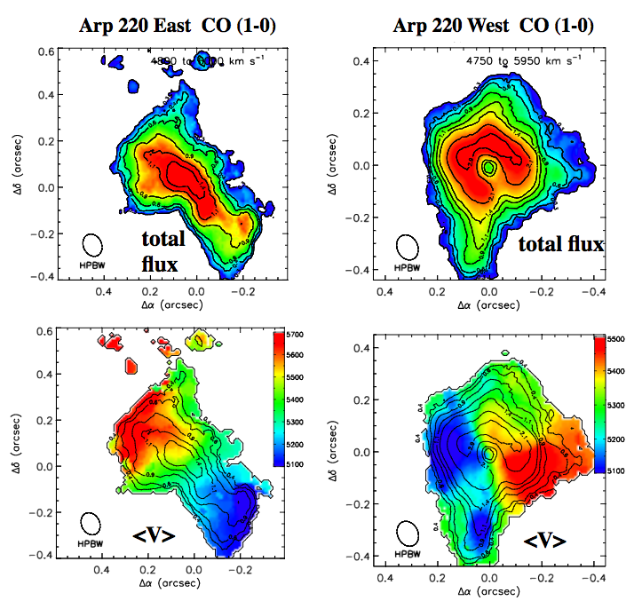
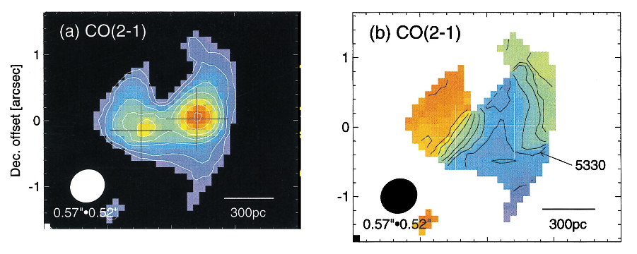
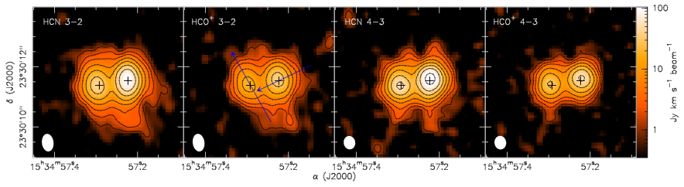
Submillimeter Observations of Arp 220
ALMA has observed Arp 220 several times in an effort to determine gas and dust continuum properties (e.g., Wilson+14, Aalto+15, Rangwala+15, Scoville+15,16, Martin+16).
Previous efforts with similar angular resolution include Sakamoto+99,08,09 with SMA.
High angular resolution (0.1” < comparable to VLA at 33 GHz) available for the first time in Cycle 3.
High resolution campaign to observe gas distribution and thermal dust continuum include Scoville+16 (CO (1-0)) and Barcos-Muñoz+18, in prep. (e.g., HCN (1-0), HCO+(1-0), SiO(2-1))
Rangwala+15
Sakamoto+08
Scoville+15
Sakamoto+99
Scoville+17
Martín+16

Slide 20
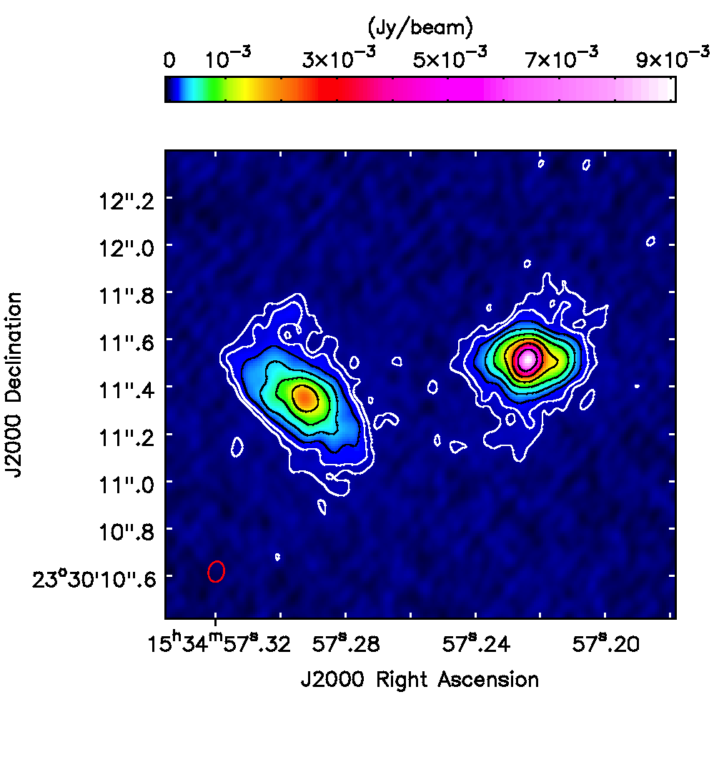
Star Formation Distribution at 30 pc Scales at a distance of 77 Mpc
Barcos-Muñoz et al. 2018
ALMA: 92 GHz
0.09” x 0.07” (33 x 26 pc)
92 GHz is optically thin. Traces star formation.

Slide 21
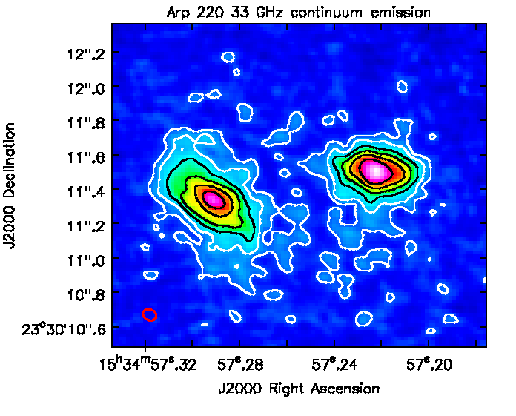
Star Formation Distribution at 30 pc Scales at a distance of 77 Mpc
33 and 92 GHz continuum emission similar
Barcos-Muñoz et al. 2018
ALMA: 92 GHz
0.09” x 0.07” (33 x 26 pc)
92 GHz is optically thin. Traces star formation.
VLA: 33 GHz
0.08” x 0.06” (30 x 23 pc)
33 GHz: recent SF

Slide 22
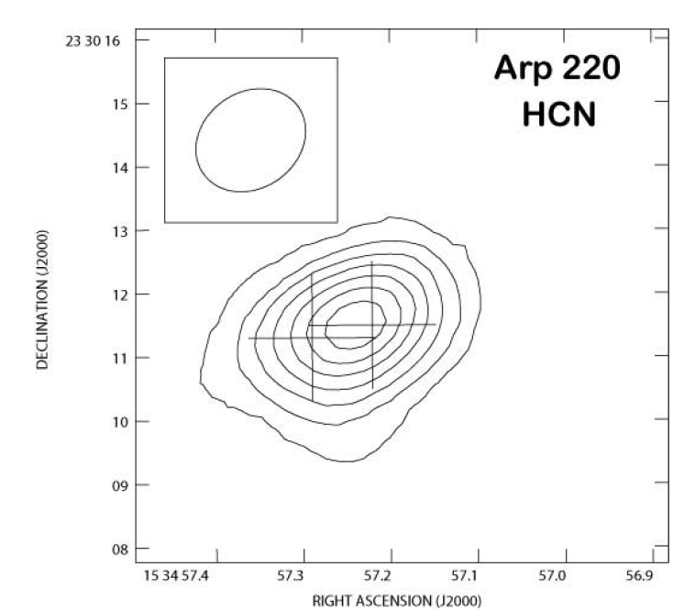
First HCN map at GMC scales for Arp 220
Imanishi+07

Slide 23
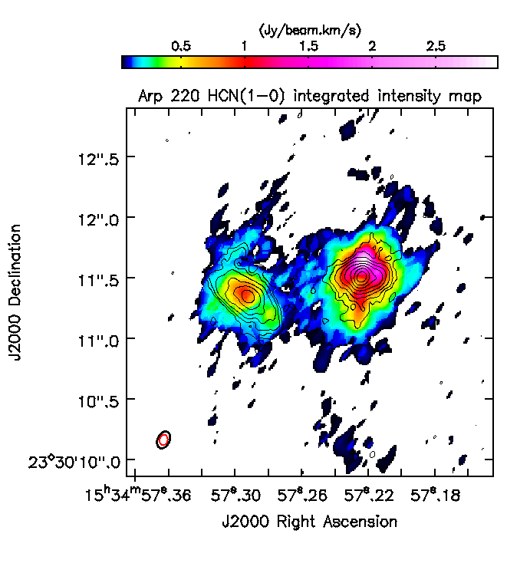
First HCN map at GMC scales for Arp 220
Imanishi+07
Barcos-Muñoz PhD thesis, in prep.

Slide 24
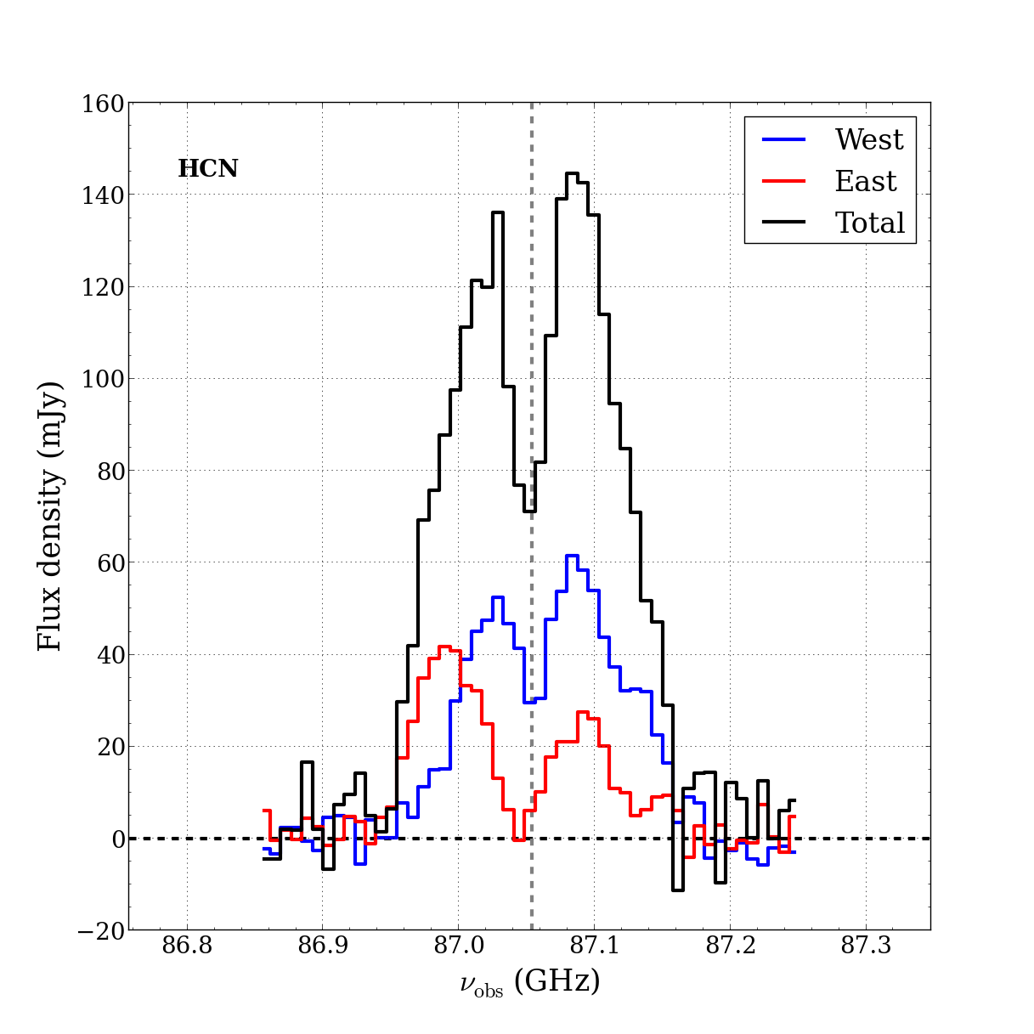
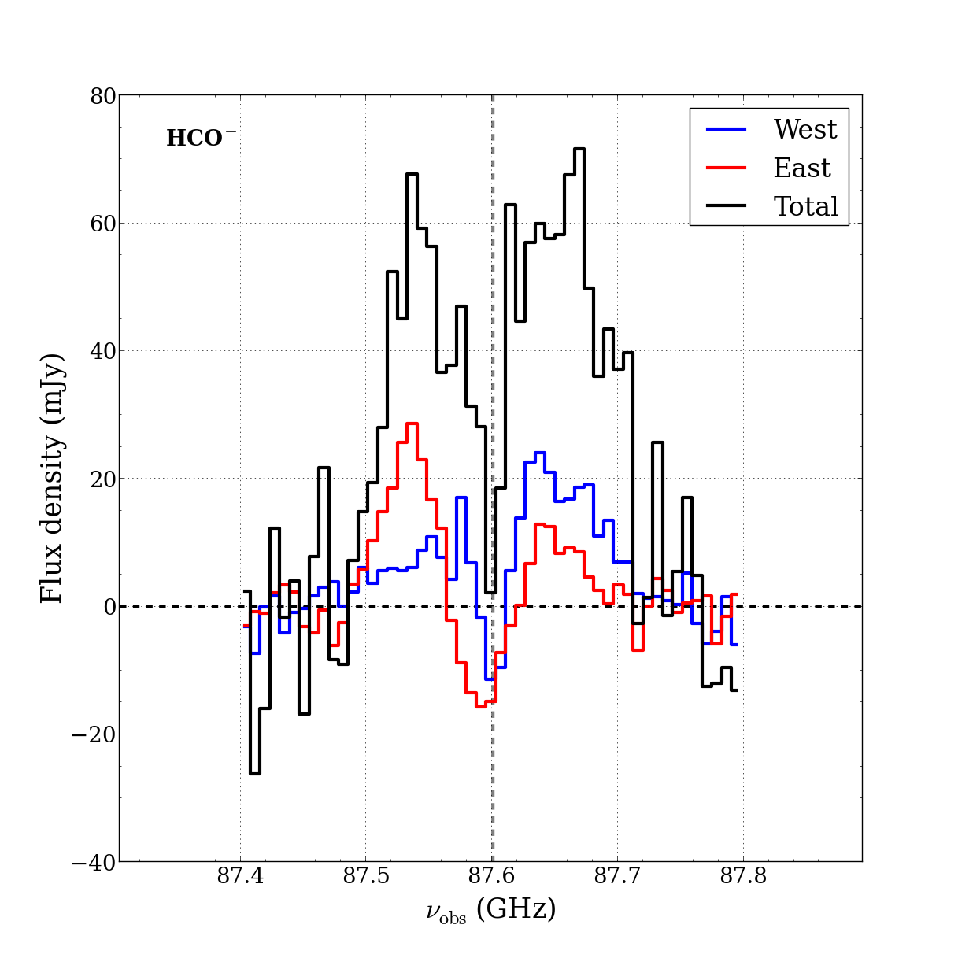
First HCN map at GMC scales for Arp 220
Recover 100% of total HCN emission: 37% in W, 23% in E, and 40% extended.
Barcos-Muñoz PhD thesis, in prep.

Slide 25
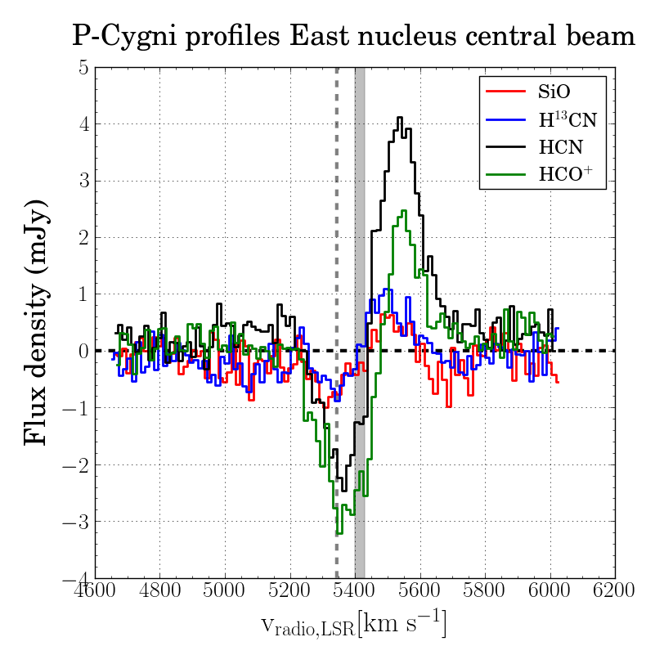
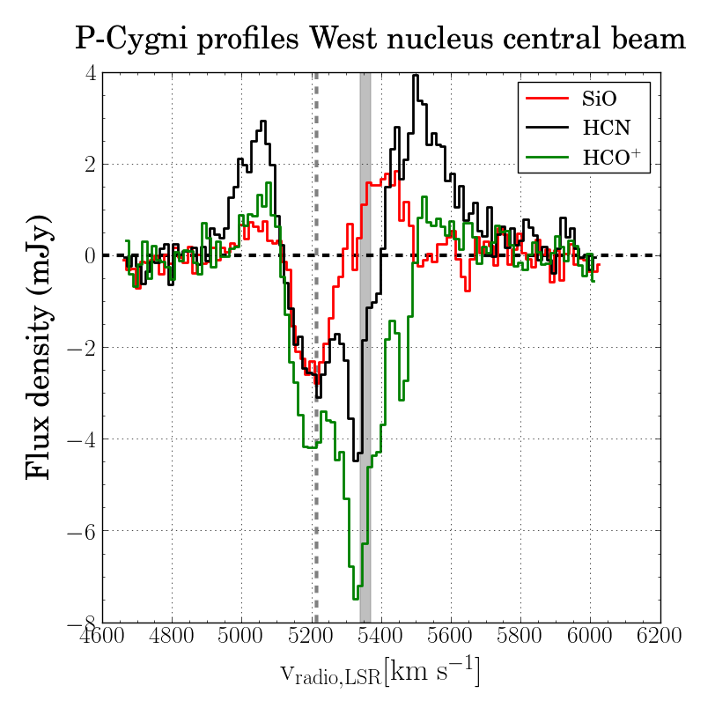
First HCN map at GMC scales for Arp 220
Outflow signature
Outflow signature + large obscuration
Barcos-Muñoz PhD thesis, in prep.

Slide 26
First 3D image of the molecular outflow in the western nucleus of Arp 220
Barcos-Muñoz et al. 2018
PI: Scoville

Slide 27
First 3D image of the molecular outflow in the western nucleus of Arp 220
Barcos-Muñoz et al. 2018
PI: Scoville
velocity ~ 850 km/s (fast)
Mass > 10⁶ M⊙ per lobe (massive)
outflow age ~ 10⁵ yr (young)
size < 120 pc (compact & collimated)
Mass outflow rate ~ 100 M⊙/yr

Slide 28
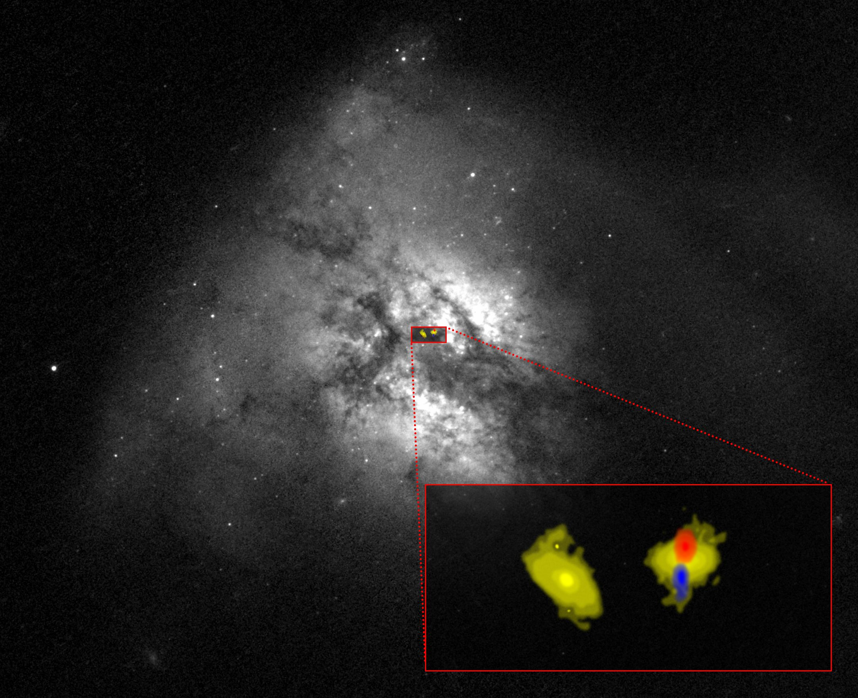
First 3D image of the molecular outflow in the western nucleus of Arp 220

Slide 29
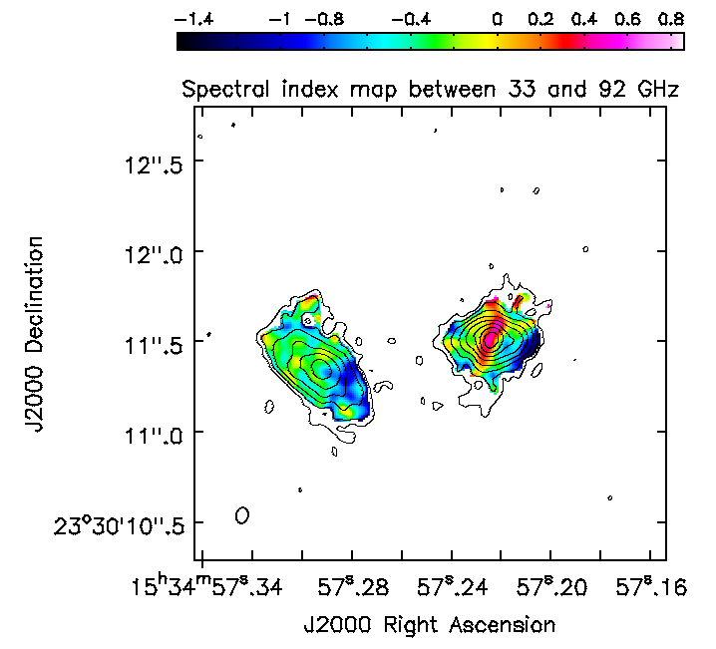
Resolved spectral index map
Spatial distribution of thermal, non-thermal, and dust emission
Evidence of outflow in the continuum?
33 GHz
92 GHz
NEED MULTIWAVELENGTH COVERAGE AT 0.1” RESOLUTION
Spectral index maps: a powerful tool to unveil distribution of different emission mechanisms

Slide 30
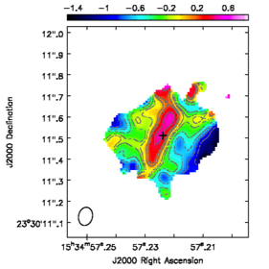
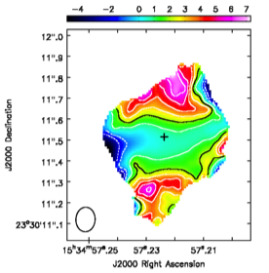
First 3D image of the molecular outflow in the western nucleus of Arp 220
Spectral index map between 33 and 92 GHz
Spectral index map between 92 and 104 GHz
(Sakamoto et al. 2017)
Barcos-Muñoz et al. 2018

Slide 31



First 3D image of the molecular outflow in the western nucleus of Arp 220
Spectral index map between 33 and 92 GHz
Spectral index map between 92 and 104 GHz
Dust emission from the outflow!
Barcos-Muñoz et al. 2018
(Sakamoto et al. 2017)

Slide 32
High Resolution Survey of the Gas and Dust Distribution in Nearby Luminous Infrared Galaxies
ALMA Cycle 5 PI project:
6 local U/LIRGs selected from VLA survey
0.1” resolution with LAS of 2”
Band 3 (continuum at 100 GHz + CO (1-0))
Band 7 (CO (3-2) + continuum at 350 GHz)
Goal is to have gas kinematics and dust continuum emission to be combined with VLA observations.
Data being delivered.
Stay tuned!

Slide 33
Conclusions
Radio interferometry is the ideal tool to study obscured compact objects, such as U/LIRGs.
U/LIRGs show compact emission with representative radii of ~150 pc with the most compact having radii of < 100 pc.
ULIRGs show one of the most extreme environments showing high Σ_{SFR} and Σ_{mol}
Arp 220 has compact nuclei with half-light radii of 30 and 50 pc, implying extreme values of Σ_{SFR} and Σ_{mol}
Arp 220 has extended dense gas distribution, from HCN. However, HCN emission is strongly absorbed in the center indicating unresolved measurements of HCN luminosity is probably underestimating total mass.
First image of the molecular outflow in the W nucleus of Arp 220. Brighter in HCN than CO (chemistry involved? And/or dust obscuration?) Still unclear what is driving the outflow, but morphology indicates is similar to outflow from compact sources, AGN?
Arp 220 is one system with six more to come. Stay tuned!

