Slide 1
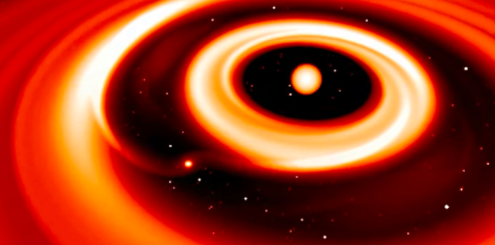
Planet Formation: Peering into the Dust & Gas that forms Rocky Worlds
Luca Ricci (California State University Northridge)
AAS Session: Theoretical Advances Guided by Radio-Millimeter-Submillimeter Arrays, Jan 9, 2019

Slide 2
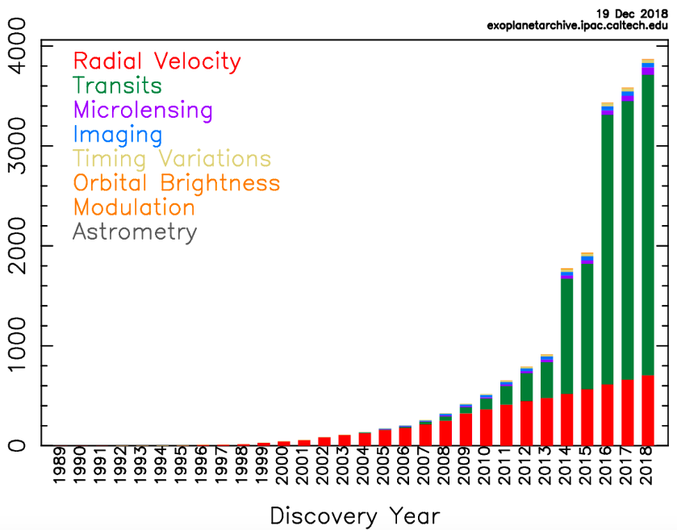
Planets: a recent history of discoveries
NUMBER OF KNOWN EXOPLANETS
AAS Session: Theoretical Advances Guided by Radio-Millimeter-Submillimeter Arrays, Jan 9, 2019
Notes:
One of the most fascinating and fastest growing fields in Astronomy is the study of exoplanets. Every year since the very first discovery in the early 90s we have been finding and characterizing more and more interesting worlds within our Galaxy. At the same time, several important questions on how these worlds come to be are still wide open.

Slide 3
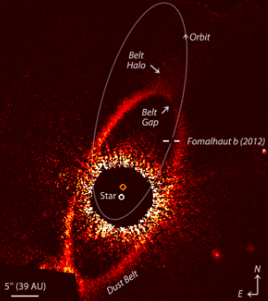
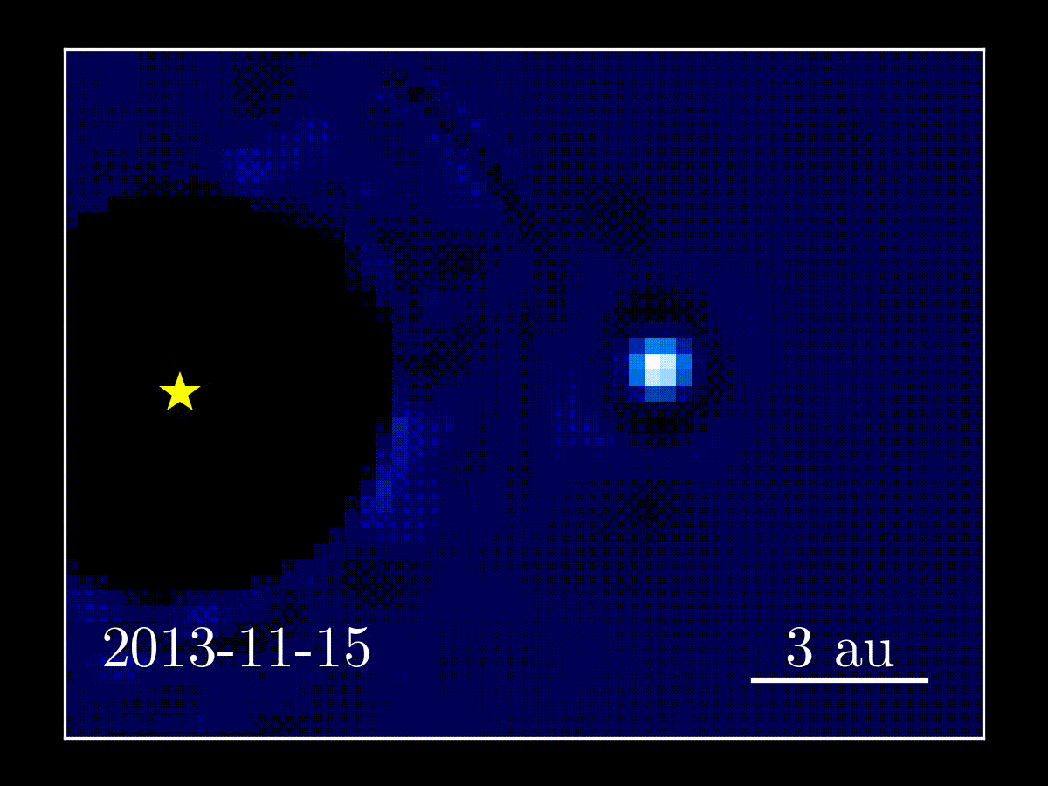
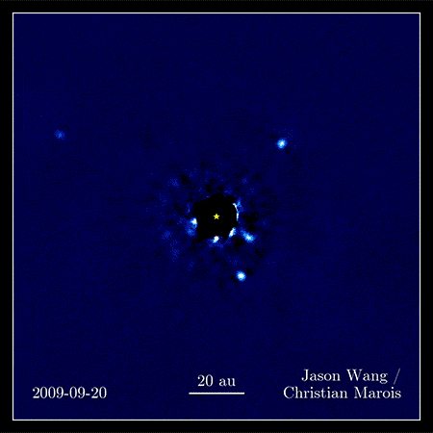
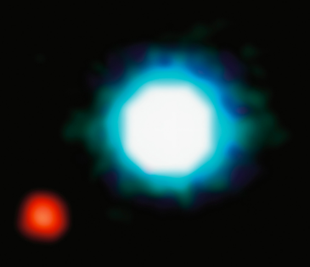
Planets: a recent history of discoveries
NUMBER OF KNOWN EXOPLANETS
AAS Session: Theoretical Advances Guided by Radio-Millimeter-Submillimeter Arrays, Jan 9, 2019
Notes:
One of the most fascinating and fastest growing fields in Astronomy is the study of exoplanets. Every year since the very first discovery in the early 90s we have been characterizing more and more interesting worlds within our Galaxy. At the same time, several important questions on how these worlds come to be are still wide open.

Slide 4
Young disks as the cradles of planets
Disks give birth to planets and feed them, planets sculpt the disk, the sculpted disk makes planets migrate
10 Earth mass planet
Planet grows from 30 Earth to 1 Jupiter
Kley & Nelson 2012
AAS Session: Theoretical Advances Guided by Radio-Millimeter-Submillimeter Arrays, Jan 9, 2019
Notes:
We know that planets form out of the gas and the tiny dust grains that are contained in disks surrounding young stars. Once a planet becomes massive enough, it starts to sculpt the disk with its gravity, as shown on this simulation for a forming Super-Earth planet. Once the disk has been significantly sculpted it starts to interact again with the planet making it migrate across the disk. And it really is this planet-disk interaction that determines most of the properties of planetary systems.

Slide 5
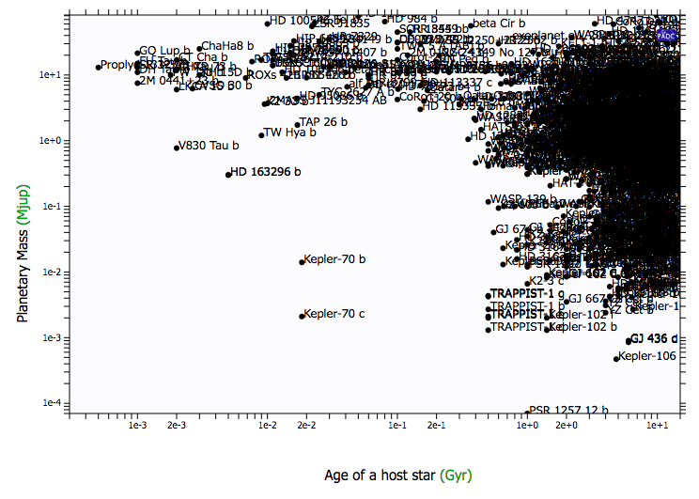
Planets & disks: the missing link
exoplanet.eu
10 Myr
100 Myr
1 Gyr
10 Gyr
AAS Session: Theoretical Advances Guided by Radio-Millimeter-Submillimeter Arrays, Jan 9, 2019
Notes:
This is all in theory, but finding observational evidence for this physical interaction between disks and young planets is extremely difficult. This diagram shows the mass of known planets on the y-axis as a function of their age. As you can see, the vast majority of discovered exoplanets orbit very mature stars with ages older than 1 Gyr, much fewer exoplanets are known around younger stars, especially those that are still embedded in their parental disk, with the recent observations of the PDS 70 system being one of the very rare examples. The most efficient way that we have to find evidence of newborn planets is by detecting the imprints of planets on the morphology of disks.

Slide 6
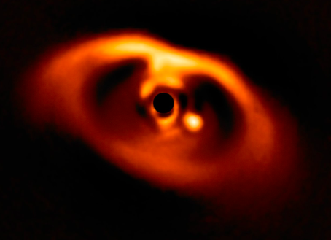
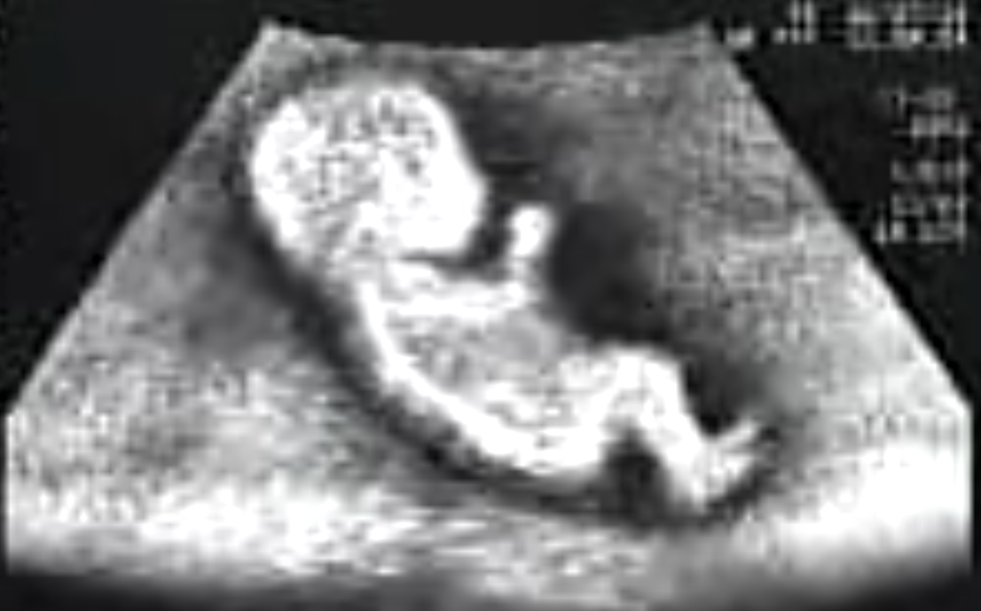
Planets & disks: the missing link
exoplanet.eu
Keppler+18
Disks
10 Myr
100 Myr
1 Gyr
10 Gyr
AAS Session: Theoretical Advances Guided by Radio-Millimeter-Submillimeter Arrays, Jan 9, 2019
Notes:
This is all in theory, but finding observational evidence for this physical interaction between disks and young planets is extremely difficult. This diagram shows the mass of known planets on the y-axis as a function of their age. As you can see, the vast majority of discovered exoplanets orbit very mature stars with ages older than 1 Gyr, much fewer exoplanets are known around younger stars, especially those that are still embedded in their parental disk, with the recent observations of the PDS 70 system being one of the very rare examples. The most efficient way that we have to characterize newborn planets is by detecting the effect of their interaction on the morphology of disks.

Slide 7
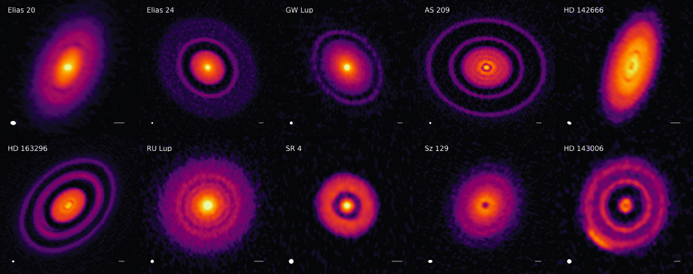
Disks at high-res: ALMA DSHARP
30mas or 6au @ 1.3mm
Andrews…Ricci+18
Huang…Ricci+18
AAS Session: Theoretical Advances Guided by Radio-Millimeter-Submillimeter Arrays, Jan 9, 2019
Notes:
Young disks, even the closest ones to us, are very small sources in the sky, and angular resolutions much below 1 arcsecond are required to find details in their structure. These images come from the recent ALMA DSHARP Large Program lead by Sean Andrews, for which we observed a sample of 20 disk systems at 1mm with an angular resolution of about 30 mas or 6 au at their distance. Among them, we found these 10 disks which show prominent multiple rings in them.

Slide 8
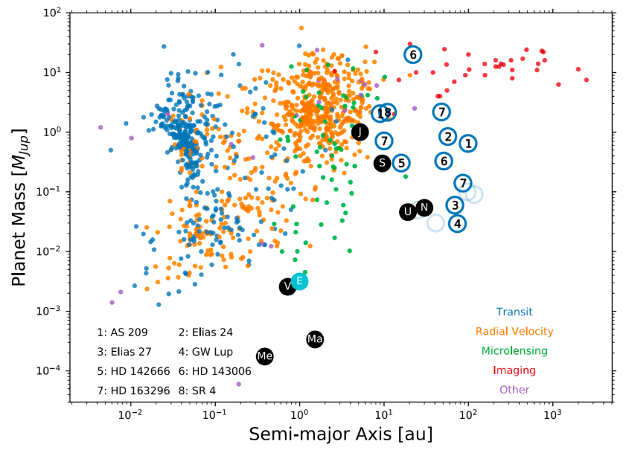
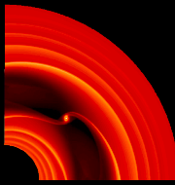
Disks at high-res: ALMA DSHARP
Zhang…Ricci+18
ALMA
“DSHARP
planets”
30mas or 6au @ 1.3mm
~ Neptune – 10x Jupiter sized planets
@ orbital radii > 6au from the star
Andrews…Ricci+18
Huang…Ricci+18
AAS Session: Theoretical Advances Guided by Radio-Millimeter-Submillimeter Arrays, Jan 9, 2019
Notes:
Under the assumption that these rings are generated by planets in the disk, we used the results of numerical simulations ran by Shanja Zhang to estimate the mass and orbital radii of the planets in these systems. The results are shown as blue circles in this planetary mass-semi-major axis diagram, so we are talking about planets with masses ranging between the mass of Neptune up to 10 times the mass of Jupiter, at orbital radii beyond 6 au which is the limit set by the ALMA resolution. In order to probe young planets with properties similar to those of the known more mature exoplanets, we need observations at much higher resolution than ALMA.

Slide 9
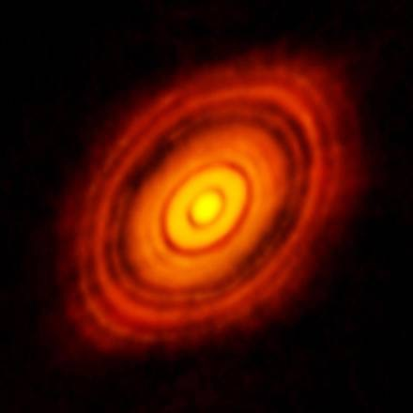
Regions of rocky planet formation
HL Tau @ 0.87mm
ang res = 25mas
ALMA Partnership+ 15
AAS Session: Theoretical Advances Guided by Radio-Millimeter-Submillimeter Arrays, Jan 9, 2019
Limited ang res & high optical depth
Notes:
Also if we look at the popular ALMA image of HL Tau at 0.87mm, which was taken with an ang res of 25 mas, and we look at the inner 5-10 au from the central star…

Slide 10
Regions of rocky planet formation
10au
HL Tau @ 0.87mm
Need for
better resolution
(< 10mas)
at longer wavelengths (lower opt depth)
1au, 7mas
ang res = 25mas
ALMA Partnership+ 15
AAS Session: Theoretical Advances Guided by Radio-Millimeter-Submillimeter Arrays, Jan 9, 2019
Limited ang res & high optical depth
Notes:
…we don’t see any substructure in the surface brightness of the disk in these inner regions which should be very active for rocky planet formation.

Slide 11
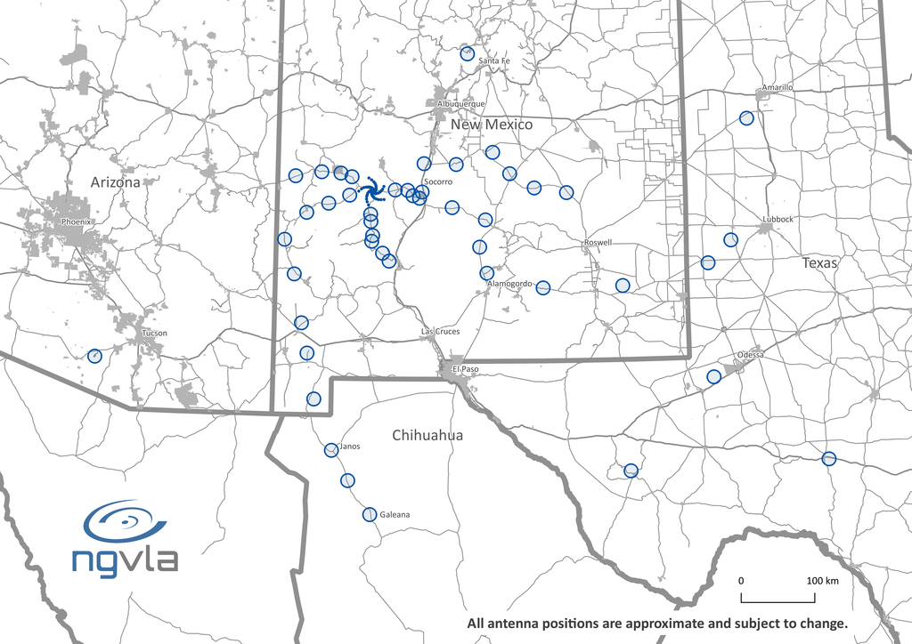
Next Generation Very Large Array
AAS Session: Theoretical Advances Guided by Radio-Millimeter-Submillimeter Arrays, Jan 9, 2019
Notes:
And this is exactly what the ngVLA would be capable of providing.

Slide 12
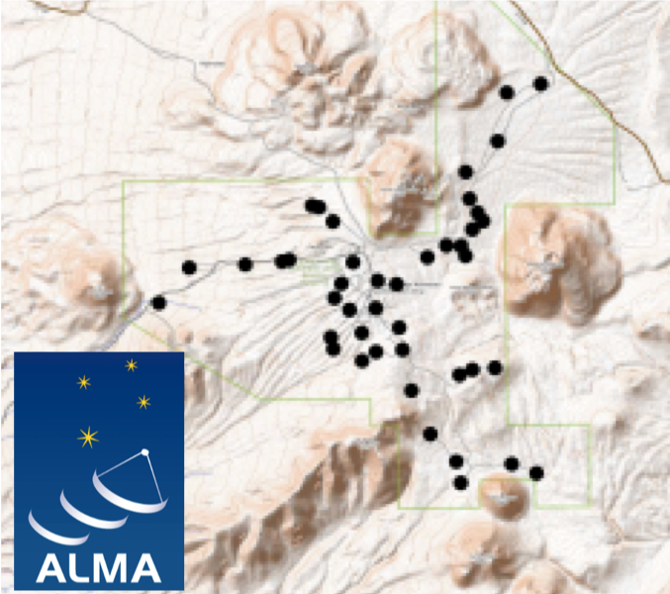
Next Generation Very Large Array
AAS Session: Theoretical Advances Guided by Radio-Millimeter-Submillimeter Arrays, Jan 9, 2019
Notes:
Just to give you a sense of the leap in angular resolution compared with ALMA, this is the size of the ALMA array compared with the ngVLA one.

Slide 13
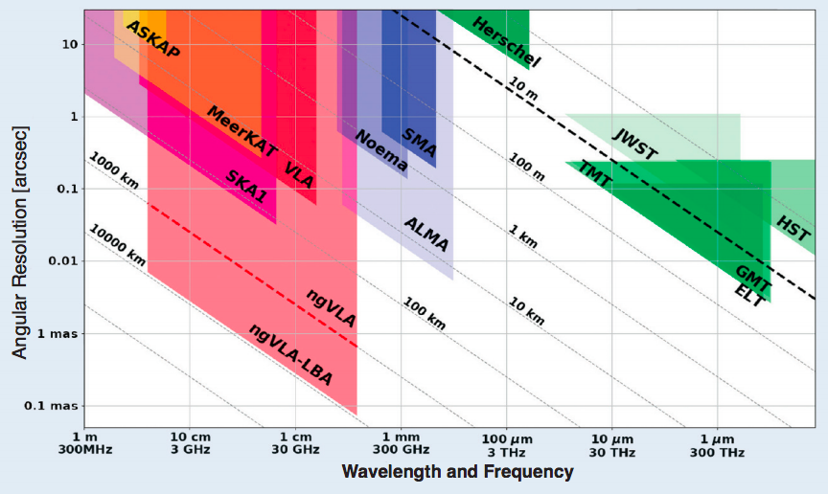
Next Generation Very Large Array
1 mas ~ 0.1 au in Taurus,
sub-au res @ d < 1 kpc
AAS Session: Theoretical Advances Guided by Radio-Millimeter-Submillimeter Arrays, Jan 9, 2019

Slide 14
Disks substructures due to planets with the ngVLA
Hydrodynamic sims of disks with planets
(LA-COMPASS bi-fluid: gas + dust)
GAS
DUST
Synthetic images to simulate obs
for the dust emission with ngVLA & ALMA
Ricci+18
AAS Session: Theoretical Advances Guided by Radio-Millimeter-Submillimeter Arrays, Jan 9, 2019

Slide 15
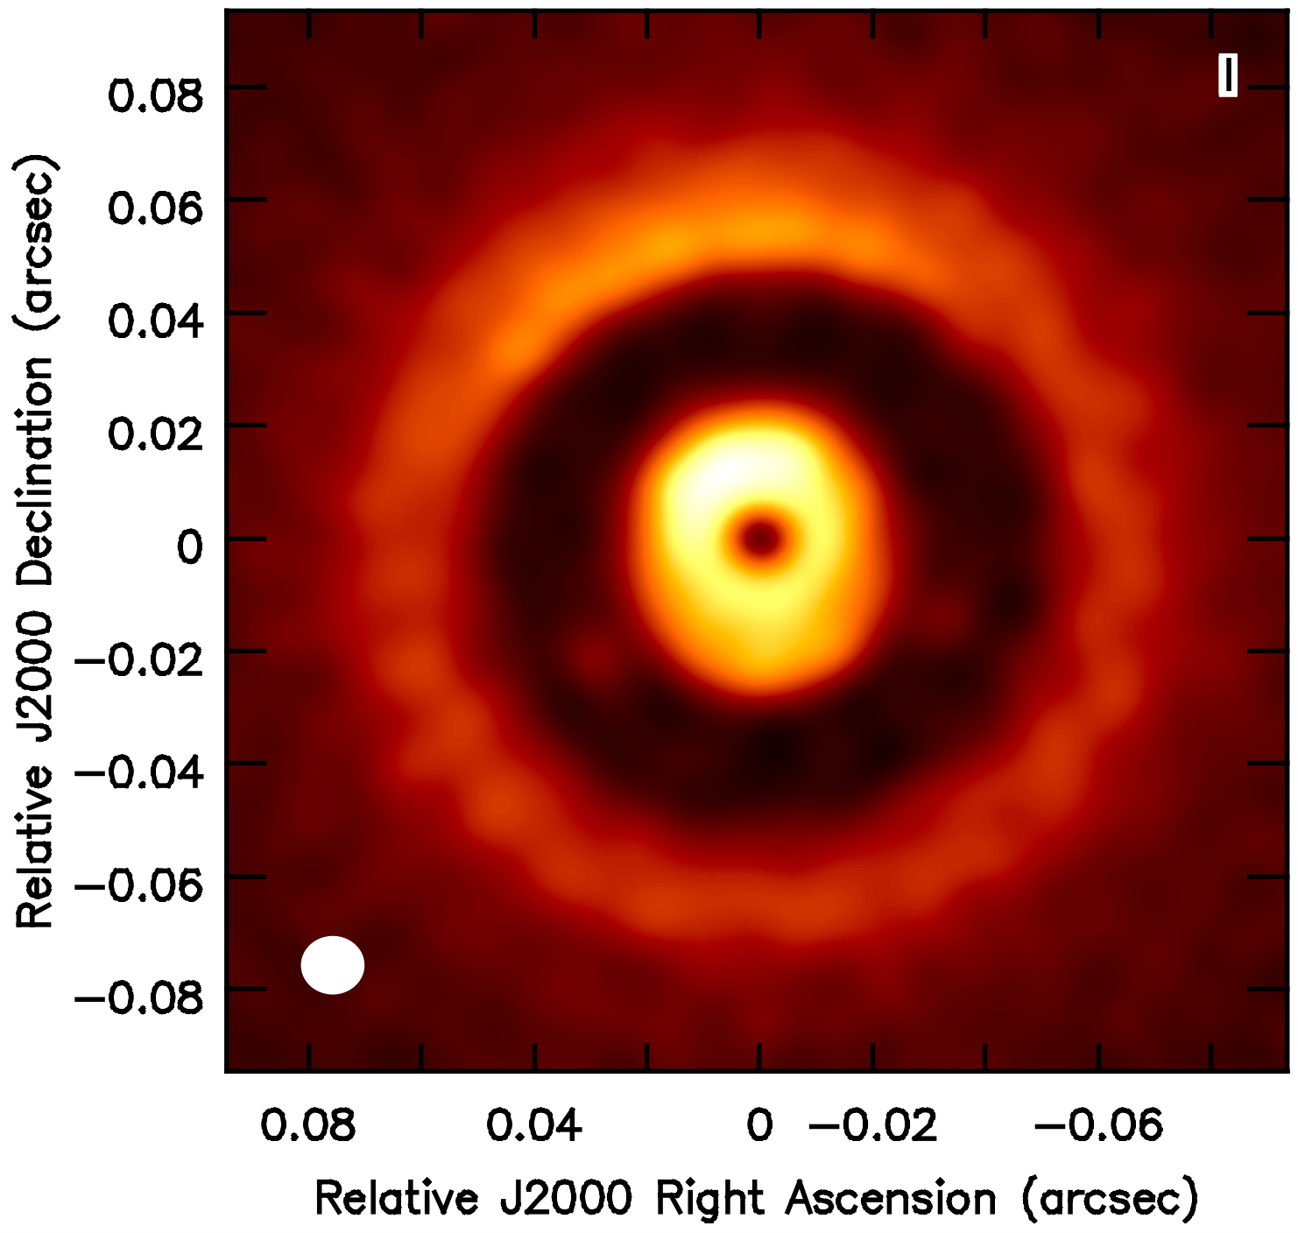
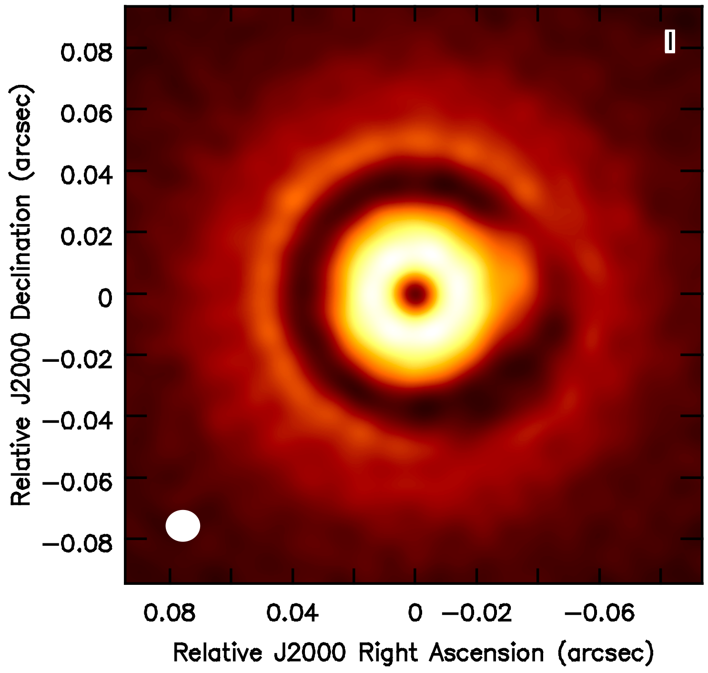
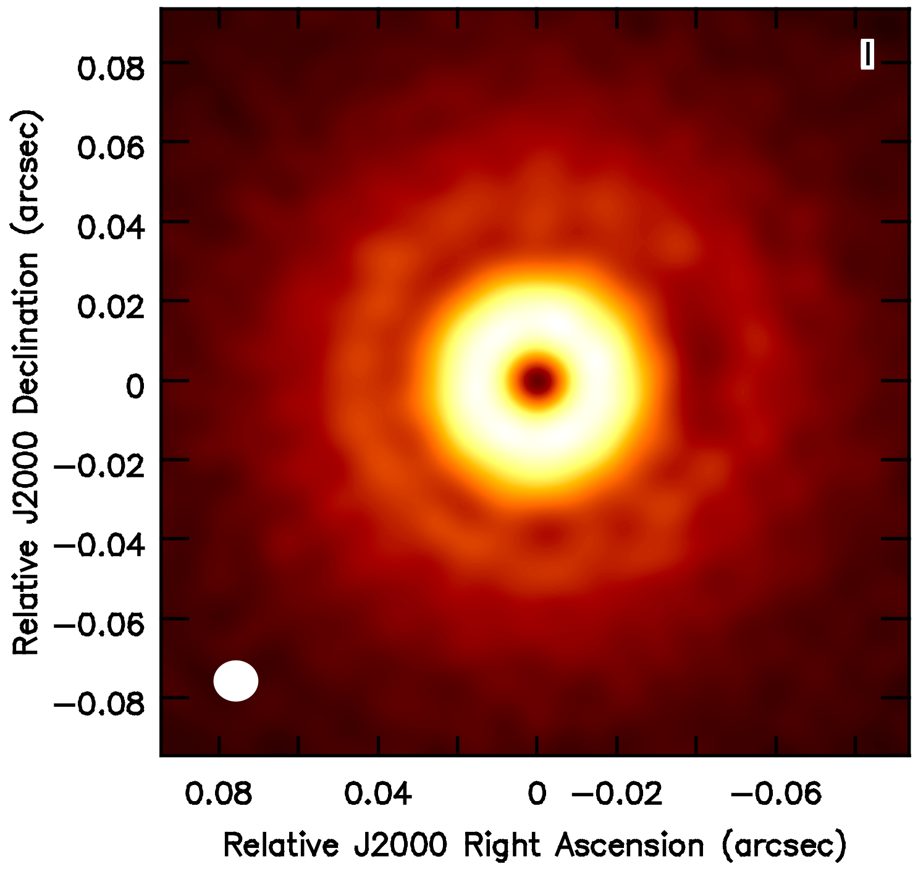
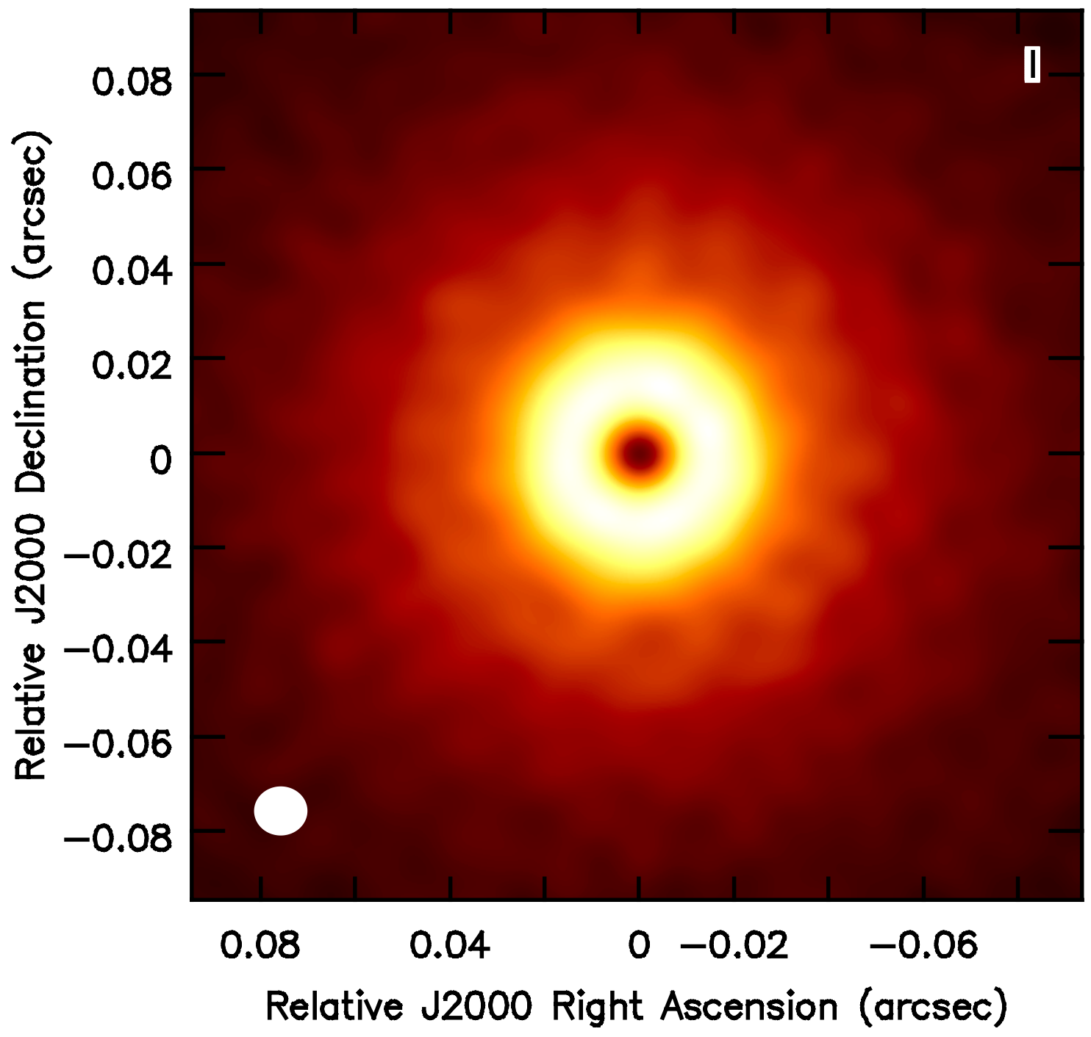
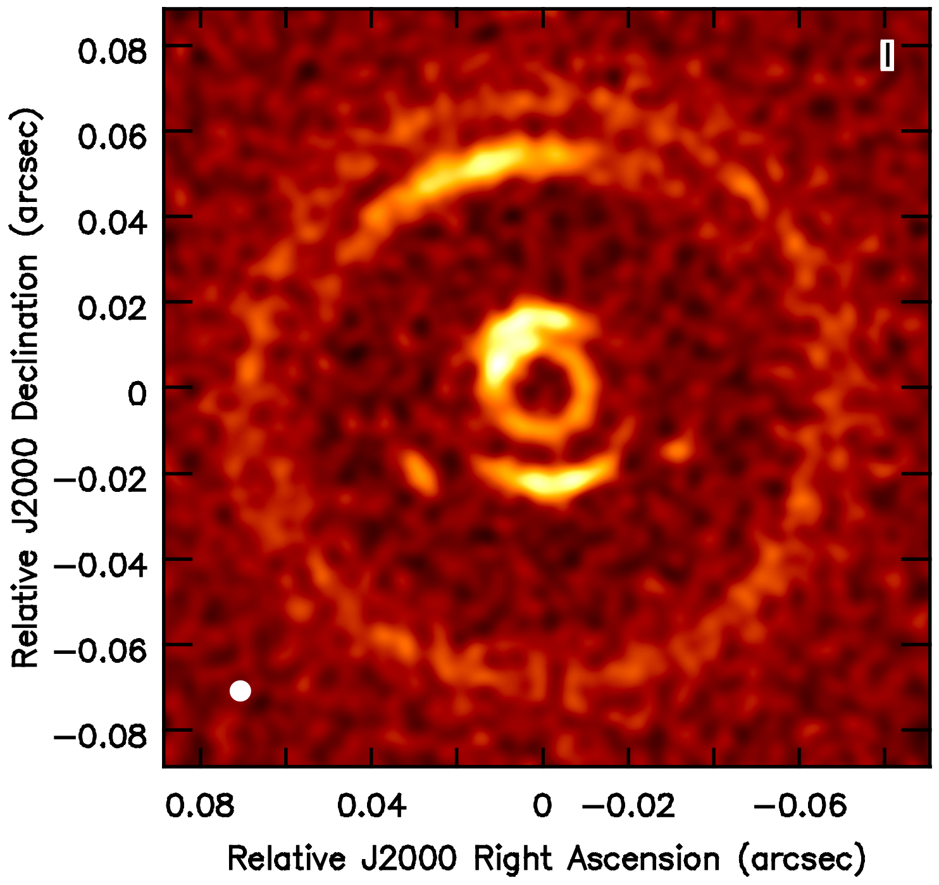
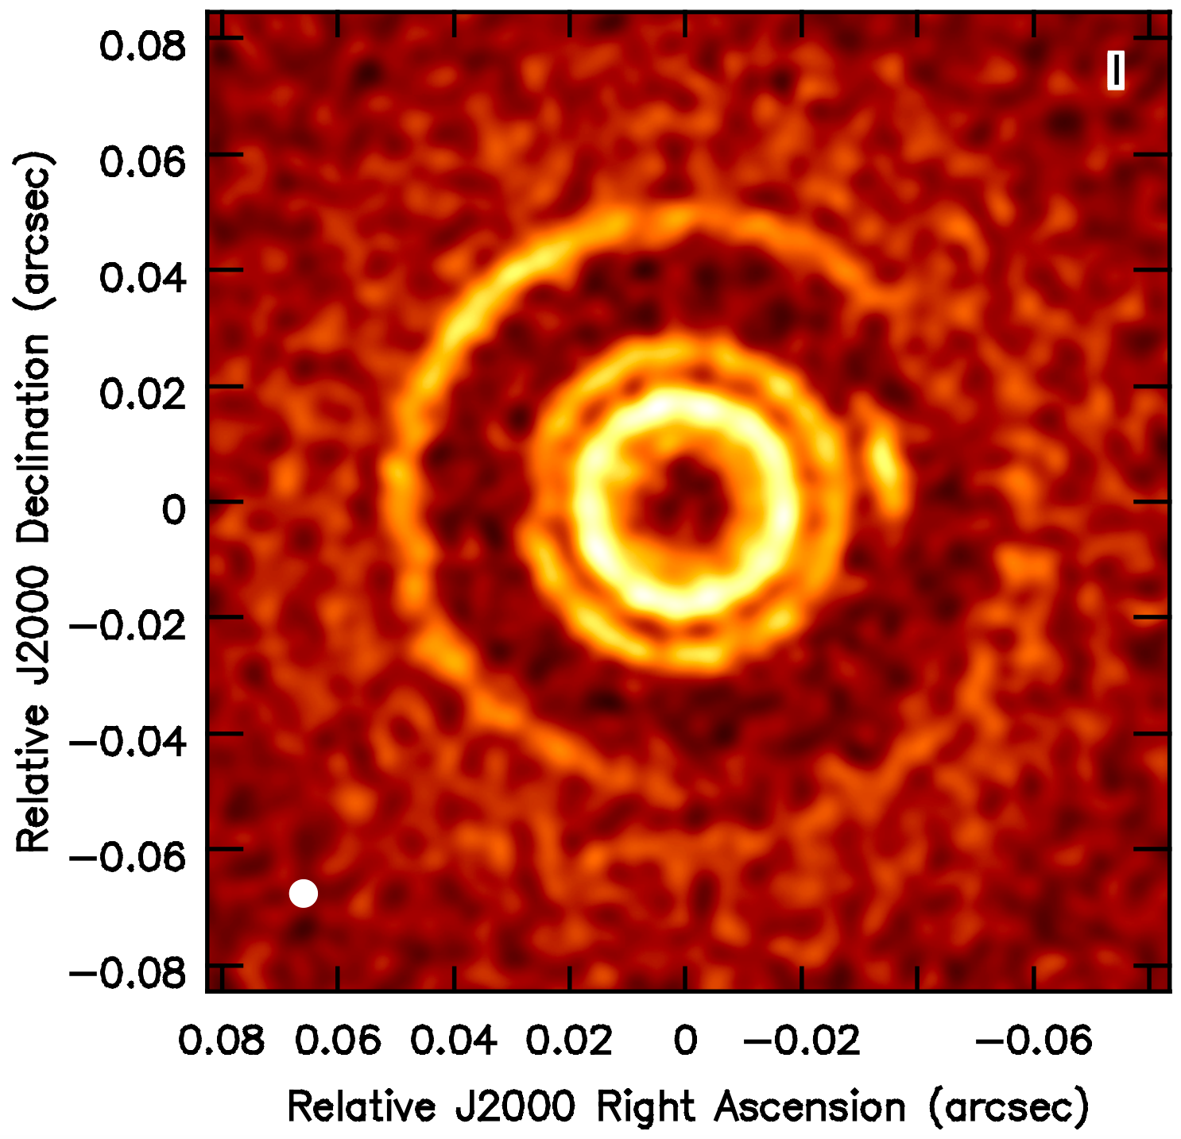
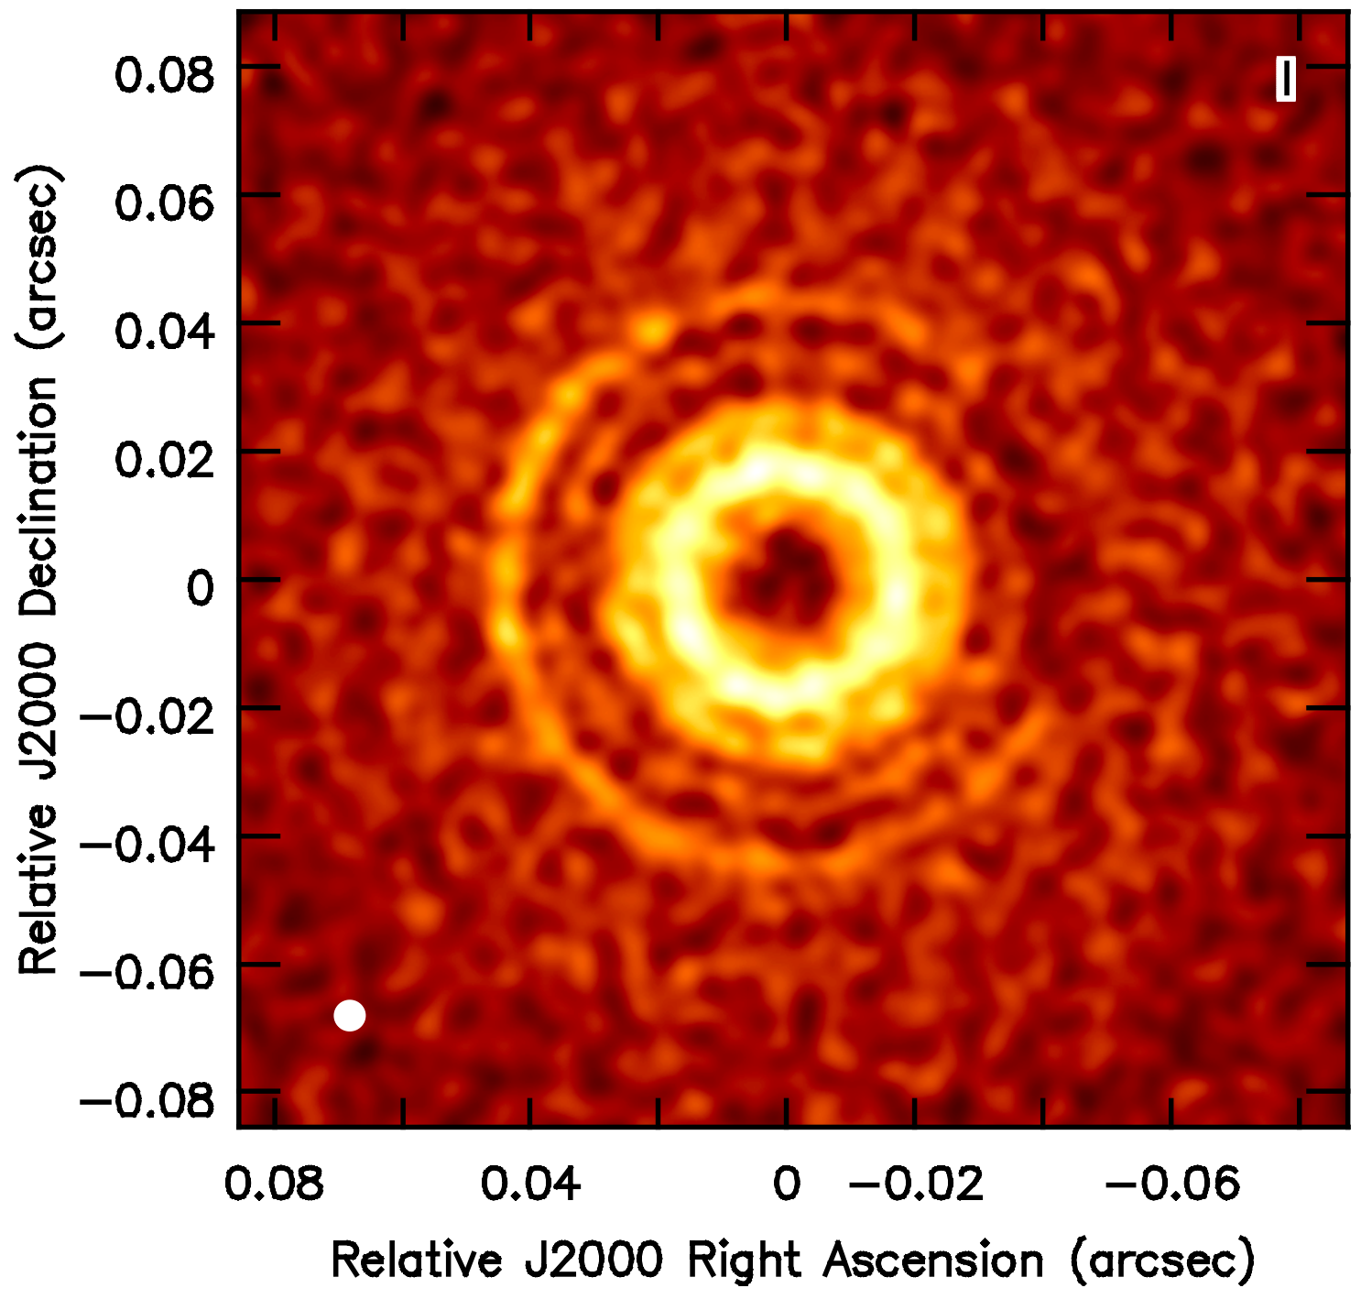
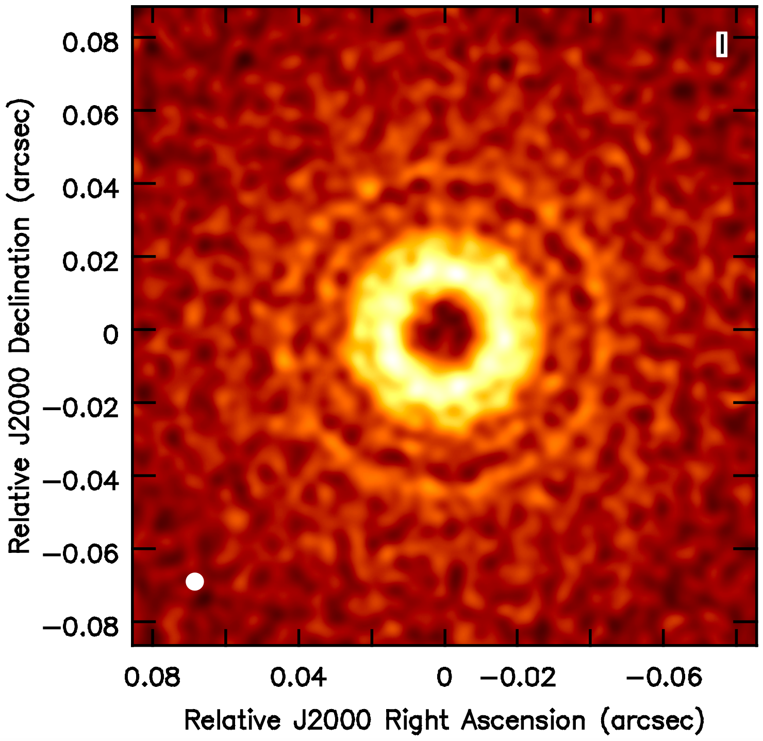
Results for planets @ 5au (Ricci+18)
Jupiter
Saturn
Neptune
10 MEarth
M_{disk} = 0.006 M_{Sun}
d = 140 pc
ALMA @ 0.87mm
(longest baselines,
8-hr synthesis)
5au
ngVLA @ 3mm
(beam = 5mas, 0.7au
rms = 5e-7 Jy/b)
AAS Session: Theoretical Advances Guided by Radio-Millimeter-Submillimeter Arrays, Jan 9, 2019

Slide 16
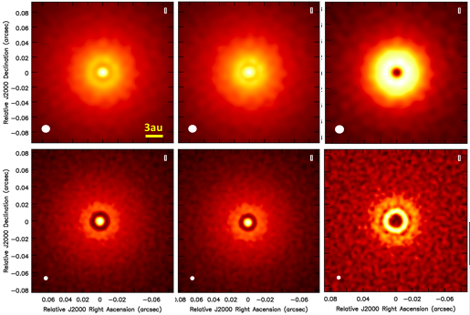
Results for planets < 5au (Ricci+18)
Jupiter @ 1au
Saturn @ 1au
30 MEarth @ 2.5au
ALMA @ 0.87mm
ngVLA @ 3mm
(beam = 5mas, 0.7au
rms = 5e-7 Jy/b)
ngVLA resolves gaps of planets down to Super-Earths
> 0.5-1au, at distances < 1kpc
AAS Session: Theoretical Advances Guided by Radio-Millimeter-Submillimeter Arrays, Jan 9, 2019

Slide 17
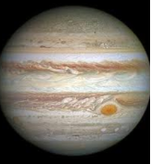
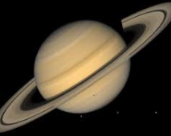
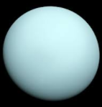
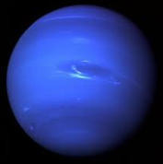
A young Solar Nebula @ 140pc
a [au]
2
4
6
8
10
Grand Tack model
(Walsh+11)
AAS Session: Theoretical Advances Guided by Radio-Millimeter-Submillimeter Arrays, Jan 9, 2019

Slide 18
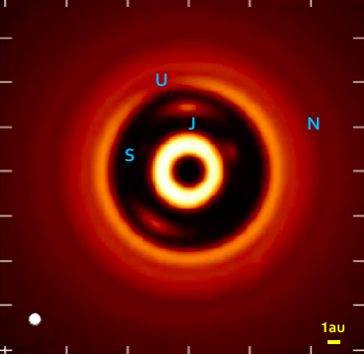
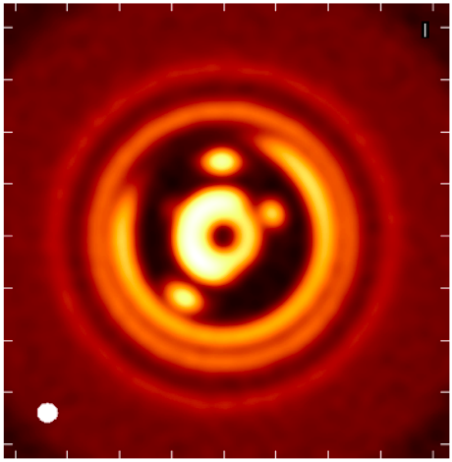
A young Solar Nebula @ 140pc
a [au]
2
4
6
8
10
Grand Tack model
(Walsh+11)
M_{disk} = 0.08 M_{Sun}
d = 140 pc
ngVLA @ 3mm
(beam = 0.7au
rms = 3e-7 Jy/b)
ngVLA @ 1cm
(beam = 1au
rms = 7e-8 Jy/b)
AAS Session: Theoretical Advances Guided by Radio-Millimeter-Submillimeter Arrays, Jan 9, 2019

Slide 19
A young Solar Nebula @ 140pc
a [au]
2
4
6
8
10
Grand Tack model
(Walsh+11)
M_{disk} = 0.08 M_{Sun}
d = 140 pc
1 frame every month
whole movie spans 24 yrs
ngVLA @ 3mm
(beam = 0.7au
rms = 3e-7 Jy/b)
AAS Session: Theoretical Advances Guided by Radio-Millimeter-Submillimeter Arrays, Jan 9, 2019

Slide 20
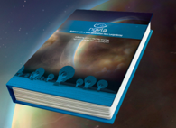
A young Solar Nebula @ 140pc
a [au]
2
4
6
8
10
Grand Tack model
(Walsh+11)
Chapter on disk-planet interaction in ngVLA Science Book @ ngvla.nrao.edu
M_{disk} = 0.08 M_{Sun}
d = 140 pc
ngVLA @ 3mm
(beam = 0.7au
rms = 3e-7 Jy/b)
AAS Session: Theoretical Advances Guided by Radio-Millimeter-Submillimeter Arrays, Jan 9, 2019

Slide 21
The ngVLA revolution
Zhang…Ricci+19
ALMA
“DSHARP
planets”
AAS Session: Theoretical Advances Guided by Radio-Millimeter-Submillimeter Arrays, Jan 9, 2019
Notes:
I would leave you with this diagram shown earlier for the mass and semi-major axes of planets invoked to explain the recent ALMA DSHARP observations.

Slide 22
The ngVLA revolution
Zhang…Ricci+19
ALMA
“DSHARP
planets”
ngVLA
Results from Ricci+18
AAS Session: Theoretical Advances Guided by Radio-Millimeter-Submillimeter Arrays, Jan 9, 2019
Notes:
The yellow box shows an estimate of the parameter space region that the ngVLA would be capable of exploring, This would allow us to extend our limits of investigation down to young Super-Earth planets at a fraction of 1 au from the star.

