Slide 1
Multi-Messenger Astrophysics: Modeling Explosive Transients
Davide Lazzati
Oregon State University

Slide 2
Outlook
A brief introduction to blast waves/shock waves
A brief introduction to synchrotron radiation
Case study: binary neutron star mergers and short GRBs
Why is this important?
Summary, discussion, conclusions, outlook

Slide 3
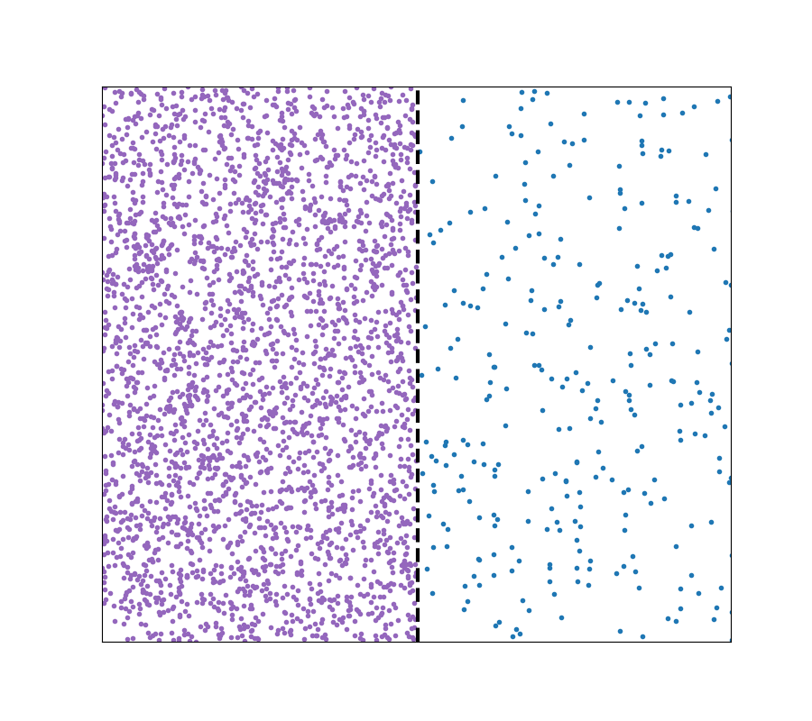
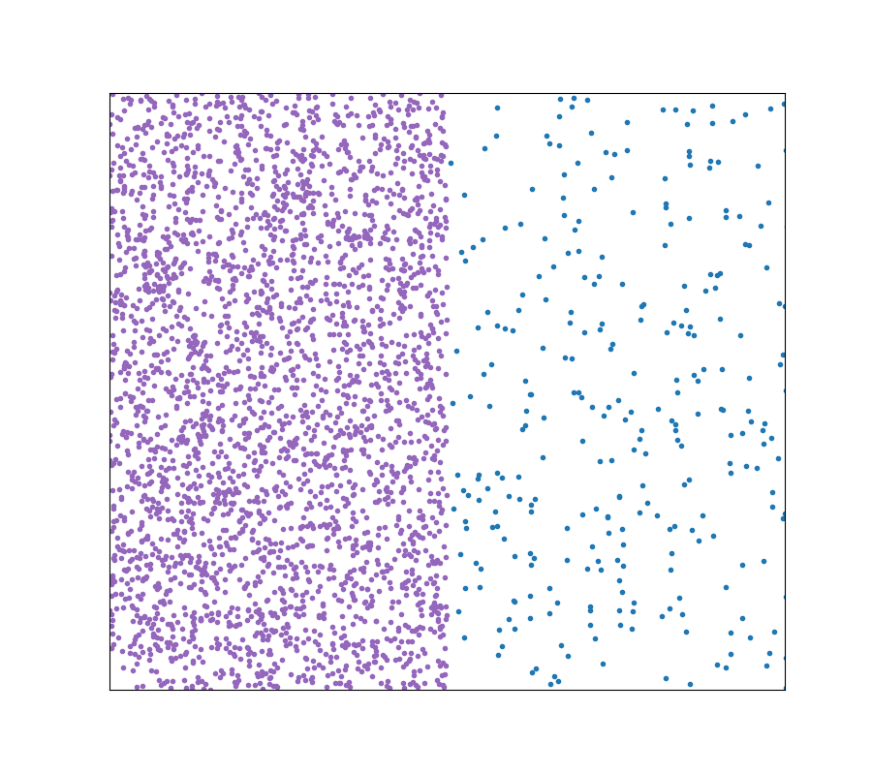
Blast waves/Shock waves
Non-relativistic v<<c
Non-thermal e⁻
LTE
High B field
Low B field
High Pressure
Low Pressure
High Velocity
No Velocity
High Density
Low Density

Slide 4
Blast waves/Shock waves
Relativistic v~c
Non-thermal e⁻
LTE
High B field
Low B field
High Pressure
Low Pressure
High Velocity
No Velocity
High Density
Low Density

Slide 5
Synchrotron Radiation
Log F(ν)
ν^{−(p−1)/2}
ν^{1/3}
ν²
Log ν

Slide 6
GW170817
Abbott et al. 2017; Goldstein et al. 2017

Slide 7
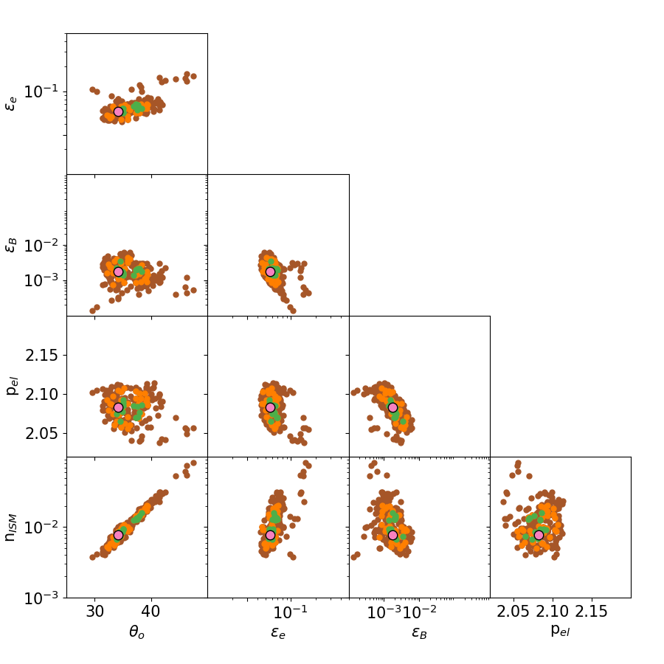
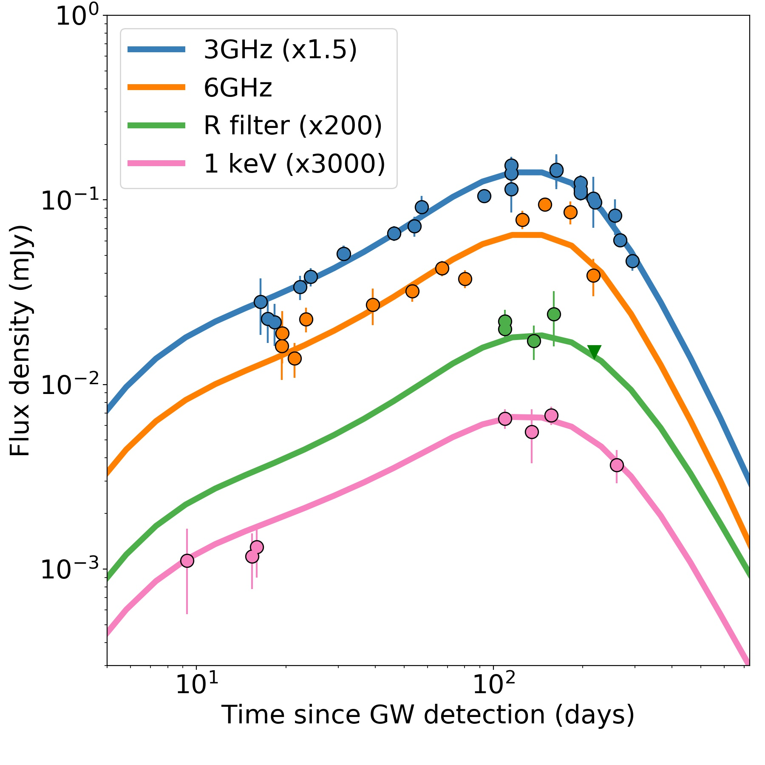
GW170817
Multiwavelength fit
DL+ 2018

Slide 8
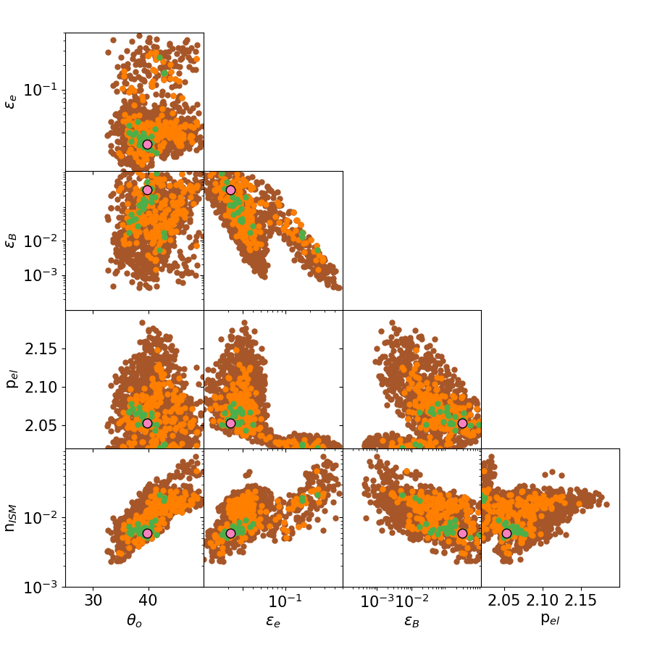
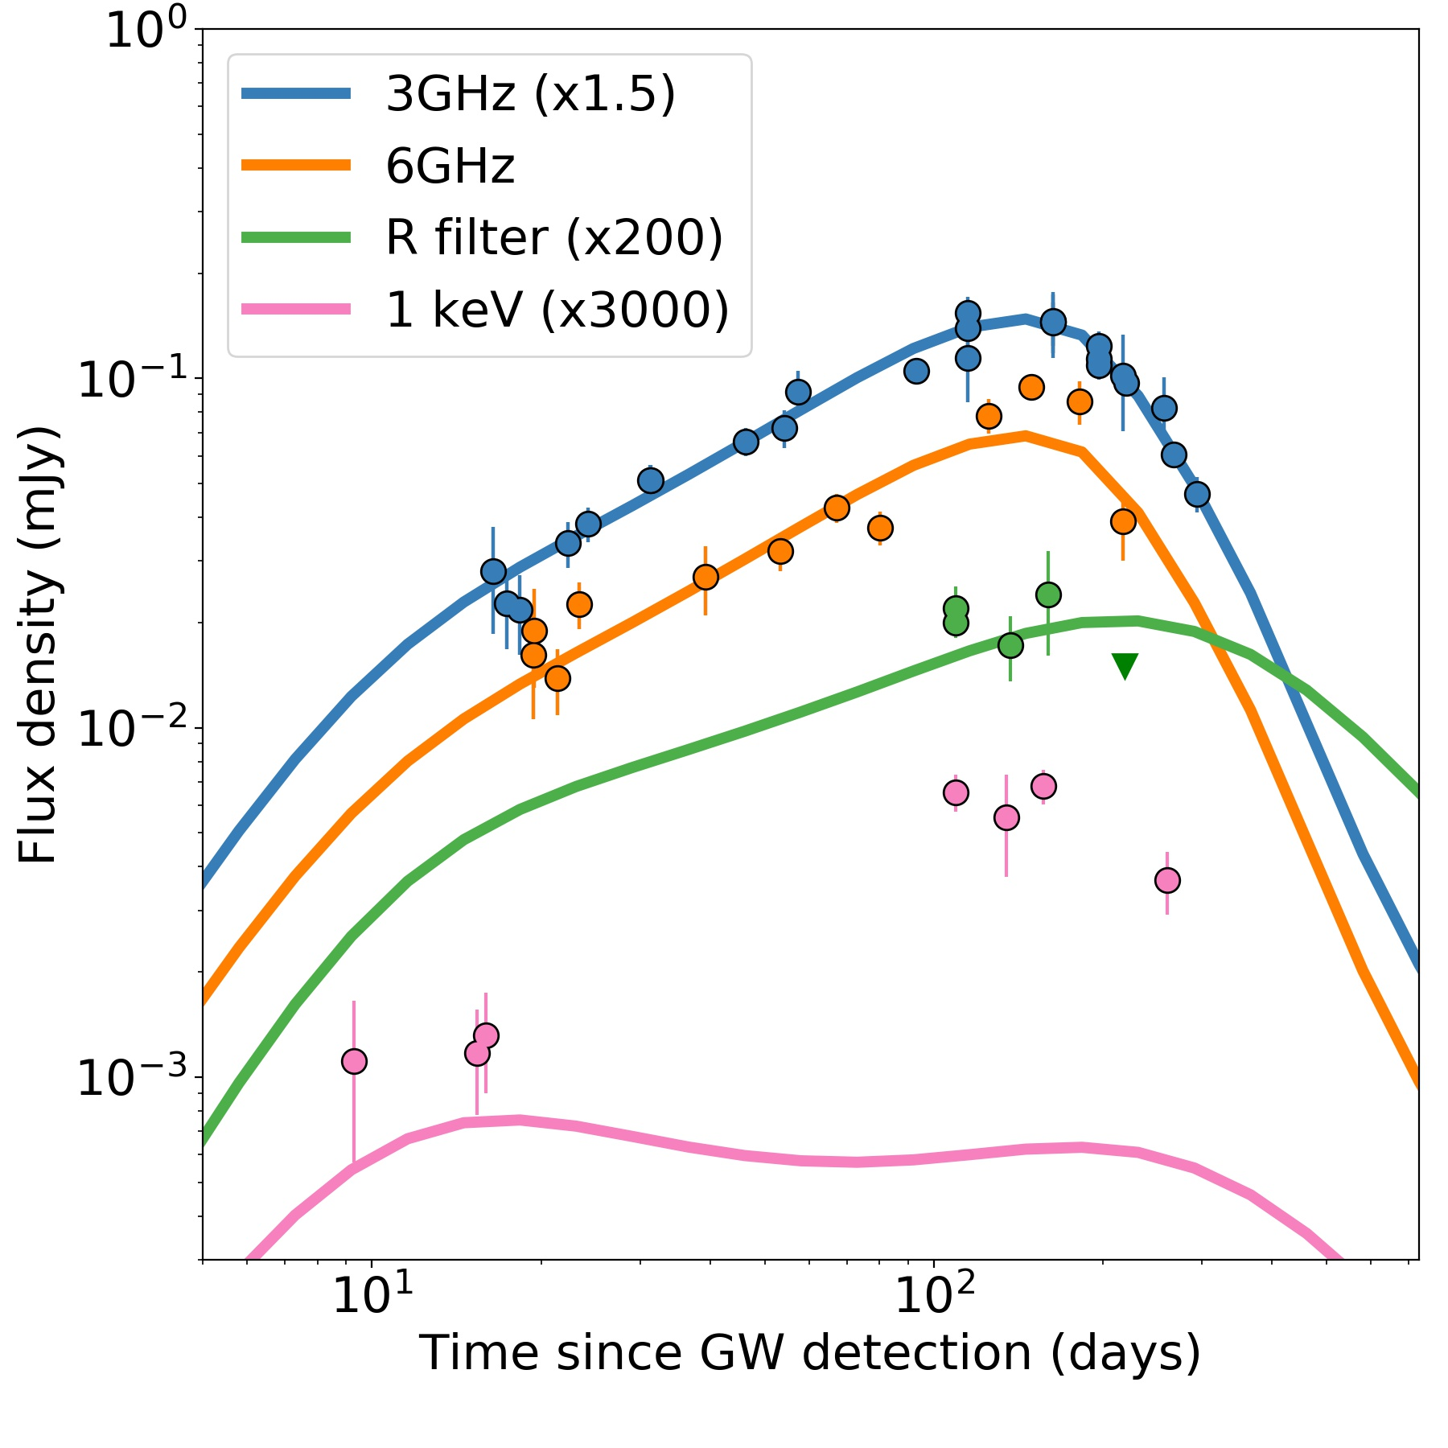
GW170817
Radio data fit
DL+ 2018

Slide 9
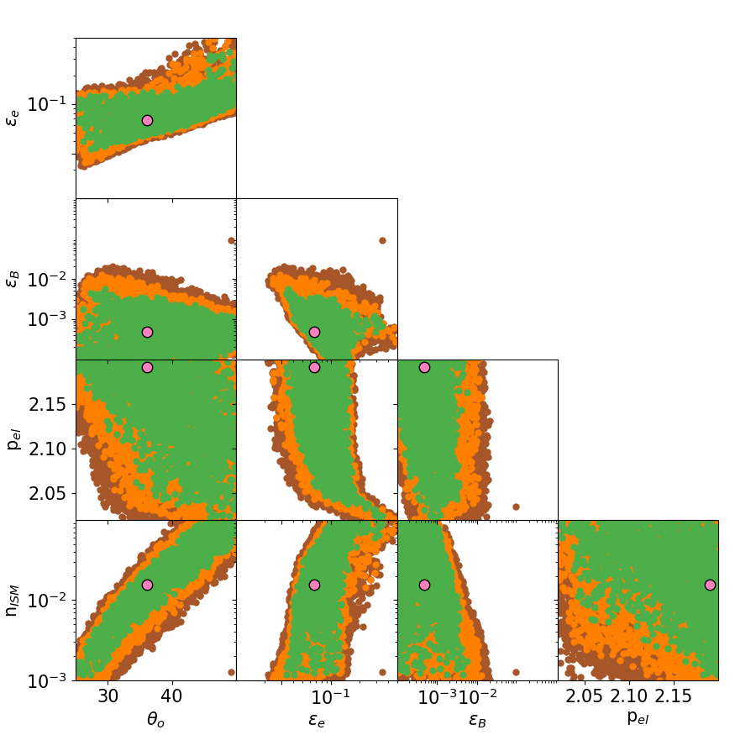
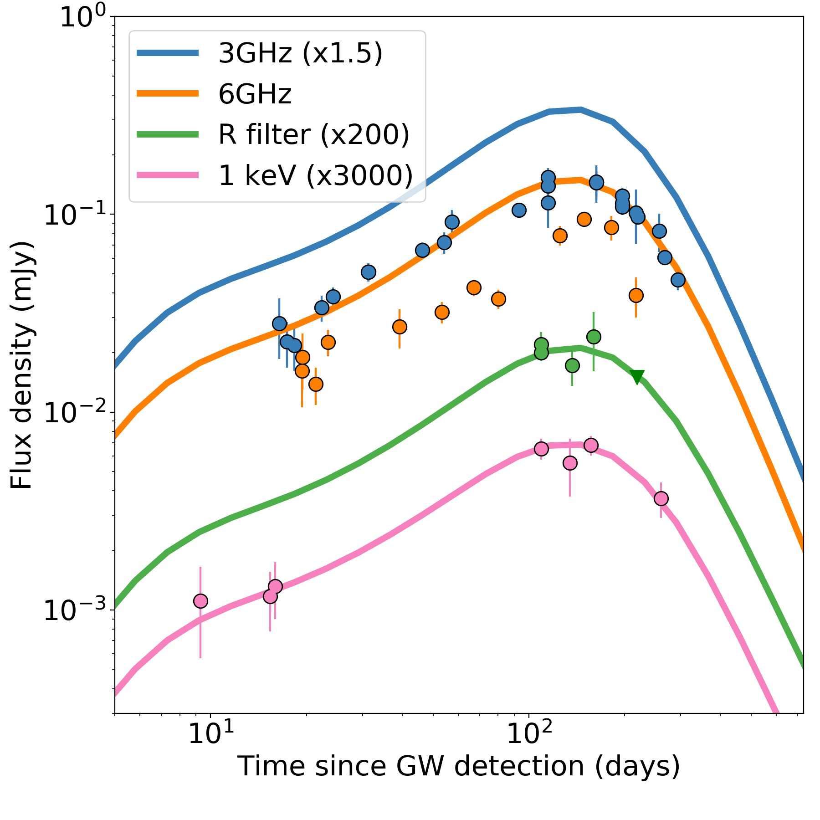
GW170817
Optical+X-ray fit
DL+ 2018

Slide 10
GW170817
Multiwavelength fit
DL+ 2018

Slide 11
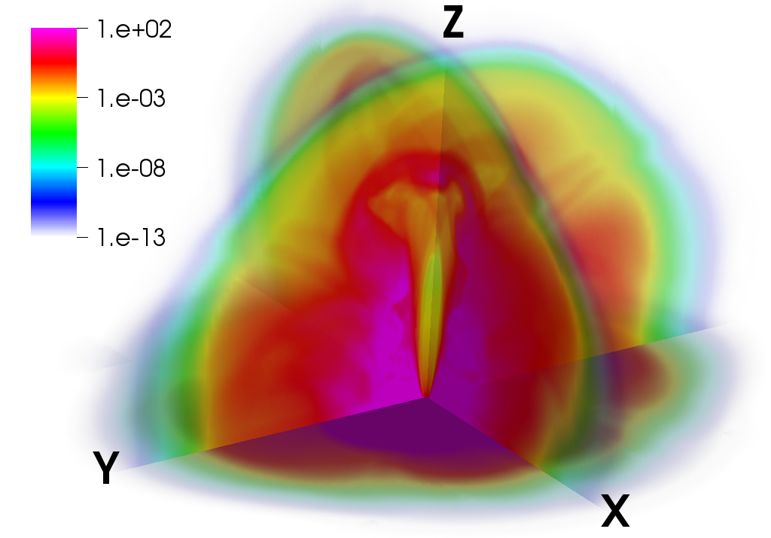
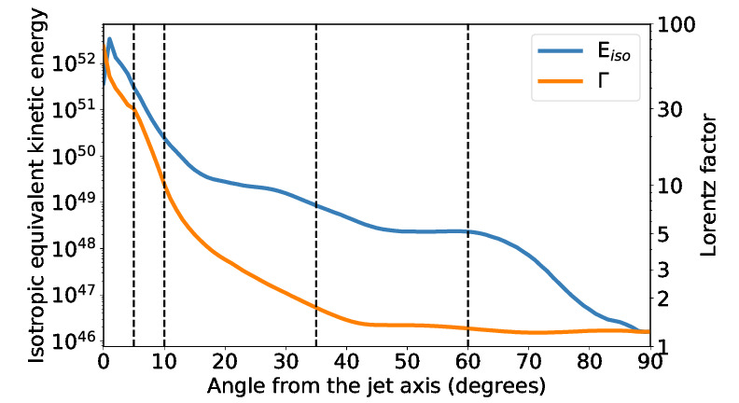
GW170817
DL+ 2017
2 s
Jet+Cocoon propagation
Remnant transition
Engine charging

Slide 12
In summary…
YES, we need radio data to model multi messenger relativistic transients
Synchrotron radiation from relativistic shocks codes a lot of information in the slopes, breaks, and their time dependence
GW170817 was awesome, but we need more to answer some key questions like:
Was there a delay between merger and launch of the relativistic jet?
What was the engine? Why did it turn on and off?
What is the jet ejection mechanism?

