Slide 1
The VLA Pipeline
Drew Medlin – 2022-10-12

Slide 2
Pipeline Overview
With the start of (Jansky) VLA Full Operations (January 2013), pipeline automatically run on all Scheduling Blocks as soon as the data are ingested into the archive (over 24,700 to date):
Deliver flagged and calibrated visibility data
You will self-calibrate and image visibility data to meet science goals, using resources at home institution or NRAO computing resources
Automated pipeline should run correctly on all “standard” Stokes I science SBs; “standard” means:
128 MHz spws, but may work on other set-ups as well
Some constraints on strength of calibrators needed
Contains correctly labeled and complete scan intents

Slide 3
Pipeline Overview
Current versions available:
CASA integrated pipeline: compatible with ALMA pipeline infrastructure, and used as real-time pipeline since Sep 2015
“scripted” pipeline: collection of python scripts that use CASA tasks wherever possible, but also uses toolkit calls; readable and easy to modify. It was the original VLA pipeline and in use in real-time pipeline operations from early 2013 and until Sep 2015.

Slide 4
Pipeline Overview
Real-time pipeline at NRAO:
Minimal human intervention: Pipeline is run automatically on every science SB as it completes (not just “continuum”)
Pipeline output undergoes basic quality assurance checks by NRAO staff, and detailed checks are made for most C-band and higher continuum; reports generated are archived as pipeline products
At your home institution:
Instructions for installation and operation of the VLA CASA Calibration Pipeline are available at http://go.nrao.edu/vla-pipe
Uses CASA 6.2.1, similar to current real-time pipeline
See the VLA CASA pipeline guide at http://go.nrao.edu/vla-casa-tut

Slide 5
Pipeline Overview
Scripted pipelines for CASA versions through 5.3.0 also available
Provides more flexibility in how to use the pipeline, options suitable for spectral line datasets, mixed correlator set-ups, multi-band observations, etc.
Working to incorporate some of these into the CASA integrated pipeline

Slide 6
Will the Pipeline work for you?
The pipeline successfully completes on ~96% of all science SBs observed on the VLA; whether the output can be used for science depends on the science goal, and whether the observations were correctly set up
Pipeline includes Hanning smoothing, RFI flagging, and weight calculations that may not be appropriate for (some) spectral line projects.
No polarization calibration (yet) but can use pipeline output as a starting point.*
Will probably work for data taken since May 2012, may work for earlier EVLA data, likely that extra flagging and editing are needed in these cases
*CASA 5.4.1 and later, requires that you have used the correct polarization intents when setting up the observations

Slide 7
Pipeline Requirements
“Standard” Stokes I science SB means:
128 MHz spws (64 MHz for L-band; default setup), but may work on other set-ups as well
Can work for narrower BWs, depends on the strength of the calibrators
Heuristics currently make some assumptions about the strength of the calibrators, in particular, the delay calibrator
currently requires the SNR=3 limit on initial gain calibration per integration
Contains correctly labeled and complete scan intents
And also that the observations have been set up correctly!

Slide 8
Pipeline Requirements
Correct observation set-up
Independent of whether you want to run the pipeline!
Remember: simple observing set-ups are always easier to calibrate
Do not skimp on calibration to spend more time on your target – you may end up not being able to calibrate the target data at all
Spending 3 minutes pointing could buy you more sensitivity than doubling the time on your target.

Slide 9
Pipeline Requirements
Scan intents
The pipeline relies entirely on correct scan intents to be defined in each SB
In order for the pipeline to run successfully on an SB it must contain, at minimum, scans with the following intents:
A flux density scale calibrator scan that observes one of the primary calibrators (3C48, 3C138, 3C147, or 3C286)* – this will also be used as the delay and bandpass calibrator if no bandpass or delay calibrator is defined
Complex gain calibrator scans
*Some of these calibrators are variable (especially 3C48, 3C138), use 3C286 if possible

Slide 10
(Real-Time) Heuristics (I)
Assuming requirements are met, the pipeline:
Loads the data (SDM-BDF → MS)
Hanning smoothing*
Retrieves information about the observing set-up from the data
Applies deterministic flags (online flags, shadowed data, end channels of spectral windows, etc.)
Identifies primary calibrators and loads models
*May want to modify inputs and/or omit entirely for spectral line reductions, unless heavily impacted by RFI or dealing with a very strong spectral line feature.

Slide 11
(Real-Time) Heuristics (II)
Derives all prior calibrations (antenna position corrections, gain curves, atmospheric opacity, requantizer gains)
Iteratively determines initial delay and bandpass solutions, including running RFLAG, and identifying system problems
Derives initial gain solutions, does flux density bootstrapping and derives spectral index of all calibrators, sets models.
Derives final delay, bandpass, and complex gain calibrations
Applies all calibrations to the MS
Runs RFLAG algorithm on all fields, including target*
Runs statwt to derive proper relative weights per antenna/spw*
*May want to modify inputs and/or omit entirely for spectral line.
Notes:
Setting the requantizer gain levels ensures optimal sensitivity for cross-correlations on a per spectral window basis.

Slide 12
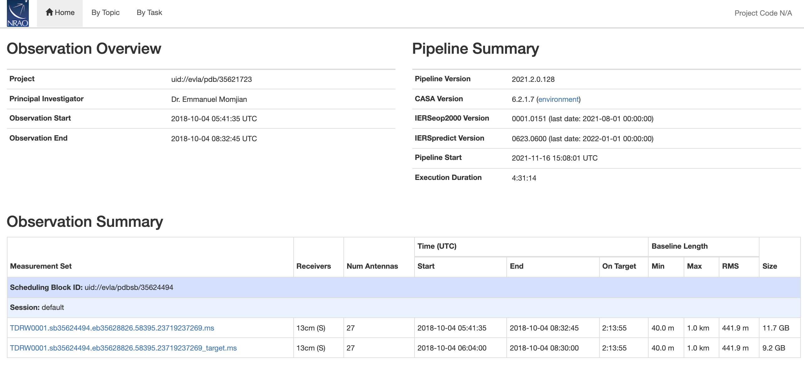
Pipeline Weblog https://casa.nrao.edu/Data/EVLA/Pipeline/S-CASA6.2.1/html/
Notes:
“QA not implemented in the CASA VLA pipeline as packaged in 4.7.2” (claimed in the online pipeline guide)

Slide 13
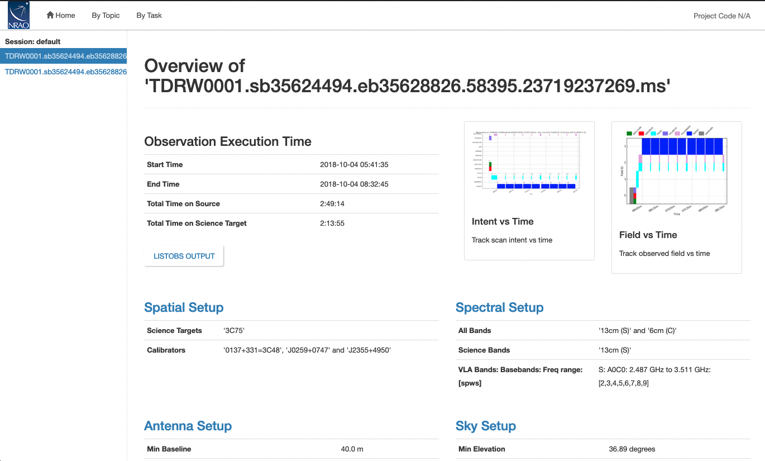
Pipeline Weblog

Slide 14
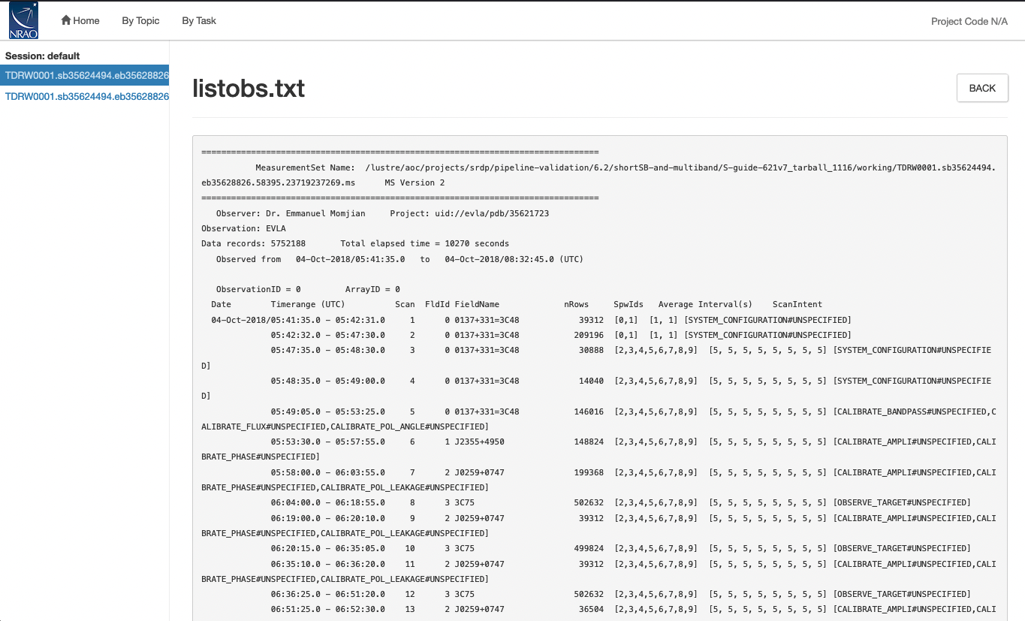
Pipeline Weblog

Slide 15
Pipeline Weblog

Slide 16
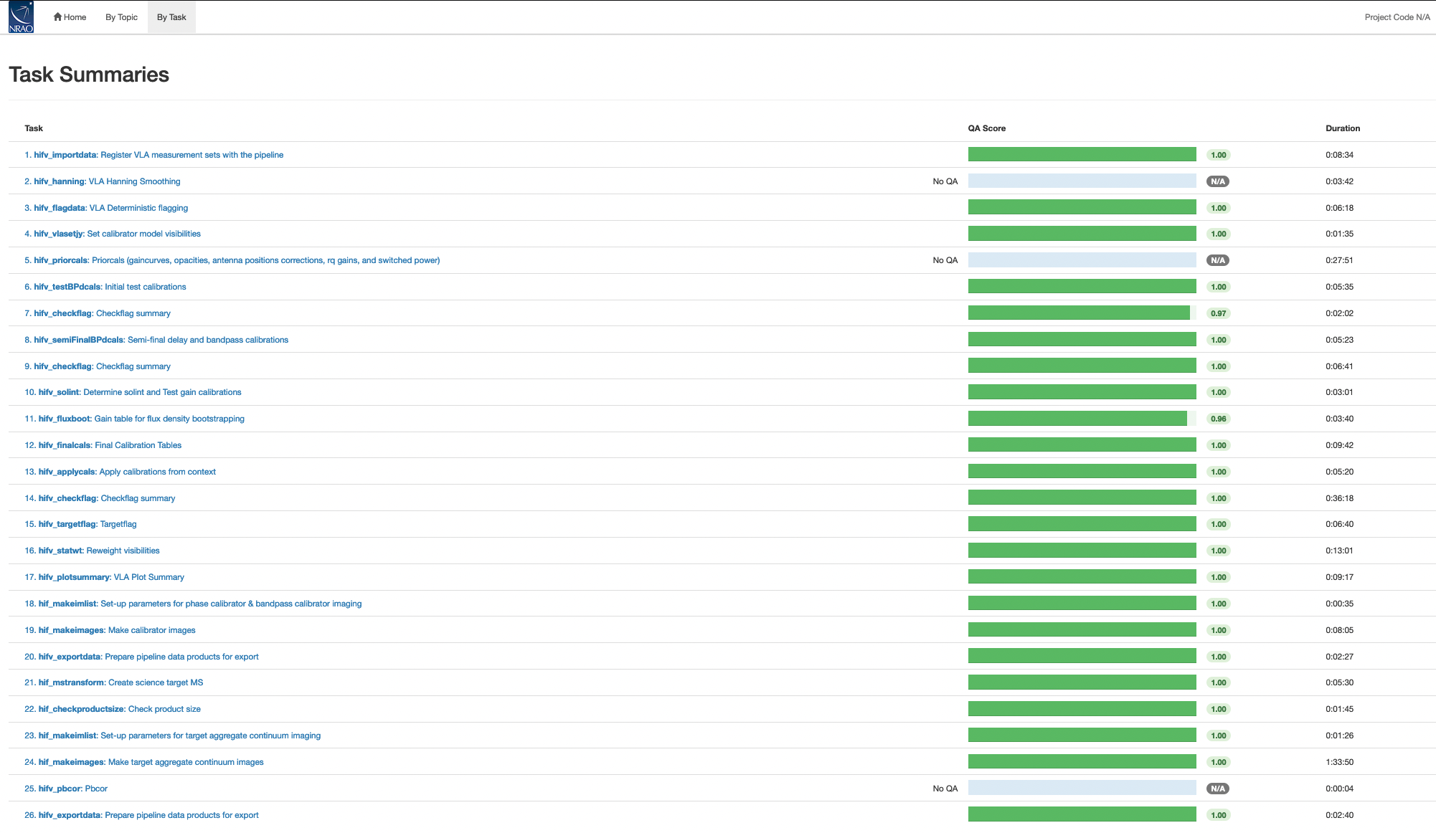
Pipeline Weblog
Notes:
Note that scores are not implemented

Slide 17
Pipeline Weblog
The following pipeline steps provide key checks for calibration quality:
hifv_flagdata deterministic flagged data fraction
hifv_testBPdcals hardware problems and other obs. issues
hifv_solint solution intervals for phase cals, input gain tables
hifv_fluxboot fitted calibrator flux densities and spectral indices
hifv_finalcals final calibration tables applied to the data
hifv_plotsummary useful diagnostic plots of calibrated data

Slide 18
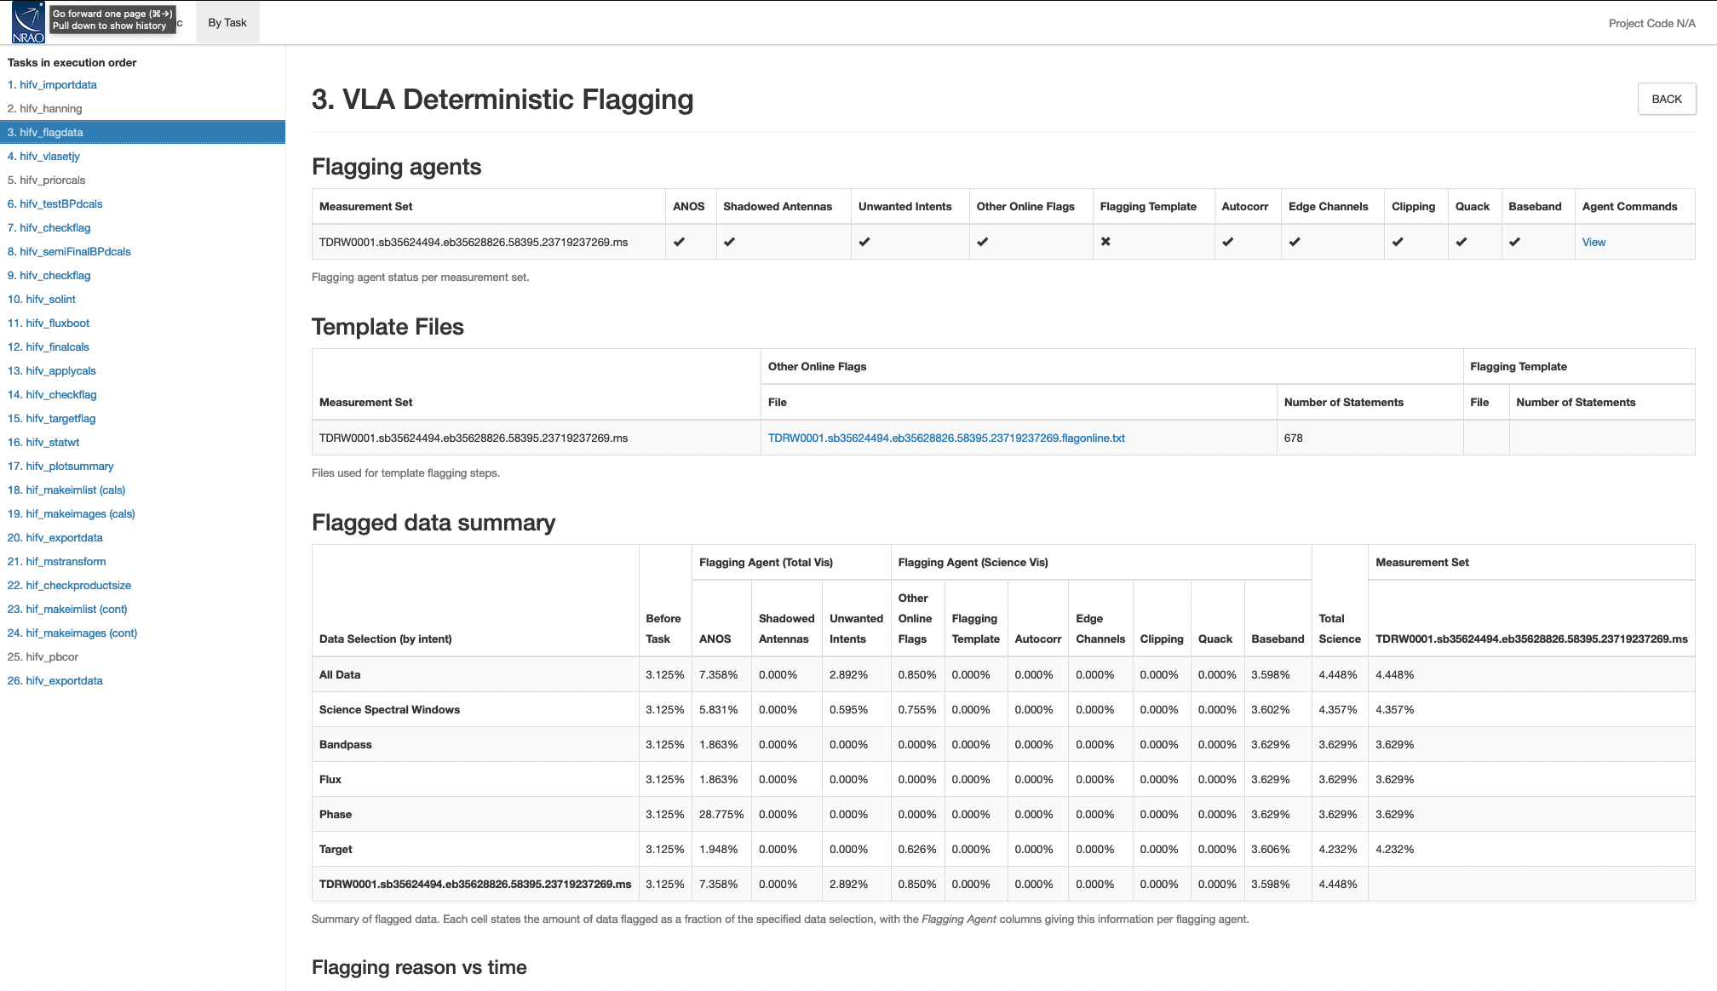
Deterministic Flags (hifv_flagdata)
Notes:
Spw edge : 3 channels
Baseband edge 10 channels

Slide 19
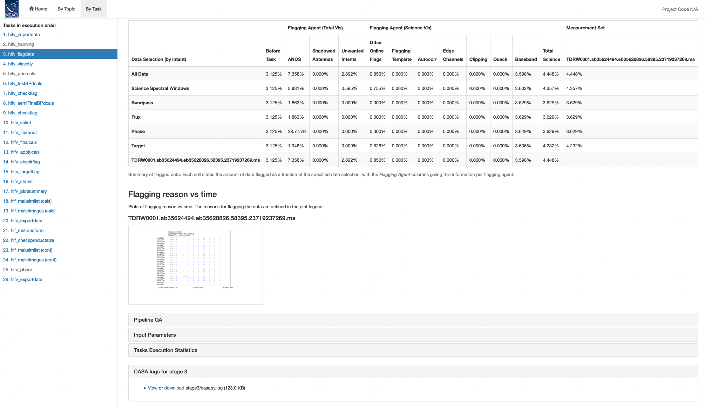
Deterministic Flags (hifv_flagdata)

Slide 20
Deterministic Flags (hifv_flagdata)

Slide 21
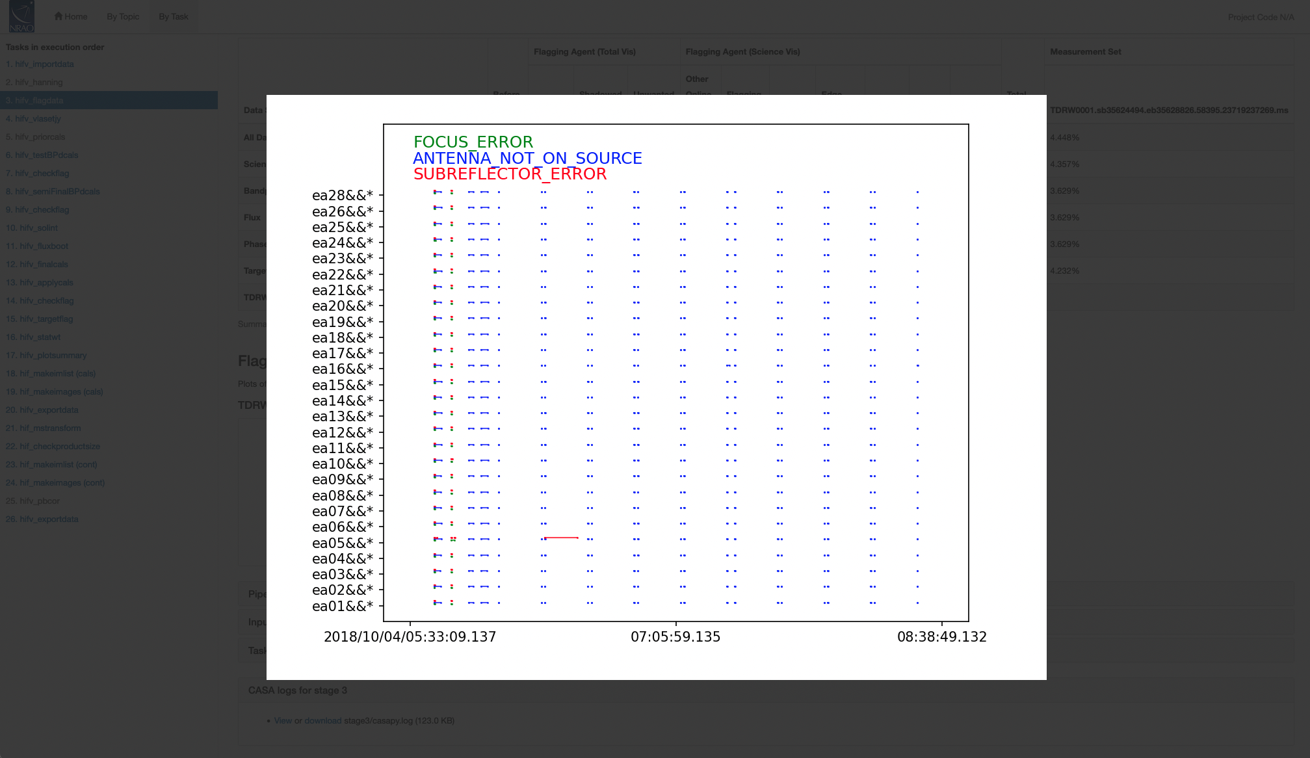
Deterministic Flags (hifv_flagdata)

Slide 22
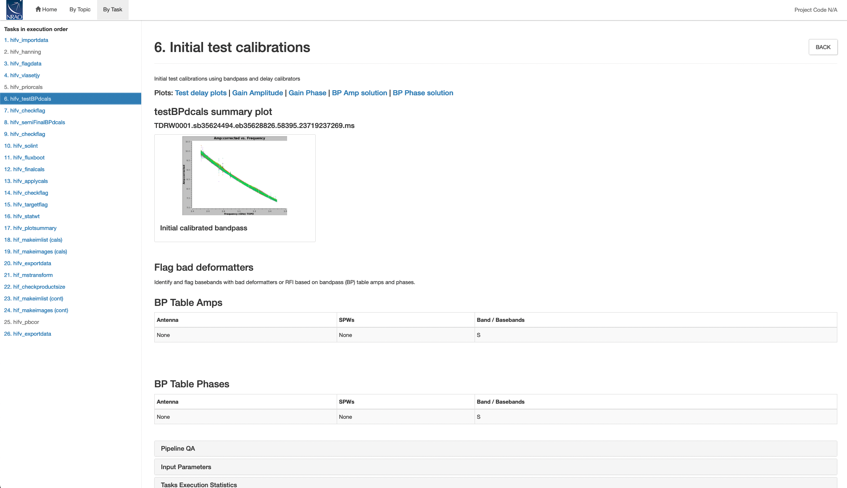
Hardware Issues (hifv_testBPdcals)
Notes:
In 5.1, short solint user input will be made available

Slide 23
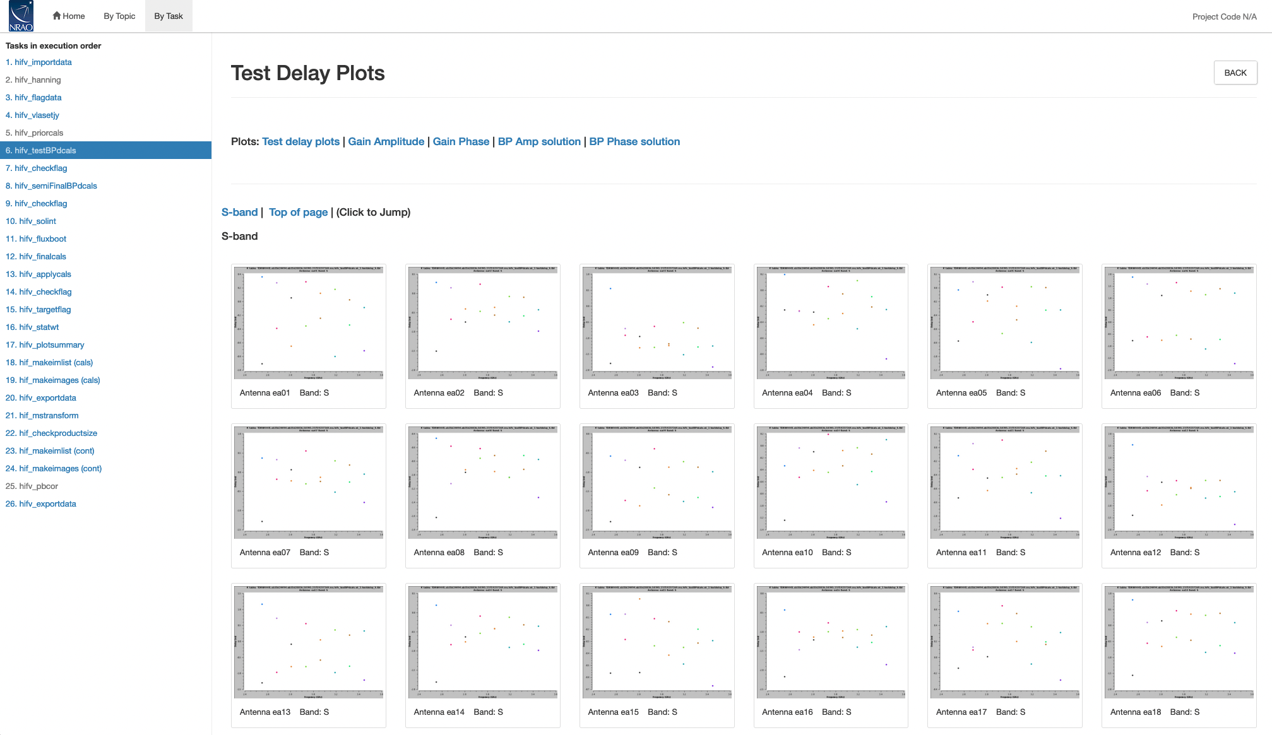
Hardware Issues (hifv_testBPdcals)
Notes:
In 5.1, short solint user input will be made available

Slide 24
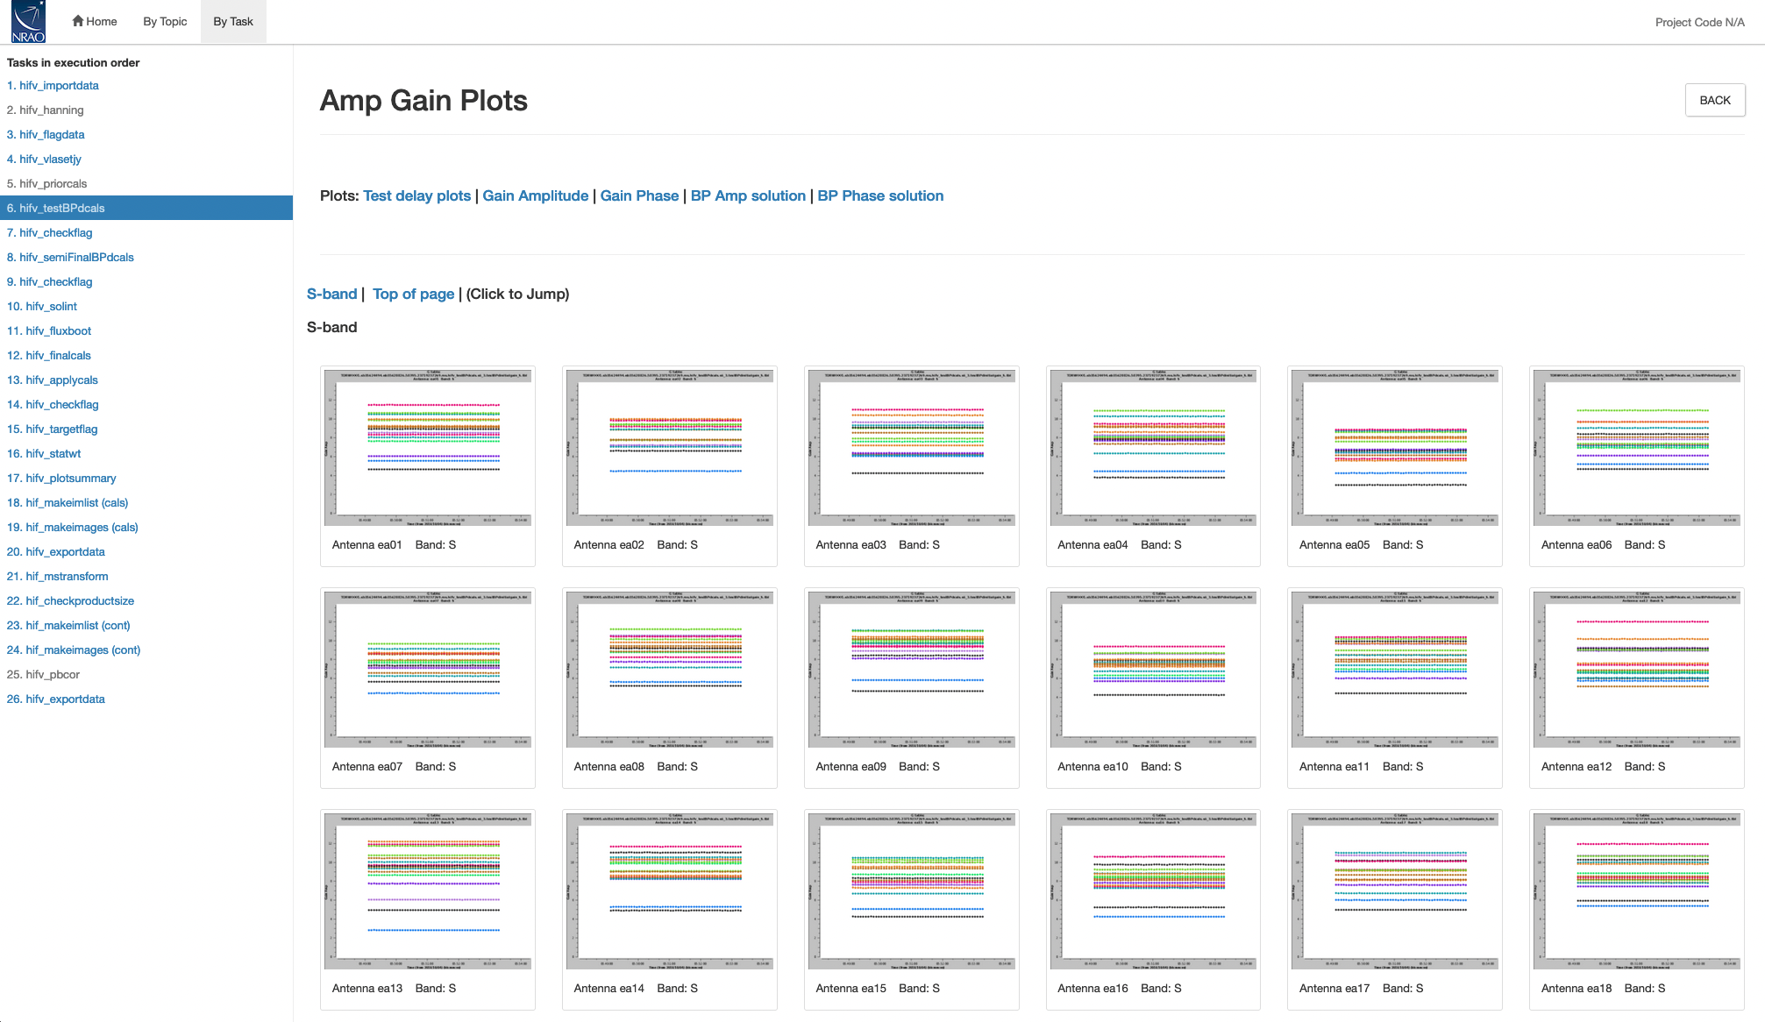
Hardware Issues (hifv_testBPdcals)
Notes:
In 5.1, short solint user input will be made available

Slide 25
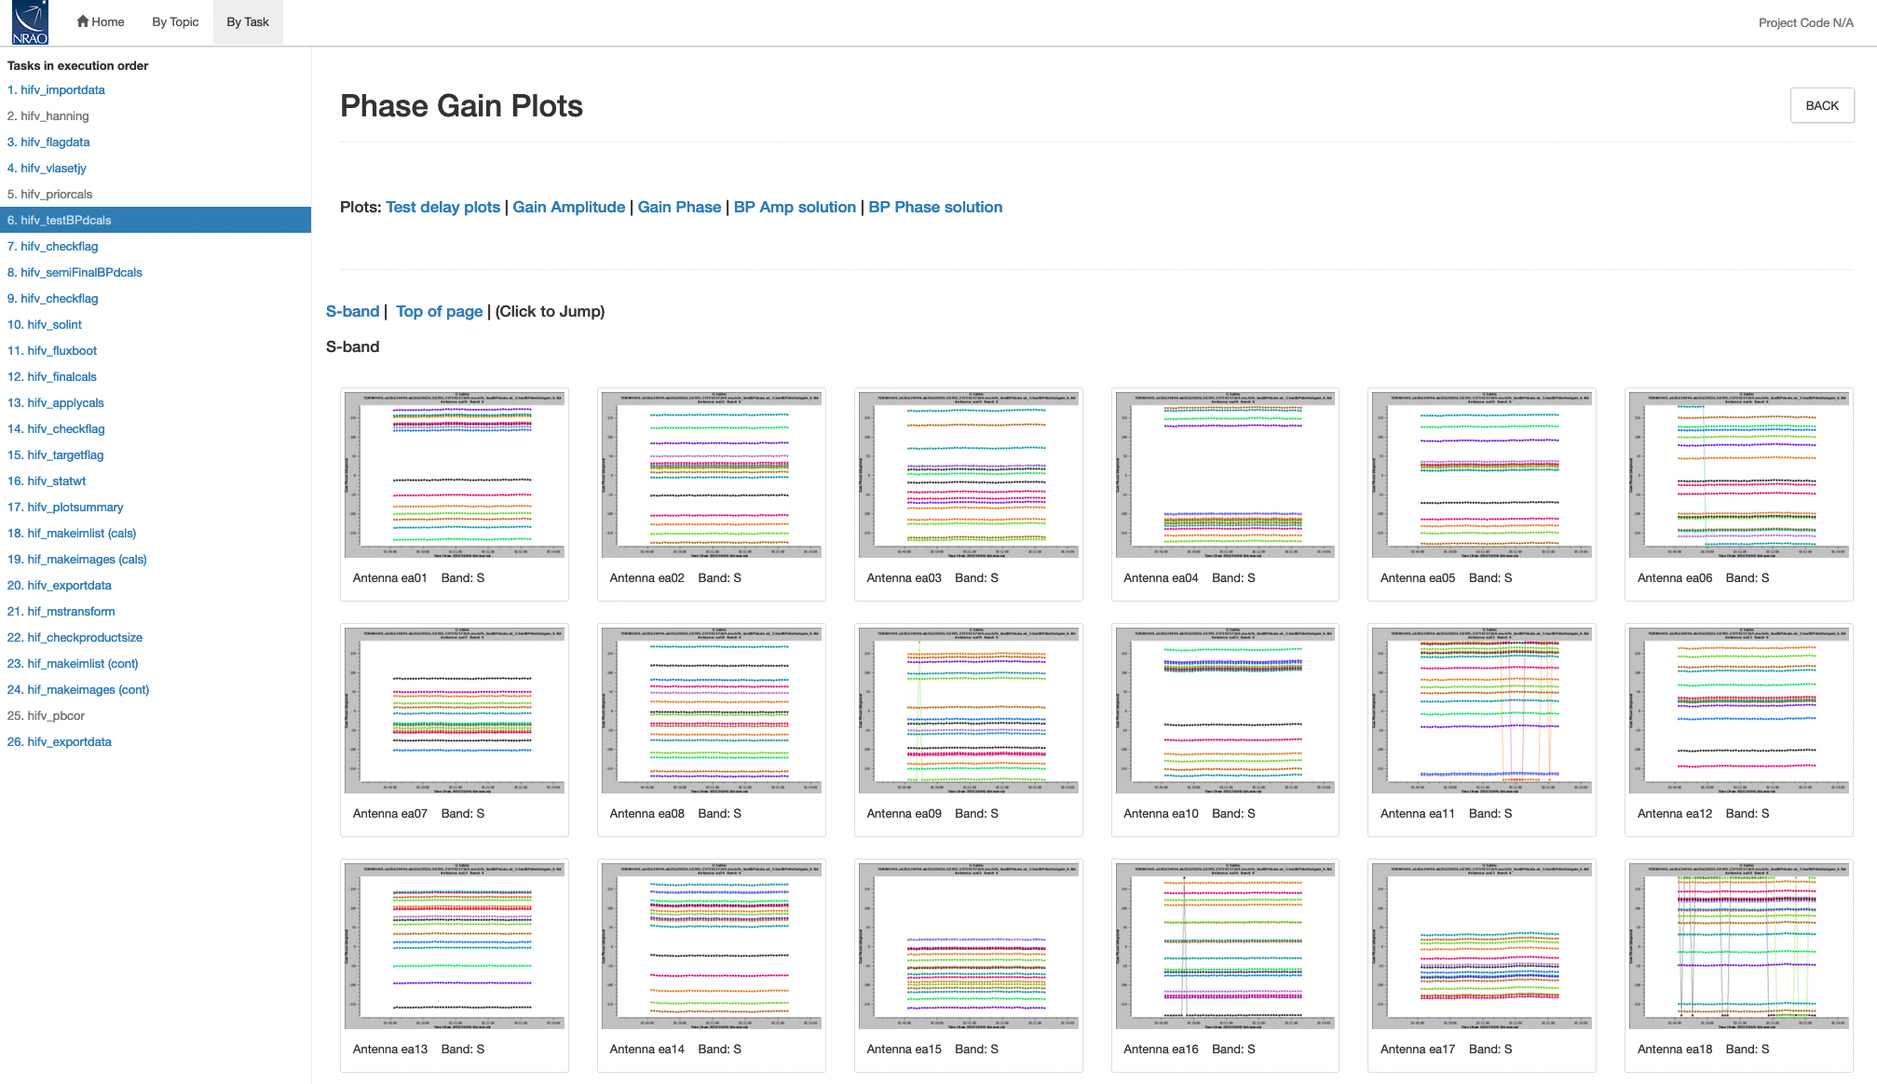
Hardware Issues (hifv_testBPdcals)
Notes:
In 5.1, short solint user input will be made available

Slide 26
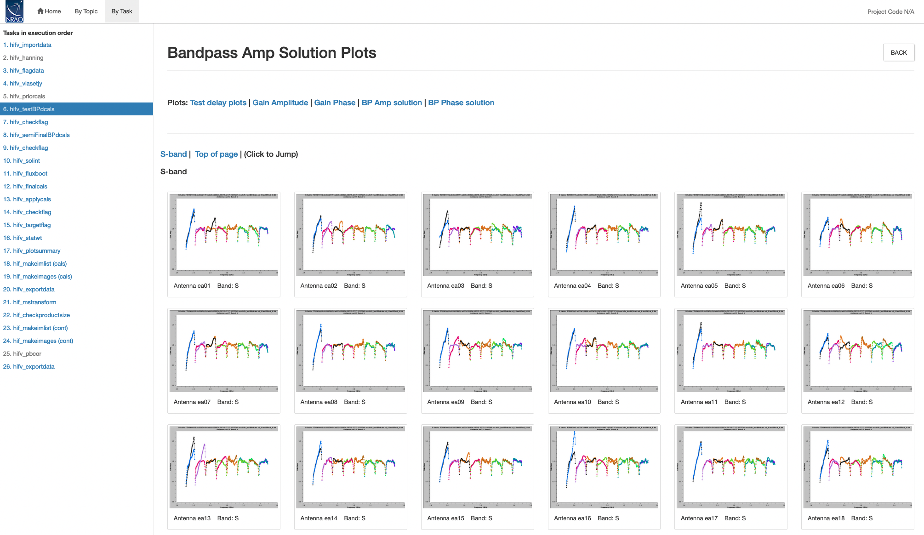
Hardware Issues (hifv_testBPdcals)
Notes:
In 5.1, short solint user input will be made available

Slide 27
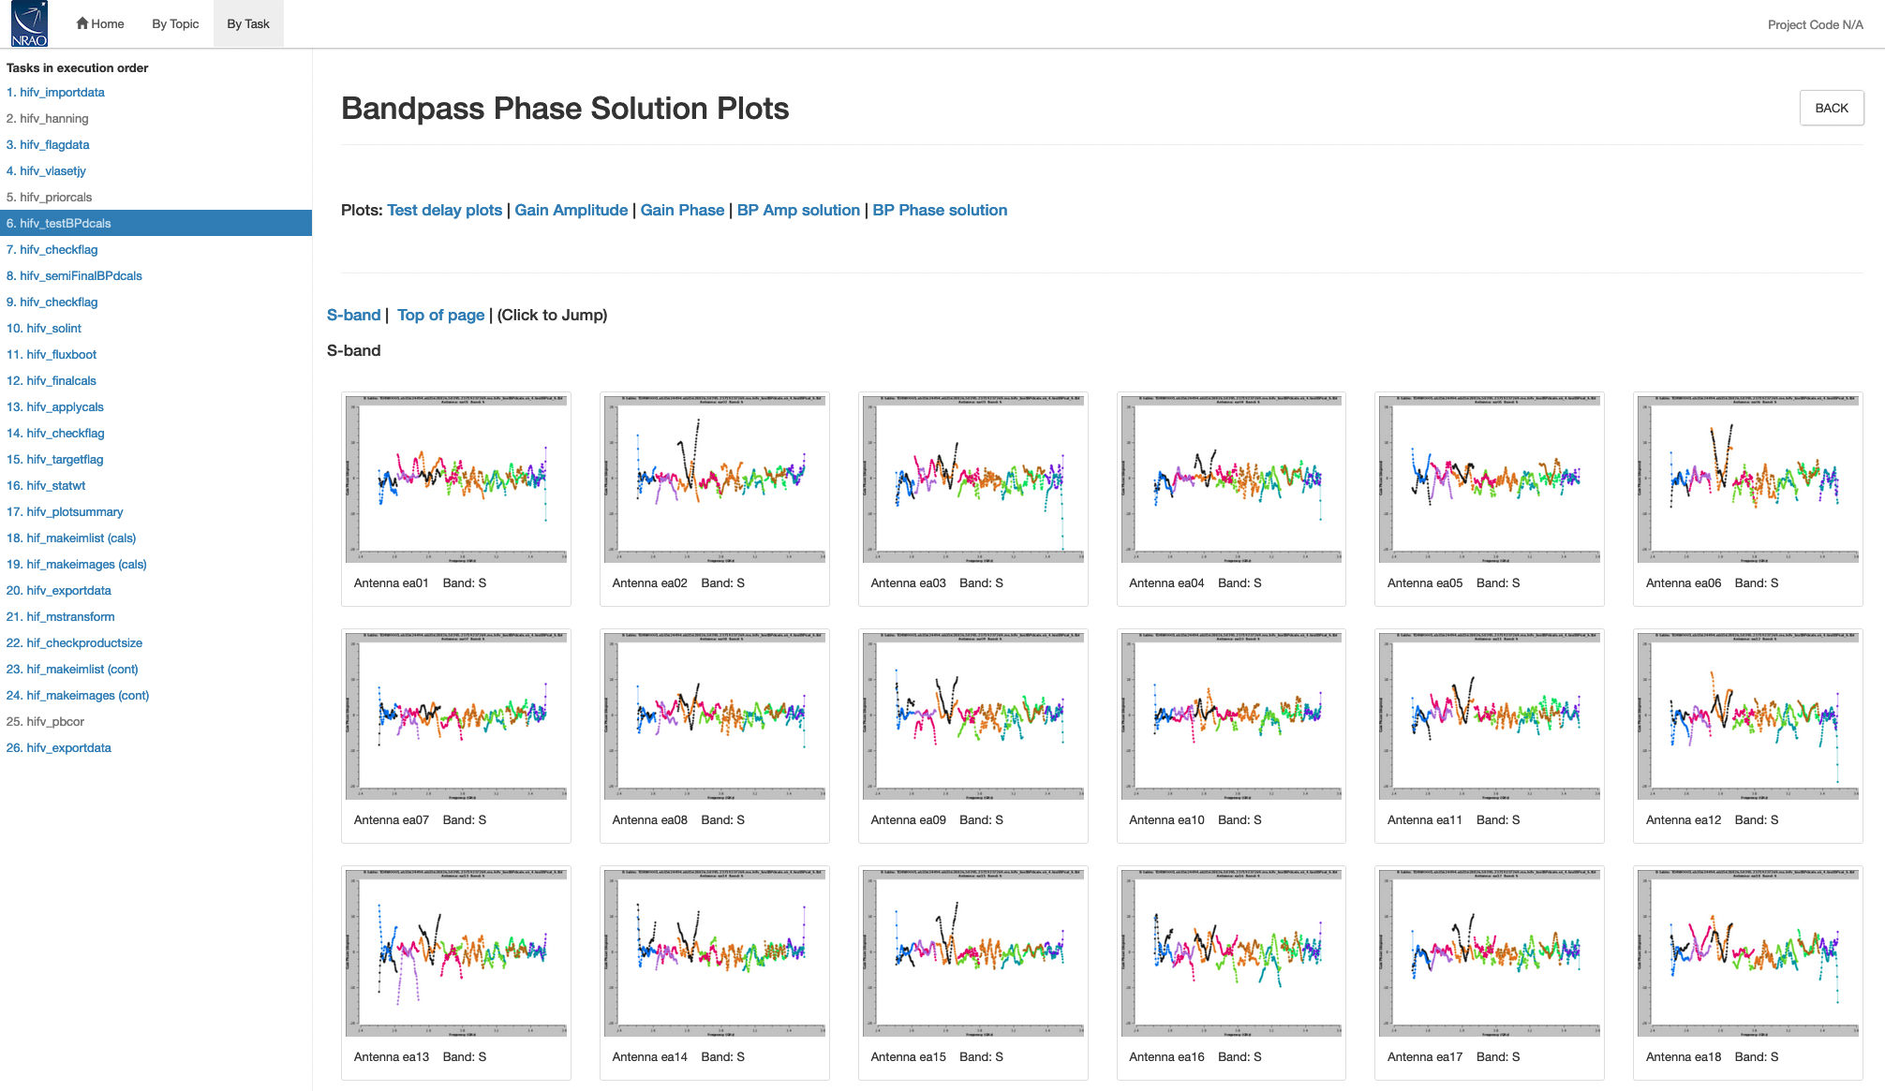
Hardware Issues (hifv_testBPdcals)
Notes:
In 5.1, short solint user input will be made available

Slide 28
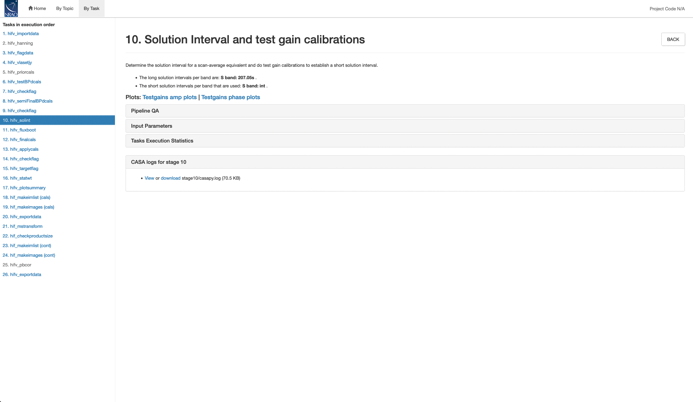
Gain Solution Intervals (hifv_solint)
Notes:
In 5.1, short solint user input will be made available

Slide 29
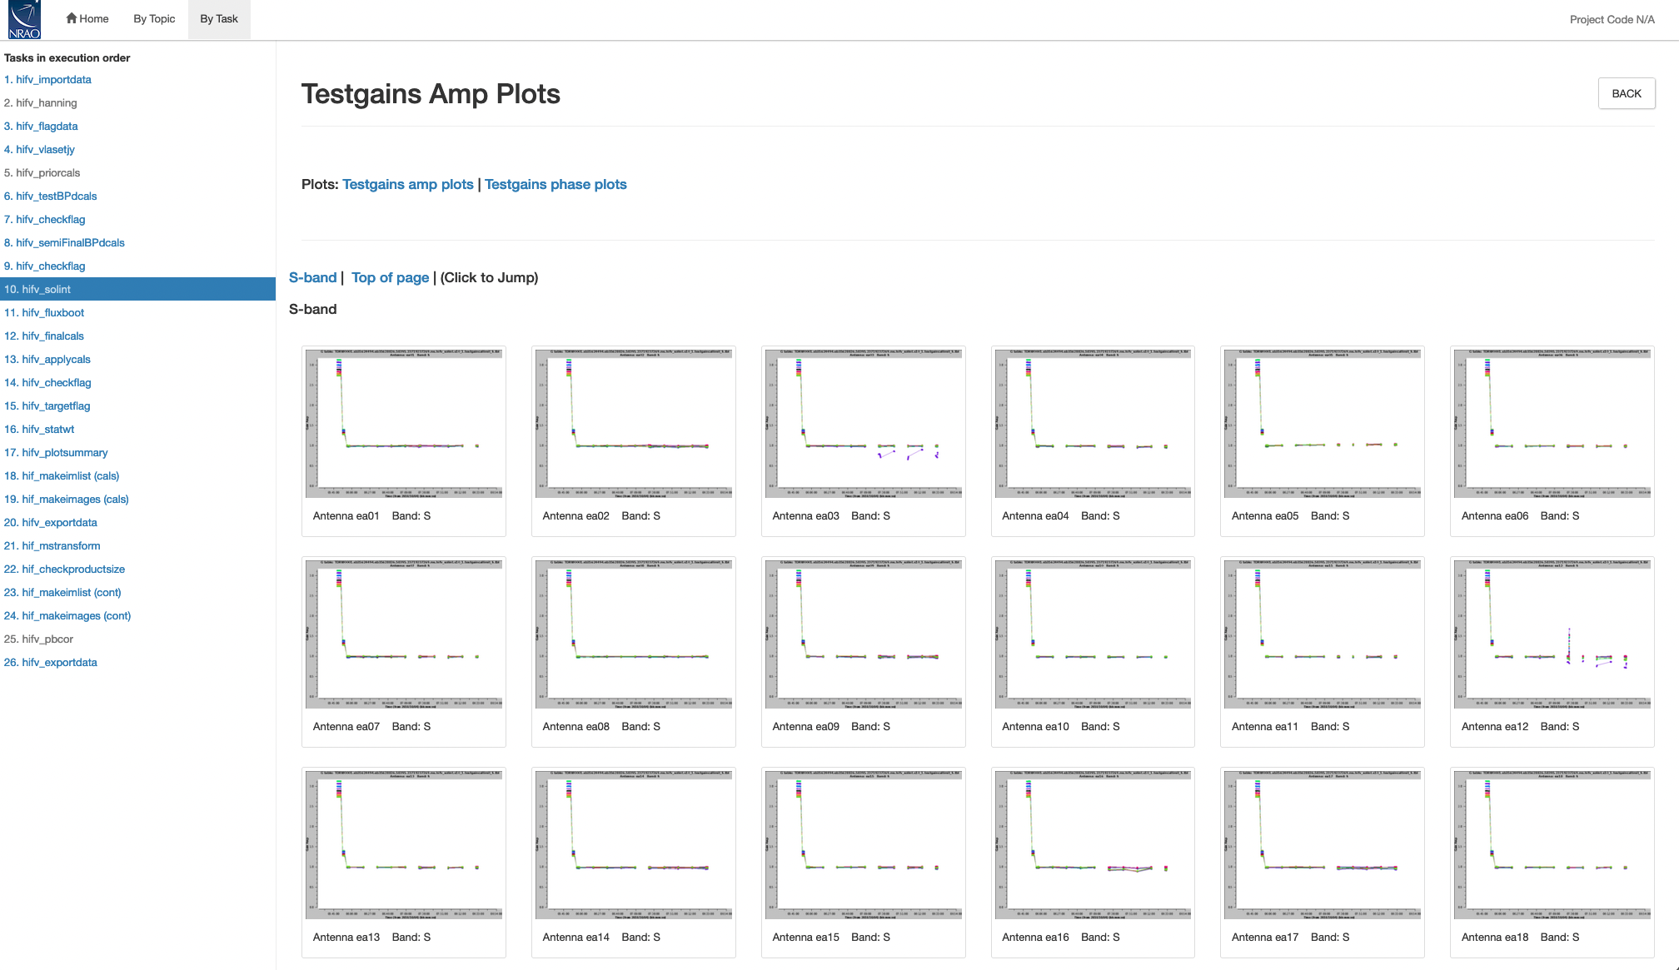
Gain Solution Intervals (hifv_solint)

Slide 30
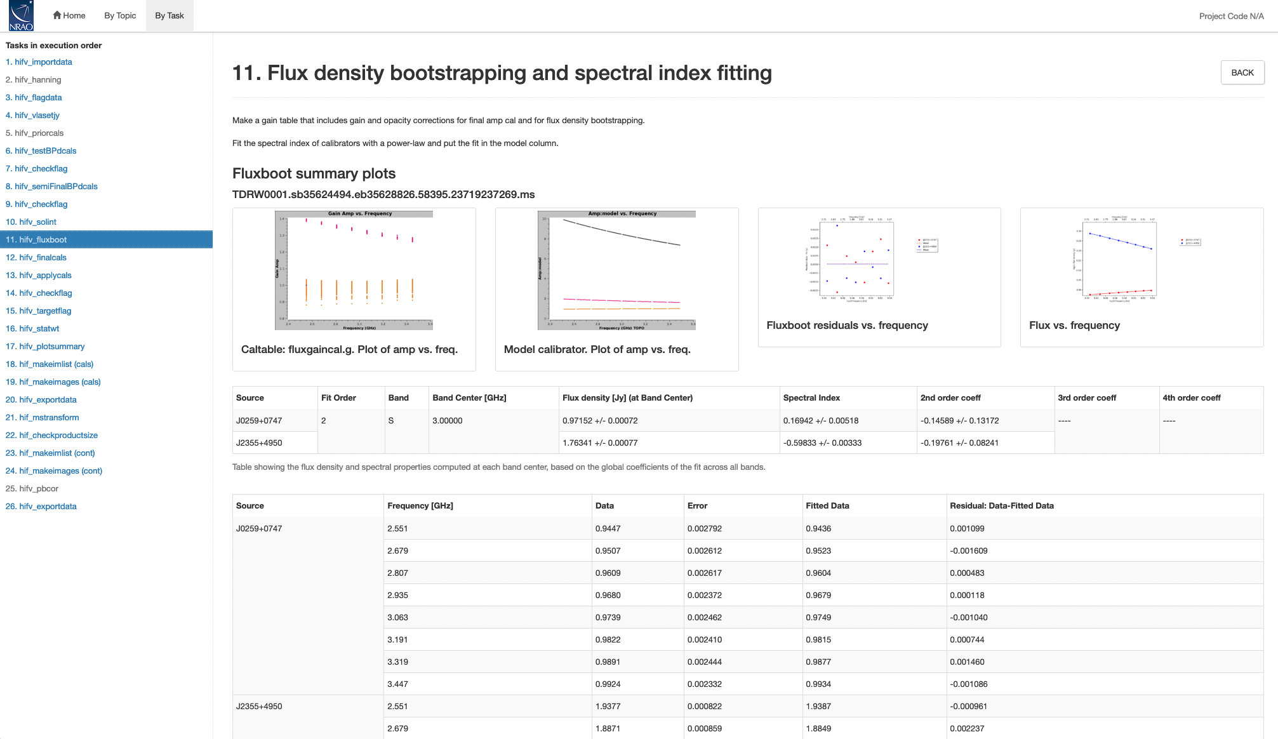
Flux Density Bootstrapping (hifv_fluxboot)

Slide 31
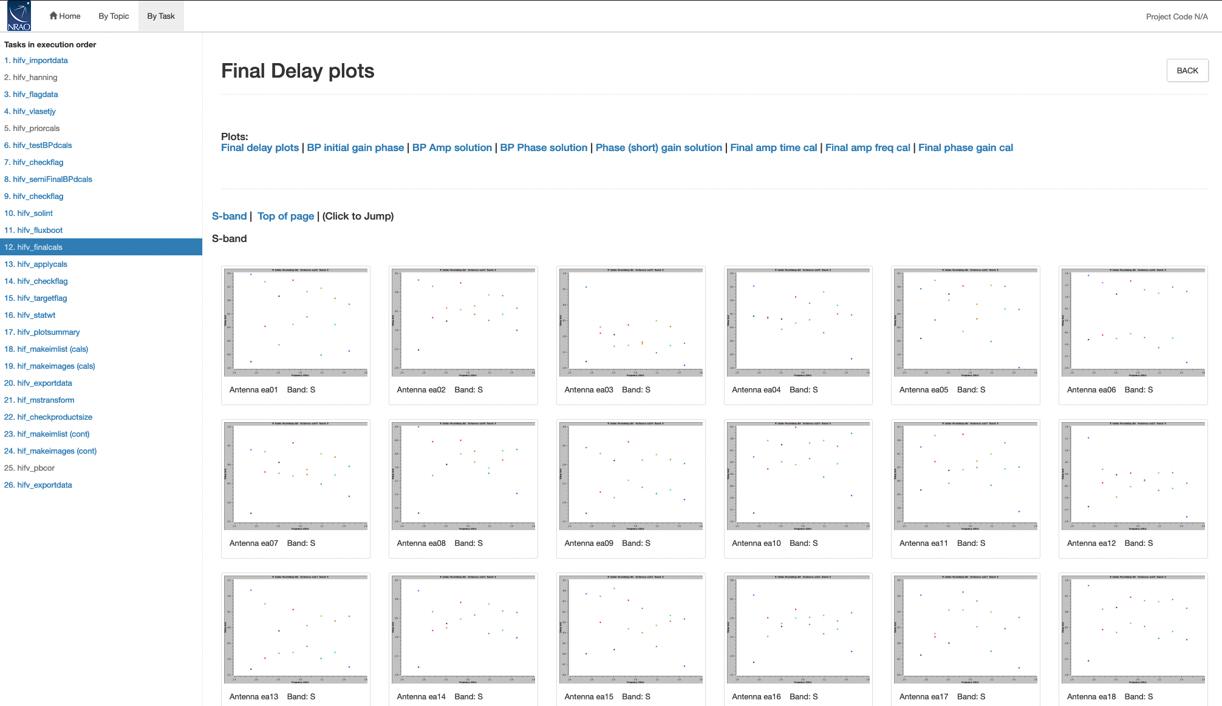
Final Calibration Tables (hifv_finalcals)

Slide 32
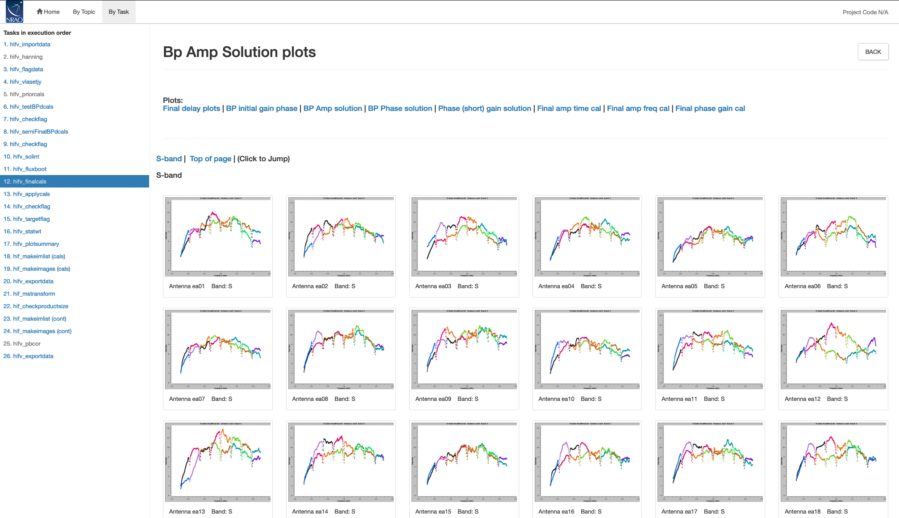
Final Cal Tables: bandpass

Slide 33
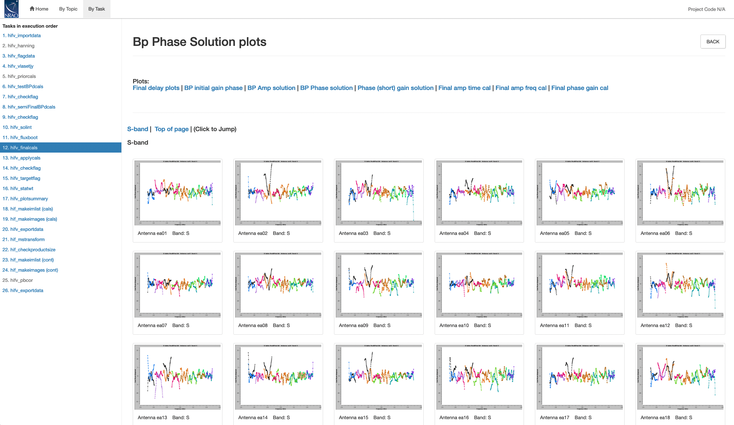
Final Cal Tables: bandpass

Slide 34
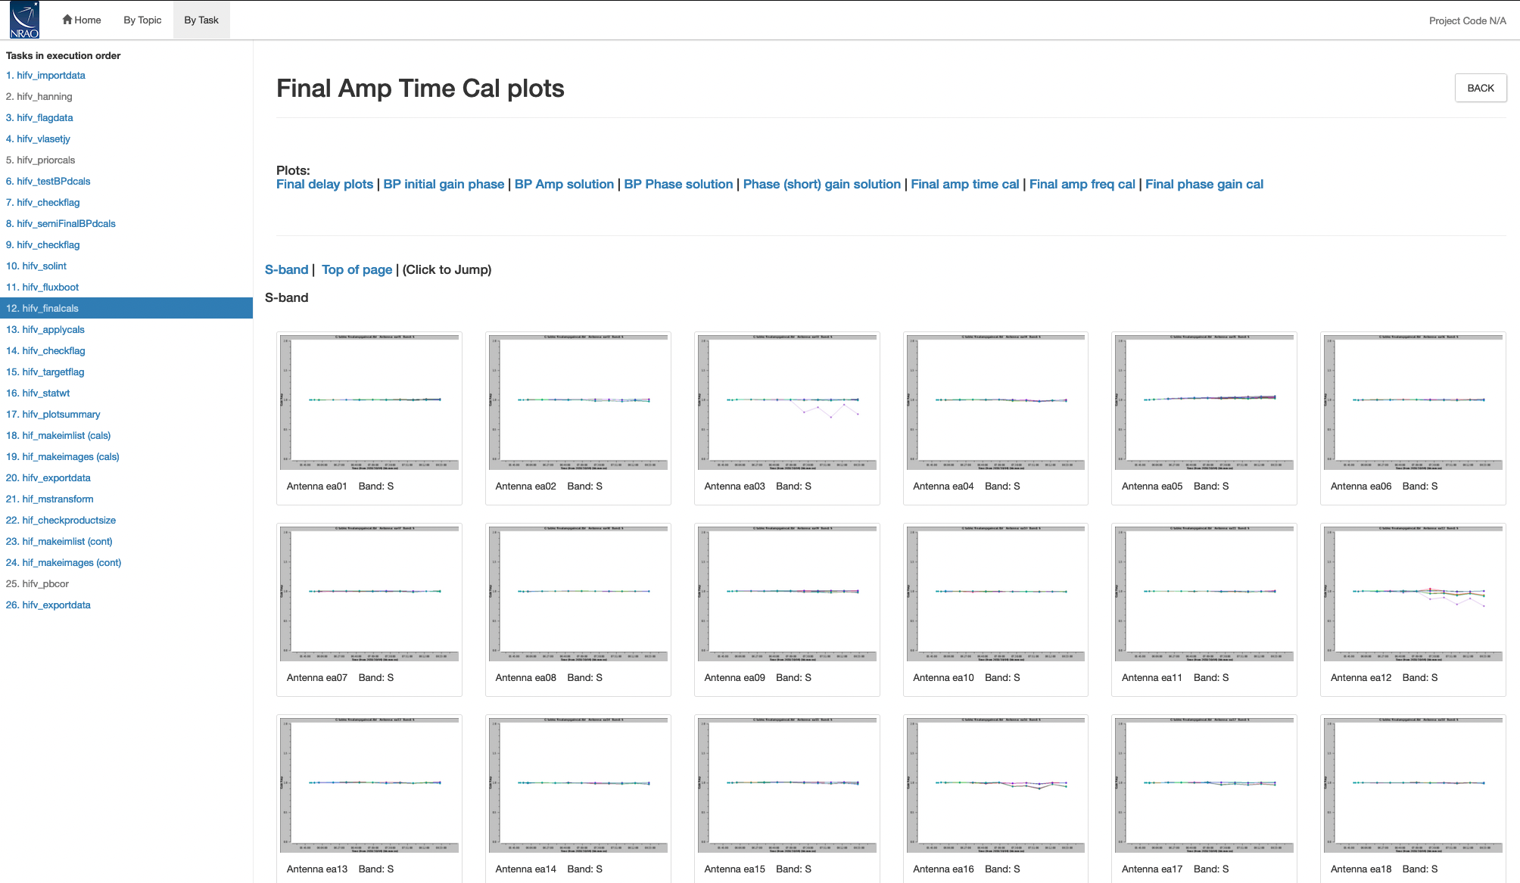
Final Cal Tables: amplitude and phase
Notes:
Should be 1.

Slide 35
Final Cal Tables: amplitude and phase

Slide 36
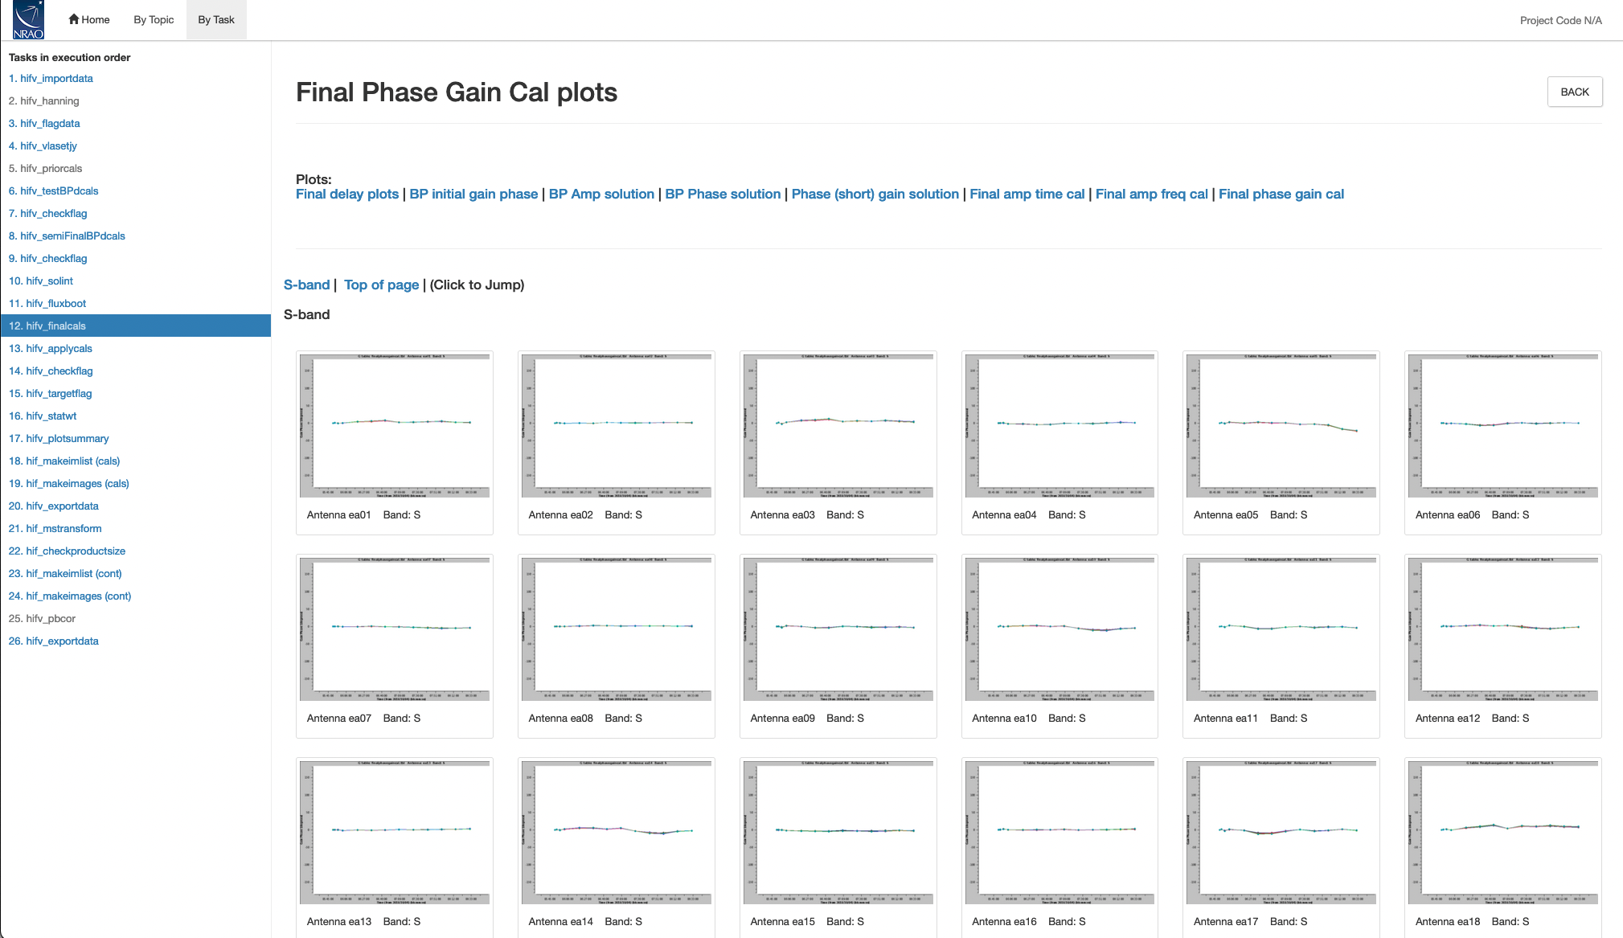
Final Cal Tables: amplitude and phase

Slide 37
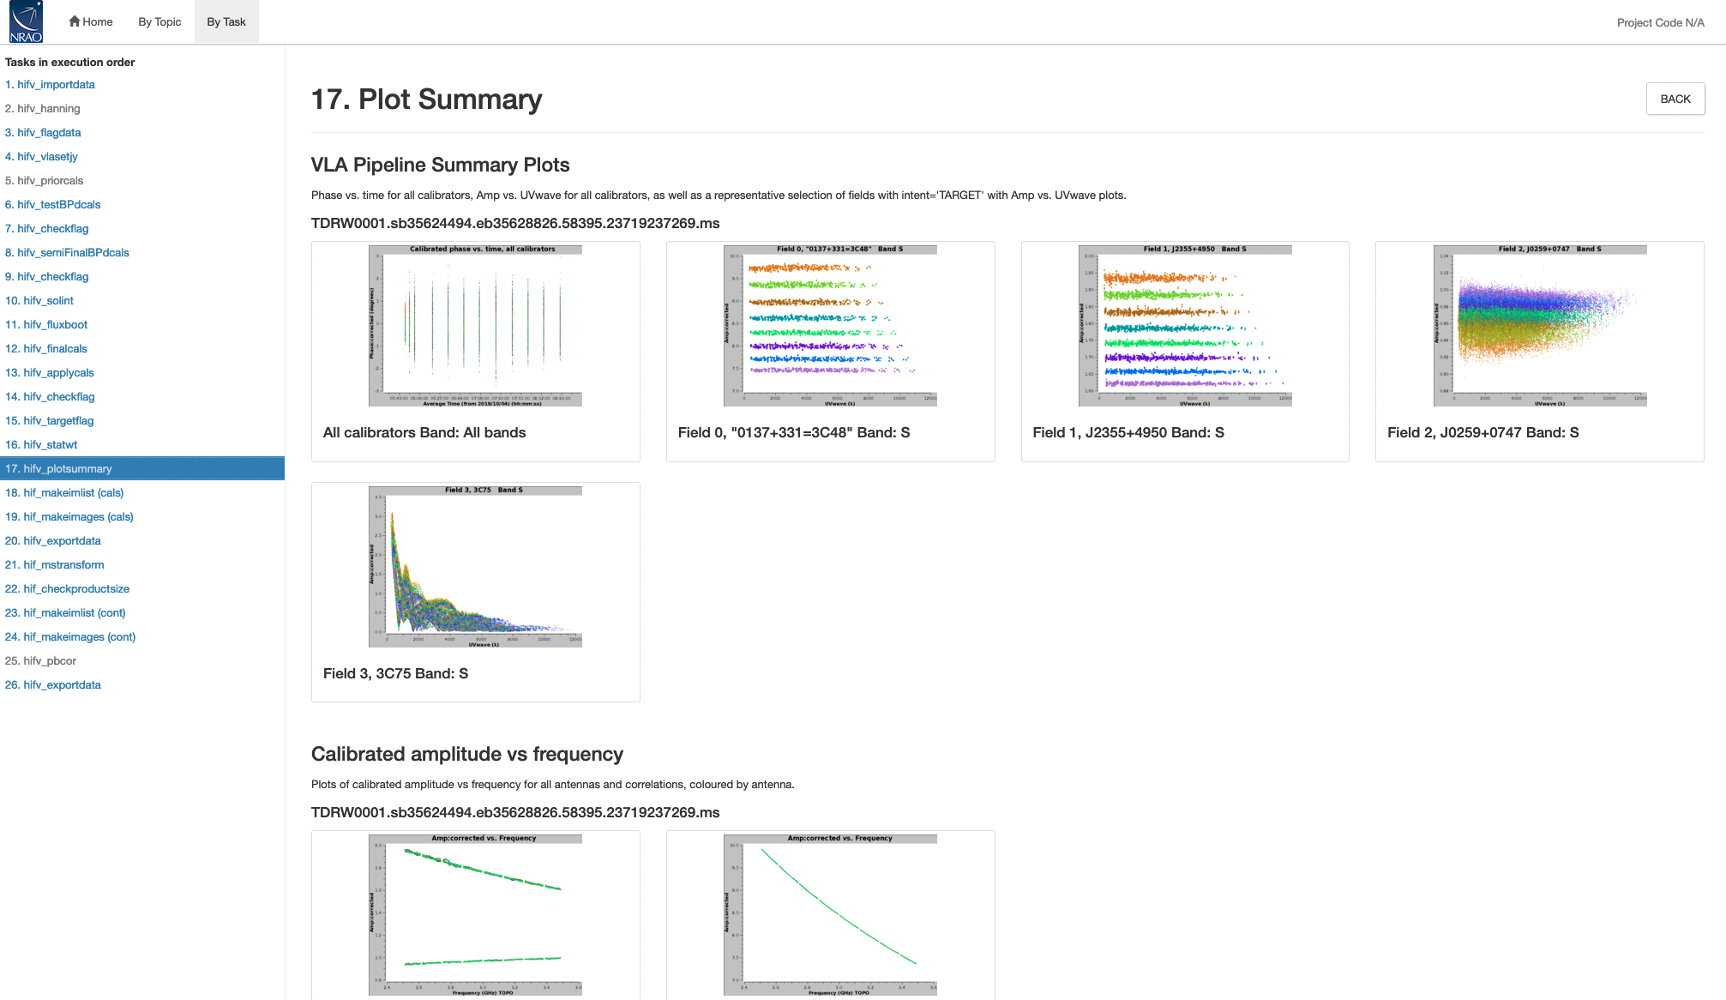
Summary Plots (hifv_plotsummary)

Slide 38
Pipeline Products and Outputs
Flagged and Calibrated MS
Final flag version and calibration tables (archived)
Logs, including weblog used by quality assurance (QA) staff and QA report (archived).

Slide 39
Pipeline Products and Outputs
The real-time pipeline produces a calibrated and flagged MS:
Calibrated MS may be requested through the archive data.nrao.edu (See next talk from Aaron!)
You may request a more detailed QA2 report from the data analysts (help.nrao.edu, Pipeline Department)
If you are happy with the pipeline calibration, then:
Do further flagging if necessary
Split out your target and image (imaging pipeline now available)
If you have the SDM or uncalibrated MS and the calibration and flag tables, instructions for applying flags and calibration tables may be found at http://go.nrao.edu/vla-pipe

Slide 40
Known failure modes and issues
In general the pipeline does very well, but there are possible failure modes:
No flux density or gain calibrator intents defined, or flux density calibrator not one for which we have models
work around in scripted pipeline
Wrong scan intents
modify Scan.xml in SDM; see https://science.nrao.edu/facilities/vla/data-processing/pipeline#section-28
Does not always identify deformatter problems (but does NOT usually have false positives – L-band an exception)
flag remaining bad spws
Calibrators are too weak for given spw bandwidth
heuristics have been developed and are being tested

Slide 41
Known failure modes and issues
6.2.1 specific failure modes:
Fluxboot fitorder >2, fit order 2 used, not higher, incorrect flux scale
fixed in CASA+pipeline 6.4.1, available now
Some setups cause overly long short solution interval
fixed in CASA+pipeline 6.4.1, available now

Slide 42
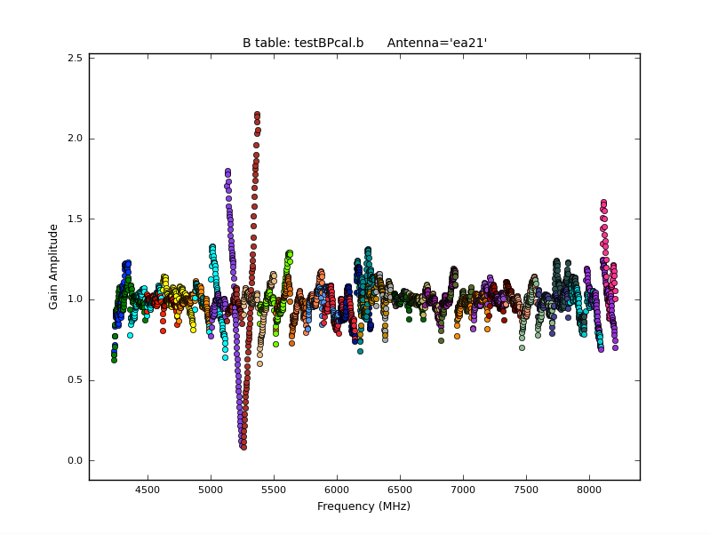
Known failure modes and issues
ea21 bandpass, bad data (DTS issue)
Notes:
DTS: data transmission system

Slide 43
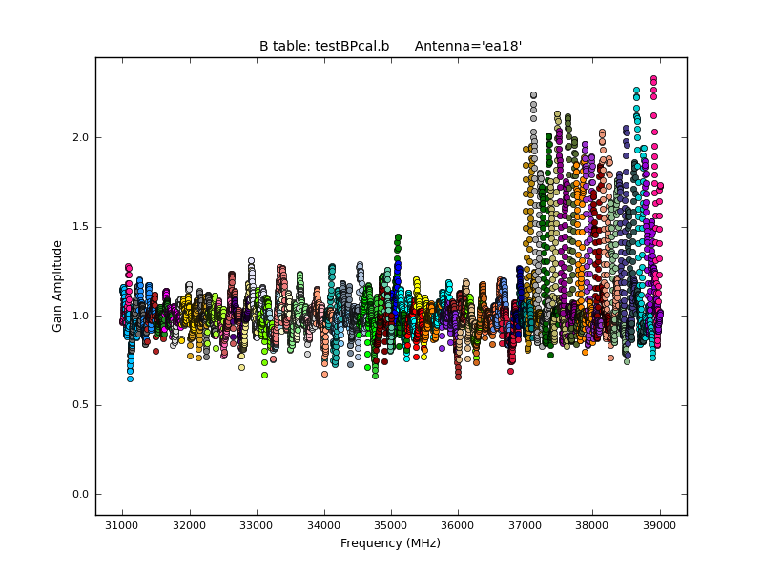
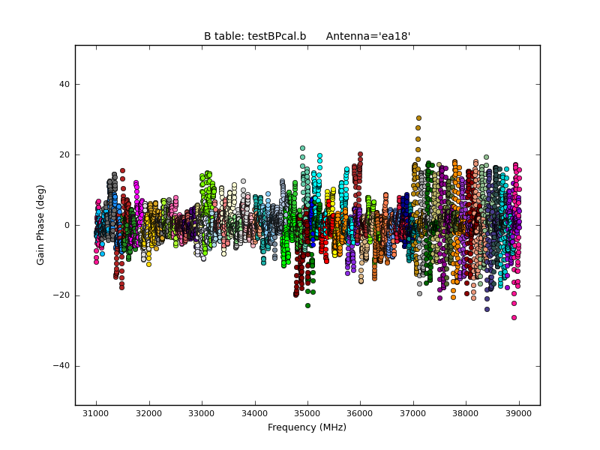
Known failure modes and issues
ea18 Amp and Phase affected (DTS issue for 37-39GHz)

Slide 44
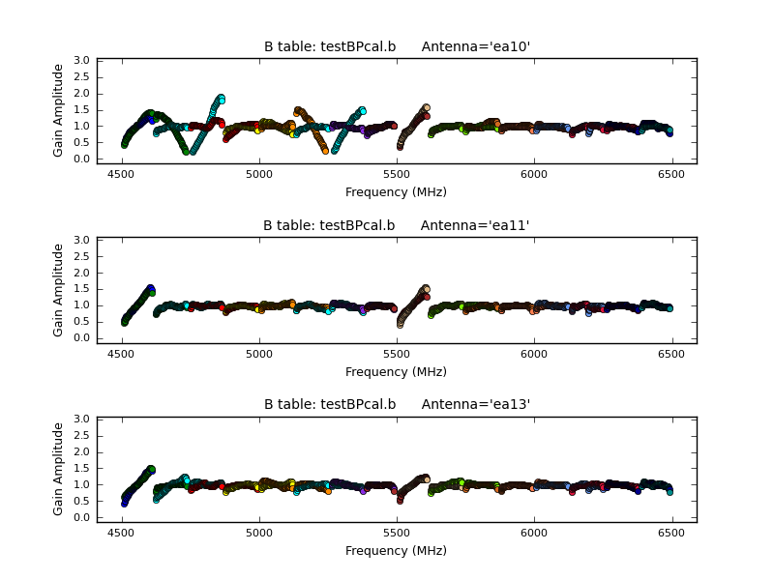
Known failure modes and issues
ea10 bandpass, bad data (DTS issue); ea11, ea12 OK

Slide 45
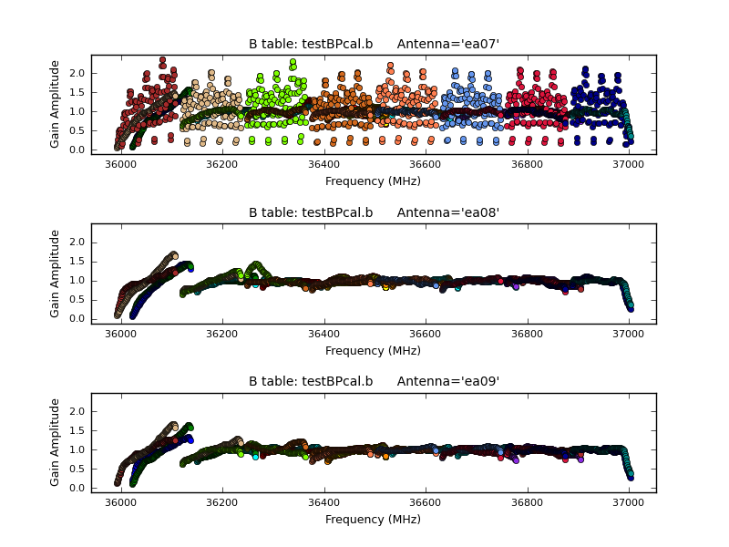
Known failure modes and issues
ea07 bandpass, bad data (DTS issue); ea08, ea09 OK

Slide 46
Science Ready Data Products (SRDP)
https://science.nrao.edu/srdp/home
Continuum only
C band or higher frequency currently
SB setup and scan intents set correctly for pipeline
Currently only those using 3C286 or 3C147 as flux cal
Staff check quality in more detail, add extra flagging and rerun

Slide 47
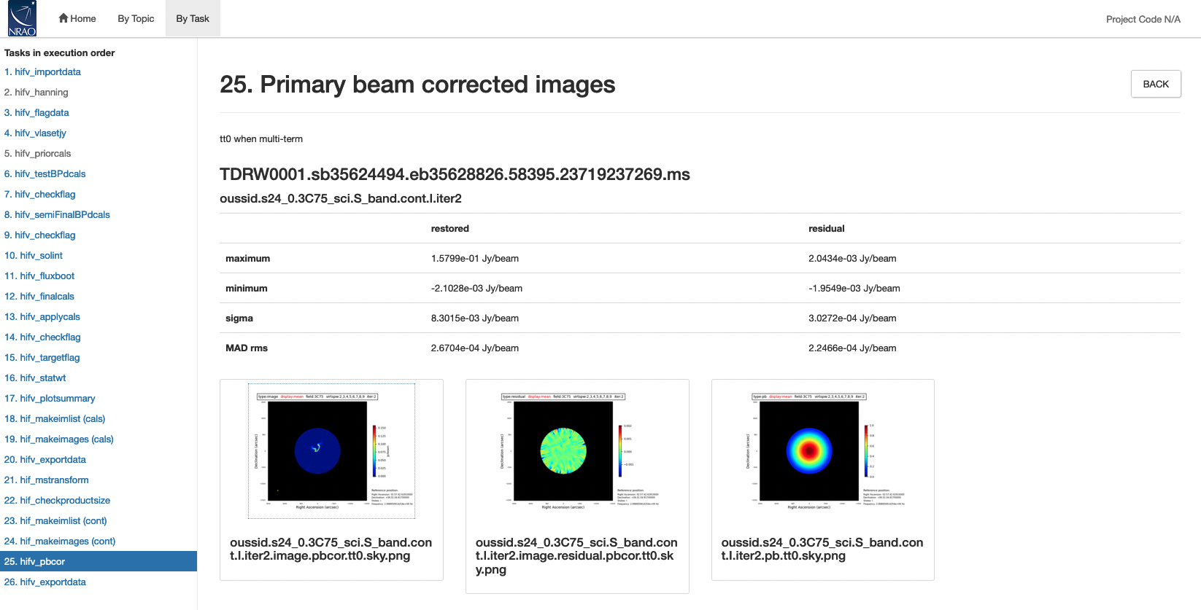
Imaging Pipeline
https://science.nrao.edu/facilities/vla/data-processing/pipeline/VIPL

Slide 48
Future Developments
Support for spectral line observations
Polarization calibration tested for VLA Sky Survey (S-band), need polarization calibrator models for other bands
More robust flux density bootstrapping that flags outliers
Improved RFI flagging and detection of system issues
Use of switched power data for determining weights

Slide 49
Viewing Weblogs
The default security preferences in Firefox block weblogs on disk from being viewed directly:
Go to about:config: security.fileuri.strict_origin_policy to False
In CASA h_weblog() should open a browser tab with weblog
Host them as a server would

Slide 50
Starting the Pipeline
SDM-BDF (MS possible, but online flags needed before)
casa_pipescript.py
/path/to/casa/bin/casa --pipeline
On NRAO machines: casa-pipe
execfile(casa_pipescript.py)
Wait …

Slide 51
Considerations Before Running
Disk space needed 3-4x raw data size, more if imaging
Compute time: 30min to … a few days (weeks)
Setup correct to work with the pipeline?
Hanning smoothing, other changes

Slide 52
Questions?
VLA CASA Calibration Pipeline information at:
http://go.nrao.edu/vla-pipe
CASA Integrated Pipeline & Scripted Pipeline available
Have Questions?
Need Help?
Report a bug?
Use the NRAO HelpDesk: https://help.nrao.edu/
Submit your ticket under the Pipeline Department.
Please include specific details when submitting HelpDesk tickets.
(Project code, SB number, CASA/PL versions, errors, etc.)

Slide 54
Spectral line data
Several steps in the real-time pipeline may not be appropriate for spectral line data:
Hanning smoothing (increases effective channel width)
Flags 5% of each spw edge and the first and last 10 channels of each baseband
Last run of RFLAG on target (may eliminate your line as interference!)
Statwt calculates rms based on scatter of channels per spw, per visibility; may want to run manually with channel selection turned on to eliminate use of channels containing line emission in calculating the rms
⇒ Specify a “cont.dat” file to avoid known lines for RFI flagging and statwt
With the above modifications, the pipeline will work with spectral line data as long as the calibrators are strong enough

Slide 55
Mixed correlator set-ups
With WIDAR capabilities it is common to observe both wide and narrow spws to obtain both continuum and spectral line data simultaneously or multiple receiver bands
A single heuristic (e.g., gain calibration solution interval) for entire dataset may not be appropriate
Solution:
Run pipeline through application of deterministic flags, including Hanning smoothing if you are going to use it
Split the MS by spw and/or scans
Run pipeline on split MSs WITHOUT Hanning smoothing (you have already applied it, if you are going to use it)
Warning: output flagging statistics may not be correct

