Slide 1
General Logistics

Slide 2
General - Contact
Organizing Committee:
Pedro Beaklini
Anna Kapinska
Drew Medlin
Juergen Ott
Frank Schinzel
Admin Support:
Lori Appel
Liz Lyons
If you need to contact us, email is best: vla-drw@nrao.edu
Attendance at this workshop implies consent to abide by our code of conduct: https://go.nrao.edu/conduct

Slide 3
Please always wear a mask while in the auditorium (exception only speaker) and take coffee break outside.
If you think you need an antigen Covid test, please let us know and we can provide you with one.

Slide 4
Program / Lectures Highlights
https://science.nrao.edu/science/meetings/2022/vla-data-reduction/program
We will broadcast all presentations via zoom webinar
Presentations will be from October 11th – 14th
Presented materials will be posted on program webpage
Data Reduction Starts Wednesday afternoon
Reception, today Tuesday evening 5-7 pm
VLA Tour Monday, October 17th 9 am – 2:30 pm (from DSOC)

Slide 5
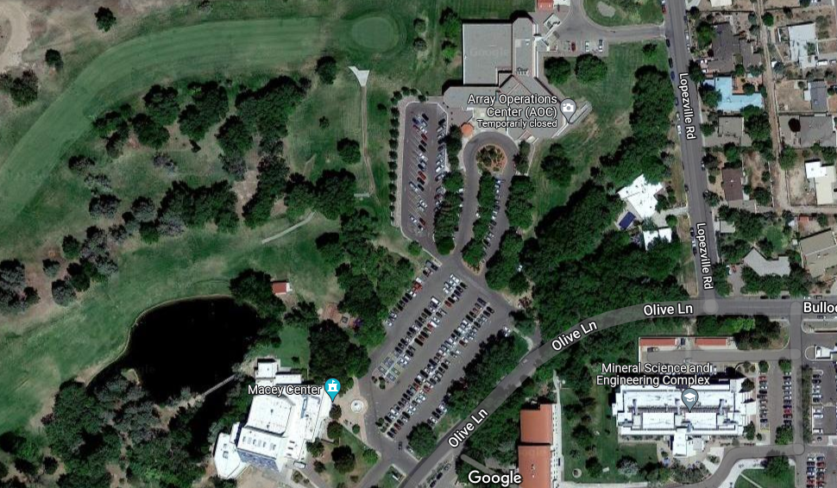
Reception tonight (5 – 7 pm) at Macey Center

Slide 6
VLA Tour
Carpool sign-up sheets in the back
Leave at 9:00 am on Monday, October 17th (about 1 hour drive), more details to be shared on Friday. Return around 2:30 pm
We will have water and snack bars and you might want to take lunch.
We recommend to bring: sunscreen, hat, sunglasses (although weather forecast right now is for possible rainy conditions)
Closed shoes and long pants for climbing a VLA antenna

Slide 7
Computing
Check that you can login to your workstation with the nm-#### account that you were provided (using your my.nrao.edu password)
General computing information, see NRAO Computing Guide https://info.nrao.edu/computing/guide
Specifically for batch processing: https://info.nrao.edu/computing/guide/cluster-processing
Note, workstations share nodes. Computing intensive data reduction and imaging is recommended to be done through batch processing.

