Slide 1
VLA Data Reduction: Standard Calibration
Amy Kimball (NRAO)

Slide 2
Using these slides as a reference
This presentation is based on a 12.5-GB (raw) data set that can be downloaded from the new NRAO Data Archive: data.nrao.edu
# When you see text like this and the sidebar to the left:
CASA commands and input parameters for CASA tasks will appear like this
ON YOUR OWN
Notes:
Note: I don't actually recommend doing this in real-time because it's better to pay attention to the presentation. But if you do want to go through it later, this will help guide you.

Slide 3
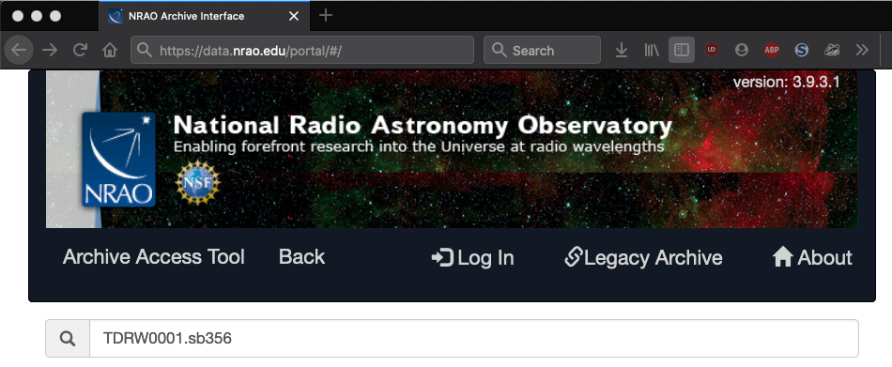
Accessing data used for this presentation
This presentation is based on a 12.5-GB (raw) data set that can be downloaded from the new NRAO Data Archive: data.nrao.edu
ON YOUR OWN
Search for: TDRW0001
Download ~12.5 GB data set: (TDRW0001.sb35624494.eb35628826.58395.23719237269)

Slide 4
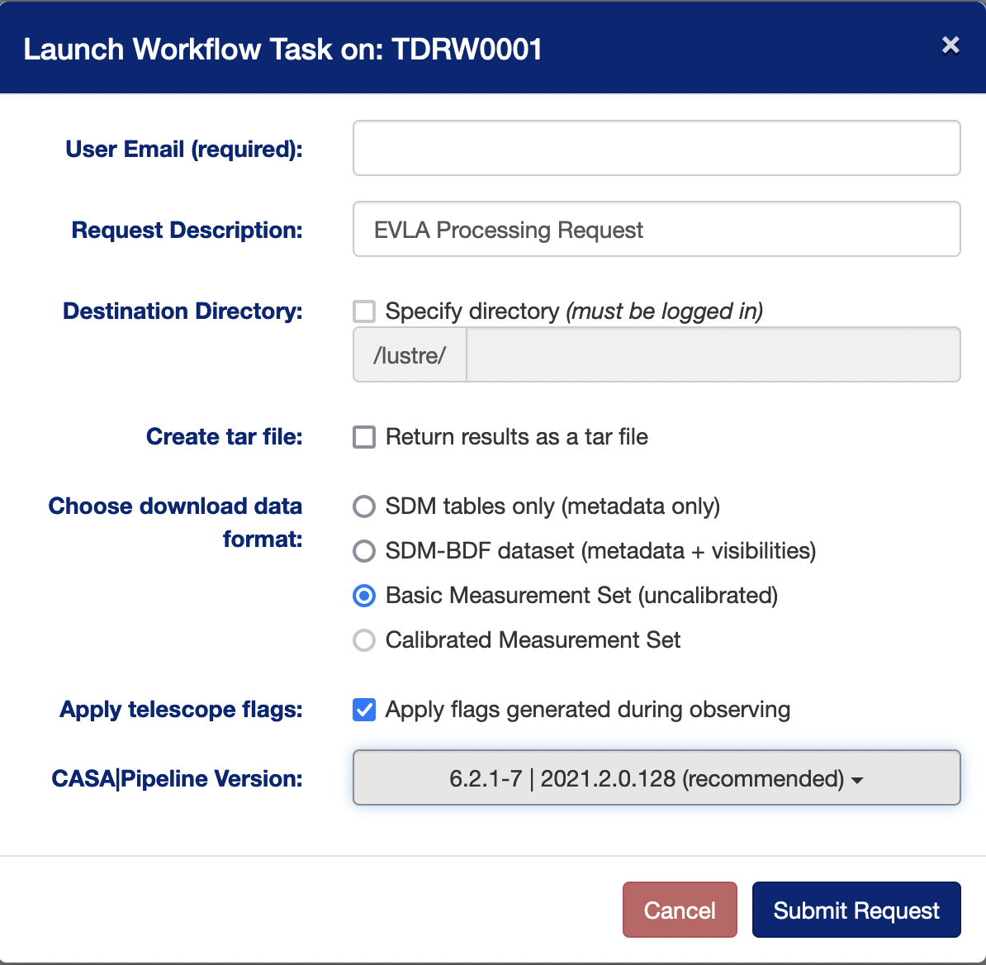
Accessing data used for this presentation
IF you are downloading a measurement set (MS), you must select the CASA version that will be used to convert the raw data (SDM-BDF) to MS.
ON YOUR OWN
CASA versions are usually (but not always) backwards compatible. CASA version shown here is the version used for this presentation: 6.2.1-7 | 2021.2.0.128.

Slide 5
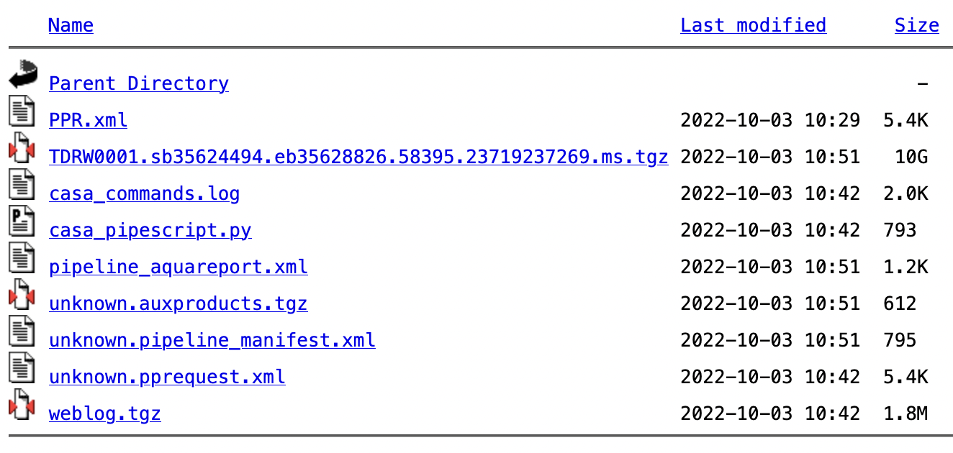
Accessing data used for this presentation
Steps to prepare the data set for this presentation:
Download and unzip/untar Measurement Set (MS):
Use mstransform to split out:
spw = '6~8'
scan = '5~11'
datacolumn = 'data'
Set outputvis to something simple: "my_data.ms"
Final data set size is ~1.2 GB.
ON YOUR OWN
keepflags = False
hanning = True
Notes:
NOTE: I also examined the data per Lorant's earlier presentation, and you should ALWAYS do that before just jumping right into calibration.

Slide 6
INFORMATION
The measurement set (MS) structure
‘Data’ column
Raw Data
‘Corrected’ Column
Calibrated Data
‘Model’ Column
(optional)
FT of source model
A raw MS starts with only the‘Data’column.
The other two columns can be created by various means.
With creation of the other two columns → MS triples in size.
The ‘Model’ Column is optional.
If not created → MS doubles in size.
“Virtual” models can be “attached” to the MS, FT-ed and used when needed (replacing the need for the ‘Model’ column).

Slide 7
INFORMATION
Calibration & Imaging Flow
The MS
The MS
‘Data’
‘Data’
‘Corrected’
TCLEAN
Calibration Tasks
Calibration
Calibration
Tables
Apply

Slide 8
INFORMATION
Calibration
Correcting antenna positions
Gain Curves (high-freq)
Opacity (high-) and Ionospheric (low-freq) corrections
Switched power **
Re-quantizer gain calibration (mostly 3-bit data)
Setting the flux density scale
Delay calibration
Pre-bandpass phase-only calibration (high-freq)
Bandpass calibration
Complex gain calibration
(Polarization Calibration)
Setting the flux density scales of the complex gain calibrators
A priori calibration
Notes:
Difference between Tsys and sys-power. The switched power gain is used to correct the visibility amplitudes, and the Tsys is used to set the weights.

Slide 9
INFORMATION
gencal: CASA task for various types of corrections
‘amp’ = amplitude correction
‘ph’ = phase correction
‘sbd’ = single-band delay
‘mbd’ = multi-band delay
‘antpos’ = ITRF antenna position corrections
‘antposvla’ = for pre-upgrade VLA (see documentation)
‘swpow’ = EVLA switched-power gains **
‘rq ’ = EVLA requantizer gains
‘swp/rq ’ = EVLA switched power gains/req. gains
‘opac ’ = Tropospheric opacity
‘gc ’ = VLA gain curve (zenith-angle-dependent gain)
‘eff ’ = VLA antenna efficiency (sqrt(K/Jy))
‘gceff ’ = VLA gain curve and efficiency
‘tecim ’ = Total electron content for ionospheric corrections
Notes:
Some of these are VLA-only. I did not include an example "tsys" which is for ALMA only.
From Claire: "The gain curves are normalized. So you need a separate scaling to go to K (=> switched power) or Jy (=> switched power plus K/Jy efficiency factor). caltype "eff" applies a canned efficiency factor, gceff applies the normalized gain curve and the efficiency factor. So, it all depends on how you are doing your calibration as to which kind of cal table you want to use. The pipeline just uses "gc" because we do not [automatically] apply the switched power, and use only the complex gain calibrator to track changes in system gain.”
From the CASA docs, a swpow calibration corrects both the visibility data and the weights. It implicitly includes any requantizer gain scale adjustments. ‘rq’ yields only the requantizer voltage gains.

Slide 10
INFORMATION
Antenna Positions: gencal
Correct baselines after antenna moves
operator’s log reports recent antenna moves
Use the task gencal to produce a calibration table that will include the antenna position corrections
(check whether table was needed/created)
Baseline correction related information is at:
http://www.vla.nrao.edu/astro/archive/baselines/

Slide 11
Antenna position corrections
CASA task gencal
# CASA parameters for gencal
vis = 'my_data.ms'
caltable = 'antpos.cal'
caltype = 'antpos'
ON YOUR OWN
Antenna position corrections (if any) are reported in the casalogger:
offsets for antenna ea02 : -0.00060 0.00220 -0.00130
offsets for antenna ea04 : 0.00150 0.00190 -0.00150
offsets for antenna ea06 : 0.00120 0.00190 -0.00140
offsets for antenna ea13 : 0.00110 0.00120 -0.00140
offsets for antenna ea16 : 0.00110 0.00120 -0.00180
offsets for antenna ea20 : -0.00190 0.00110 -0.00130
offsets for antenna ea25 : -0.00340 0.00190 -0.00280
Notes:
You do need to pay attention to *whether* there were any corrections because if none were found then no calibration table will be created, and therefore you don't need to apply it, in the later calibration steps (and in fact the later CASA tasks will fail if you try to apply a calibration table that doesn't exist!)

Slide 12
INFORMATION
Gain Curves: gencal
Large antennas have a forward gain that changes with elevation.
Gain curves describe how each antenna behaves as a function of elevation, for each receiver band.
The polynomial coefficients for the VLA are available directly from the CASA data repository.
Important for higher frequencies (>15 GHz).
The VLA pipeline always performs this step.
In gencal, set:
caltype = 'gc'
caltable = 'gaincurve.cal'

Slide 13
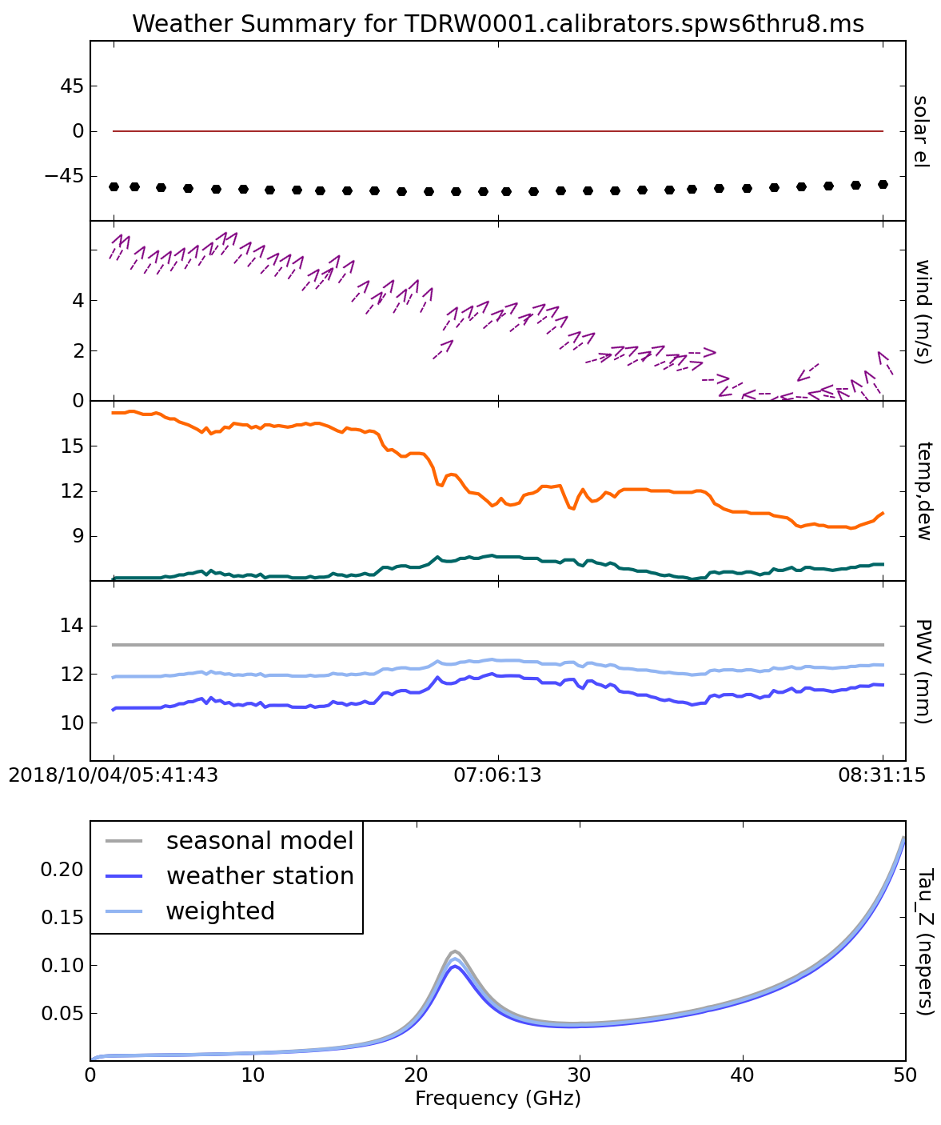
INFORMATION
Opacity Corrections: plotweather
Atmospheric optical depth, important for high frequencies (>15 GHz)
CASA task plotweather uses weather statistics and/or seasonal models to estimate opacities and make weather plots
tau_val = plotweather( vis='<ms name>', doPlot=True, plotName='weather.png' )
Gives one value per spw:
SPW : Frequency (GHz) : Zenith opacity (nepers)
0 : 3.000 : 0.006
1 : 3.128 : 0.006
2 : 3.256 : 0.006
Apply to data with gencal task:
caltype = 'opac'
caltable = 'opacity.cal'
parameter = tau_val
spw = '0~2' # (match to tau_val spws)
Notes:
Plotweather returns a value that can be captured in a variable. The “plotweather” command takes a while to run, so I should have the plot ready to look at.

Slide 14
INFORMATION
“Sys” Power / Switched-power gain
For the VLA, the total power received is continuously monitored during an observation, using a calibration signal of known power switched in/out at 10 Hz.
The values stored in the syspower table can be used to calibrate amplitude gains.
We do not recommend blind application of syspower (e.g., in gencal with caltype=‘swpow’); this is not a commissioned mode.
What is now available in the newest (6.4) pipeline is optional application of a polynomial fit to the syspower pattern to correct for gain compression.
Gain compression: when a strong signal (e.g. RFI) increases the gain of the amplifier into a non-linear regime.
Notes:
Reminder: newest pipeline, only just released, not the one we are using for this

Slide 15
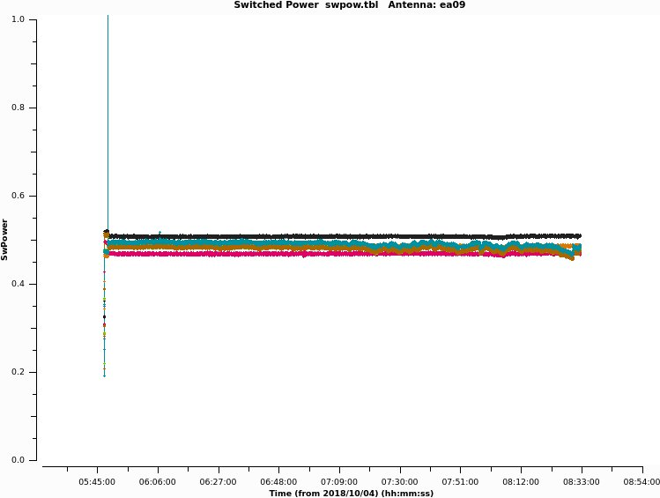
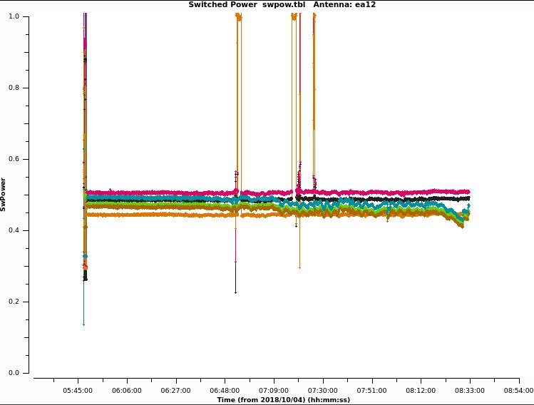
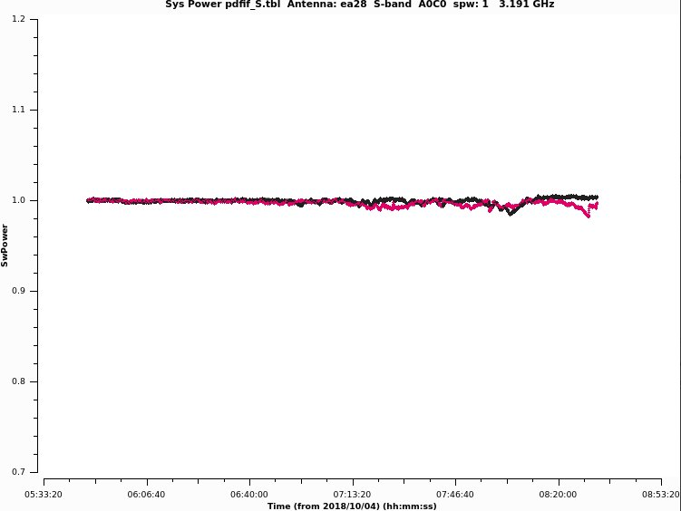
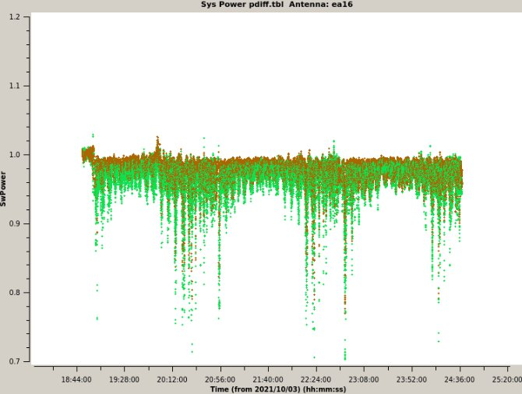
INFORMATION
Sys-power examples (pipeline plots)
Switched power table values:
this data, ea09
this data, ea12
severe compression (VLA Sky Survey example)
“Pdiff”-- on/off power difference:
“mild compression”

Slide 16
INFORMATION
The Ionosphere: Total Electron Content (TEC)
Free electrons in the atmosphere cause a dispersive delay (phase errors). Effect goes as 𝜈⁻² but depends on ever-changing atmosphere:
introduces Faraday rotation
changes measured source position
TEC corrections are:
Important for VLA low frequencies (P, L, S bands; C and X if active Sun)
Important for large arrays (baselines ≳ 5 km; VLA's A and B config)
Important for polarimetry
Still under commissioning
By default the VLA pipeline does NOT perform TEC corrections.
(in pipelines 6.4 and onward: TEC corrections are optional
Notes:
Data comes from a NASA database.

Slide 17
Ionosphere correction (Total Electron Content)
CASA “recipe” and CASA task gencal
tec_maps module retrieves TEC info from a NASA database.*
# In CASA
# import the TEC image (in CASA 5, import from "recipes")
from casatasks.private import tec_maps
tec_image, tec_rms_image, tec_graph = tec_maps.create( vis='my_data.ms', doplot=True)
# gencal parameters
caltype = 'tecim'
caltable = 'tecim.cal'
infile = tec_image
ON YOUR OWN
* https://cddis.nasa.gov/Data_and_Derived_Products/GNSS/atmospheric_products.html
Notes:
Need to specify what observers should do with this information. That is: we don't actually recommend doing this or not doing this. The pipeline doesn't do this. If they want to check whether this helps or hurts their data, they can do what Frank did by comparing before and after phase scatter.

Slide 18
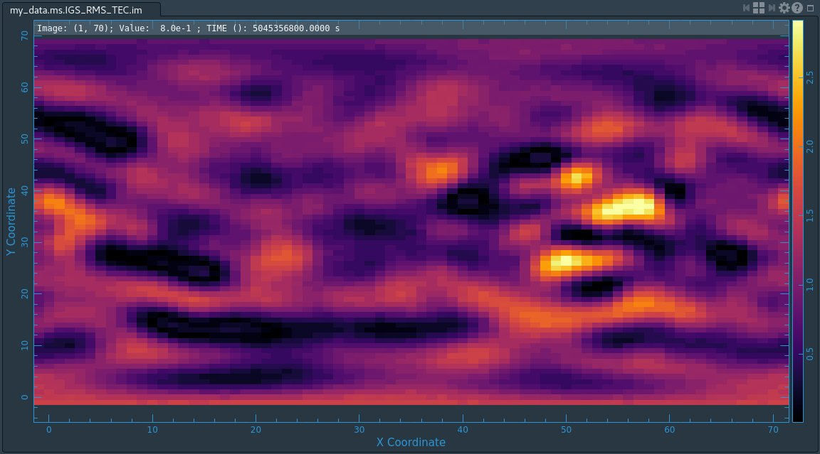
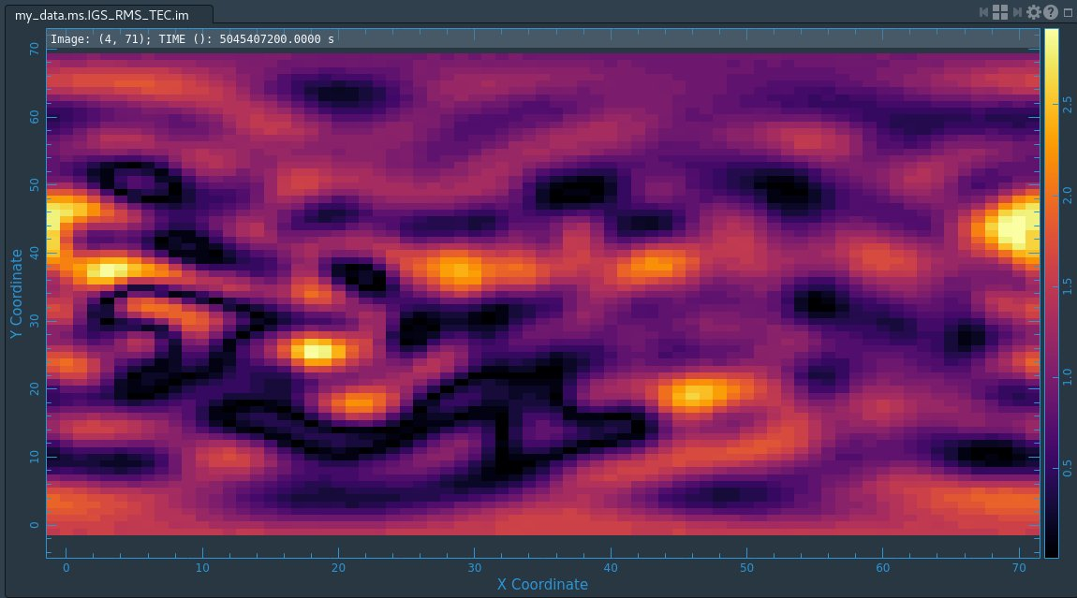
TEC image and rms image for this dataset
# open carta in a terminal, paste the reported URL into a local browser tab
carta --no_browser
TEC is time dependent:
open animator widget
ON YOUR OWN
press “Play”
Notes:
Most important thing to note is that in each of these plots we are looking at the whole sky... so although we can track the variation over time, the VLA is effectively a *single* pixel here (except maybe A-configuration which is the most extended configuration?). So there is some discussion as to how useful this correction is, and that's part of why we are not yet applying this by default. You can always feel free to compare calibration results when you do or don't apply this, and thus decide whether or not to use it in your final calibration.

Slide 19
INFORMATION
Requantizer gains: gencal
Optimizes the digital power within each spectral window.
Required for 3-bit data. (This example data set is 8-bit data.)
Strongly recommended for all P-band data.
In gencal, set:
caltype = 'rq'
caltable = 'requant_gains.cal'
Notes:
requantizers: a part of the electronics that helps put the electronic signal in the right dynamic range for the correlator

Slide 20
INFORMATION
Calibration
Correcting antenna positions
Gain Curves (high-freq)
Opacity (high-) and Ionospheric (low-freq) corrections
Switched power **
Re-quantizer gain calibration (mostly 3-bit data)
Setting the flux density scale
Delay calibration
Pre-bandpass phase-only calibration (high-freq)
Bandpass calibration
Complex gain calibration
(Polarization Calibration)
Setting the flux density scales of the complex gain calibrators
A priori calibration

Slide 21
Calibration: setting the flux density scale
INFORMATION
CASA task setjy calculates the absolute flux density as a function of frequency (and time):
for standard flux density calibrators (e.g., Perley-Butler 2017)
for Solar System objects (e.g., Butler-JPL-Horizons 2012)
If provided, attaches a model record to the MS
field = ‘ <fluxcal field name or #>'
standard = ' Perley-Butler 2017' model = ' <source/band model name>'
listmodels = True or False
usescratch = False

Slide 22
Identifying available flux density models
CASA task setjy
# CASA parameters for setjy
standard = 'Perley-Butler 2017' # default; other models available
listmodels = True
listmodels
For True, instead of calculating flux density, CASA will list the available primary calibrator models (3C138, 3C147, 3C286, 3C48; P, L, S, C, X, U, K, A, Q bands).
P-band models have another standard available:
standard = 'Scaife-Heald 2012':
3C48, 3C147, 3C196, 3C286, 3C295, 3C380
3C123 and 3C138 available for P-band only with "Perley-Butler 2017"
ON YOUR OWN
Notes:
From Frank:
"The P image models are from Rick and were recently added, they are based on clean components, so technically not images. They can either be scaled by PB2017 or Scaife-Heald, so they are ok to be used in both cases."

Slide 23
Setting the flux density scale
CASA task setjy
# In CASA
result = setjy(vis='my_data.ms', field='0', model='3C48_S.im')
output of setjy captured in variable "result":
{'0': {'0': {'fluxd': array([ 8.44827557, 0. , 0. , 0. ])},
'1': {'fluxd': array([ 8.13441944, 0. , 0. , 0. ])},
'2': {'fluxd': array([ 7.84281111, 0. , 0. , 0. ])},
'fieldName': '0137+331=3C48'},
'format': "{field Id: {spw Id: {fluxd: [I,Q,U,V] in Jy}, 'fieldName':field name }}"}
CASA reports in casalog:
Selected 54756 out of 97929 rows.
0137+331=3C48 (fld ind 0) spw 0 [I=8.4483, Q=0, U=0, V=0] Jy @ 3e+09Hz, (Perley-Butler 2017)
0137+331=3C48 (fld ind 0) spw 1 [I=8.1344, Q=0, U=0, V=0] Jy @ 3.128e+09Hz, (Perley-Butler 2017)
0137+331=3C48 (fld ind 0) spw 2 [I=7.8428, Q=0, U=0, V=0] Jy @ 3.256e+09Hz, (Perley-Butler 2017)
ON YOUR OWN
Notes:
MENTION: capturing setjy output into a variable is useful for polarization (as you'll see later in Frank's polarization talk)

Slide 24
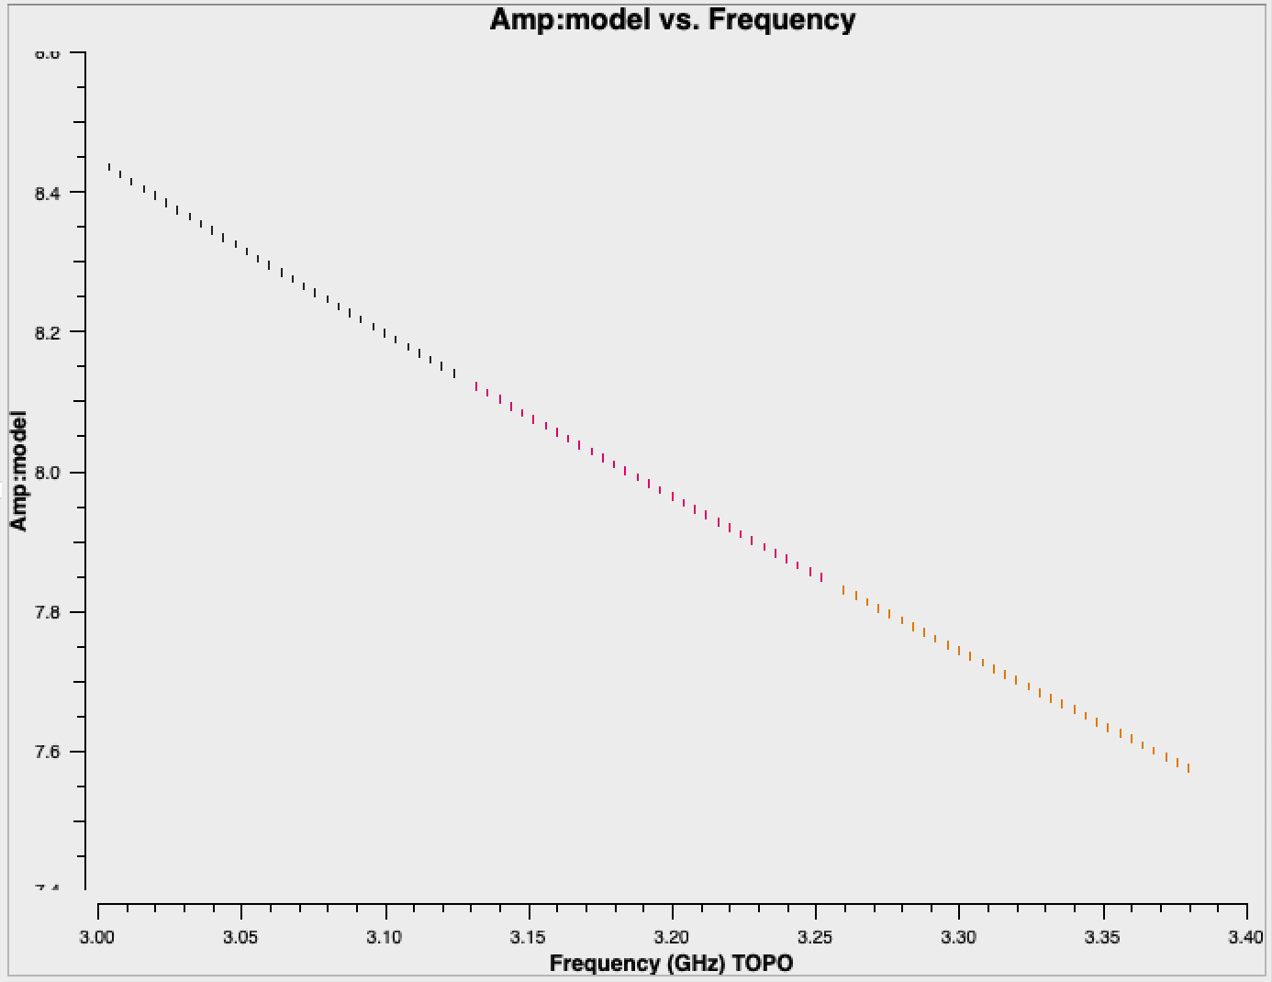
Examine flux density scale calibrator model
CASA task plotms
# CASA parameters for plotms
vis = 'my_data.ms'
xaxis = 'freq'
yaxis = 'amp'
ydatacolumn = 'model'
field = '0'
correlation = 'RR,LL'
coloraxis = 'spw'
ON YOUR OWN
Notes:
this is 3C48 at 3 GHz. We can see that it is a very strong source (8 Jy) and has a strong spectral index

Slide 25
INFORMATION
Setting the flux density scale manually: setjy
User can choose to provide flux density values rather than letting the task calculate them (manual mode)
standard = 'manual'
fluxdensity = [8.446, 0, 0, 0] # Stokes I, Q, U, V in Jy
spix = [-0.925,0] # [alpha, curvature]
reffreq = '3 GHz'
Can also use setjy to provide:
polindex: coefficients for frequency dependence of linear polarization fraction polangle: coefficients for frequency dependence of polarization angle rotmeas: rotation measure (rad/m²)
* Polarization discussed tomorrow in Frank Schinzel's talk

Slide 26
INFORMATION
Calibration
Correcting antenna positions
Gain Curves (high-freq)
Opacity (high-) and Ionospheric (low-freq) corrections
Switched power **
Re-quantizer gain calibration (mostly 3-bit data)
Setting the flux density scale
Delay calibration
Pre-bandpass phase-only calibration (high-freq)
Bandpass calibration
Complex gain calibration
(Polarization Calibration)
Setting the flux density scales of the complex gain calibrators
A priori calibration

Slide 27
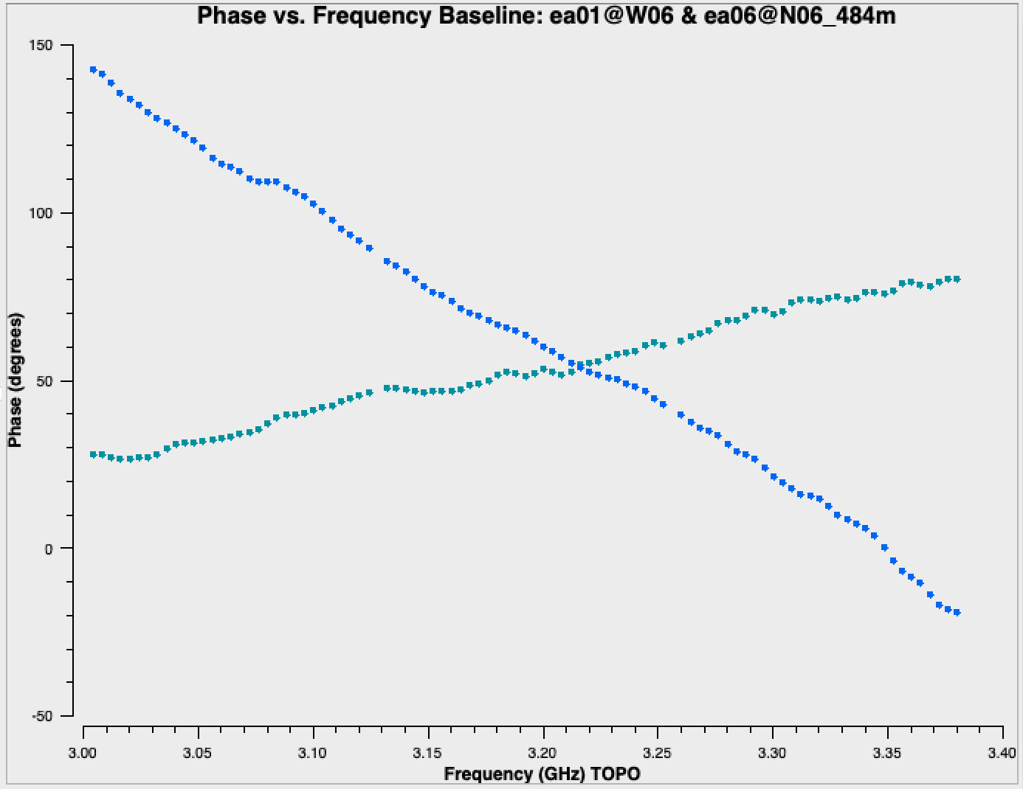
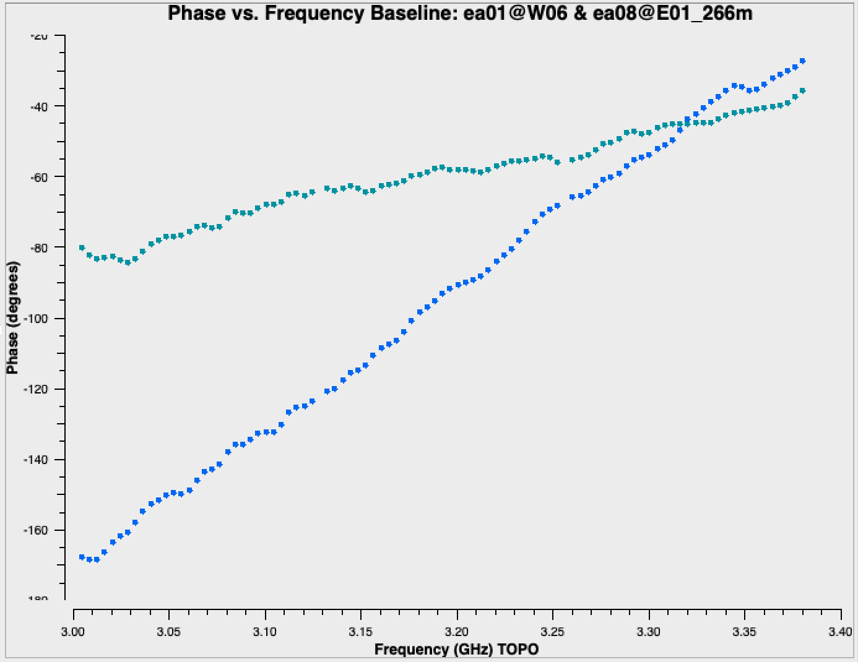
Antenna-based residual delays
INFORMATION
Seen in UV data as linear phase-ramp vs frequency:
varying with baseline, correlation (RR, LL), baseband
Notes:
SAY PER EMMANUEL REQUEST
These antenna based delays can be seen in the UV data through the varying phase slope in frequency on each baseline and correlation (and baseband if the data set has more than one baseband pair)

Slide 28
Calibrating antenna-based delays
CASA task gaincal
# CASA parameters for gaincal
vis = 'my_data.ms'
caltable = 'delays.cal'
solint = 'inf' # 'inf ' = infinite: combines all data within a scan
refant = 'ea10'
scan = '5' # can use one scan, or use all with e.g.: field = '0' combine = 'scan'
gaintype = 'K'
gaintable = ['antpos.cal', 'tecim.cal']
ON YOUR OWN
Use a strong (high signal-to-noise) source--- e.g. flux/bandpass calibrator.
gaintype = 'K': solve for the residual delay solutions
gaintable = [list]: include all previous calibration tables
* Warning!* Data with "failed" solutions will be flagged later, during applycal stage
Notes:
Using refant = ea10; Lorant explained in his earlier presentation about how one might choose an appropriate reference antenna.

Slide 29
INFORMATION
Calibration
Correcting antenna positions
Gain Curves (high-freq)
Opacity (high-) and Ionospheric (low-freq) corrections
Switched power **
Re-quantizer gain calibration (mostly 3-bit data)
Setting the flux density scale
Delay calibration
Pre-bandpass phase-only calibration (high-freq)
Bandpass calibration
Complex gain calibration
(Polarization Calibration)
Setting the flux density scales of the complex gain calibrators
A priori calibration
Bandpass

Slide 30
INFORMATION
Before Bandpass Calibration
Bandpass calibration is needed not just for spectral-line observations, but also for continuum.
Before calibrating the bandpass, may choose to do a phase-only calibration on the bandpass calibrator (to be applied only when calibrating the bandpass).
Prevents de-correlation when vector averaging.
Critical for high frequency observations.
Can also be used in low frequency observations.

Slide 31
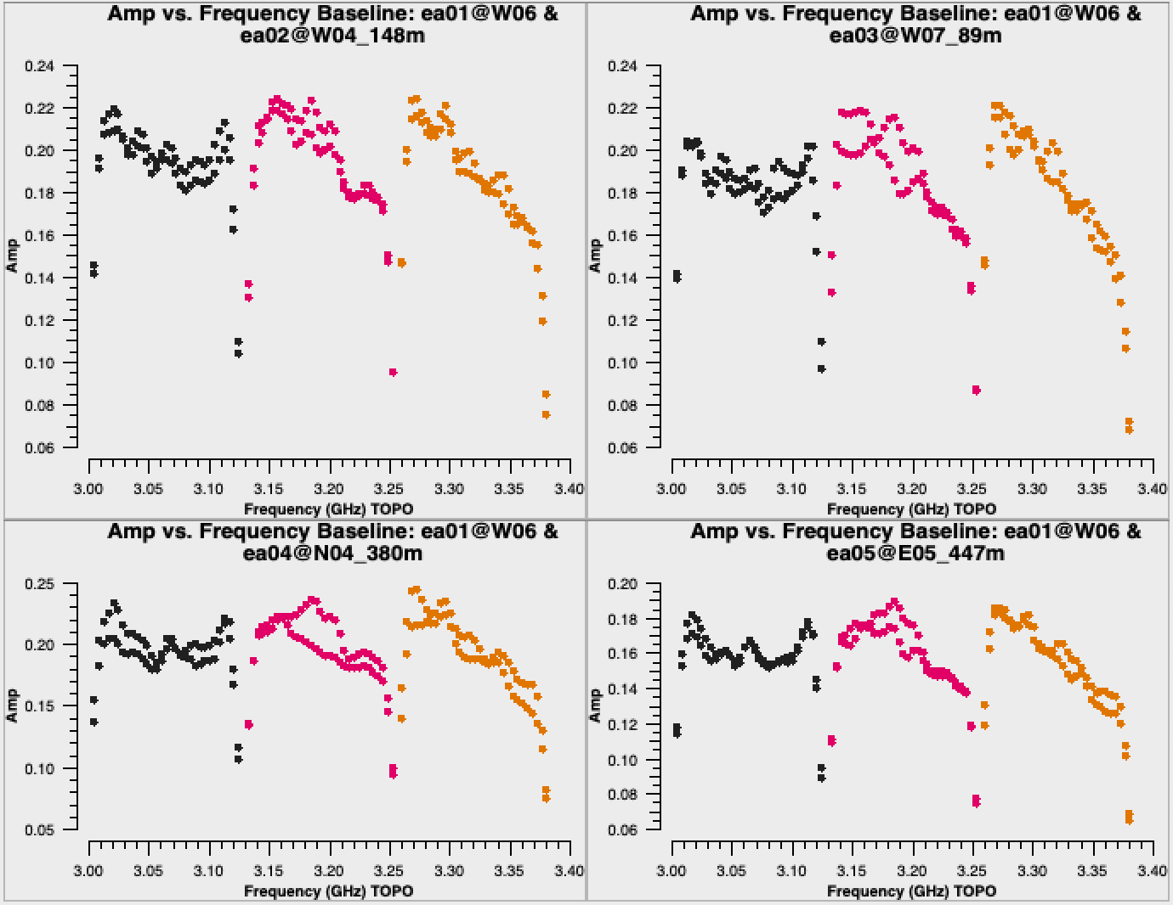
INFORMATION
Bandpass Calibration
Needed for continuum observations too!
Uncalibrated bandpass!
Plotms settings:
bandpass calibrator
amp vs freq
parallel-hands (RR, LL)
avg in time
iterate over baseline
color by spw
Note: sensitivity falls off in ~3 channels at each edge of a spw. (Effect of digital filtering.)

Slide 32
INFORMATION
Pre-bandpass phase-only calibration
CASA task gaincal
caltable = '<output cal table>'
solint = 'int' # 'int' = integration
calmode = 'p' # phase-only
spw = '0~2:13~18' # a few RFI-free channels
gaintype = 'G' # standard gaincal: one solution per pol, spw
gaintable = ['antpos.cal', 'tecim.cal', 'delays.cal']
Use short solution interval and a few channels per spw (RFI-free) to avoid de-correlation.
The resulting caltable must only be used for calibrating the bandpass.
Notes:
We are skipping this step because we are dealing with low-frequency data. It doesn’t hurt to run it for low-frequency, but it isn’t necessary. Note: the pipeline always runs this step (for consistency I believe but don’t quote me on that)

Slide 33
Bandpass calibration
CASA task bandpass
# CASA parameters for bandpass
vis = 'my_data.ms'
caltable = 'bandpass.cal'
field = '0'
solint = 'inf'
refant = 'ea10'
gaintable = ['antpos.cal', 'tecim.cal', 'delays.cal']
ON YOUR OWN
("pre-bandpass phase-only" caltable would also go in this list)
solint can provide an interval in time and/or frequency
If bandpass cal ≠ flux cal, must account for spectral index/curvature.
Topical CASAguide: “Correcting for a Spectral Index in Bandpass Calibration” :
https://casaguides.nrao.edu/ → VLA
Notes:
I might want to run with this one because it reports “insufficient unflagged antennas to proceed with this solve”. And can tell people that this is okay because those got flagged in the hanning smoothing step. (I verified check this.)

Slide 34
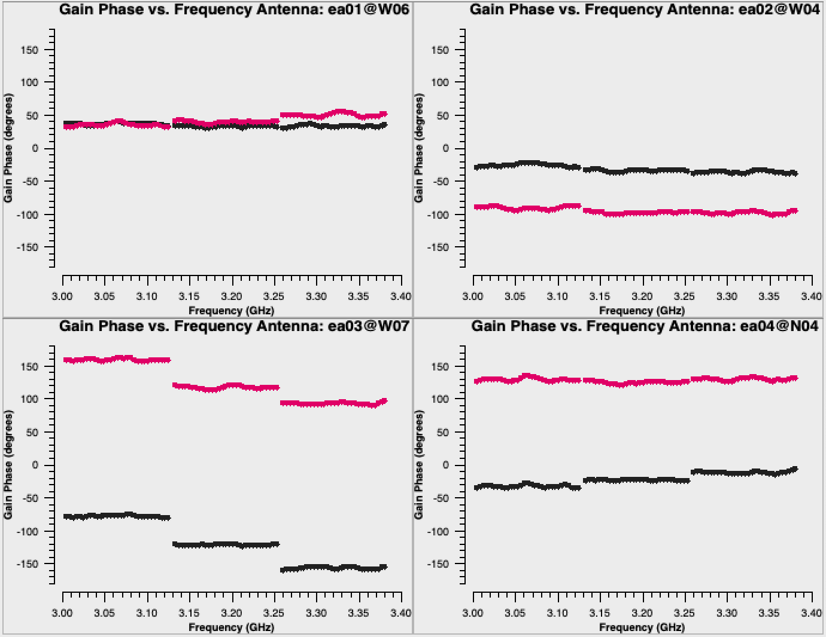
Examine bandpass calibration phase solutions
CASA task plotms
Parameter "vis" can be a caltable
coloraxis = 'corr' → actually polarization
# CASA parameters for plotms
vis = 'bandpass.cal'
gridrows = 2
gridcols = 2
xaxis = 'freq'
yaxis = 'phase'
iteraxis = 'antenna'
coloraxis = 'corr'
plotrange = [-1,-1,-180,180]
ON YOUR OWN
Move forward with and see that reference antenna (ea10) has phases = 0°.
Notes:
Run this one: see that reference antenna has phases = 0deg.

Slide 35
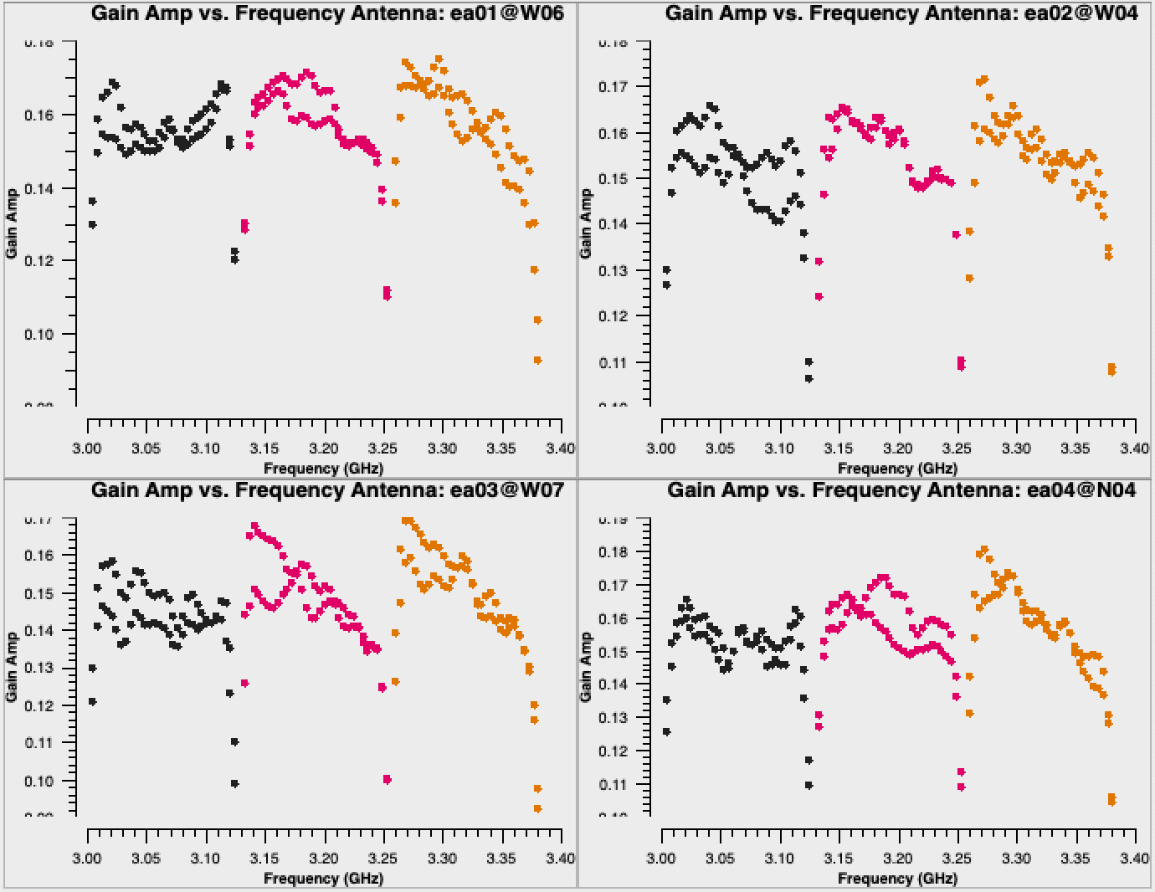
Examine bandpass calibration amp solutions
CASA task plotms
# CASA parameters for plotms
vis = 'bandpass.cal'
gridrows = 2
gridcols = 2
xaxis = 'freq'
yaxis = 'amp'
iteraxis = 'antenna'
coloraxis = 'spw'
plotrange = []
ON YOUR OWN
Note similarity to bandpass amp shapes (slide 29). These are the values that will be applied to the data in order to "correct" the bandpasses.

Slide 36
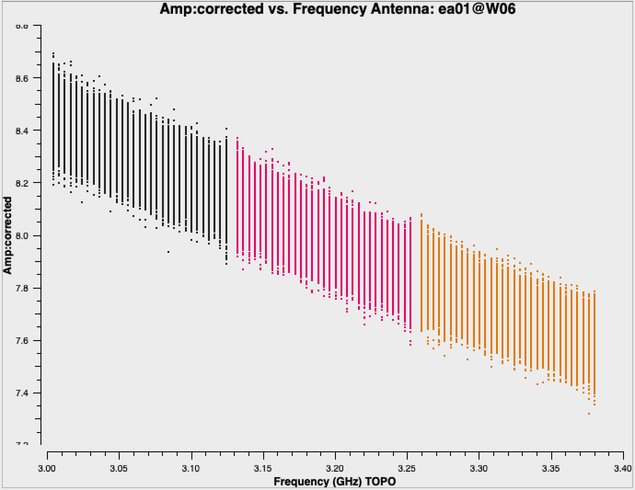
INFORMATION
Bandpass-corrected 3C48 data
(CASA tasks applycal and plotms)
Notes:
More scatter than in the model that we looked at originally! That's okay and expected. Some scatter could be due to structure such that the flux density detected on different baselines is slightly different, but what we are seeing here is from a typical amount of noise that varies a bit on the different baselines.
applycal(

Slide 37
INFORMATION
Calibration
Correcting antenna positions
Gain Curves (high-freq)
Opacity (high-) and Ionospheric (low-freq) corrections
Switched power **
Re-quantizer gain calibration (mostly 3-bit data)
Setting the flux density scale
Delay calibration
Pre-bandpass phase-only calibration (high-freq)
Bandpass calibration
Complex gain calibration
(Polarization Calibration)
Setting the flux density scales of the complex gain calibrators
A priori calibration
Bandpass

Slide 38
Complex Gain Calibration: gaincal, High Freq
INFORMATION
On all calibrators
calmode = 'p'
short solint
prior cal tables
1)
‘Data’
intphase.g
prior cal tables
On all calibrators
calmode = 'ap'
solint = 'inf '
2)
‘Data’
ampphase.g
intphase.g
bootstrap
flux density
scales
On Complex gain calibrator
prior cal tables
calmode = 'p'
solint = 'inf '
3)
‘Data’
scanphase.g
ampphase.g
calibrate target’s phases
Notes:
Especially for higher frequencies, phases change on a much shorter timescale than amplitude; we will solve for phase/amp solutions separately.
When phase changes significantly over time: if the un-corrected phase were averaged over this timescale, the amplitude would decorrelate. Note that we now also re-solve for the gain solutions of the bandpass calibrator to derive new solutions that are corrected for the bandpass shape. This is not strictly necessary, since the bandpass calibrator will not be used again, but it is useful to check its calibrated flux density.
- Parameter solint='int' coupled with parameter calmode='p' will derive a single phase solution for each integration. Note that the bandpass table is applied on-the-fly before solving for the phase solutions, however the bandpass is NOT applied to the data permanently until applycal is run later on.
- Although solint='int' is the best choice to apply before for solving for the amplitude solutions, it is not a good idea to use this to apply to the target. That is because the phase-scatter within a scan can dominate the interpolation between calibrator scans. Instead, we also solve for the phase on the scan time, solint='inf' for application to the target later on.
- Eventually we will apply both the amplitude (scaling) solutions from ampphase and the phase solutions from scanphase. We need to make sure that the combination (multiplication) of ampphase and scanphase lead to the total phase solution. So that is why we pre-apply ampphase when we are solving for scanphase.

Slide 39
INFORMATION
Complex Gain Calibration: gaincal, Low Freq
On all calibrators
calmode = 'ap'
solint = 'inf '
1)
‘Data’
prior cal tables
scanphase.g
bootstrap
flux density
scales
Examine the resulting solutions (plotms)
If the phases show rapid variations (e.g., due to ionosphere), use the method outlined for high frequencies.
The VLA calibration pipeline always uses the high-frequency approach.
Notes:
At lower frequencies, there is not usually a significant variation of phase over a single scan. Therefore we do not have to worry so much about decorrelation of the amplitudes if we don't take out the within-scan phase variation. So, as is typical for low-frequency, we will skip the "intphase" step, and go straight to solving for the phase and amplitude together.
VLA pipeline always uses the high-frequency approach. Doing so does not hurt the data, but can just amount to superfluous steps at this stage. If you are ever concerned whether it is necessary, you should examine your data to see if there is significant integration-to-integration phase variation, or just go with the high-frequency approach to be extra safe.

Slide 40
Complex gain calibration
CASA task gaincal
field: include fluxcal and gain calibrator in order to (later) transfer flux scaling
spw: could choose to avoid low-sensitivity channels at each spw edge
# CASA parameters for gaincal
vis = 'my_data.ms'
caltable = 'scanphase.gcal'
field = '0,J0259+0747'
refant = 'ea10'
gaintable = ['antpos.cal', 'tecim.cal', 'delays.cal', 'bandpass.cal']
ON YOUR OWN
Important defaults
solint = 'inf': yields one solution per scan on complex gain calibrator
minsnr = 3.0: reject solutions at lower signal to noise than this value
calmode = 'ap': perform both amplitude (a) and phase (p) calibration
solnorm = False: no need to normalize, because we're doing amplitude calibration

Slide 41
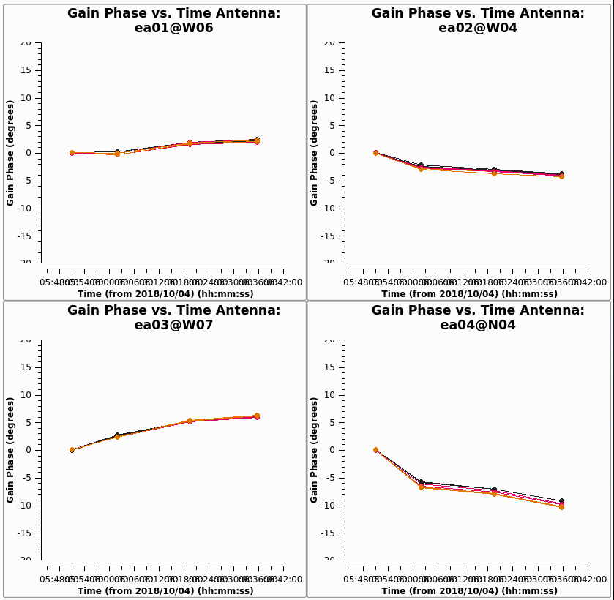
Examine complex gain cal phase solutions
CASA task plotms
# CASA parameters for plotms
vis = 'scanphase.gcal'
gridrows = 2
gridcols = 2
xaxis = 'time'
yaxis = 'phase'
iteraxis = 'antenna'
coloraxis = 'spw'
xconnector = 'line'
plotrange = [-1,-1,-20,20]
ON YOUR OWN

Slide 42
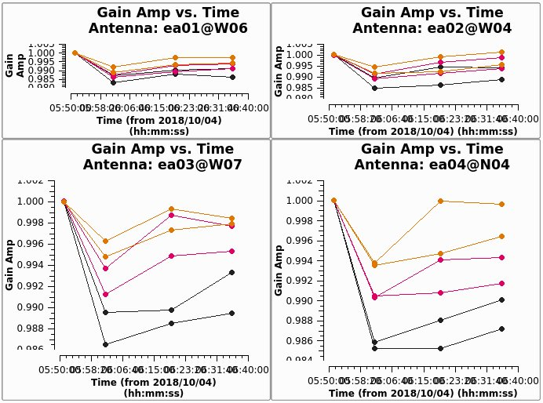
Examine complex gain cal amp solutions
CASA task plotms
# CASA parameters for plotms
vis = 'scanphase.gcal'
gridrows = 2
gridcols = 2
xaxis = 'time'
yaxis = 'amp'
iteraxis = 'antenna'
coloraxis = 'corr'
xconnector = 'line'
plotrange = []
ON YOUR OWN
Data point with value of 1 is the flux calibrator (3C48):
in this observation, bandpass cal and flux cal are the same source. (This is common).
Notes:
replace with new figure; color by spw

Slide 43
INFORMATION
Calibration
Correcting antenna positions
Gain Curves (high-freq)
Opacity (high-) and Ionospheric (low-freq) corrections
Switched power **
Re-quantizer gain calibration (mostly 3-bit data)
Setting the flux density scale
Delay calibration
Pre-bandpass phase-only calibration (high-freq)
Bandpass calibration
Complex gain calibration
(Polarization Calibration) Frank Schinzel's talk tomorrow
Setting the flux density scales of the complex gain calibrators
A priori calibration
Bandpass

Slide 44
INFORMATION
Scaling the flux densities: CASA task fluxscale
Bootstrapping the flux density scales:
We earlier used setjy to set the flux density values for the flux calibrator, and gaincal to solve for the antenna gains ('scanphase.gcal') based on those values. In the fluxscale task, those gains are used to determine flux densities of the complex gain calibrators.
Fits a 1st- (linear) or 2nd-order curve to each spectrum to report spectral index and curvature. Choice of fit order may depend on amount of curvature, signal-to-noise of calibrator.
Results can be stored in a variable or written to a file.
reference = name of flux density calibrator
transfer = name or fields of complex gain calibrators
fitorder = N # for N^{th} order polynomial fit to spectrum (default is 1)
listfile = name of output file to store results (optional)
Notes:
fitorder: 1 means it fits a power-law (constant spectral index), 2 fits curvature. If the code doesn’t find enough solutions it’ll default to a lower fitorder. Most common to use fitorder=1 unless multi-band data, in which case fitorder=2 is common.

Slide 45
INFORMATION
Scaling the flux densities: CASA task fluxscale
Fluxscale produces a new calibration table but there are two options:
fluxtable = ‘<output cal table>’
incremental = True or False
If incremental = False:
The <output cal table> replaces the input 'ap' table.
If incremental = True:
The <output cal table> contains only the scaling factors, and must be used alongside the input 'ap' table when applying calibration.
Which approach to use is purely a matter of personal preference.

Slide 46
Bootstrap the flux density, fit spectrum
CASA task fluxscale
# CASA parameters for fluxscale
vis = 'my_data.ms'
caltable = 'scanphase.gcal'
fluxtable = 'fluxscale.cal'
reference = '0137+331=3C48'
transfer = ['J0259+0747']
fitorder = 1
incremental = False
ON YOUR OWN
Output can be captured in a variable, e.g.: output = fluxscale(<inputs>)
Results reported in casalogger:

Slide 47
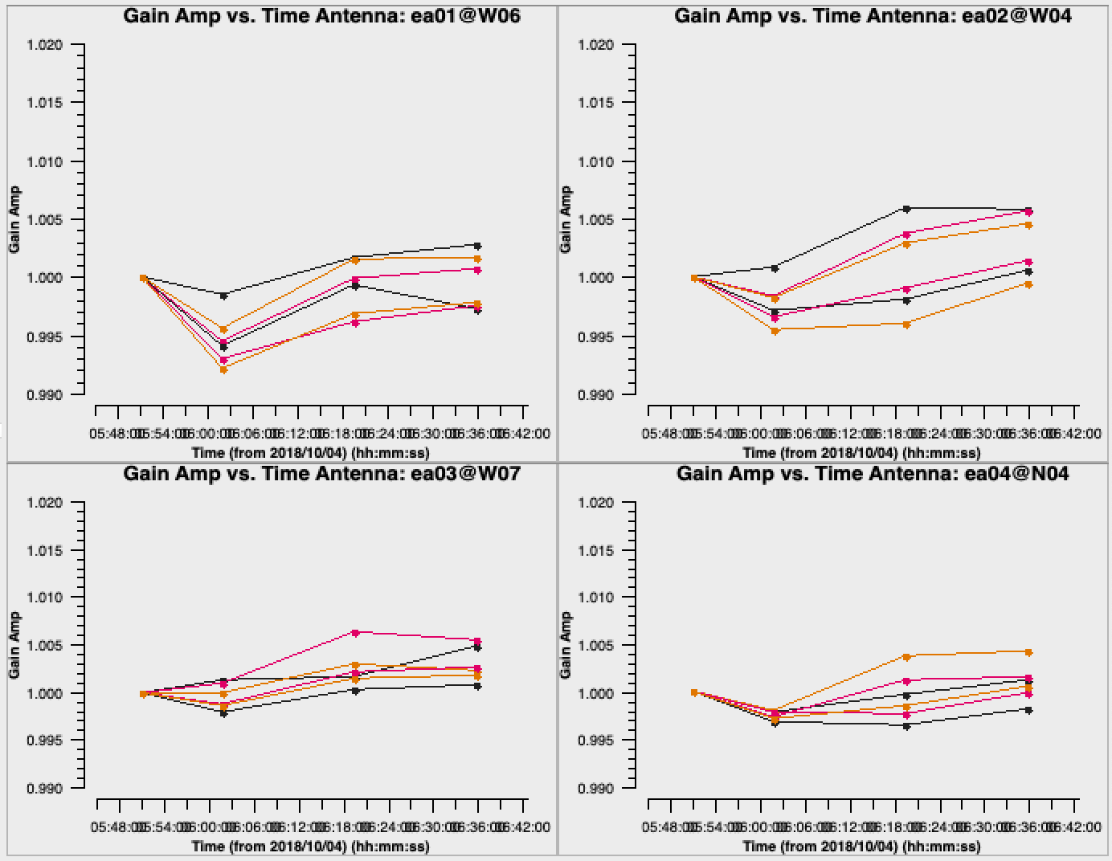
Examine rescaled amplitude solutions
CASA task plotms
# CASA parameters for plotms
vis = 'fluxscale.cal'
xaxis = 'time'
yaxis = 'amp'
gridrows = 2
gridcols = 2
coloraxis = 'spw'
iteraxis = 'antenna'
yselfscale = True
xconnector = 'line'
ON YOUR OWN
Notes:
colored here by spw; previously we looked at a version that was colored by correlation (RR,LL)

Slide 48
INFORMATION
Calibration
Correcting antenna positions
Gain Curves (high-freq)
Opacity (high-) and Ionospheric (low-freq) corrections
Switched power **
Re-quantizer gain calibration (mostly 3-bit data)
Setting the flux density scale
Delay calibration
Pre-bandpass phase-only calibration (high-freq)
Bandpass calibration
Complex gain calibration
(Polarization Calibration) Frank Schinzel's talk tomorrow
Setting the flux density scales of the complex gain calibrators
A priori calibration
Bandpass

Slide 49
INFORMATION
Applying the calibration
First apply calibration not to the targets, but to the calibrators themselves.
Looking at calibrated visibilities for the calibrators is a good way to confirm that the calibration is good and to identify bad data that may have been missed before (e.g. RFI).
Multiple calibrators in the data?
Simplest approach is to use one run of the applycal task for each calibrator

Slide 50
Apply the calibration: flux/bandpass calibrator
CASA task applycal
gaintable: the calibration tables
gainfield: fields from the above tables (if table has solutions from >1 source)
interp: apply nearest solution? or interpolate between solutions (linear)?
calwt: use system calibration to weight the data? not yet for VLA data! (False)
ON YOUR OWN
# CASA parameters for applycal: apply calibration to bandpass/flux cal
vis = 'my_data.ms'
field = '0137+331=3C48'
gaintable = ['antpos.cal', 'tecim.cal', 'delays.cal', 'bandpass.cal', 'fluxscale.cal']
gainfield = ['', '', '', '', '0137+331=3C48']
interp = ['', '', '', '', 'nearest']
calwt = False
Notes:
calwt=False : For the VLA, we do not use system calibration data to compute real (1/Jy²) weights, thus trying to calibrate them during the applycal stage can produce nonsensical results. In particular, experience has shown that calibrating the weights will lead to problems especially in the self-calibration steps. We will instead set the weights before imaging using the statwt task (further details below).

Slide 51
Apply the calibration: gain calibrators
CASA task applycal
Now apply the calibration to each of the phase calibrators. Most of the input parameters remain the same...
# CASA parameters for applycal: apply calibration to gain calibrator
vis = 'my_data.ms'
field = 'J0259+0747'
gaintable = ['antpos.cal', 'tecim.cal', 'delays.cal', 'bandpass.cal', 'fluxscale.cal']
gainfield = ['', '', '', '', 'J0259+0747']
interp = ['', '', '', '', 'nearest']
calwt = False
ON YOUR OWN

Slide 52
INFORMATION
Examine the calibrated data (the corrected column) with plotms.
Flag, if needed, and re-calibrate.

Slide 53
Apply the calibration: targets
CASA task applycal
gainfield: apply the solution from the appropriate complex gain calibrator
interp: use linear interpolation to interpolate in time between the complex gain calibration solutions
# CASA parameters for applycal: apply calibration to target
vis = 'my_data.ms'
field = '3C75'
gaintable = ['antpos.cal', 'tecim.cal', 'delays.cal', 'bandpass.cal', 'fluxscale.cal']
gainfield = ['', '', '', '', 'J0259+0747']
interp = ['', '', '', '', 'linear']
calwt = False
ON YOUR OWN
Notes:
Use linear now because we are applying solutions found for the complex gain calibrator to the target. The complex gain calibrator scans bracketed the target scans in time.

Slide 54
Split target source(s) into their own MS
CASA task mstransform
Split target source(s) using corrected column.
Optionally:
apply time and/or frequency averaging
choose certain spws/channels
# CASA parameters for mstransform or split
vis = 'my_data.ms'
outputvis = '3C75.ms'
field = '3C75'
correlation = 'RR,LL'
datacolumn = 'corrected'
ON YOUR OWN
The split out data will occupy the ‘data’ column in the output MS.
This step is recommended before re-weighting the data (statwt) and before imaging.
Note: for full-polarization data that has not been polarization-calibrated, use: correlation = 'RR,LL'

Slide 55
Re-weight the visibilities
CASA task statwt
# CASA parameters for statwt
vis = '3C75.ms'
datacolumn = 'data'
Data weights are initialized to be based on channel bandwidth and integration-time (2ΔνΔτ).
statwt re-weights the visibilities according to their scatter:
down-weight underperforming antennas
down-weight frequency ranges affected by RFI
Use on fully-calibrated data!
ON YOUR OWN
Note for spectral lines:
use fitspw parameter to exclude strong lines

Slide 56
INFORMATION
The VLA Calibration Pipeline
Performs basic flagging and calibration using CASA.
Primarily designed for Stokes I continuum data.
To run successfully, the scan intents in the observation scheduling block must be set correctly.
Information is at:
https://science.nrao.edu/facilities/vla/data-processing/pipeline
More details later Drew Medlin’s talk tomorrow

Slide 57
INFORMATION
Science-Ready Data Products (SRDP)
Provide calibrated (and eventually imaged) PI observations
⇾ users can focus on their science!
Intended ultimately for all NRAO instruments
SRDP project will cover increasing functionality over the next several years. Currently available for:
C-band and higher frequencies (≥ 4 GHz)
continuum science only
these standard flux/BP/delay cals only: 3C286, 3C147
Observing setups must follow all VLA observing guidelines and be pipeline compatible (e.g. scan intents, calibrator cycles)

Slide 59
INFORMATION
A note on gaincal parameter docallib
In current version of CASA, make sure
docallib = False
docallib refers to a “calibration library”, a new portable interface for describing ensembles of calibration replacing gaintable, gainfield, etc.… parameters.
Enables on-the-fly calibration in CASA's calibration tasks.
Provides increased capability and flexibility.
Incorporated into the next CASA-pipeline release.

Slide 60
Add sys-power to calibration, mention that pipeline does not apply it, but next pipeline will allow choice to apply.
Slide 38: what does it mean “no need to normalize because we are doing amplitude calibration”? (should it say “DON’T” instead of “no need”?

