Slide 1
Visibility Data Inspection
Loránt Sjouwerman, NRAO

Slide 2
Goal: prepare for (easier) calibration
Examine the visibility data, start from archive download
Science Data Model (SDM) and Binary Data Format (BDF)
SDM = metadata; sources, antennas, correlator, weather, etc
BDF = single scan data (“missing BDF”: scan lost)
Convert to data reduction package format, here CASA
Retrace observing schedule, observing conditions
Data structure, scan intents, antennas, operator logs (cf. OPT)
Remove (flag) problematic data, items for watchlist
Known issues (off-source, unused antenna)
Unforeseen issues (RFI, unnoticed by operator)
Questionable data (may need flagging later, or not..)

Slide 3
CASA
See previous lecture…
Documentation is available at
http://casa.nrao.edu/
Training material is available at
http://casaguides.nrao.edu/
For help use the NRAO helpdesk at
http://help.nrao.edu/
CASA 6.2.1 will be used at this workshop
Type “casa –ls” to find the exact version string
Then “casa [-r <version-string>]” to start

Slide 4
Loading the data: importasdm
Goal: convert SDM/BDF into CASA visibility data format
Skip if CASA MS (“measurement set”) format is downloaded
Task importasdm converts SDM/BDF to MS for CASA processing
importvla for older data; more options like importfits ..
importasdm understands and applies VLA online flags:
Read:
Write:
default importasdm |  | set task and default parameters
inp |  | review parameter options
asdm | = | ‘SDM/BDF_directory_string’
vis | = | ‘CASA_MS_directory_string’
ocorr_mode | = | ‘co’
applyflags | = | True
inp |  | review parameter selections
go |  | execute task

Slide 5
Loading the data: flagdata
If applyflags=False (default) a FLAG_CMD table is created
Examine, list/plot (before applying by default) using flagcmd
Also used for other flagging operations, see later in this talk
Additional useful a-priori flagging uses flagdata (also see later)
Read/write:
Shadowing:
Pure zero data:
default flagdata |  | set task and default parameters
vis | = | ‘CASA_MS_directory_string’
mode | = | ‘shadow’
inp | = | review parameter selections
go | = | execute task
mode | = | ‘clip’
correlation |  | ‘ABS_ALL’
clipzeros |  | True
go |  | execute task

Slide 6
Examine your observation/data
Goal: know your data content and find/fix possible issues (that will give problems) before starting the calibration
Operator observing log (email to observers)
http://www.vla.nrao.edu/cgi-bin/oplogs.cgi
Plotting the antenna positions: plotants
Array configuration, possible reference antennas
Observing summary: listobs
Calibrator sources, scan intents, spectral configurations, etc..
Plotting/displaying/editing data: plotms
Examine, assess, act: (visibility) to be or not to be (retained)
(pipeline operations weblog might be useful too if available)

Slide 7
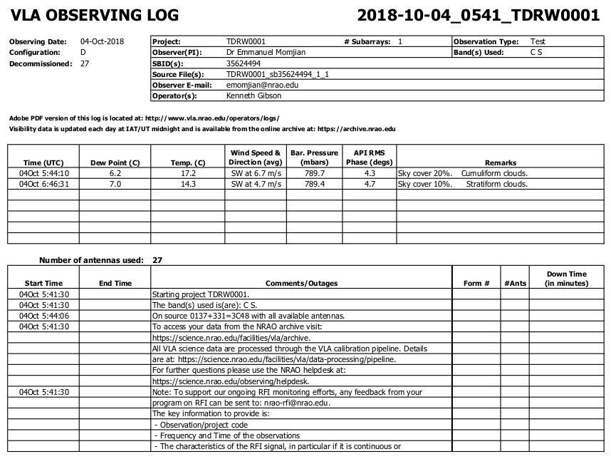
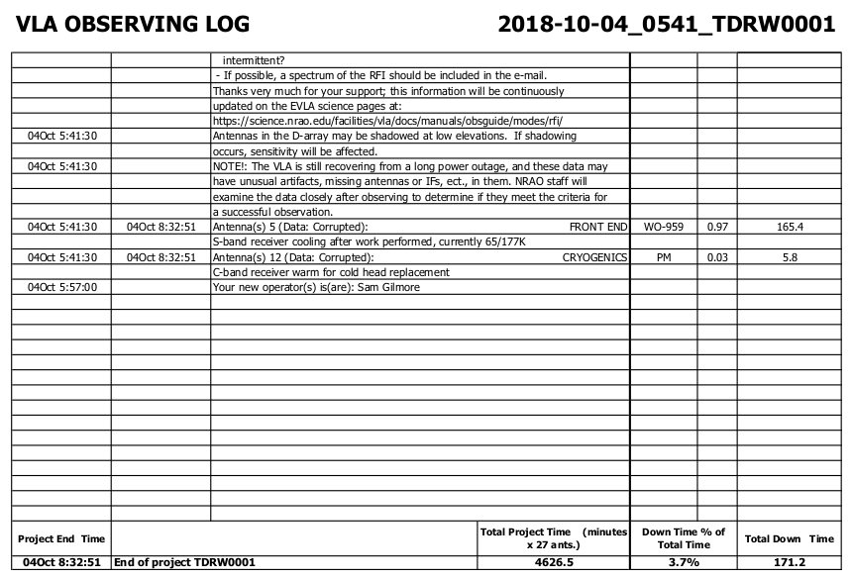
Operator observing log
Goal: first impression about the observation
Array status, weather, antenna problems etc, downtime measure

Slide 8
Choosing the reference antenna(s)
Goal: good ‘refant’ reduces loss due to flagging/calibration
Use plotants:
Baselines/uv-dist not too long
Near physical array center
Use listobs/vishead
e.g. 08-pad: [WNE]08
A: inner antennas
D: no shadowing !
Good on all calibrator scans
Target scans irrelevant
No antenna “issues”
Clean from RFI
default plotants |  | set task and default parameters
inp |  | review parameter options
vis | = | ‘CASA_MS_directory_string’
antindex | = | True
inp |  | review parameter selections
go |  | execute task

Slide 9
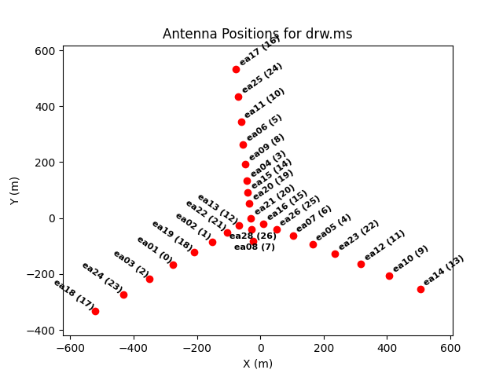
Choosing the reference antenna(s)
Goal: good ‘refant’ reduces loss due to flagging/calibration
Use plotants:
Baselines/uv-dist not too long
Near physical array center
Use listobs/vishead
e.g. 08-pad: [WNE]08
A: inner antennas
D: no shadowing !
Good on all calibrator scans
Target scans irrelevant
No antenna “issues”
Clean from RFI

Slide 10
Observing structure
Goal: identify key strategy, scan outline, calibration hints
Use listobs (not vishead):
Source (i.e. field) names
Scan intents: calibrators
Flux density
Bandpass
Gain (phase and amp!)
Correlator setup
Spectral windows
(IFs/subbands, channels)
Polarization
Doppler setting
default listobs |  | set task and default parameters
vis | = | ‘CASA_MS_directory_string’
inp |  | review parameter selections
go |  | execute task
NOTE:
listfile | = | ‘output_filename_string’

Slide 11
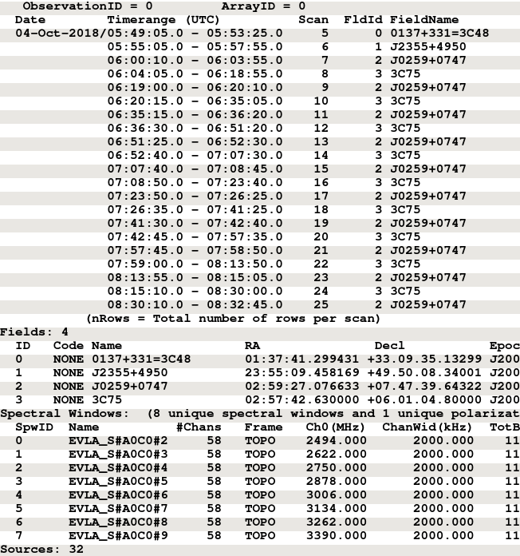
Observing structure
Goal: identify key strategy, scan outline, calibration hints
Use listobs (not vishead):
Source (i.e. field) names
Scan intents: calibrators
Flux density
Bandpass
Gain (phase and amp!)
Correlator setup
Spectral windows
(IFs/subbands, channels)
Polarization
Doppler setting

Slide 12
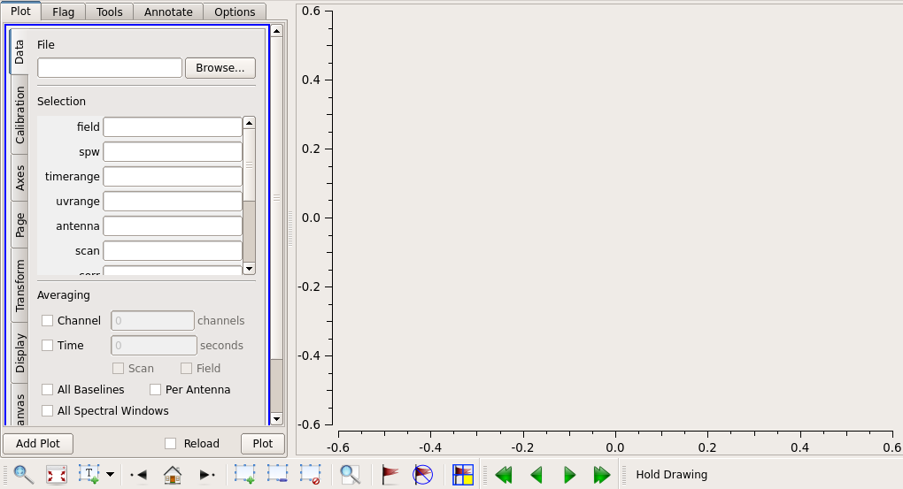
Examine MS visibility data: plotms
Intermezzo: introduction to plotms GUI and panels:

Slide 13
Examine MS visibility data: plotms
Intermezzo: introduction to plotms GUI and panels:
Control
Panel
Graphics Display

Slide 14
Examine MS visibility data: plotms
Intermezzo: introduction to plotms GUI and panels:
Action
tabs
Parameter
tabs
Selection
icons

Slide 15
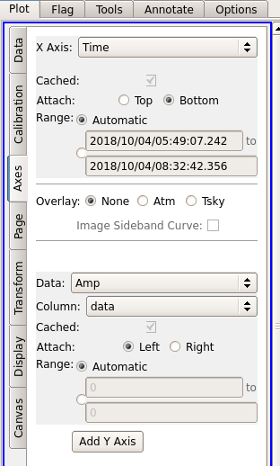
Control panel parameters
Axes options
Typical X Axis selections (not all):
‘time’/’scan’/’field’
‘frequency’(freq)/’spw’
‘channel’(chan)/’velocity’(vel)
‘antenna1’(ant1)/’antenna2’(ant2)/’baseline’
‘UVdist’/’UVwave’
Typical Data (i.e. Y-axis) selections:
‘amplitude’(amp)
‘phase’
‘real’/’imaginary’(imag)
‘weight’(wt)/’flag’

Slide 16
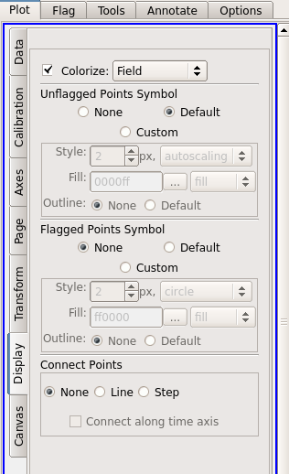
Control panel parameters
Display options
Typical Colorize selections:
For time-sequence-like x-axis
Field, scan
Antenna1/2, baseline
For frequency-order-like x-axis
spw
Correlation (i.e. polarization)
Antenna1/2, baseline
For array-configuration-like x-axis
Antenna1/2, baseline, spw, field, correlation

Slide 17
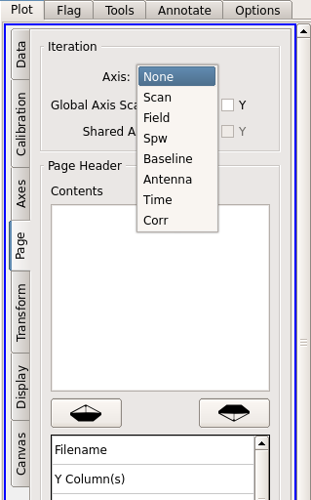
Control panel parameters
Page options
In multi-page mode, when plots are distributed over more than one plot, one can cycle through the plots using the page-selection tool icons:
Typical multi-page selections:
Antenna
Correlation
Field
spw

Slide 18
Examine, assess, act
Goal: remove potentially problematic data, identify other potential problems that may influence calibration/imaging
Overall sense of calibrators/intents and target visibilities, frequency setup, observing conditions, instrumental response
Where to expect potentially bad data, note the reference antenna!
Ill-performing antennas/baselines/samplers/polarizations (instrument)
In time domain:
Start of scans (not yet on-source, settling time)
Bad weather/pointing/RFI-bursts (observing conditions)
In frequency domain:
Bandpass, subband edges and baseband roll-off (channel sensitivity)
RFI-frequencies – not your line!

Slide 19
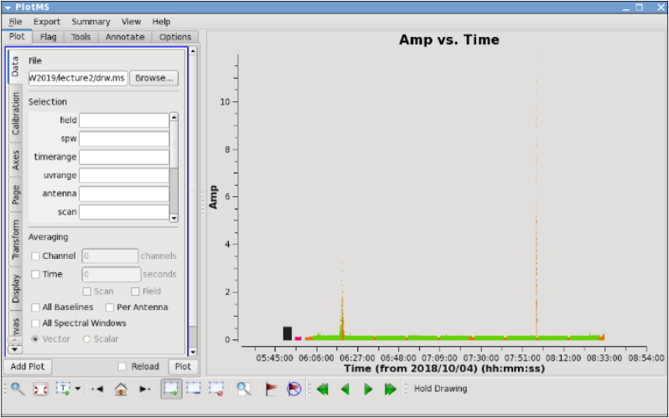
Time/scan/field dependent issues
Example: xaxis=‘time’, yaxis=‘amp’, coloraxis=‘field’

Slide 20
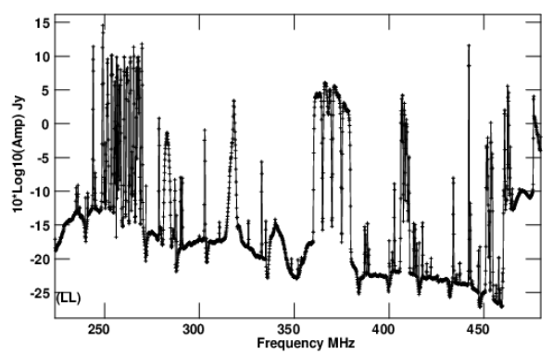
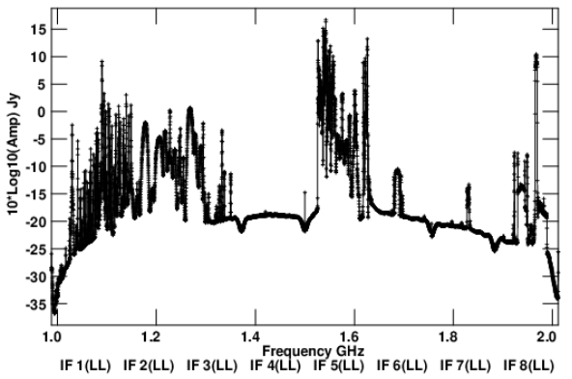
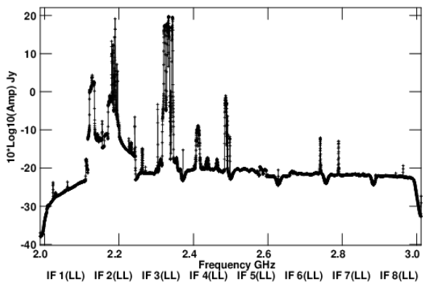
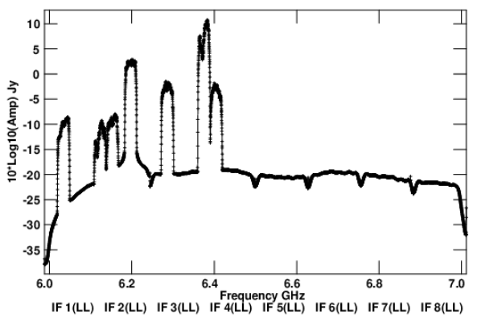
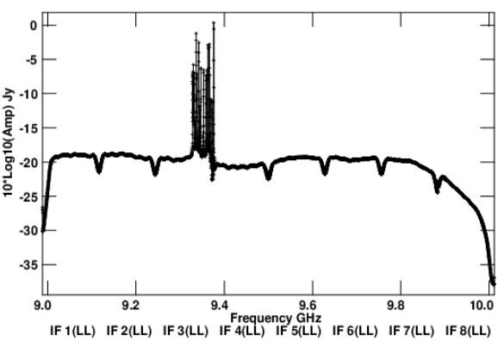
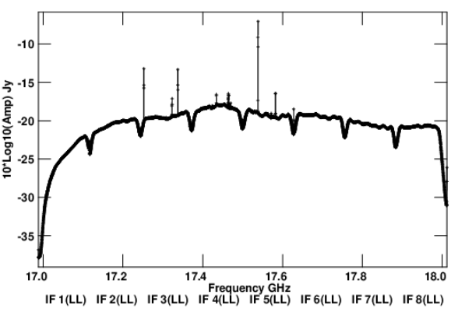
Radio frequency interference (RFI)
Intermezzo: RFI awareness
Observations, in particular in the observing bands 4, P, L, S, C, but also X and Ku, will be affected by time/frequency dependent RFI
VLA RFI information is available at http://go.nrao.edu/vla-rfi
Contains RFI listings per frequency band and array configuration
Shows (snapshot) spectra of various RFI sweeps between 1-50 GHz
P
L
S
C
X
Ku

Slide 21
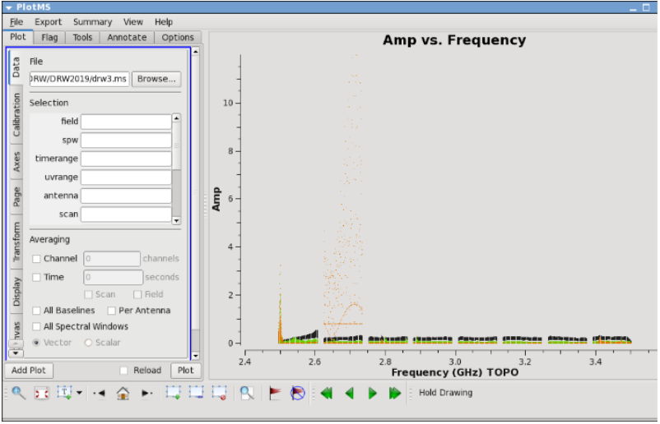
Frequency/spw dependent issues
Example: xaxis=‘frequency’, yaxis=‘amp’, coloraxis=‘field’

Slide 22
Editing (flagging or unflagging) data
Goal: introduce different flagging tasks and methods
flagdata: All purpose flagging based on selection and algorithms
In particular automated RFI flagging operations RFLAG and TFCROP
flagcmd: All purpose flagging based on commands
See earlier shadowing and pure zero visibility examples
plotms: interactive flagging using graphical user interface
Note that the VLA operator log has useful information but may not capture all (or too many) possible items to flag, e.g.
Antennas not participating in array may need manual flagging
“low amplitude”/”weak”: pointing/baseband error or recoverable?

Slide 23
Editing (flagging or unflagging) data
Goal: understand flagging and flag-backups in CASA
Each visibility is either used (not flagged) or flagged (ignored)
A flag-column contains a False (default) or True bit for each visibility
“Applying flagging” converts this bit to True, regardless the state it was in before; there is no record keeping of the original value
“Unflagging” resets this bit to False, with no knowledge of the original value – if it was previously flagged this will be undone too!
Most flagging tasks – but not plotms! - allow to save a copy of the previous state, before applying new flags, in a flag-backup file
flagmanager restores/creates a/the previous/current flagging state
When planning to flag with plotms, maybe make a flag-backup first?
Sequential flag-backup files restore to sequential stages in process

Slide 24
Using flagdata
Different modes and options to use in flagdata
manual – flag based on specific selection of parameters (default)
list – apply a list of flagging commands in a file or list of files/string
clip/quack – clip on amplitude or (scan)time range values
shadow/elevation – flag on antenna geometry
tfcrop – algorithmic removal of outliers in time-frequency plane
rflag – algorithmic removal of outliers with respect to local RMS
extend/antint – expand flags along different axis (time, freq, ants, ..)
summary – list what is flagged
unflag – reset flag-column bits to False (but be aware and careful!)

Slide 25
Using flagcmd
Different modes and options to use in flagcmd
Table – flag items in the FLAG_CMD table (default)
List - apply a list of flagging commands in a file
Xml – apply on-line flags as listed in the Flag.xml file of the MS
flagcmd can make a plot of flags but lacks runtime displays
Both flagcmd and flagdata allow saving to FLAG_CMD file
Both flagcmd and flagdata have unflag/unapply operations
Both flagcmd and flagdata also operate on calibration tables

Slide 26
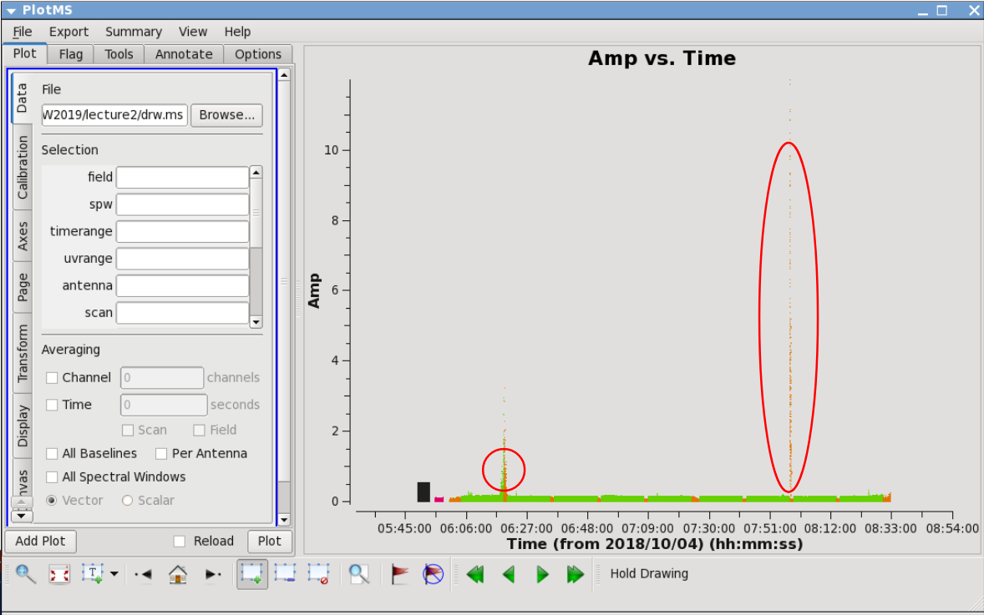
Example plotms editing
Goal: look for outliers, here amplitude versus time
Two obvious times where probably “something is going on”

Slide 27
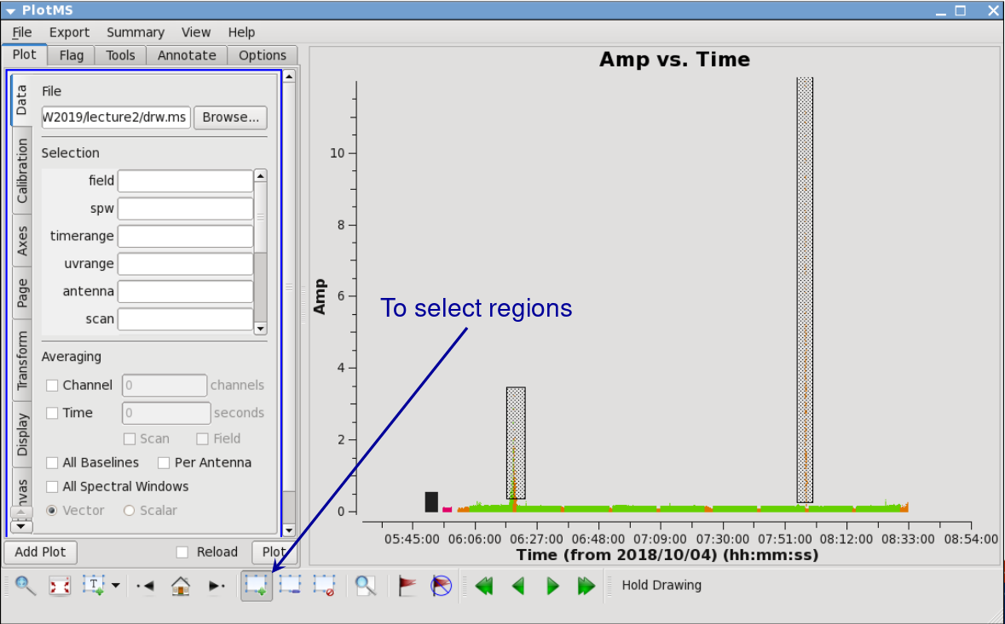
Example plotms editing
Goal: select outliers with select tool icon
Use mouse to draw; selections show up as shaded regions

Slide 28
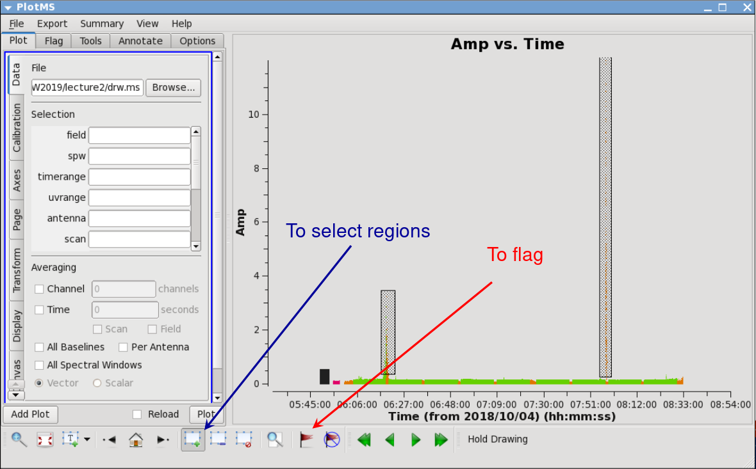
Example plotms editing
Goal: remove outliers with flag tool icon (but wait..!)
Flag tool may miss low-level bad data – it only flags in the regions

Slide 29
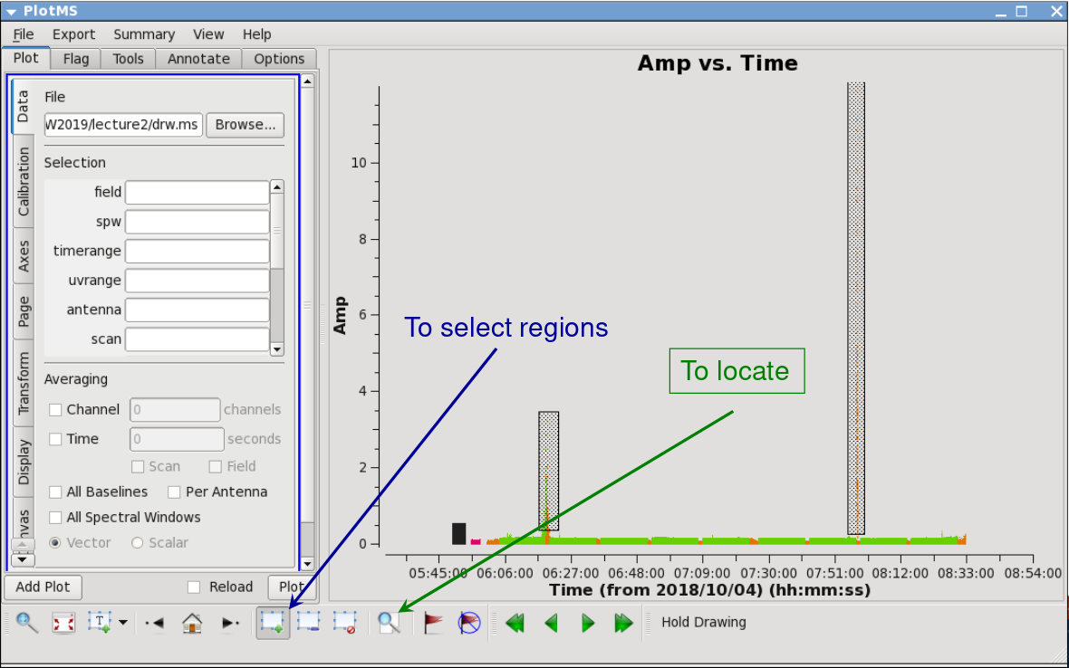
Example plotms editing
Goal: list outliers with locate tool icon
Locate will list visibilities in region in message log (can be many!)

Slide 30
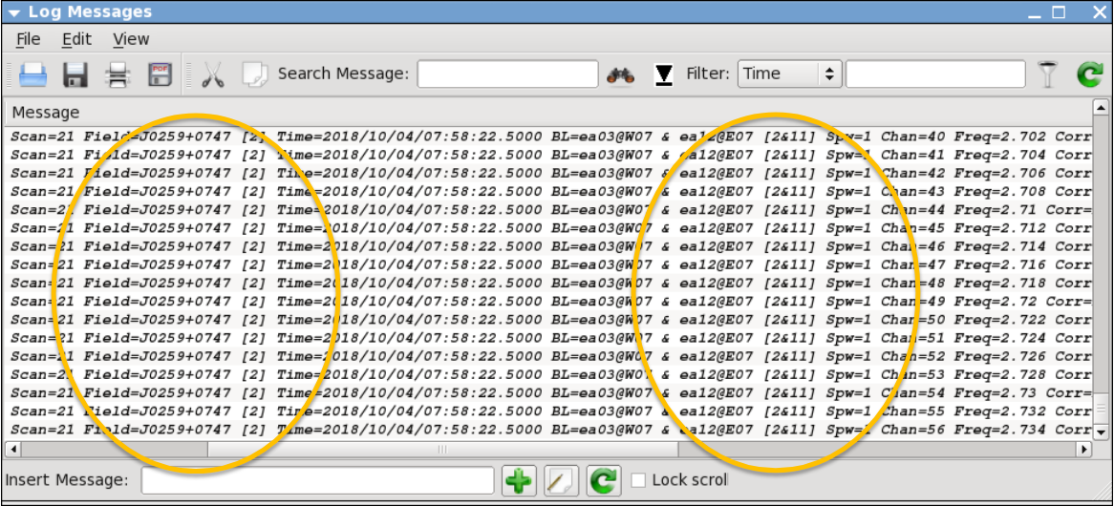
Example plotms editing
Goal: identify common identifying parameters with locate
all channels in spw 1, on baseline ea03-ea12 at 7h58m in scan 21

Slide 31
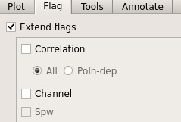
Important final notes
FYI:
Be careful when using plotms for editing data
Interactive unflag possibility may not properly unflag
No flag backup file (must use flagmanager)
Editing data with plotms perhaps may require extending the flags using the Flag tab:
Probably best practice:
Use the locate feature and message log window in plotms to identify bad data
Flag the bad data using flagcmd or flagdata
Check that all bad data is gone (extended the flags?)
Repeat if necessary (new bad data may appear)

Slide 32
Finally!(?)
Summary of visibility data inspection achievements
Data structure is understood, reference antenna is picked
Calibrators (flux density, bandpass, gain) are identified
Bad antennas and other instrumental flaws are flagged
RFI is removed (as much as possible); Hanning smooth?
Residual bad individual visibilities are flagged (at least on calibrators – bad target data can be flagged before imaging)
Maybe inspect (some parts) of the data again to make sure
More flagging may need to be done during/after calibration steps
Ready to start with data calibration (next lecture)

