Slide 1
Polarization Calibration
Frank Schinzel (NRAO)

Slide 2
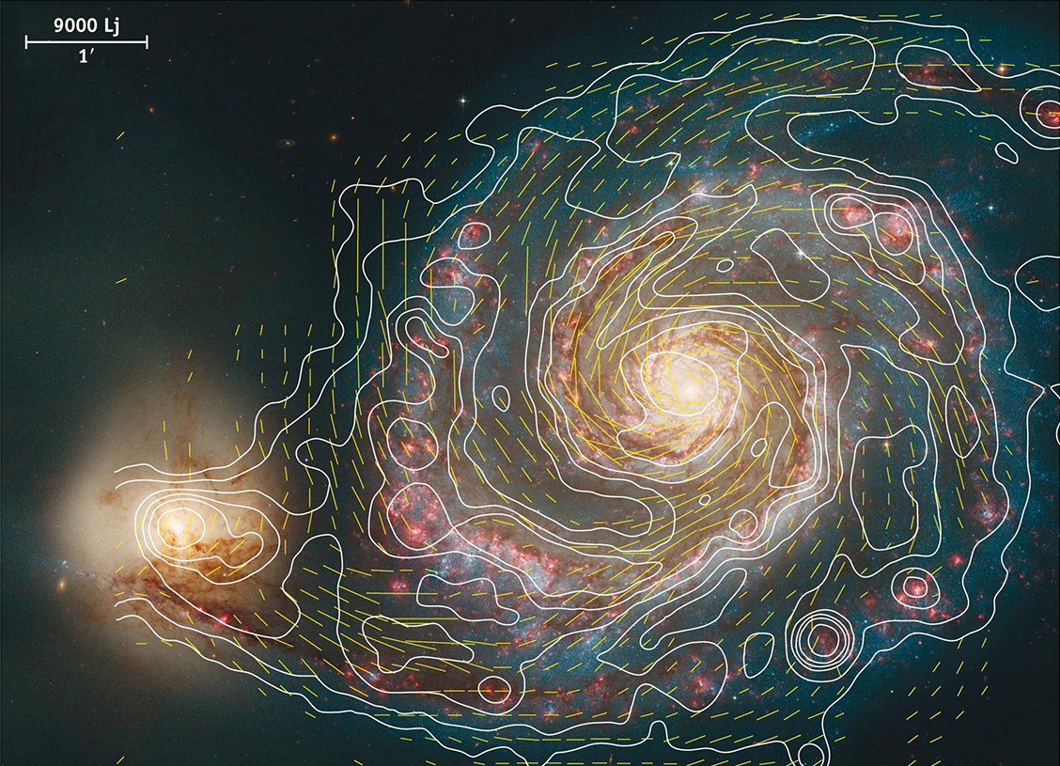
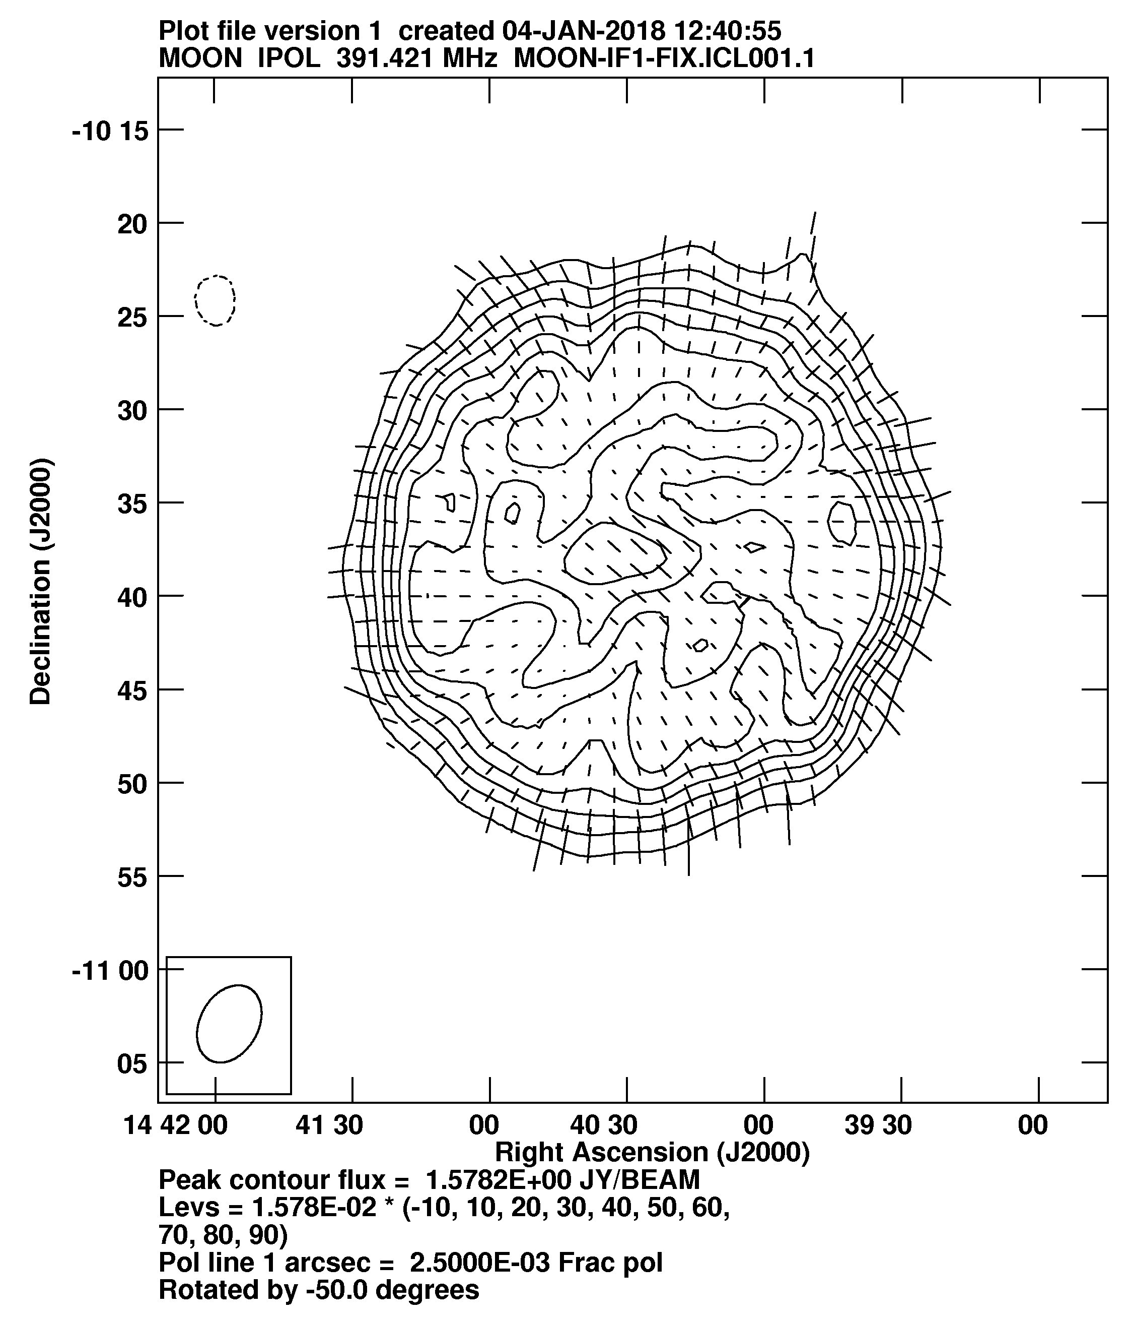
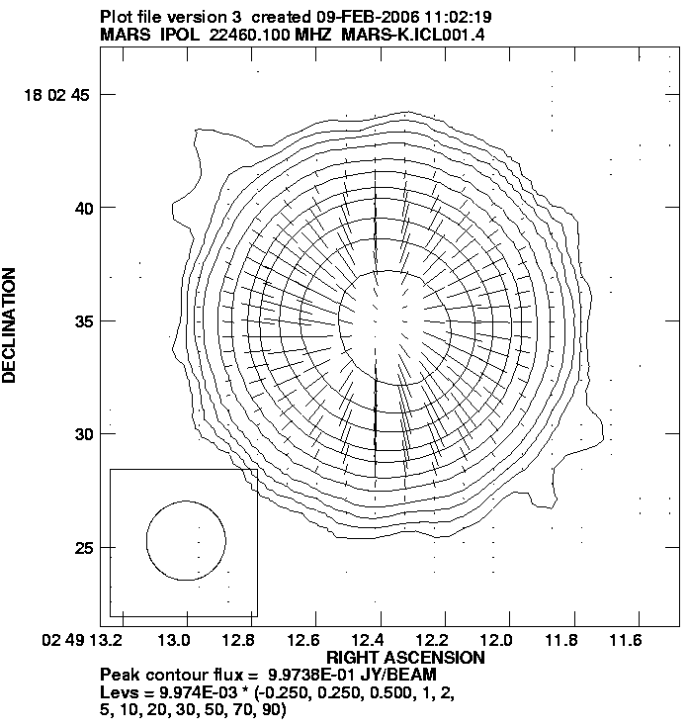
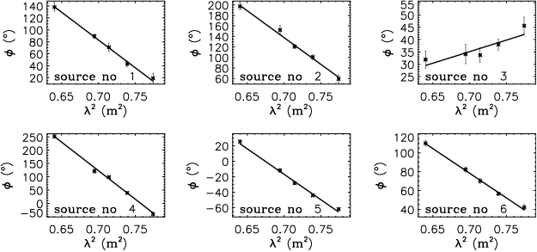
Polarized Radio Emission – Why do we care?
Synchrotron Emission
Zeeman Splitting
M51
Fletcher, Beck,
& Hubble Heritage Team
Moon @ P-band
Mars @ K-band
Haverkorn, Katgert, & de Bruyn 2003

Slide 3
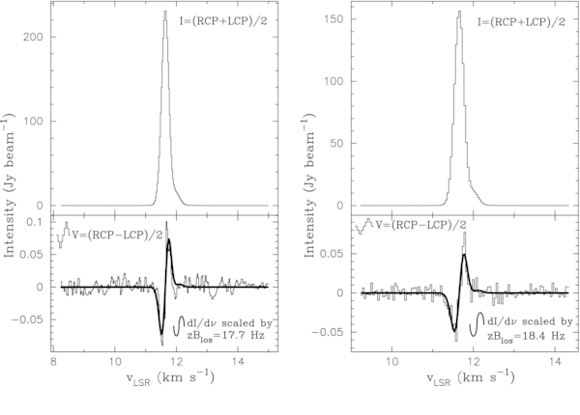
Polarized Radio Emission – Why do we care?
Synchrotron Emission
Zeeman Splitting
M51
Fletcher, Beck,
& Hubble Heritage Team
Momjian & Sarma (2012)
Moon @ P-band
Mars @ K-band
Haverkorn, Katgert, & de Bruyn 2003

Slide 4
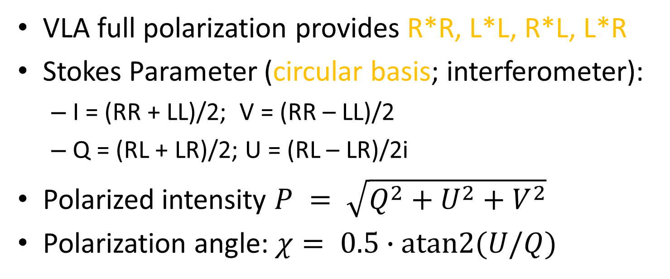
Polarization Basics
on-axis linear polarization (VLA 1 – 50 GHz)
VLA full polarization provides R*R, L*L, R*L, L*R
Stokes Parameter (circular basis; interferometer):
  I = (RR + LL)/2; V = (RR – LL)/2
  Q = (RL + LR)/2; U = (RL – LR)/2i
Polarized intensity $P = \sqrt{Q^{2}+U^{2}+V^{2}}$
Polarization angle: $χ= 0.5∙atan2(U/Q)$
Note: The following does not apply to <1 GHz VLA observations with linear feeds

Slide 5
Linear Polarization Observation Preparation
general recipe for circular basis
Two additional calibrators are needed:
  Leakage Calibrator (D-terms):
  Determine frequency dependent polarization impurity between the R and L polarizations (per-channel S/N >10).
  Absolute Polarization Angle Calibrator:
  Determine the R-L phase/delay offsets.
Your flux density/bandpass calibrator and complex gain calibrator can double as polarization calibrators. Requiring no additional overheads in this case.

Slide 6
Linear Polarization Observation Preparation
general recipe for circular basis
Different observing strategies for leakages:
  Unpolarized Leakage Calibrator: Df
  (one scan sufficient)
  Polarized/or Unknown polarization Leakage Calibrator: Df+QU
  (at least 3 scans; >60 deg. parallactic angle coverage)
  Known polarization Leakage Calibrator: Df+X
  (at least 2 scans; >30 deg. parallactic angle coverage; known polarized model)
  Note: In case of strategy 2: If the leakage calibrator has significant frequency dependent polarization properties, i.e. large rotation measure, the derived
  D-terms will be less accurate. CASA currently does not support Df+QUf.
For Polarization Angle Calibrator, a single scan on a bright source with known polarization properties is sufficient (Typically 3C48, 3C138, or 3C286).

Slide 7
Polarization Calibration
on-axis linear polarization (VLA 1 – 50 GHz)
Parallel Hand Calibration for Stokes I discussed
in presentation on standard calibration.
For Cross-hand calibration we need three fundamental steps and one step to prepare:
  0. Preparation
  Correct for any signal delay offset between the R and L circular pol.
  Correct for leakage of signal between the R & L circular pol. signals; i.e. instrumental leakage
  Align the phases of the RL visibilities to obtain information on the orientation of the measured linear polarization angle.
  Apply calibration tables & inspect results

Slide 8
Some words about the VLA pipeline
VLA calibration pipeline currently does not support polarimetry (except for VLASS)
Can use parallel hand calibration of pipeline in two ways to follow the steps discussed in this presentation:
  Carry all calibration tables generated and used in the final applycal step to continue polarization calibration.
  Revert application of parallactic angle correction, then apply calibration from pipeline and split out the corrected column.
VLA pipeline discussed later today, here we focus on the polarization calibration steps that are universal.

Slide 9
Step 0: Preparation

Slide 10
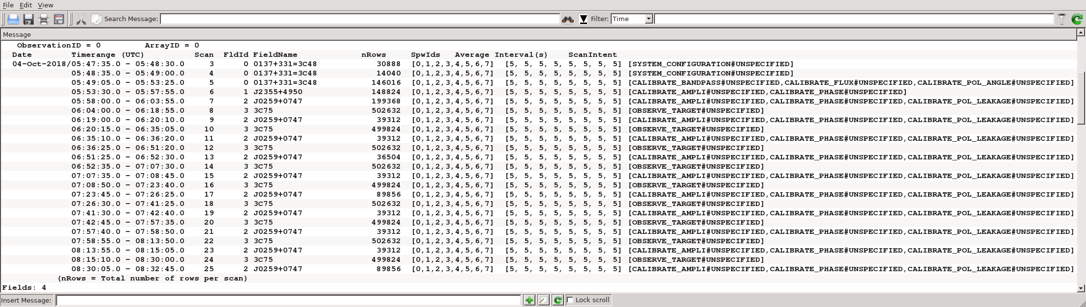
Example dataset: 3C 75 (observed Oct. 2018)
Frequency setup: 8x128 MHz spectral windows, 2.488 – 3.512 GHz
Target: 3C 75 (intent = OBSERVE_TARGET)
Bandpass/Flux Density Calibrator: 3C 48 (1 scan)
Instrumental polarization calibrator (D-term): J0259+0747
Guess why we also observed J2355+4950?
(marked as phase calibrator)

Slide 11
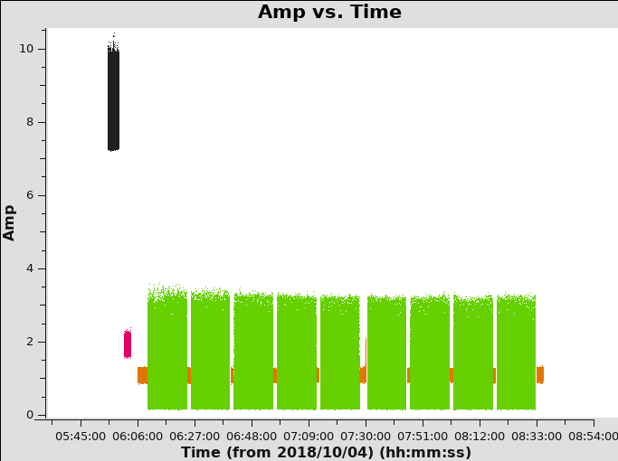
Inspect dataset
3C48 (Flux Density/Bandpass/Pol. Angle Calibrator)
3C75
J0259+0747
J2355+4950

Slide 12
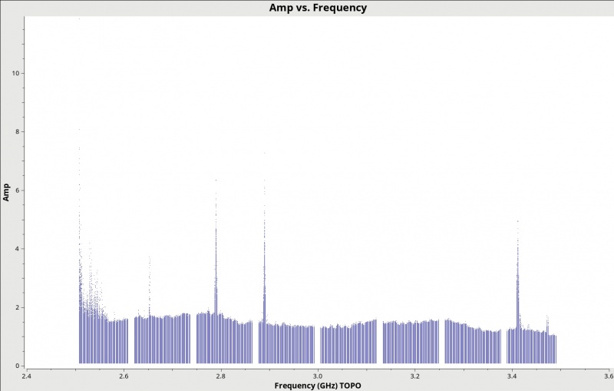
RL/LR Amplitudes – residual RFI

Slide 13
Additional flagging of RL/LR
# for all correlations
flagdata(vis='TDRW0001_calibrated.ms',
mode='tfcrop',
field='0~2',
correlation='',
freqfit = 'line',
extendflags = False,
flagbackup = False)
# for the cross-hands
flagdata(vis='TDRW0001_calibrated.ms',
mode = 'rflag',
datacolumn='data',
field = '0~2',
correlation='RL,LR',
extendflags = True,
flagbackup = False)

Slide 14
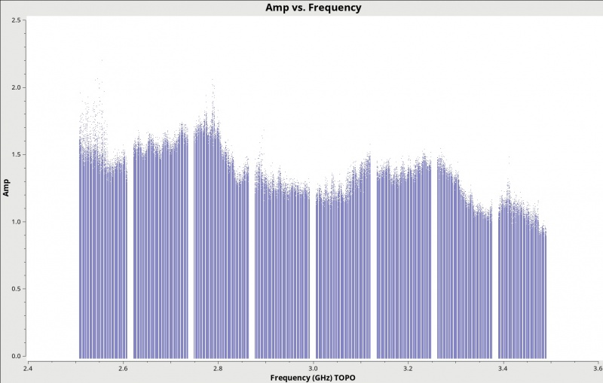
RL/LR Amplitudes – after flagging

Slide 15
Linear polarization angle calibrator models
You can find broad-band polarimetric information on 3C48, 3C138, 3C147, and 3C286 in Perley & Butler (2013)
Note, 3C48, 3C138, and 3C147 are variable. Updated values from 2019 available on VLA webpages:
  https://science.nrao.edu/facilities/vla/docs/manuals/oss/performance/fdscale
  https://science.nrao.edu/facilities/vla/docs/manuals/obsguide/modes/pol
  http://www.aoc.nrao.edu/~fschinze/DRW21/ (for 3C48)
Additional calibrators monitored through projects TPOL0003 & TCAL0009, currently you have to reduce this data yourself if needed or submit a
helpdesk ticket to request more information.
We are working toward providing time and frequency dependent models
in the future.

Slide 16
CASA task setjy (https://casadocs.readthedocs.io/en/stable/api/tt/casatasks.imaging.setjy.html)
Note: setjy in manual w/o model assumes all emission is from a point source at the phase center! No spatial models are provided within CASA or by NRAO for polarimetry.
standard = 'manual' # Flux density standard
fluxdensity = [1, 0, 0, 0] # Specified flux density in Jy [I,Q,U,V]
spix = [] # Spectral index (including higher terms) of I fluxdensity
reffreq = '' # Reference frequency for spix
polindex = [] # Coeff. of an expansion of freq.-dependent linear pol. fraction
polangle = [] # Coeff. of an expansion of freq.-dependent pol. angle (in radians)
rotmeas = 0.0 # Rotation measure (in rad/m^2)
$$S(ν)=fluxdensity[0]∗{\frac{ν}{reffreq}}^{spix[0]+spix[1]∗log(ν/reffreq)+..}$$
$$PI=\frac{\sqrt{Q^{2}+U^{2}}}{I}=p0+p1∗\frac{ν−reffreq}{reffreq}+p2∗(\frac{ν−reffreq}{reffreq})^{2}+...$$
$$χ=0.5arctan\frac{U}{Q}=a0+a1∗\frac{ν−reffreq}{reffreq}+a2∗(\frac{ν−reffreq}{reffreq})^{2}+..$$

Slide 17
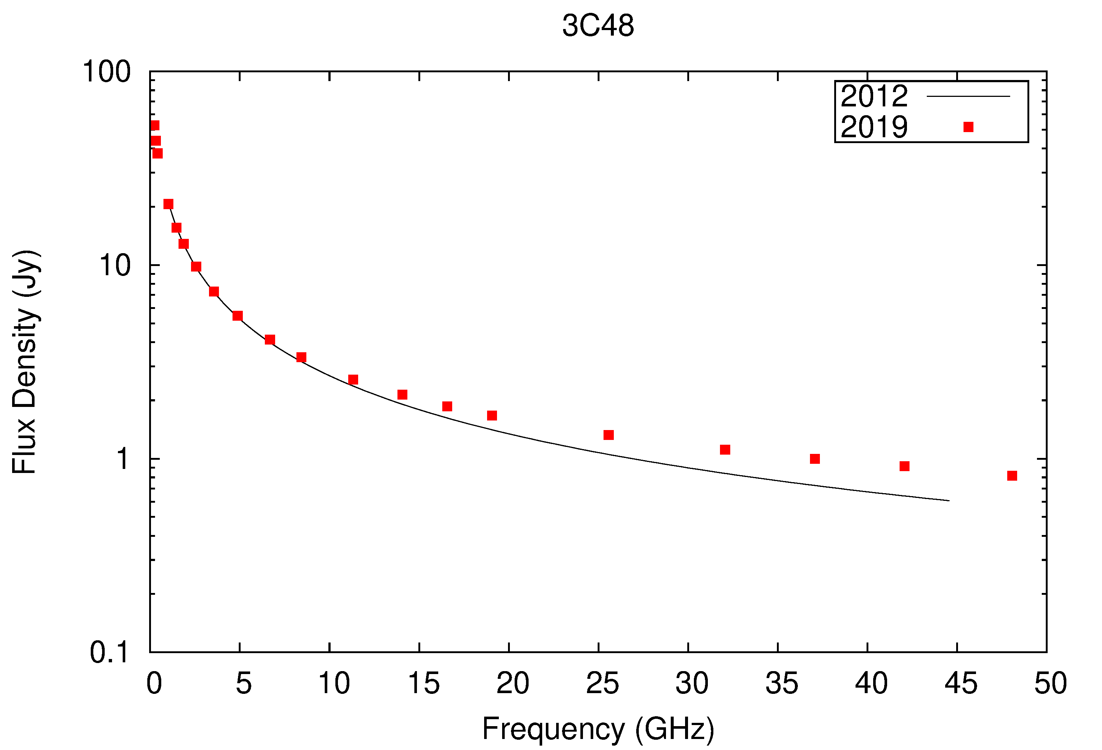
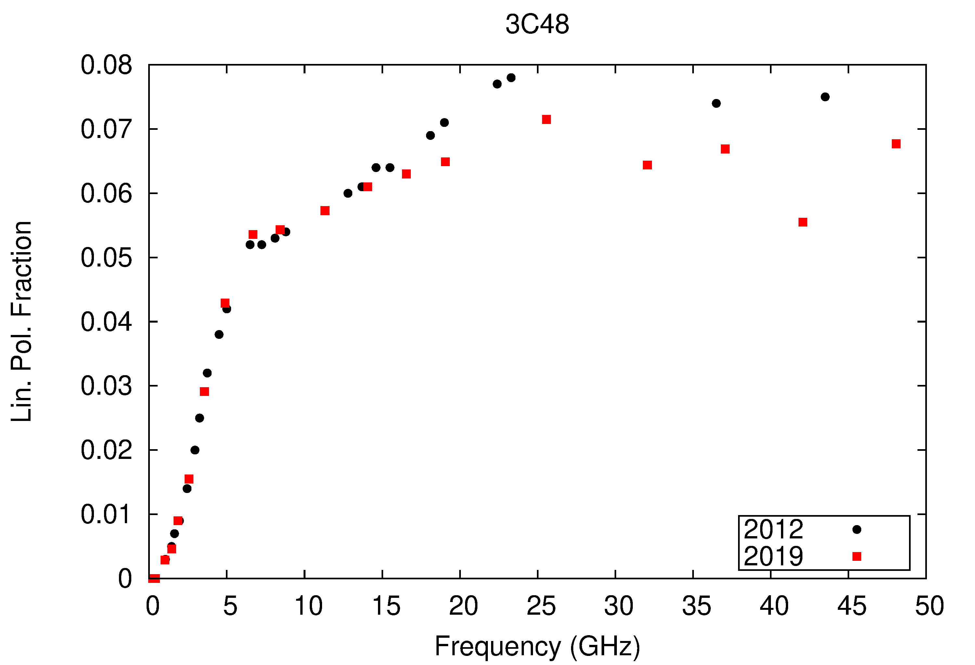
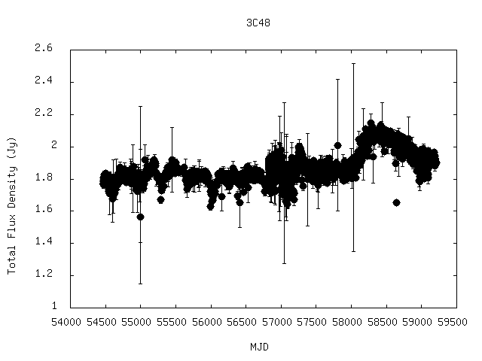
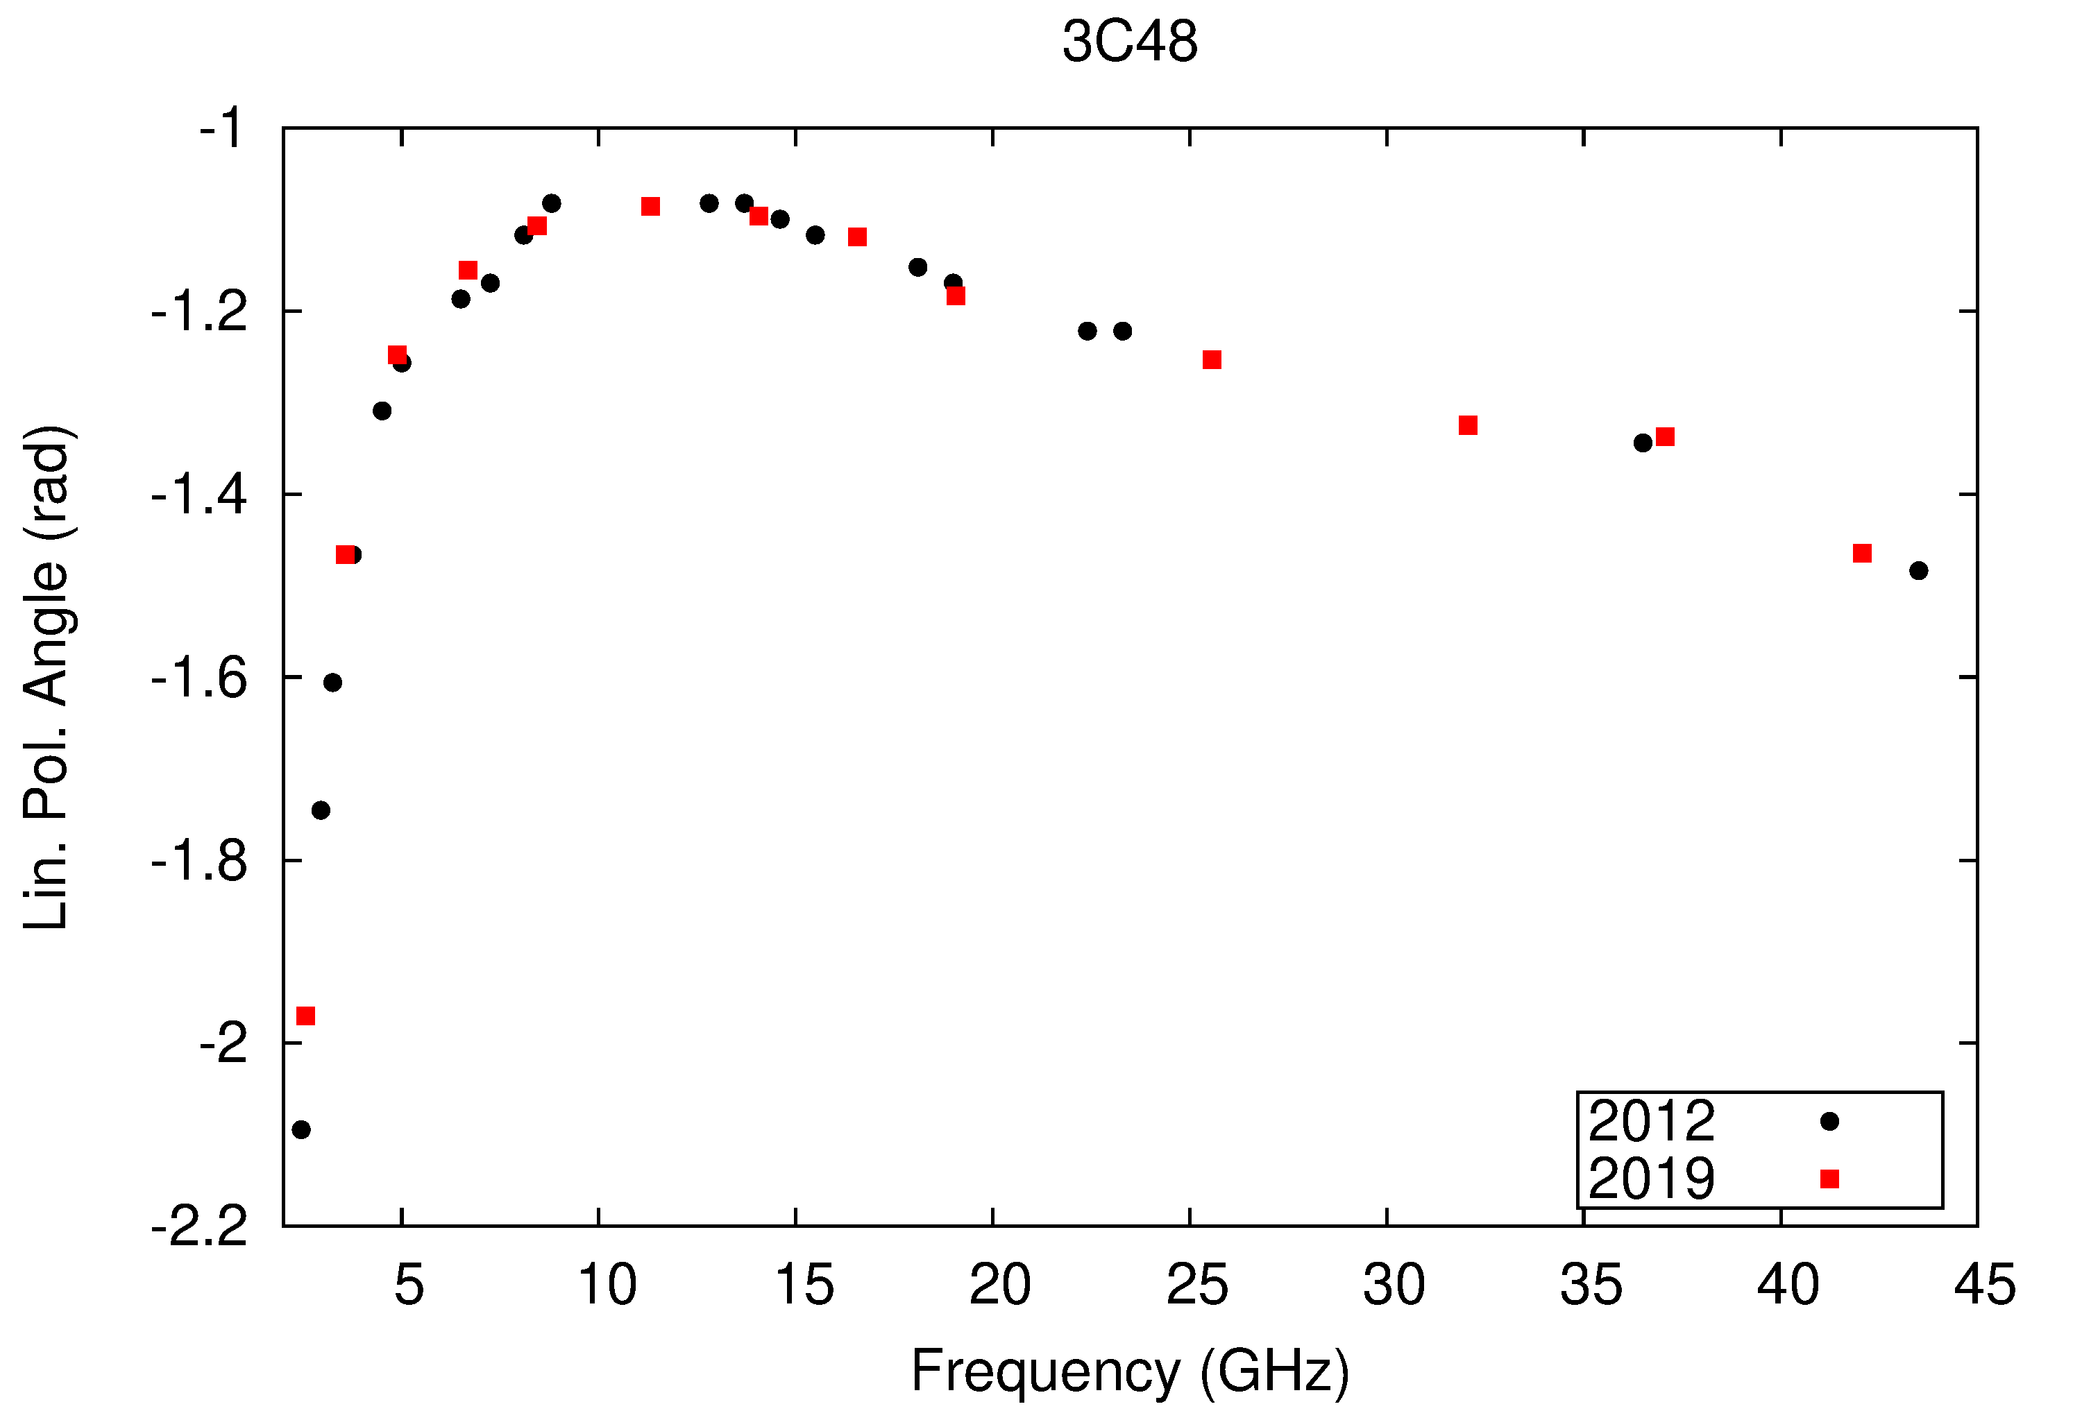
3C48: Lin. Pol. Angle Calibrator
OVRO 15 GHz (single-dish)
Kiehlmann et al.

Slide 18
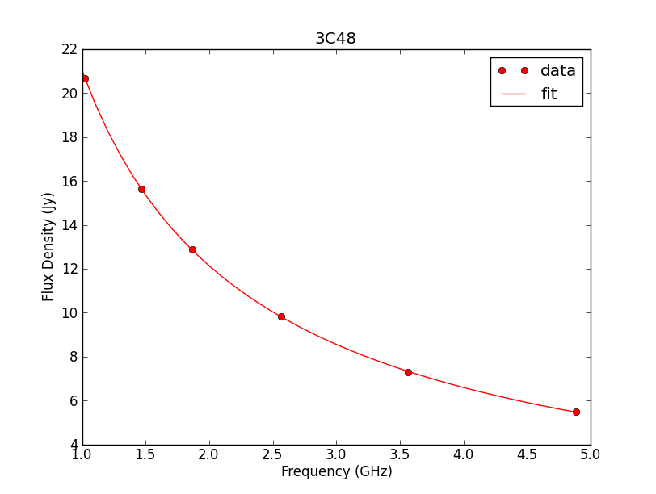
CASA task setjy (https://casadocs.readthedocs.io/en/stable/api/tt/casatasks.imaging.setjy.html#description)
Common question: determining the coefficients for 3C48 at S-band – Spix
http://www.aoc.nrao.edu/~fschinze/DRW/fit_I.py
We use known values of 3C48 to fit Stokes I and spectral index & curvature.
I@3GHz = 8.5555 Jy
spix = [-0.88640,
-0.14323]
Text files for different calibrators
(3C48, 3C138, 3C147, 3C196, 3C295)

Slide 19
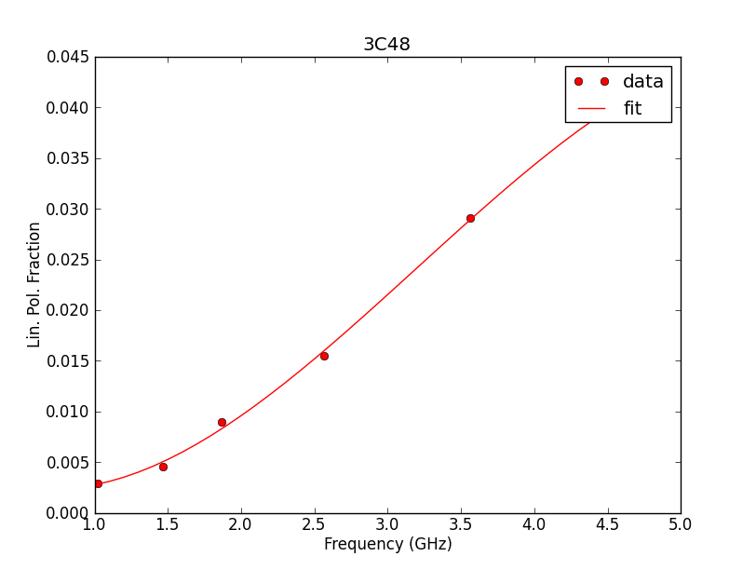
CASA task setjy (https://casadocs.readthedocs.io/en/stable/api/tt/casatasks.imaging.setjy.html)
Common question: determining the coefficients for 3C48 at S-band – polindex
http://www.aoc.nrao.edu/~fschinze/DRW21/fit_PF.py
We use known values of 3C48 to fit linear polarization fraction.
polindex = [0.02152579,
0.03924469,
0.00382036,
-0.0192665]
Notes:
Need to provide updated fit_PF.py script.

Slide 20
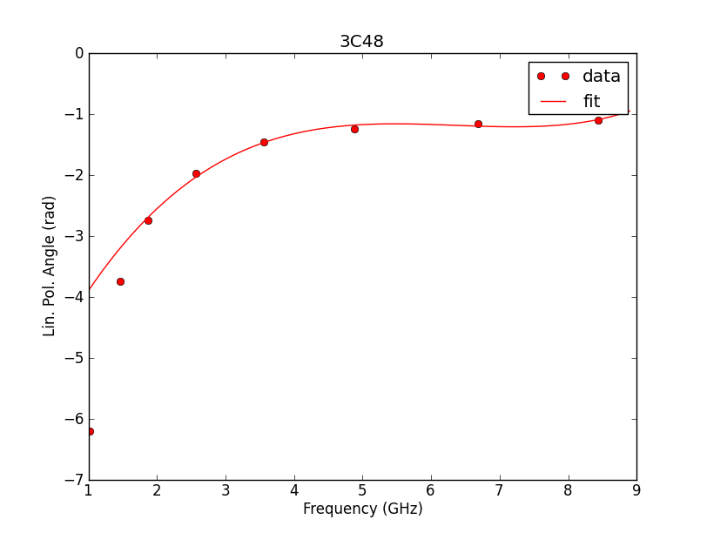
CASA task setjy (https://casadocs.readthedocs.io/en/stable/api/tt/casatasks.imaging.setjy.html)
Common question: determining the coefficients for 3C48 at S-band – polangle
http://www.aoc.nrao.edu/~fschinze/DRW/fit_PA.py
We use known values of 3C48 to fit linear polarization angle in radians.
polangle = [-2.74383385,
1.77521589,
-1.76969593,
0.60267279,
0.96191507]
Notes:
Need to provide updated fit_PA.py script.

Slide 21
Putting it all together in a setjy() call
%cpaste
reffreq = '3.0 GHz' # reference frequency for fit values
I = 8.5555 # Stokes I flux density @ reference frequency
alpha = [-0.8864, -0.14323] # spectral index and curvature
polindex = [0.02152579, 0.03924469, 0.00382036, -0.0192665] # polarization fraction
polangle = [-2.74383385, 1.77521589, -1.76969593, 0.60267279, 0.96191507] # pol. angle
mysetjy = setjy(vis = 'TDRW0001_calibrated.ms',
field='0137+331=3C48',
scalebychan=True,
standard='manual',
fluxdensity=[I,0,0,0],
spix=alpha,
reffreq=reffreq,
polindex=polindex,
polangle=polangle,
rotmeas=0,
usescratch=True)

Slide 22
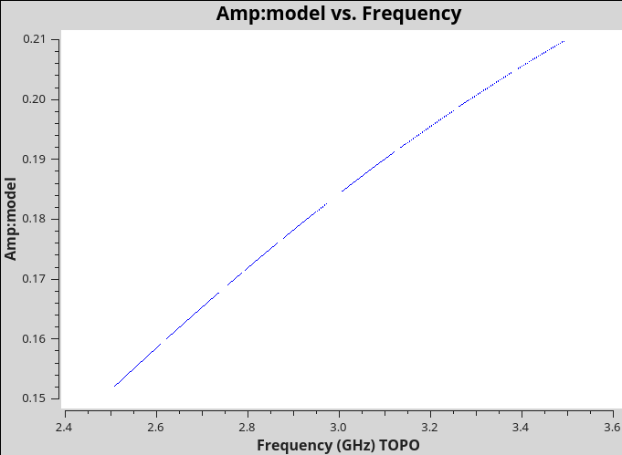
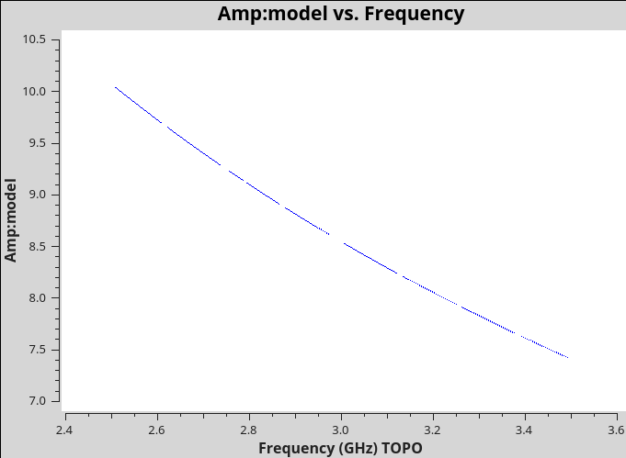
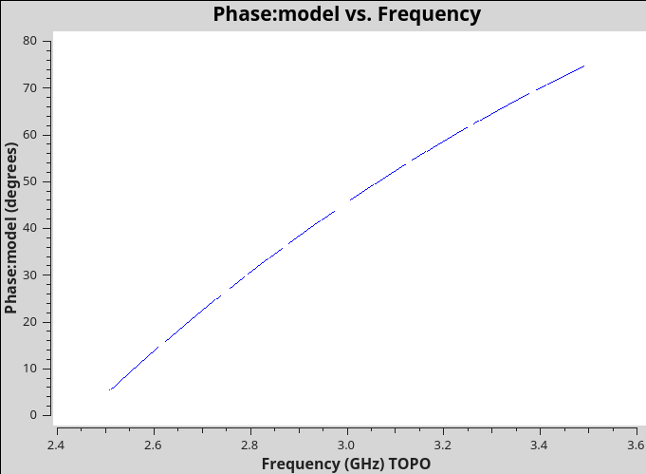
Check the model was set correctly
RL amplitude
RR amplitude
RL phase

Slide 23
Step 1: Determine R-L delay

Slide 24
Solving for the cross-hand delays
# solve using Single Band Delay
kcross_sbd = 'TDRW0001_calibrated.Kcross_sbd'
gaincal(vis='TDRW0001_calibrated.ms',
caltable=kcross_sbd,
field='0137+331=3C48',
spw='0~7:5~58', # ignore edge channels
refant='ea10', # same reference antenna used from parallel hand calibration
gaintype='KCROSS',
solint='inf',
combine='scan',
calmode='ap',
append=False,
gaintable=[''],
gainfield=[''],
interp=[''],
spwmap=[[]],
parang=True)

Slide 25
Solving for the cross-hand delays
Output printed in the logger
For single band delay there are 8 solutions:
Spw=0 Global cross-hand delay=5.71477 nsec
Spw=1 Global cross-hand delay=1.51269 nsec
Spw=2 Global cross-hand delay=-1.36895 nsec
Spw=3 Global cross-hand delay=0.468607 nsec
Spw=4 Global cross-hand delay=4.29537 nsec
Spw=5 Global cross-hand delay=1.23363 nsec
Spw=6 Global cross-hand delay=3.72454 nsec
Spw=7 Global cross-hand delay=3.04475 nsec

Slide 26
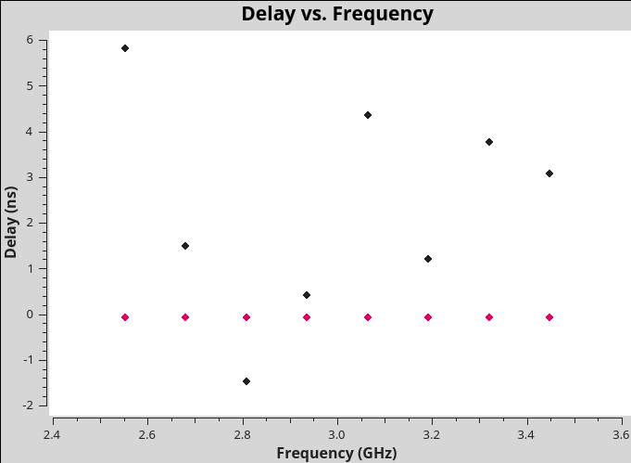
Solving for the cross-hand delays
visualize resulting delays

Slide 27
Solving for the cross-hand delays
# solve using Multi-Band Delay
%cpaste
kcross_mbd = 'TDRW0001_calibrated.Kcross_mbd'
gaincal(vis='TDRW0001_calibrated.ms',
caltable=kcross_mbd,
field='0137+331=3C48',
spw='0~7:5~58', # ignore edge channels; spw of a single baseband 1 GHz
refant='ea10', # same reference antenna used from parallel hand calibration
gaintype='KCROSS',
solint='inf',
combine='scan,spw', # combine spectral windows
calmode='ap',
append=False,
gaintable=[''],
gainfield=[''],
interp=[''],
spwmap=[[]],
parang=True)

Slide 28
Solving for the cross-hand delays
Output printed in the logger
For single band delay there are 8 solutions:
Spw=0 Global cross-hand delay=5.71477 nsec
Spw=1 Global cross-hand delay=1.51269 nsec
Spw=2 Global cross-hand delay=-1.36895 nsec
Spw=3 Global cross-hand delay=0.468607 nsec
Spw=4 Global cross-hand delay=4.29537 nsec
Spw=5 Global cross-hand delay=1.23363 nsec
Spw=6 Global cross-hand delay=3.72454 nsec
Spw=7 Global cross-hand delay=3.04475 nsec
mean: 2.33 nsec; median: 2.28 nsec
For multiband delay there is one solution:
Multi-band cross-hand delay=3.68198 nsec

Slide 29
Step 2: Determine Polarization
Leakage b/w R & L

Slide 30
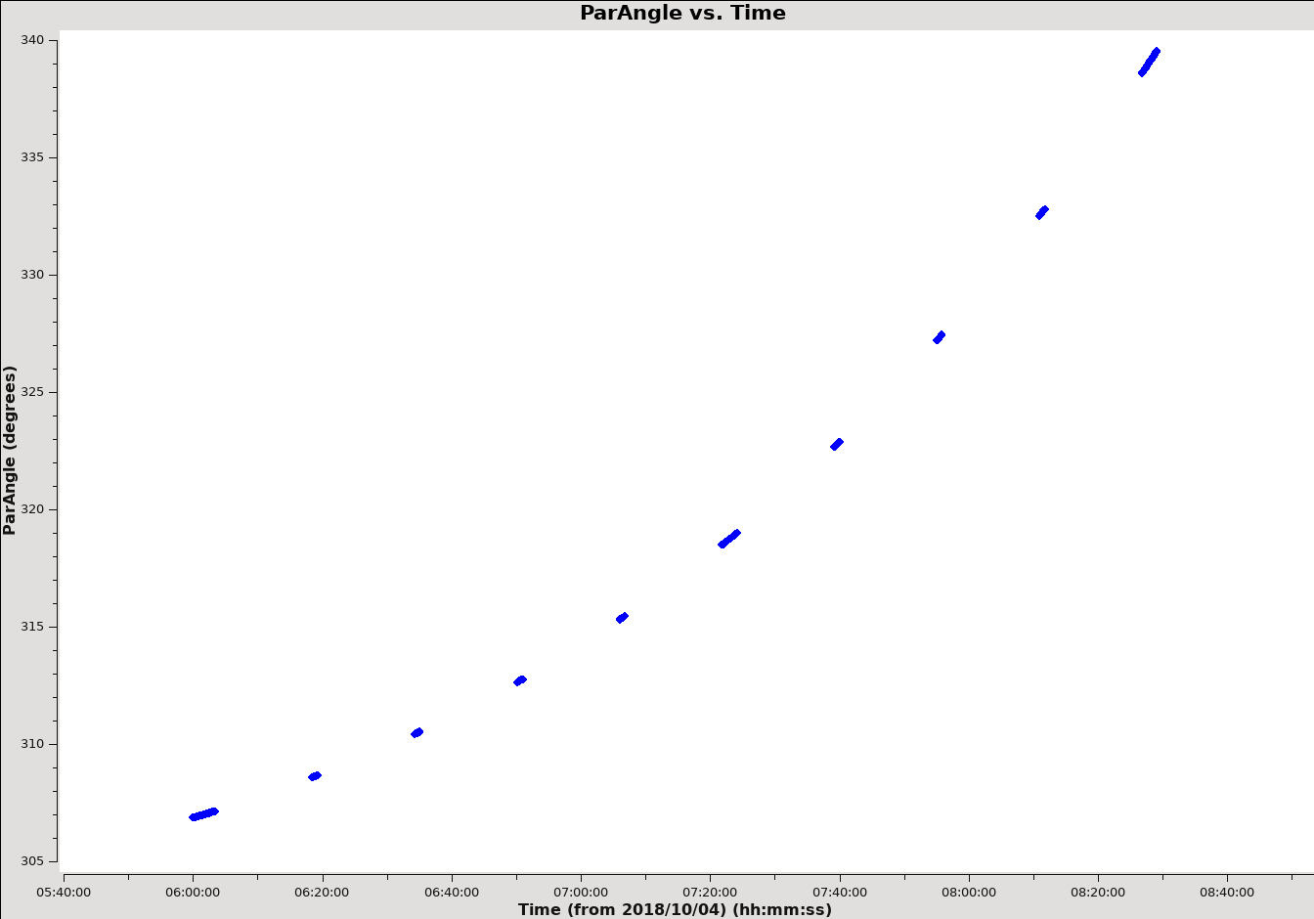
Solving for instrumental polarization
J0259+0747
~33 degrees parallactic angle coverage
10 scans/slices; Flux density ~0.9 Jy
Hales (2017)
1 min scan ~ 900 S/N ~ 1% on-axis spurious
will check using J2355+7828

Slide 31
Solving for instrumental polarization
J0259+0747 / Df+QU – polarized
%cpaste
dtab_J0259 = 'TDRW0001_calibrated.DfQU'
polcal(vis='TDRW0001_calibrated.ms',
caltable=dtab_J0259,
intent='CALIBRATE_POL_LEAKAGE#UNSPECIFIED',
spw='0~7',
refant='ea10',
poltype='Df+QU',
solint='inf,2MHz',
combine='scan',
gaintable=[kcross_mbd], # Note, we are using the multi-band Kcross delay solutions.
gainfield=[''],
spwmap=[[0,0,0,0,0,0,0,0]],
append=False)

Slide 32
Solving for instrumental polarization
J0259+0747 / Df+QU – polarized
Check output in logger:
Fractional polarization solution for J0259+0747 (spw = 0): : Q = 0.0261594, U = 0.0334233
(P = 0.0424432, X = 25.9754 deg)
Fractional polarization solution for J0259+0747 (spw = 1): : Q = 0.0145776, U = 0.038399
(P = 0.041073, X = 34.6057 deg)
Fractional polarization solution for J0259+0747 (spw = 2): : Q = 0.016288, U = 0.0391953
(P = 0.042445, X = 33.7171 deg)
Fractional polarization solution for J0259+0747 (spw = 3): : Q = 0.0111993, U = 0.041723
(P = 0.0432, X = 37.4874 deg)
Fractional polarization solution for J0259+0747 (spw = 4): : Q = 0.00822594, U = 0.040461
(P = 0.0412887, X = 39.254 deg)
Fractional polarization solution for J0259+0747 (spw = 5): : Q = 0.00605818, U = 0.0410209
(P = 0.0414658, X = 40.7995 deg)
Fractional polarization solution for J0259+0747 (spw = 6): : Q = -0.00189636, U = 0.0432816
(P = 0.0433232, X = 46.2544 deg)
Fractional polarization solution for J0259+0747 (spw = 7): : Q = -0.00785128, U = 0.0475776
(P = 0.048221, X = 49.6853 deg)

Slide 33
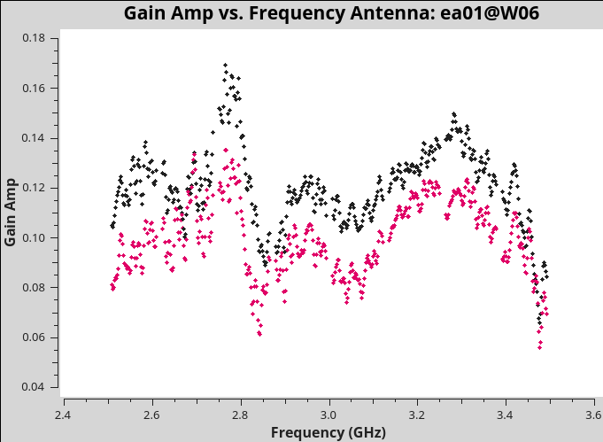
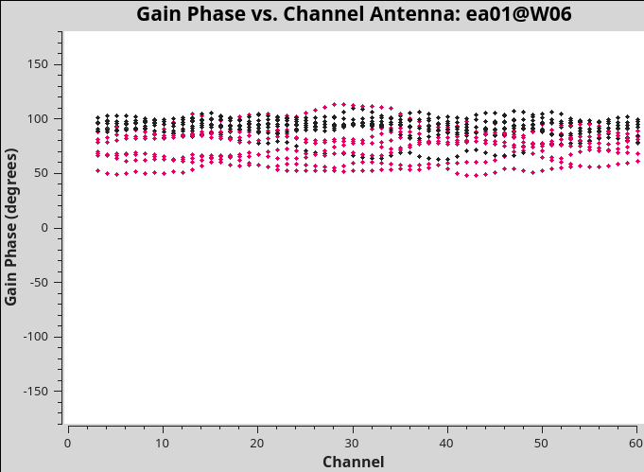
Solving for instrumental polarization
J0259+0747 / Df+QU – polarized – inspect results

Slide 34
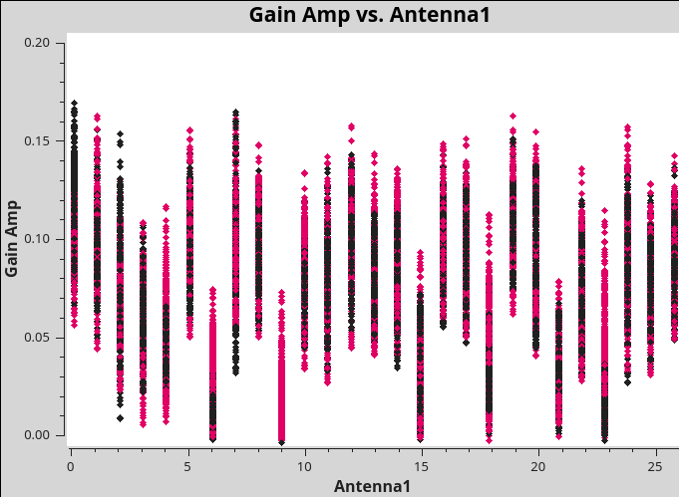
Solving for instrumental polarization
J0259+0747 / Df+QU – polarized – inspect results

Slide 35
Solving for instrumental polarization
J2355+4950 / Df - unpolarized
dtab_J2355 = 'TDRW0001_calibrated.Df'
polcal(vis='TDRW0001_calibrated.ms',
caltable=dtab_J2355,
field='J2355+4950',
spw='0~7',
refant='ea10',
poltype='Df',
solint='inf,2MHz',
combine='scan',
gaintable=[kcross_mbd],
gainfield=[''],
spwmap=[[0,0,0,0,0,0,0,0]],
append=False)

Slide 36
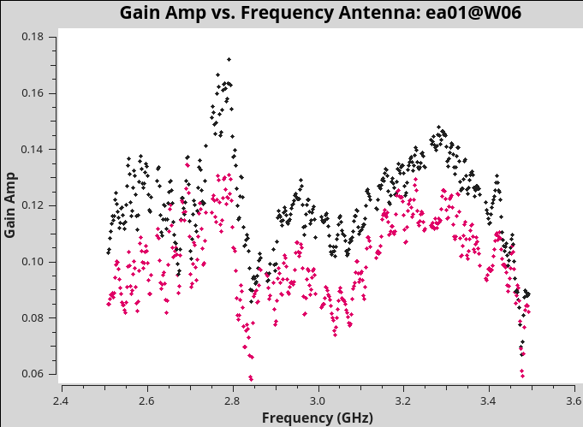
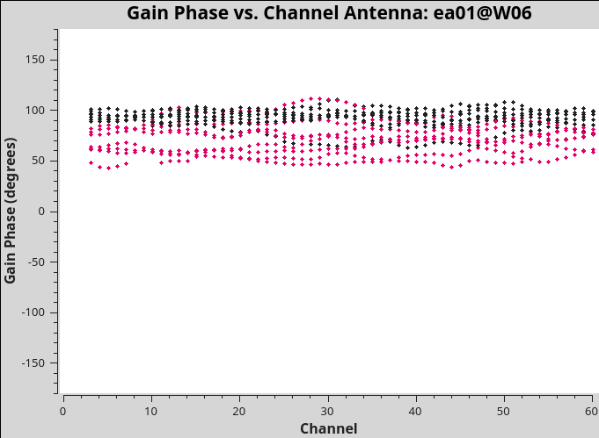
Solving for instrumental polarization
J2355+4950 / Df – unpolarized – inspect results

Slide 37
Solving for instrumental polarization
Comparison Df+QU / Df
Df+QU
Df

Slide 38
Flagging amplitude outliers in D-term solutions
In some cases there are outlier solutions above 0.25 that are most likely due to residual RFI. You can flag those using flagdata.
flagdata(vis=dtab_J2355,
mode='clip',
correlation='ABS_ALL',
clipminmax=[0.0, 0.25],
datacolumn='CPARAM',
clipoutside=True,
action='apply',
flagbackup=False,
savepars=False)
flagdata(vis=dtab_J0259, mode='clip', correlation='ABS_ALL', clipminmax=[0.0, 0.25],
datacolumn='CPARAM', clipoutside=True, action='apply', flagbackup=False,
savepars=False)
This clips everything above 25% instrumental polarization,
which is unexpected.

Slide 39
Step 3: Determine/Set R-L phase

Slide 40
Setting R-L phase
To obtain accurate polarization position angle we need to rotate the R-L phase. We have set a model for 3C 48 before, which we will use now.
xtab = 'TDRW0001_calibrated.Xf'
polcal(vis='TDRW0001_calibrated.ms',
caltable=xtab,
spw='0~7',
field='0137+331=3C48',
solint='inf,2MHz',
combine='scan',
poltype='Xf',
refant = 'ea10',
gaintable=[kcross_mbd,dtab_J0259],
gainfield=['',''],
spwmap=[[0,0,0,0,0,0,0,0],[]],
append=False)

Slide 41
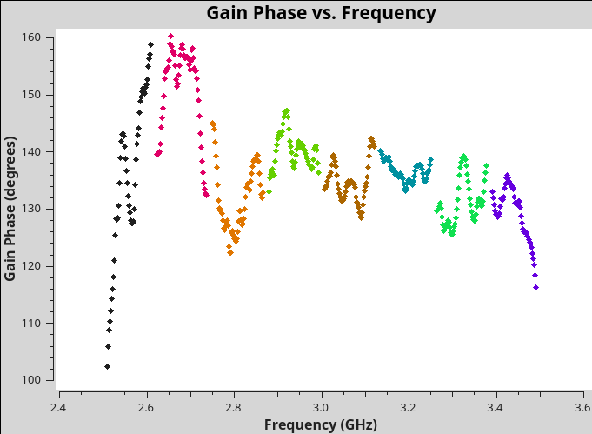
Setting R-L phase
Inspect results
Check output in logger:
Mean position angle offset solution for 0137+331=3C48 (spw = 0) = 67.7459 deg.
Mean position angle offset solution for 0137+331=3C48 (spw = 1) = 75.1599 deg.
Mean position angle offset solution for 0137+331=3C48 (spw = 2) = 65.9715 deg.
Mean position angle offset solution for 0137+331=3C48 (spw = 3) = 70.0648 deg.
Mean position angle offset solution for 0137+331=3C48 (spw = 4) = 67.361 deg.
Mean position angle offset solution for 0137+331=3C48 (spw = 5) = 68.2629 deg.
Mean position angle offset solution for 0137+331=3C48 (spw = 6) = 65.6135 deg.
Mean position angle offset solution for 0137+331=3C48 (spw = 7) = 64.6514 deg.
plotms(vis=xtab,
xaxis='frequency',
yaxis='phase',
coloraxis='spw')

Slide 42
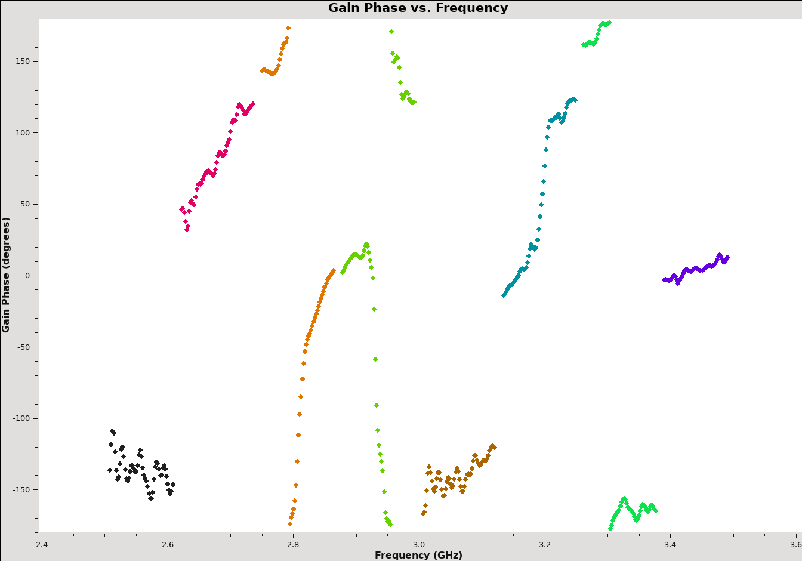
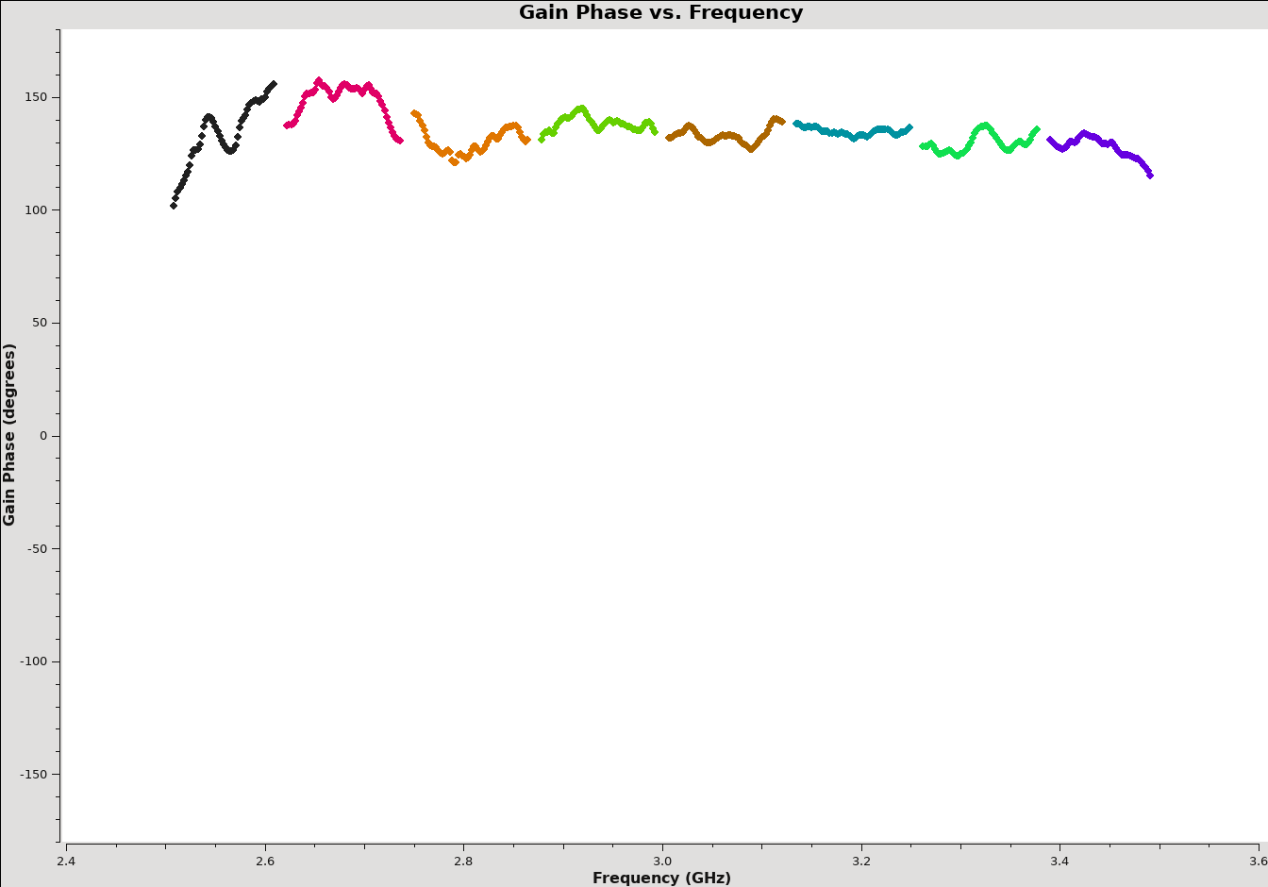
Setting R-L phase
  If we had used single band delays, the R-L phase solutions are independent for each spectral window, but should be flat if the R-L delay offset was set correctly.
single-band delay
multi-band delay

Slide 43
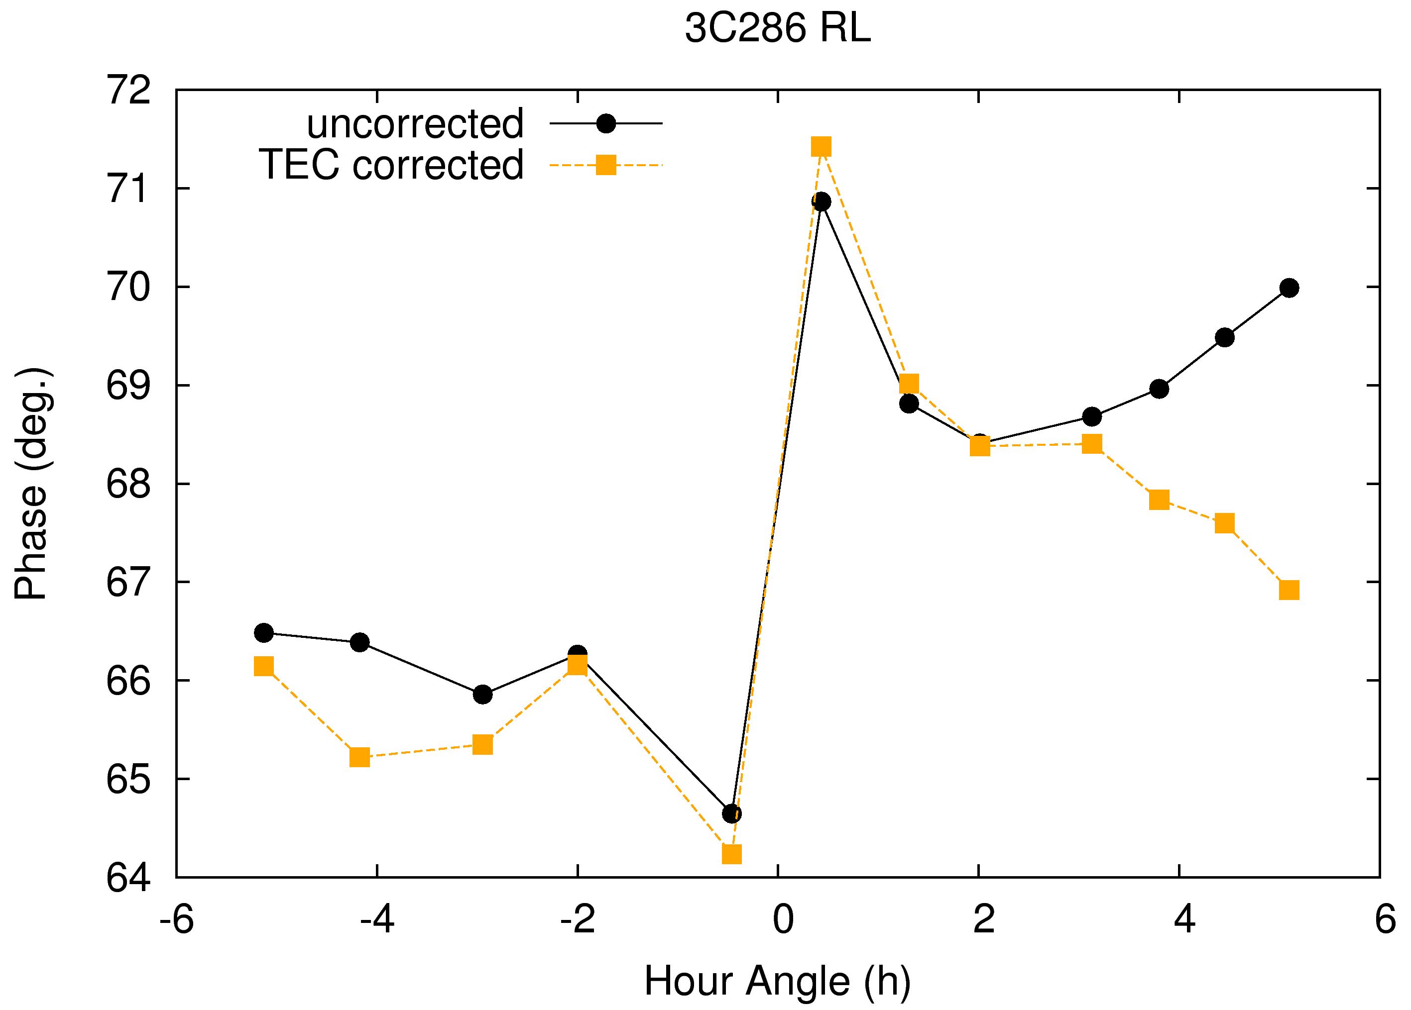
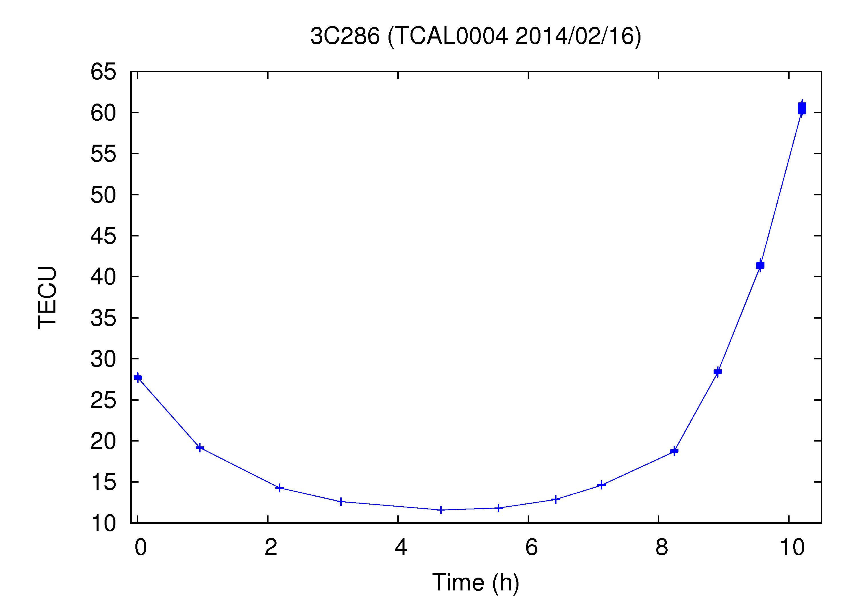
VLA RL phase stability
Ionosphere – typically a few degrees at 3GHz
Large dTEC leads to
Faraday rotation.

Slide 44
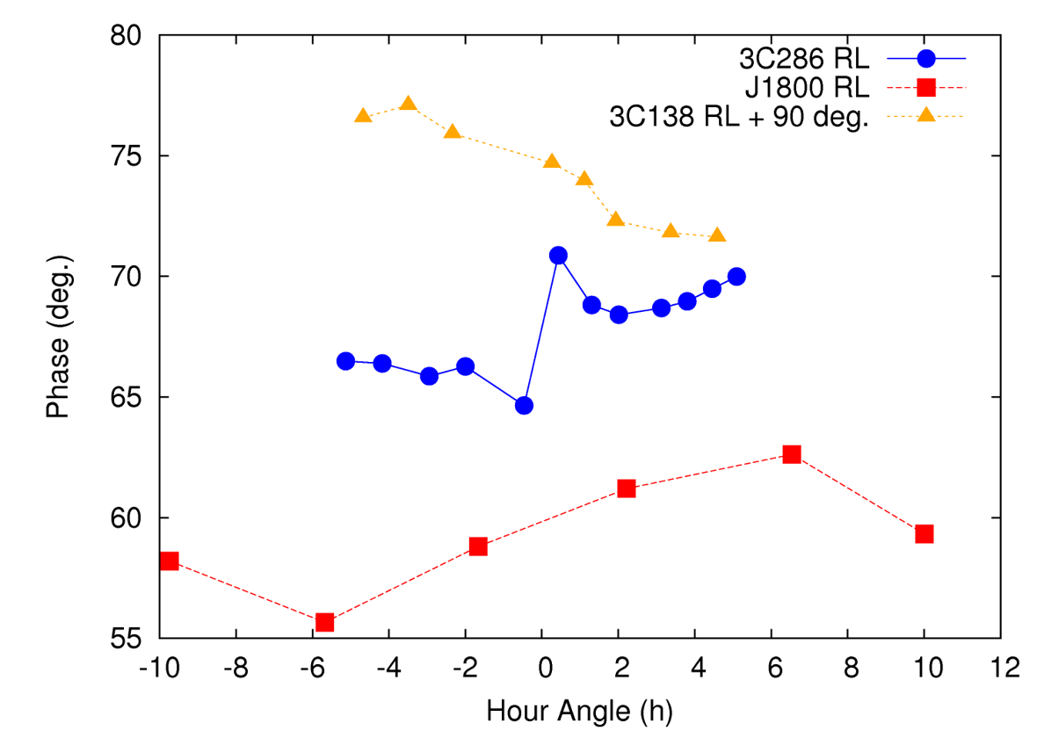
VLA RL phase stability
Instrumental – limit to ~5 deg. absolute accuracy

Slide 45
Step 4: Apply Calibration & Inspect

Slide 46
Finally let’s apply the calibration
applycal(vis = 'TDRW0001_calibrated.ms',
field='',
gainfield=['', '', ''],
flagbackup=True,
interp=['', '', ''],
gaintable=[kcross_mbd,dtab_J0259,xtab],
spw='0~7',
calwt=[False, False, False],
applymode='calflagstrict',
antenna='*&*',
spwmap=[[0,0,0,0,0,0,0,0],[],[]],
parang=True)

Slide 47
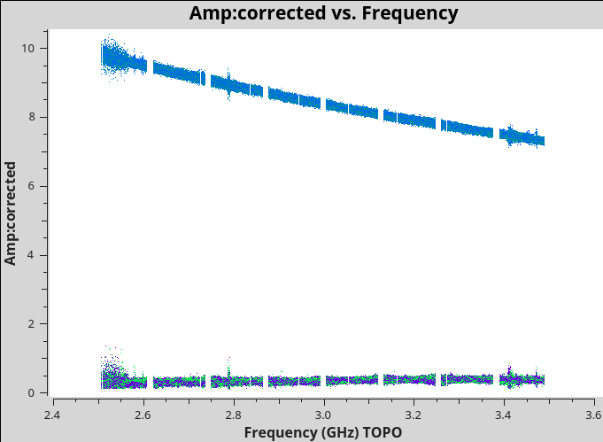
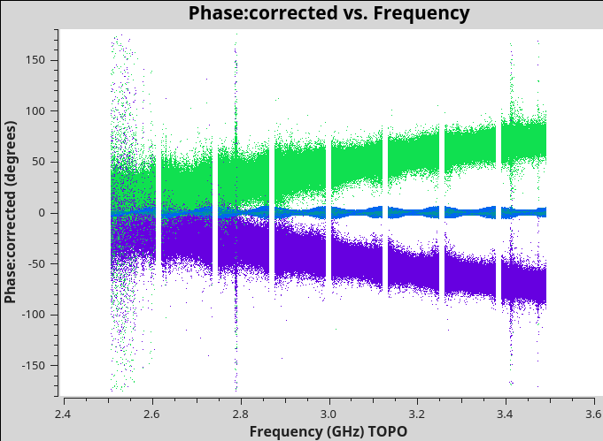
Inspect calibration – 3C48
plotms(vis='TDRW0001_calibrated.ms',field='0',correlation='',
timerange='',antenna='',avgtime='60',
xaxis='frequency',yaxis='amp',ydatacolumn='corrected',
coloraxis='corr')
plotms(vis='TDRW0001_calibrated.ms',field='0',correlation='',
timerange='',antenna='',avgtime='60',
xaxis='frequency',yaxis='phase',ydatacolumn='corrected',
plotrange=[-1,-1,-180,180],coloraxis='corr')

Slide 48
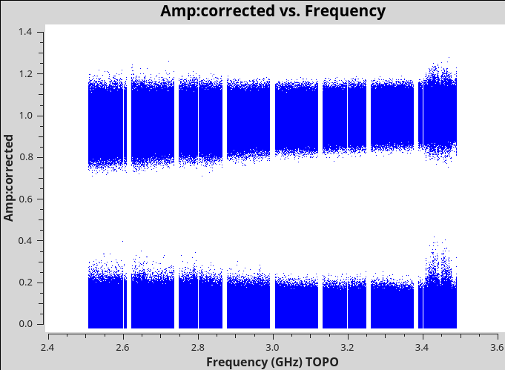
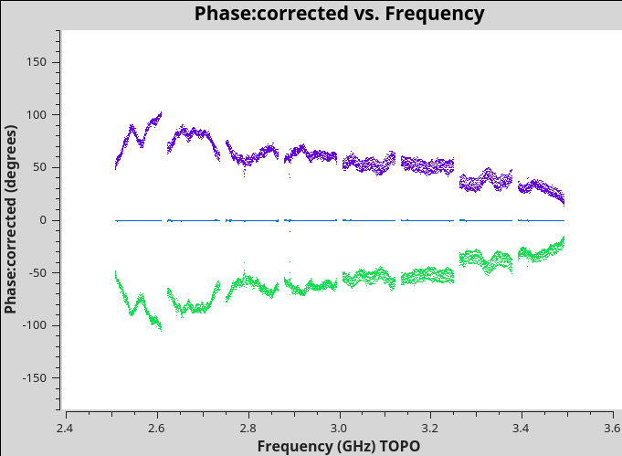
Inspect calibration – J0529+4950
plotms(vis='TDRW0001_calibrated.ms',field='1',correlation='',
timerange='',antenna='',avgtime='60',
xaxis='frequency',yaxis='amp',ydatacolumn='corrected',
coloraxis='corr')
plotms(vis='TDRW0001_calibrated.ms',field='1',correlation='RR,LL',
timerange='',antenna='',avgtime='60',
xaxis='frequency',yaxis='phase',ydatacolumn='corrected',
plotrange=[-1,-1,-180,180],coloraxis='corr')

Slide 49
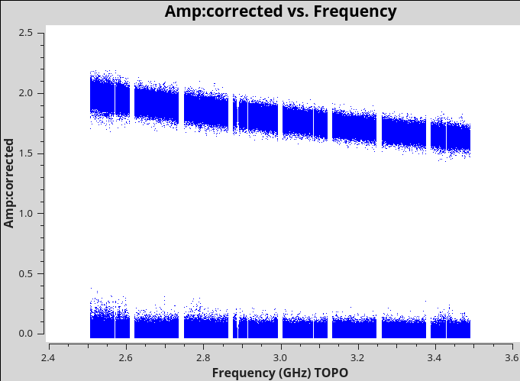
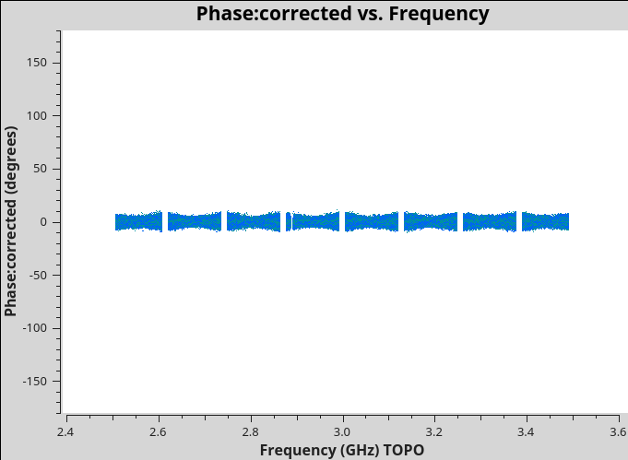
Inspect calibration – J2355+4950
plotms(vis='TDRW0001_calibrated.ms',field='2',correlation='',
timerange='',antenna='',avgtime='60',
xaxis='frequency',yaxis='amp',ydatacolumn='corrected',
coloraxis='corr')
plotms(vis='TDRW0001_calibrated.ms',field='2',correlation='',
timerange='',antenna='',avgtime='60',
xaxis='frequency',yaxis='phase',ydatacolumn='corrected',
plotrange=[-1,-1,-180,180],coloraxis='corr',avgbaseline=True)
The average residual RL/LR amplitudes are 0.5-1%.
Notes:
what is the average residual for J2355?

Slide 50
Polarization Calibration
some words on circular polarization
Beam squint – R/L beams are offset from each other
No calibrator with Stokes V=0?
Also no known V>0 calibrator.
Stokes V good diagnostic for issues in linear polarization calibration.
plotms cannot plot Stokes yet.

Slide 51
Further Information
Polarization CASA guide: https://casaguides.nrao.edu/index.php/Polarization_Calibration_based_on_CASA_pipeline_standard_reduction:_The_radio_galaxy_3C75
VLA Polarimetry:
https://science.nrao.edu/facilities/vla/docs/manuals/obsguide/modes/pol
CASA Polarimetry:
https://casadocs.readthedocs.io/en/stable/notebooks/synthesis_calibration.html#Polarization-Calibration
RL phase stability memo: https://library.nrao.edu/public/memos/evla/EVLAM_205.pdf
CASA Pipeline Requirements & Design Specifications for Polarization: https://library.nrao.edu/public/memos/evla/EVLAM_201.pdf

