Slide 1
RFI Identification and Flagging
Evangelia (Lilia) Tremou (NRAO)
etremou@nrao.edu

Slide 2
This Talk:
CASA version 6.2
On lustre:
> casa -r 6.2.0-124
Interactive steps can be done after the talk
- tasks & parameters are given in the following slides
Data access: https://astrocloud.nrao.edu/s/DcwqTKkKTEi98sk
(drwRFI.ms ~ 235MB)

Slide 3
What is RFI?
RFI - Radio Frequency Interference
A disturbance caused by various sources (man-made) of radio waves emitting around our targeted frequencies that affect our data, introducing noise.
Often RFI is stronger than the science data, and can limit science (parts of the spectrum are unusable)
RFI increases the detected power and the estimated antenna temperature → degradation of the retrieved astronomical signal.
Multiple approaches to perform RFI mitigation (i.e. detection algorithms, filters)

Slide 4
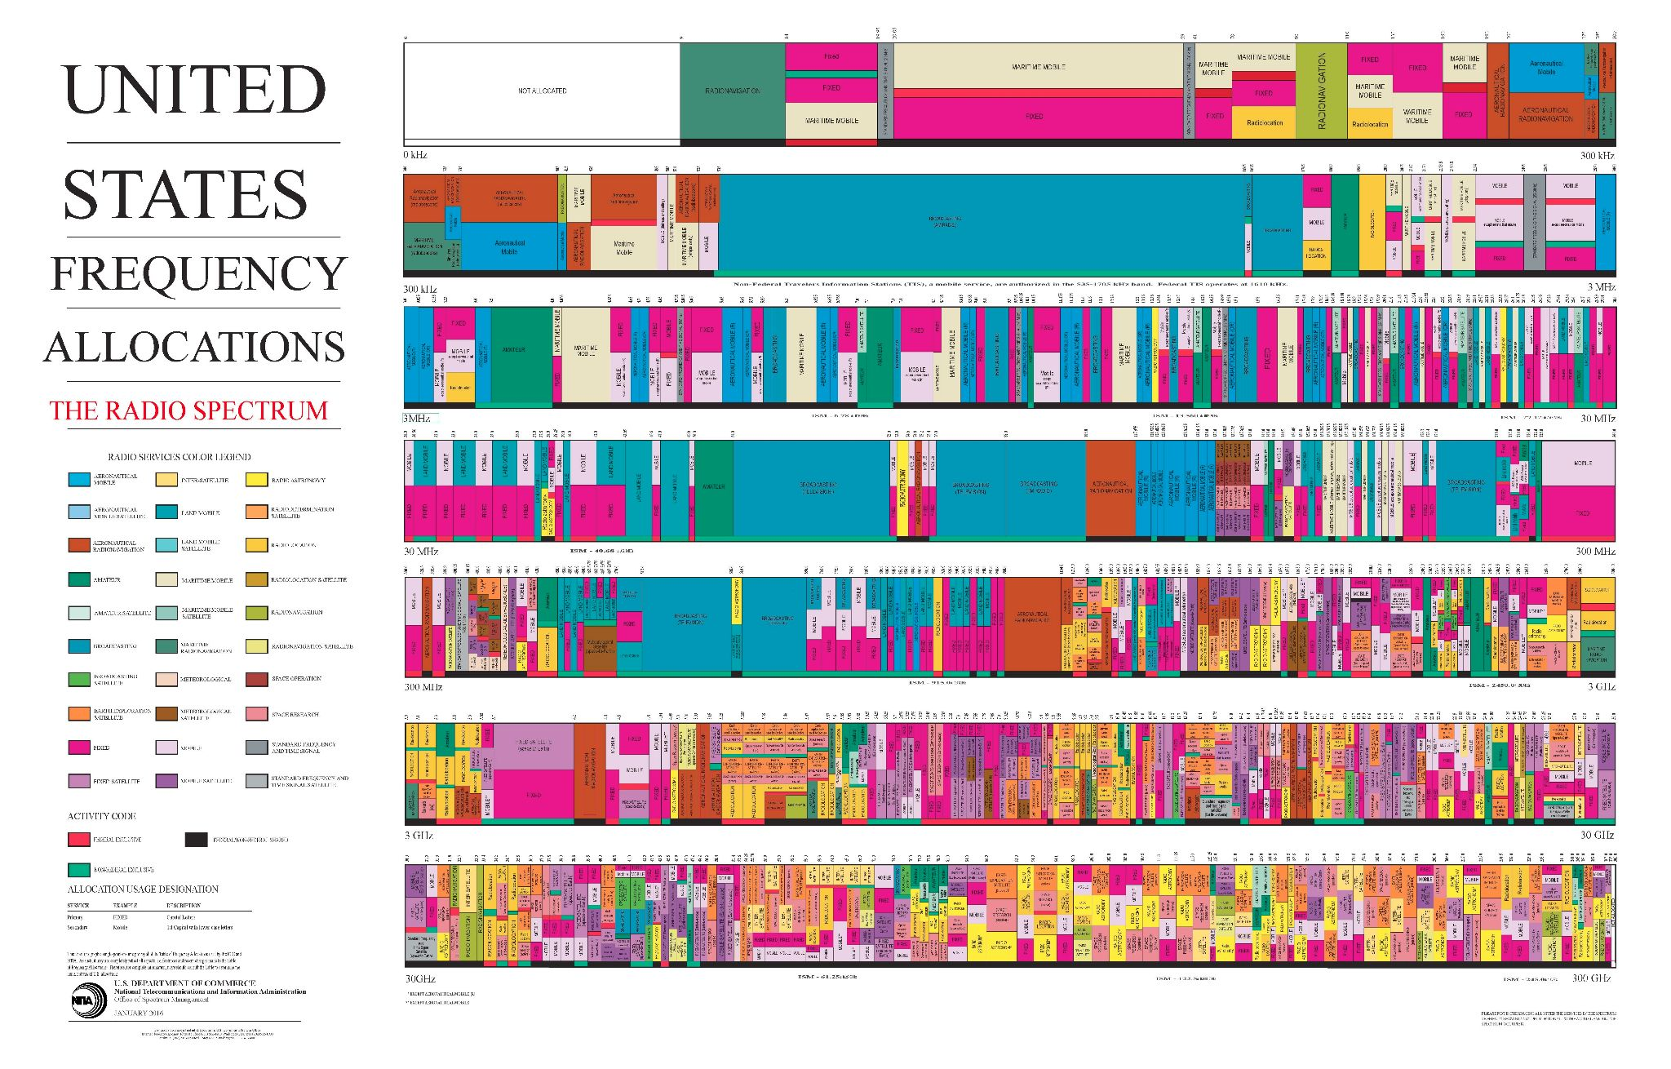
VLA frequency range

Slide 5
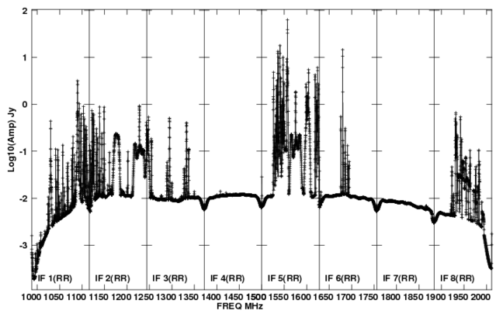
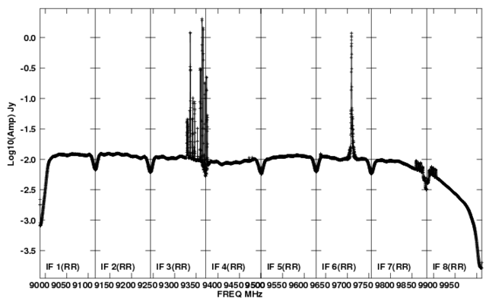
RFI at the VLA
https://science.nrao.edu/facilities/vla/docs/manuals/obsguide/rfi
Biggest issue at lower frequency bands: 4, P, L, S, C, and D-configuration.
But it does not mean it doesn’t exist at higher frequency bands.
Can be internal or external. Internally-generated RFI is minimised
L band
X band

Slide 6
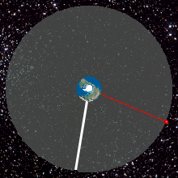
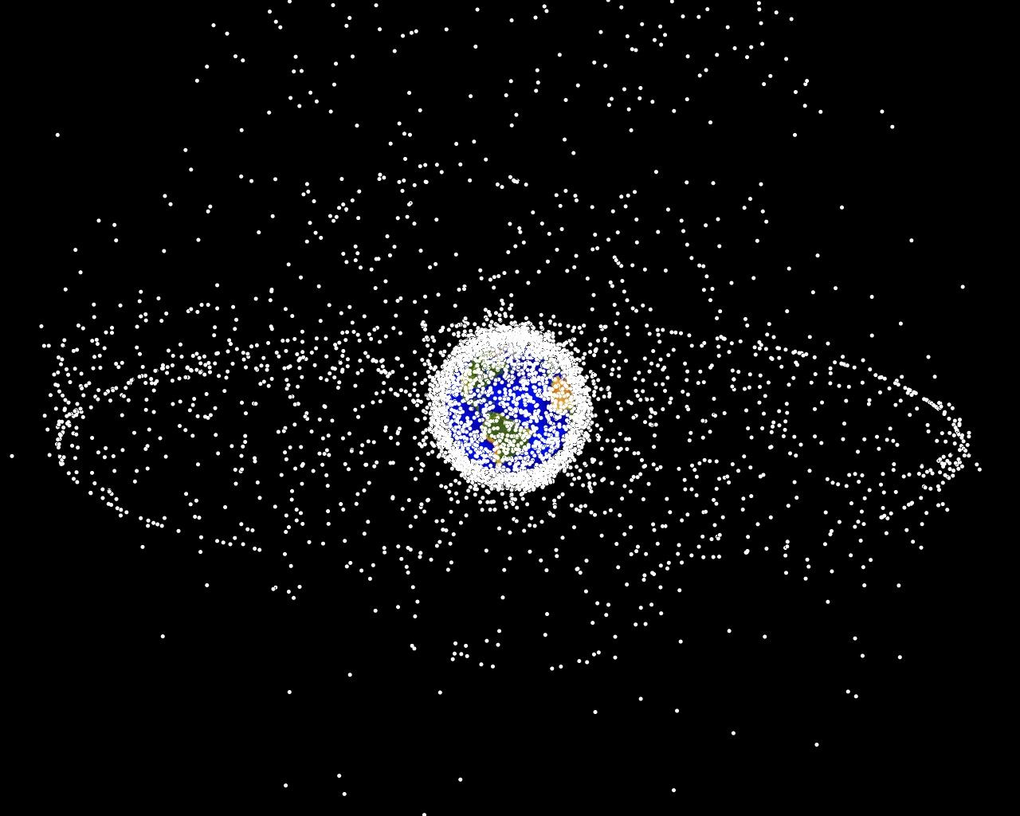
Satellite Transmissions & Clarke Belt
Earth is heavily surrounded by the satellites (2000+)
Hundreds along the Clarke belt
How does it affect VLA data?
significant degradation of data can occur if VLA antenna observes within 10° of the satellite
@VLA Clarke Belt at declinations –15° to +5°
mainly S, C, Ku, K and Ka bands
in C, X and Ku bands satellites can also saturate
the 3-bit samplers (special 8/3-bit set up required)

Slide 7
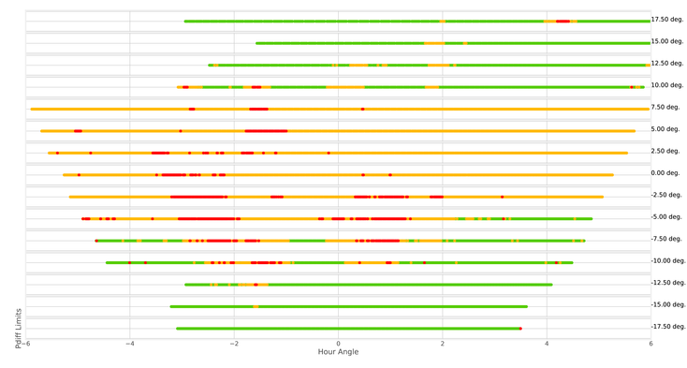

Satellite Transmissions & Clarke Belt
S band (2 - 4 GHz) survey of satellite interference at VLA (conducted in 2016/2017)

Slide 8
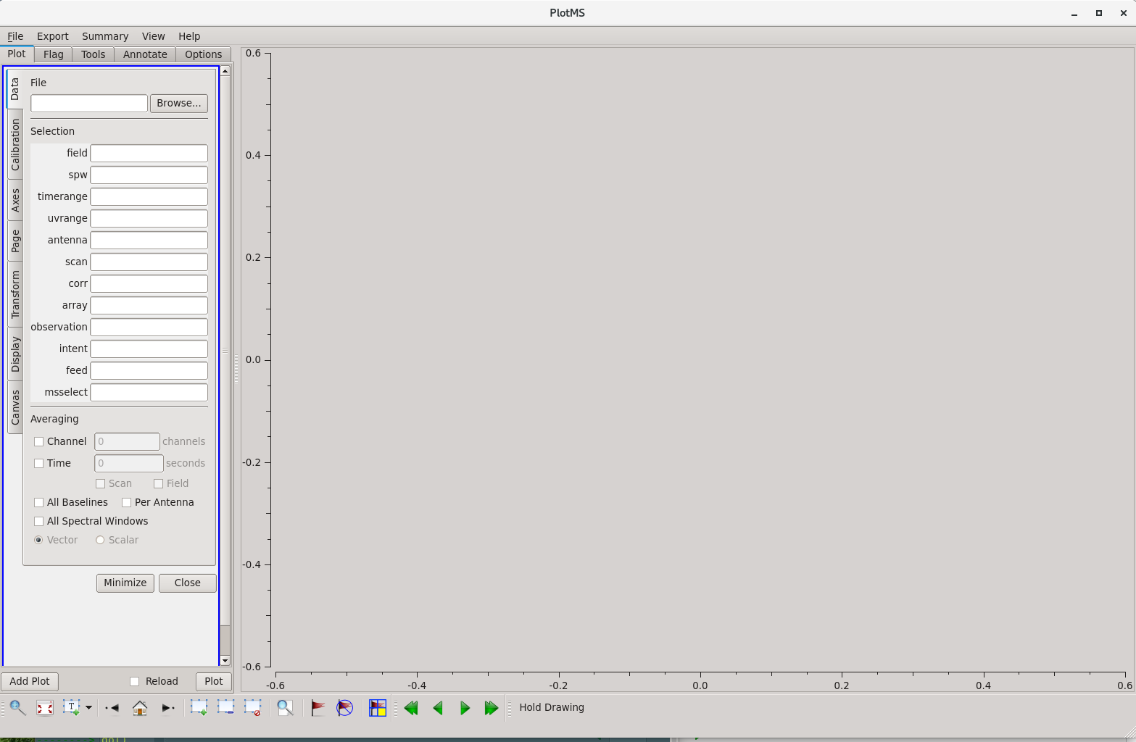
Finding RFI in your data
CASA task that allow you to visually inspect the data: plotms()
Leaving off strong RFI in your images will have issues such as “ripples”, high noise, etc.
This is also how you can check for the remaining offending RFI in your data: image!

Slide 9
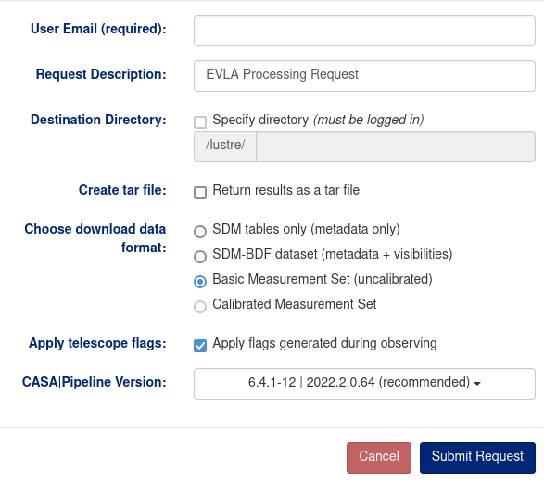
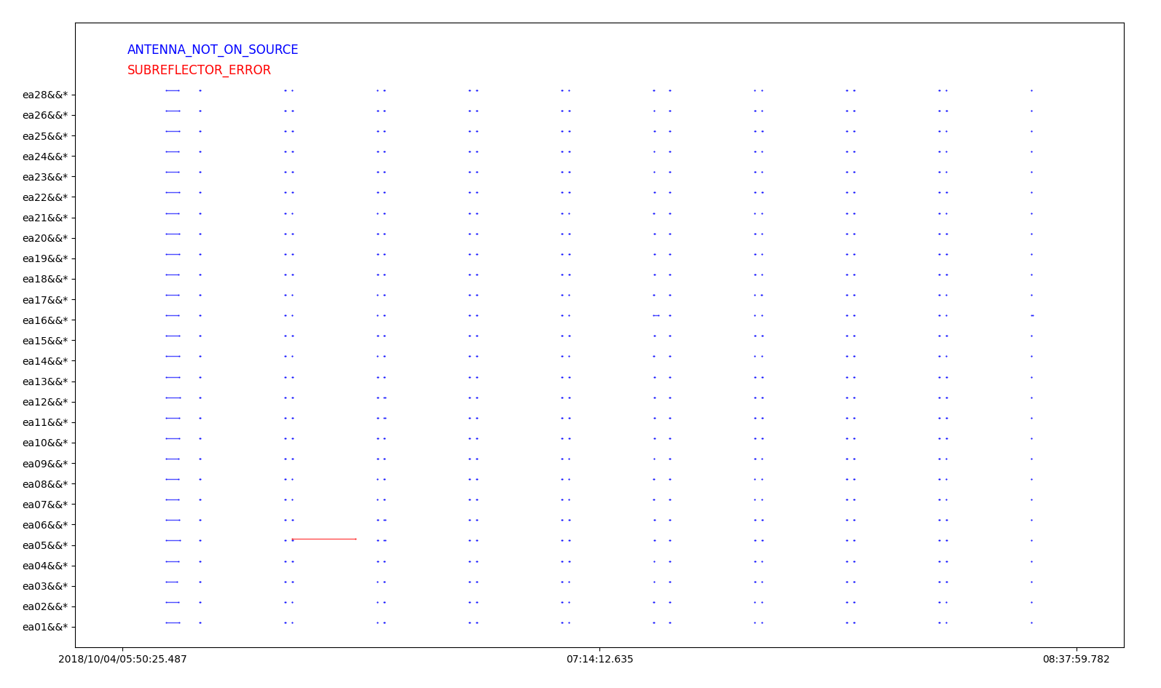
CASA Flagging tasks
flagcmd () → apply flags info on which stored in external file
Example: Online Flags
  issues recorded by the operators such as slew, subreflector, focus
  During downloading data from NRAO archive → apply online flags
flagcmd(vis='drwRFI.ms', action='plot')

Slide 10
CASA Flagging tasks
flagdata () → recommended task to flag data
mode=‘manual’ or mode=‘unflag’ # Use MS-selection syntax to pick subsets of flag/unflag
mode=‘quack’ # Flag data at the beginning or end of a scan (operate on selected data)
mode=‘elevation’ # Flag data between specified elevation limits (operate on selected data)
mode=‘shadow’ # Flag baselines with shadowed-antennas
mode=‘clip’ # Threshold-based flagging on data-expressions (ABS_RR, ABS_I, etc.)
Deterministic
mode=‘tfcrop’ # Find outliers on the 2D time-frequency plane
mode=‘rflag’ # Find outliers based on sliding-window RMS filters
mode=‘extend’ # Grow/extend flags around existing ones
Autoflag
mode=‘summary’ # Count existing flags and return a dictionary of counts per antenna, spw, etc.
mode=‘list’ # Supply a list of flag commands, built out of parameters of any other mode
Run-modes: “apply / calculate” + runtime “display” of data before and after flagging, and reports.
Operational

Slide 11
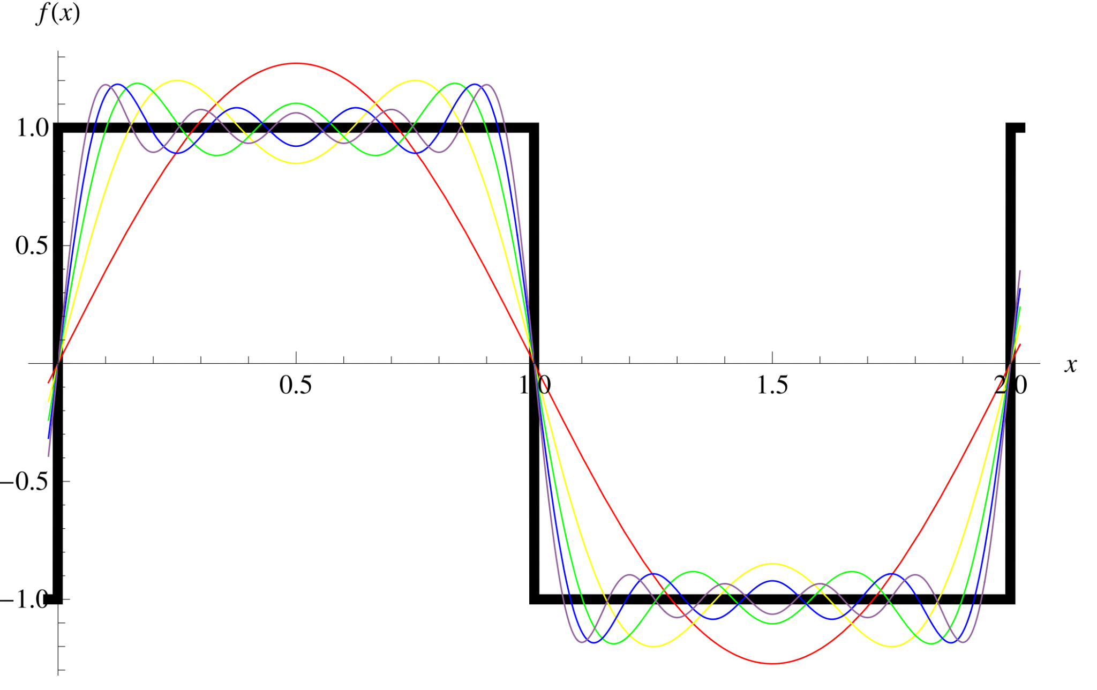
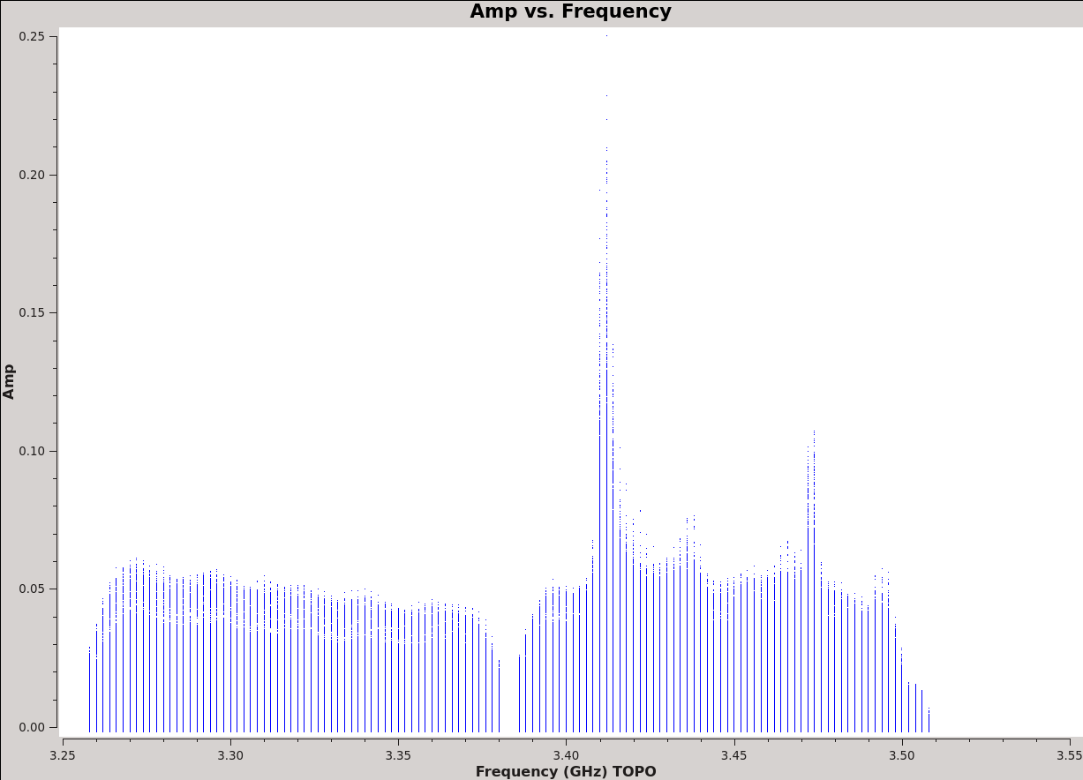

Hanning smoothing
Not for spectral line data!
Gibbs phenomenon
Oscillatory behaviour of Fourier series at a discontinuity
“Ringing” pattern spreading to channels neighbouring the strong narrow RFI spike
hanningsmooth ()
removes amplitude spikes and reduce the ringing, reducing number of affected channels
reduces the spectral resolution by a factor of ~2
doubles the disk space requirement (new MS)
https://mathworld.wolfram.com/
hanningsmooth(vis = 'drwRFI.ms', outputvis = 'drwRFI_hansm.ms')
before
after
Our data:

Slide 12
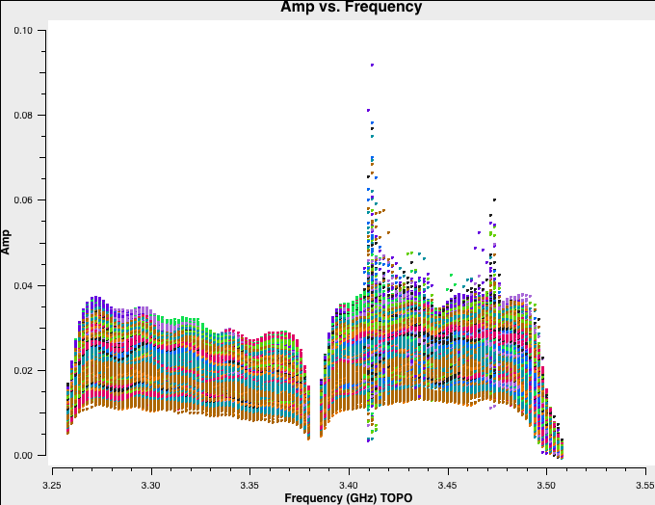
Interactive
Manual flagging
plotms () → to see where the RFI is in our current dataset
default plotms
vis = 'drwRFI.ms'
xaxis= 'frequency'
yaxis='amp'
avgtime = '1e4'
coloraxis = 'Antenna1'
customsymbol=True
symbolshape='circle'
symbolsize=2
inp
go

Slide 13


Manual flagging
plotms () → to see where the RFI is in our current dataset
Inspecting all antennas (paging through) one by one with the parameter : iteraxis = 'antenna'
Spike: spw=1, channels=13~15

Slide 14
Interactive
Manual flagging
flagdata () task with mode = 'manual'
Once the RFI is located, the best is to use flagging tasks outside the plotms ().
This way we can backup the flags, and revert steps if needed.
# In CASA
default flagdata
vis='drwRFI.ms'
mode='manual'
spw='1:13~15'
flagbackup=True # required if to restore previous flagging versions
inp
go

Slide 15
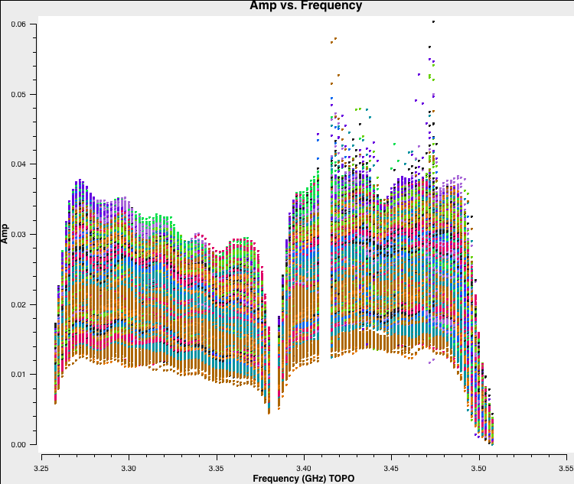

Interactive
Manual flagging
To see the effect of our flagging get back to plotms () and inspect the data again.
If plotms () is still open:
If not:
tget plotms
go
Spike is gone!

Slide 16
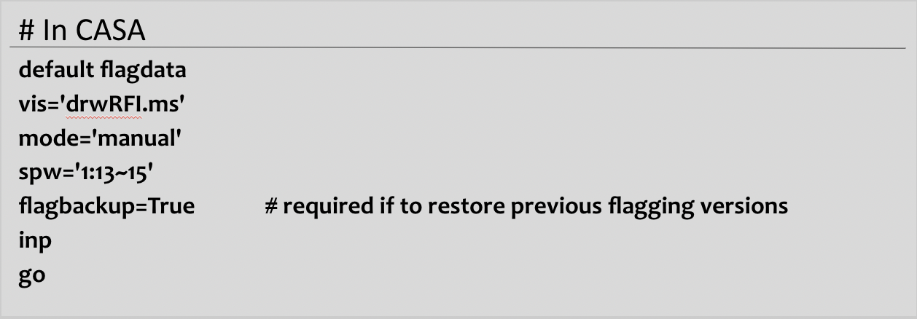
Interactive
Flagging manager
flagdata ()
# In CASA
default flagmanager
vis='drwRFI.ms'
mode='save'
versionname='after_manual'
comment='after manual flagging'
inp
go
flagmanager ()
Manual save of the flag state at any time

Slide 17
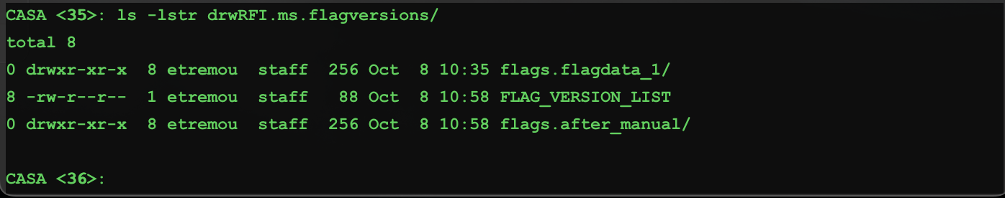
Interactive
Flagging manager
If you run both the flagmanager() task to save the flags, and the flagdata()
task with flagbackup=True, you should have two files now within the MS that
contain the flagging done so far.
flagmanager() task can be also used to access information in these files and revert flagging

Slide 18
Flagging manager
Restoring flagged data
Flagging with plotms(): data can’t be restored!
Using flagdata() to restore the data with mode = 'unflag' :
It will unflag everything, not only the last execution!
flagmanager() may be a better tool!

Slide 19
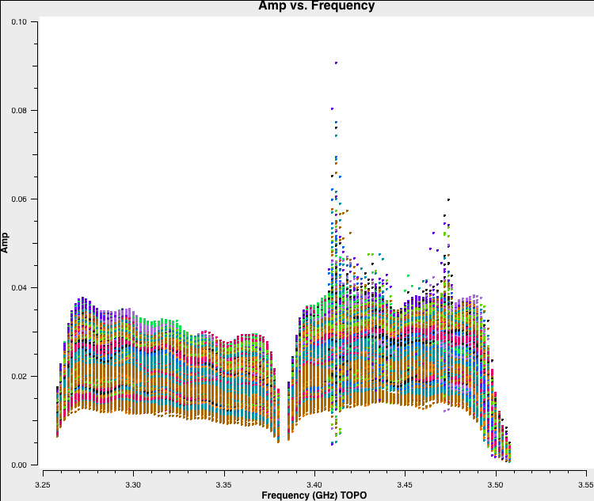
Interactive
Flagging manager
flagmanager () task with mode = 'restore'
# In CASA
default flagmanager
vis='drwRFI.ms'
mode='restore'
versionname='flagdata_1'
inp
go
Check the result:
tget plotms
go

Slide 20
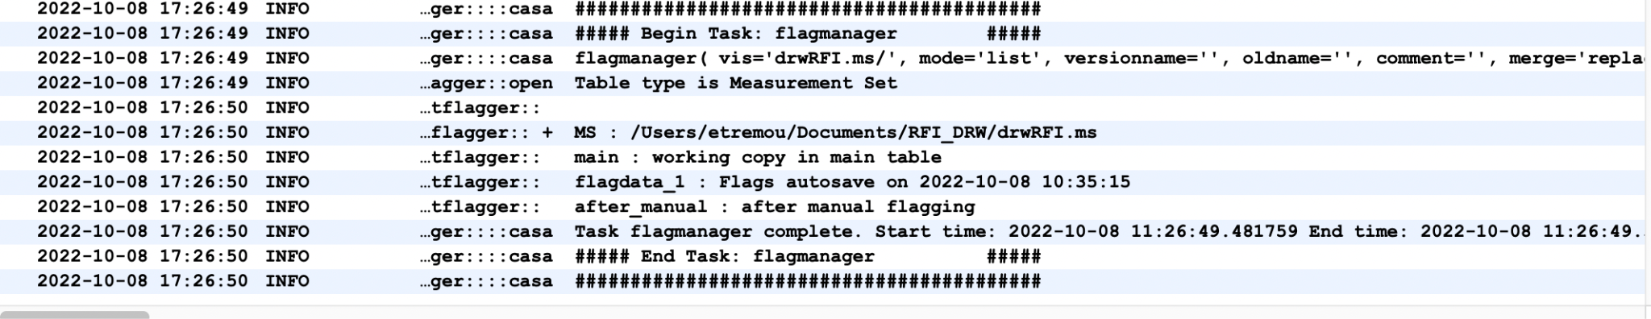
Interactive
Flagging manager
flagmanager () task with mode = 'list'
# In CASA
default flagmanager
vis='drwRFI.ms'
mode='list'
inp
go
The previous flag tables won’t be removed by the restore mode, mode=’delete’ will do that!
Check the result in CASA logger window:

Slide 21
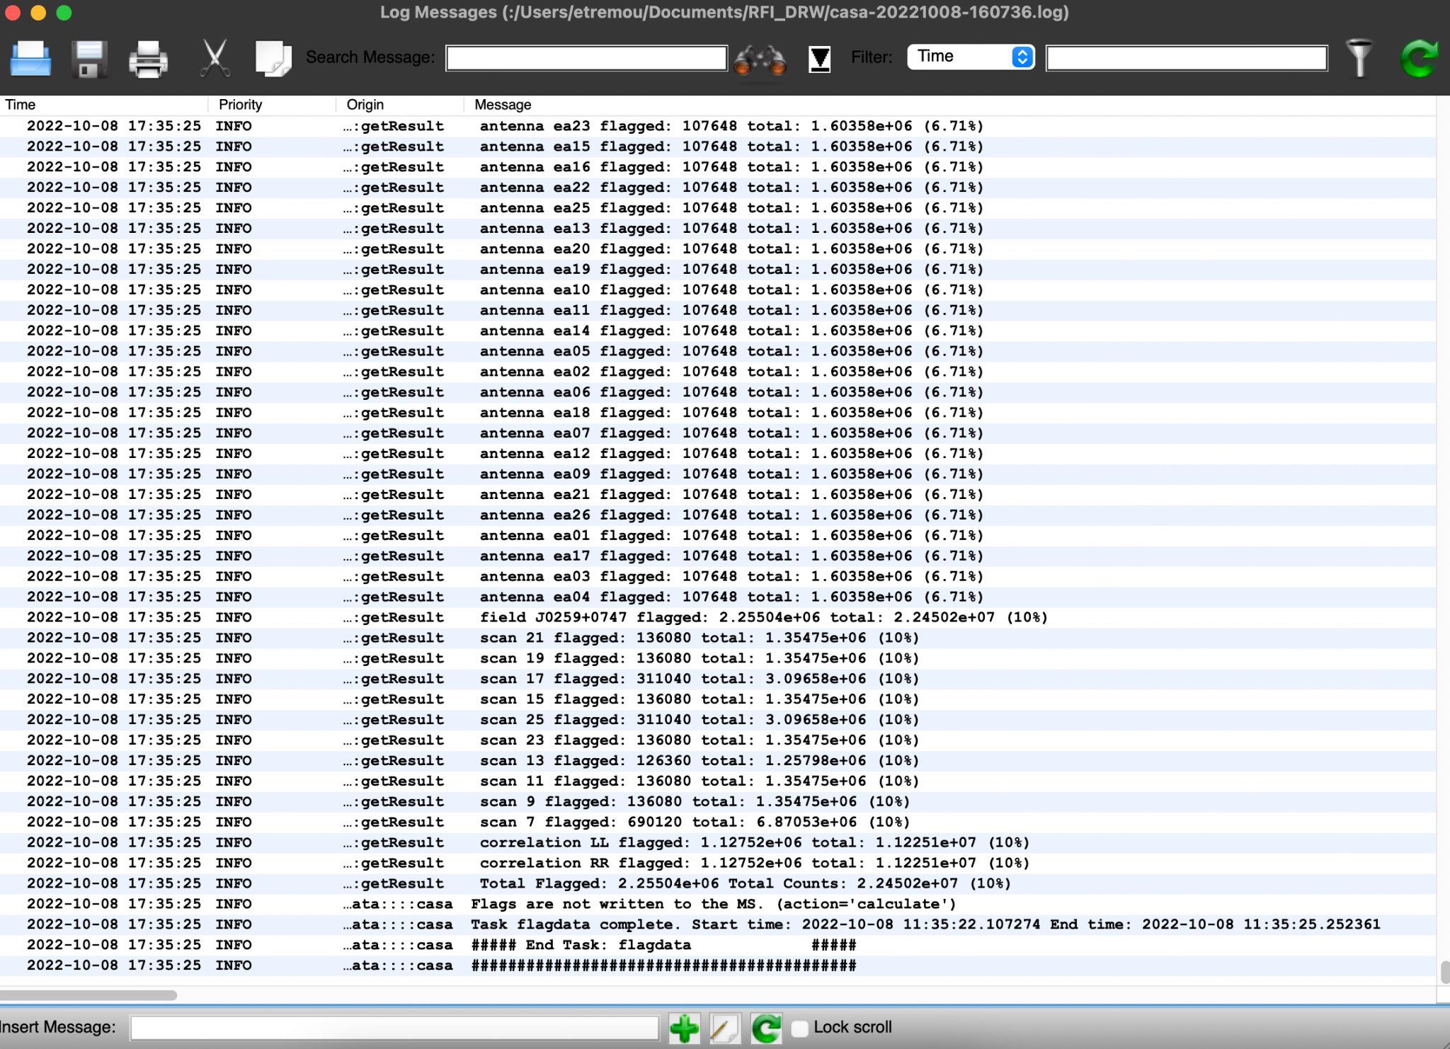
Interactive
Flagging statistics
flagdata () task with mode = 'summary'
# In CASA
default flagdata
vis='drwRFI.ms'
mode='summary'
inp
go
CASA logger output:

Slide 22
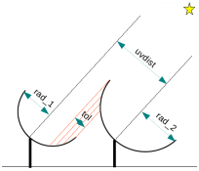
Deterministic flagging modes
flagdata () task with mode = 'quack'
quack mode is used to remove data at scan boundaries
antennas have just been slewing to new source, the slewing is flagged (online flags), but often they need “settling” time
quackinterval and quackmode parameters available
flagdata () task with mode = 'shadow'
shadow mode is used when one antenna blocks part of the aperture of a second antenna that is behind the first one.
Compact configurations may be affected (e.g. D-configuration)

Slide 23
Interactive
Auto-flagging: TFCrop
TFCrop is an auto-flag algorithm that detects outliers on the 2D time - frequency plane
It can operate on un-calibrated data (non-bandpass corrected)
Statistics based on each baseline, correlation
Its default parameters are optimised for strong narrow band RFI
# In CASA
tget flagdata
mode='tfcrop'
spw='1'
timecutoff=3.0 # threshold in units of deviations from the fit
action = 'calculate'
display = 'both'
flagbackup=True # required if to restore previous flagging versions
inp
go

Slide 24
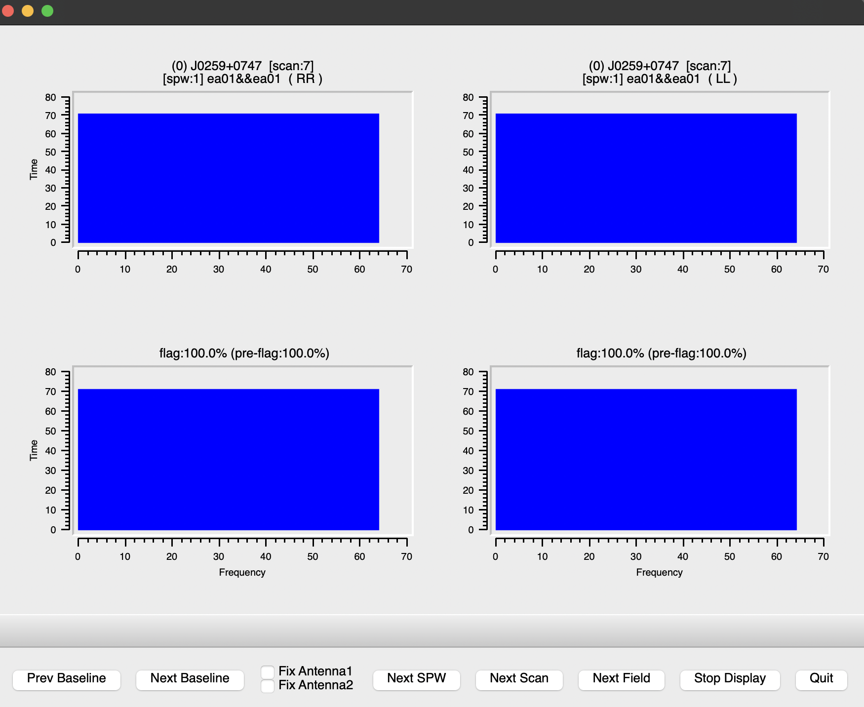
Interactive
Auto-flagging: TFCrop
Blue shows the flagged data
Navigate through different baselines

Slide 25
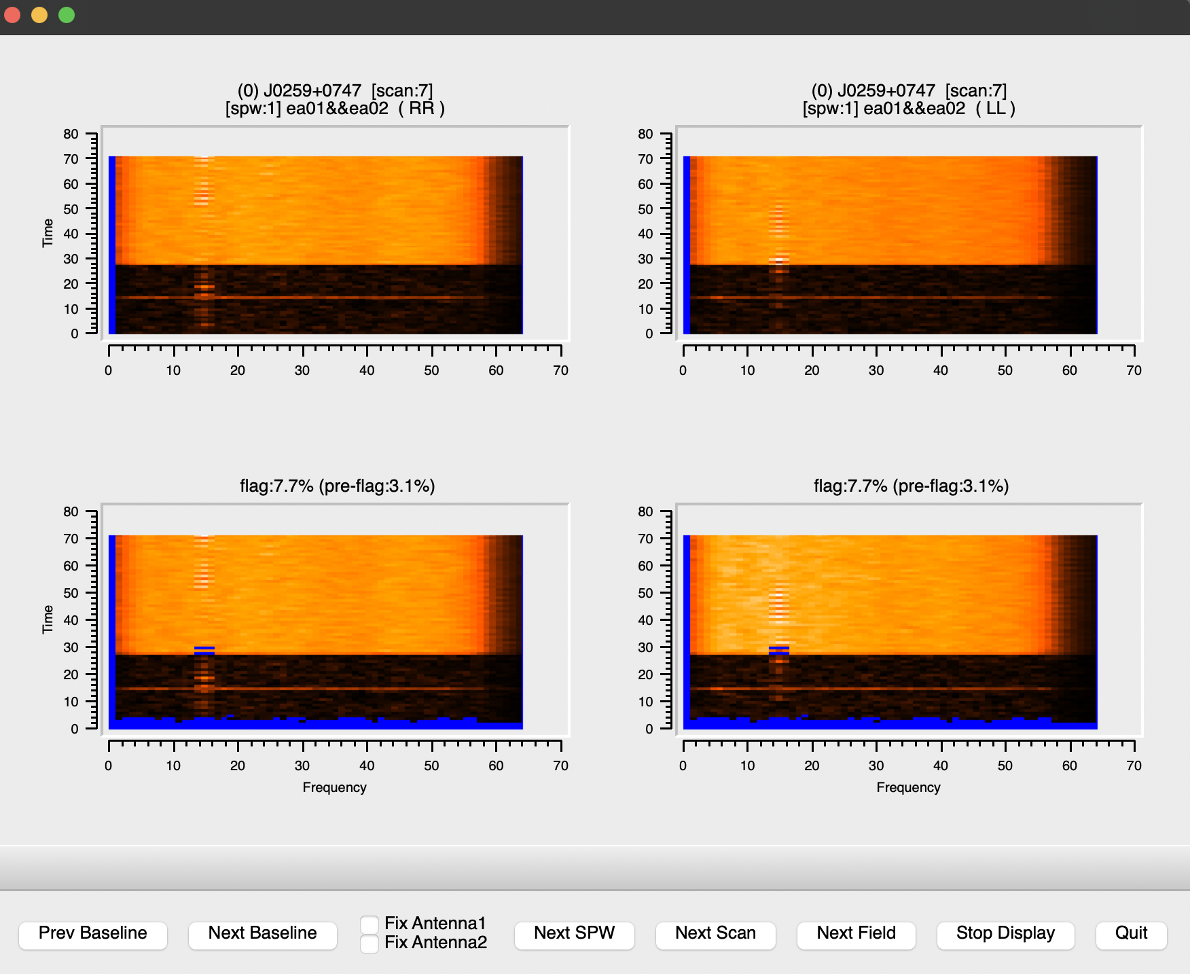
Interactive
Auto-flagging: TFCrop
Quit kills the task
Stop Display will just turn off display and let flagdata() to finish.
But we are in action =’calculate’, either ways will work.
Current flagging status
After TFCrop flagging

Slide 26
Auto-flagging: TFCrop
Tuning parameters may give the best result:
timecutoff, freqcutoff # threshold for finding outliers, in units of fit st.dev.
flagdimension = ‘freqtime’ # direction(s) in which to calculate statistics
channelavg, timeavg # pre-average the data
timefit = ‘line’ # fitting function along time axis, line is default (ok: poly/line)
freqfit = ‘poly’ # fitting function along freq axis, poly is default (ok: poly/line)
maxnpieces = n # n order of polynomial in fitting functions above
Sometime you may also need to vary the parameters for e.g. spws or bands within the same data set.
Each data set is different and may need different parameter set up for best results
→ make sure you inspect your data well
→ know what you are dealing with
→ choose the parameters accordingly.
tfcrop can be run multiple times on the same data

Slide 27
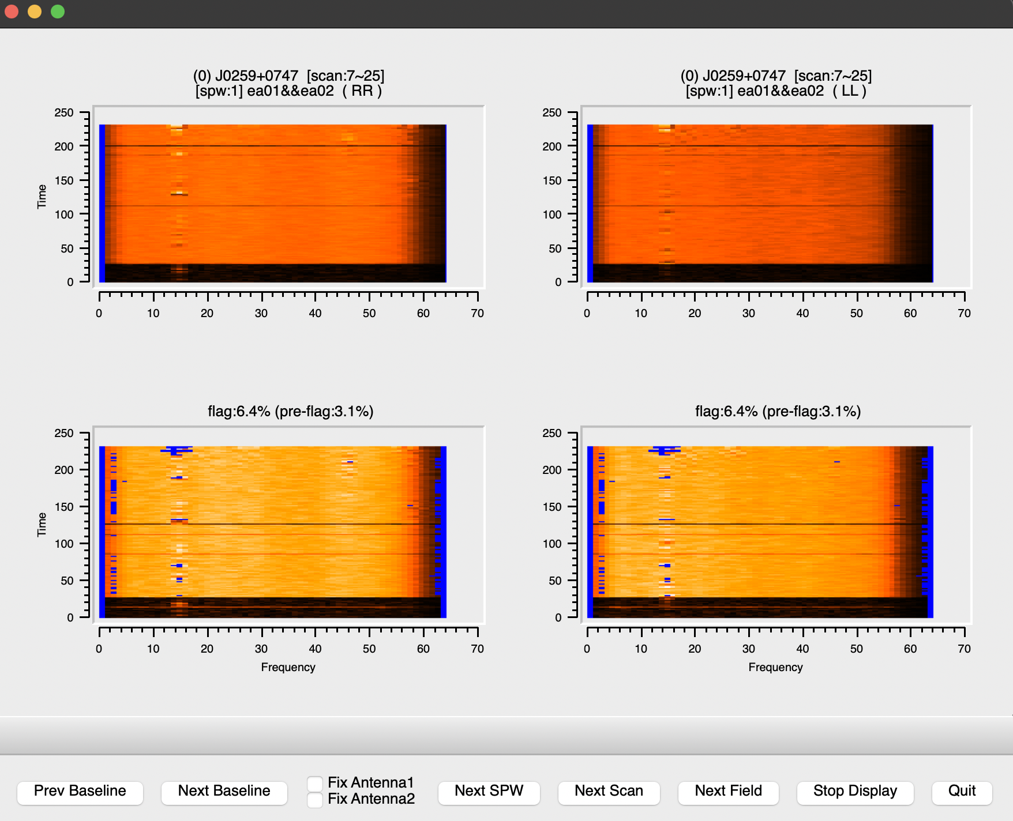
Interactive
Auto-flagging: TFCrop
Let’s try some tuning:
# In CASA
tget flagdata
maxnpieces=4
usewindowstats='std'
halfwin=2
combinescans=True
inp
go

Slide 28
Interactive
Auto-flagging: TFCrop
Once you are happy with the flagging, apply it:
# In CASA
tget flagdata
action='apply'
display=''
inp
go

Slide 29
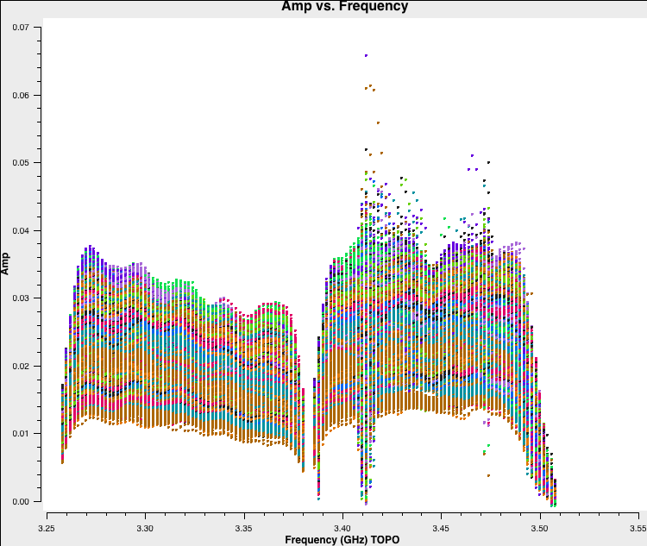
Interactive
Auto-flagging: Inspect results
plotms () for inspection:
# In CASA
tget plotms
inp
go
before
after

Slide 30
Extending the flags
standalone mode in flagdata()
as an extend flags parameter within tfcrop and rflag modes
It will extend or grow flags accumulated in the MS file along time, frequency, polarisation, baseline etc
e.g. if you applied flag only to RR product, you can extend that afterwards also to LL.
Flag growing, example parameters:
growtime=80.0 # for each time flag entire timerange if >80% data flagged
growfreq=92.0 # for each channel flag selected chans if >92% data flagged
growaround # flag a data point if >4 neighbouring points are flagged
flagneartime # flag a data point before and after a flagged one
flagdata () task with mode = 'extend'
It is recommended when executing auto-flagging modes.

Slide 31
Interactive
Extending the flags
# In CASA
tget flagdata
mode='extend'
combinescans=True
growtime=30
growfreq = 30
growaround=True
flagneartime = True
flagnearfreq = True
action = 'calculate'
display = 'both'
inp
go

Slide 32
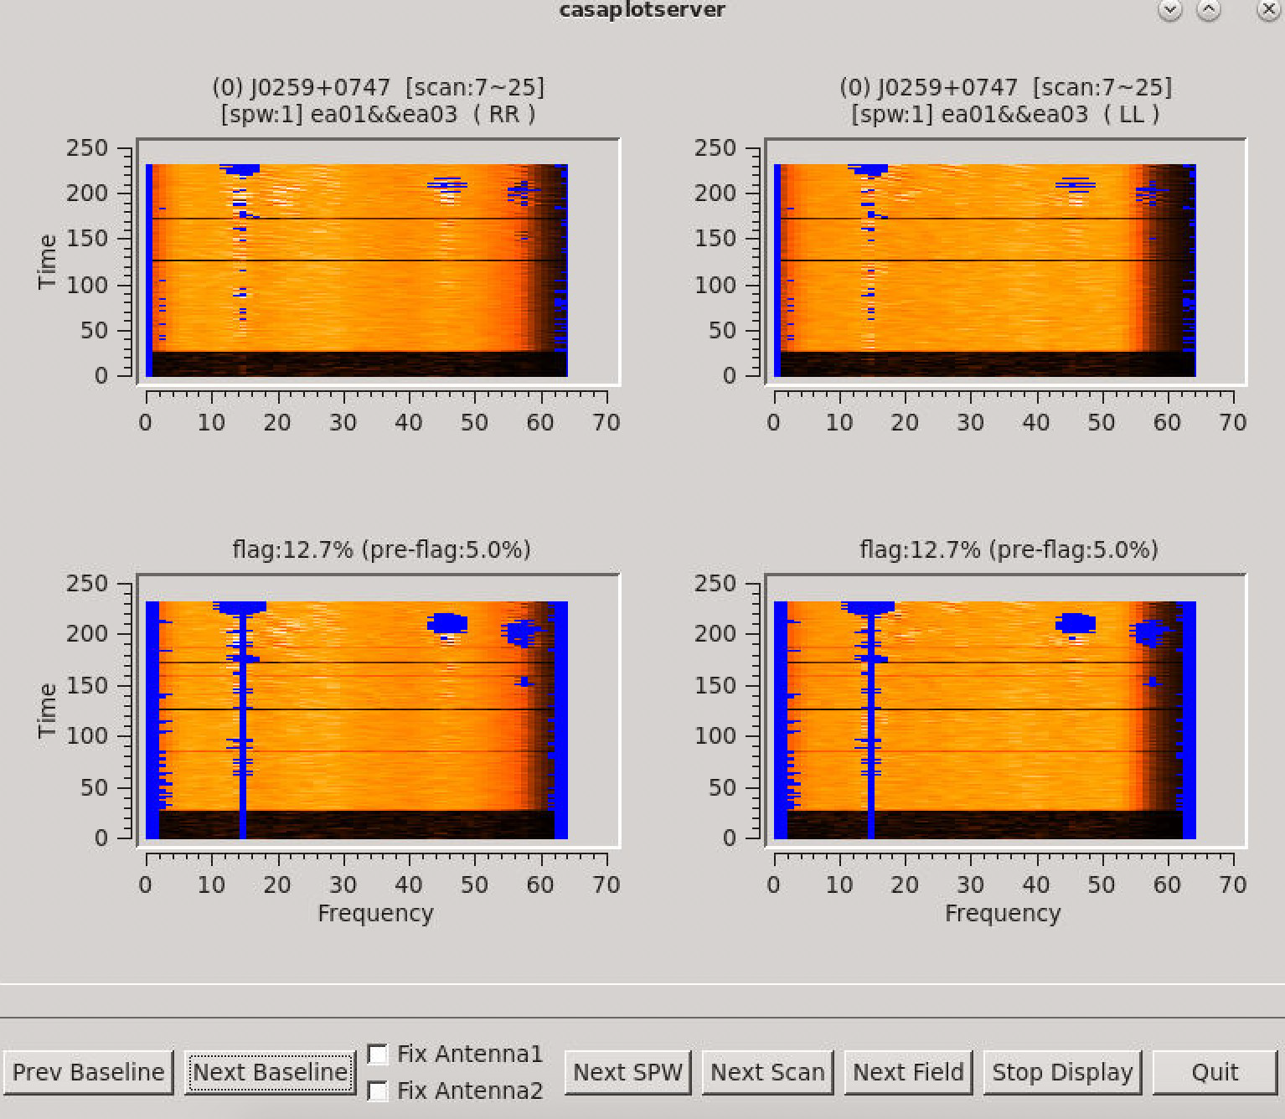
Interactive
Extending the flags
Baseline: ea01&ea03
SPW: 2
RFI removed!
Let’s apply them!

Slide 33
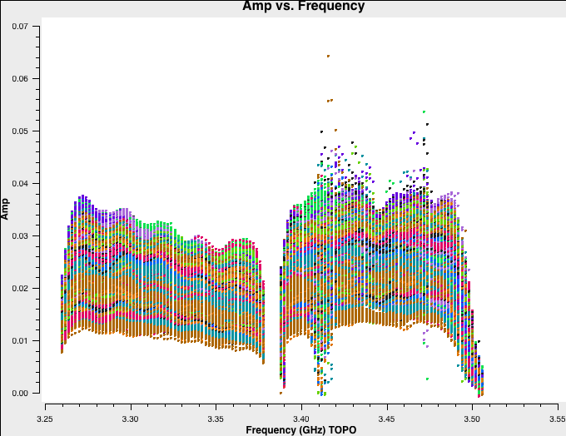
Interactive
Extending the flags
# In CASA
tget flagdata
action = 'apply'
display = ''
inp
go
tget plotms
inp
go
After extending the flags

Slide 34
Auto-flagging: Rflag
Rflag is an auto-flag algorithm that detects outliers based on local rms statistics
It requires calibrated data
It iterates through time chunks calculating local rms of imag and real visibilities within a sliding time window, and deriving a median rms across given time window
It iterates through frequency chunks (channels) for each time chunk calculating rms of avg of imag and real visibilities
The VLA calibration uses Rflag
Tuning parameters may give the best result:
winsize # number of timesteps in the sliding time window
timedevscale, freqdevscale # st.dev. threshold for outlier flagging
channelavg, timeavg # pre-average the data

Slide 35
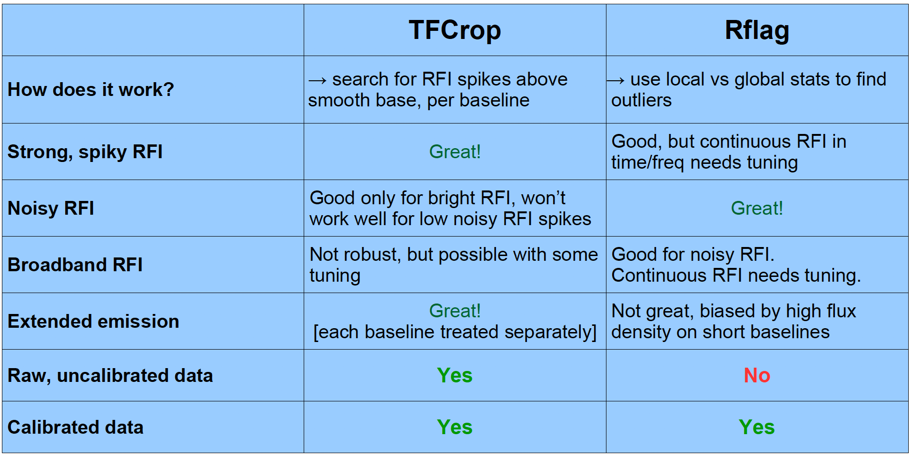
TFCrop vs Rflag: which one to use when?
Worth executing both in the same data set

Slide 36
Auto-flagging: Spectral lines
TFCrop and Rflag may remove precious spectral lines in auto-flagging.
If the spectral lines are not known, then auto-flagging is not recommended.
Adjust the parameters in advance by excluding the location of spw/channels of the interesting spectral lines.
Example:
you have 2 spectral windows (0,1), each with 64 channels
your line is in spw=1, channels=21~22
exclude that location with the following format of the spw parameter:
spw = ’0, 1:0~20; 23~63’

Slide 37
A note on statwt() task
DATA
MODEL
CORRECTED
WEIGHT
SIGMA
WEIGHT and SIGMA columns are set to some arbitrary values (e.g. 1).
statwt() will empirically measure the visibility scatter (e.g. as a function of time, antenna, and/or baseline) and use it to set WEIGHT and SIGMA
it may be beneficial sometimes to weight down any remaining RFI in your data with statwt() prior to imaging
It requires calibrated visibilities

Slide 38
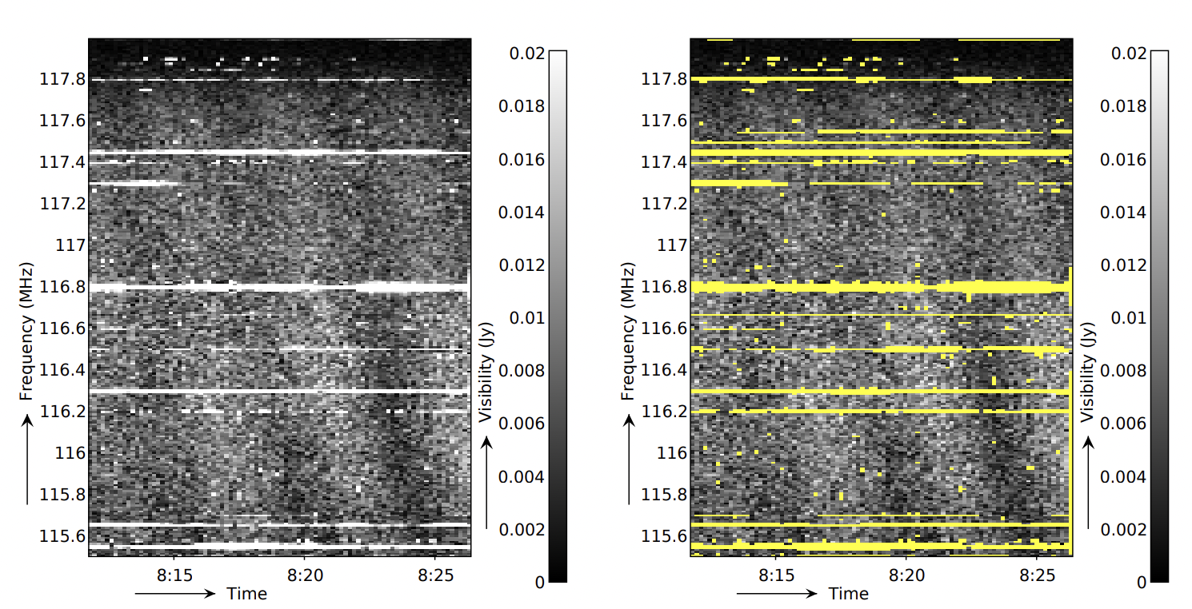
A note on other flagging algorithms
AOFlagger, https://aoflagger.readthedocs.io/en/latest/
  It can make use of Lua scripts to make flagging strategies flexible
  Applicable to a wide set of telescopes especially in low frequency arrays (initially developed for LOFAR)
  Accompanied with python scriptable plotting tools
Offringa et al. 2012
Tricolour (Hugo et al. 2021), https://github.com/ratt-ru/tricolour
  Optimised for channelized wideband data (e.g. MeerKAT)
  Configurable, parallel and optimized (Dask and Numba)

Slide 39
Summary
All data have a level of RFI and it will only get worse over time.
Automatic Flagging options exist.
They all need tuning. Usually, one setup per SPW or band
  Look at small pieces of your data, and decide flagging strategy
  Use plotms or viewer or flagdata (action=‘calculate’, display=‘both’) and try different flagging setups.
  Defaults will not suffice for all cases, experiment with various parameters.
All types of data can be flagged (e.g. visibilities, weights, calibration tables)
Documentation:
https://casadocs.readthedocs.io/en/stable/notebooks/data_examination.html
https://colab.research.google.com/github/casangi/casadocs/blob/2316c9b/docs/notebooks/data_examination.ipynb

Slide 40


