Slide 1
The Green Bank Observatory
National Radio Astronomy Observatory
David Frayer
“Planning a GBT Proposal”:
GBT Science and Capabilities
NRAO

Slide 2
Outline:
Green Bank and GBT background
GBT Science
GBT Capabilities
GBT Proposal Process and Planning Tools

Slide 3
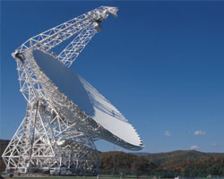
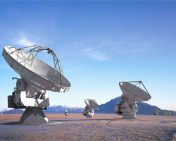

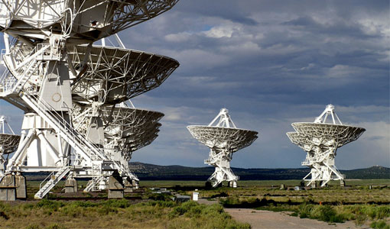
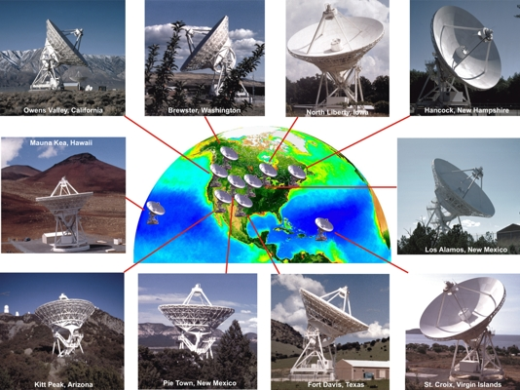
NRAO telescopes and facilities
GBT
New Technology Center
(Charlottesville, Virginia)
ALMA
(Chile)
Green Bank Observatory
Very Large Array
(Socorro, New Mexico)
Very Long Baseline Array

Slide 4
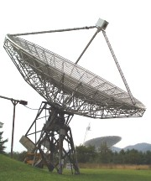
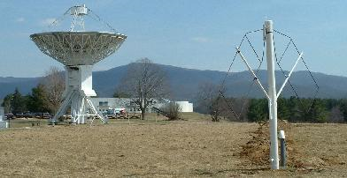
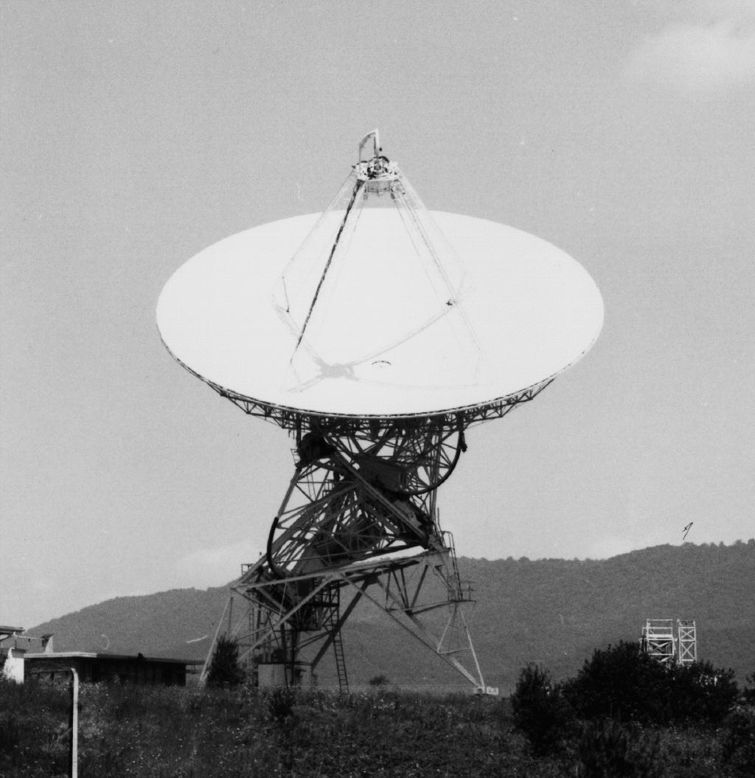
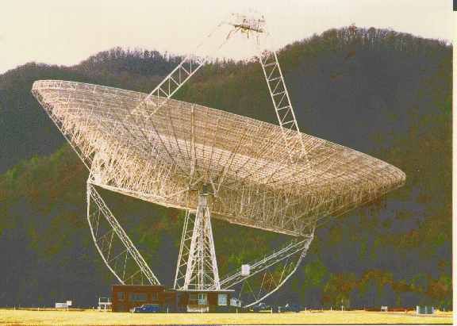
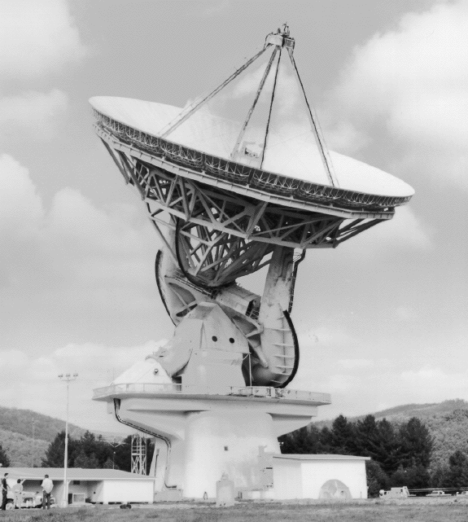
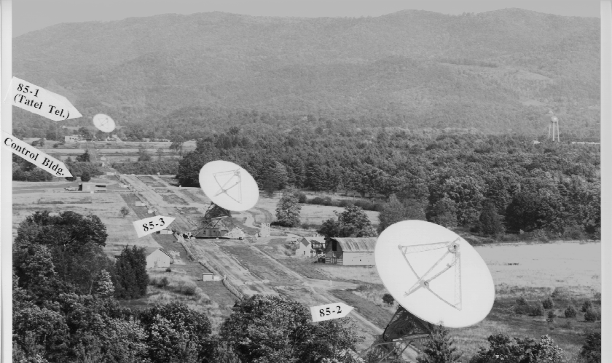
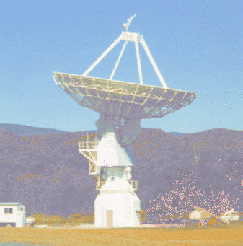
Green Bank is original NRAO site, with world class telescopes for >50 years
Completed 1995
Started 1958
Completed 1959
Completed
1962
Completed 1962
Completed 2000
Completed 1965
Completed 1967
Completed
1994

Slide 5
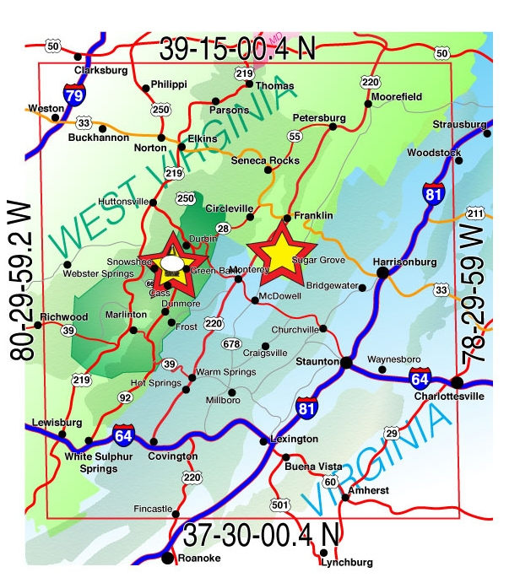
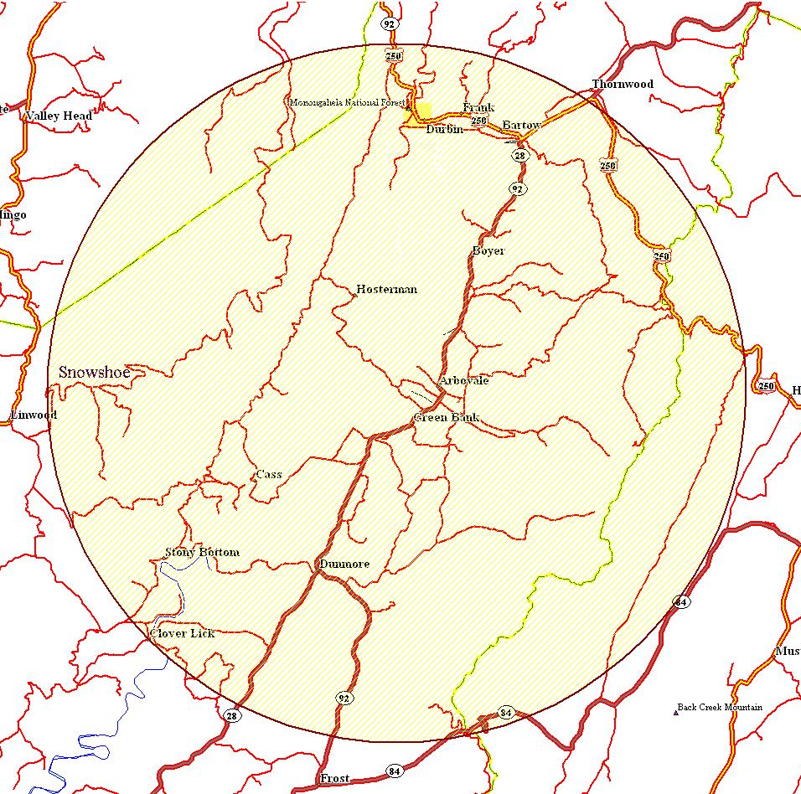
WV Radio Astronomy Zone
Established by the West Virginia Legislature (1956)
Protection within ten miles
of the Observatory
National Radio Quiet Zone
Established by the FCC and NTIA
(1957)
13,000 Square Miles

Slide 6
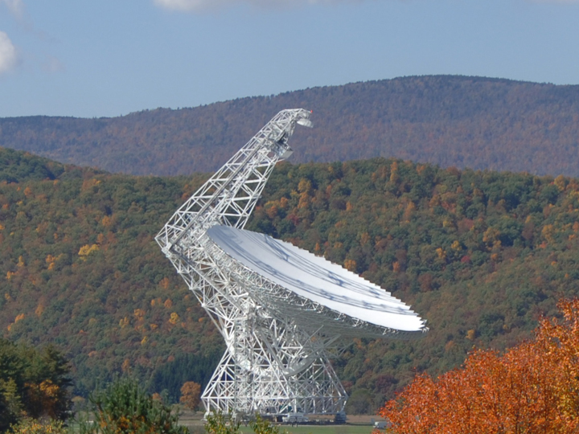
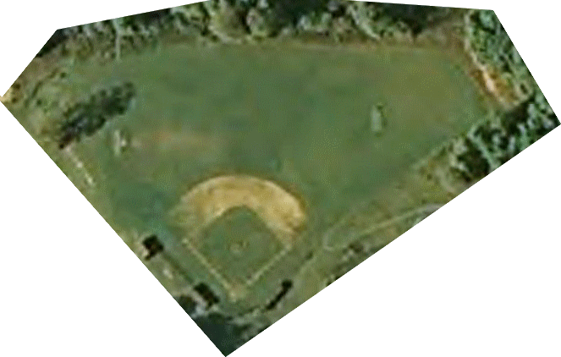

At 100 m, the GBT is the largest fully steerable telescope (and the largest movable structure) in the world.
Unblocked Aperture
Active Surface
Operates from ~100 MHz to 100 GHz
Fully Steerable
>85% of total sky covered δ≥-46°
Pointing to 1”-2” accuracy
Surface good for 3mm work
485 ft
2.3 acre collecting area
151 ft

Slide 7
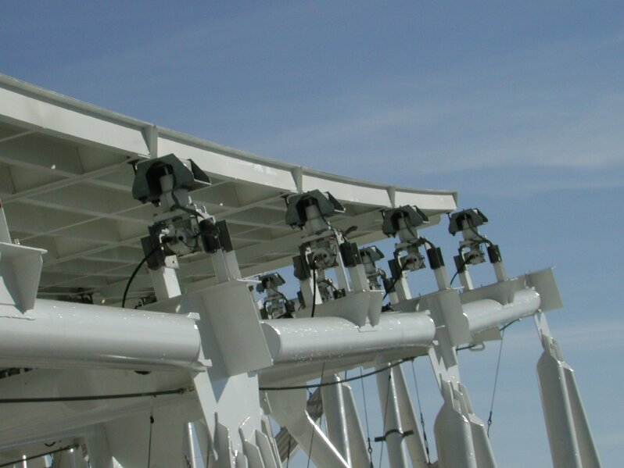

The Active Surface
2209 actuators
Currently rms < 240μm at night, the goal is 210μm
University of Georgia, Sept 2011
7

Slide 8
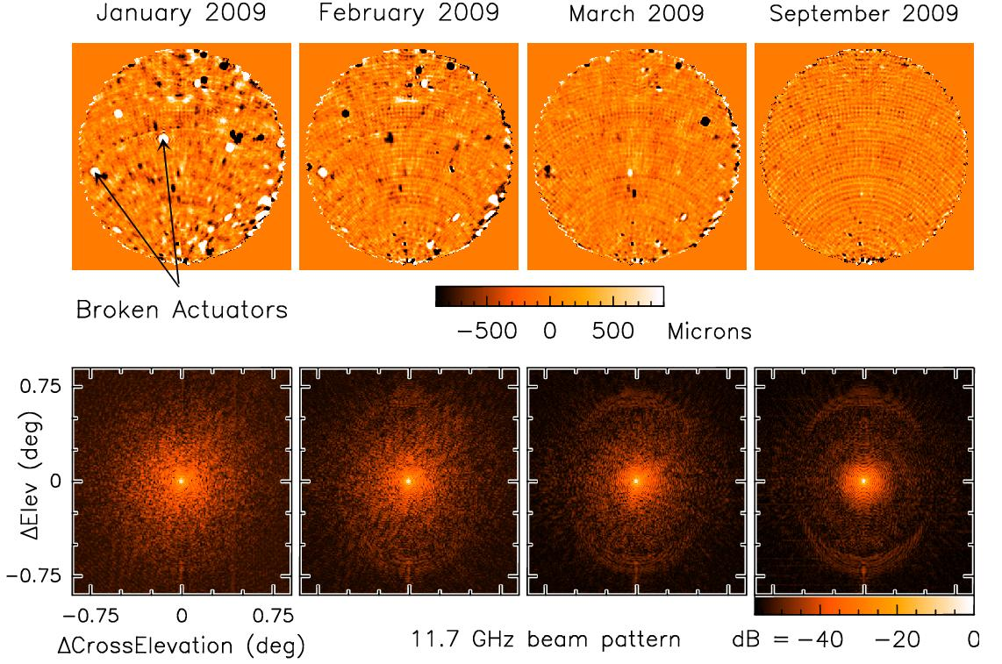
Improvements to Surface Makes 3mm Possible
(From Todd Hunter, PTCS group)

Slide 9
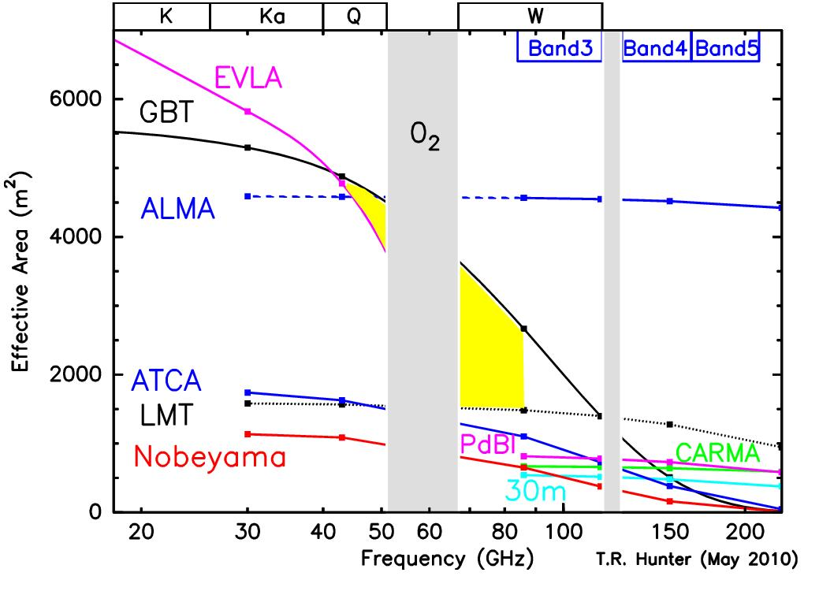
GBT Effective Collecting Area (η_{a} * Area)
Assumes current ~240um rms surface errors➔ 35% at 90 GHz
➔ most sensitive facility at Q and W-low (ALMA-band2, 4mm).

Slide 10
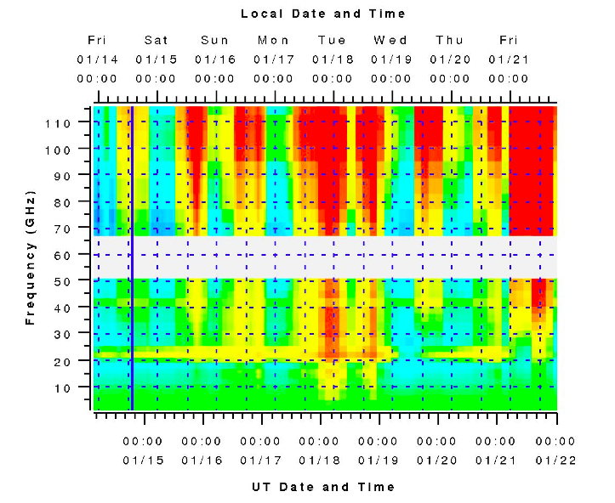
6500 hours a year scheduled
for astronomy on the GBT
Dynamic Scheduling System (DSS) matches the project to the weather
In 2010 there were 1776 hours used at frequencies above 18 GHz
10

Slide 11
Outline:
Green Bank and GBT background
GBT Science
GBT Capabilities
GBT Proposal Process and Planning Tools

Slide 12
Some Key GBT Science Areas:
(~30%) Pulsars: Discovery of new pulsars, the most massive pulsar, search for gravitational radiation
(~30%) Neutral Hydrogen HI: Gas masses of local galaxies, Kinematics of galaxy and local group/dark matter, HI intensity mapping at high-redshift
(~30%) High-frequency science:
90 GHz imaging with Mustang
CO at redshift (K/Ka{+Zpectrometer}/Q)
Interstellar Organic Molecules & Astro-chemistry
Masers: black hole masses, distances via proper motions
Star Formation: NH3 mapping (KFPA)
Solar system astronomy (radar mapping)
12

Slide 13
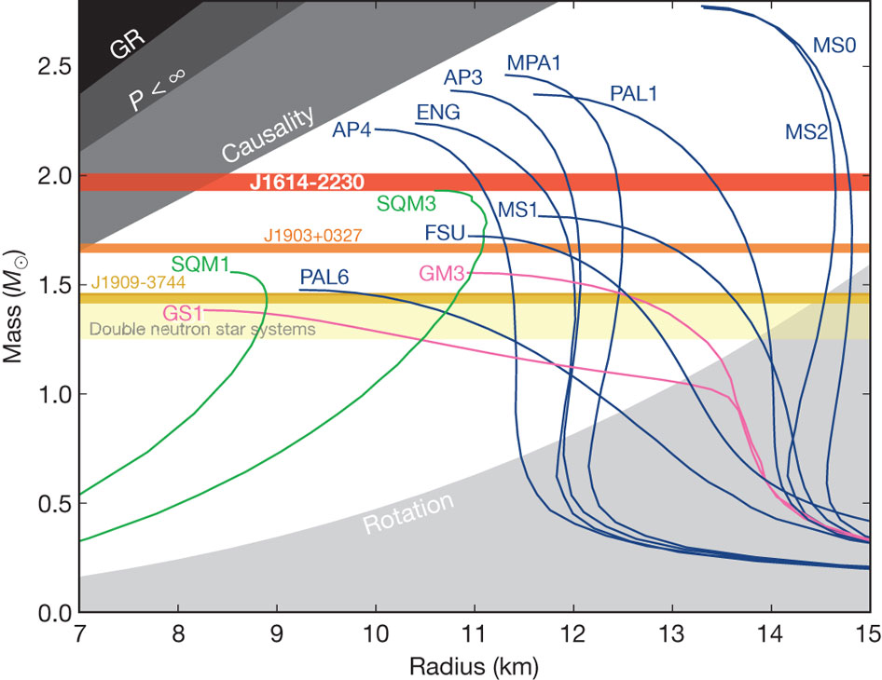
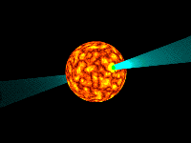
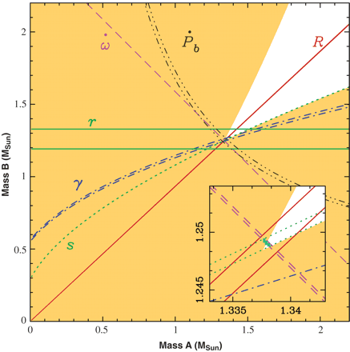
Pulsar timing results
Most massive neutron star
PSG J1614-2230 ~2M(sun)
Demorest et al. 2010
Measuring binary pair eccentricity to test general relativity
Notes:
Needs GBT for instantaneous sensitivity, sky coverage
Image: Enough eccentricity such that we have already measured their orbital precession. The precession is likely
caused by general relativity and provides the total system mass (Mtot).

Slide 14
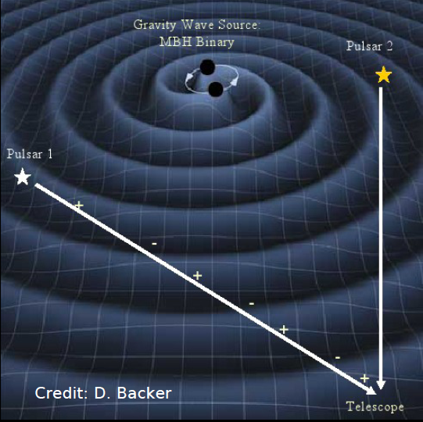
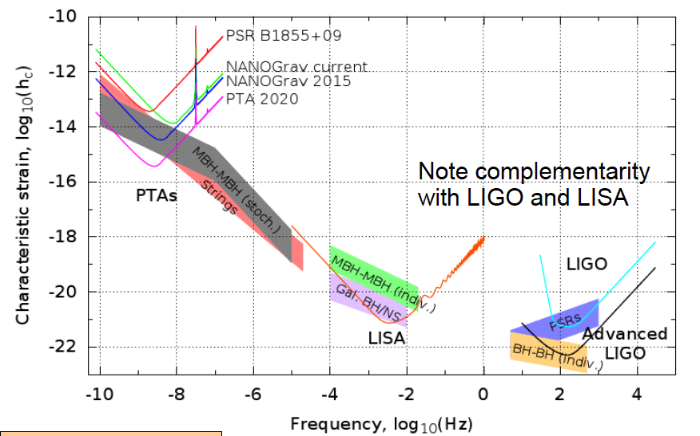
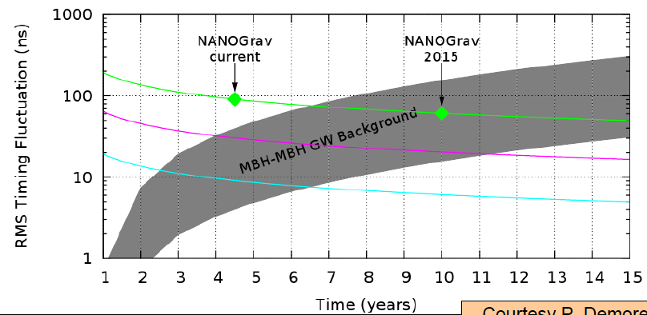

Gravity Waves
NANOGrav
The GBT may provide first detection of gravitational waves
Need 40 pulsars with <100ns timing residuals
Notes:
Cannot be done without GBT within any reasonable timescale; Needs GBT for instantaneous sensitivity, sky coverage
Nanograv status: We are timing 34 pulsars with Arecibo and Green Bank. Two pulsars have RMS residuals less than 100 ns. We require at least ~40 pulsars being timed at this level for GW detection

Slide 15
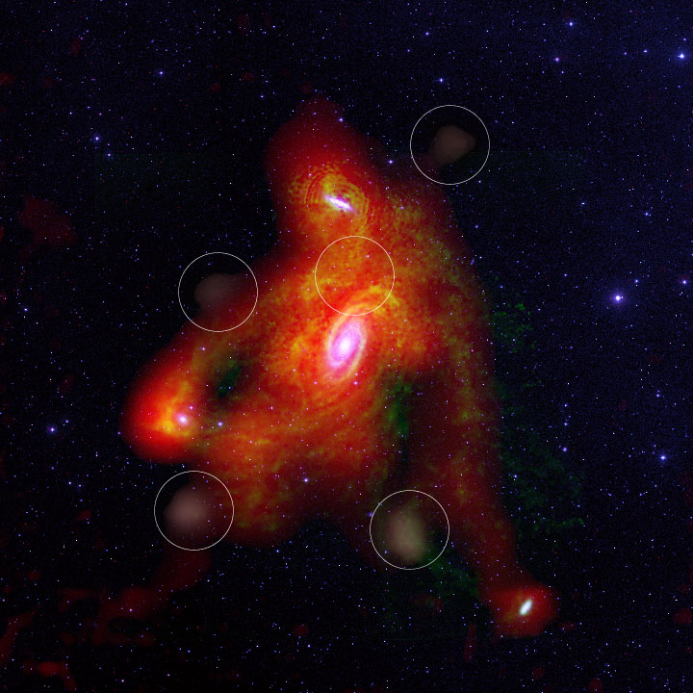
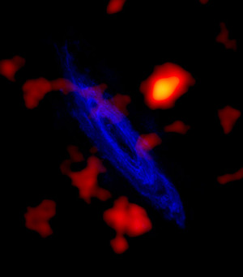
Local Galaxies and Dark matter via HI
Chenowyth et al 2008
Westerbork + GBT
Thilker et al 2004 ApJ

Slide 16
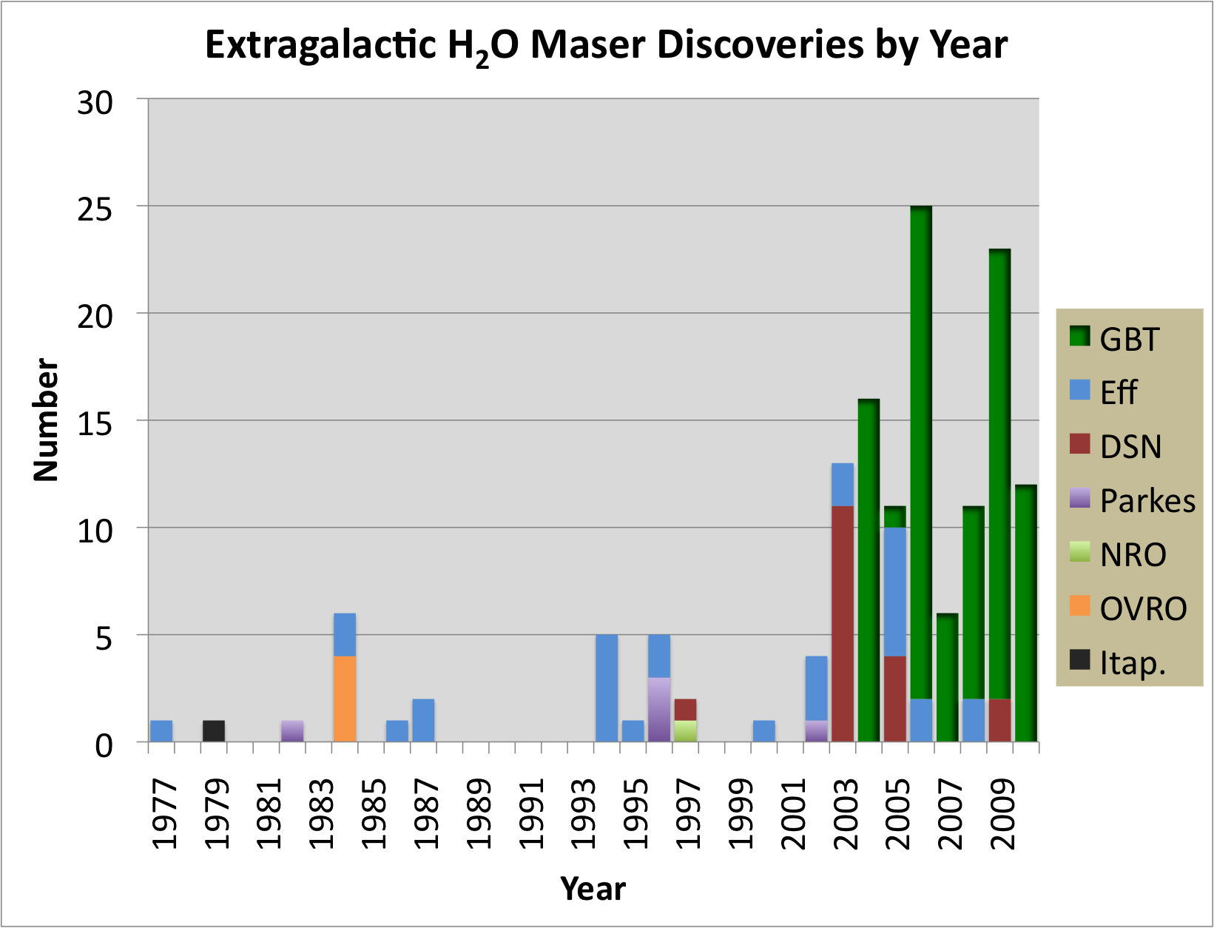
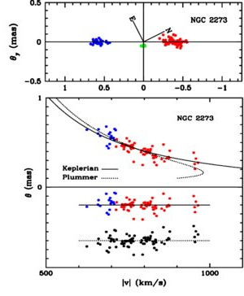
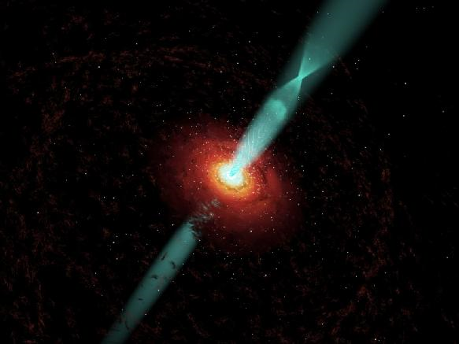

Measurements of Ho and SMBH masses via H20 Masers
Over 80 masers from the GBT
Measuring H₀ within 3% precision by obtaining geometric distances to water masers in other galaxies*
Measuring precise masses of the black holes in megamaser disk galaxies*
*GBT used both for Maser discovery and providing necessary sensitivity to VLBA
Notes:
Maser distributions (top panels) and rotation curves (bottom panels) for NGC 1194, NGC 2273, UGC 3789, and NGC 2960. The maser distribution has been rotated to horizontal to show the scatter in the maser positions and the offset of the systemic masers from the plane defined by high-velocity masers more clearly. The coordinate system is chosen to place the centroid of the high-velocity maser disk (blue and red points) at θ_{y} = 0 and the centroid of the systemic masers (green points) at θ_{x} = 0. The axes for the maps show relative position in milliarcseconds, and north (N) and east (E) are indicated by directional arrows on each map. The bottom panel for each galaxy shows the rotation curves of the redshifted and blueshifted masers (red and blue points on the curves) plotted with the best-fit Keplerian (solid curve) and Plummer (dotted curve) rotation curves. The velocities shown in the figure are the LSR velocities after the special and general relativistic corrections. The residuals (data minus Keplerian curve in red and blue; data minus Plummer curve in black) are in the bottom part of each figure. Note that we plot the rotation curve with the impact parameter θ (mas) as the ordinate and rotation speed |v| (km s^{–1}) as the abscissa for the convenience of fitting.

Slide 17
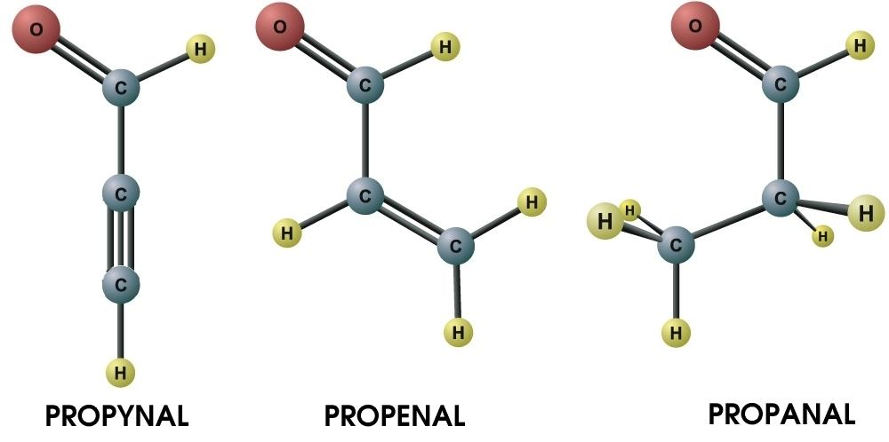
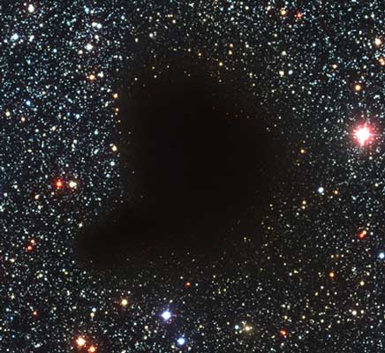
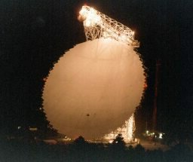
Organic chemistry in interstellar clouds
H2O (water)
H2CO (formaldehyde)
NH3 (ammonia)
CO (Carbon monoxide)
HCOOH (formic acid)
CNCHO (cyanoformaldehyde)
CH3OH (methanol)
CH2CHCN (vinyl cyanide)
HOCH2CH2OH (ethylene glycol)
CH3CO2H (acetic acid)
CH3CH2OH (ethyl alcohol)
CH2OHCHO (glycolaldehyde)
The GBT has detected 14 new interstellar organic molecules
including the first interstellar anions:
C6H⁻ & C8H⁻
(McCarthy et al 2006;
Cordiner et al 2011)
17

Slide 18
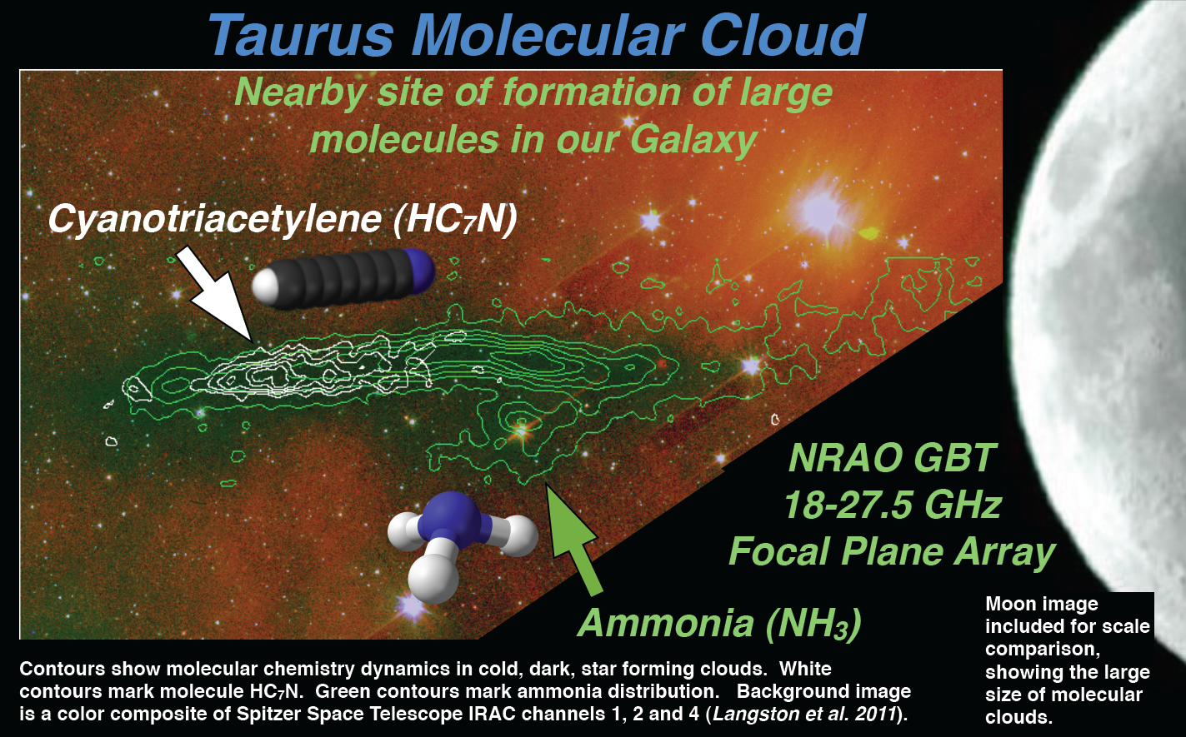
Mapping of Star-Formation Regions with the K-FPA

Slide 19
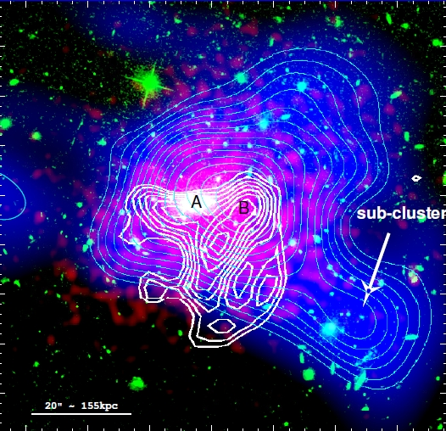
Mustang 3mm Imaging of SZ-Effect and Cluster Structure
Image of CL1226.9+3332 (z = 0.89); White is MUSTANG; Green is optical (HST); Red is X-ray (Chandra); Blue is mass density (HST) Courtesy Korngut, et al.
Notes:
MUSTANG is a uniquely capable instrument for studies of the SZE in that it has 5+x higher resolution than the other instruments in use.
Includes High resolution imaging of the Sunyeaev-Zel’dovich effect
IMAGE: In our highest redshift system, CL1226, we find a
multiply peaked pressure distribution with an asymmet-
ric morphology. The location and orientation of a ridge
found in the SZE, along with a south-westerly elongated
shape, are qualitatively supportive of the merger scenario
proposed by Jee & Tyson (2009).
Composite image of CL1226. Red shows the Chandra surface brightness in the 0.7keV to 7.0keV band. Blue color scale and
cyan contours show the surface mass density distribution of Jee & Tyson (2009). Contours are linearly spaced in 15 intervals between
= 0:25 and = 0:59. Green traces the optical emission as measured by the HST/ACS in the F814W band. White contours show
the MUSTANG measurement in units of 0:5 starting at 3. Location A demarcates the BCG and is coincident with the X-ray surface
Brightness peak. Location B shows the Dark Matter peak which is coincident with the northern lobe of the SZ ridge revealed by MUSTANG
imaging.

Slide 20
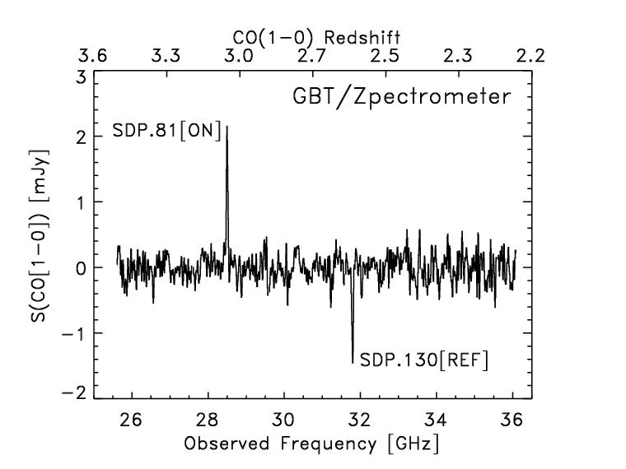
Studying star formation in the early universe via high-redshift CO
Frayer et al. 2011: Molecular gas measurements and redshifts of ultra-luminous infrared galaxies discovered by Herschel with the GBT/Zpectrometer.
(around 15-20 Herschel sources with GBT redshifts)

Slide 21
Outline:
Green Bank and GBT background
GBT Science
GBT Capabilities
GBT Proposal Process and Planning Tools

Slide 22
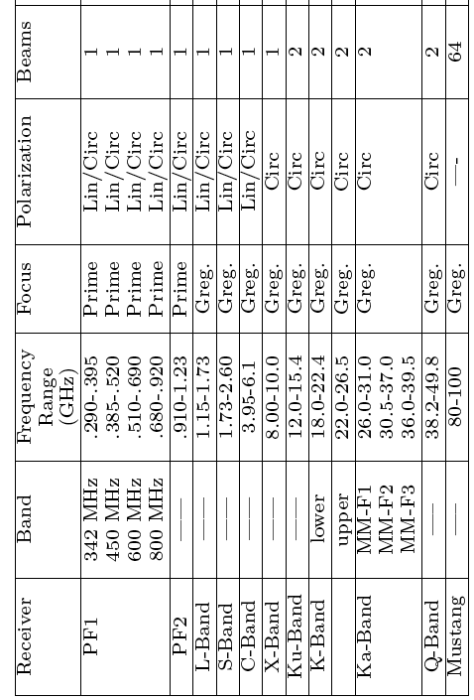
Current Instruments – Front Ends
Example lines:
HI, OH
NH3, HC5N, C2S, H2O
KFPA
-- 7
HCN, HNC, HCO+, HDO, DCN, SiO, SO2, H2CO, N2H+, N2D+, CH3CN, C2H
{W-band (4mm Rx) 67-93.3 Greg. Lin/Circ 2}

Slide 23
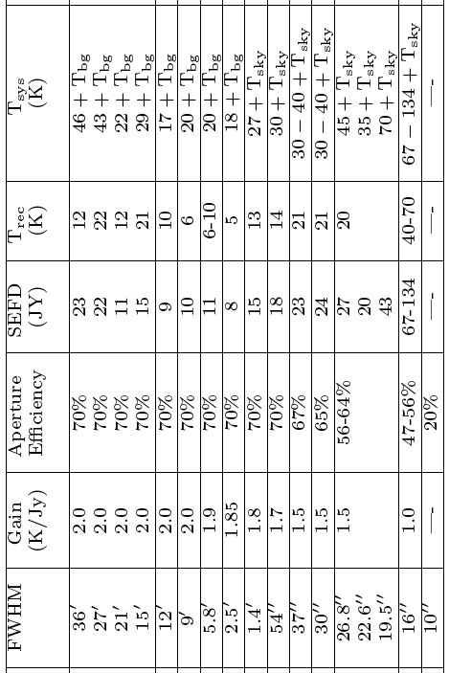
Current Instruments – Front Ends-2
--→68%
--→67%
----→65%
----→60%
--→35%

Slide 24
Backends/Spectrometers
Spectrometer with bandwidths: 800, 200, 50, 12.5 MHz. Maximum resolution is 49 Hz with 12.5MHz bandwidth. Minimum integration times 1-2 sec.
Spectral Processor (FFT spectrometer) for high-time resolution data (useful at low freq where RFI is an issue).
Continuum with DCR (digital continuum receiver) for most bands, CCB used for continuum at Ka, and Mustang for continuum at 90GHz.
GUPPI used for Pulsar Observations
VEGAS (VErsitile GBT Astronomical Spectrometer) is the new replacement for the Spectrometer available in 2012 (FPGA based).

Slide 25
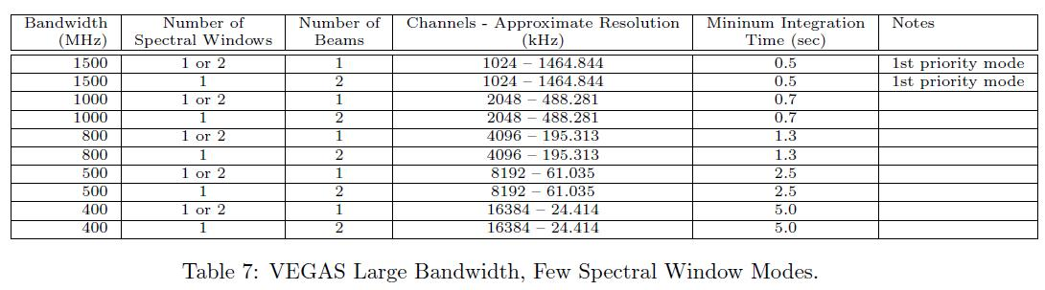
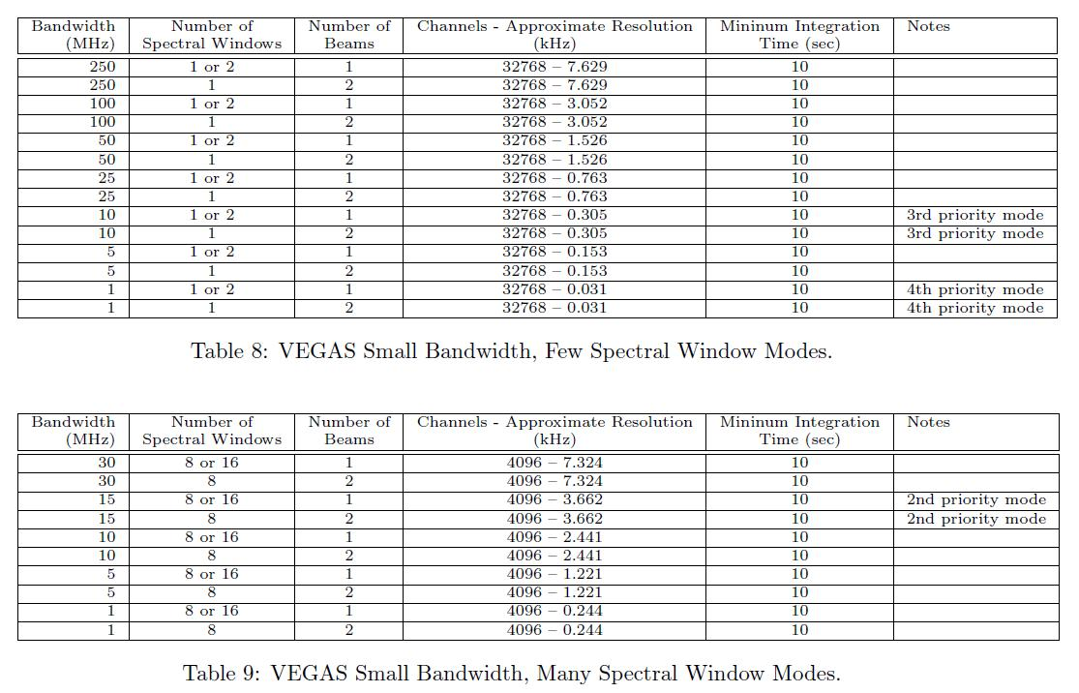
VEGAS:
Supports 8 beams, dual polarization (e.g., K-FPA). Up to 16 windows (one beam), 8 windows (two beams).
Maximum continuous bandwidth of 10 GHz, eventually.

Slide 26
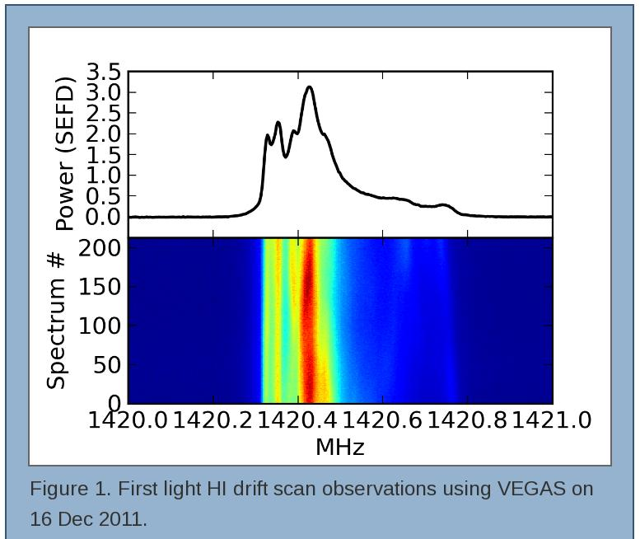
VEGAS First Light Dec 2011

Slide 27
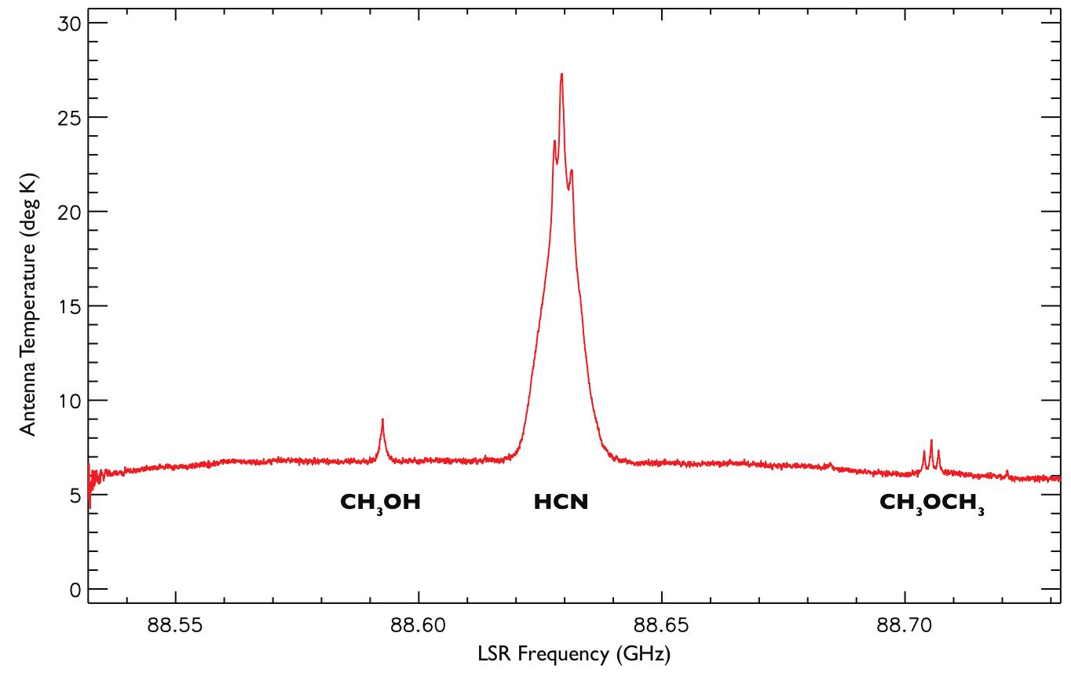
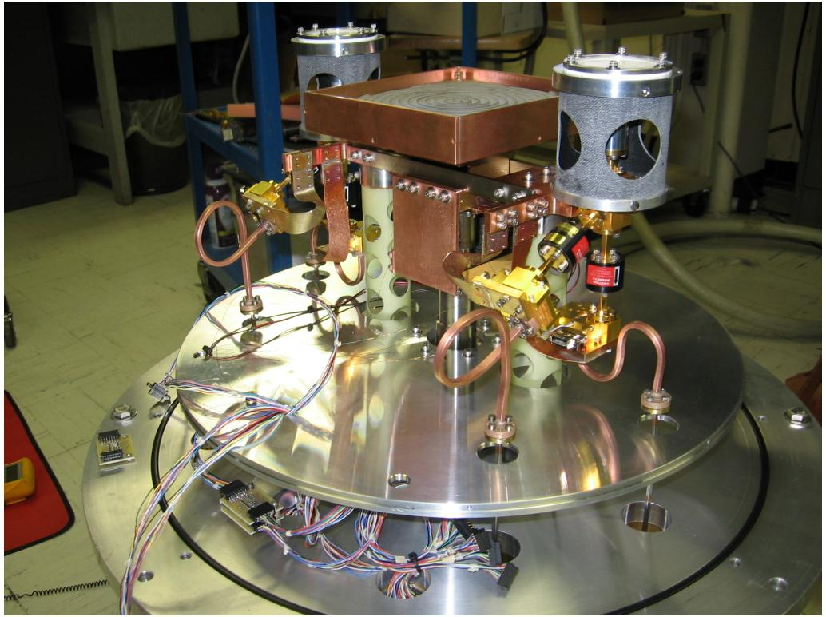
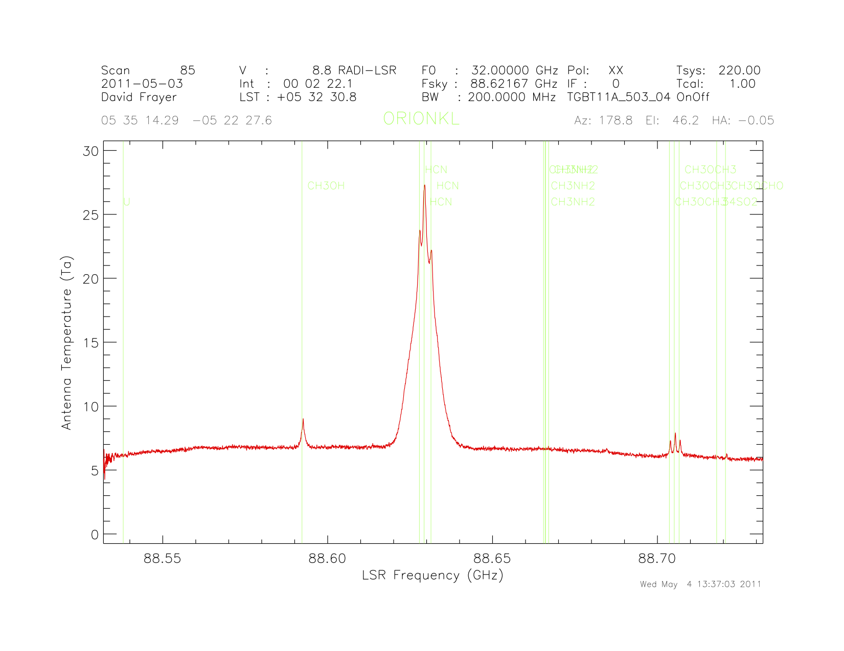
GBT’s newest receiver: The 4mm Receiver (67-93.3 GHz). First Light, May 2011: HCN in Orion-KL
{couple of minutes taken during the day in marginal weather}
Commissioned: 2012 Jan-Mar
Feeds, Cold Load
Orion-KL
See http://www.gb.nrao.edu/4mm for more details.

Slide 28
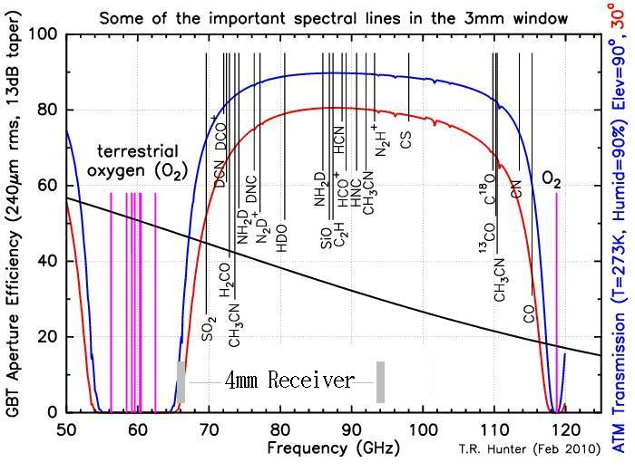

Slide 29
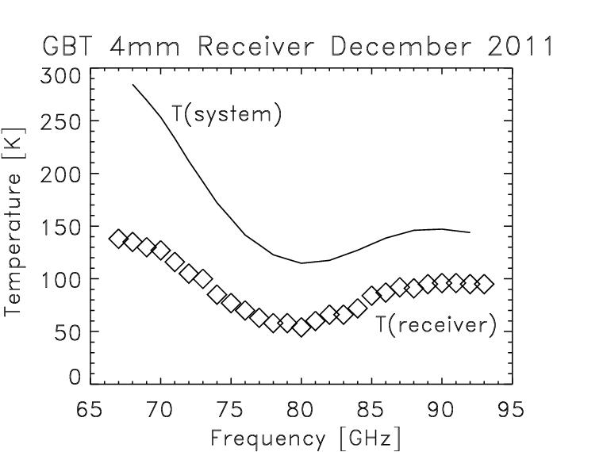
4mm System Performance {with current non-optimized amplifiers}
With resources and a bit of effort could reach T(rx)~40K across the band.
Solid curve shows Tsys for “typical” weather scheduled by DSS. In good weather, sky contributes <30K.

Slide 30
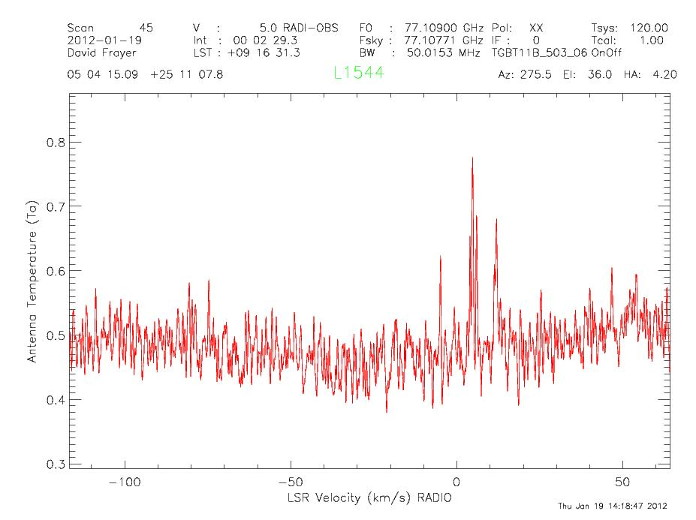
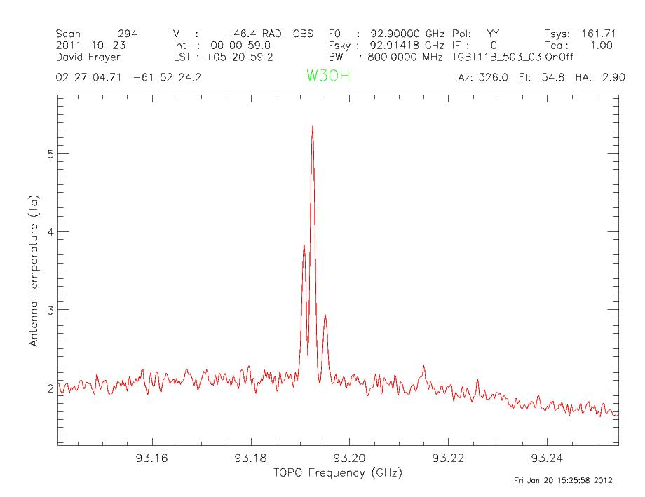
4mm Rx: Cold starless-cores ➔molecular freeze-out ➔D-species enhanced
N2D+ in L1544 at 77 GHz (S. Schnee et al.)
N2H+ in W3OH at 93 GHz

Slide 31
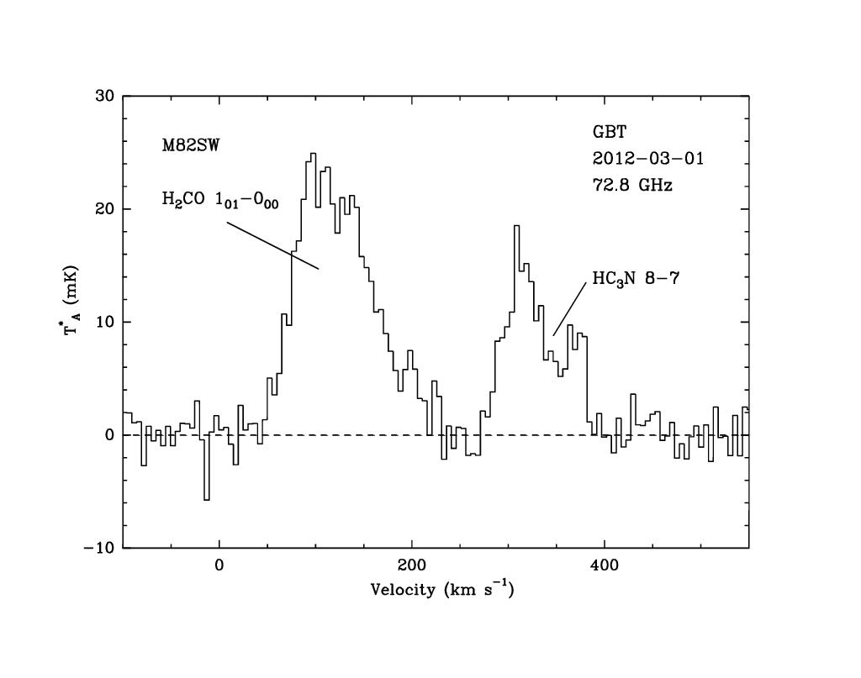
4mm: Dense gas and Molecular Diversity in Nearby Galaxies
M82
H2CO
(formaldehyde)
& HC3N
(J. Mangum)

Slide 32
Outline:
Green Bank and GBT background
GBT Science
GBT Capabilities
GBT Proposal Process and Planning Tools

Slide 33
NRAO Semester 2013A Call for Proposals
The NRAO Semester 2013A Call for Proposals for the Green Bank Telescope, Jansky Very Large Array, and Very Long Baseline Array/High Sensitivity Array will be published as a special issue of the NRAO eNews on Monday, 9 Jul 2012.
The 2013A proposal submission deadline will be
Wed, 1 Aug 2012, at 5 p.m. EDT.

Slide 34
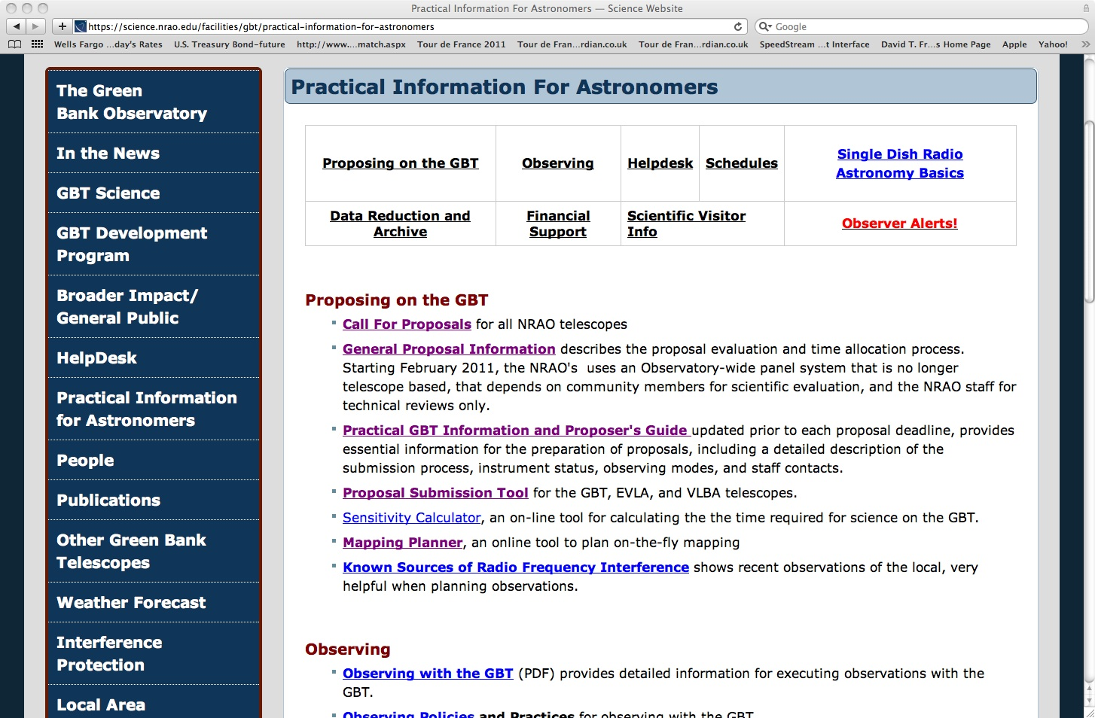
See NRAO web pages for the eNews Proposal call and GBT proposal guide to get the latest information

Slide 35

GBT Proposal Guide

Slide 36

GBT Performance

Slide 37

GBT Web Links related to proposals:

Slide 38

GBT Proposals are submitted via the “PST” (Proposal Submission Tool)
1st step, click here;-)

Slide 39

Click here when done
Fill out proposal sections

Slide 40




Slide 41

Use GBT Sensitivity Calculator for proposal time estimates, and also used for verifying available modes.

Slide 42

Sensitivity Calculator – Hardware modes

Slide 43

Sensitivity Calculator – Source Info

Slide 44

Sensitivity Calculator – Data processing

Slide 45

GBT Mapping Planner

Slide 46

GBT Mapping Planner: Results

Slide 47

Help?? --- NRAO HelpDesk

Slide 48
Help?? --- GBT Contacts (listed in GBTpg)

Slide 49
Summary
The GBT is a powerful instrument – single-dish flexibility, large collecting area, wide-frequency coverage
Diverse science
Development ongoing (higher frequency, multi-pixel/feeds frontends, flexible backends) to enhanced capabilities
The 2013A proposal submission deadline will be Wed, 1 Aug 2012, at 5 p.m

