Slide 1

A Crash Course in
Radio Astronomy and Interferometry:
3. Interferometric Imaging
James Di Francesco
National Research Council of Canada
North American ALMA Regional Center – Victoria
(thanks to S. Dougherty, C. Chandler, D. Wilner & C. Brogan)

Slide 2
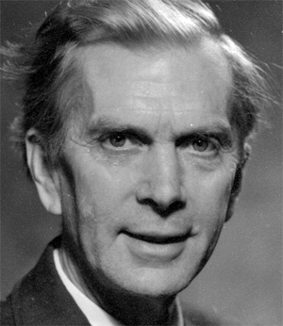
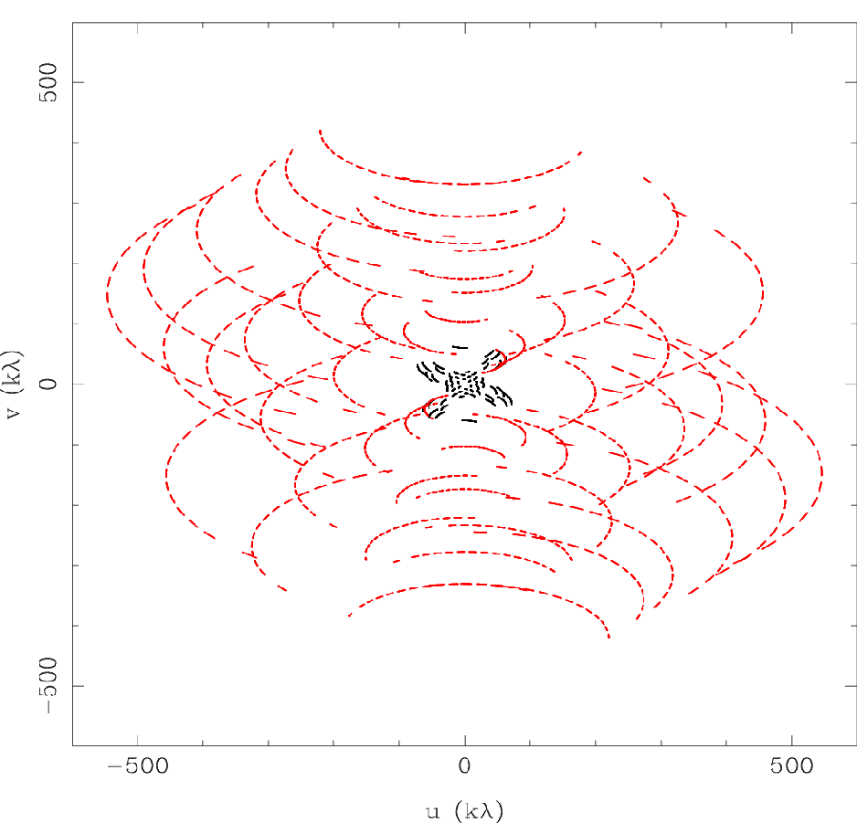

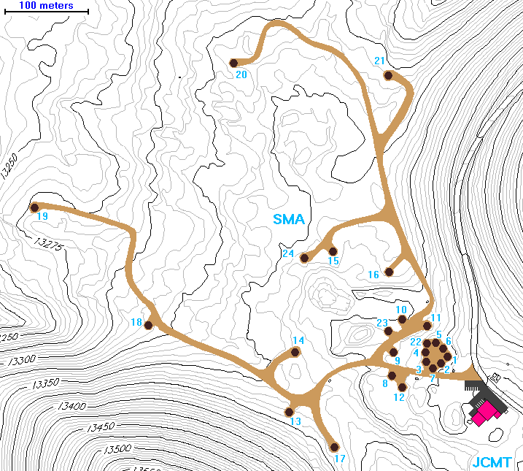
Aperture Synthesis
Aperture Synthesis
sample V(u,v) at enough points to synthesize the equivalent large aperture of size (u_{max},v_{max})
  1 pair of telescopes → 1 (u,v) sample at a time
  N telescopes → number of samples = N(N-1)/2
  fill in (u,v) plane by making use of Earth rotation: Sir Martin Ryle, 1974 Nobel Prize in Physics
  reconfigure physical layout of N telescopes for more
Sir Martin Ryle 1918-1984
2 configurations
of 8 SMA antennas
345 GHz
Dec = -24 deg

Slide 3
Imaging
(u,v) Plane Sampling
in aperture synthesis, V(u,v) samples are limited by number of telescopes, and Earth-sky geometry
  high spatial frequencies:
    maximum angular resolution
  low spatial frequencies:
    extended structures invisible
    (aka. only a max scale can be imaged; also ``zero-spacing problem” = no large scales)
  irregular within high/low limits:
    sampling theorem violated
    still more information missing

Slide 4
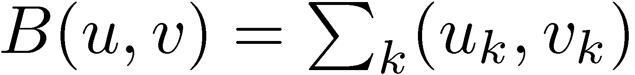
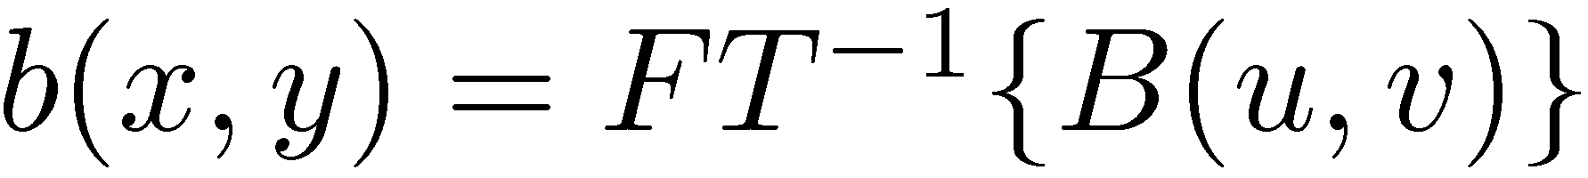
Imaging
Formal Description
sample Fourier domain at discrete points, i.e.,
so, the inverse Fourier transform of the ensemble of visibilities is:
but the convolution theorem tells us:
where (the point spread function)
Fourier transform of sampled visibilities yields the true sky brightness convolved with the point spread function
(the “dirty image” is the true image convolved with the “dirty beam”)
δ_{ij}(u,v)
I
I
I

Slide 5
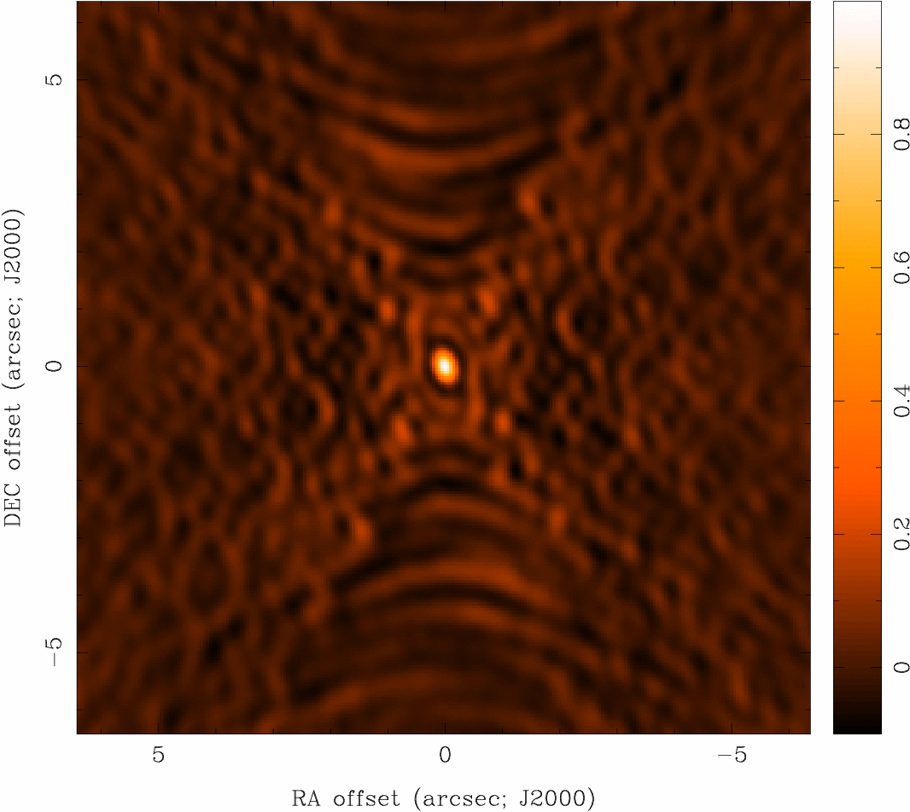
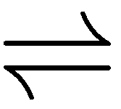

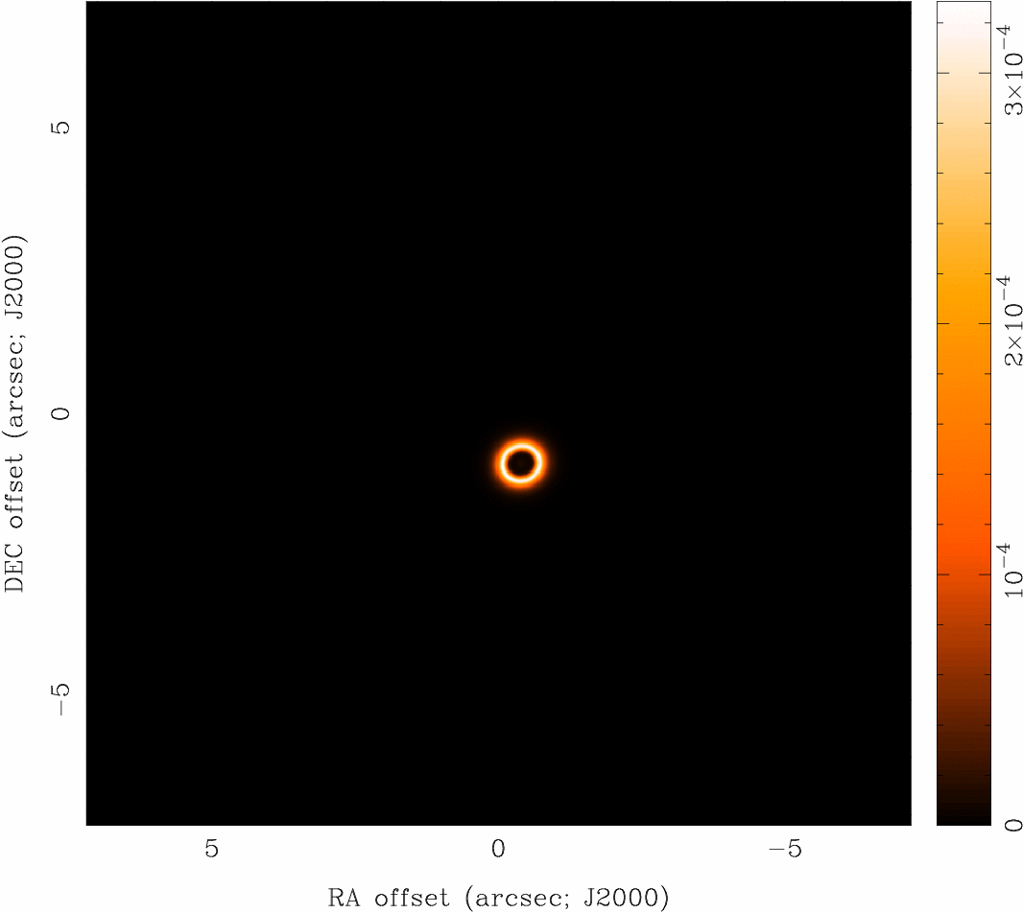
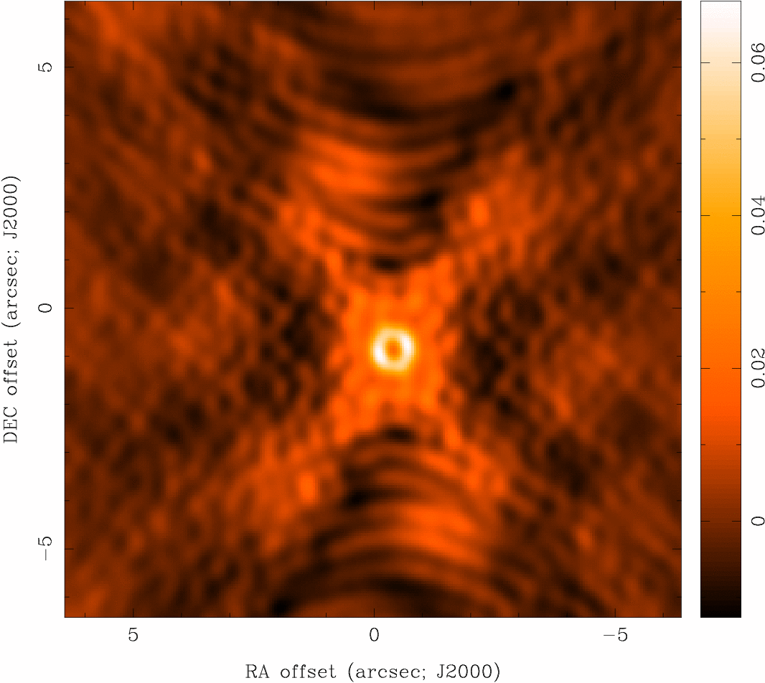

Imaging
Dirty Beam and Dirty Image
b(x,y)
(dirty
beam)
B(u,v)
I^{D}(x,y)
(dirty
image)
I(x,y)

Slide 6
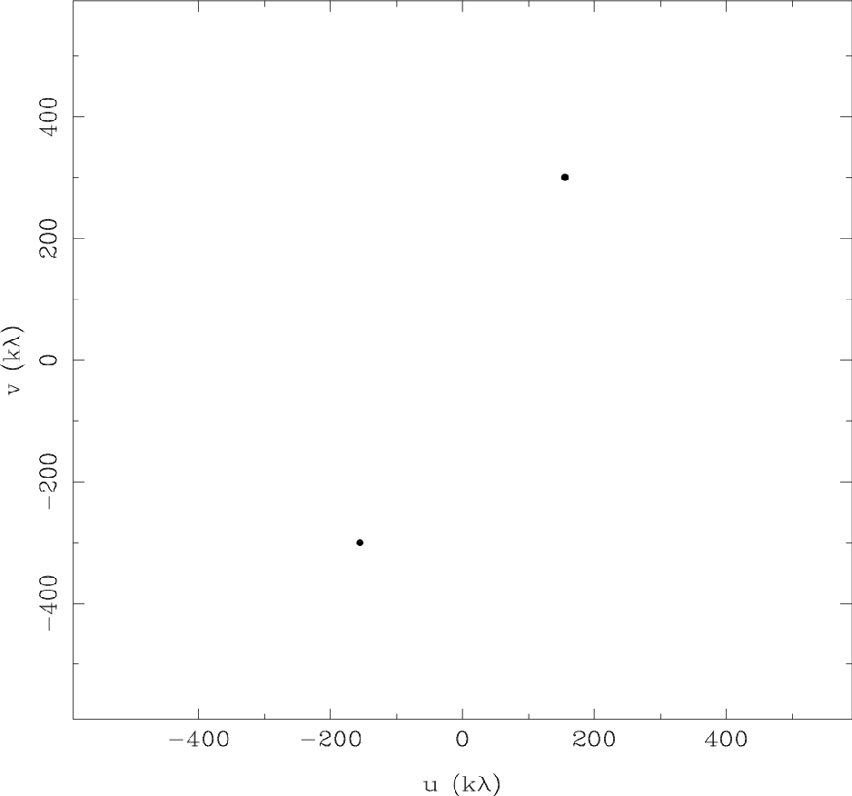
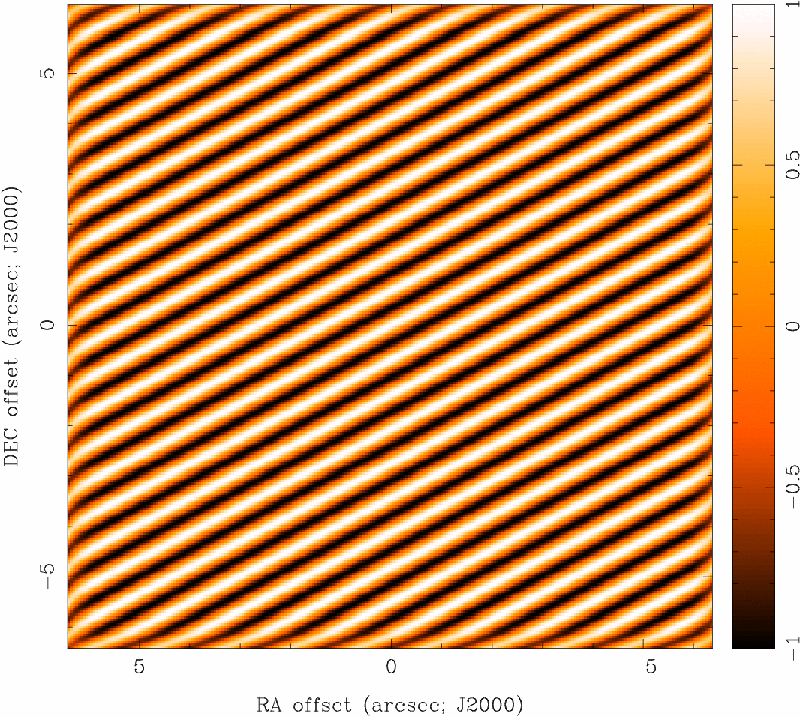
Imaging
Dirty Beam Shape and N Antennas
2 Antennas

Slide 7
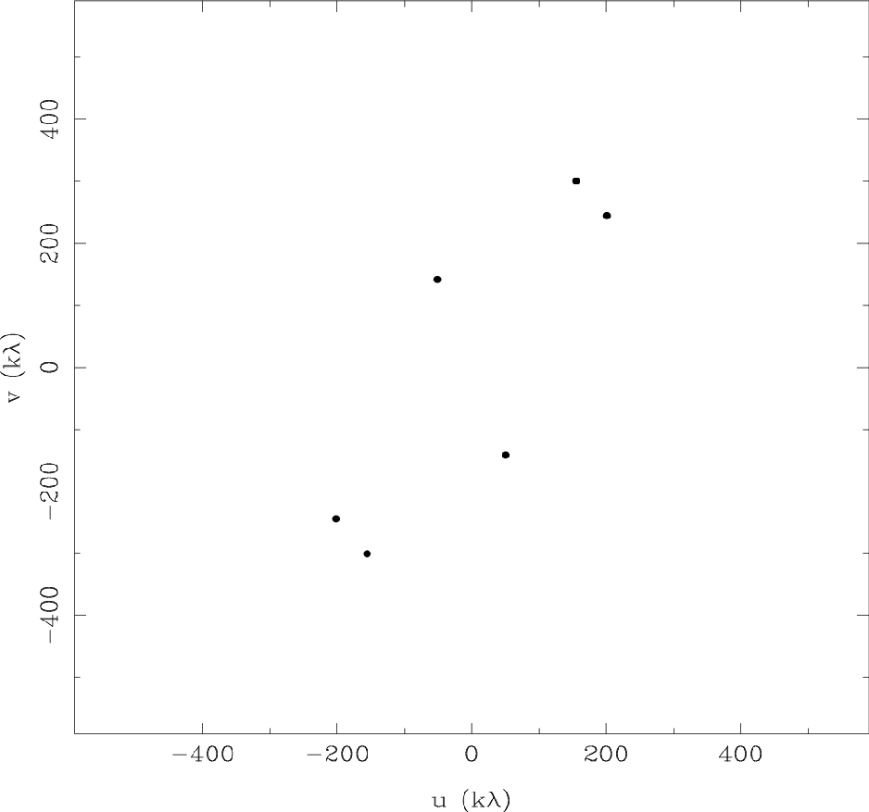
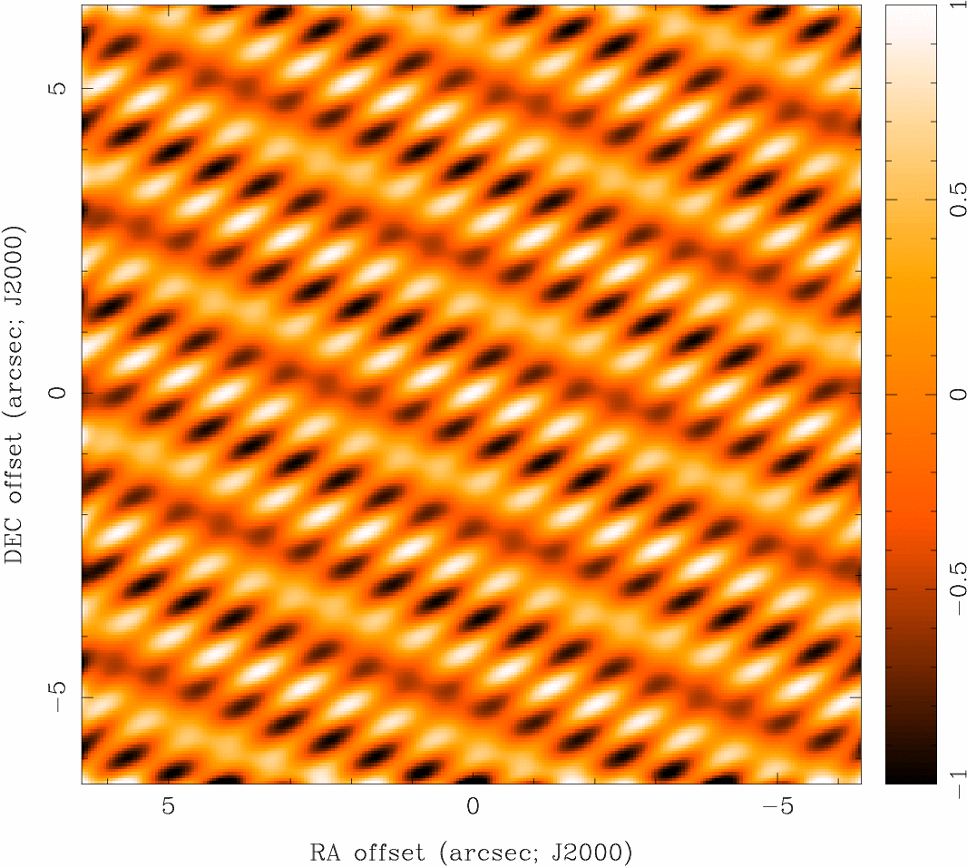
Imaging
Dirty Beam Shape and N Antennas
3 Antennas

Slide 8

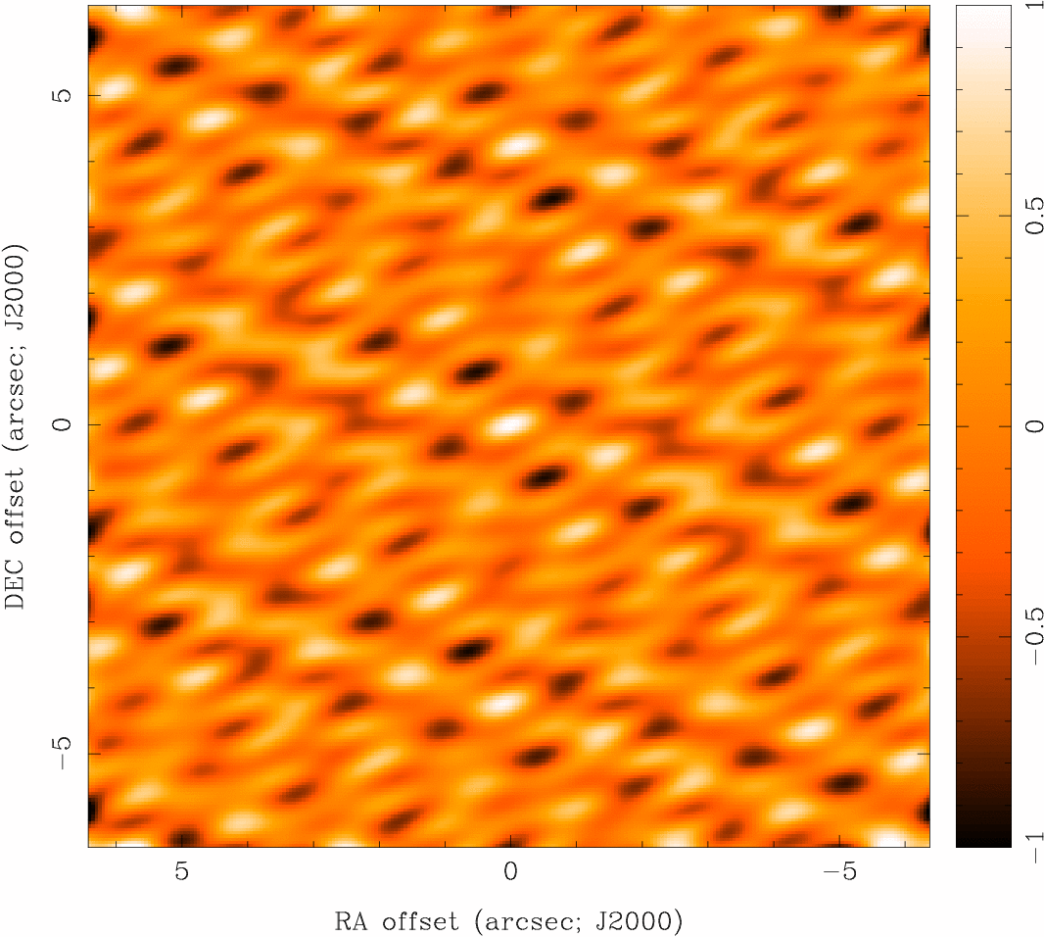
Imaging
Dirty Beam Shape and N Antennas
4 Antennas

Slide 9
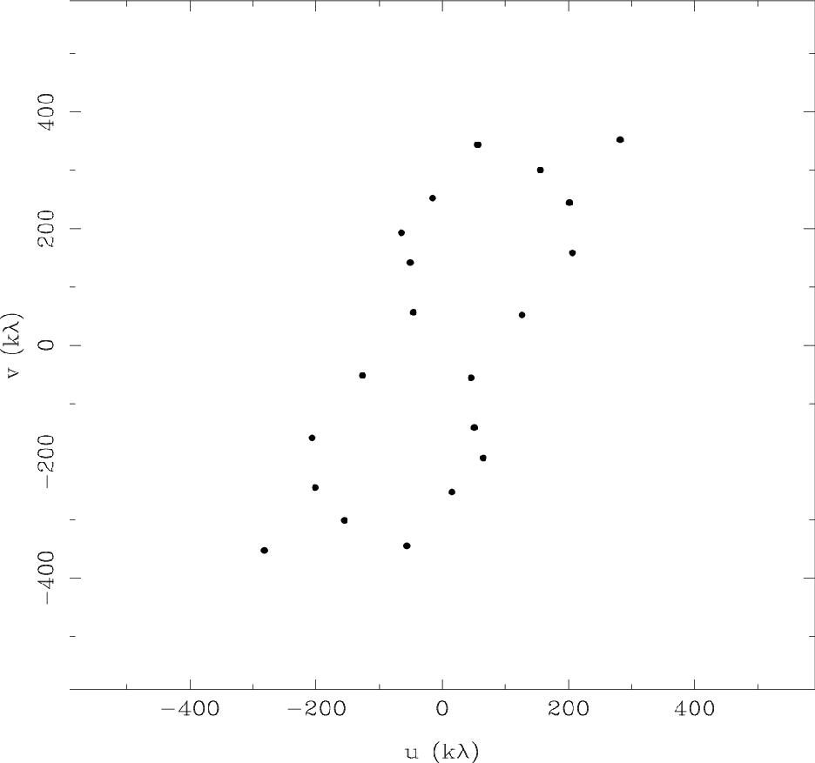
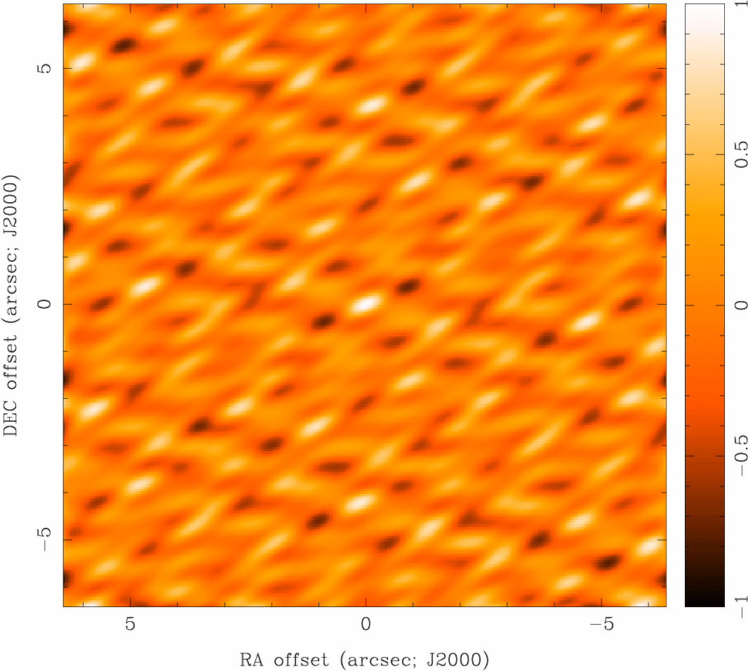
Imaging
Dirty Beam Shape and N Antennas
5 Antennas

Slide 10

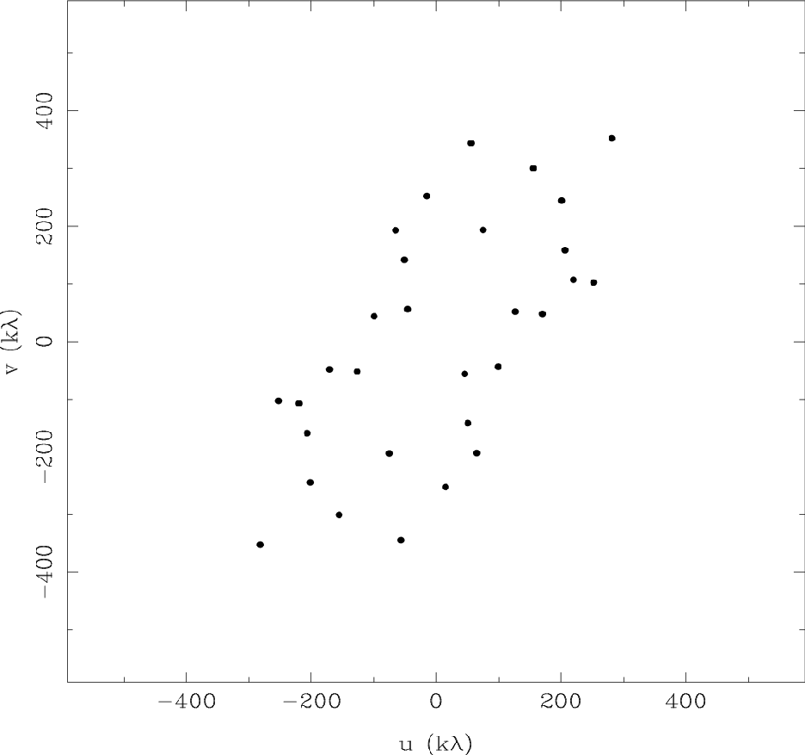
Imaging
Dirty Beam Shape and N Antennas
6 Antennas

Slide 11
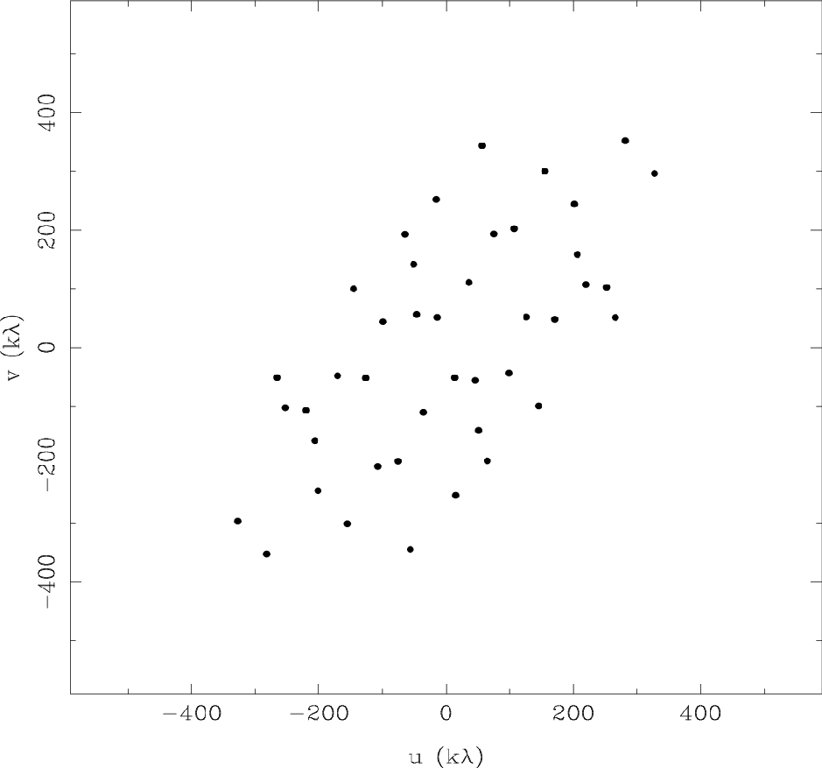
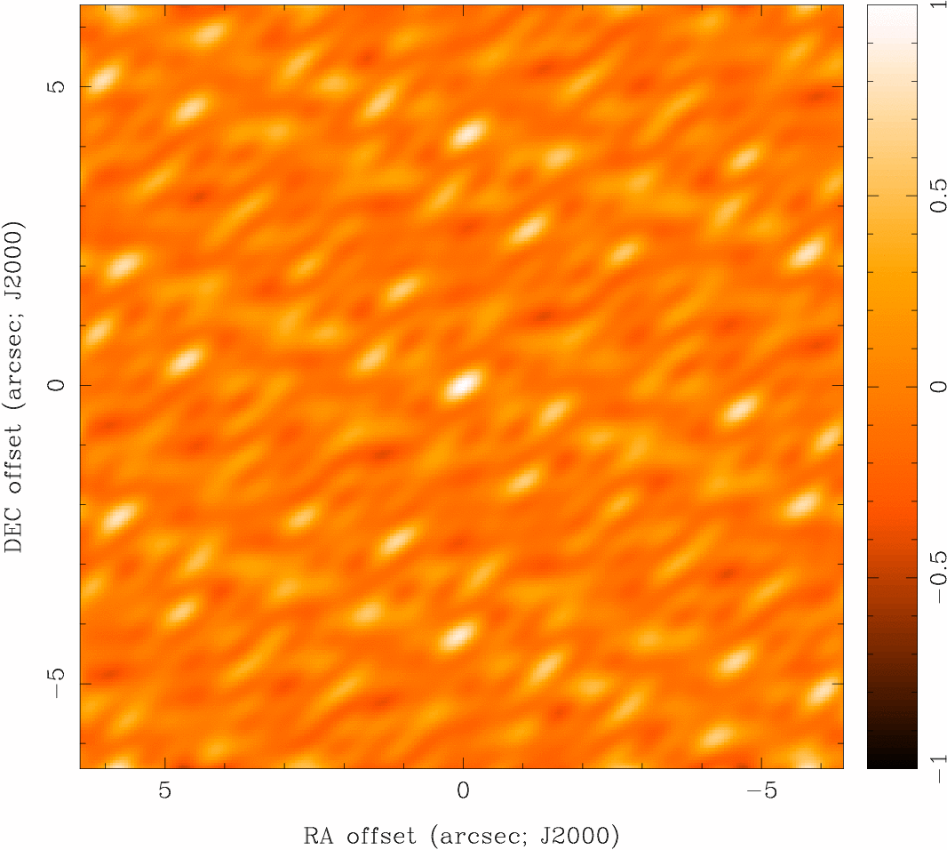
Imaging
Dirty Beam Shape and N Antennas
7 Antennas

Slide 12
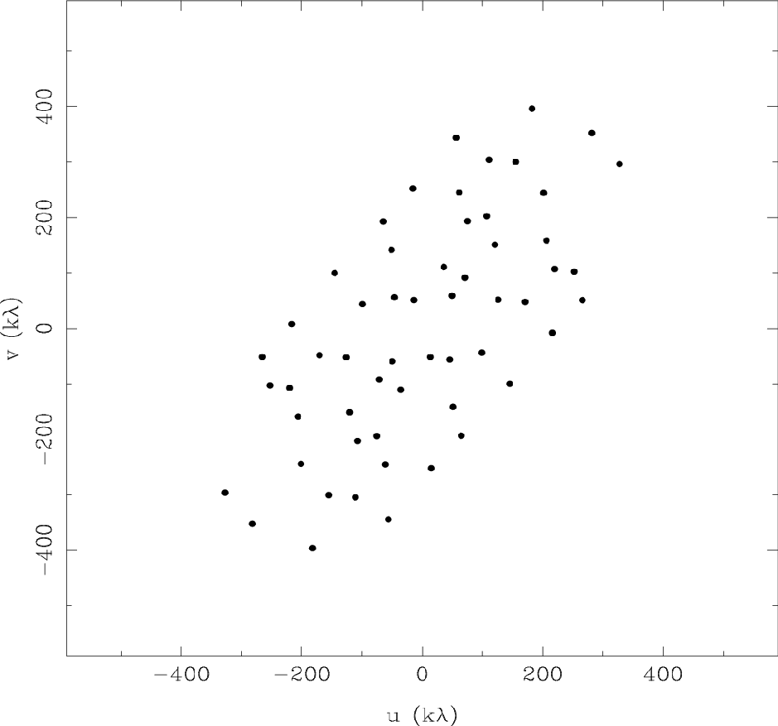
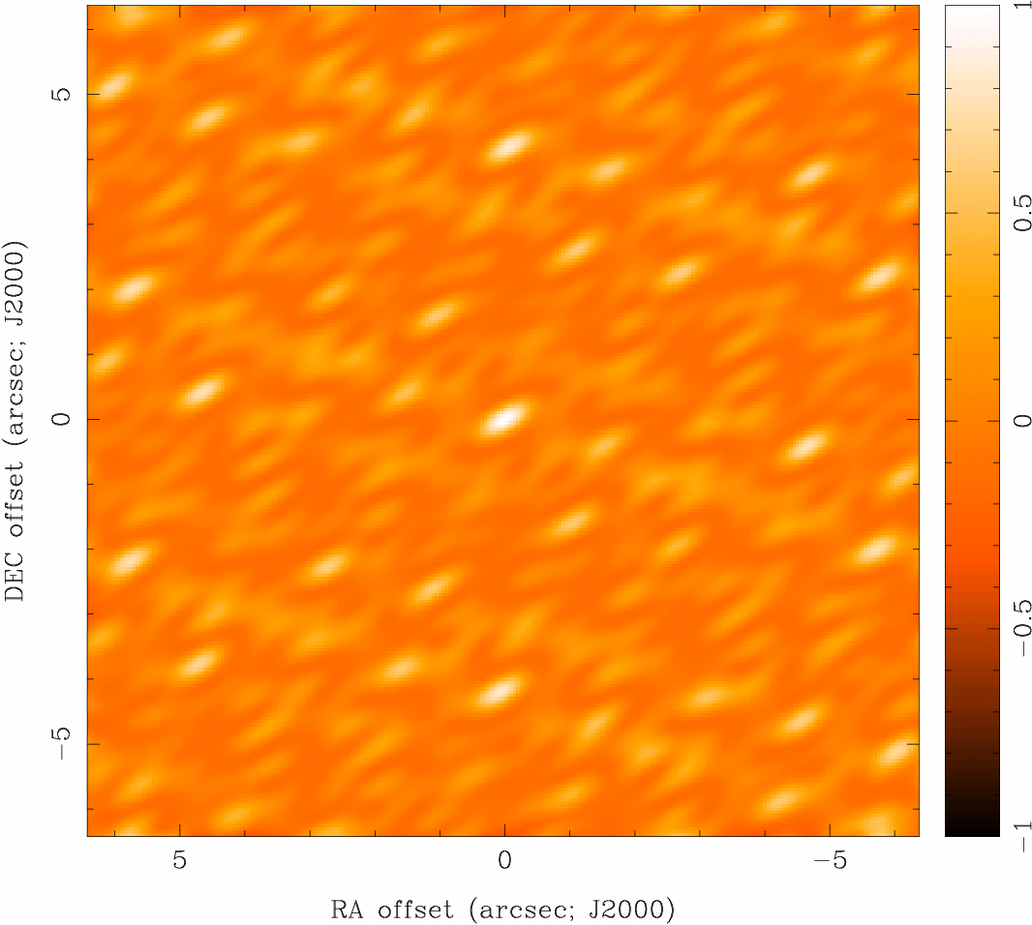
Imaging
Dirty Beam Shape and N Antennas
8 Antennas

Slide 13
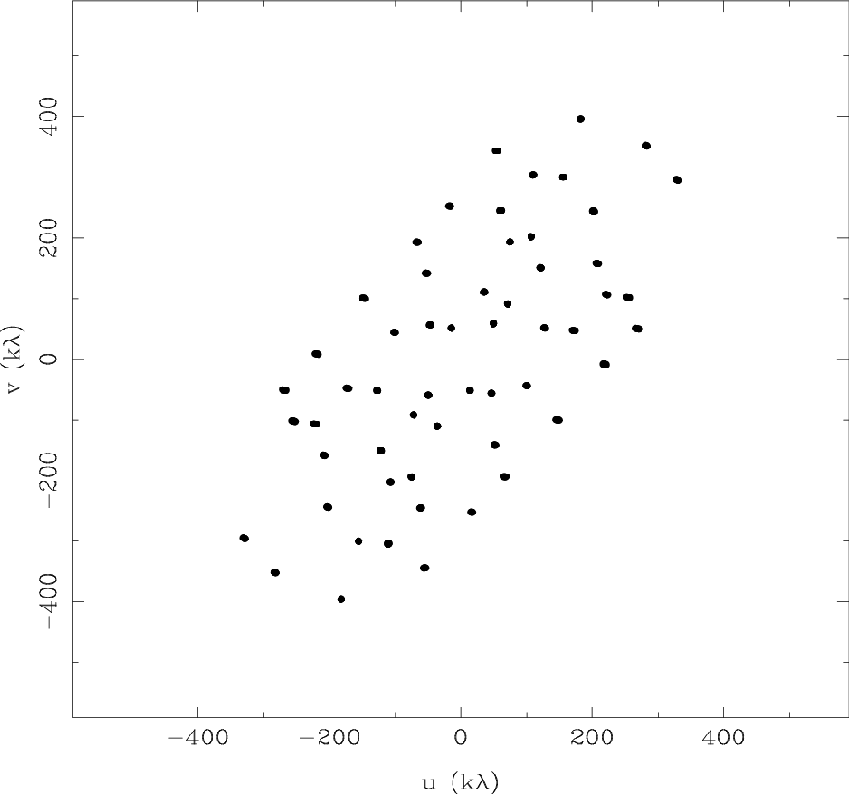

Imaging
Dirty Beam Shape and N Antennas
8 Antennas x 6 Samples

Slide 14
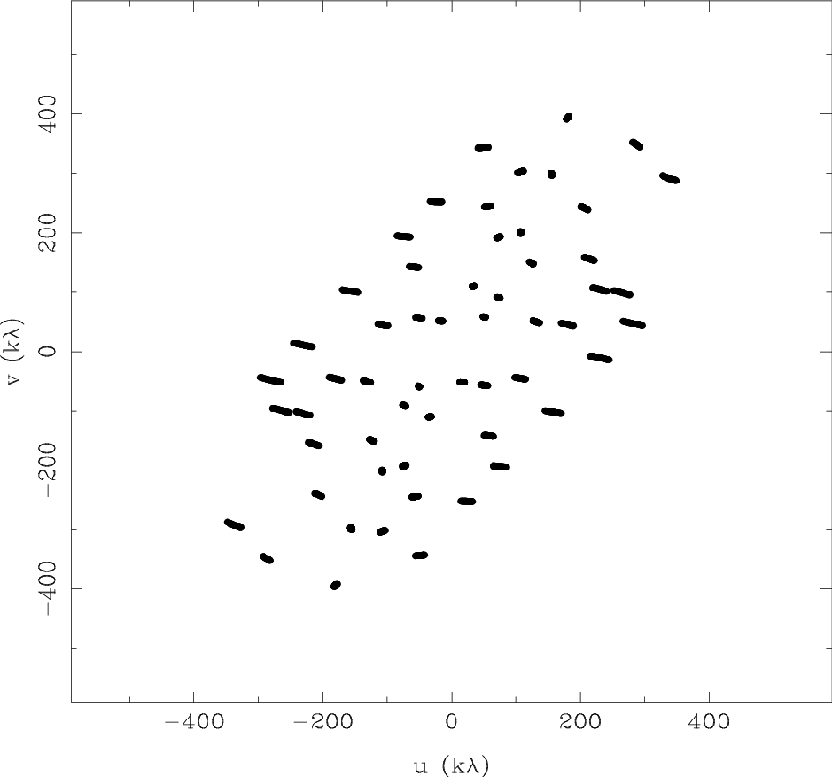

Imaging
Dirty Beam Shape and N Antennas
8 Antennas x 30 Samples

Slide 15
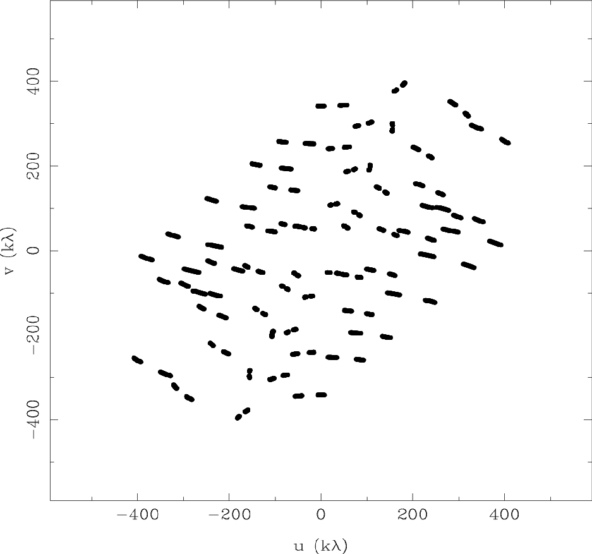
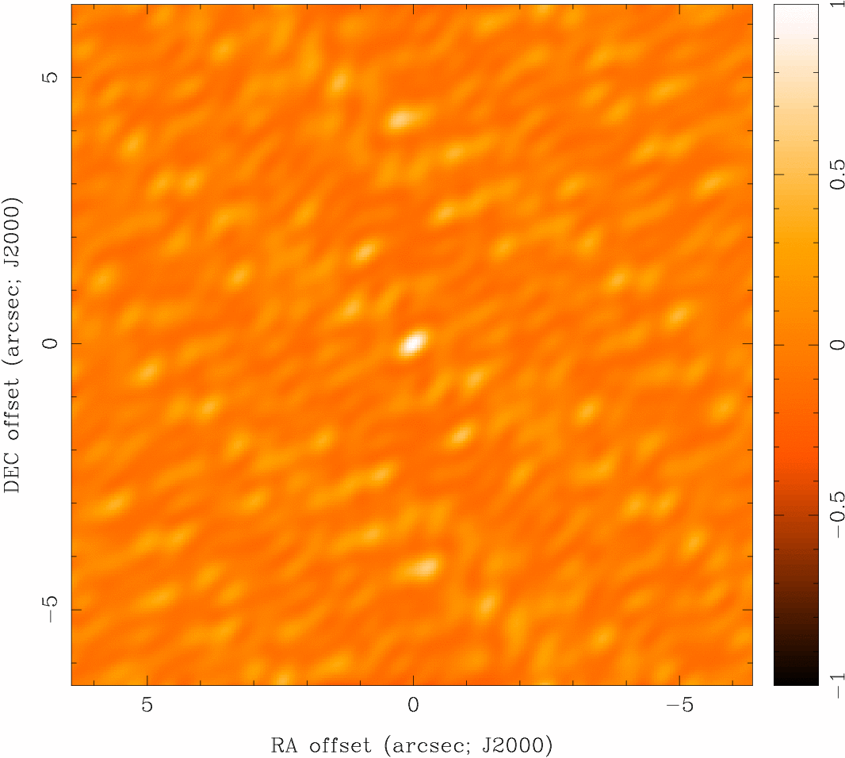
Imaging
Dirty Beam Shape and N Antennas
8 Antennas x 60 Samples

Slide 16
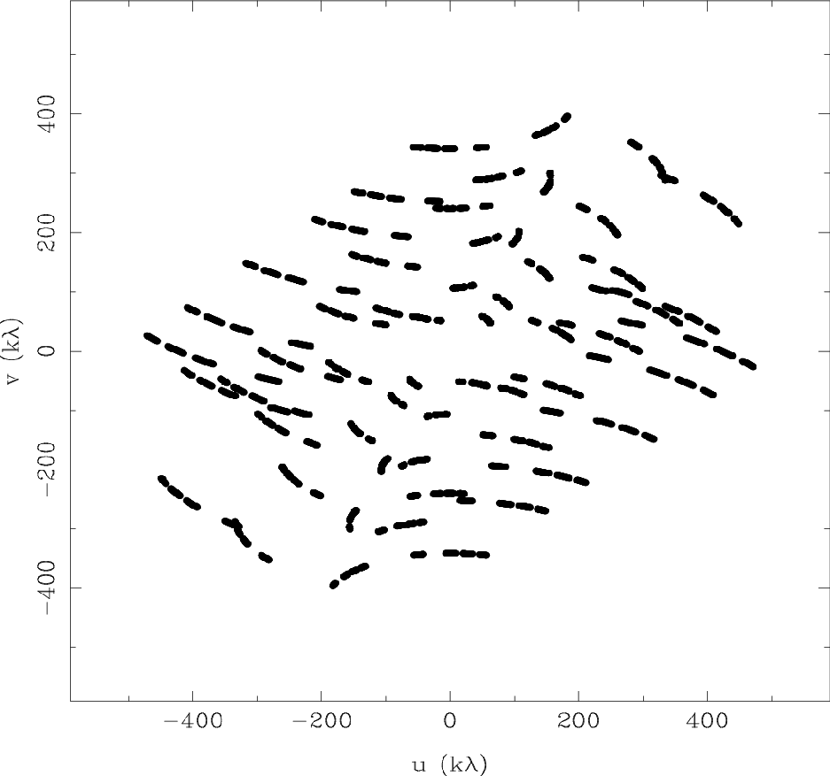
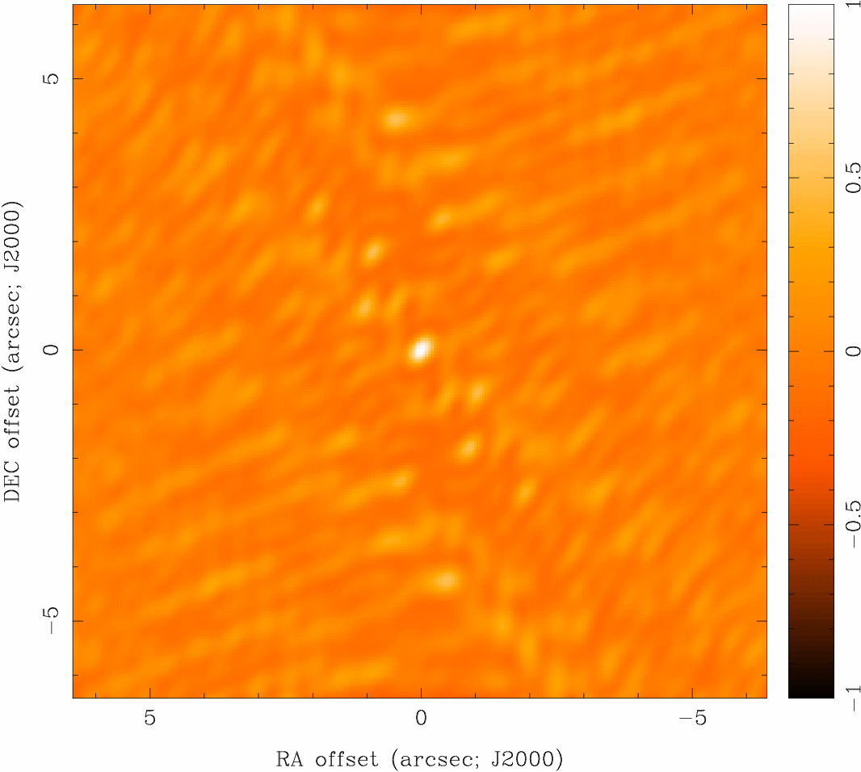
Imaging
Dirty Beam Shape and N Antennas
8 Antennas x 120 Samples

Slide 17
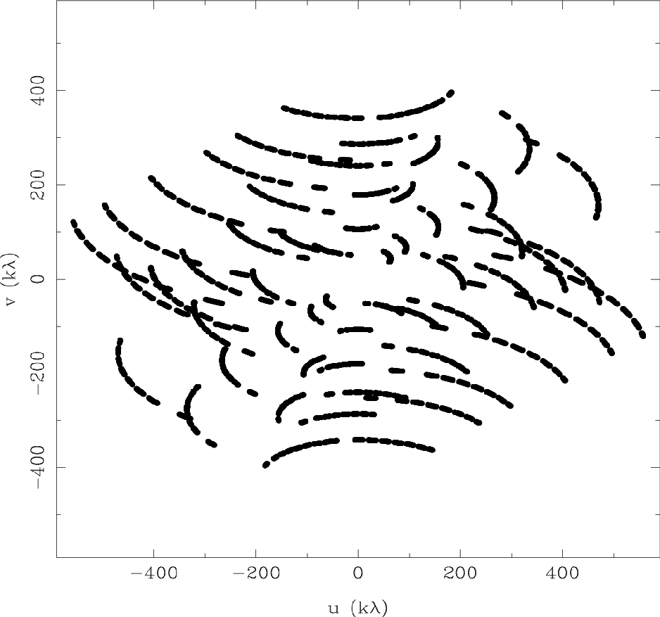
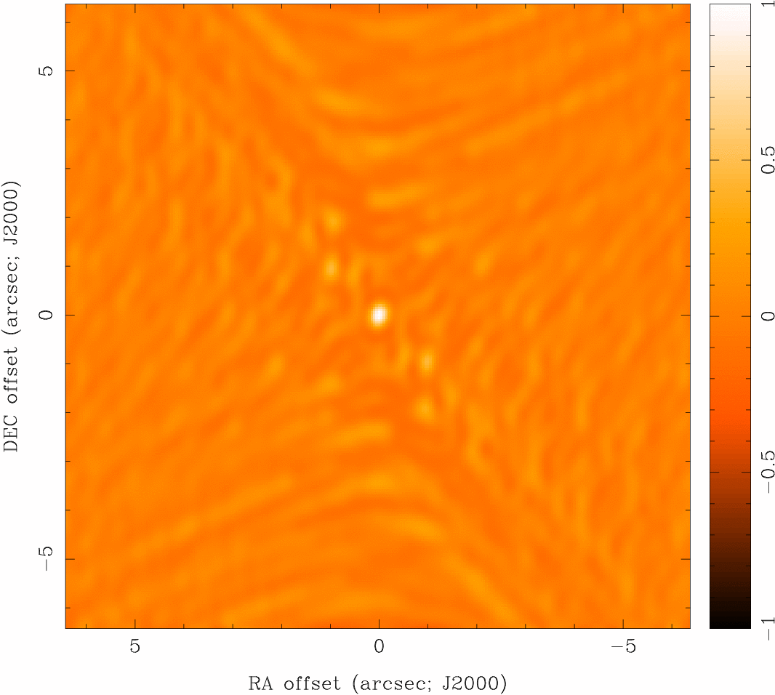
Imaging
Dirty Beam Shape and N Antennas
8 Antennas x 240 Samples

Slide 18
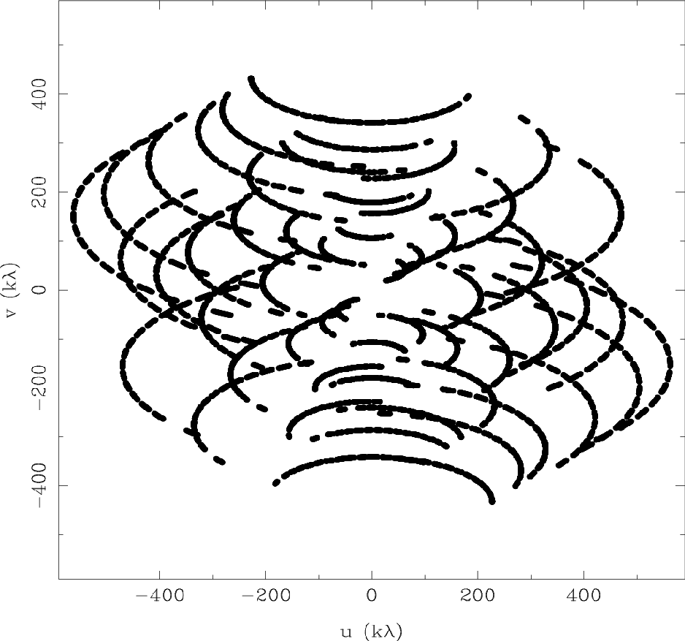

Imaging
Dirty Beam Shape and N Antennas
8 Antennas x 480 Samples

Slide 19
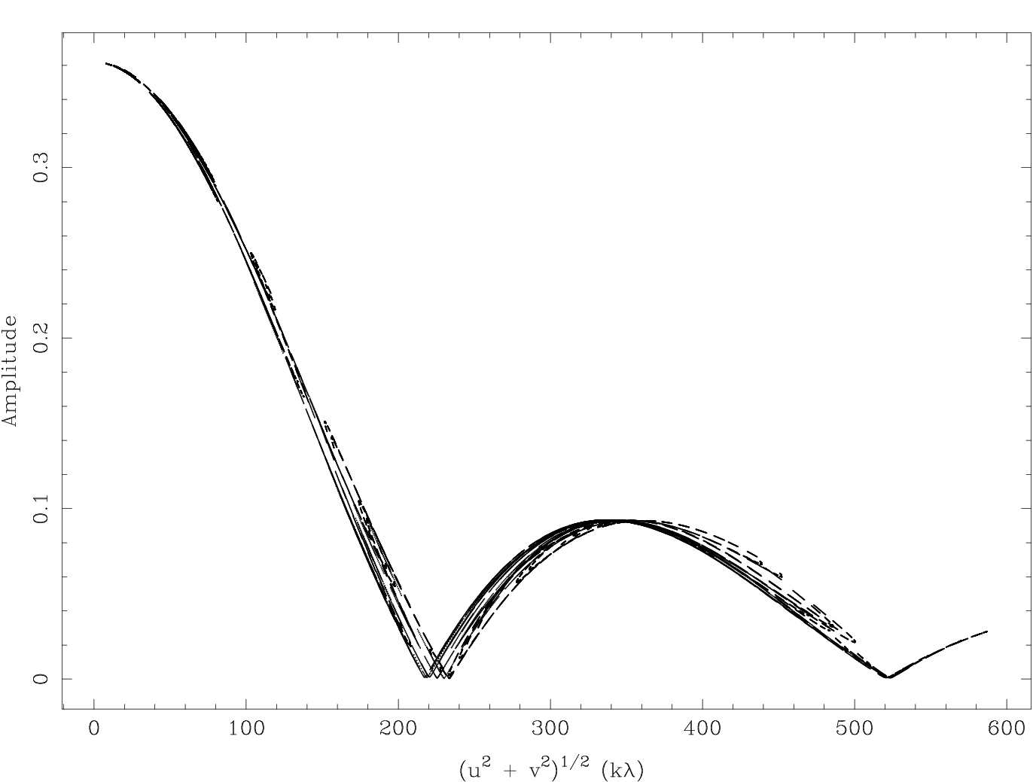
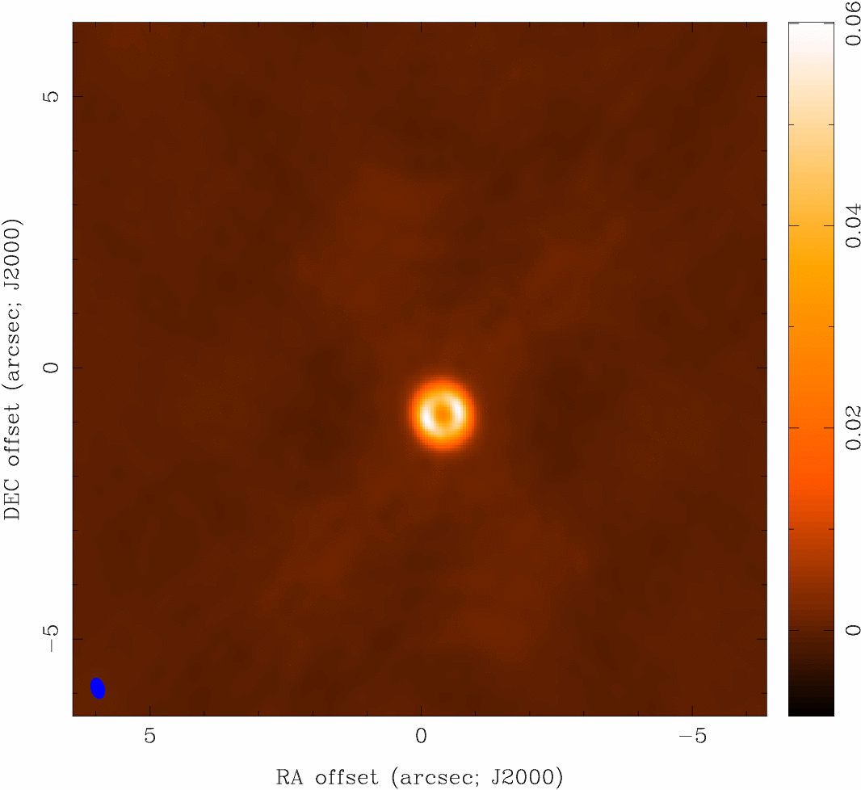
Imaging
How to analyze interferometer data?
uv plane analysis
  best for “simple” sources, e.g., point sources, disks
image plane analysis
  Fourier transform V(u,v) samples to image plane, get I^{D}(x,y)
  but difficult to do science on dirty image
  deconvolve b(x,y) from I^{D}(x,y) to determine (model of) I(x,y)
visibilities dirty image sky brightness
Fourier transform
deconvolve

Slide 20
Imaging
Weighting and Tapering
Visibility Weighting in the FT:
  Including weighting function W to modify dirty beam sidelobes:
  natural weighting: density of uv-coverage = highest compact flux sensitivity
  uniform weighting: extent of uv-coverage = highest resolution
  robust weighting: compromise between natural and uniform
  tapering: downweights high spatial frequencies = higher extended flux sensitivity
imaging parameters provide a lot of freedom
appropriate choice depends on science goals
recall that the primary beam FWHM is the “field-of-view” of a single-pointing interferometric image

Slide 21
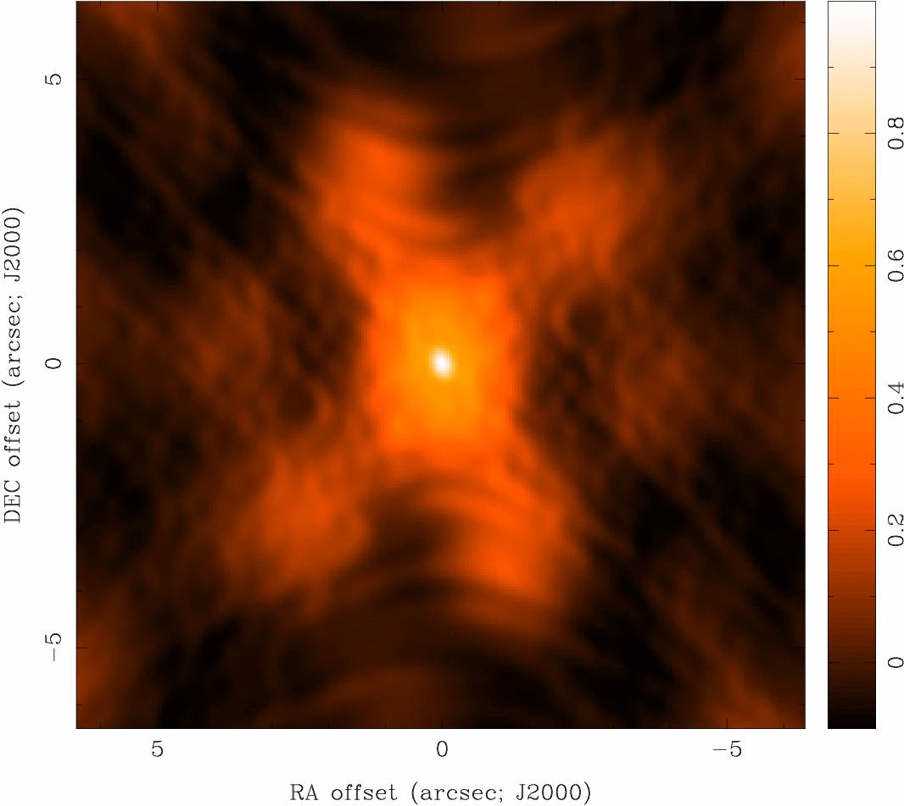
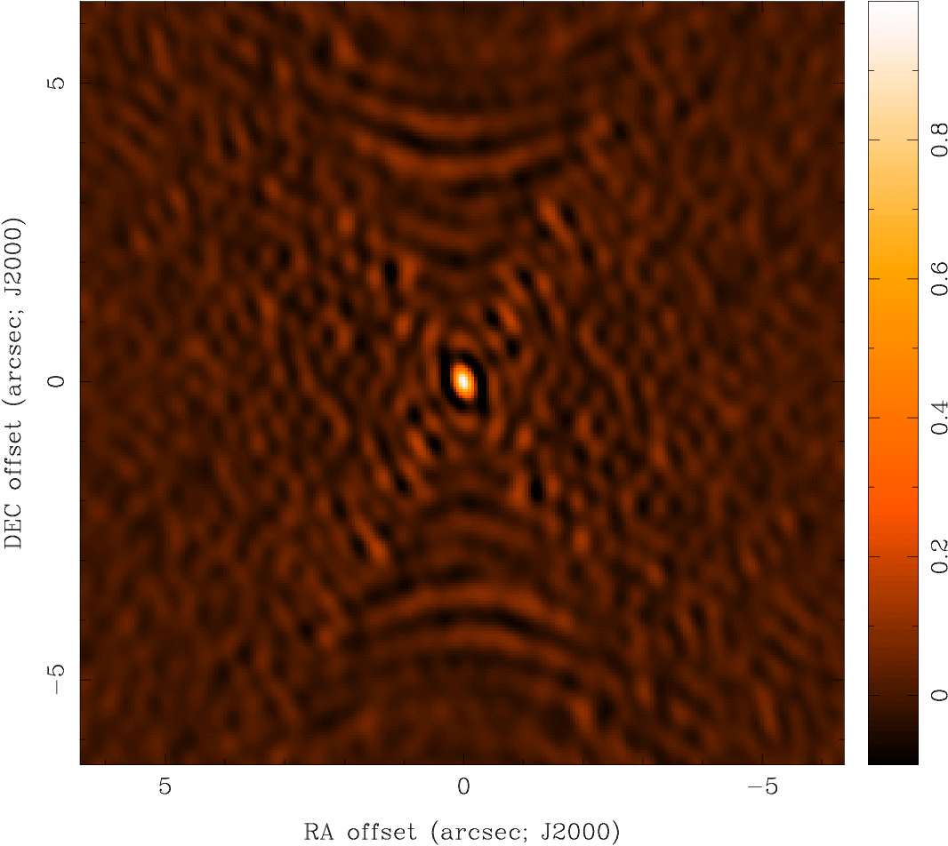
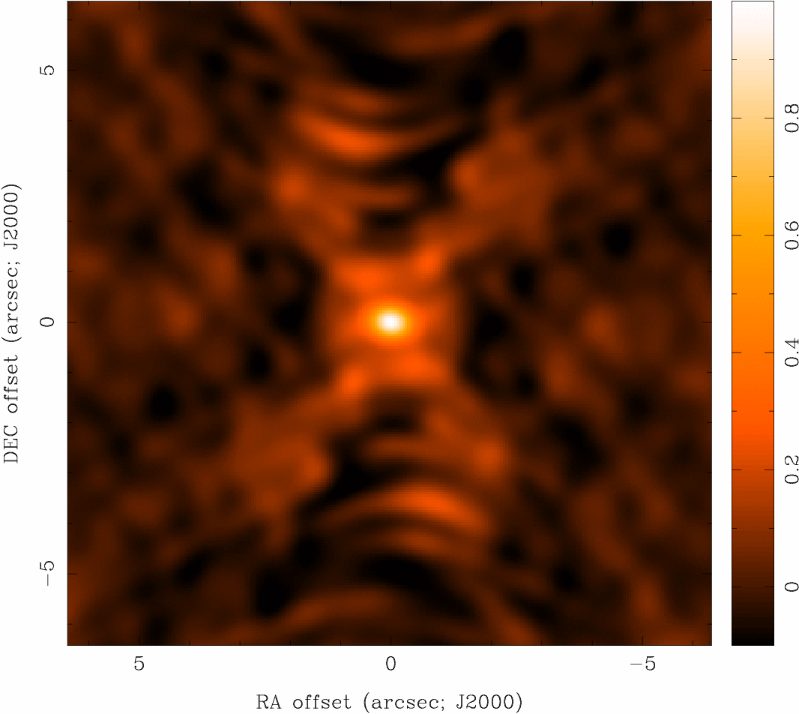
Imaging
Weighting and Tapering: Examples
Natural
0.77x0.62
σ = 1.0
Robust 0
0.41x0.36
σ = 1.6
Robust 0
+ Taper
0.77x0.62
σ = 1.7
Uniform
0.39x0.31
σ = 3.7

Slide 22
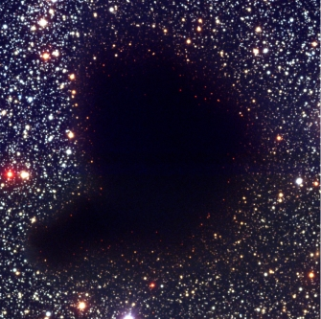
Field of View: Single Pointing
FOV [12 m]
Band 3 (54”)
~4’
Band 6 (27”)
Band 7 (18”)
Band 9 (9”)
B68 ALMA single pointing

Slide 23
Field of View: Mosaics
Nyquist Spacing
= 3^{-1/2} (λ/D) rad.
= 29.75” x
(ν/100 GHz)⁻¹
= constant rms over inner area
Mosaics of up to 50 pointings OK for Early Science
~4’
B68 ALMA Band 3 mosaic

Slide 24
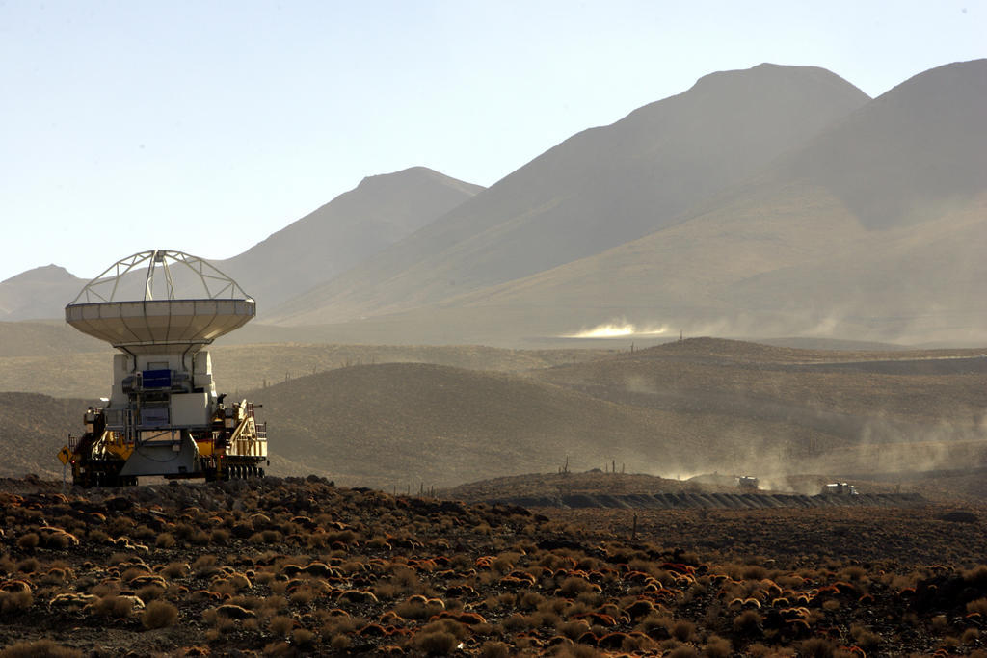
Next: Deconvolution

