Slide 1

A Crash Course in
Radio Astronomy and Interferometry:
4. Deconvolution Techniques
James Di Francesco
National Research Council of Canada
North American ALMA Regional Center – Victoria
(thanks to S. Dougherty, C. Chandler, D. Wilner & C. Brogan)

Slide 2
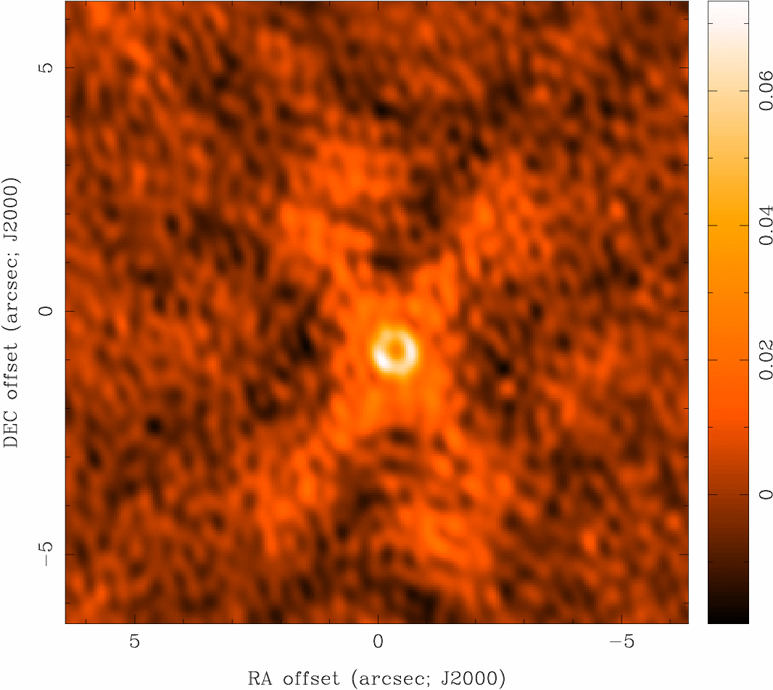
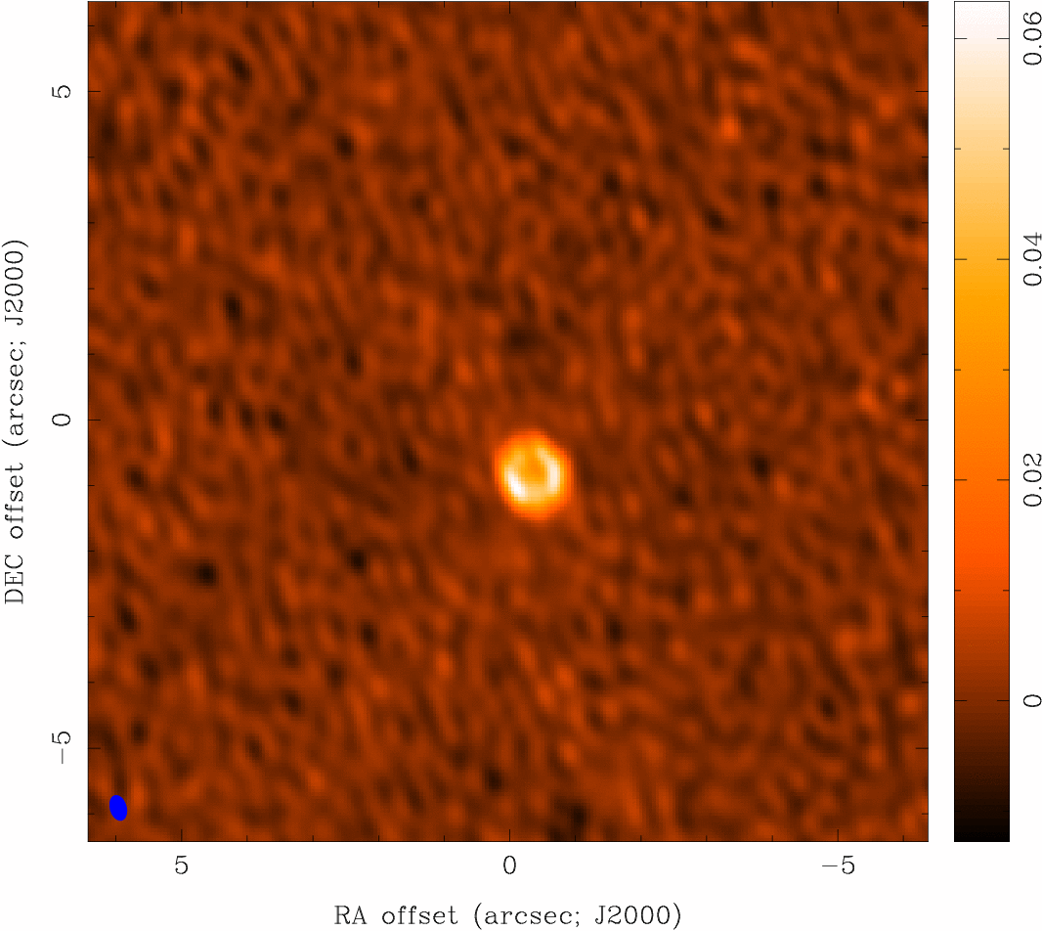
Deconvolution
Deconvolution
difficult to do science on dirty image
deconvolve b(x,y) from I^{D}(x,y) to recover I(x,y)
information is missing, so be careful! (there’s noise, too)
dirty image “CLEAN” image

Slide 3
Deconvolution
Deconvolution Algorithms
Deconvolution:
  uses non-linear techniques effectively interpolate/extrapolate samples of V(u,v) into unsampled regions of the (u,v) plane
  aims to find a sensible model of I(x,y) compatible with data
  requires a priori assumptions about I(x,y)
CLEAN (Högbom 1974) is most common algorithm in radio astronomy
  a priori assumption: I(x,y) is a collection of point sources
  variants for computational efficiency, extended structure
deconvolution requires knowledge of beam shape and image noise properties (usually OK for aperture synthesis)
  atmospheric seeing can modify effective beam shape
  deconvolution process can modify image noise properties

Slide 4
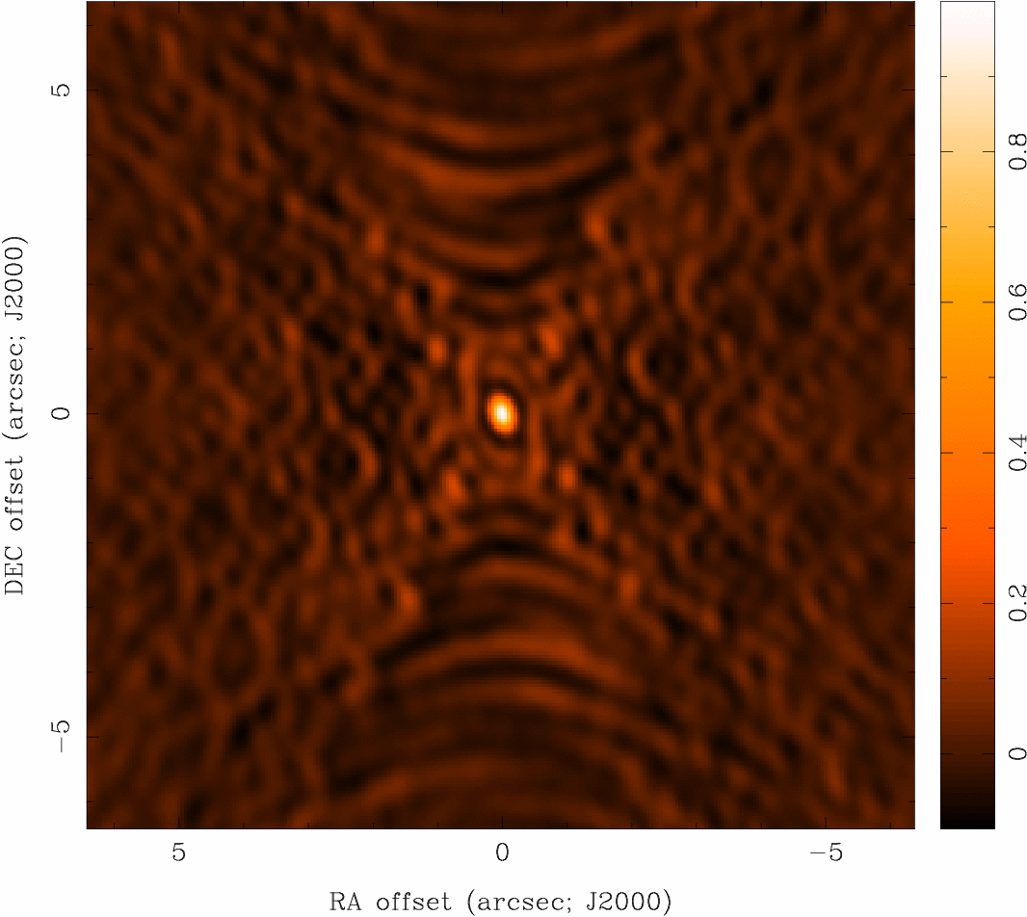
Deconvolution
Basic CLEAN Algorithm
  Initialize
    a residual map to the dirty map
    a CLEAN component list
  Identify strongest feature in residual map as a point source
  Add a fraction g (the loop gain) of this point source to the clean component list (g ~ 0.05-0.3)
  Subtract the fraction g times b(x,y) from residual map
  If stopping criteria* not reached, go back to step 2 (an iteration), or…
  Convolve CLEAN component (cc) list with an estimate of the main dirty beam lobe (i.e., the “CLEAN beam”) and add residual map to make the final “restored” image
b(x,y)
I^{D}(x,y)
I(x,y)
* Stopping criteria = N x rms (if noise limited), or I^{max}/N (if dynamic range limited), where N is some arbitrarily chosen value

Slide 5
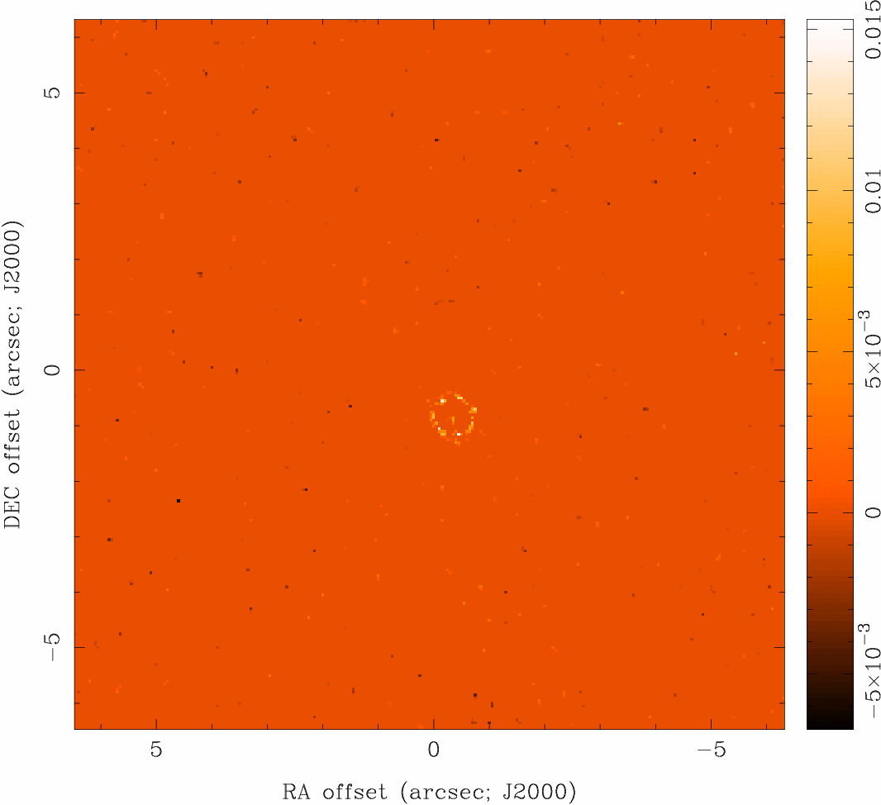
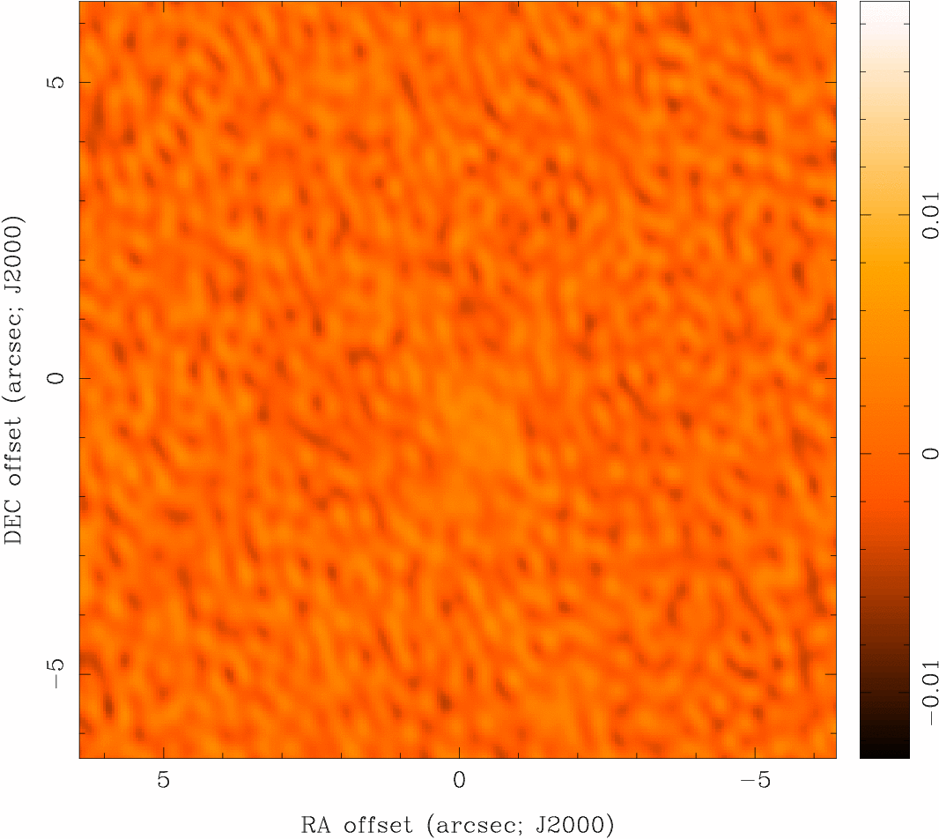
Deconvolution
CLEAN
I^{D}(x,y)
CLEAN model
restored image
residual map

Slide 6
Deconvolution
“Restored” Images
CLEAN beam size:
  natural choice is to fit the central peak of the dirty beam with elliptical Gaussian
  unit of deconvolved map is Jy per CLEAN beam area (= intensity, can convert to brightness temperature)
  minimize unit problems when adding dirty map residuals
  modest super resolution often OK, but be careful
photometry should be done with caution
  CLEAN does not conserve flux (extrapolates)
  extended structure missed, attenuated, distorted
  phase errors (e.g. seeing) can spread signal around

Slide 7
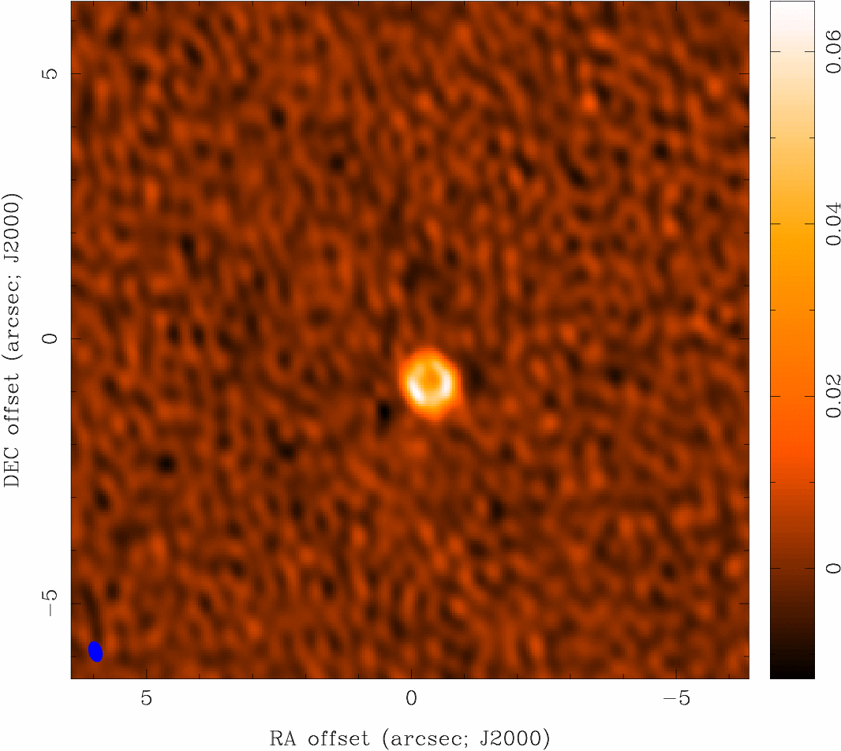
Deconvolution
Measures of Image Quality
“dynamic range”
  ratio of peak brightness to rms noise in a region void of emission (common in astronomy)
  an easy to calculate lower limit to the error in brightness in a non-empty region
“fidelity”
  difference between any produced image and the correct image
  a convenient measure of how accurately it is possible to make an image that reproduces the brightness distribution on the sky
  need a priori knowledge of correct image to calculate
  fidelity image = input model / difference
  fidelity is the inverse of the relative error

Slide 8
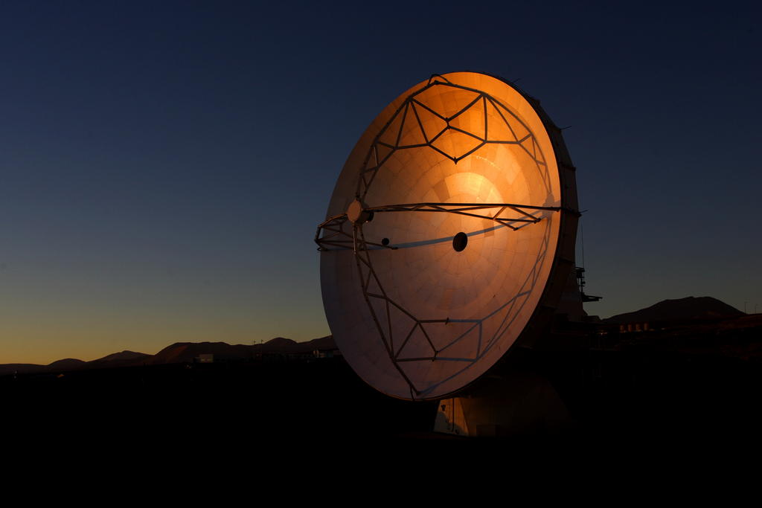
Summary
Radio Telescopes are cool
  Single-dish telescopes measure “temperatures” across the sky
  They have fat beams making details hard to see
Interferometers use optics to achieve high resolution
  Antenna pairs sample the FT of the image plane, an inverse FT of the ensemble of visibilities returns the image
  Resulting images are spatially filtered; only compact emission seen
  “Dirty” images can be deconvolved (with care), e.g., CLEAN
  Weighting can be used to manipulate resolution and/or surface brightness sensitivity
  Mosaics can be used to increase field-of-view but can be observationally expensive

