Slide 1
A Crash Course in Radio Astronomy and Interferometry: 4. Deconvolution Techniques
James Di Francesco
National Research Council of Canada
North American ALMA Regional Center – Victoria
(thanks to S. Dougherty, C. Chandler, D. Wilner & C. Brogan)

Slide 2
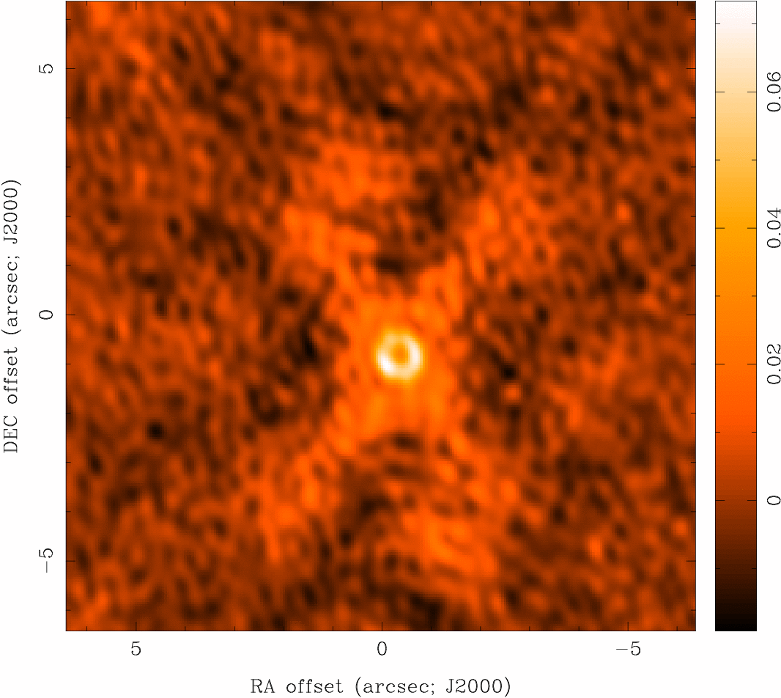
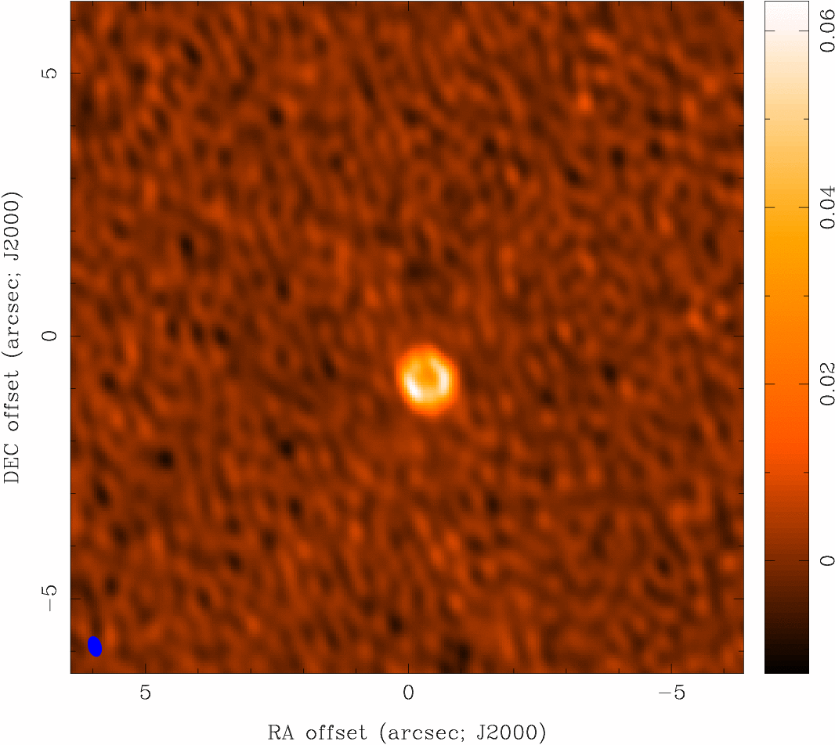
Deconvolution
Deconvolution
difficult to do science on dirty image
deconvolve b(x,y) from I^{D}(x,y) to recover I(x,y)
information is missing, so be careful! (there’s noise, too)
dirty image “CLEAN” image

Slide 3
Deconvolution
Deconvolution Algorithms
Deconvolution:
uses non-linear techniques effectively interpolate/extrapolate samples of V(u,v) into unsampled regions of the (u,v) plane
aims to find a sensible model of I(x,y) compatible with data
requires a priori assumptions about I(x,y)
CLEAN (Högbom 1974) is most common algorithm in radio astronomy
a priori assumption: I(x,y) is a collection of point sources
variants for computational efficiency, extended structure
deconvolution requires knowledge of beam shape and image noise properties (usually OK for aperture synthesis)
atmospheric seeing can modify effective beam shape
deconvolution process can modify image noise properties

Slide 4
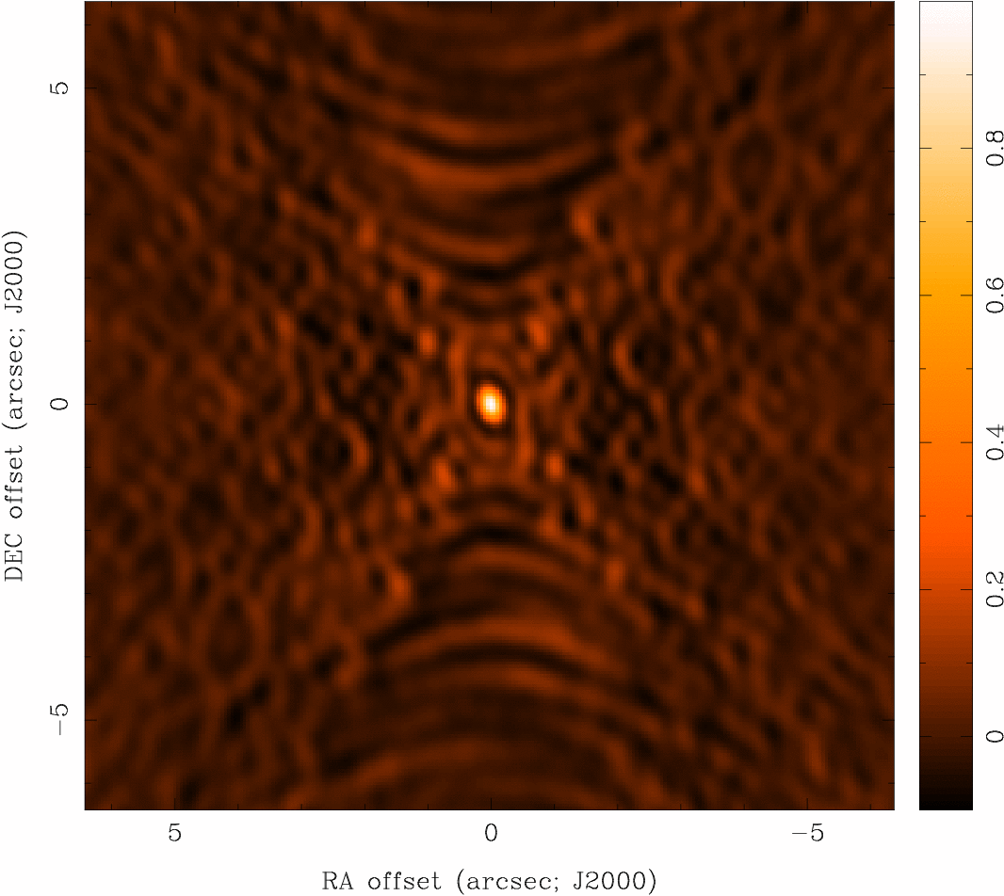
Deconvolution
Basic CLEAN Algorithm
Initialize
a residual map to the dirty map
a CLEAN component list
Identify strongest feature in residual map as a point source
Add a fraction g (the loop gain) of this point source to the clean component list (g ~ 0.05-0.3)
Subtract the fraction g times b(x,y) from residual map
If stopping criteria* not reached, go back to step 2 (an iteration), or…
Convolve CLEAN component (cc) list with an estimate of the main dirty beam lobe (i.e., the “CLEAN beam”) and add residual map to make the final “restored” image
b(x,y)
I^{D}(x,y)
I(x,y)
* Stopping criteria = N x rms (if noise limited), or I^{max}/N (if dynamic range limited), where N is some arbitrarily chosen value

Slide 5
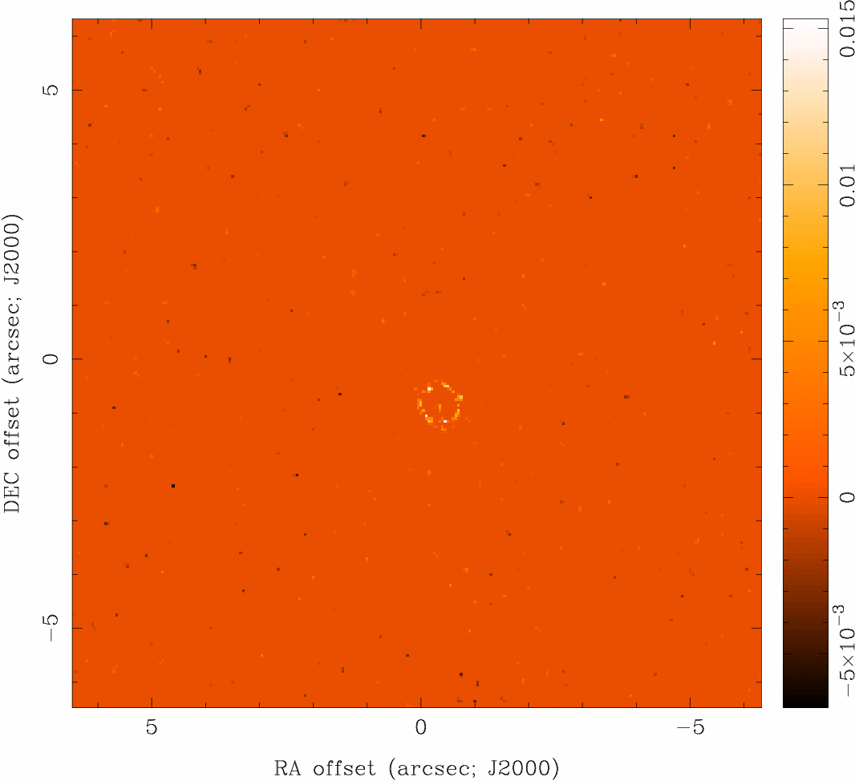
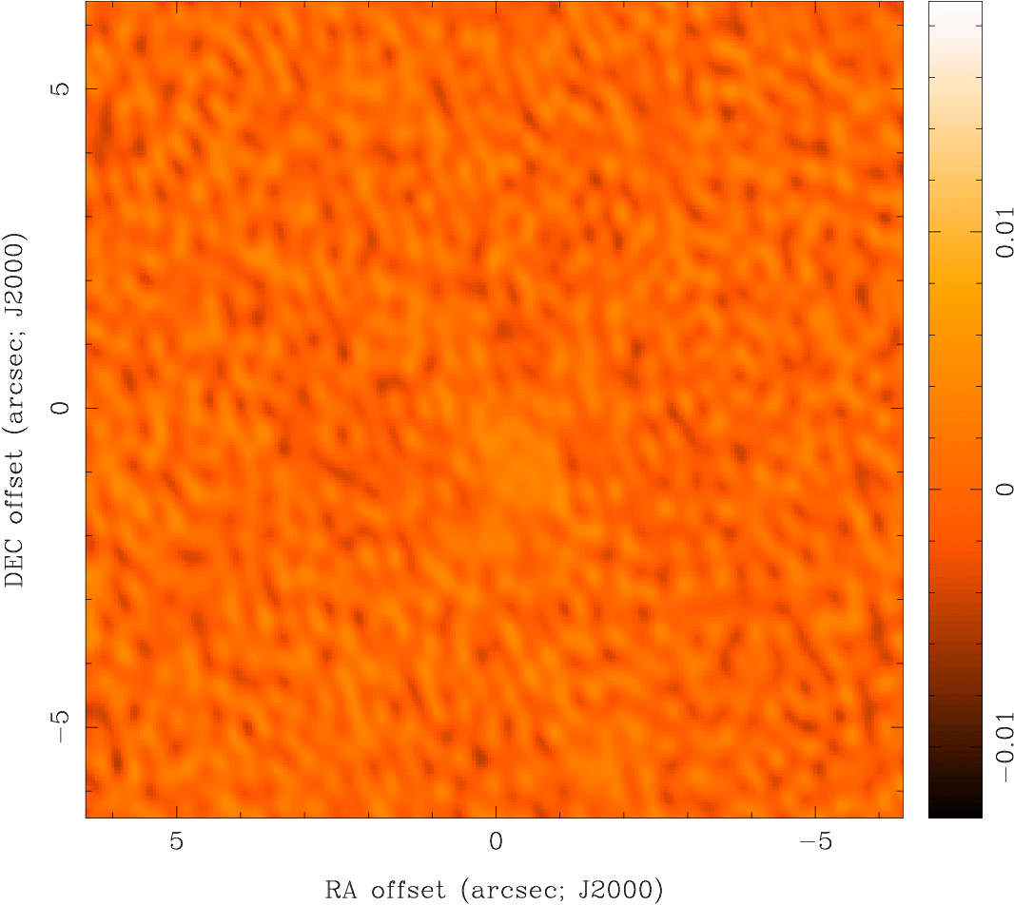
Deconvolution
CLEAN
I^{D}(x,y)
CLEAN model
restored image
residual map

Slide 6
Deconvolution
“Restored” Images
CLEAN beam size:
natural choice is to fit the central peak of the dirty beam with elliptical Gaussian
unit of deconvolved map is Jy per CLEAN beam area (= intensity, can convert to brightness temperature)
minimize unit problems when adding dirty map residuals
modest super resolution often OK, but be careful
photometry should be done with caution
CLEAN does not conserve flux (extrapolates)
extended structure missed, attenuated, distorted
phase errors (e.g. seeing) can spread signal around

Slide 7
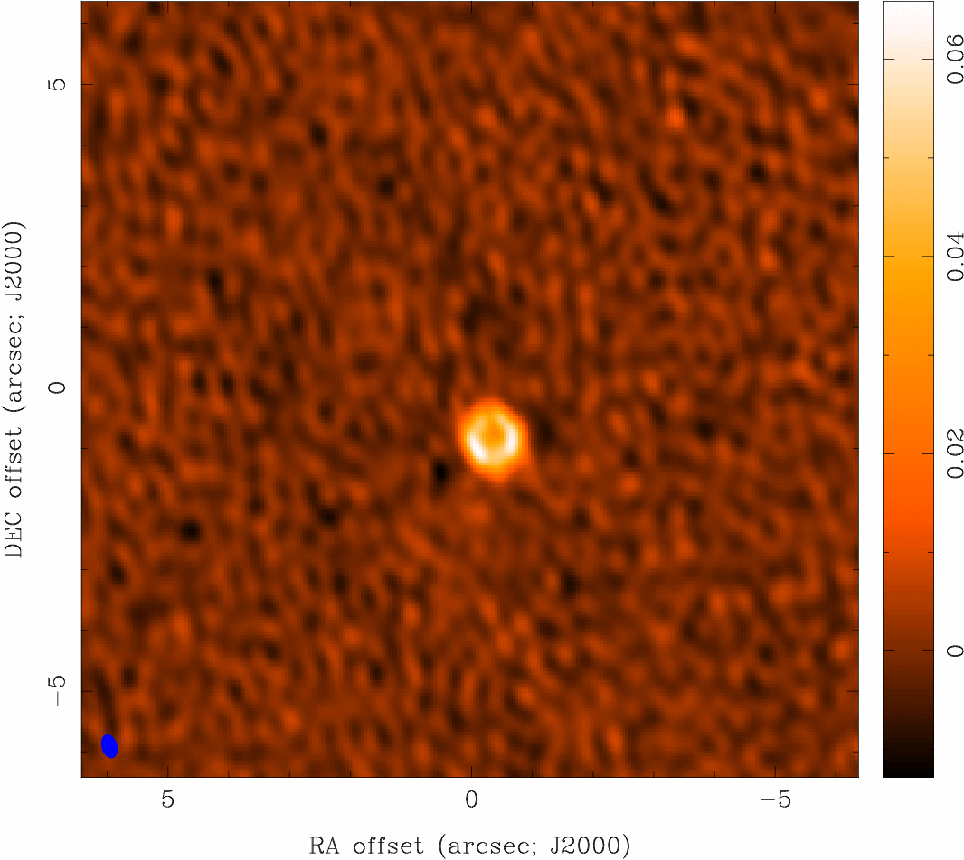
Deconvolution
Measures of Image Quality
“dynamic range”
ratio of peak brightness to rms noise in a region void of emission (common in astronomy)
an easy to calculate lower limit to the error in brightness in a non-empty region
“fidelity”
difference between any produced image and the correct image
a convenient measure of how accurately it is possible to make an image that reproduces the brightness distribution on the sky
need a priori knowledge of correct image to calculate
fidelity image = input model / difference
fidelity is the inverse of the relative error

Slide 8
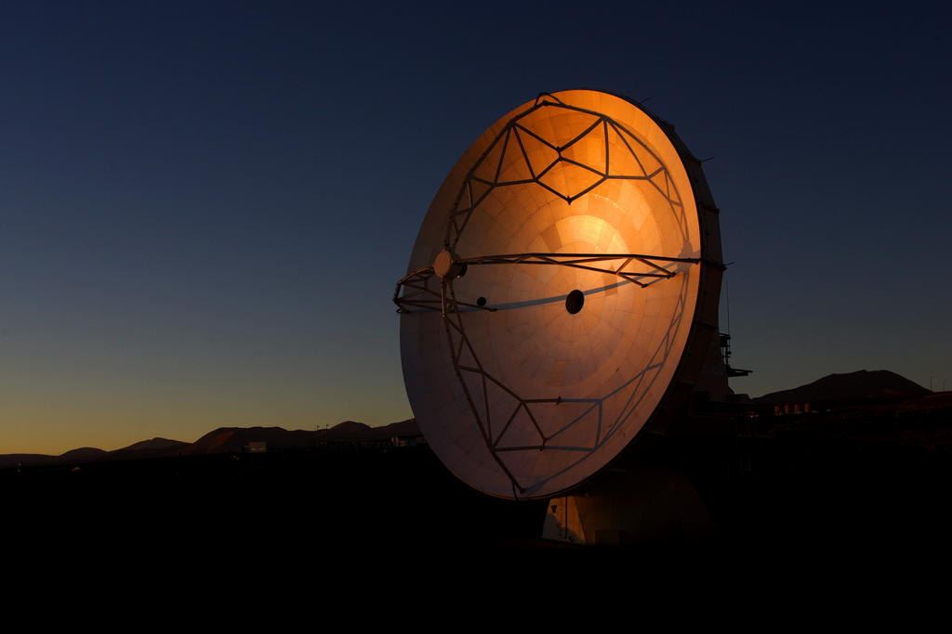
Summary
Radio Telescopes are cool
Single-dish telescopes measure “temperatures” across the sky
They have fat beams making details hard to see
Interferometers use optics to achieve high resolution
Antenna pairs sample the FT of the image plane, an inverse FT of the ensemble of visibilities returns the image
Resulting images are spatially filtered; only compact emission seen
“Dirty” images can be deconvolved (with care), e.g., CLEAN
Weighting can be used to manipulate resolution and/or surface brightness sensitivity
Mosaics can be used to increase field-of-view but can be observationally expensive

