Slide 1




NRAO Proposal Planning Webinar
Webinar Schedule:
17:00 UT (1pm EDT) – Planning an ALMA Proposal
18:30 UT (2:30pm EDT) – Planning a GBT Proposal
19:30 UT (3:30pm EDT) – Planning a JVLA/VLBA Proposal
21:30 UT (5:30pm EDT) – Open Questions & Answers
Important information:
Sound available only through voice bridge.
  USA Toll Number : +1-210-835-9155
  USA Toll Free Number : 866-815-0456
  Participant Passcode: 3535975#
Ask question through webinar “Chat” feature
  Click green area in top center of your screen
  Click on “Chat”
  Select Send to: Aaron Evans (Host)
Supporting Material: https://science.nrao.edu/science/meetings/nrao-cde

Slide 2
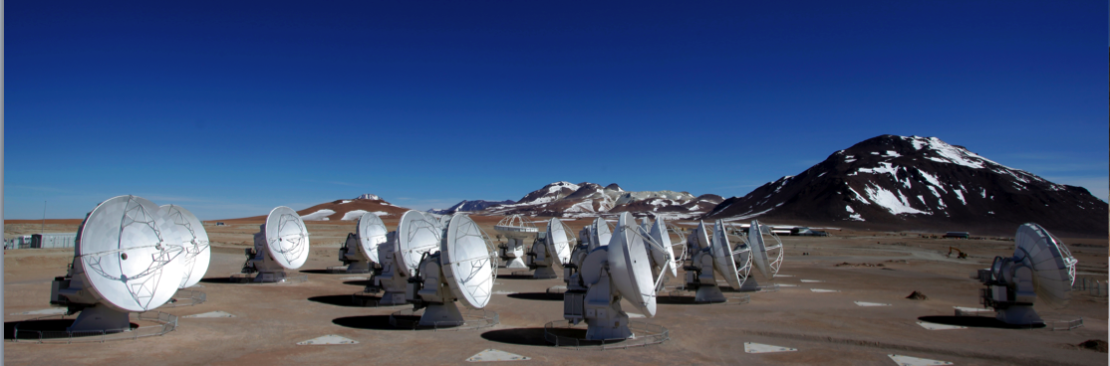
Planning ALMA Observations
Atacama Large mm/sub-mm Array
Al Wootten
North American ALMA Science Center
Atacama Large Millimeter/submillimeter Array
Expanded Very Large Array
Robert C. Byrd Green Bank Telescope
Very Long Baseline Array
Notes:
Hi and welcome to the NRAO webinar presentation
… on planning ALMA Observations

Slide 3


Talk Outline
ALMA
ALMA Overview and Status
The Key Decisions When Proposing for ALMA
Notes:
This talk will take about 40 minutes and has two main parts
I will begin by giving you a quick update
… on the status of the ALMA project
… and the capabilities offered at the upcoming July 12 deadline
After that, I’ll step through the key decisions that you need to make
… as you prepare an ALMA proposal

Slide 4
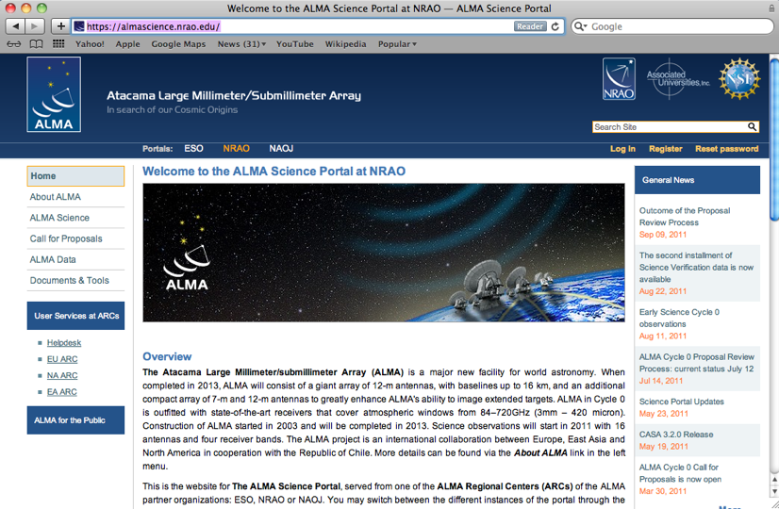
The ALMA Science Portal
ALMA
https://almascience.nrao.edu
Hub for project-wide material.
Observing Tool
Sensitivity Calculator
Proposer’s Guide
Technical Handbook
Science Verification Data
CASA & Simulations
Tutorials
Helpdesk
Registration required to propose for PIs and coIs.
Notes:
Finally, let me wrap by pointing out again
… where you can go
… for more information
… to get help
… and to download the tools that I told you about
The ALMA science portal
… at almascience.nrao.edu for our North American users
… serves as the hub for project wide material
… including the required observing tool
… and key docs like the proposer’s guide
… the technical handbook and so on
From there you can also register
… and access our helpdesk to get any support that you need

Slide 5
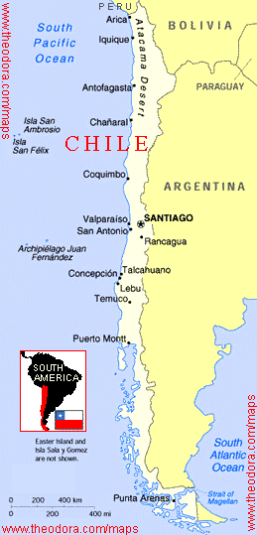
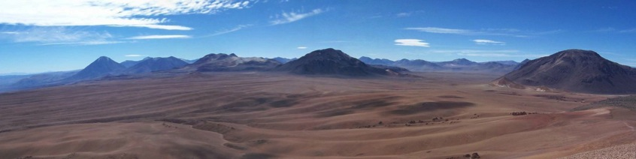
ALMA Basics
ALMA
Global partnership (shared cost ~1.3 billion 2006$):
  North America (US, Canada, Taiwan)
  Europe (ESO)
  East Asia (Japan,Taiwan)
  In collaboration with Chile
Unique high, dry site:
  5000m (16,500 ft) in Chilean Atacama desert
At least 66 submillimeter/millimeter telescopes:
12-m Array – 50 x 12-m
Atacama Compact Array (ACA) - 12x7-m, 4x12-m
On budget and on time for completion in 2013
Notes:
So on to the talk.
As most of you already know
… ALMA is the Atacama Large Milimeter/sub-Millimeter Array
… this is a global partnership
… consisting of partners from North America, Europe, and East Asia
… in collaboration with Chile
That cost is in 2006 dollars!
As a millimeter/sub-millimeter telescope, the site of ALMA is crucial
… and we’ve built ALMA at a uniquely high, dry site
… in the Chilean Andes
… where the atmospheric transmission allows the best submillimeter science
… you can do from the ground

Slide 6
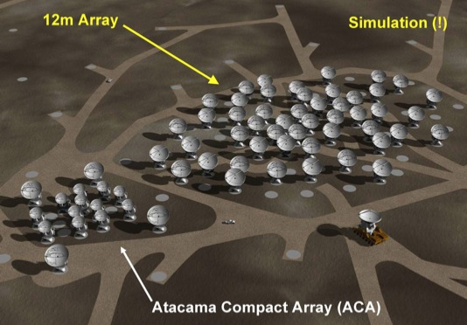
ALMA Basics
ALMA
Global partnership (shared cost ~1.3 billion):
  North America (US, Canada, Taiwan)
  Europe (ESO)
  East Asia (Japan,Taiwan)
  In collaboration with Chile
Unique high, dry site:
  5000m (16,500 ft) in Chilean Atacama desert
At least 66 submillimeter/millimeter telescopes:
12-m Array – 50 x 12-m
Atacama Compact Array (ACA) - 12x7-m, 4x12-m
On budget and on time for completion in 2013
Notes:
ALMA itself consists of three types of Antennas
… a “twelve-meter array” consisting of 50 12-m antennas
… and the smaller “ACA” – the Atacama Compact Array
… consisting of 12 seven meter antennas
… and 4 12-m antennas devoted to recovering the total flux of sources
So in total we expect to end up with at least 66 antennas
The project is due for completion in 2013 and is on time and on budget

Slide 7
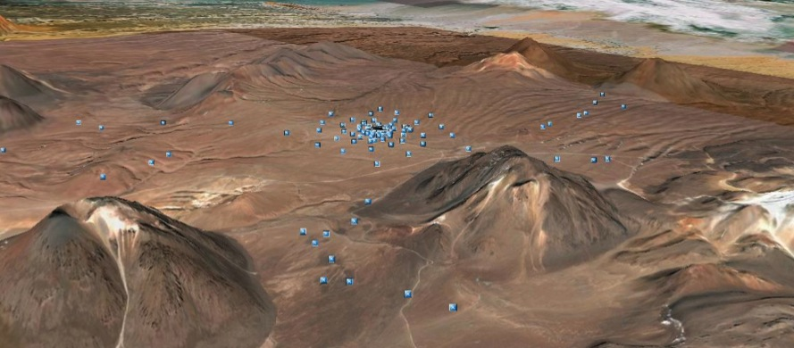
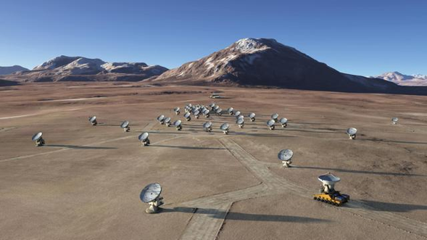
Full Science Capabilities
ALMA
10-100× better sensitivity and resolution than current mm arrays.
Baselines to ~15 km (0.015” at 300 GHz) in “zoom lens” configurations
Sensitive, precision imaging 84 to 950 GHz
(3 mm to 315 µm) employing state-of-the-art low-noise, wide-band SIS receivers (8 GHz bandwidth per polarization)
Flexible correlator with high spectral resolution at wide bandwidth
Full polarization capabilities
Development Program: Future upgrades
  (B1,B2, B5, ?)
Notes:
On completion, ALMA will represent an absolutely enormous
… leap forward in our ability to observe the submillimeter sky
… delivering sensitivities and resolutions 10 to 100 times better
… than current mm or sub-mm arrays
The key stats for the full array will be
… baselines out to 15 km
… the ability to image from 84 to 950 GHz
… fantastic receiver sensitivity
… 8 GHz bandwidth
… a very flexible correlator
… and full polarization capabilities
When is FS? Probably not Cycle 2 (1 Nov 2013)—it was always planned that B10 be completed after normal construction owing to its technical difficulty.
Upgrade proposals spring from the ALMA communities.

Slide 8
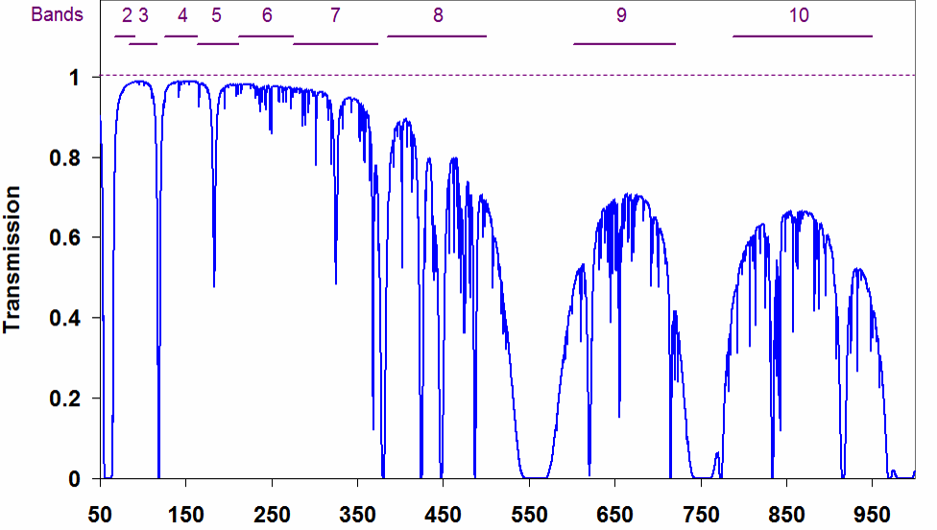
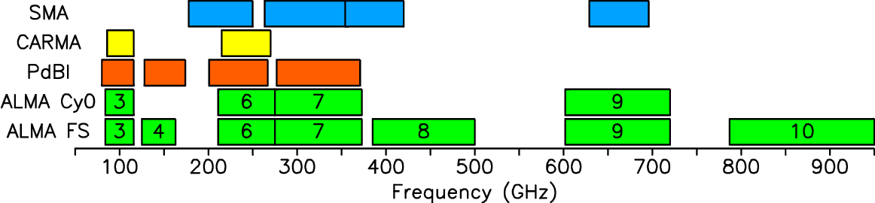
Frequency Coverage
ALMA
Early Science (now)
Full Operations
Frequency [GHz]
ES
3
6
7
9
Notes:
When I say mm/sub-mm frequencies, this is what I mean
…here you can see illustrated the frequency coverage of the full array
… in yellow and green
… and the current frequency coverage in yellow
This is what you can propose for now
… four receiver bands are available on all telescopes
… these are so-called bands 3, 6, 7, and 9
… operating at roughly 100, 250, 350, and 650 GHz
These other bands will be filled in as the array moves towards completion
… eventually offering more or less complete coverage
… of all the high-transmission atmospheric windows

Slide 9
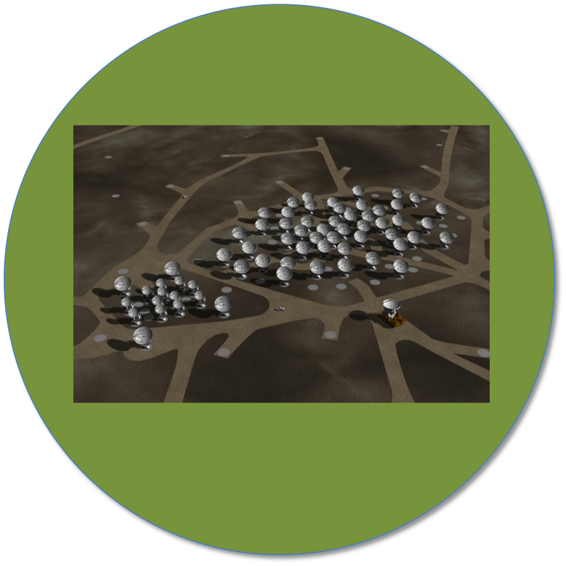
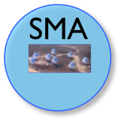

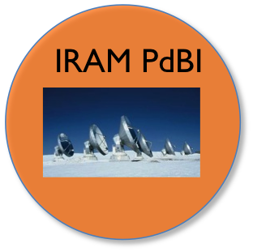
Collecting Area & Baselines
ALMA
ALMA
Full Science
50+12+4 (1225+66)
8 (28)
CARMA
Cycle I
32+9+2 (496+36.)
23 (253)
6 (15)
Circles Show Collecting Area (sensitivity)
Captions give # of antennas and # of baselines (fidelity)
Notes:
ALMA’s phenomenal sensitivity comes from a combination
… of sensitive receivers
… a favorable atmosphere
… and large collecting area
To give you the cartoon view
… here are the graphically represented collecting area
… and in parentheses baselines
… of present day arrays
The collecting area dictates sensitivity
… the number of baselines dictate image fidelity
… you can see that Cycle 1, the capabilities offered at 12 July
… is already a large part of the way towards the Full ALMA

Slide 10
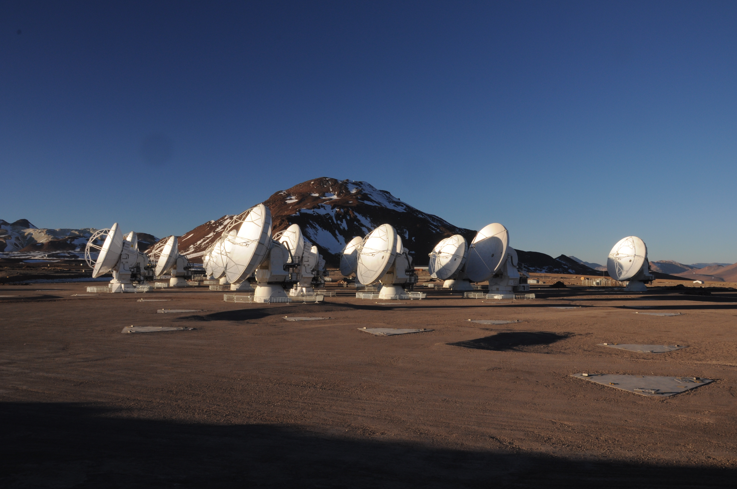
Current Status
ALMA
Cycle 0 observing began 30 Sep ’11.
Cycle 1 call for proposals out (12 July)
Data delivered to PIs.
Commissioning ongoing.
31+ antennas at high site.
Correlators (ACA and main) working.
All antennas: B3, 6, 7, and 9 receivers.
Science verification ongoing, data publicly available.
20 September 2011
Notes:
Where are we right now?
… Cycle 0 – our first PI-science campaign
… began observing began 30 September
… a significant amount of data has been delivered to Pis
Both commisioning and science verification are ongoing
… with over 30 antennas at the high site and more on their way up at all times
The correlators for both the main array
… and the one for the Atacama compact array
… are working
And as I mentioned
… there are four receiver bands installed on all telescopes
… covering roughly the 100 GHz, 250 GHz, 350 GHz, and 650 GHz windows

Slide 11
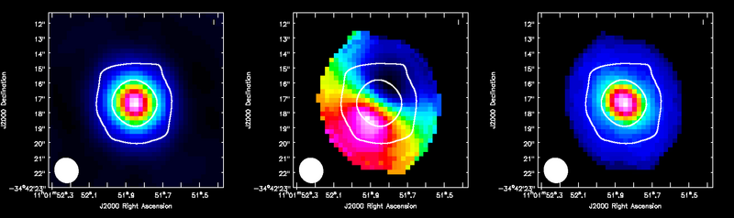
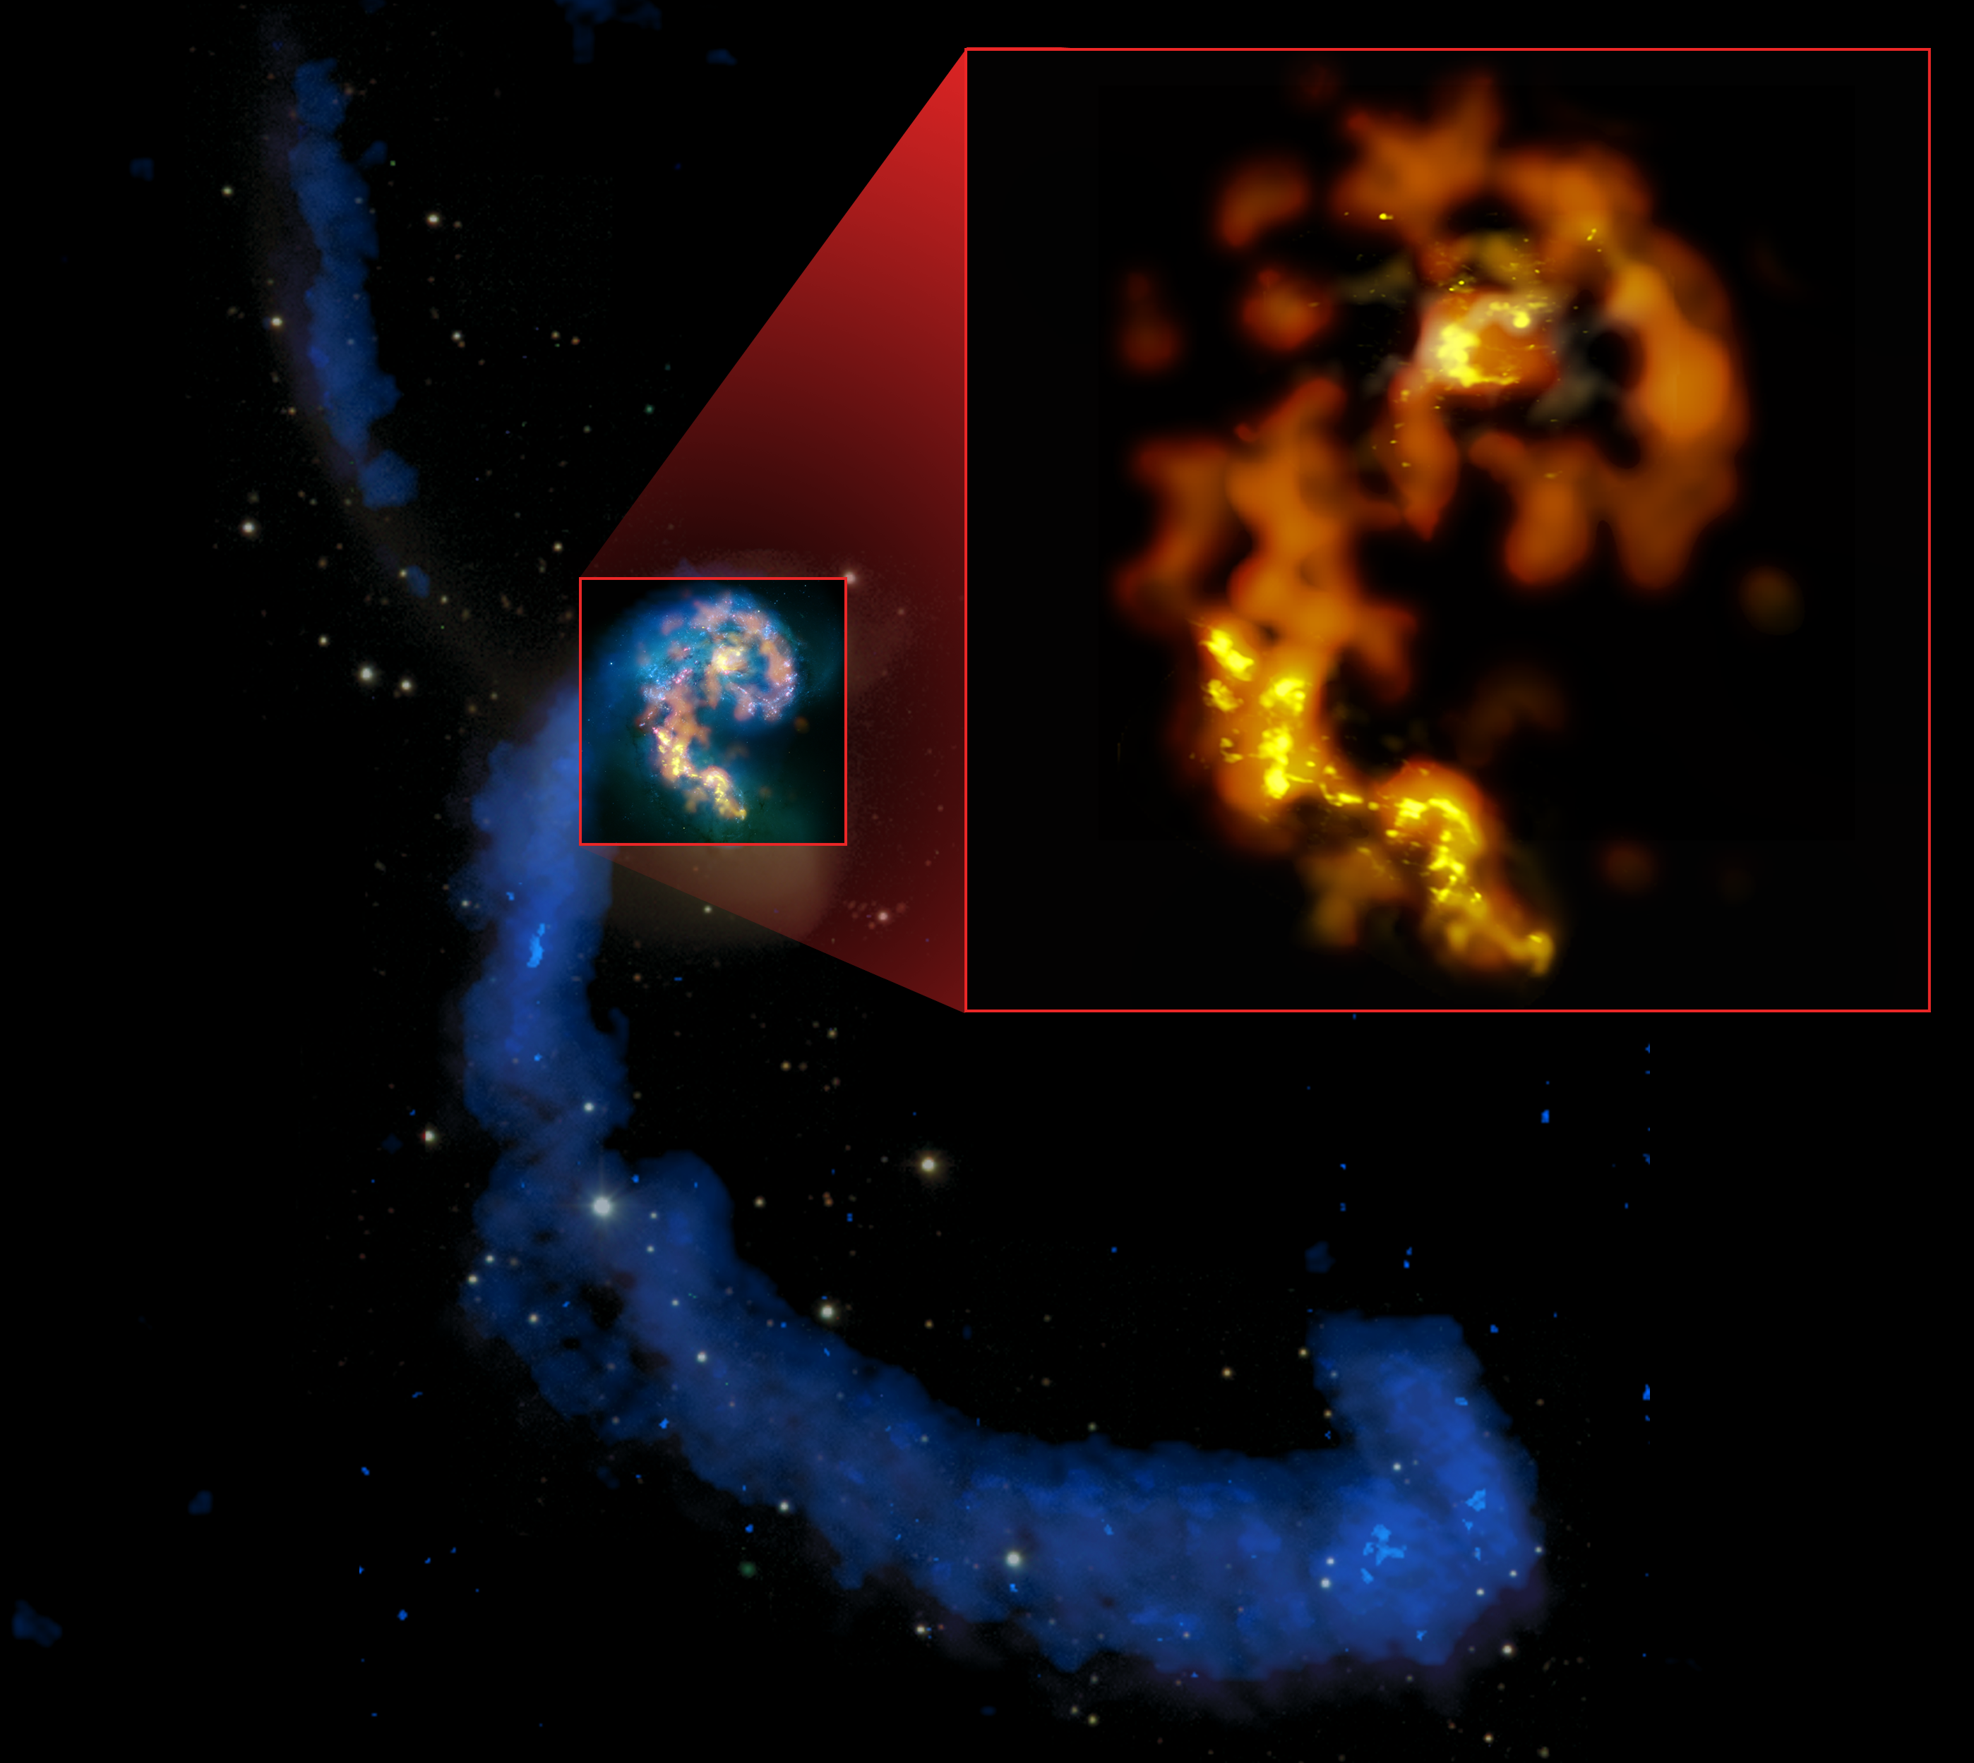
Science Verification Data
ALMA
ALMA data released for:
BR1202 (high redshift quasar)
The Antennae Galaxies*
NGC 3256*
M100
Sgr A-star
Ori B6 Spectral Scan
IRAS 16923 (B9*)
TW Hydra*
Calibrated & uncalibrated data, images, periodically augmented
download from ALMA Science Portal
http://almascience.org/
* - CASA guide available at
http://casaguides.nrao.edu
HCO+ J=4-3 in TW Hya
CO J=3-2 in the Antennae
Notes:
In addition to data delivery to Pis
… we have released a number of data sets
… obtained as part of the Science Verification program
You can see a list of released data here
… you can download from the Science Portal
… these include calibrated and uncalibrated data
… and for a subset of these, guides explaining their reduction
… and imaging are available in detail at this CASA guides website

Slide 12
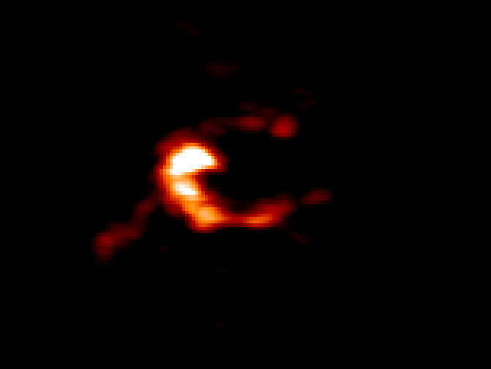
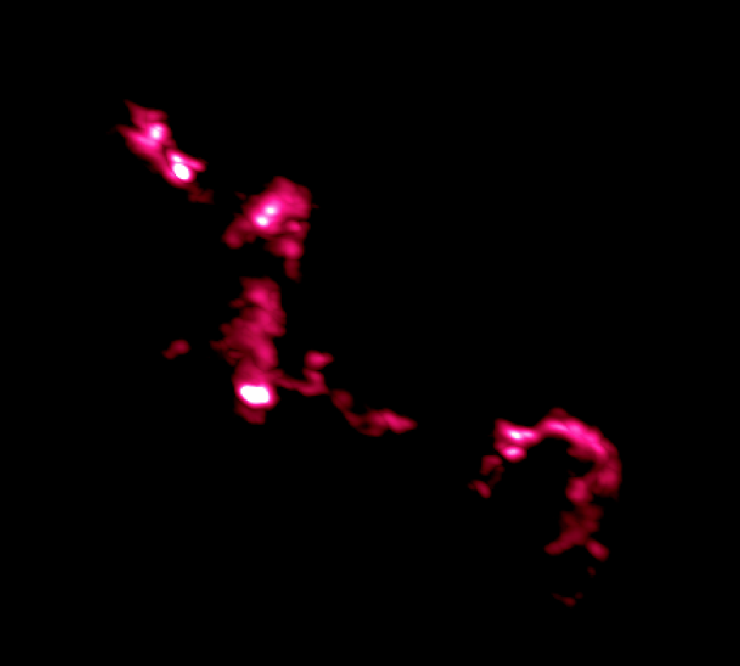
ALMA Images Nearby Galaxies
Science verification imaging of the Antennae Galaxies
CO 2-1
CO 3-2
HI, CO 3-2, CO 1-0
Notes:
Here I’m showing you a particularly striking example
… obtained as part of this science verification program
… images of molecular gas in the merging the Antennae Galaxies
In a limited, roughly 11 telescope, configuration
… ALMA imaged low-J CO emission in three transitions
… across the body of these nearest colliding galaxies
… and even in this limited mode, the results are a just fantastic view
… of the dense-star-forming gas in a major merger
You can see that in these images here
… where you can see that we have sufficient resolution
… to pick out individual star-forming clouds and complexes

Slide 13
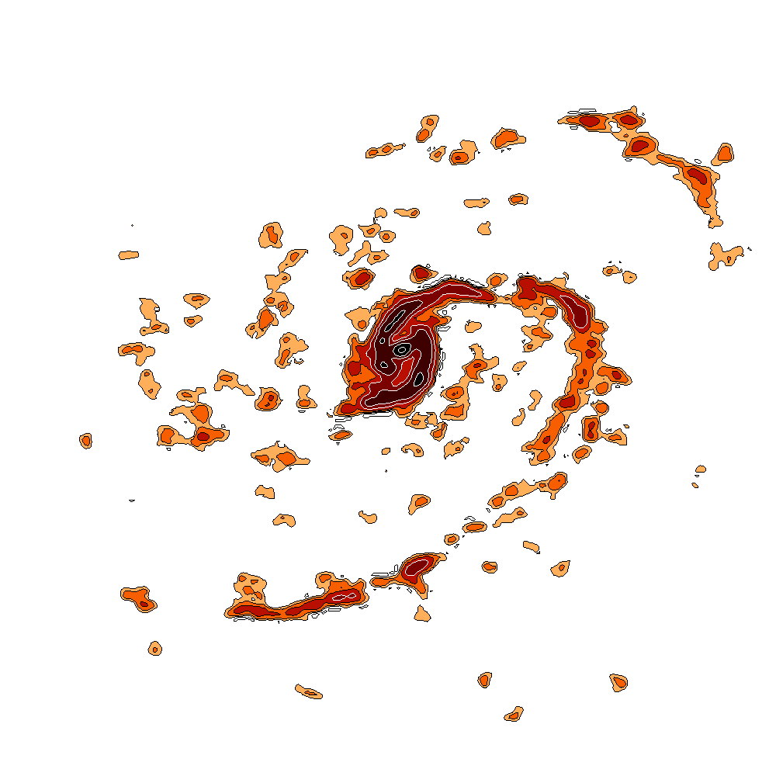
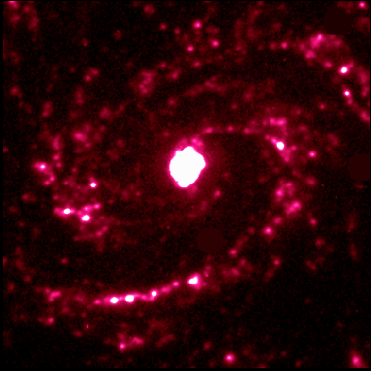
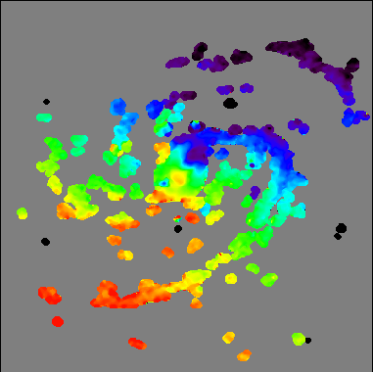
ALMA Images Nearby Galaxies
Science verification imaging of M100
Hα
CO 1-0
47-pt mosaic
Velocity
Notes:
(SKIP, I think – maybe replace with BR1202)
You can see the same power at work in these just-released data
… on M100, a bright Virgo cluster spiral galaxy
This is a big, 50-point mosaic
… obtained in about 6 hours using 13 antennas
… so spending a total of around 7 minutes per point
Again, you see the distribution of star forming gas in detail
… including individual star-forming knots
… along sharp, well-defined spiral arms

Slide 14
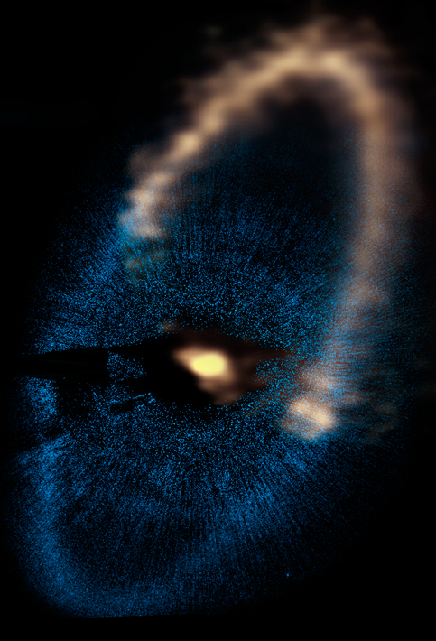

ALMA Images Debris Disks
PI Boley (U. Florida) Data on Fomalhaut Debris Disk
ALMA
HST Scattered Light
Notes:
And here you can see the press release version
… of one of the first data delivered to a PI
This is ALMA imaging of the debris disk around
… the nearby star Fomalhaut in vanilla
… you can even see photospheric emission from the star
… ALMA picks up dust emission from the debris disk
… which you can see here in scattered light
… from HST imaging.
You get a direct view of the dust disk here
… and some prospect soon, for ALMA to see a sign
… of the planet located up here
ALMA’s high angular resolution and excellent surface brightness sensitivity allows it to rule out a Fomalhaut disk which is dynamically hot, like the Kuiper Belt, favoring instead a cold disk like the rings of the outer planets shepherded by small bodies.

Slide 15
ALMA Cycle 1
ALMA
Proposals due July 12
Observing period covers ~10 months
32 12-m Antennas (“Twelve Meter Array”)
ACA: Nine 7-m Antennas, Two “Total Power” 12-m Antennas
ACA observations may be requested to supplement 12-m with “short spacings”
Maximum baselines 160-m to 1-km
Receiver Bands 3, 6, 7, and 9
Mosaics up to 150 pointings
About 800 hours of 12-m array time available
up to ~ one-third of time may have ACA observations
Notes:
So that’s where we are
… you’re presumably here
… because you are interested in the upcoming call for proposals
… what we call Cycle 1
Here are the basics
… the deadline is July 12, one month from today
… with about 800 hours expected to be awarded for the main 12-m array
… the 12-m array for Cycle 1 will consist of 32 antennas
And the major new addition is the Atacama Compact Array
… which can be used to supplement the spatial frequency coverage
… of the 12-m array, giving better short-spacing and total flux recovery
… there is expected to be enough ACA time available so that
… about one third of approved 12-m proposal
Maximum baselines now extend from 160 to 1 km in several configurations
… and the four receiver bands that I mentioned will be available
800 for 12m array is what TAC will allocate. 800 hours of ACA also, 3x 12m time ==> only ~1/3 of high prio proposals can have ACA time

Slide 16
Talk Outline
ALMA
ALMA Overview and Status
The Key Decisions When Proposing for ALMA
Notes:
Okay, so that’s roughly where we are
... for the rest of the talk, I’m going to step you through
… the key decisions that you need to make
… as you prepare an ALMA proposal
… to take advantage of the Cycle 1 capabilities to do your science

Slide 17
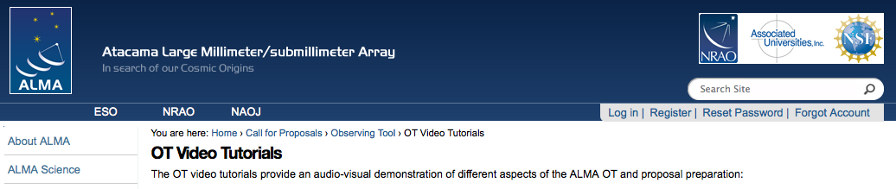
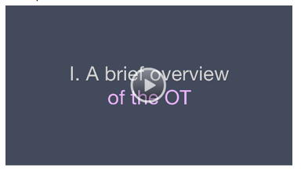
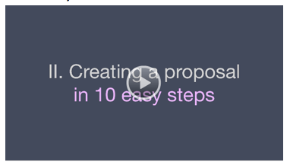
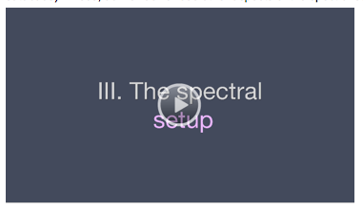
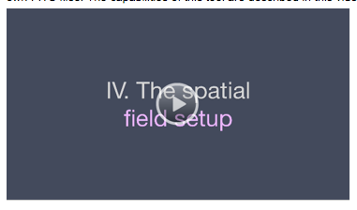
Practical Introduction
Video Tutorials and Quickstart Guides
https://almascience.nrao.edu/call-for-proposals/observing-tool/video-tutorials
Notes:
I’ll emphasize the technical decisions
… and structure of the proposal
… rather than going into a lot of GUI details
For a practical introduction to the graphical user interface
… and the details of the ALMA Observing Tool
Let me refer you to the excellent series
… of video tutorials
… designed to introduce you to the Observing Tool
These can be found on the web
… at the ALMA science portal
… at the URL shown here

Slide 18
Key Proposal Factors
ALMA
Framework: Science Goals
Spectral Setup
Spatial Setup
Control and Performance Specifications
Logistics
Notes:
What I’ll step through here
… are the decisions you need to make
… when putting together the proposal
In the ALMA framework
… these decisions are organized together
… into units called Science Goals
… and that’s where I’ll start

Slide 19
Science Goal (Cycle I)
ALMA
One correlator + front end setup in one ALMA band
spectral windows, rest frequency, polarization, line vs. continuum
Subject to one set of control parameters
spatial resolution, largest angular scale, sensitivity, dynamic range
Using one mapping strategy
mosaic, offsets, single fields
Using one calibration strategy
system or user defined
Applied to Sky Targets within 15°
up to 15 per science goal or 150 fields per mosaic, up to 5 different velocities
Notes:
So a science goal is the basic unit within a proposal for ALMA
… a science goal is defined as a request for observations
… that use one correlator and front end setting
... (so one receiver band)
… meaning effective one “spectral set up”
A science goal is subject single set of control parameters
… so one target RMS, one angular resolution, one target sensitivity
And it uses one mapping strategy
… mosaic, offsets, etc.
A science goal can target up to 15 sources
… but they need to be within 15 degrees of each other on the sky
…this is fewer targets total than in Cyc0!!!

Slide 20
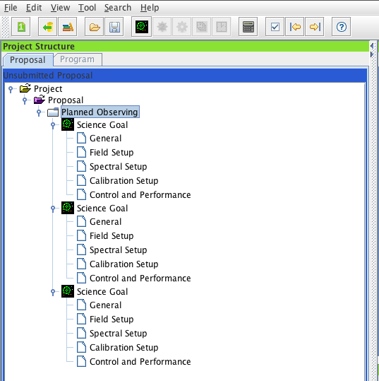
Science Goal (Cycle I)
ALMA
Fundamental unit (below proposal) in the ALMA OT
Five Science Goals allowed per proposal in Cycle 1
In practice:
• Up to 5 Science Goals
• Specify control & performance, spectral setup, field setup for each
Notes:
You are allowed up to five science goals per proposal
… in the upcoming proposal round
… like I said, these are the basic unit
… beneath the proposal level
… you can see that in this OT screenshot here
And defining these represents the technical side
… of preparing an ALMA proposal

Slide 21
Key Proposal Factors
ALMA
Framework: Science Goals
Spectral Setup
Spatial Setup
Control and Performance Specifications
Logistics
Notes:
Defining a science goal has three key aspects
… the spectral setup
… the spatial setup
… and the control and performance parameters
Let’s start with the spectral setup

Slide 22
Spectral Setup: Receiver
ALMA
Four receiver “bands,” set spectral coverage
observing frequency also affects resolution, primary beam
Band | Frequency (GHz) | Primary beam (arcsec) | Angular Resolution (arcsec) | Continuum Sensitivity (mJy min^{1/2})
3 | 84 - 116 | 62 | 0.6 - 4.1 | 0.09
6 | 211 - 275 | 25 | 0.3 - 1.7 | 0.14
7 | 275 - 373 | 19 | 0.2 - 1.2 | 0.25
9 | 602 - 720 | 9 | 0.1 - 0.6 | 2.5
Notes:
As I mentioned a couple times
… ALMA currently has four receiver bands
… on all telescopes
These are shown in this table here
… and roughly target 100, 250, 350, and 650 GHz
When you pick a band to work in
… it’s important to keep in mind
… that the observing frequency dictates not only
… the lines or part of the SED you access
… but also the angular resolution and field of view
… of the telescope

Slide 23
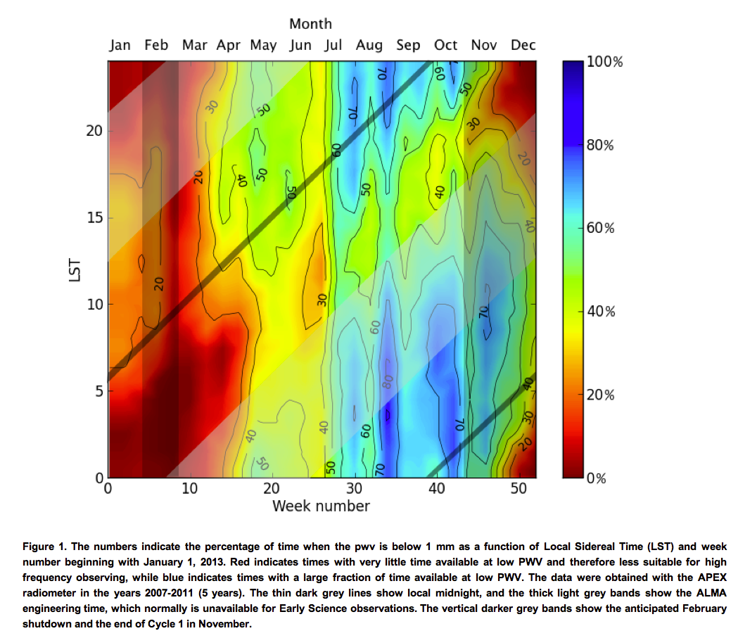
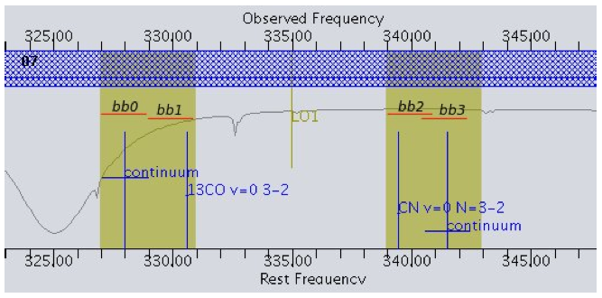
Spectral Setup
More transparent
Frequency view of spectral setup plus atmospheric absorption
More opaque
Atmospheric water absorption line
Notes:
Aside from choice of band
… there are several important aspects of the ALMA receivers that you need to be aware of
… I’ll step through them here using an example figure
… from the technical handbook
The atmospheric transparency figure is from the Proposer’s Guide Chapter 3.2.

Slide 24
Sidebands
Receivers sensitive to two separate ranges of sky frequency: sidebands
Sideband width varies by receiver band
Band 3: 4 GHz, Band 6: 5 GHz, Band 7: 4 GHz, Band 9: 8 GHz
Fixed separation between sidebands
Bands 3, 7, 9: 8 GHz, Band 6: 10 GHz
Notes:
So first, the receivers are each sensitive to two separate ranges of sky frequencies
… called sidebands and referred to as “upper” or “lower”
… you can ONLY observe inside these sidebands
… but you can observe both at once
The width of these sidebands varies between the bands
… consult the OT, proposer’s guide, or technical handbook
… to check the band you’re interested in
The two sidebands are separated by a fixed frequency difference
… that also depends on the band, it’s 8 GHz for bands 3, 6, and 9
… and 10 GHz for band 6

Slide 25
Basebands
Each antenna has 4 digitizers which can each sample 2 GHz of bandwidth
These 2 GHz chunks are termed basebands (they may overlap)
Basebands must be distributed in the frequency covered by the sidebands
(all 4 in one sideband, or two in each; Band 9 does not have this restriction)
Local Oscillator Frequency
2 GHz Basebands
Notes:
Within these side bands
… you are able to actually process
… four 2 GHz-wide chunks of the spectrum
… these chunks are called basebands
... they can can overlap
… and there are restrictions on their configuration
The OT knows about these restrictions
… so that the best way is learn about the rules
… is to try to implement your idea in the OT

Slide 26
Spectral Windows
To collect data, you set up a spectral window in one or more basebands
These regions of the spectrum are processed by the correlator
The correlator allows tradeoff of frequency resolution and bandwidth
In Cycle 1, 4 spectral windows are available.
Spectral windows must lie within the baseband, sideband, receiver range.
Spectral Windows
Notes:
The spectral unit that you actually get in your data
… is called a spectral window
… these are parts of the spectrum that are processed by the correlator
… these can lie anywhere within a baseband, they don’t have to be centered
… with a limit of one per baseband in Cycle 1 (though this will be relaxed later)
You can select the channel width and total bandwidth of each spectral window
… allowing you to trade off total bandwidth for spectral resolution

Slide 27
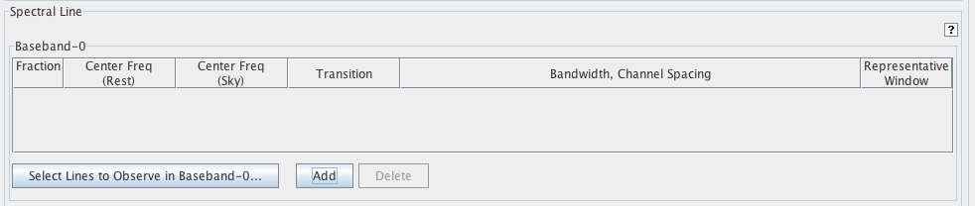
In Practice
Pick a frequency (by hand or source + line) for each SPW
  Splatalogue may help guide choice of lines
Pick a correlator mode for each SPW
The OT will configure the LO and basebands to match (if possible)
Select a line, with your source velocity, this defines a frequency.
Add a spectral window by hand.
Notes:
In practice the way that this goes is that
… you will define up to four desired spectral windows
… and the Observing Tool will try to set up
… the basebands and LO (or sidebands)
… to match

Slide 28
e.g. Type in “H₂O”
A window that can search Splatalogue will open.
Notes:
This causes a splatalogue window to open up
… it allows us to specify the species of interest
… we want H2O
… and so type H2O here in this window

Slide 29
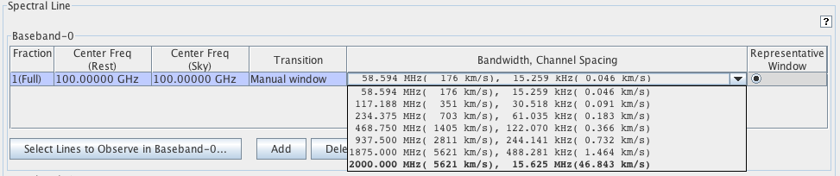
In Practice
Pick a frequency (by hand or source + line) for each SPW
Pick a correlator mode for each SPW
This involves trading off between resolution and bandwidth.
The OT will configure the LO and basebands to match (if possible)
Pick a correlator mode from the drop-down menu.
Notes:
As you define each spectral window
… you will pick a correlator mode from the available list
… setting your spectral resolution and bandwidth

Slide 30
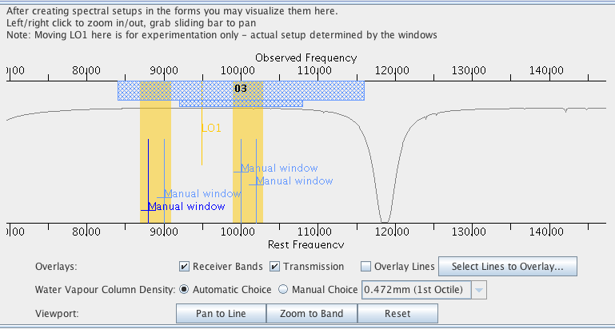
In Practice
Pick a frequency (by hand or source + line) for each SPW
Pick a correlator mode for each SPW
The OT will configure the LO and basebands to match (if possible)
Visualizing the Spectral Setup in the OT
Notes:
You can then have a look at what the OT has done
… using the spectral visualization tab in the OT

Slide 31
In Practice
Pick a frequency (by hand or source + line) for each SPW
Pick a correlator mode for each SPW
The OT will configure the LO and basebands to match (if possible)
Atmospheric Transmission
Sideband Coverage
Receiver Range
Spectral
Windows
Visualizing the Spectral Setup in the OT
Notes:
This shows the sideband placement, overall receiver range
… current spectral window setup
… and atmospheric transmission for various weather conditions

Slide 32
Key Proposal Factors
ALMA
Framework: Science Goals
Spectral Setup
Spatial Setup
Control and Performance Specifications
Logistics
Notes:
In addition to specifying the frequency setup
… of your observations
You obviously have to specify your source
… and mapping strategy

Slide 33
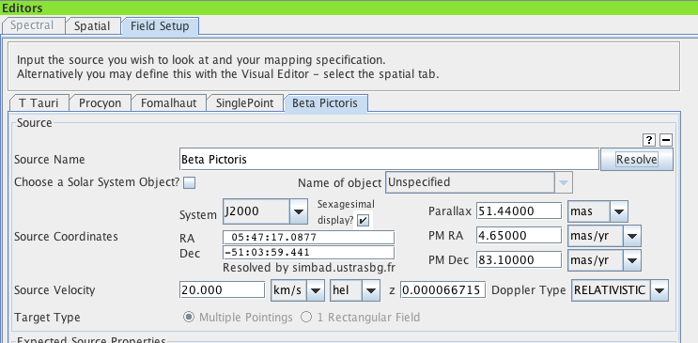
Target Definition
Single field
Up to 15 individual fields in one Science Goal if they are within 15°
Up to 5 different velocities in each Science Goal
Mosaic
offsets are mosaics, mosaics Trade efficiency for imaging quality
up to 150 points (total: mosaic, offset) per proposal
Multiple sources in one Science Goal
Notes:
And here you have a few options
… you can define a series of individual fields
… as implemented here – see these tabs
You can have up to 15 of these individual sources
… in one science goal, provided that they are within 15 degrees of one another
… (making scheduling and calibration more tractable)

Slide 34
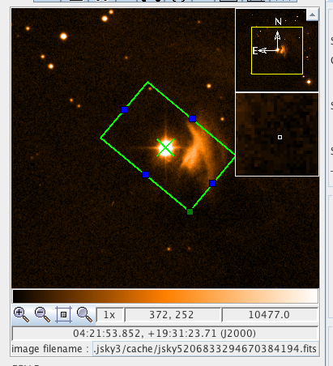
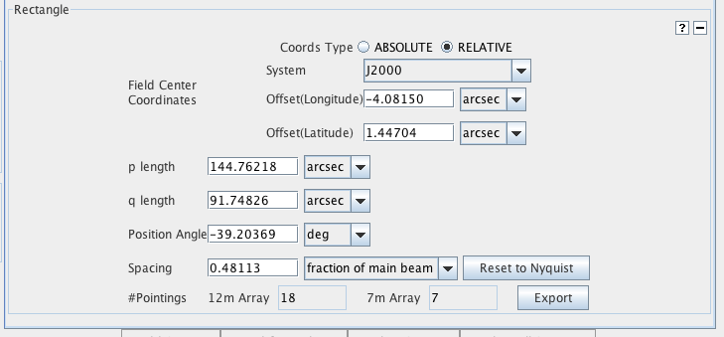
Target Definition
Single field
Up to 15 individual fields in one Science Goal if they are within 15°
Up to 5 different velocities in each Science Goal
Mosaic
offsets are mosaics, mosaics trade efficiency for imaging quality
up to 150 points (total: mosaic, offset) per proposal
Notes:
You can also define a mosaic to map an area near a single source
… and mosaics come in two flavors
… you can either define a rectangular field, as illustrated here

Slide 35
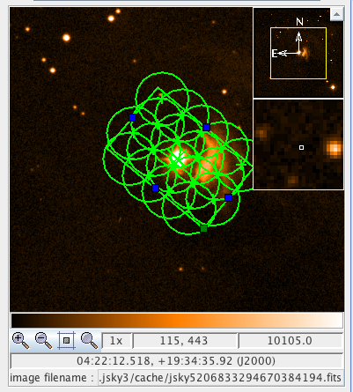
Target Definition
Single field
Up to 15 individual fields in one Science Goal if they are within 15°
Up to 5 different velocities in each Science Goal
Mosaic
offsets are mosaics, mosaics trade efficiency for imaging quality
up to 150 points (total: mosaic or offsets) per proposal
Orientation and Extent
Field Spacing
Number of Fields
Notes:
In this case you can
… set the width, height, and orientation of the region covered
… and the field spacing
The field spacing dictates the distribution of sensitivities in the final mosaic
… our recommended default is about half the primary beam size
… which will be the default
You can see an example of the individual 12-m array pointings
… that make up a rectangular mosaic here

Slide 36
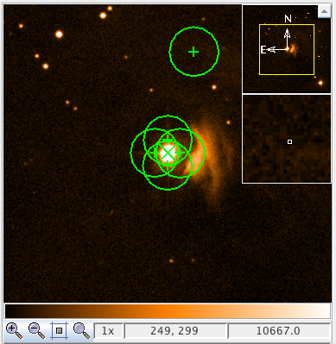
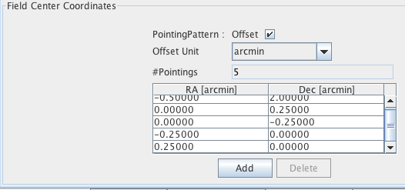
Target Definition
Single field
Up to 15 individual fields in one Science Goal if they are within 15°
Up to 5 different velocities in each Science Goal
Mosaic
offsets are mosaics, mosaics trade efficiency for imaging quality
up to 150 points (total: mosaic, offset) per proposal
Individual Offset Field Centers
Notes:
Alternatively, you can define the individual pointings
… in the mosaic yourself, just setting individual fields
… defined like so
These “offsets” are mosaics
… treated the same way and having the same overhead
… as if you defined a rectangular field
The actual observing script will attempt to achieve
… even integration per field
… among your offsets

Slide 37
Key Proposal Factors
ALMA
Framework: Science Goals
Spectral Setup
Spatial Setup
Control and Performance Specifications
Logistics
Notes:
So you’ve picked a spectral setup and a spatial setup
… the final trick to define a science goal
… is to ask what you actually would like to do
… with that spectral and spatial setup

Slide 38
Control and Performance
ALMA
Target angular resolution
Constrains telescope configuration allowed when data are taken
Target RMS noise
for a fiducial frequency and bandwidth (both user specified)
Request for ACA observations
Largest angular scale + target angular resolution will recommend
Notes:
This is done via setting the control and performance parameters
… the target angular resolution
… the target RMS
… and the binary decision of whether to ask for ACA observations

Slide 39
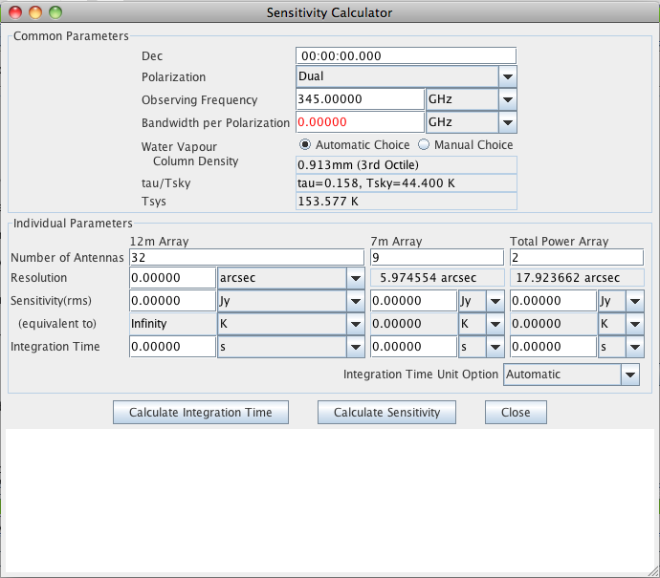
Sensitivity
ALMA
Target RMS noise
for a fiducial frequency and bandwidth (both user selected)
Notes:
The target RMS noise is exactly what it sounds like
… the noise in the final reduced data product
… either map or cube
… that must be achieved to declare the science goal a success
This RMS is defined only for a specified frequency and bandwidth
… which need to jive with your spectral setup, but can otherwise be defined by you
You can explore the time on source needed to reach a particular noise
… with the sensitivity calculator
… which is built into the OT

Slide 40
Sensitivity
ALMA
Target RMS noise
for a fiducial frequency and bandwidth (both user selected)
Fiducial Frequency
Fiducial
Bandwidth
Cycle 1
Capabilities
Notes:
This lets you rapidly explore the tradeoffs
… among bandwidth, frequency
… time on source, target noise level
… and angular resolution (in the case of surface brightness sensitivity)

Slide 41
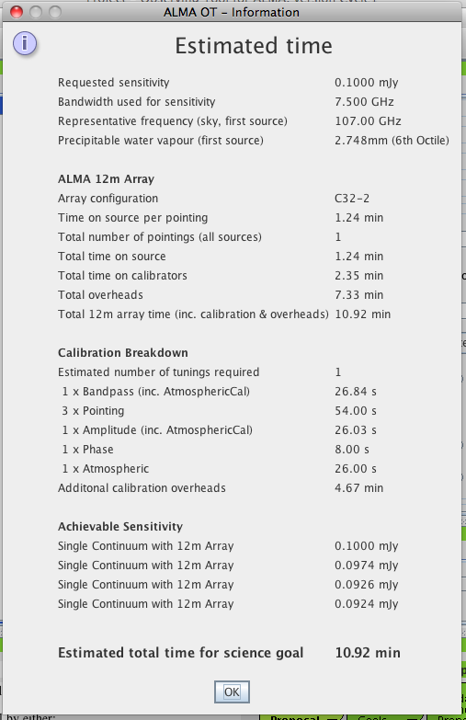
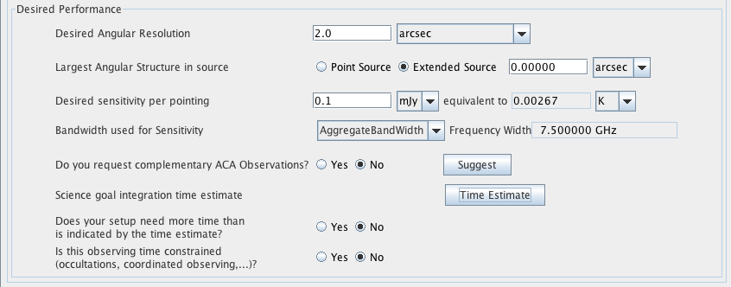
Sensitivity
ALMA
Time Request
OT will calculate a rough time estimate, including overheads
Control and Performance
Notes:
Once you’ve used the sensitivity calculator to pick your target RMS
… the observing tool allows you to input the requested noise
… for a fiducial bandwidth and frequency that are possible given your observing setup
And then can calculate a rough time request for your science goal
… given your desired resolution, sensitivity, frequency, and band width
Take these times as indicative
… you cannot request more than 100 hours
… but your are fundamentally proposing for an RMS
… not a telescope time
…must use screen capture if you want to keep them

Slide 42
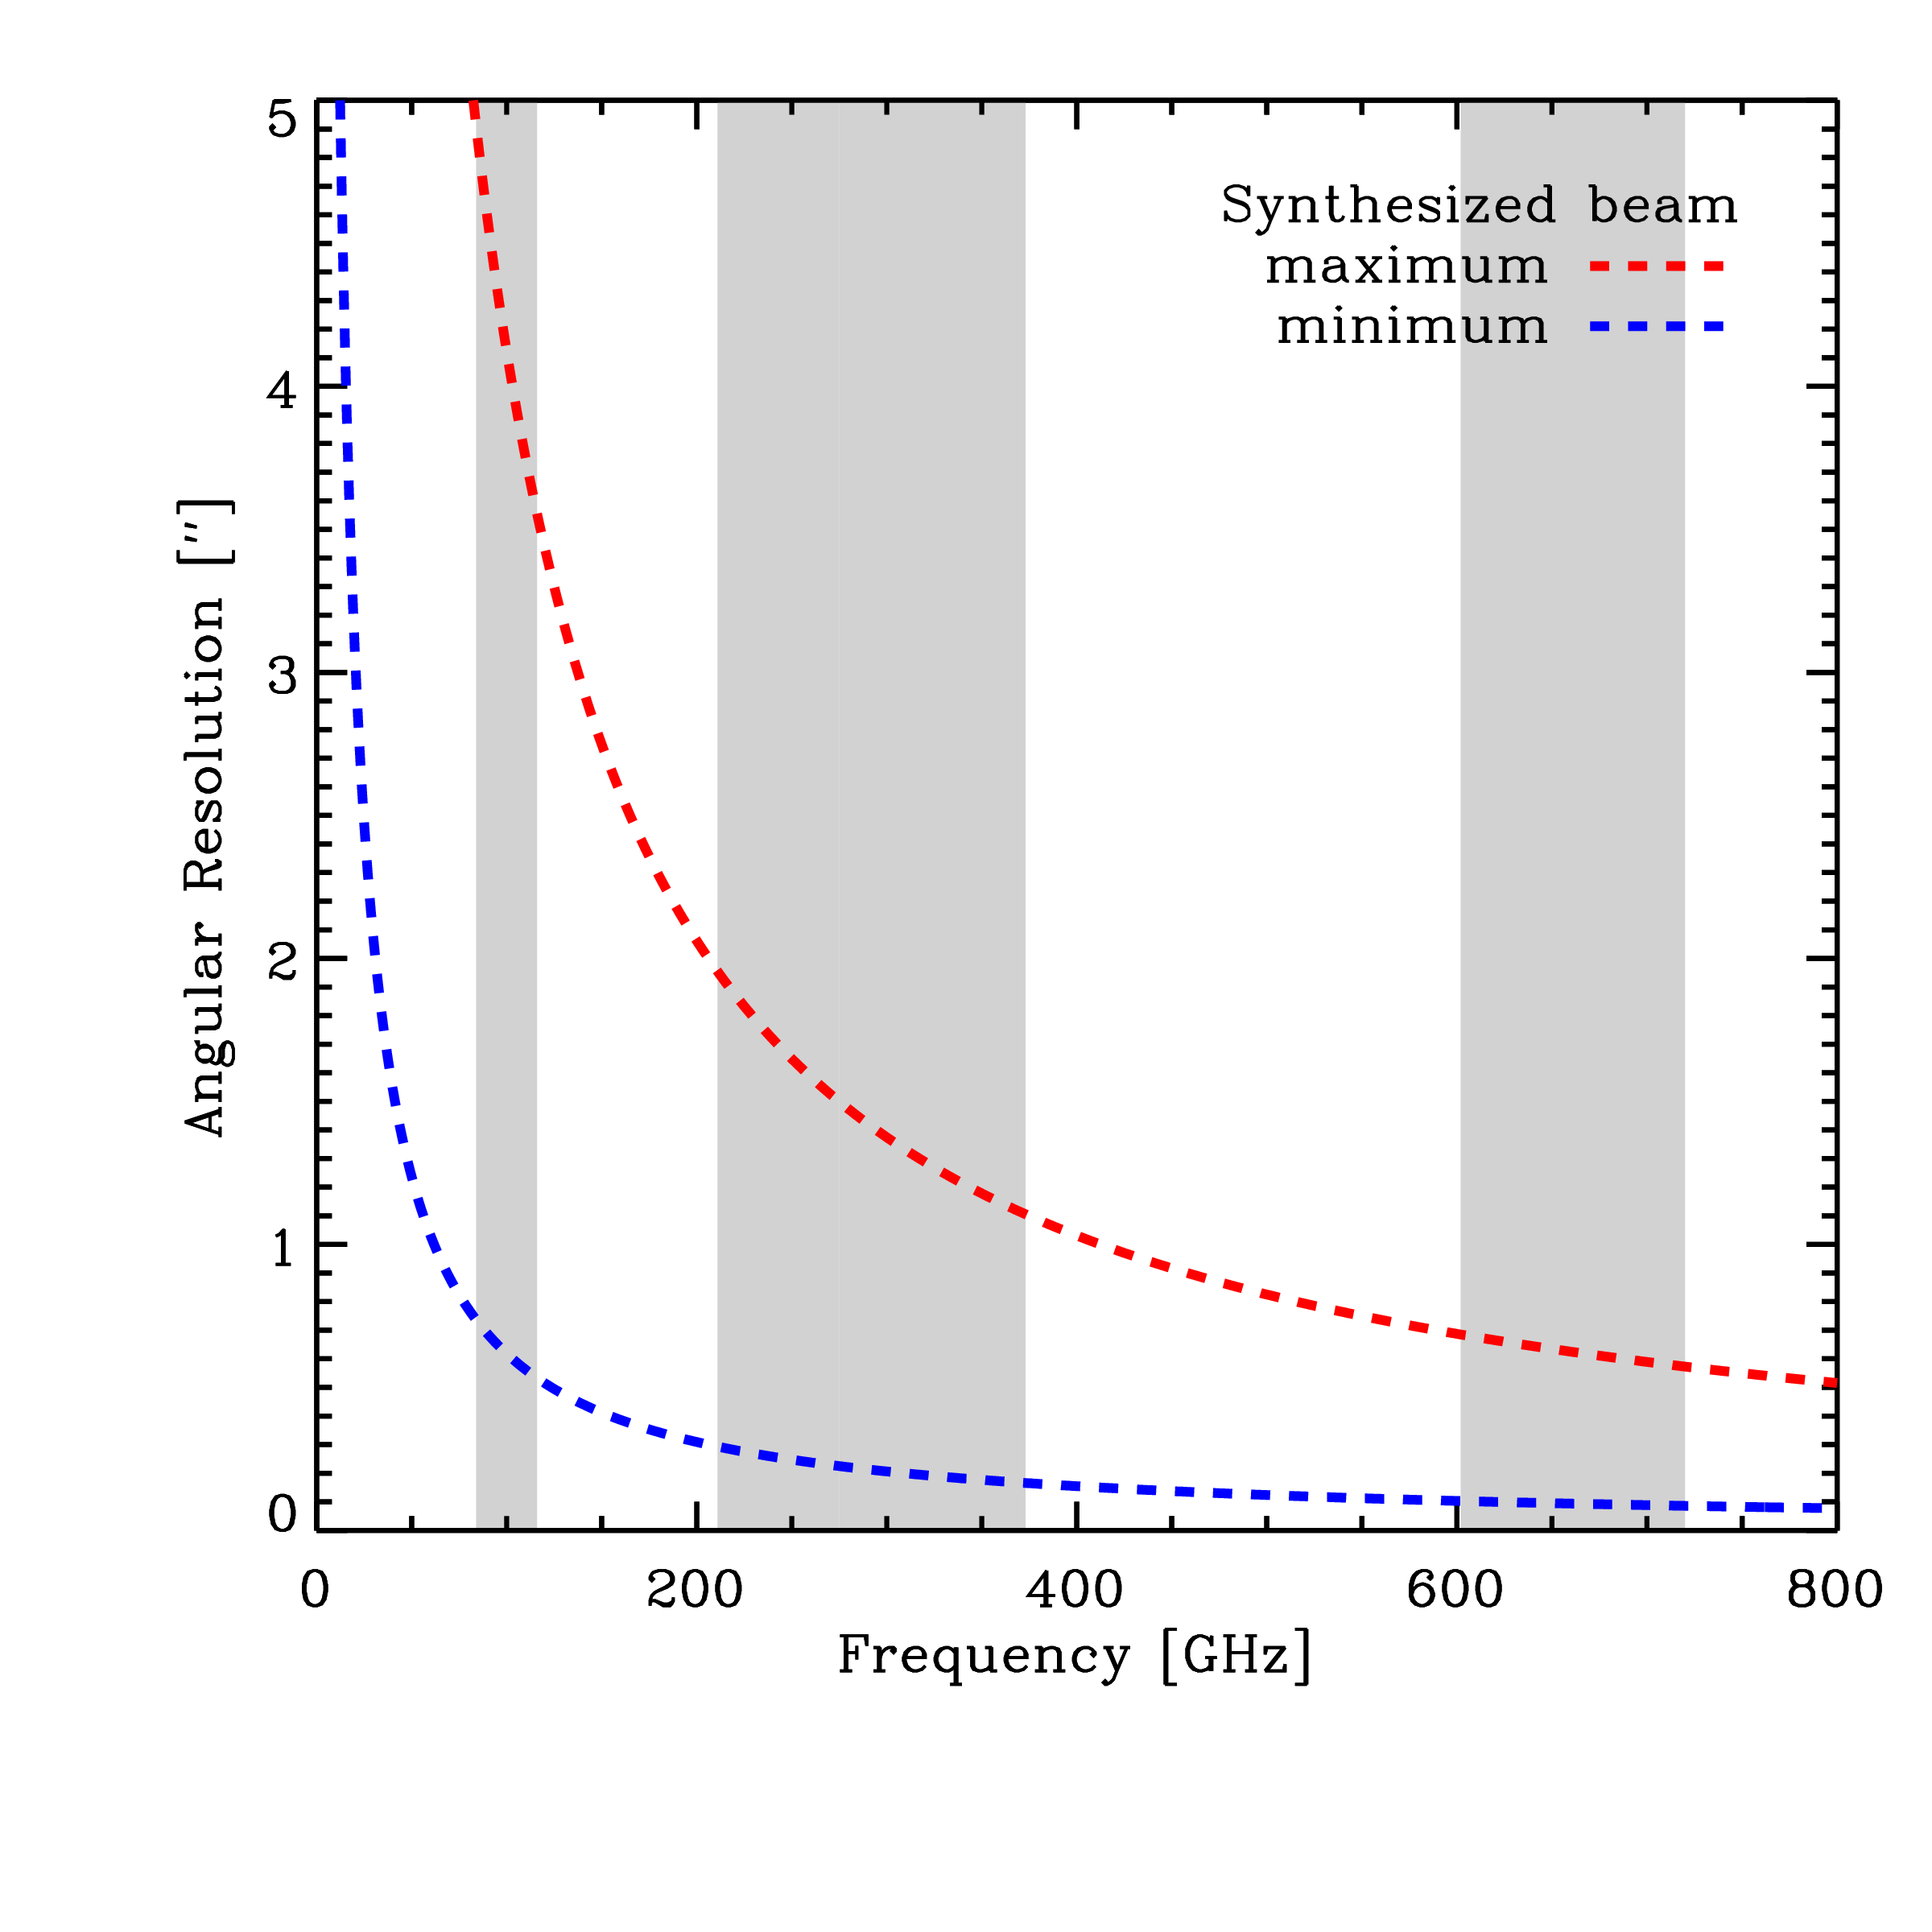
Resolution
ALMA
Target angular resolution
Constrains telescope configuration allowed when data are taken
High resolution leads to lower surface brightness sensitivity
RMS proportional to beamwidth² holding all other factors fixed.
BAND 3
BAND 6
BAND 7
BAND 9
Notes:
Your second key decision is angular resolution
… the ALMA antennas will move among a range of configurations
… during Cycle 1, allowing resolutions between these two lines here
As you can see, available resolutions (like the field of view)
… depend on frequency
… ranging from just below and arcsecond to twiddle 4 in Band 3
… and from about a tenth of an arcsecond to about half an arcsecond in band nine
One thing to bear in mind
… is that if you are interested in surface brightness sensitivity
… aiming for higher angular resolution leads to lower surface brightness sensitivity
… holding everything else fixed, so it’s not entirely free

Slide 43
Maximum Angular Scale
ALMA
Maximum angular scale (MAS) recovered by array
Band | Frequency (GHz) | Primary beam (“) | Range of Scales (“) C32-1 C32-6
3 | 84-116 | 72 - 52 | 4.2 - 24.6 | 0.7 - 15.1
6 | 211-275 | 29 - 22 | 1.8 - 10.7 | 0.3 - 6.6
7 | 275-373 | 22 - 16 | 1.2 - 7.1 | 0.2 - 4.4
9 | 602-720 | 10 – 8.5 | 0.6 - 3.6 | 0.1 - 2.2
Smooth structures larger than MAS begin to be resolved out.
All flux on scales larger than λ/B_{min} (~2 x MAS) completely resolved out.
Need additional observations with a single-dish or a compact array of small telescopes.
Notes:
So you’ve picked your target RMS and your target angular resolution
… the last major decision you make
… is a new one for Cycle 1
… and that’s whether to request the use of the Atacama Compact Array or not
The reason that the ACA exists is that
… the 12-m array is only sensitive to power on a range of angular scales
… with the exact range depending on the configuration

Slide 44
Maximum Angular Scale
ALMA
Maximum angular scale (MAS) recovered by array
Band | Frequency (GHz) | Primary beam (“) | Range of Scales (“) C32-1 C32-6
3 | 84-116 | 72 - 52 | 4.2 - 24.6 | 0.7 - 15.1
6 | 211-275 | 29 - 22 | 1.8 - 10.7 | 0.3 - 6.6
7 | 275-373 | 22 - 16 | 1.2 - 7.1 | 0.2 - 4.4
9 | 602-720 | 10 – 8.5 | 0.6 - 3.6 | 0.1 - 2.2
Smooth structures larger than MAS begin to be resolved out.
All flux on scales larger than λ/B_{min} (~2 x MAS) completely resolved out.
Need additional observations with a single-dish or a compact array of small telescopes.
Notes:
So that emission from any source
… that is smooth on scales larger than the maximum angular scale
… to which the 12-m array is sensitive
… will be filtered out and missing from your final data product
The filtered scales are a function of frequency and configuration
… with the configuration of telescopes driven by your requested angular resolution
If you want to recover structure on scales larger than this maximum angular scale
… then you need observations with a single dish or a compact array of small telescopes
This is what the ACA is for.

Slide 45
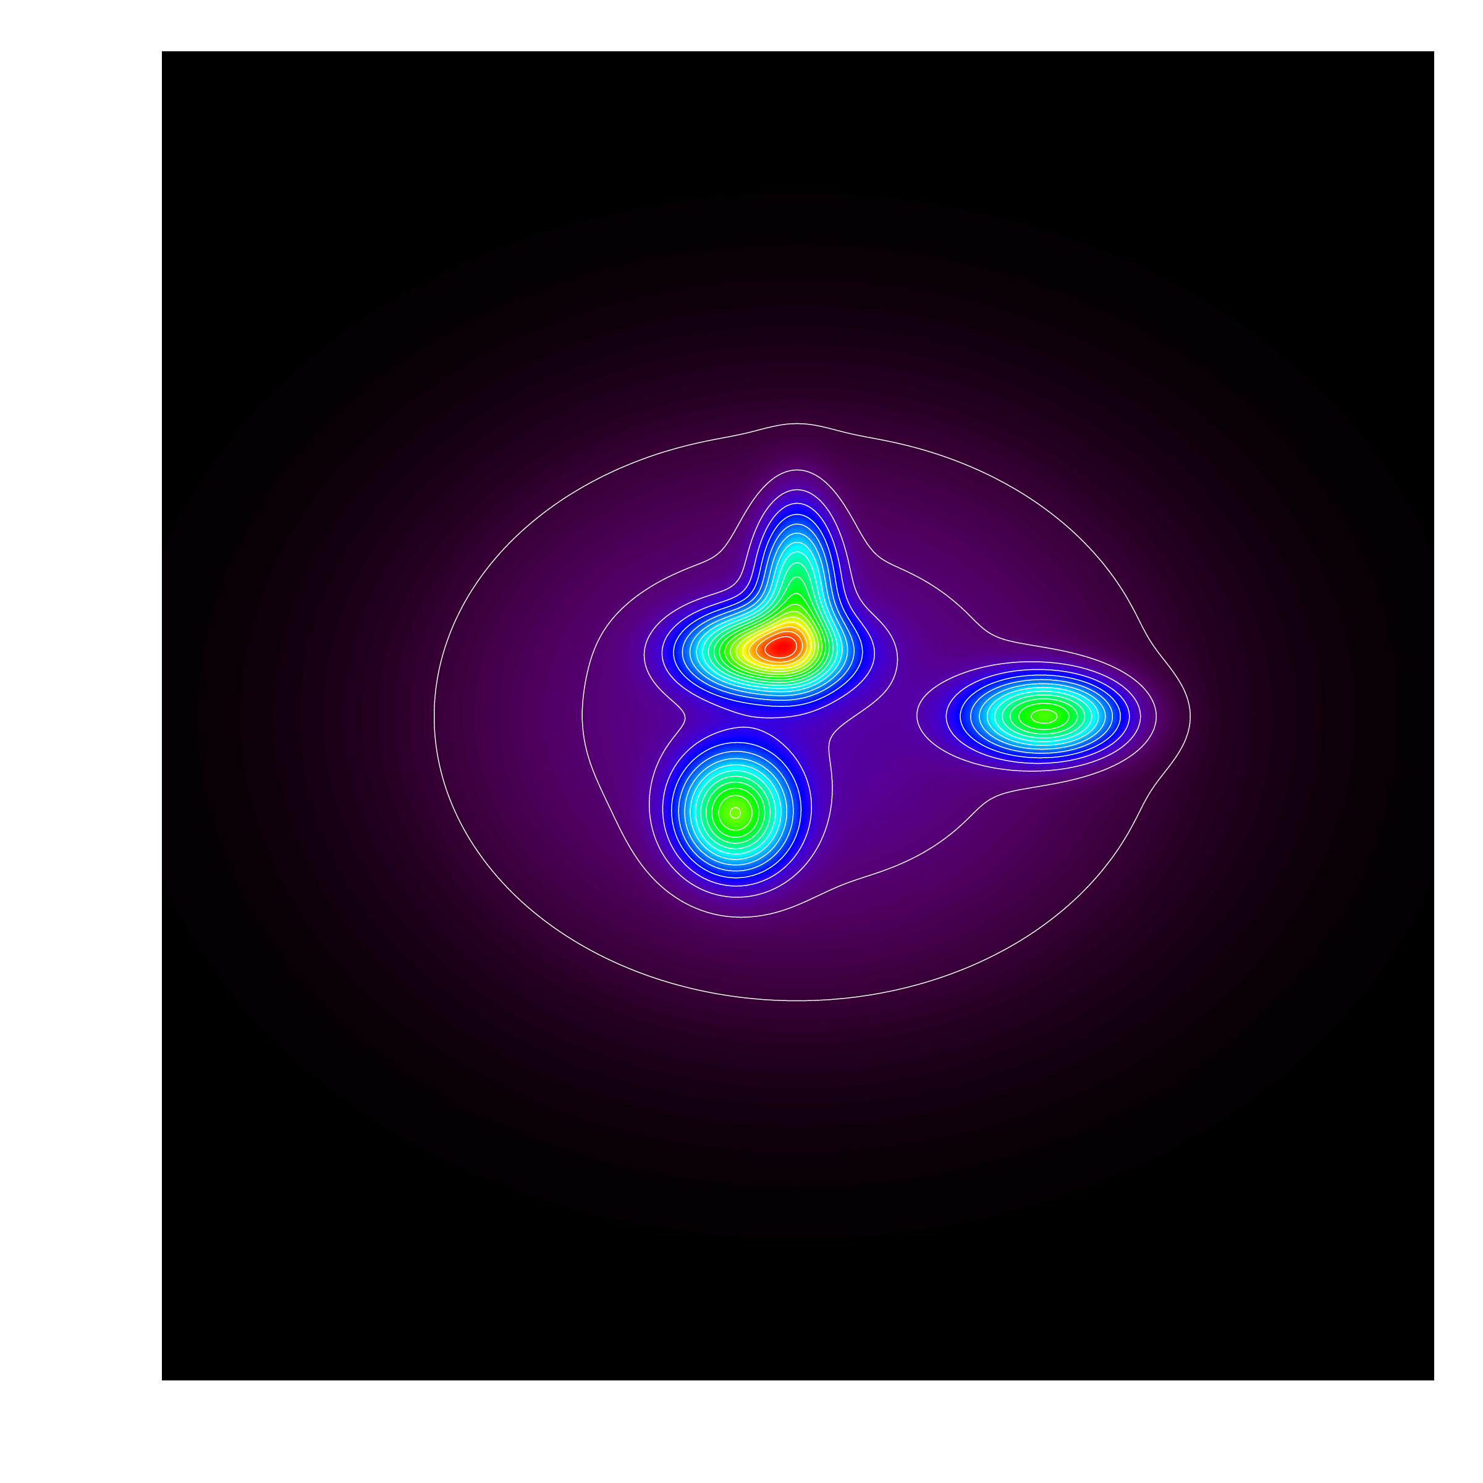
Largest Angular Scale (LAS)
ALMA
Largest angular scale of interest for target
Depends on source structure and science aims
e.g., compact sources embedded in a smooth superstructure holding ~65% of flux
(here with perfect S/N)
Notes:
So the critical decision on your part
… is whether to request the ACA
This is an interaction of the largest angular scale that you need
… to do your science
… and the maximum angular scale to which the array is sensitive
The largest angular scale needed to do your science depends
… on the structure of your source and your science aims
As a trivial example, consider this made-up source
… which consists of a few compact sources
… embedded in a large, smooth superstructure
… that holds 65% of the total flux of the source

Slide 46
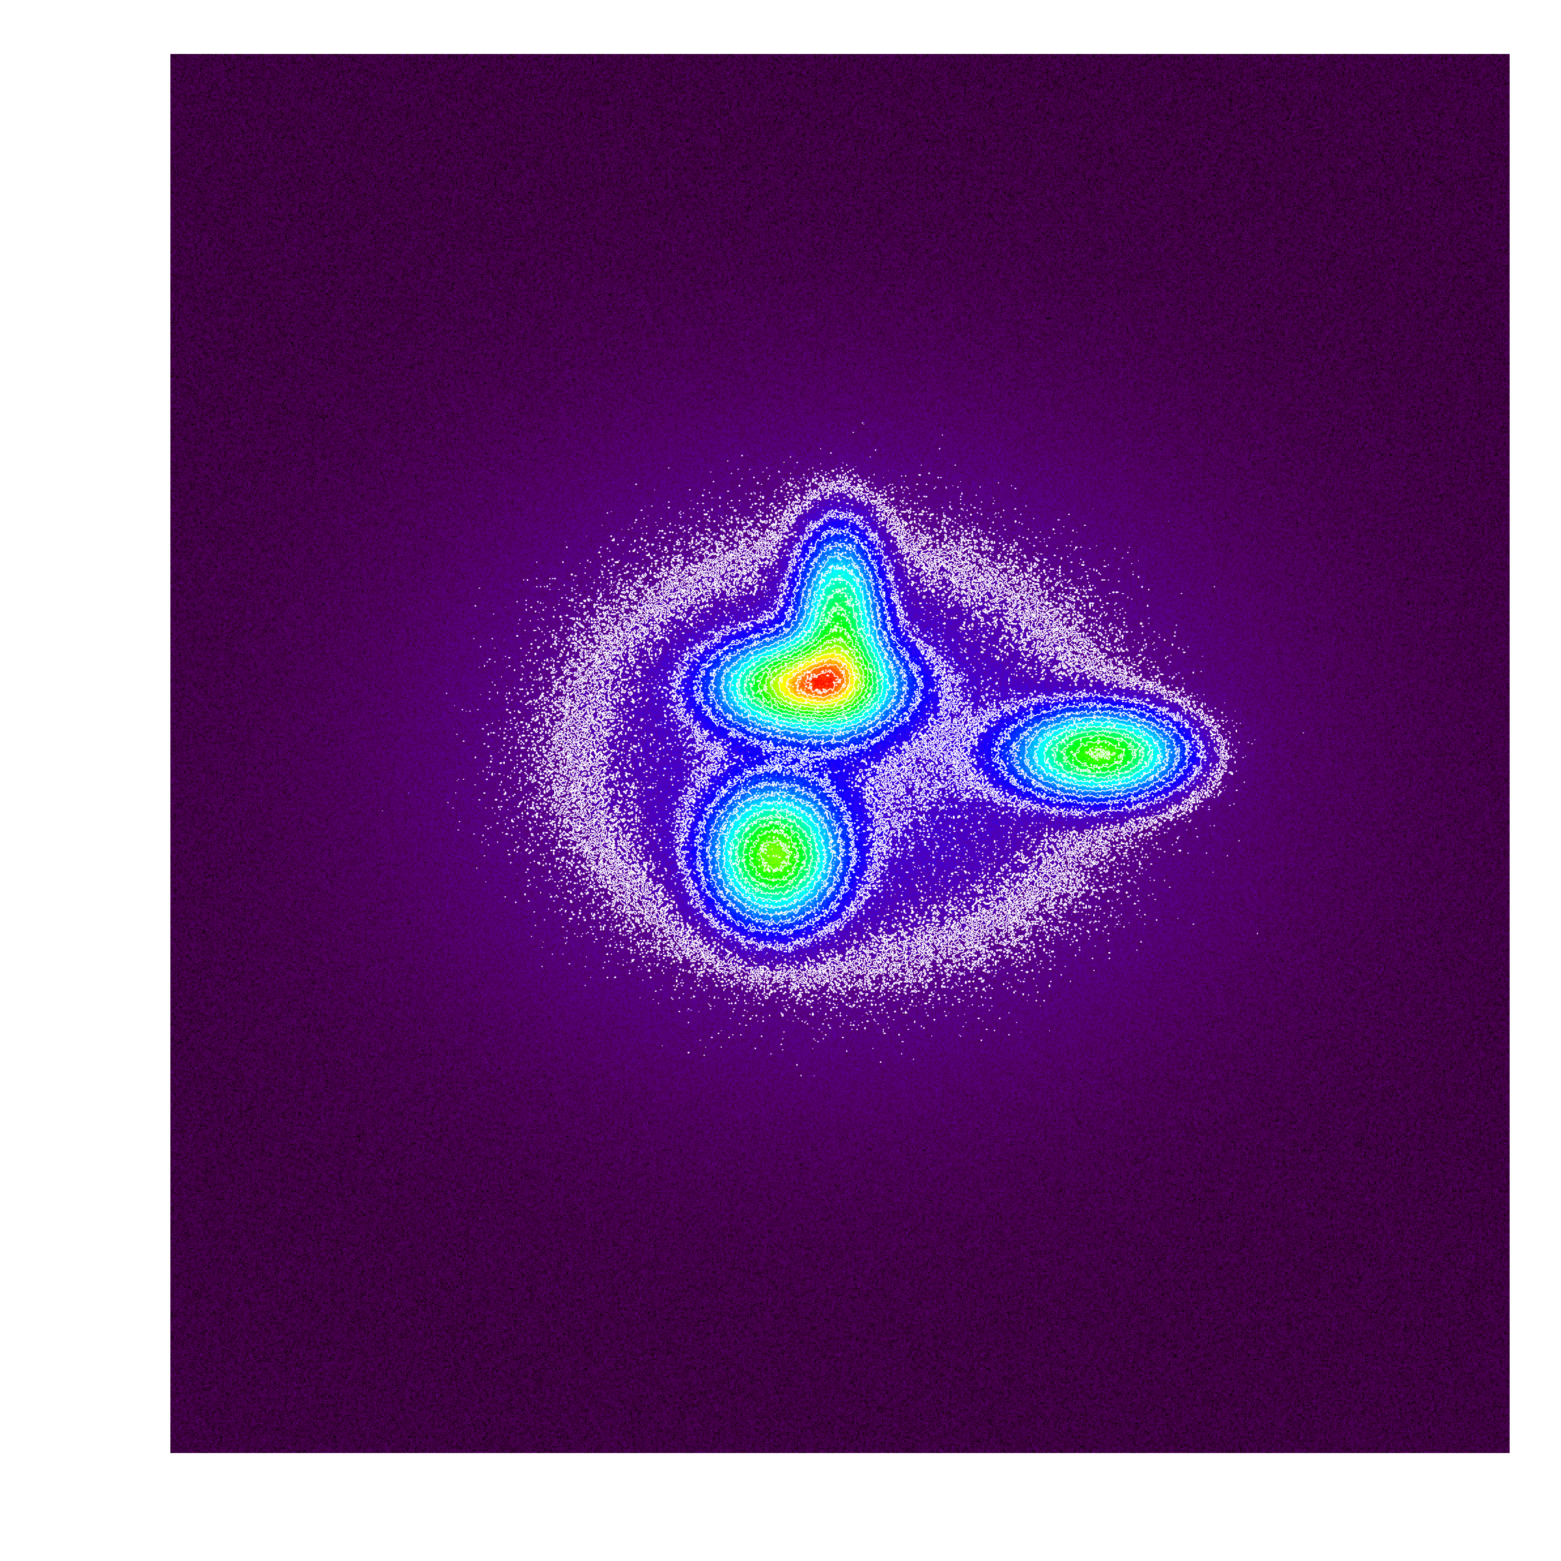
Largest Angular Scale (LAS)
ALMA
Superstructure of scientific interest?
Then your RMS and LAS must reflect that.
Largest Angular Scale
RMS set to detect superstructure and LAS input to reflect size of structure.
Notes:
So the key question with a source like this
… is whether the superstructure is of scientific interest
If the superstructure is of interest
… then your estimate of the largest angular scale
… must reflect that
… and of course your target RMS
… must also be set to recover the superstructure

Slide 47
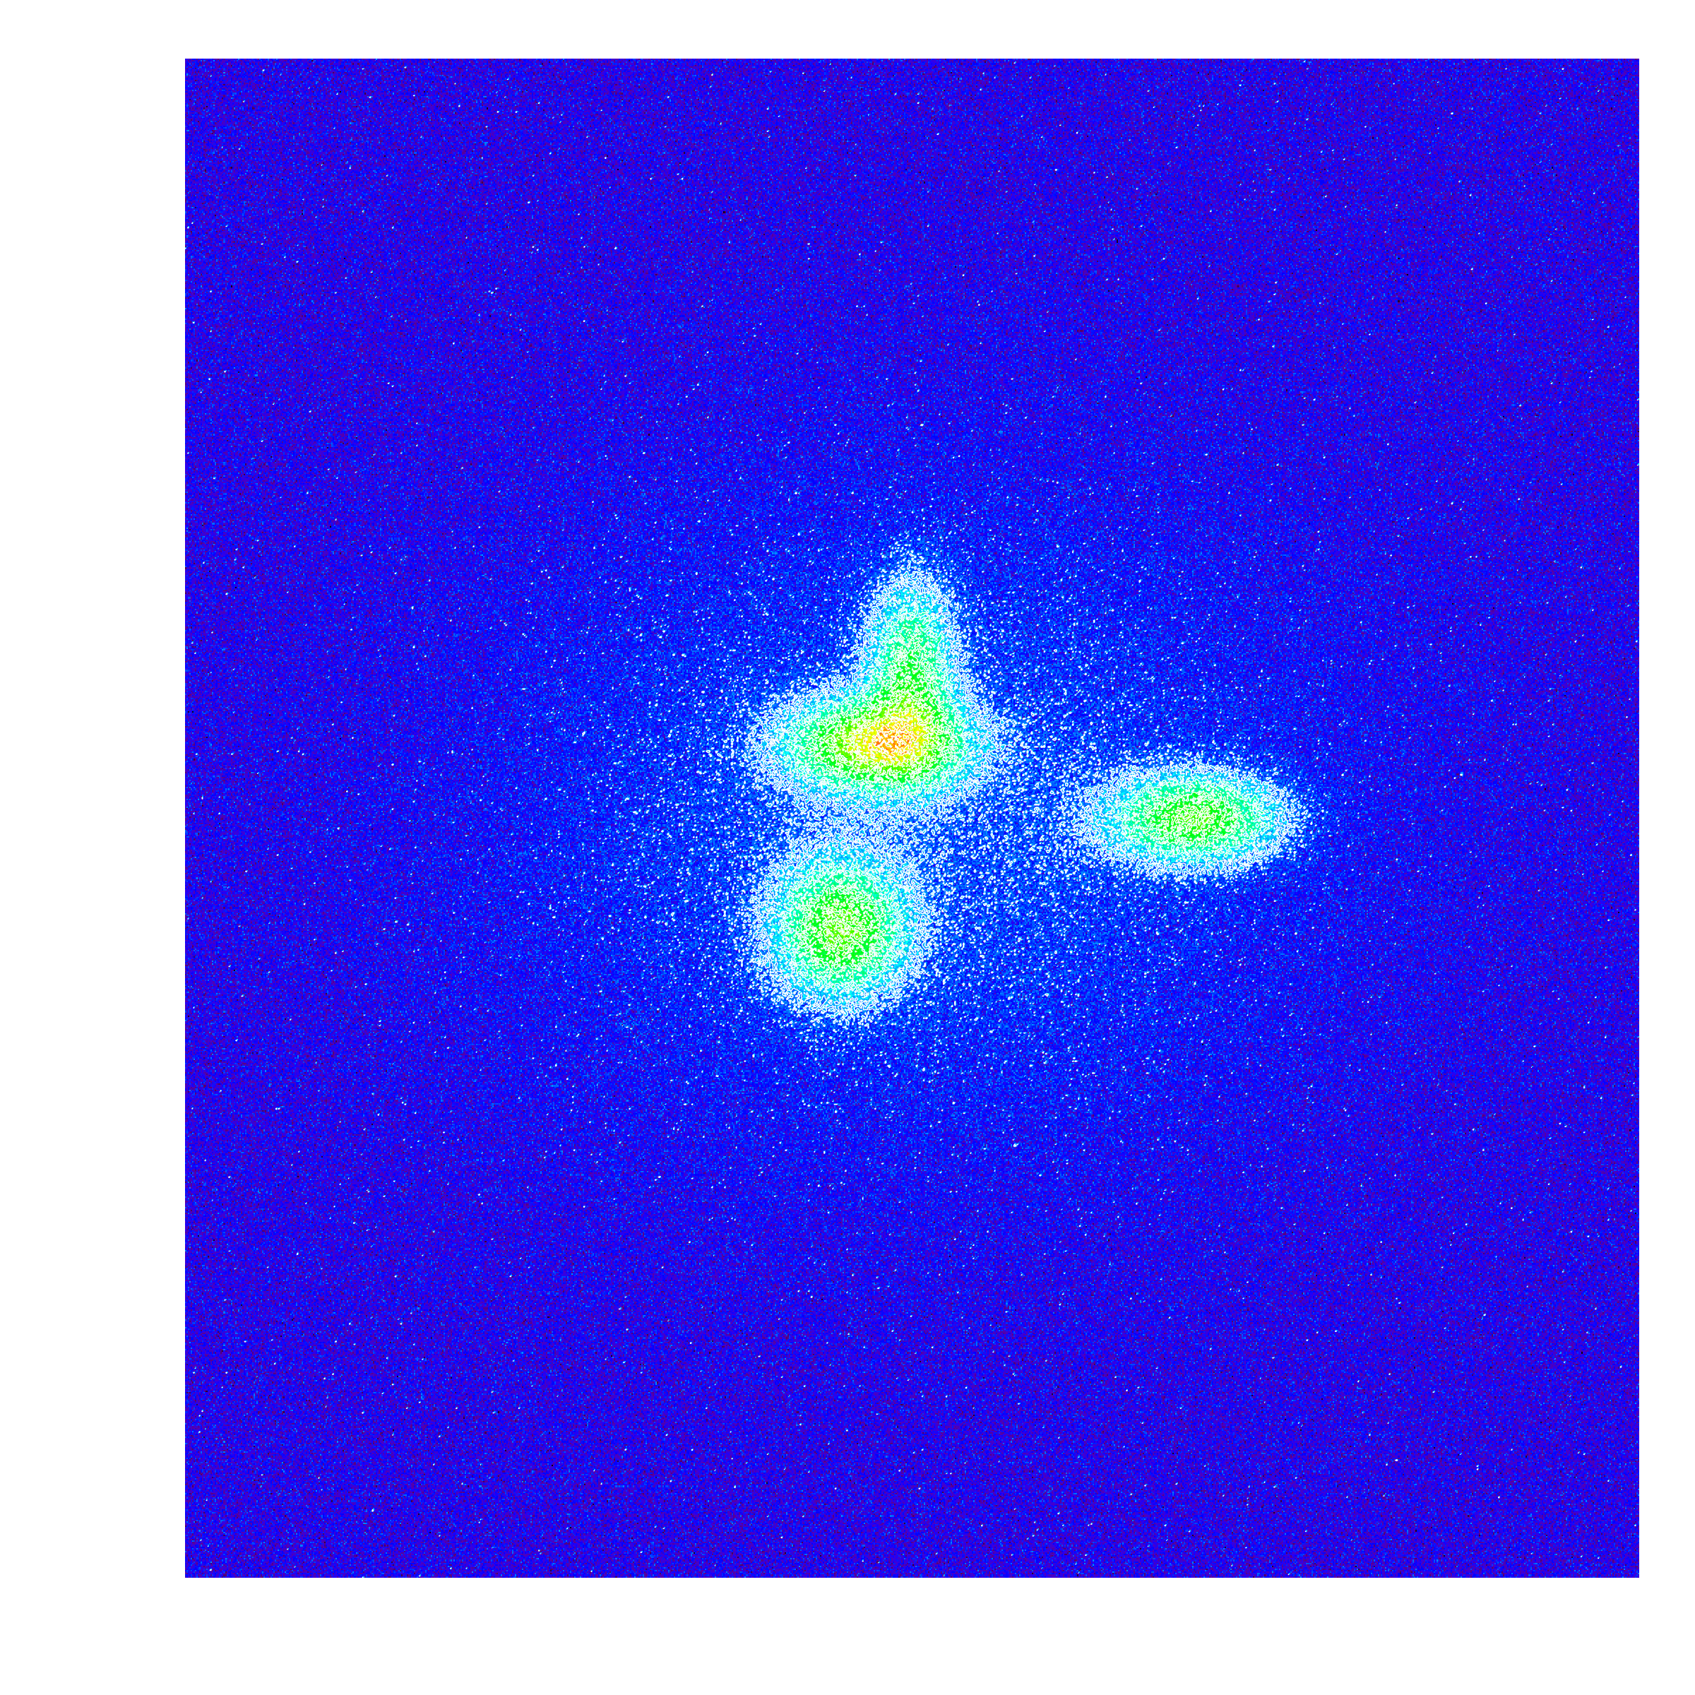
Largest Angular Scale (LAS)
ALMA
Only embedded compact sources of interest?
Largest
Angular
Scale
RMS set to detect compact sources and LAS input to reflect compact source size.
Notes:
On the other hand if only the compact cores are of interest
… then your RMS and largest angular scale
… should reflect that aim
The point of this silly illustration
… is that largest angular scale is a property of your source
… and your science
if a proposal requests an angular scale that requires ACA but doesn't select it the TAC will surely downgrade the proposal .... need to justify carefully to go against the OT recommendations.

Slide 48
ACA Example (see Primer)
Notes:
Demonstrated
here is a simulated observation of a source
with structure on very large angular
scales. This theoretical model of e.g. a protostellar
disk has a power-law envelope, so
in principle has power on all spatial scales
(top left). In this case, for a highsensitivity
observation, the LAS is clearly
as large as the field of view.
When observed at 345GHz with a desired resolution of 0.75", the 12m-only ALMA observation (top center) shows that significant
large-scale structure has been resolved out; this cleaned image has negative bowls, and a significant amount of restored flux
is missing. The OT will recommend use of the ACA in this case, and indeed the combined 12-m Array + ACA 7-m image (top
right) shows that more, but not all, of the large-scale structure is recovered (incorporating the TP Array 12-m data will add in the
missing flux density). The bottom row shows the u-v coverage of the ACA (red) and ALMA-array (blue) (left) and the amplitude
versus u-v spacing for the ACA and 12-m Array baselines (right). The correlated flux densities for the ACA baselines are significantly
Larger than that for the shortest ALMA baselines.

Slide 49
To Use the ACA?
ALMA
Largest Angular Scale of Source
Property of the source and your science.
Maximum Angular Scale Recovered by Array
Related to target angular resolution (in Cycle 1) because that drives the configuration of antennas used.
ACA Recommended?
If Largest Angular Scale too big for Maximum Angular Scale of 12-m Array, then the OT will recommend the inclusion of the ACA.
Ultimately YOUR Decision
ONLY ~250 hours (1/3 of total time) will go to projects needing ACA.
Notes:
Once you have these in mind
… you should compare the largest angular scale of interest
… to the maximum angular scale recovered by the 12m-array
… for your band
The OT will do this for you if you input the Largest Angular Scale
… and it will recommend whether you should request the ACA
Ultimately though this is your decision
… and at least part of the reason that we’re making a big deal of it
… is that there’s only enough time available with the ACA
… to allow about 1/3 of the 12-m array projects to include ACA
… so it may be that ACA projects are more heavily competed
… though we don’t know that for sure, that depends on you

Slide 50
To Use the ACA?
ALMA
Largest Angular Scale of Source
Property of the source and your science.
Maximum Angular Scale Recovered by Array
Related to target angular resolution (in Cycle 1) because that drives the configuration of antennas used.
ACA Recommended?
If Largest Angular Scale too big for Maximum Angular Scale of 12-m Array, then the OT will recommend the inclusion of the ACA.
ACA not available for highest resolutions (not enough overlap in u-v coverage)
Ultimately YOUR Decision
ONLY ~250 hours (1/3 of total time) will go to projects needing ACA.
Notes:
One important technical note
… it’s not possible to have it all, unfortunately
… in Cycle 1 the maximum angular resolution dictates the 12-m configuration
… that will be used to take your data
… because this also sets the shorter spacings in the array
… it does not make sense to allow ACA observations
… for the highest angular resolutions at each band
Consult the technical handbook to see the details
… but the basic issue is that there’s not enough overlap
… between the ACA and the main array in the u-v plane to have such observations
… make sense

Slide 51
To Use the ACA?
A spiral galaxy where the model (center) is an IRAC 8 micron image as a proxy for CO.
In the top row, a simulated image reconstructed using a smaller LAS is shown; only compact bright features are present in the image on the left. On the right, the ACA was used to recover extended emission; the fidelity of the image is improved markedly.
In the bottom row, the image was reconstructed using a larger LAS is shown; compact structure is much better represented. Image fidelity is further improved through the use of the ACA.
Notes:
Figure 14: Simulation of an ALMA Cycle 1 spectral-line
observation of an M100-like galaxy at a redshift of 0.05.
Inset: IRAC 8μm image of M100 used as a proxy of how
the CO would appear if the galaxy were moved to z=0.05.
The leftmost images show a simulated 8-hour observation of
the redshifted galaxy in Band 3, using just the 32 antennas
of the 12-m array in the most extended (top) and a moderately
compact (bottom) configuration. The right images
show the same observation after including ACA 8-hour
(top) and 16-hour (bottom) data. Such simulations can be
made using the Simulator in CASA, or using the on-line
Observation Support Tool.

Slide 52
Key Proposal Factors
ALMA
Framework: Science Goals
Spectral Setup
Spatial Setup
Control and Performance Specifications
Logistics
Notes:
Okay so that’s my rundown of the decisions that you need to make
… to build an ALMA proposal
Let me close with a few words about the logistics of proposing

Slide 53
Proposal Checklist
ALMA
Read Primer and Proposer’s Guide
Create an ALMA account by registering at the Science Portal
Download the Observing Tool (OT)
Familiarize yourself with the OT via the Quickstart Video
Define your Science Goals within the OT
use the OT to understand if your science goals match ALMA’s capabilities
use CASA simdata for a more thorough exploration
take advantage of the TA Checklisted generated by the OT
Prepare the Science & Technical Justifications (one PDF file)
Annotated LaTeX template available
Make use of the Helpdesk & the Knowledgebase
Submit!
Required Step
Notes:
Your overall path to proposal should look something like this
We’ve put together a lot of excellent documentation
… we suggest that you start by familiarizing yourself with at least the basic docs
… the ALMA Proposer’s Guide and the Early Science Primer
You then need to create an account at the ALMA science portal
… to be involved in ANY ALMA proposals
From the science portal you can also download the ALMA Observing Tool
… and have a look at the quickstart tutorials that I mentioned earlier
From here it makes sense to try implementing your science plan
… in the OT
… this will give you a very concrete check of whether your plan
… actually meshes with ALMA’s capabilities
A really valuable tool here is the TA checklist
… that is generated when you generate a PDF of your proposal
… (flip)

Slide 54
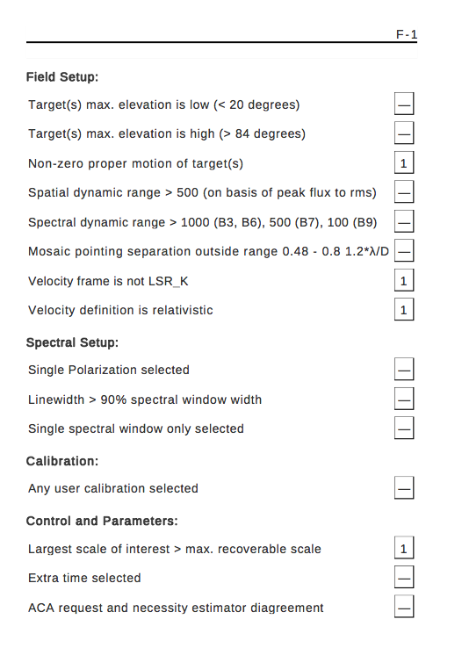
TA Checklist
ALMA
Checklist of technical concerns generated by the OT as part of PDF output
Notes:
This checklisht, shown here
… gives you a list of “gotchas” and highlights possible worry areas
... basically it highlights anything out of the ordinary about your proposal
It will be used to aid technical assessment of your proposal
… but you can also use it to see if you may have issues
… or if there are points that need to be addressed in the technical justification.

Slide 55
Proposal Checklist
ALMA
Read Primer and Proposer’s Guide
Create an ALMA account by registering at the Science Portal
Download the Observing Tool (OT)
Familiarize yourself with the OT via the Quickstart Video
Define your Science Goals within the OT
use the OT to understand if your science goals match ALMA’s capabilities
use CASA simdata for a more thorough exploration
take advantage of the TA Checklisted generated by the OT
Prepare the Science & Technical Justifications (one PDF file)
Annotated LaTeX template available
Make use of the Helpdesk & the Knowledgebase
Submit!
Required Step
Notes:
Once you are sure that your proposal matched ALMA’s capabilities
… You can prepare and attach your science and technical justification
… which are of course the main thing by which your proposal will be judged
And once your are satisfied with these you can submit the proposal to the ALMA archive!

Slide 56
The ALMA Science Portal
ALMA
https://almascience.nrao.edu
Hub for project-wide material.
Observing Tool
Sensitivity Calculator
Proposer’s Guide
Technical Handbook
Science Verification Data
CASA & Simulations
Tutorials
Helpdesk
Registration required to propose for PIs and coIs.
.
Notes:
Finally, let me wrap by pointing out again
… where you can go
… for more information
… to get help
… and to download the tools that I told you about
The ALMA science portal
… at almascience.nrao.edu for our North American users
… serves as the hub for project wide material
… including the required observing tool
… and key docs like the proposer’s guide
… the technical handbook and so on
From there you can also register
… and access our helpdesk to get any support that you need

Slide 57
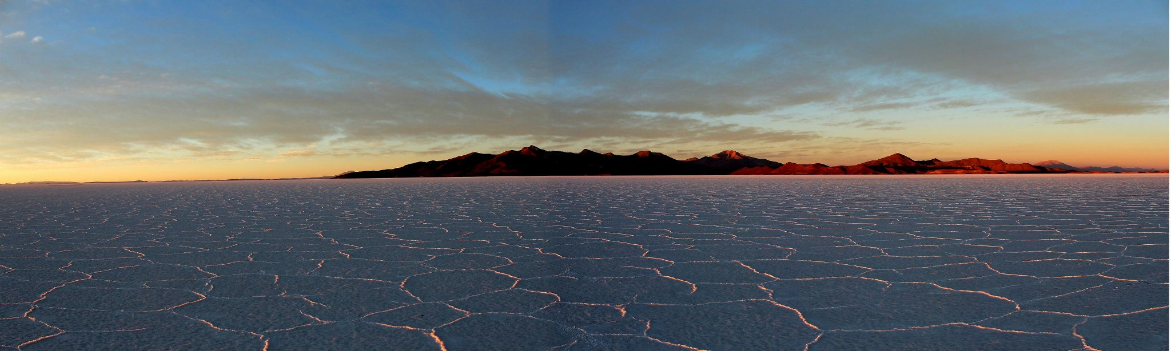
almascience.nrao.edu
science.nrao.edu/alma
The Atacama Large Millimeter/sub-millimeter Array (ALMA), an international astronomy facility, is a partnership of Europe, North America and East Asia in cooperation with the Republic of Chile. ALMA is funded in Europe by the European Organization for Astronomical Research in the Southern Hemisphere (ESO), in North America by the U.S. National Science Foundation (NSF) in cooperation with the National Research Council of Canada (NRC) and the National Science Council of Taiwan (NSC) and in East Asia by the National Institutes of Natural Sciences (NINS) of Japan in cooperation with the Academia Sinica (AS) in Taiwan. ALMA construction and operations are led on behalf of Europe by ESO, on behalf of North America by the National Radio Astronomy Observatory (NRAO), which is managed by Associated Universities, Inc. (AUI) and on behalf of East Asia by the National Astronomical Observatory of Japan (NAOJ). The Joint ALMA Observatory (JAO) provides the unified leadership and management of the construction, commissioning and operation of ALMA.

Slide 58
NRAO Proposal Planning Webinar
NEXT PRESENTATION: 18:30 UT
17:00 UT (1pm EDT) – Planning an ALMA Proposal
18:30 UT (2:30pm EDT) – Planning a GBT Proposal
19:30 UT (3:30pm EDT) – Planning a JVLA/VLBA Proposal
21:30 UT (5:30pm EDT) – Open Questions & Answers
Important information:
Sound available only through voice bridge.
  USA Toll Number : +1-210-835-9155
  USA Toll Free Number : 866-815-0456
  Participant Passcode: 3535975#
Ask question through webinar “Chat” feature
  Click green area in top center of your screen
  Click on “Chat”
  Select Send to: Aaron Evans (Host)
Supporting Material: https://science.nrao.edu/science/meetings/nrao-cde

Slide 59
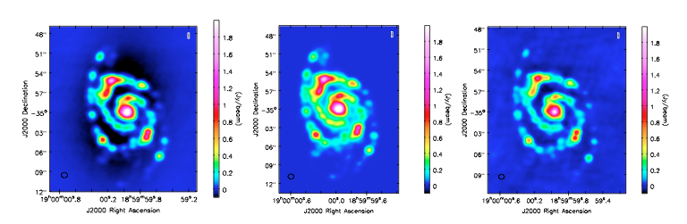
To Use the ACA?
ALMA
When in doubt, simulate!
“Observe” a model of your target with 12-m and 12-m+ACA, compare
12-m Array Only
Model
12-m + 7-m ACA
Image reconstruction artifact (“bowls”)
Not present when 7-m antennas included
Notes:
As a final note on this whole ACA business
… it can seem confusing and a bit hand-wavy
If you really want a crystal-clear understanding of the effect
… of including the ACA or not
… there’s no substitute for carrying out simulated observations
The CASA software package includes a powerful simulator
… and the CASA guides web site includes examples of how to simulate
… combined ACA and ALMA observations
With a good model of your source and a clear idea of your target science
… you should be able to quantitatively test whether you really need the ACA or not

