Slide 1
A Crash Course in Radio Astronomy and Interferometry: 0. Introduction
James Di Francesco
National Research Council of Canada
North American ALMA Regional Center – Victoria
(thanks to S. Dougherty, C. Chandler, D. Wilner & C. Brogan)

Slide 2
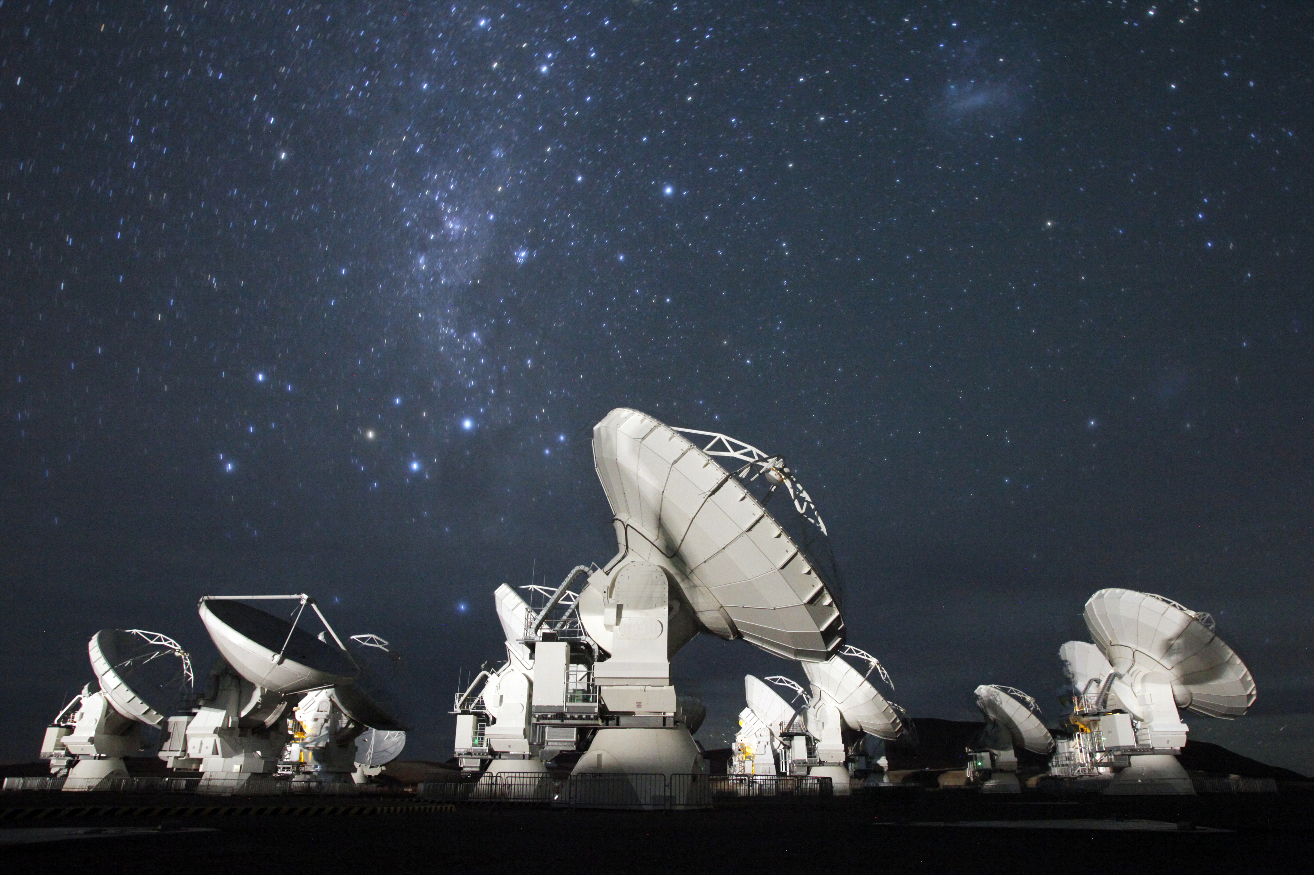
Radio vs. Optical Astronomy
Both optical and radio astronomy techniques observe electromagnetic radiation, i.e., light, from space
Radio astronomy has a different heritage than optical astronomy though, one couched in terms of electrical engineering and cognizant of the wave-like nature of light
This series of four short lectures will provide viewers with a basic appreciation of:
- the basics of radio/mm astronomy
- concepts of aperture synthesis
- interferometric imaging
- deconvolution techniques

Slide 3
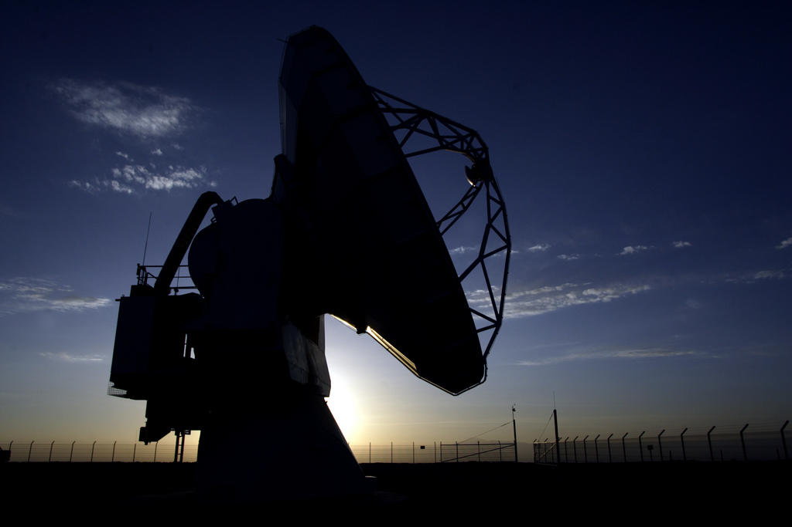
Next: Basic Radio/mm Astronomy

