Slide 1
Proposing for VLA and VLBA Time
Lorant Sjouwerman
National Radio Astronomy Observatory, Socorro NM

Slide 2
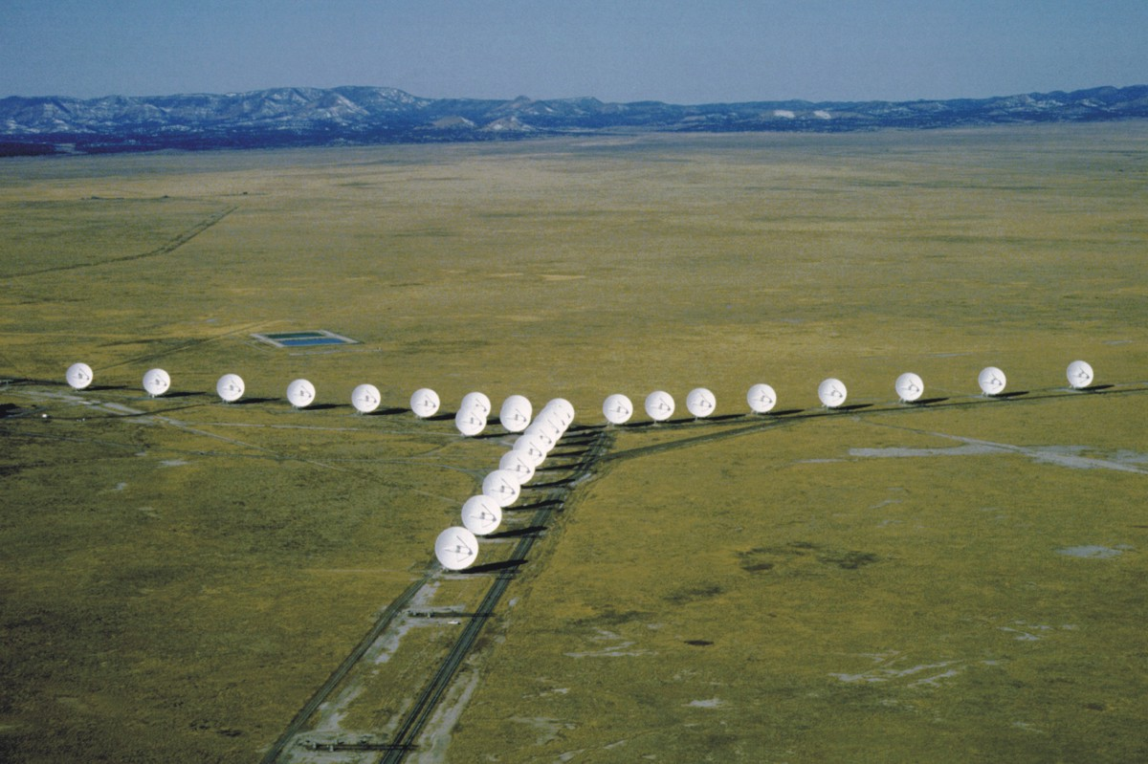

Outline
NRAO VLA
NRAO VLBA
Proposal writing
  Generic
    Science goal
    Requirements
    Other considerations
  VLA and VLBA (and GBT)
    NRAO call for proposals
    VLA configurations and VL(B)A dynamic scheduling
    Proposal Submission Tool (PST)
    Regular proposal submission process
    Other Proposal Types and Routes

Slide 3
Generic: science goal
Start with a scientific idea and target list
Draft a scientific justification: what and why
  Write to astrophysically-literate but non-expert reviewers
  Give science context and motivation
  Pose specific science questions
  State specific science goals
  Describe target selection criteria
  Say how the proposed observations will …
    Answer the science questions
    Achieve the science goals
  Be quantitative !

Slide 4
Generic: requirements
Draft a technical justification: how
  Angular resolution (longest projected baseline required)
  Largest angular scale (shortest projected baseline required)
  (redshifted) Observing frequency, Stokes parameters (polarization)
  Spectral resolution and bandwidth coverage, e.g., line-of-sight velocity
  Elevation limits and snapshot or full uv-coverage
  Sensitivity: use (online) sensitivity calculators!
    In the image (dynamic range and signal to noise ratio on target)
    On a baseline (for calibration, self-calibration)
  Be quantitative !
  Flexibility, or what are the possible trade-offs?
Check the archives for existing data

Slide 5
Generic: other considerations
Enough field of view?
  Primary beam attenuation; single field or mosaic?
  Time and bandwidth smearing affect sources at the edge of the field
Nearby calibrators?
  Need to find better ones, are there other lists to be used?
Optimal timeframes?
  Time of day (night versus day observing, maintenance/RFI)
  Season (summer, winter)
  Is the required configuration observing mode offered for this cycle?
  Solar activity, planet positions, other..
Data reduction plan for large data sets
Cover sheets:
  Consult collaborators, abstract, student support

Slide 6
VL(B)A (and GBT): Call for Proposals
See NRAO Call for Proposals at https://science.nrao.edu/enews
  Proposal deadlines at 5pm Eastern Time on
    1st of February, for observing during about July through December
    1st of August , for observing during about January through June
  Call for proposals issued about 3-4 weeks before each deadline
    Occasional out-of-cycle calls for special opportunities
  Everyone can apply for NRAO time (“open skies” policy)
  If you are interested in applying for time
    Read the call for proposals!
      It contains the latest updates; things do change
      Planned capabilities offered
      Special opportunities offered
  Start as early as possible; you are competing for time

Slide 7
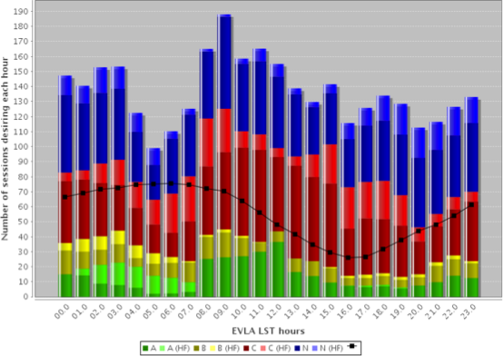
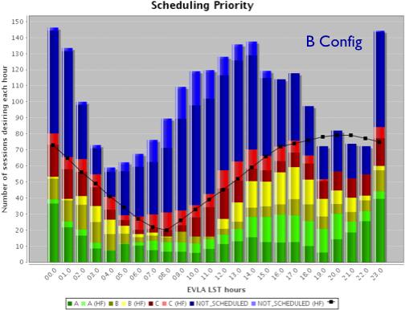
VLA Configuration and dynamic scheduling
Upcoming VLA configurations at
https://science.nrao.edu/facilities/evla/proposing/configpropdeadlines
  This1st of August: D, DnC, C (smaller configurations, up to 1 or 3 km)
  12A and 12B:
    13A daytime:
    late LST (R.A.)
Both VLA and VLBA use dynamic scheduling
  Range of starting times
  Calibration and overhead included in your scheduling blocks
  Include calibration and overhead in the observing time request
    Depending on the science this can be anywhere from 20 to >50%

Slide 8
Proposal Submission Tool (PST)
Prepare a PDF file using any editor to include
  The scientific and technical justification (i.e., what, why and how)
  The combined PDF file should meet the requirements:
    Content, minimum font size, maximum number of pages
      Up to 4 pages for a regular proposal (total, including figures, etc.)
      Up to10 pages for a large proposal (~200 or more NRAO hours)
Access the NRAO PST at https://my.nrao.edu
  Register and invite co-authors to register (required!)
  Select VLA, VLBA, GBT (and further select any joint combination)
  Fill out the cover sheets and abstract, and attach the PDF file
Numbers (etc.) in cover and justification text should match!
Inclusion of a NRAO staff co-author is optional but may be useful
Single submission, no updated submissions without canceling first!

Slide 9
VLA/VLBA Proposals and Students
Consider submitting a deadline early
  Use referee feedback to prepare, re-submit improved proposal
Are the proposed observations for a thesis ?
  If yes, amend your user profile at https://my.nrao.edu
    Add a “Plan of Dissertation”: ~ timeline + NRAO resources
    Update graduation year
Is the student eligible for funding ?
  https://science.nrao.edu/opportunities/student-programs/sos
  US universities and colleges and for Regular or Large proposals
  Apply via NRAO PST at the submission stage (extra work: start early!)
Donate thesis copies to NRAO
  http://www.nrao.edu/library

Slide 10
Regular proposal submission process
Received for deadlines 1st Feb, 1st Aug for semesters (year)B, (year+1)A
Classified by scientific categories
Sent to category’s scientific review panel and NRAO technical reviewers
Referees return ratings and comments
Ratings and comments sent to Proposal Selection Committee (PSC)
  5-10 representatives of the community
  3-5 representatives of NRAO
PSC meets around early April and October
PSC results emailed to proposers around 1st June and1st December
Approved projects will appear in the Observation Preparation Tool
Details at https://science.nrao.edu/observing/proposal-types/timeallocation

Slide 11
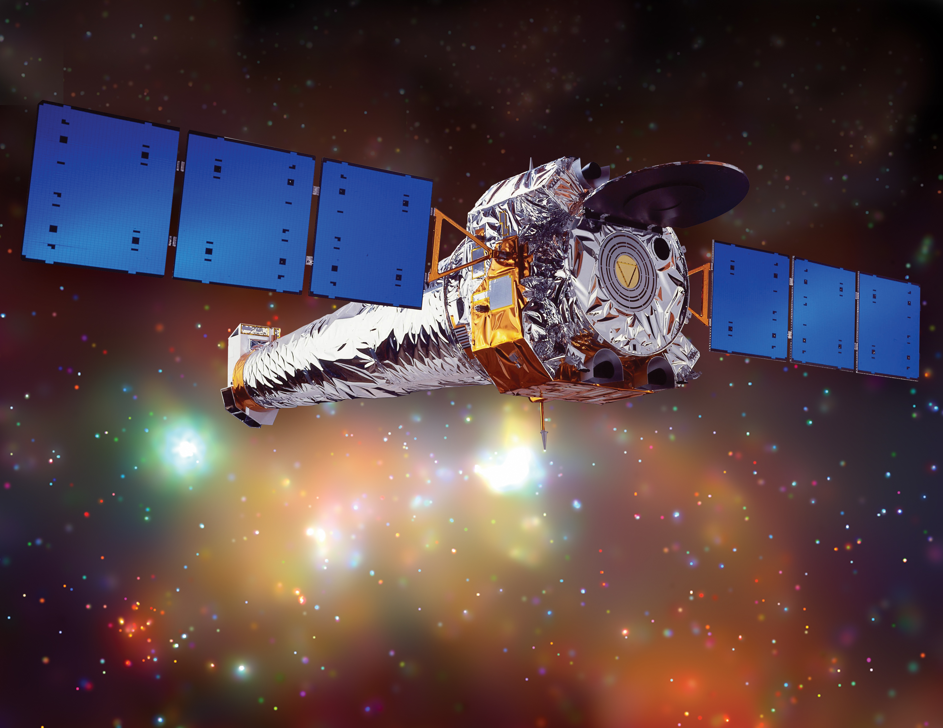
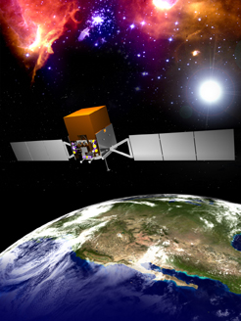
Other Proposal Types and Routes
VLA/VLBA Director's Discretionary Time (a.k.a. rapid response science)
  Exploratory or filler: e.g., quick follow-up of recent discovery
  Target of opportunity: e.g., unpredicted phenomenon
  https://science.nrao.edu/observing/proposal-types/directorsdiscretionarytime
  NOT for a missed deadline
Joint proposal routes, not through PST
  Chandra/VLA/VLBA
    http://cxc.harvard.edu
  Fermi/VLA/VLBA
    http://fermi.gsfc.nasa.gov/ssc
Chandra
Fermi

Slide 12
Most useful web pages for help
General NRAO
https://science.nrao.edu
Specific NRAO instrument
https://science.nrao.edu/facilities
Helpdesk
https://help.nrao.edu
(Google, etc)

