Slide 1
The Expanded Very Large Array Project
Observing with the Jansky VLA
Gustaaf van Moorsel
Array Science Center
National Radio Astronomy Observatory

Slide 2
EVLA Project Overview
The Expanded Very Large Array is a major upgrade of the Very Large Array
The fundamental goal is to improve major observational capabilities of the original VLA (sensitivity, bandwidth) by at least an order of magnitude
The project is on schedule to be completed at the end of this year.
Key aspect: This is a leveraged project – building upon existing infrastructure of the VLA
Renamed the Jansky Very Large Array (Jansky VLA) during a rededication on 31 March, 2012

Slide 3
Key EVLA Project Goals
Full frequency coverage from 1 to 50 GHz.
Provided by 8 frequency bands with cryogenic receivers.
Up to 8 GHz instantaneous bandwidth per polarization
All digital design to maximize instrumental stability and repeatability.
New correlator with 8 GHz/polarization capability
Designed, funded, and constructed by our Canadian partners, HIA/DRAO
Unprecedented flexibility in matching resources to attain science goals.
Noise-limited, full-field imaging in all Stokes parameters for most observational fields.
New software for telescope operations, correlator management, and post-processing.

Slide 4
What is the JVLA?
27x25m antennas reconfigurable on baselines 35m to 36km
located in Southern New Mexico at 2100m altitude

Slide 5
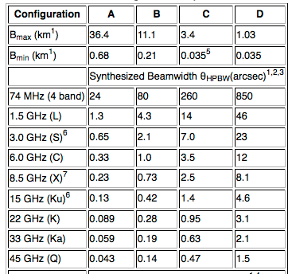
Spatial Resolution (unchanged!)
With reconfiguration of the antennas, the JVLA can vary its spatial resolution by a factor of ~50.
Configuration sequence: D → C → B → A
Reconfiguration about every 4
months (modifications during
commissioning).
Hybrid configurations (DnC, CnB,
BnA) extend for about 2 weeks
in between regular configurations
Notes:
Hybrid configurations are for sources outside the range -15 and 75 deg declination.

Slide 6
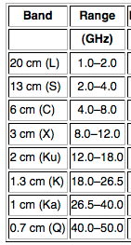
Receivers
8 wideband receivers
Switching receivers can be as fast as 20s
Notes:
Narrowest is L-band: 1GHz. Widest is Ka-band 13.5 GHz

Slide 7
JVLA-VLA Capabilities Comparison
The JVLA’s performance will be vastly better than the VLA’s:
Parameter | VLA | JVLA | Factor | Current(OSRO)
Point Source Cont. Sensitivity (1σ,12hr.) | 10 μJy | 1 μJy | 10 | 2 μJy
Maximum BW in each polarization | 0.1 GHz | 8 GHz | 80 | 2 GHz
# of frequency channels at max. BW | 16 | 16,384 | 1024 | 4096
Maximum number of freq. channels | 512 | 4,194,304 | 8192 | 4096
Coarsest frequency resolution | 50 MHz | 2 MHz | 25 | 2 MHz
Finest frequency resolution | 381 Hz | 0.12 Hz | 3180 | 0.12 kHz
# of full-polarization spectral windows | 2 | 64 | 32 | 16
(log) Frequency Coverage (1 – 50 GHz) | 22% | 100% | 5 | 100%

Slide 8
EVLA Project Current Status (06/2012)
Installation of new wideband receivers now complete at:
4 – 8 GHz (C-Band)
18 – 27 GHz (K-Band)
27 – 40 GHz (Ka-Band)
40 – 50 GHz (Q-Band)
Installation of remaining four bands completed late-2012:
1 – 2 GHz (L-Band) 22 now, completed end of 2012.
2 – 4 GHz (S-Band) 24 now, completed Sept. 2012.
8 – 12 GHz (X-Band) 20 now, completed end of 2012.
12 – 18 GHz (Ku-Band) 21 now, completed end of 2012.
Low frequency (50-436 MHz) (not part of project)

Slide 9
EVLA Project Current Status (06/2012)
The last major construction component has been the installation of the 3-bit , 4 Gsamp/sec samplers.
There are eight such samplers in each antenna. These provide the full 8 GHz/polarization capability needed for the high frequency bands (above 4 GHz observing frequency).
Status:
17 antennas now fully outfitted.
3 others with half the sampler complement.
Outfitting scheduled for completion in mid-August.

Slide 10
The ‘WIDAR’ Correlator
This extraordinarily flexible machine is now fully installed at the VLA site, and is working magnificently.
We are far from deploying all of its capabilities, however. This is a lengthy process, which is months to years away from completion.
Installation of WIDAR began January, 2010. It was turned on for astronomy in early March, 2010. This was the only time during the whole project that the instrument did not observe

Slide 11
Enabling capabilities during construction and commissioning
Open Shared Risk Observing (OSRO)
Restricted, but well tested capabilities
Scheduling block setup supported in OPT
Shared risk: we’ll do all in our power to make observations successful but we don’t guarantee re-observation in case of problems
Resident Shared Risk Observing (RSRO)
Far fewer restrictions; observers encouraged to test uncharted waters
OPT unlikely to support scheduling block creation
Residency requirement to help us in commissioning
After full cycle of configurations (new D-configuration) we expand OSRO capabilities based on success of commissioning effort
Huge leap every 16 months instead of piecemeal introduction

Slide 12
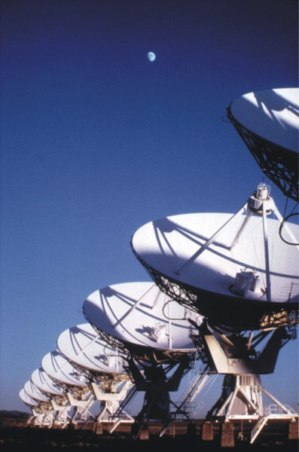
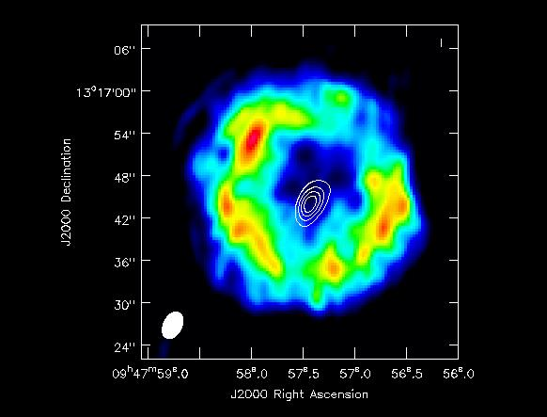
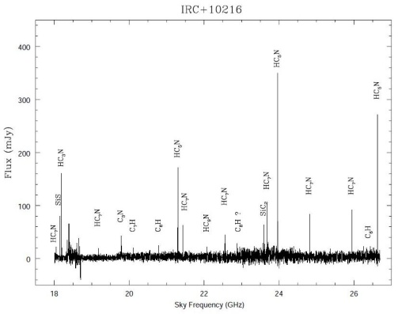
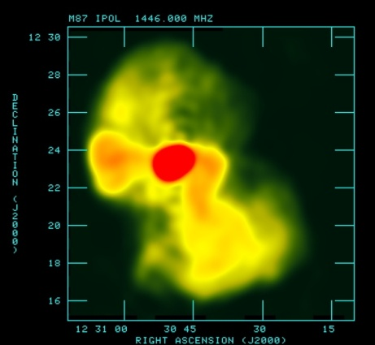
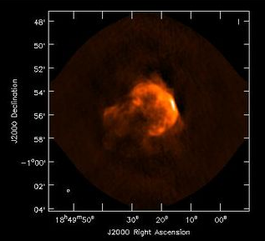
Next Proposal Deadline August 1, 2012 (2013A)
http://science.nrao.edu/evla/
12

Slide 13
Observing Capabilities
Will be offered in three categories (note: OSRO is now gone):
General capabilities (akin to what used to be OSRO)
Includes all well tested capabilities.
Data rate limit of 20 MB/sec.
Shared Risk
For not well tested capabilities,
Can be set up and executed with the observing and scheduling software.
SR observers will receive 1 hr of test time to validate their correlator set-up and observing procedure.
Resident Shared Risk
For capabilities that have not been tested, or known not to be robust.
Requires residency; 1 month visit per 20 hours of observing time.

Slide 14
General Capabilities 2013A (1)
8-bit samplers
2 basebands, 1 GHz bandwidth each (same)
Up to 16 subband pairs per baseband (was: 8)
Independently tunable (anywhere in the baseband)
Independent bandwidths
Doppler setting per baseband
Baseline board stacking by factors of 2, to give up to 4096 channels per subband
Up to 16384 channels total.

Slide 15
General Capabilities 2013A (2)
3-bit samplers
128 MHz subbands, contiguous in frequency within a baseband.
Up to 64x128 MHz subbands to cover available receiver bandwidth.
Full, dual, or single polarization to give spectral resolutions 2, 1, or 0.5 MHz (64, 128, or 256 channels per subband).

Slide 16
General Capabilities 2013A (3)
Phased VLA output for VLBI
8-bit samplers
1 or 2 x 128 MHz subbands, independently phased
256 channels per subband
No subarrays or baseline board stacking
No simultaneous access to unused correlator resources

Slide 17
General Capabilities 2013A (4)
Subarrays
Up to 3 independent subarrays
8-bit samplers, 128 MHz contiguous subbands only
Separate SBs for each subarray
Observer specifies which antennas go in each subarray
Some restrictions on number of antennas per subarray

Slide 18
Shared Risk Capabilities
One or two recirculation set-ups that have already been used by RSRO participants
For 8-bit samplers
Fast dump modes up to 60 MB/s, dump times >=50ms
More than 16 subband pairs per baseband
For 3-bit samplers
Subarrays
Subband bandwidths narrower than 128 MHz

Slide 19
Resident Shared Risk (RSRO) Capabilities
OTF mosaics
Phased array for all but VLBI
Real-time transient detection
Pulsars
Complicated subarrays
General recirculation set-ups

Slide 20
Examples of exploiting the general capabilities offered for 2013A:
8 GHz wide observation in any of the high frequency bands. Gives unprecedented continuum sensitivity and spectral index info
Uses the new 3-bit samplers. Not much versatility yet in tuning subbands but for pure sensitivity that is not needed
Simultaneous observation of a wide variety of lines within one band with very high spectral resolution, e.g. by tuning each one of the 16 subband pairs (per baseband) on each of the lines
Uses the ‘traditional’ 8-bit samplers but exploits the newly introduced versatility in tuning subbands
Refinement 1: use some wide-bandwidth (128 MHz) subbands to form a continuum, and use remaining subbands (at much narrower bandwidth) to target lines
Refinement 2: use several subbands per line to increase # channels

Slide 21
Concluding Remarks
The EVLA project is near completion
Most key, and many new, capabilities are already available.
Increased capabilities will be added over the next few years.
Capabilities will continue to grow, as more capable correlator and post-processing software is developed.
Many challenges remain before full throughput is obtained.
The JVLA will be, as the VLA has been, a general-purpose, open-access, cm-wavelength telescope
Important dates:
Call for proposals: ~ July 9, 2012. Will be final word on capabilities offered
Proposal deadline: August 1, 2012

Slide 22
Resources
Main EVLA observing page: https://science.nrao.edu/facilities/evla
EVLA Observational Status Summary: https://science.nrao.edu/facilities/EVLA/docs/manuals/oss
Helpdesk: https://help.nrao.edu
NRAO science page: https://science.nrao.edu
NRAO eNews: https://science.nrao.edu/enews/5.4/

