Slide 1

A Crash Course in
Radio Astronomy and Interferometry:
2. Aperture Synthesis
James Di Francesco
National Research Council of Canada
North American ALMA Regional Center – Victoria
(thanks to S. Dougherty, C. Chandler, D. Wilner & C. Brogan)

Slide 2
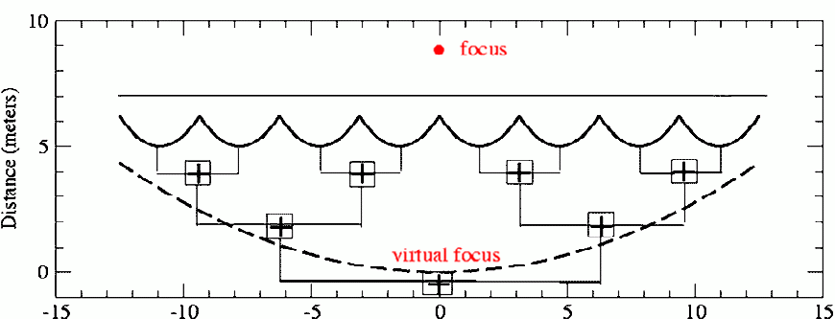
Aperture Synthesis
Output of a Filled Aperture
Signals at each point in the aperture are brought together in phase at the antenna output (the focus)
Imagine the aperture to be subdivided into N smaller elementary areas; the voltage, V(t), at the output is the sum of the contributions ΔV_{i}(t) from the N individual aperture elements:

Slide 3
Aperture Synthesis
Aperture Synthesis: Basic Concept
The radio power measured by a receiver attached to the telescope is proportional to a running time average of the square of the output voltage:
Any measurement with the large filled-aperture telescope can be written as a sum, in which each term depends on contributions from only two of the N aperture elements
Each term ⟨ΔV_{i}ΔV_{k}⟩ can be measured with two small antennas, if we place them at locations i and k and measure the average product of their output voltages with a correlation (multiplying) receiver

Slide 4
Aperture Synthesis
Aperture Synthesis: Basic Concept
If the source emission is unchanging, there is no need to measure all the pairs at one time
One could imagine sequentially combining pairs of signals. For N sub-apertures there will be N(N-1)/2 pairs to combine
Adding together all the terms effectively “synthesizes” one measurement taken with a large filled-aperture telescope
Can synthesize apertures much larger than can be constructed as a filled aperture, giving very good spatial resolution

Slide 5
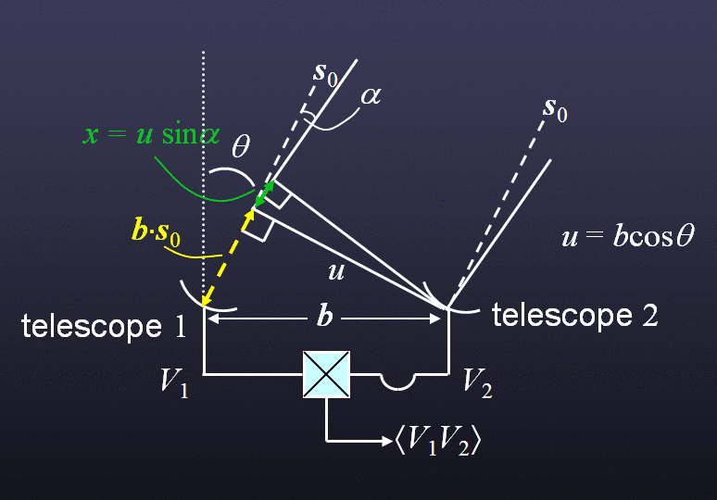
Aperture Synthesis
A Simple 2-Element Interferometer
What is the interferometer response as a function of sky position, l = sinα ?
In direction s₀ (α = 0) the wavefront arriving at telescope #1 has an extra path b × s₀ = b sinθ to travel relative to #2
The time taken to traverse this extra path is the geometric delay, τ_{g} = b × s₀/c
This delay is compensated for by inserting a signal path delay for #2 equivalent to τ_{g}

Slide 6
Aperture Synthesis
Response of a 2-Element Interferometer
At angle α, a wavefront has an extra path x = u sinα = ul to travel
Expand to 2D by introducing β orthogonal to α, m = sinβ, and v orthogonal to u, so that in this direction the extra path y = vm
Write all distances in units of wavelength, x ≡ x/λ, y ≡ y/λ, etc., so that x and y are now numbers of cycles
Extra path is now ul + vm
V₂ = V₁ e^{-2πi(ul+vm)}

Slide 7
Aperture Synthesis
Correlator Output
The output from the correlator (the multiplying and time-averaging device) is:
For (l₁≠l₂, m₁≠m₂) the above average is zero (assuming mutual sky), so

Slide 8
Aperture Synthesis
The Complex Visibility
Thus, the interferometer measures the complex visibility, V, of a source, which is the FT of its intensity distribution on the sky:
  u,v are spatial frequencies in the E-W and N-S directions, are the projected baseline lengths measured in units of wavelength, i.e., B/λ
  l, m are direction cosines relative to a reference position in the E-W and N-S directions
  (l = 0, m = 0) is known as the phase center
  the phase φ contains information about the location of structure with spatial frequency u,v relative to the phase center

Slide 9
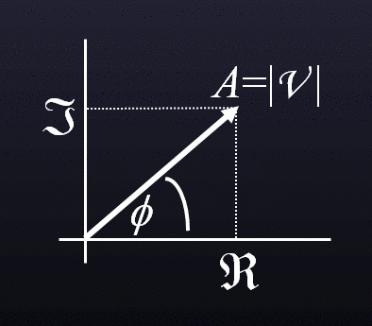
Aperture Synthesis
The Complex Visibility
This FT relationship is the van Cittert-Zernike theorem, upon which synthesis imaging is based
It means there is an inverse FT relationship that enables us to recover I(l,m) from V(u,v):
The correlator measures both real and imaginary parts of the visibility to give the amplitude and phase:
A=|V |
φ

Slide 10
Aperture Synthesis
The Primary Beam
The elements of an interferometer have finite size, and so have their own response to the radiation from the sky
This results in an additional factor, A(l,m), to be included in the expression for the correlator output, which is the primary beam or normalized reception pattern of the individual elements
Interferometer actually measures the FT of the sky multiplied by the primary beam response
Need to divide by A(l,m) to recover I(l,m), the last step of image production
Primary Beam FWHM is the “Field-of-View” of a single-pointing interferometric image

Slide 11
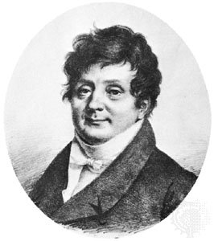
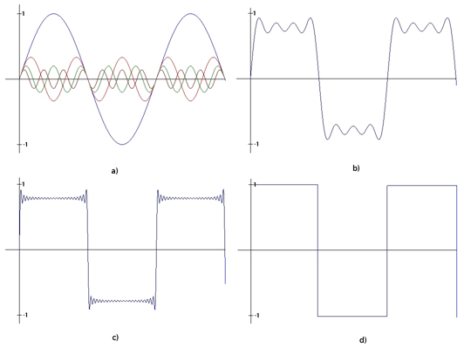
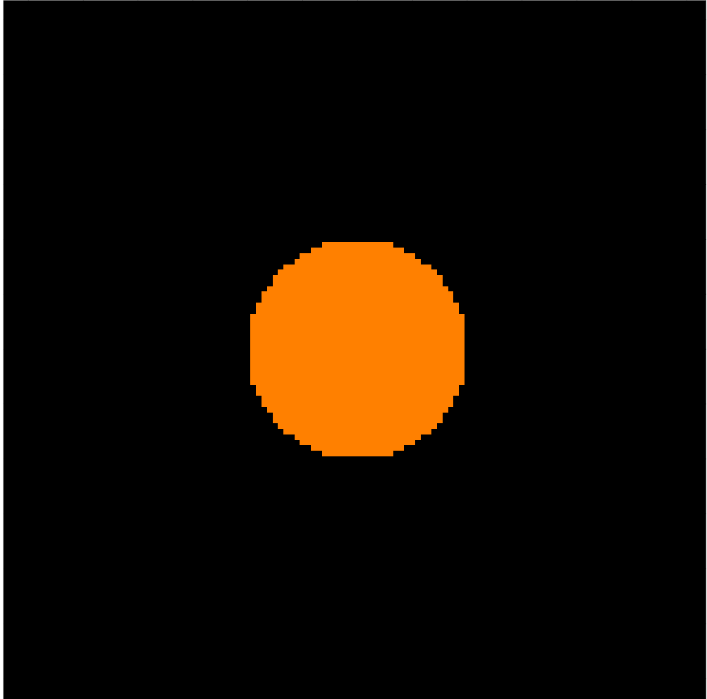
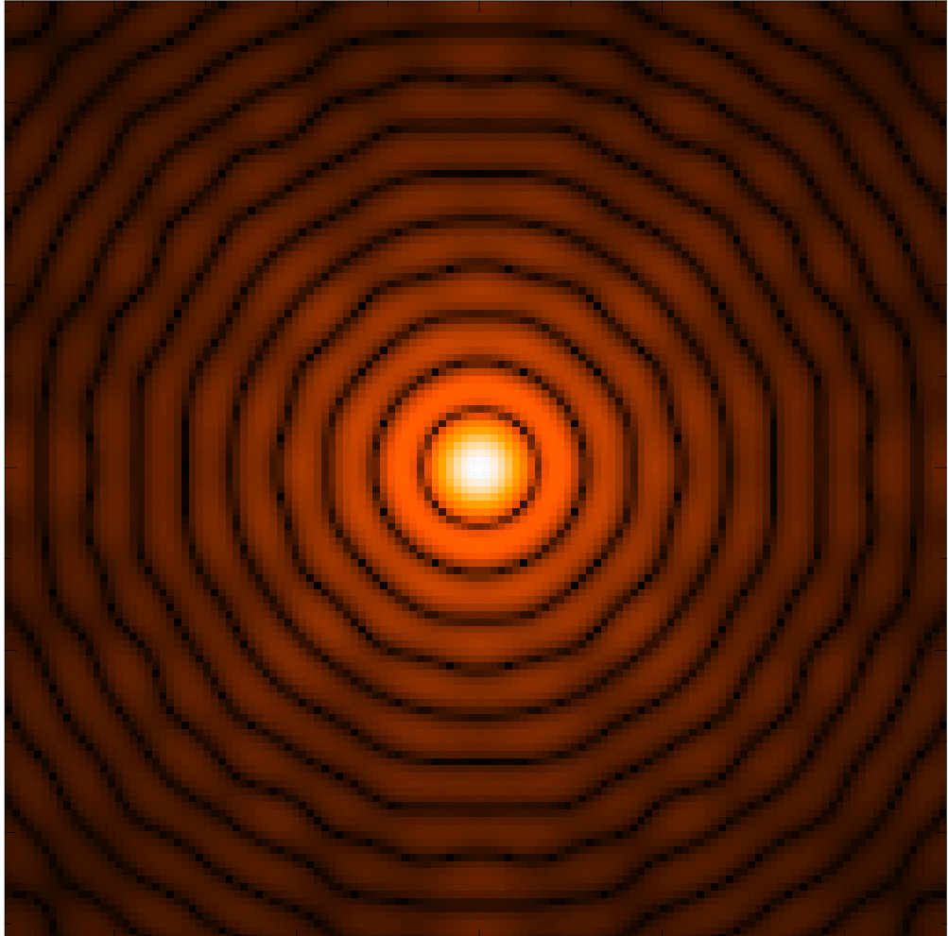
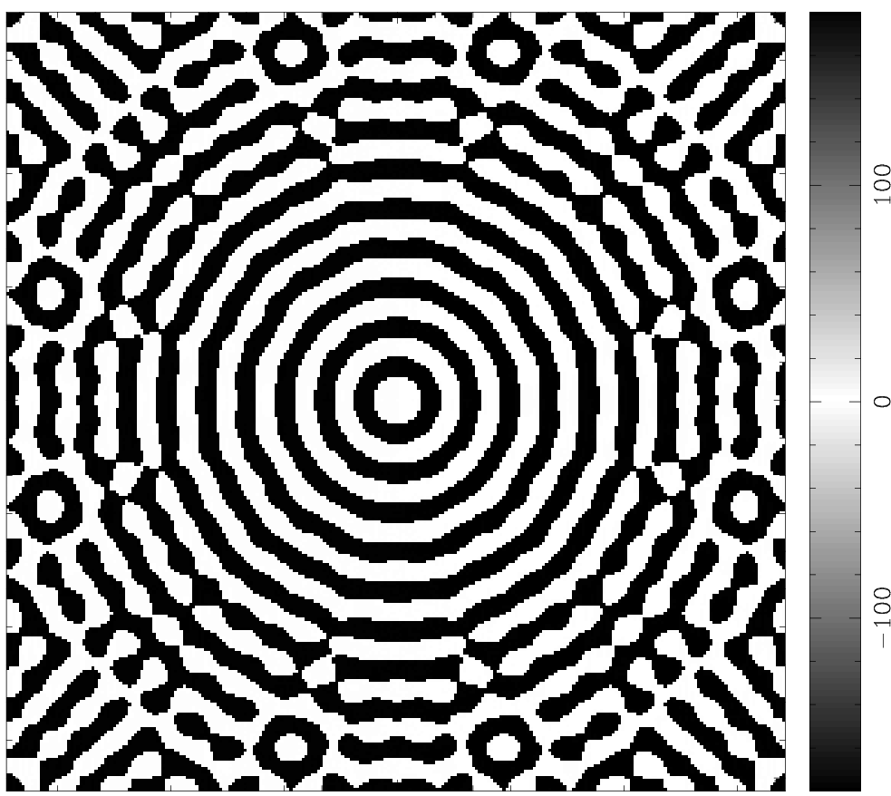
Aperture Synthesis
The Fourier Transform
Fourier theory states that any signal (including images) can be expressed as a sum of sinusoids
Jean Baptiste Joseph Fourier 1768-1830
signal
4 sinusoids
sum
(x,y) plane and (u,v) plane are conjugate coordinate systems
  I(x,y) V(u,v) = FT{I(x,y)}
the Fourier Transform contains all information of the original

Slide 12
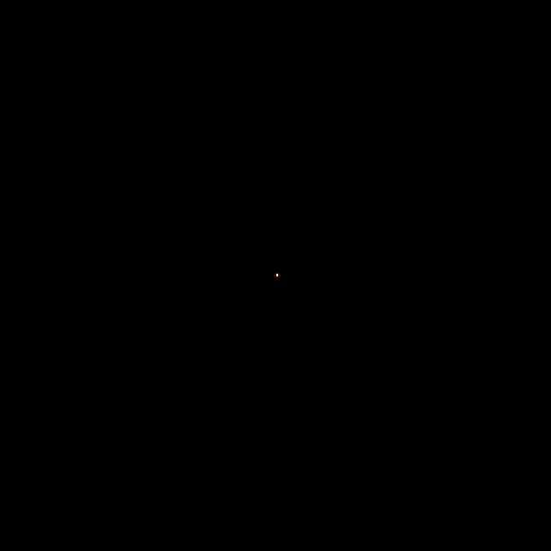

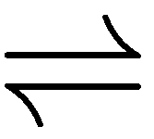
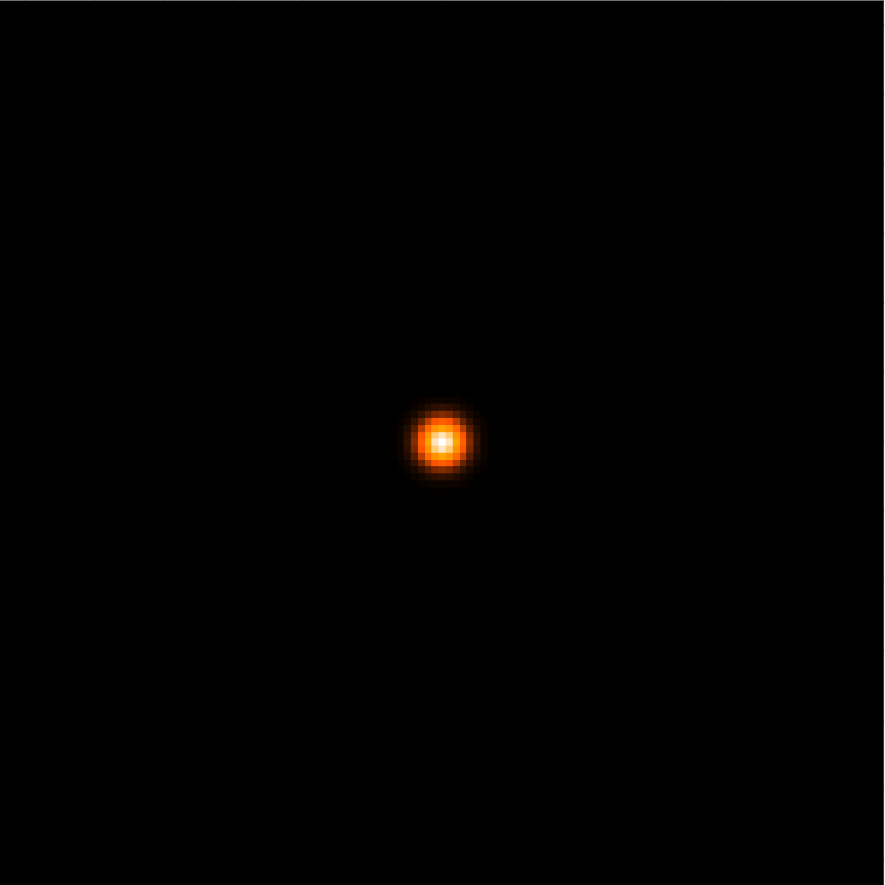
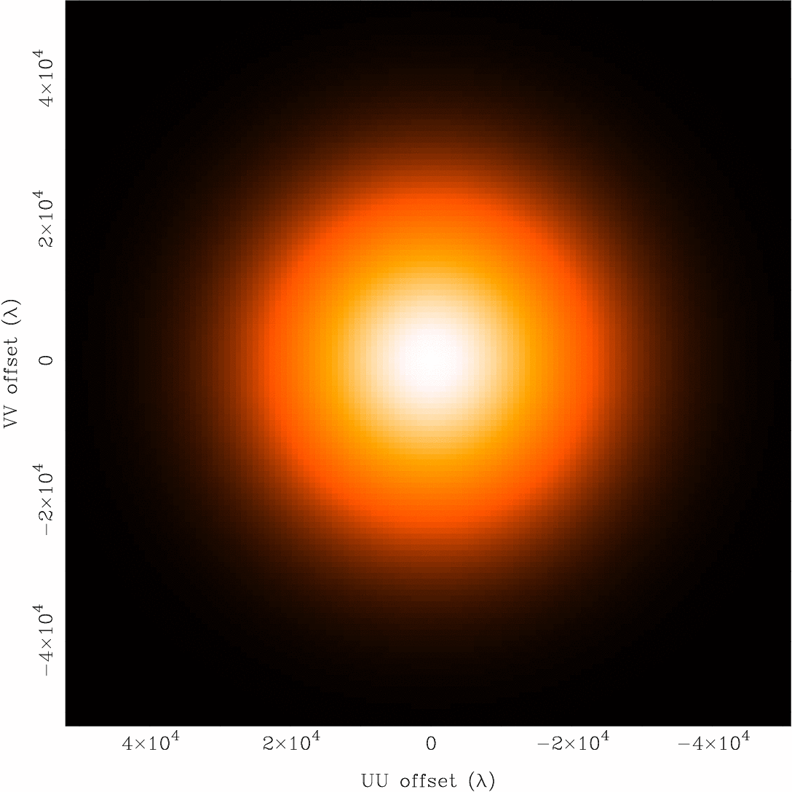
Aperture Synthesis
Some 2-D Fourier Transform Pairs
I(x,y)
Amp{V(u,v)}
δ Function
Constant
Gaussian
Gaussian
narrow features transform to wide features (and vice-versa)

Slide 13
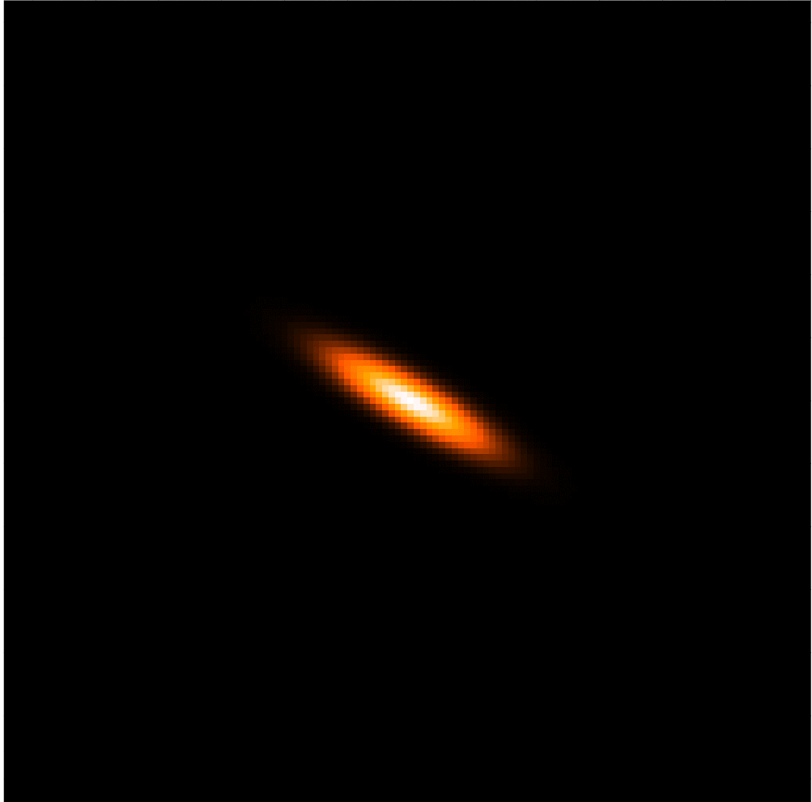
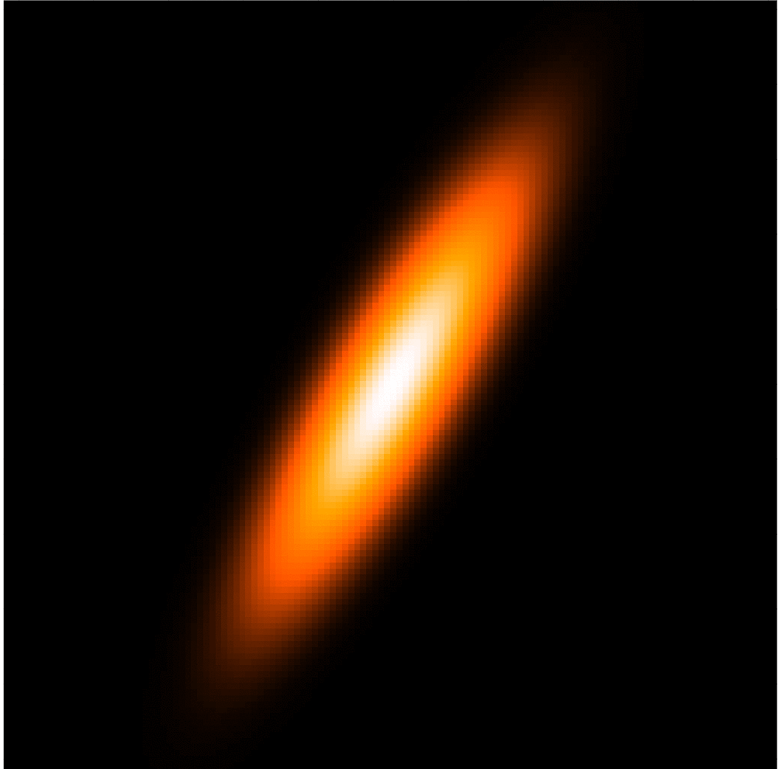
Aperture Synthesis
More 2-D Fourier Transform Pairs
I(x,y)
Amp{V(u,v)}
elliptical
Gaussian
elliptical
Gaussian
Disk
Bessel
sharp edges result in many high spatial frequencies

Slide 14
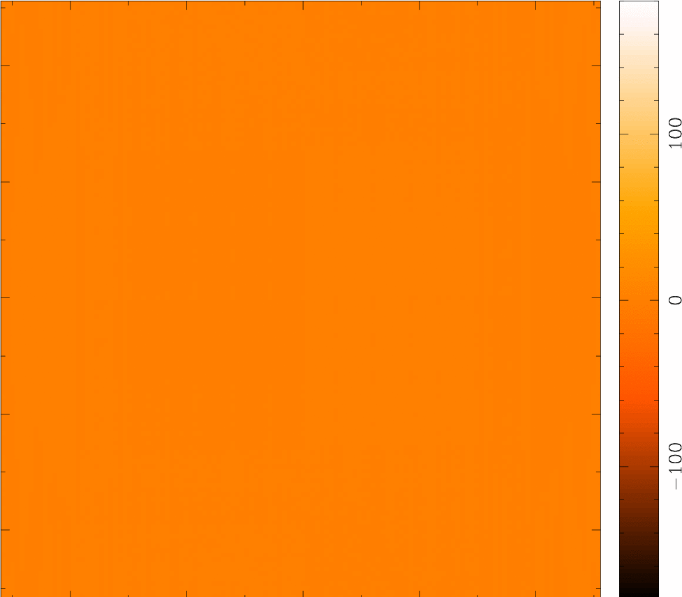
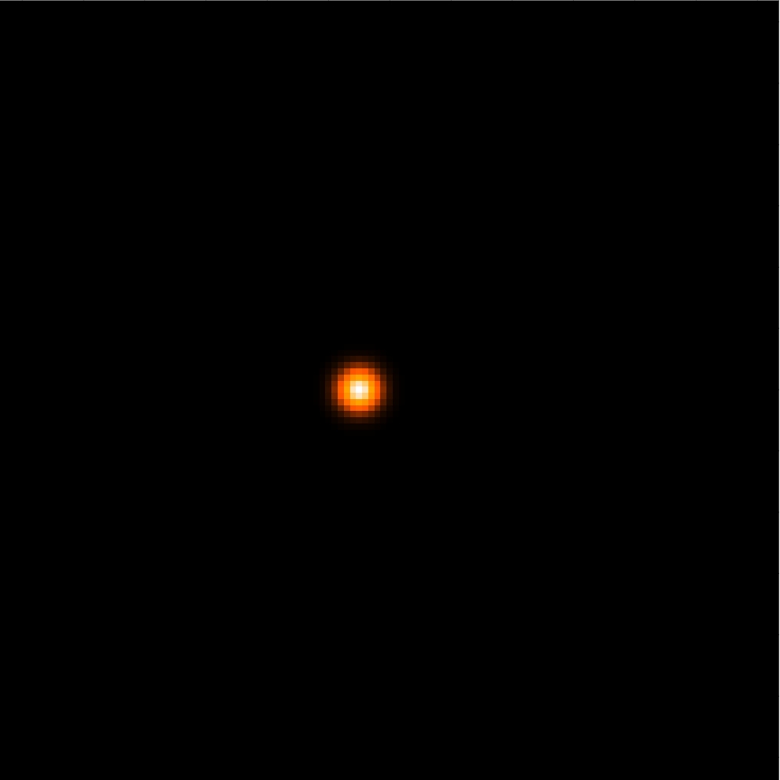
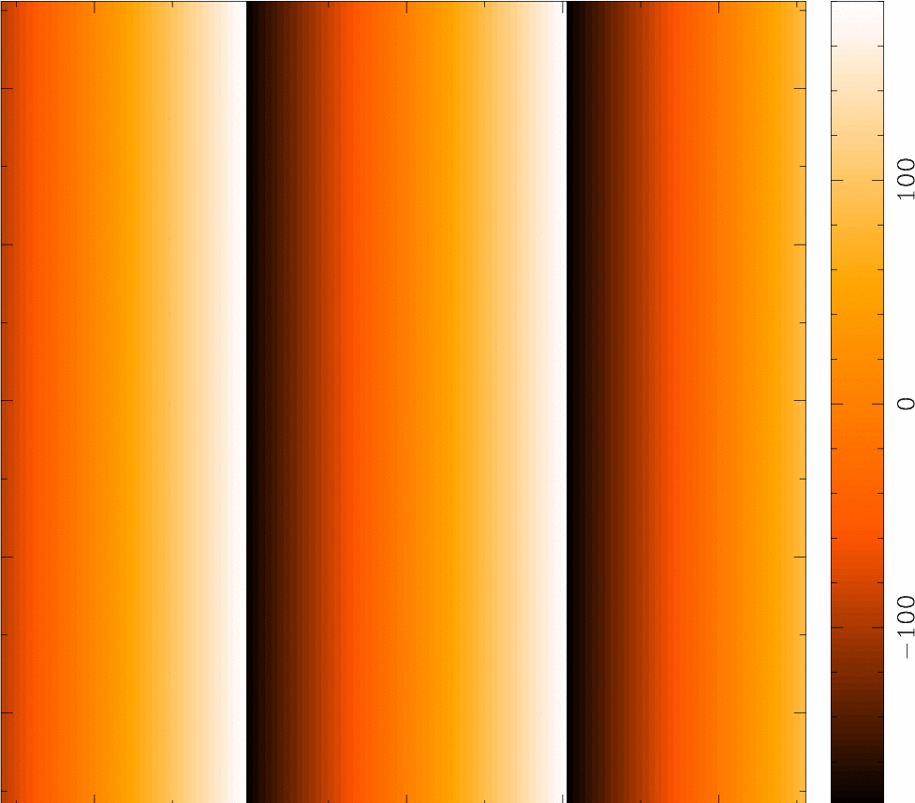
Aperture Synthesis
Amplitude and Phase
complex numbers: (real, imaginary) or (amplitude, phase)
  amplitude tells “how much” of a certain spatial frequency component
  phase tells “where” this component is located
I(x,y)
Amp{V(u,v)}
Pha{V(u,v)}

Slide 15

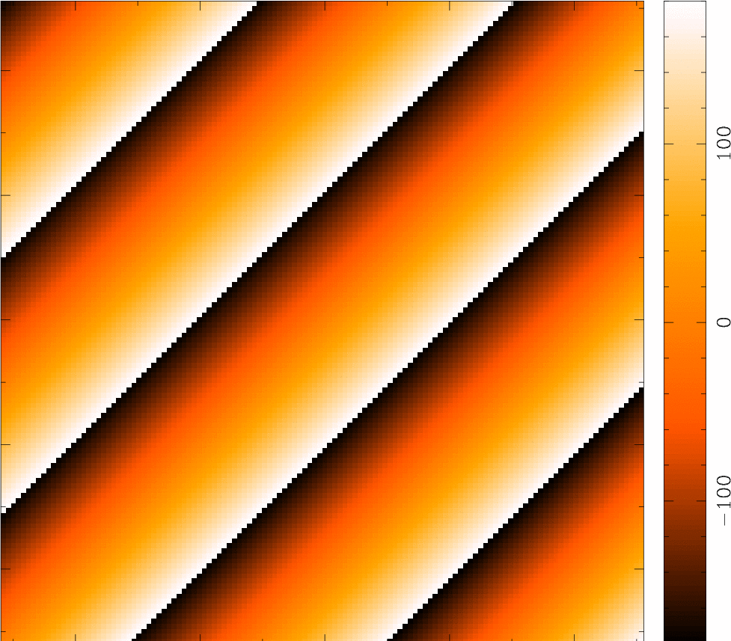
Aperture Synthesis
Amplitude and Phase
complex numbers: (real, imaginary) or (amplitude, phase)
  amplitude tells “how much” of a certain spatial frequency component
  phase tells “where” this component is located
I(x,y)
Amp{V(u,v)}
Pha{V(u,v)}

Slide 16
Aperture Synthesis
Picturing the Visibility: Fringes
The FT of a single visibility measurement is a sinusoid with spacing 1/u = λ/B between successive peaks, or “fringes”
Build up an image of the sky by summing many such sinusoids (addition theorem)
FT scaling theorem shows:
  Short baselines have large fringe spacings and measure large-scale structure on the sky
  Long baselines have small fringe spacings and measure small-scale structure on the sky
λ/B rad.
Source
brightness
− + − + − + − Fringe Sign

Slide 17
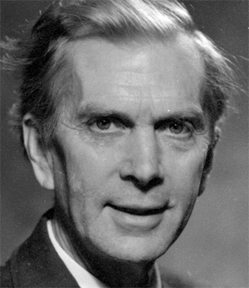
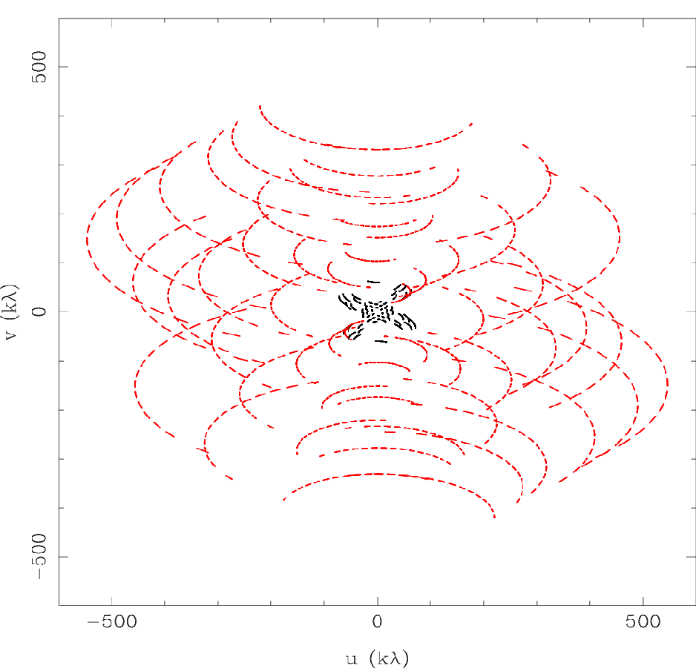

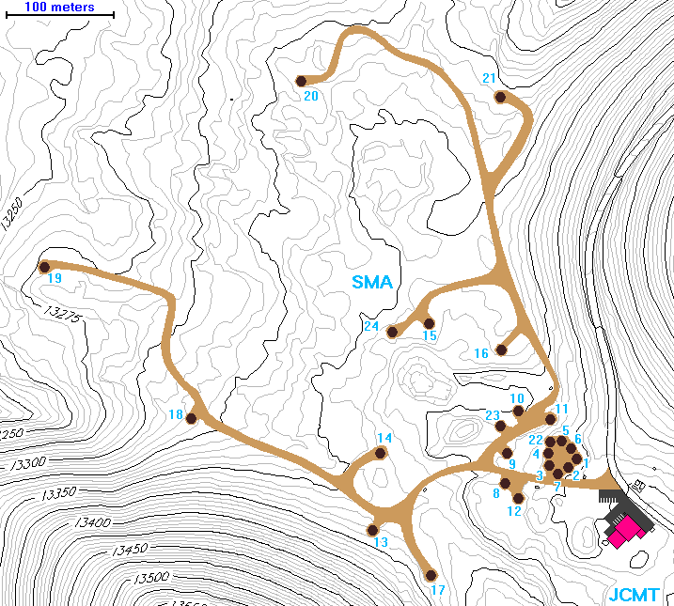
Aperture Synthesis
Aperture Synthesis
sample V(u,v) at enough points to synthesize the equivalent large aperture of size (u_{max},v_{max})
  1 pair of telescopes → 1 (u,v) sample at a time
  N telescopes → number of samples = N(N-1)/2
  fill in (u,v) plane by making use of Earth rotation: Sir Martin Ryle, 1974 Nobel Prize in Physics
  reconfigure physical layout of N telescopes for more
Sir Martin Ryle 1918-1984
2 configurations
of 8 SMA antennas
345 GHz
Dec = -24 deg

Slide 18
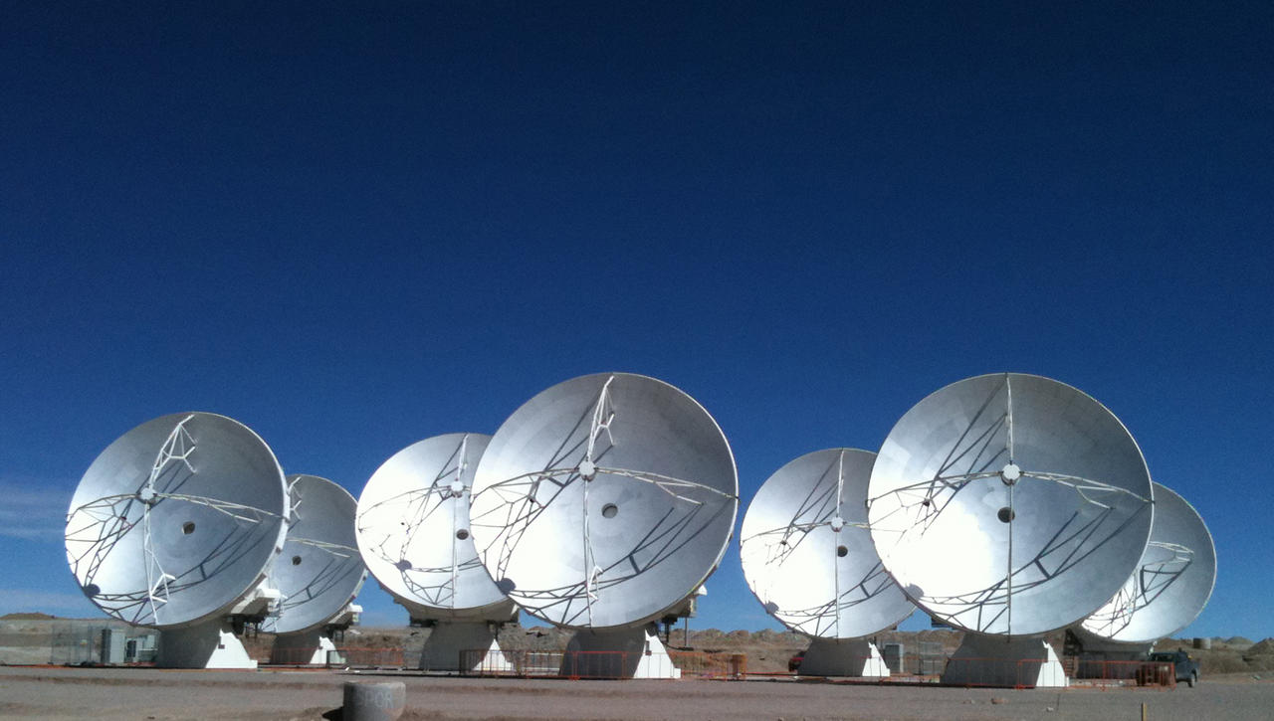
Next: Interferometric Imaging

