Slide 1
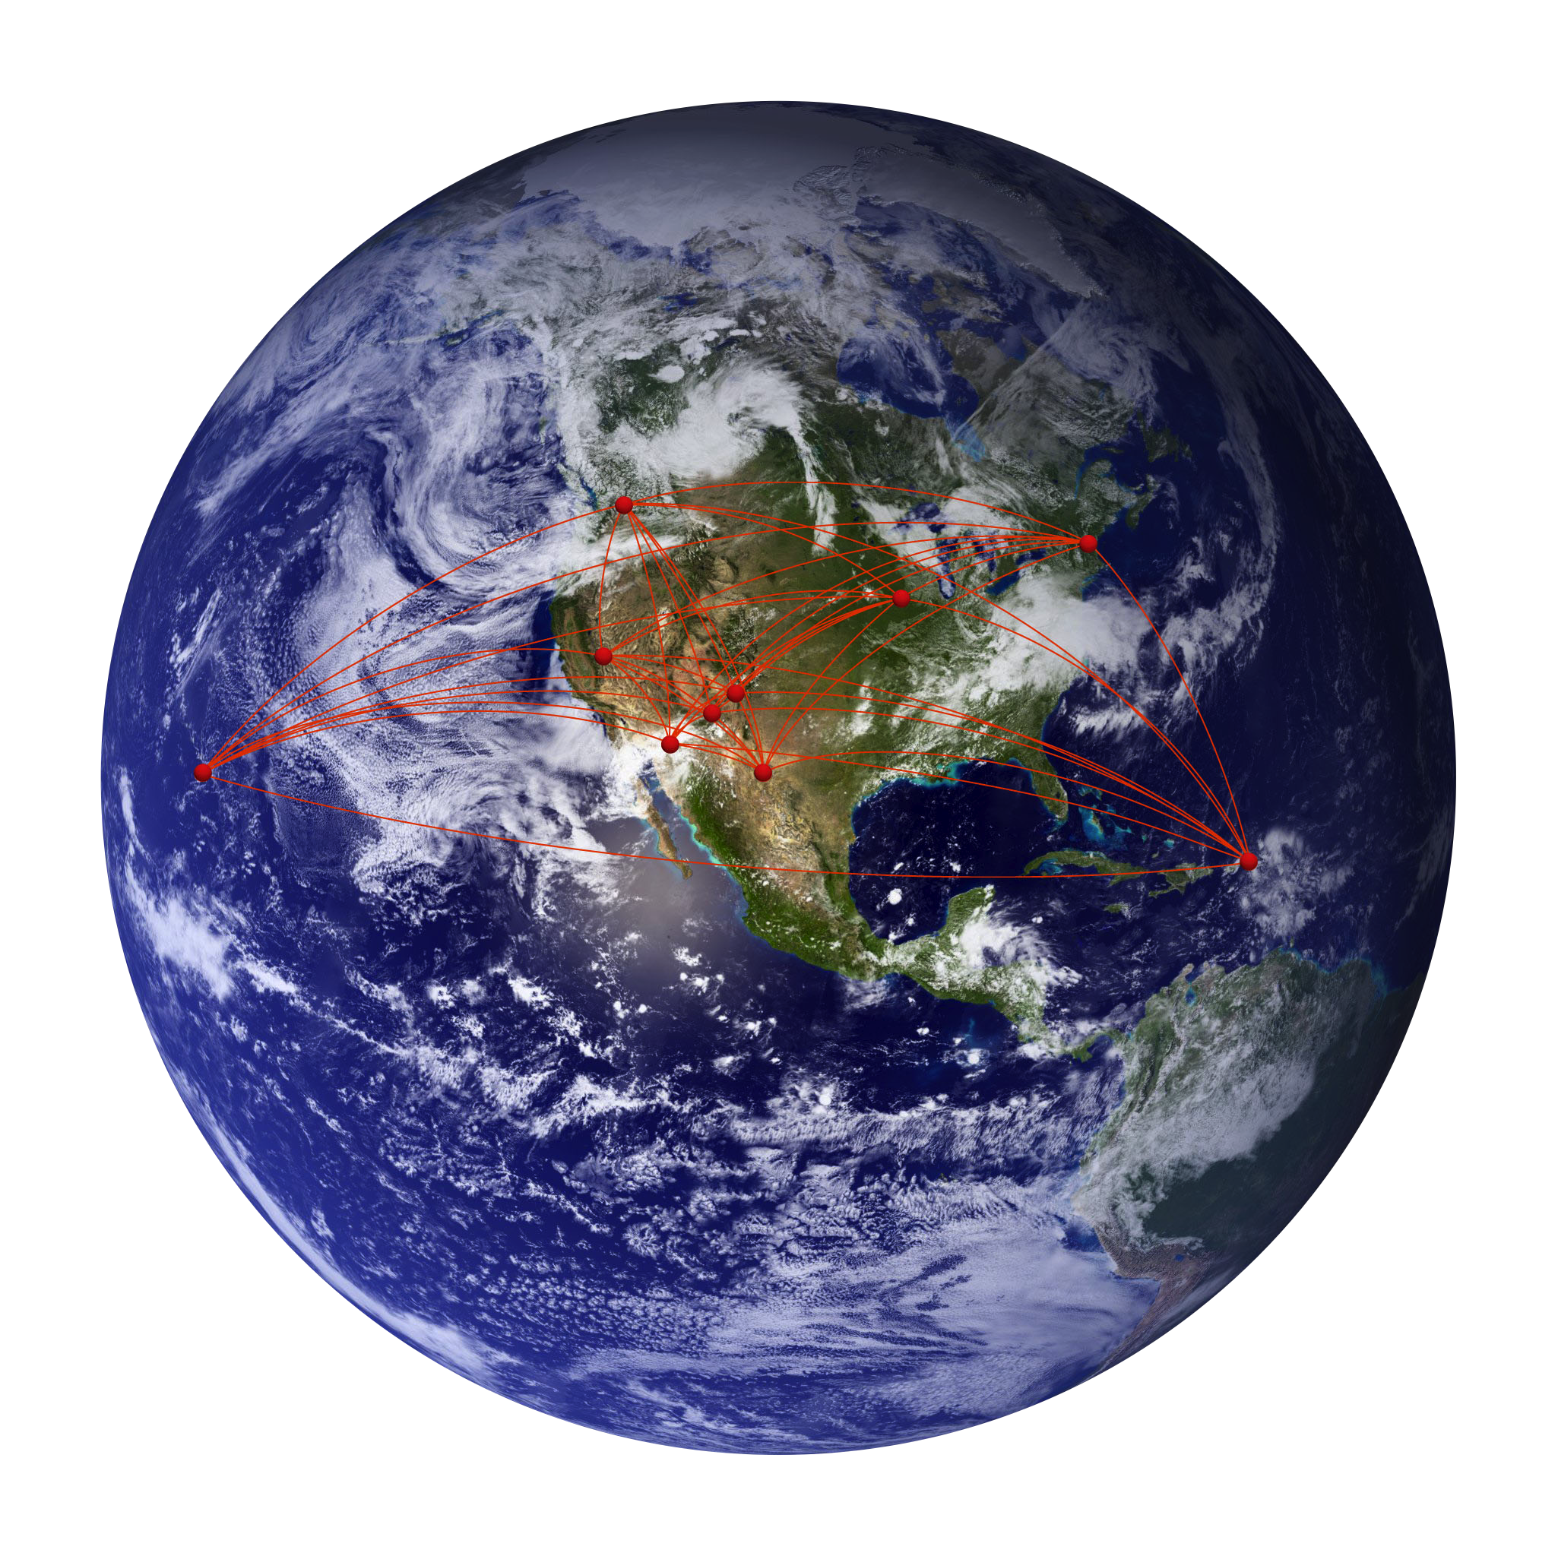
The Very Long Baseline Array: Capabilities
Amy Mioduszewski
Array Science Center

Slide 2
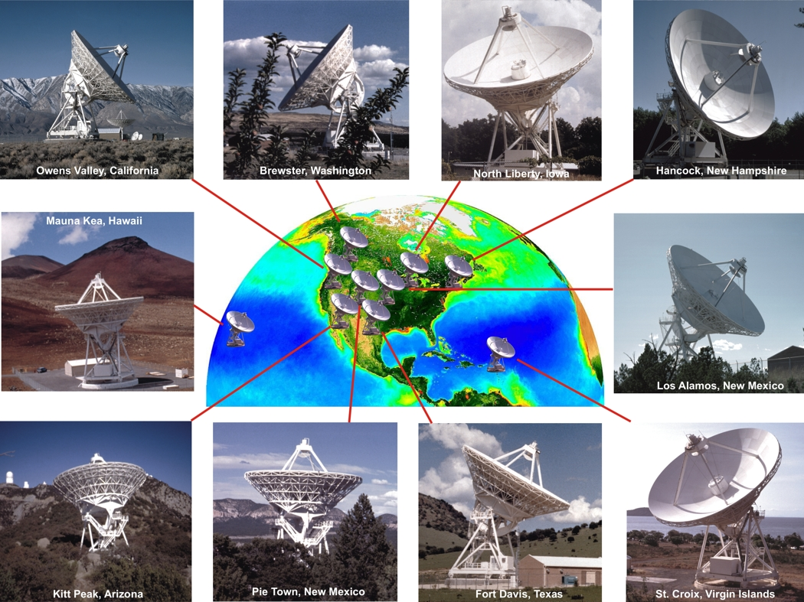
Basics
10 x 25 meter antennas.
Spread from Mauna Kea, Hawaii to St. Croix, Virgin Islands.
Baseline lengths range from 200 to 8600 km.
Sensitive to compact structures with brightness temperatures above10⁵ K.
Correlated on a software correaltor, DiFX.
Notes:
On the edge of thermal

Slide 3
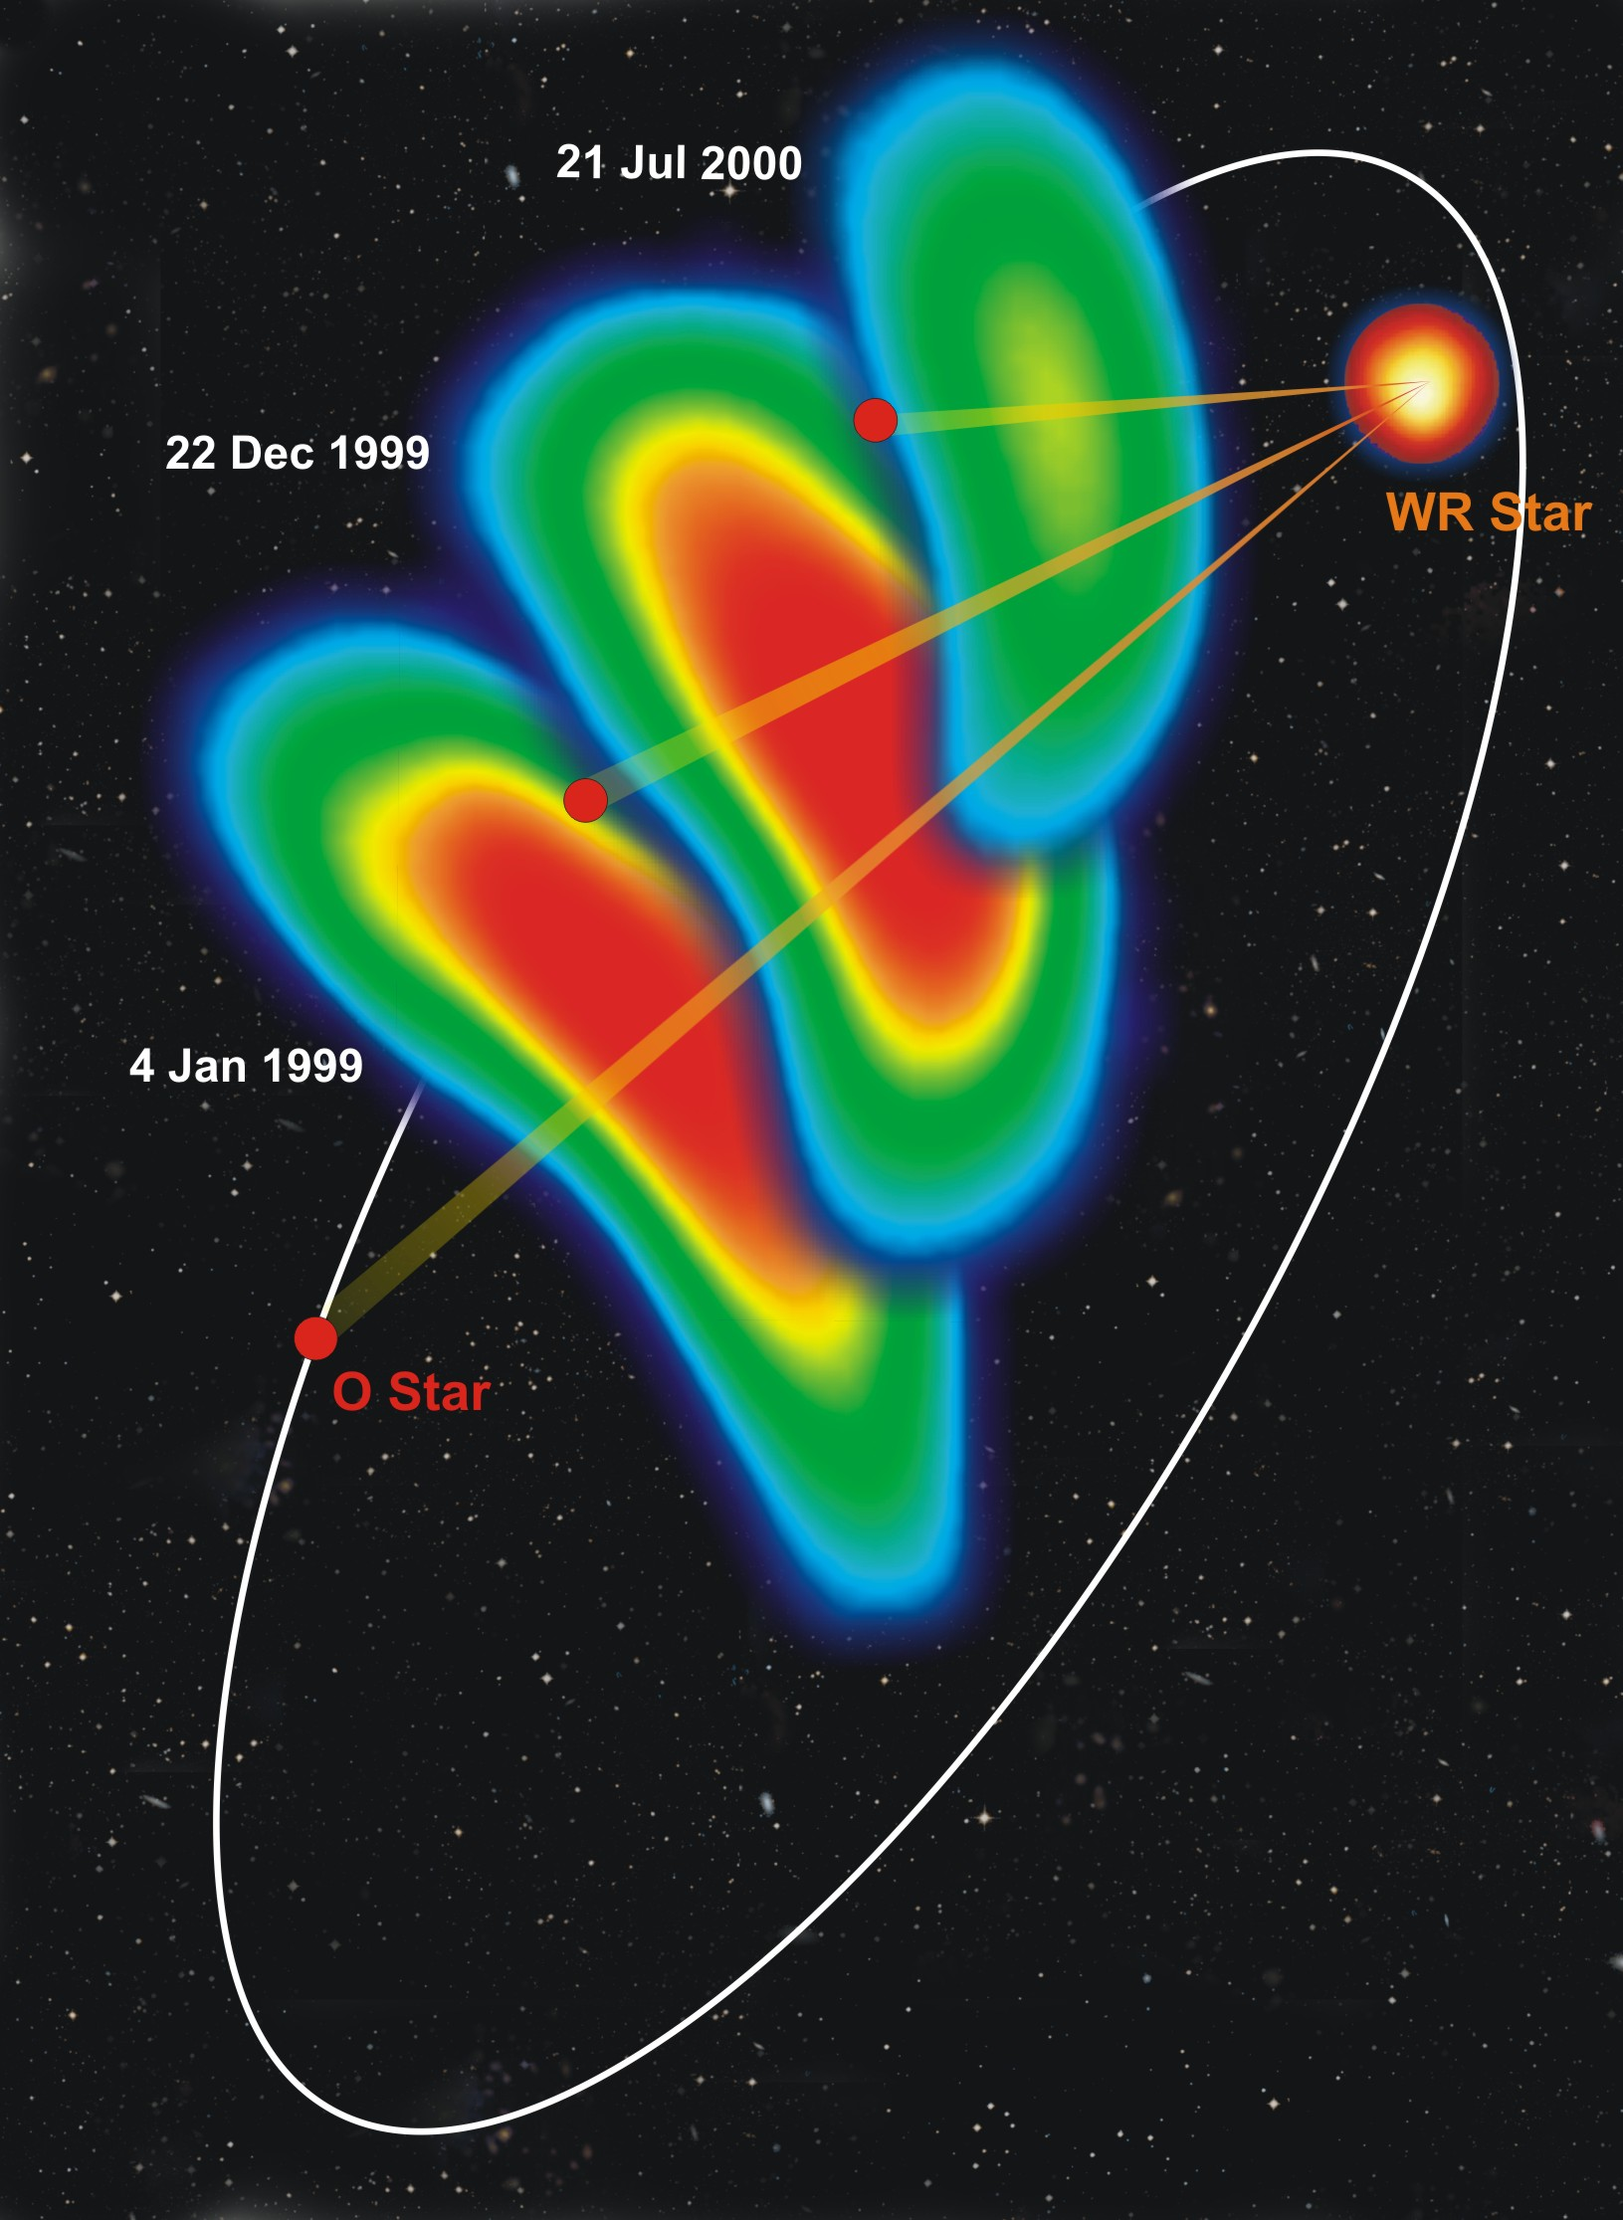
What can the VLBA do?
Resolution
  80μas to 25 mas
    In the galaxy (100pc-10kpc): 1 mas resolution is 0.1-10 AUs (even less than a stellar radius for nearby stars)
    For nearby extragalactic (1-1000Mpc): 1 mas resolution is 1000 AU-5pc
  E.g., WR140, colliding wind region in Wolf-Rayet binary star system
Dougherty et al. 2005

Slide 4
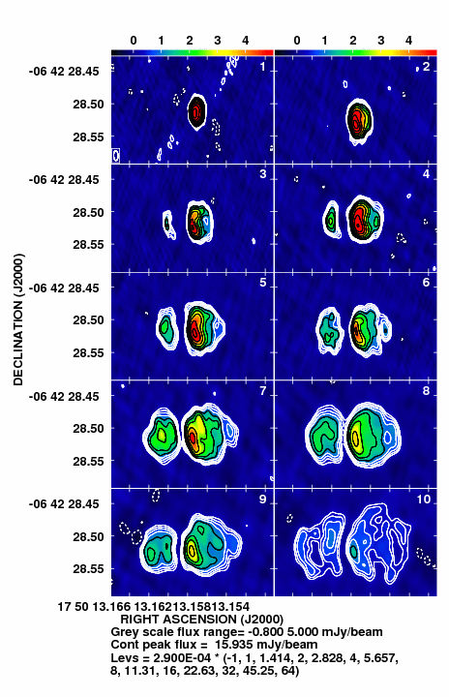
What can the VLBA do?
14 days
21 days
Monitoring/fast response
  Dedicated array
  Targets of Opportunity
  Watching objects evolve
    E.g. 1.6 GHz observations recurrent nova RS Ophiuchi (Rupen et al. 2007)
27 days
29 days
34 days
39 days
45 days
49 days
51 days
63 days

Slide 5
What can the VLBA do?
Geodesy
Earth Rotation and Orientation, tectonic plate motions
E.g. Daily UT1-UTC observations
  US Naval Observatory is contributing to VLBA operations in exchange for daily ~1 hour observations using 2 VLBA antennas: Mauna Kea and Pie Town
  High speed network links have been installed at these two sites
    MK and PT to Washington D.C. at ~250 Mbps
  Daily ~1 hour observations to begin soon
    When the US Government establishes a budget…
  VLBA science to face potential interruptions
    Users have been contacted with tips to reduce impact on observing
Notes:
Add precision

Slide 6
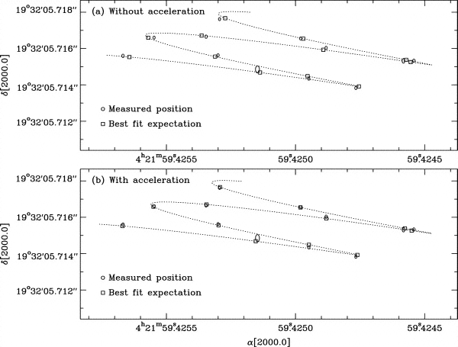
What can the VLBA do?
Astrometry
Highly precise positions
  100μas precision easily obtained
  20μas precision with effort
Fundamental reference frame
Parallax, proper motions… (e.g., TTauSb Loinard et al. 2007)
π=6.83 ± 0.03mas d = 147.6 ± 0.6 – 0.4% precision
Notes:
Add precision

Slide 7
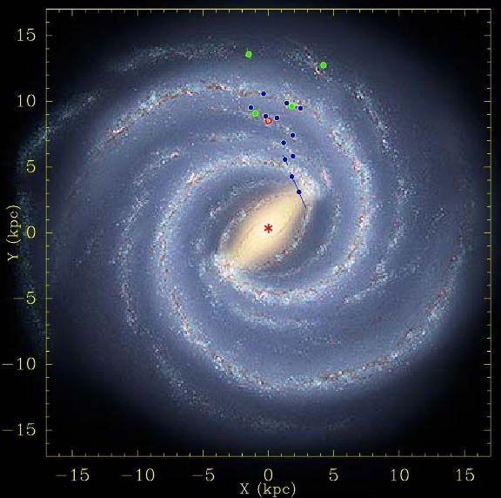
Bar and spiral structure legacy survey
(BeSSeL) Reid et al.
Goal: determine structure and kinematics of the Milky Way Galaxy
Perform astrometry on masers in star forming regions
  Water masers at 22 GHz
  Methanol at 11 and (soon) 6.7 GHz
Early results have improved measurements of the distance to the Galactic Center and rotational velocity
  R₀ = 8.4 ± 0.6 kpc
  Θ₀ = 254 ± 16 km/s

Slide 8
Frequency bands and sensitivity
λ(cm) | ν(GHz) | σ(μJy/beam) in 4 hrs at 2Gbps
90 cm | 0.312 - 0.342 | 277*
50 cm | 0.596 - 0.626 | 782*
21 cm | 1.35 - 1.75 | 13-14
13 cm | 2.15 - 2.35 | 14
6 cm | 4.6 - 5.1 | 13
6 cm (upgrade) | 4.1 - 7.9 | 8
4 cm | 8.0 - 8.8 | 13
2 cm | 12.0 - 15.4 | 24
1 cm | 21.7 - 24.1 | 18-22
7 mm | 41.0 - 45.0 | 66
3 mm | 80.0 - 90.0 | 316†
New maximum bandwidth 256 MHz with two polarizations (2Gbps)
More later about:
  Increasing sensitivity by adding more/larger telescopes to the array
  Sensitivity upgrade
  C-band upgrade
* Narrower bandwidths
† 8 stations

Slide 9
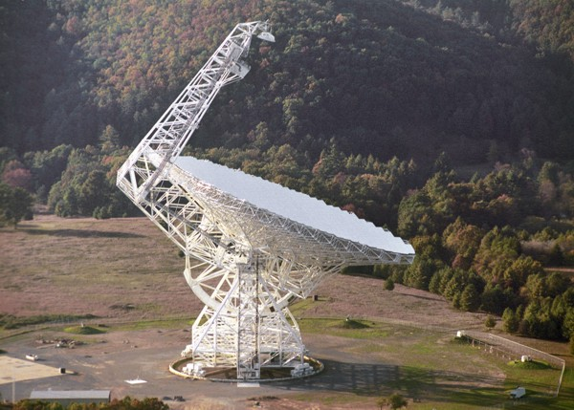
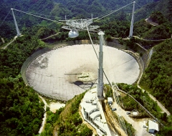
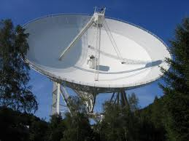
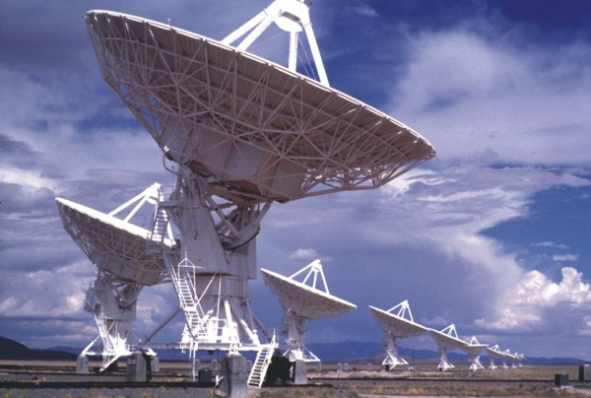
High Sensitivity Array (HSA)
Adding the Green Bank Telescope (GBT), Arecibo (AR), Effelsberg (EB) and/or the phased VLA with the VLBA can increase the sensitivity by an order of magnitude
  The VLBA + any two of these telescopes is considered an HSA experiment
All these telescopes have a smaller field of view than the VLBA and may not have all the frequencies available at the VLBA.
Phased VLA under development and can be proposed for in the 2012 August 1 deadline.

Slide 10
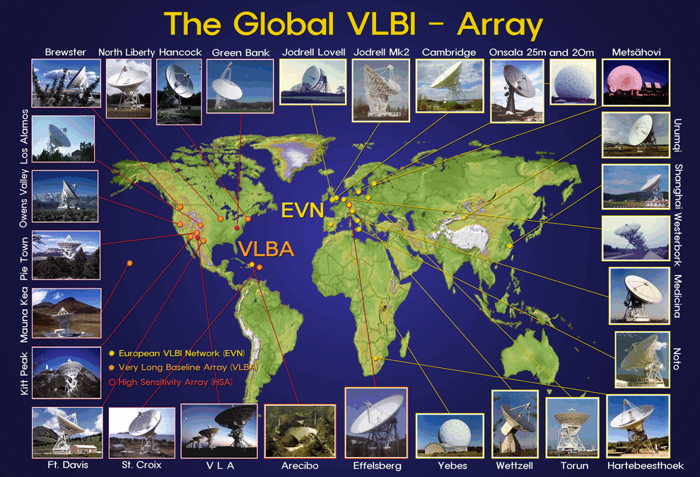
Global VLBI
Add telescopes from the European VLBI Network (EVN) to the VLBA.
The EVN has many large sensitive telescopes adding them increases the sensitivity as well as improving uv coverage (e.g. EVN has many more short baselines so can be more sensitive to larger structures.)

Slide 11
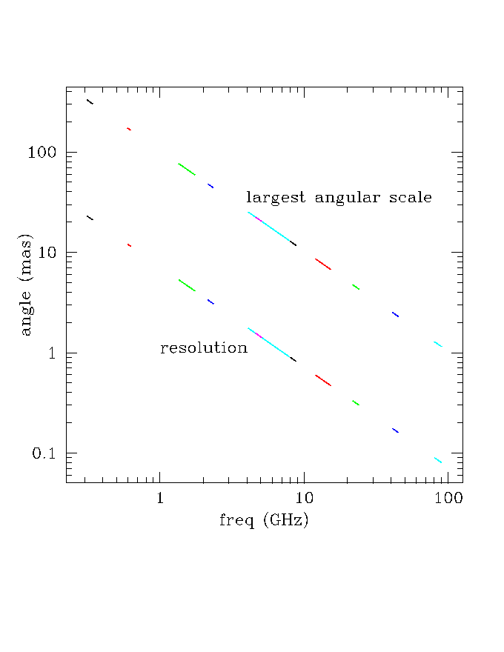
Resolution and Largest Angular scale
Depending on frequency the resolution of the VLBA is anything from 0.08 to 25 mas
The largest angular scale determines the largest structure the telescope is sensitive to.
Notes:
RS Ophiuchus (ofu-cus)

Slide 12
Sensitivity Upgrade
There are many parts to the sensitivity upgrade, some have already been implemented:
  DiFX correlator: allows several new capabilities (more later)
  Wider bandwidths: for a total of 256 MHz, dual polarization. This gives a total bit rate of 2 Gbps, and enables twice the sensitivity of the old VLBA.
    256 MHz bandwidth must be justified in proposal
    64 MHz bandwidths are standard
Some in the process of being implemented:
  C-band upgrade: replace the VLBA's 6 cm receivers
    To expand the tuning range to 4.1 - 7.9 GHz. Which will enable observations of the 6.7 GHz transition of methanol.
    To increase sensitivity: noise will go down by ~35%
    New receivers installed on 7.5 antennas. Complete mid-August.

Slide 13
DiFX Correlator Capabilities I: Spectral Resolution
DiFX is a software correlator in Socorro, NM
Supports up to 4096 channels per sub-band routinely
Up to 32,768 channels if required and adequately justified
Spectral zooming – can do higher spectral resolution in one or more sub-bands. Useful for:
  Masers with in-beam continuum calibrators: wide bands used for maximum sensitivity on calibrator while at the same time high spectral resolution on maser lines.
  Masers with multiple transitions: wide bands are used to cover a large number of widely separated maser transitions, spectral zooming allows the empty portions of high-resolution spectrum to be discarded

Slide 14
DiFX Correlator Capabilities II: Wide Field Imaging
DiFX enables wide field imaging due to high spectral and time resolution.
This ability has been widely used since the introduction of DiFX
However, full-beam
VLBA imaging is still
a logistical impracticality,
primary beam: 30’
Time resolution:
20 ms
Freq. resolution:
4 kHz
phase centre
Smearing-limited
field of view
30’
Calculations for 1.6 GHz, total smearing = 10%
Notes:
immpracti

Slide 15
DiFX Correlator Capabilities III: Multi- Field Imaging
The sky is almost entirely empty at VLBI resolution
  “full beam” imaging not needed; rather, many small “fields” (phase centers)
In previous correlators, multiple fields required multiple correlator passes (usually at same or twice the rate of observation time)
  Impractical for more than a few fields.

Slide 16
DiFX Correlator Capabilities III: Multi- Field Imaging
Using uv shifts inside the correlator
  DiFX allows many phase centers in one correlator pass
  The overhead is ~2.5 and is only weakly dependent on the number of phase centers
For reasonable spectral and time resolution requirements, 200 phase centers require only 20% more correlator time than 2 phase centers.

Slide 17
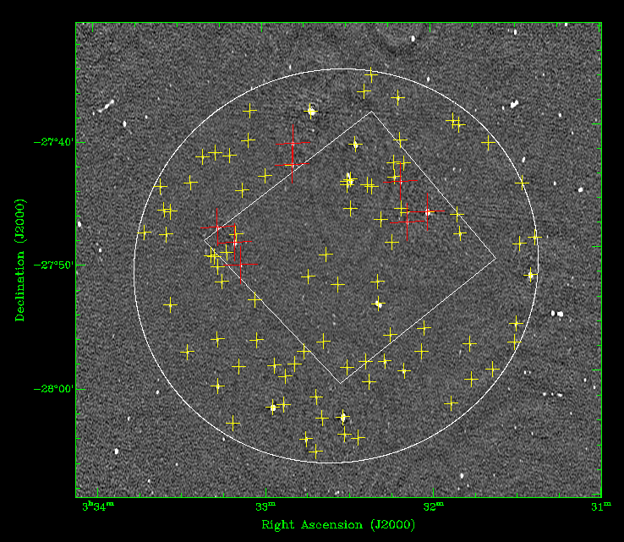
DiFX Correlator Capabilities III: Multi- Field Imaging
This enables new science:
  mJy-sensitivity secondary calibrator searches within a beam
  Efficient VLBI surveys of mJy and sub-mJy objects are feasible. E.g. Middelberg et al. (2011) already published VLBA results on Chandra Deep Field South
From Middelberg et al., 2011

Slide 18
Commissioning Opportunities
Resident Shared Risk Observations – early access to new capabilities in exchange for a period of residency in Socorro to help commission those capabilities.
For example, phased-array VLBI on the JVLA
  We are offering the very simple phased-VLA for next year but there are many things that still need to be commissioned (multiple subarrays, phase transfer from one bandwidth to another…).

Slide 19
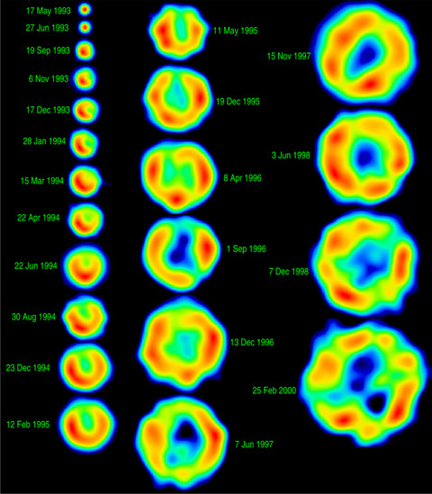
Important Links
SN1993J in M81
NRAO Help Desk
  https://help.nrao.edu
VLBA Observational Status Summary
  http://www.vlba.nrao.edu/astro/obstatus/current/
EVN Sensitivity Calculator
  http://www.evlbi.org/cgi-bin/EVNcalc
Proposal Submission Tool
  my.nrao.edu
SCHED – observation preparation software
  http://www.aoc.nrao.edu/software/sched/index.html
AIPS – data reduction software
  http://www.aips.nrao.edu/index.shtml
10 mas
36,000 AU
Bartel et al. 2000
Notes:
Add helpdesk!

