Slide 1

A Crash Course in
Radio Astronomy and Interferometry:
1. Basic Radio/mm Astronomy
James Di Francesco
National Research Council of Canada
North American ALMA Regional Center – Victoria
(thanks to S. Dougherty, C. Chandler, D. Wilner & C. Brogan)

Slide 2
Intensity & Flux Density
Basic Radio/mm Astronomy
EM power in bandwidth δν from solid angle δΩ intercepted by surface δΑ is:
Defines surface brightness I_{v} (W m⁻² Hz⁻¹ sr⁻¹ ; aka specific intensity)
Flux density S_{v} (W m⁻² Hz⁻¹) – integrate brightness over solid angle of source
Convenient unit – the Jansky ➔ 1 Jy = 10⁻²⁶ W m⁻² Hz⁻¹ = 10⁻²³ erg s⁻¹ cm⁻² Hz⁻¹
Note:

Slide 3
Basic Radio/mm Astronomy
Surface Brightness
In general surface brightness is position dependent, ie. I_{ν} = I_{ν}(θ,φ)
(if I_{ν} described by a blackbody in the Rayleigh-Jeans limit; hν/kT << 1)
Back to flux:
In general, a radio telescope maps the temperature distribution of the sky

Slide 4
Brightness Temperature
Basic Radio Astronomy
Many astronomical sources DO NOT emit as blackbodies!
However….
Brightness temperature (T_{B}) of a source is defined as the temperature of a blackbody with the same surface brightness at a given frequency:
This implies that the flux density

Slide 5
Basic Radio Astronomy
What does a Radio Telescope Detect?
Recall :
Telescope of effective area A_{e} receives power P_{rec} per unit frequency from an unpolarized source but is only sensitive to one mode of polarization:
Telescope is sensitive to radiation from more than one direction with relative sensitivity given by the normalized antenna pattern P_{N}(θ,ϕ):

Slide 6
Basic Radio Astronomy
Antenna Temperature
Johnson-Nyquist theorem (1928):
Power received by the antenna:
Antenna temperature is what is observed by the radio telescope.
A “convolution” of sky brightness with the beam pattern
It is an inversion problem to determine the source temperature distribution.

Slide 7
Basic Radio/mm Astronomy
Radio Telescopes
The antenna collects the E-field over the aperture at the focus
The feed horn at the focus adds the fields together, guides signal to the front end

Slide 8
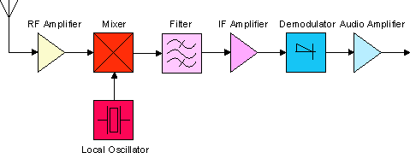
Basic Radio/mm Astronomy
Components of a Heterodyne System
Feed Horn
Back end
Power detector/integrator
or Correlator
Amplifier
  amplifies a very weak radio frequency (RF) signal, is stable & low noise
Mixer
  produces a stable lower, intermediate frequency (IF) signal by mixing the RF signal with a stable local oscillator (LO) signal, is tunable
Filter – selects a narrow signal band out of the IF
Backend – either total power detector or more typically today, a correlator

Slide 9
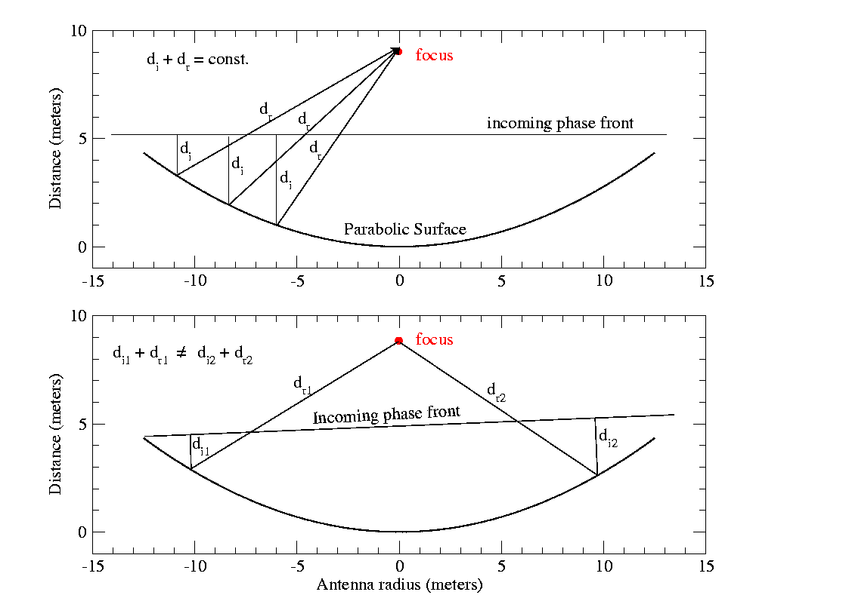
Basic Radio/mm Astronomy
Origin of the Beam Pattern
On-axis
incidence
Antenna response is a coherent phase summation of the E-field at the focus
First null occurs at the angle where one extra wavelength of path is added across the full aperture width,
i.e., θ ~ λ/D
Off-axis
incidence

Slide 10
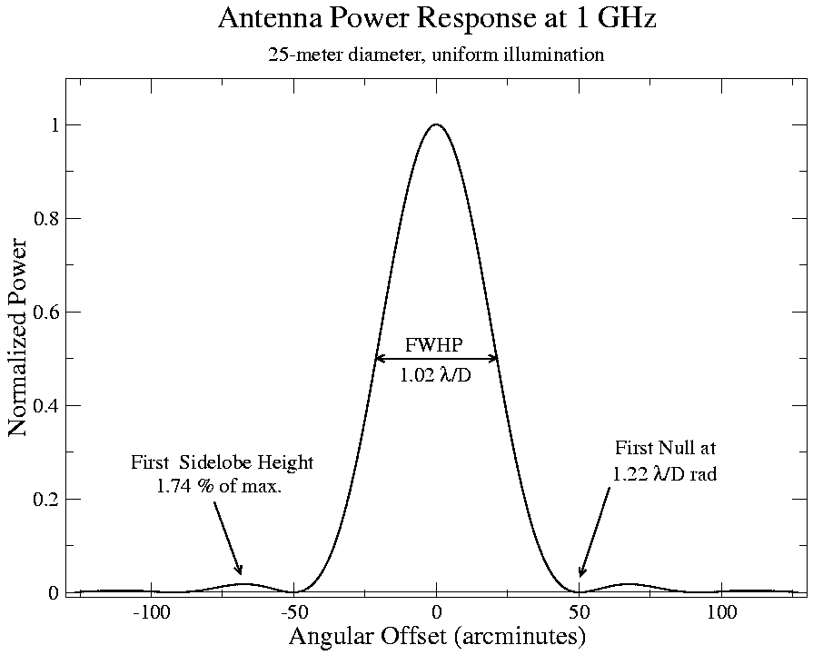
Basic Radio/mm Astronomy
Antenna Power Pattern
Defines telescope resolution
The voltage response pattern is the FT of the aperture distribution
The power response pattern, P(θ ) ∝ V²(θ ), is the FT of the autocorrelation function of the aperture
for a uniform circle, V(θ ) is J₁(x)/x and P(θ ) is the Airy pattern, (J₁(x)/x)²

Slide 11
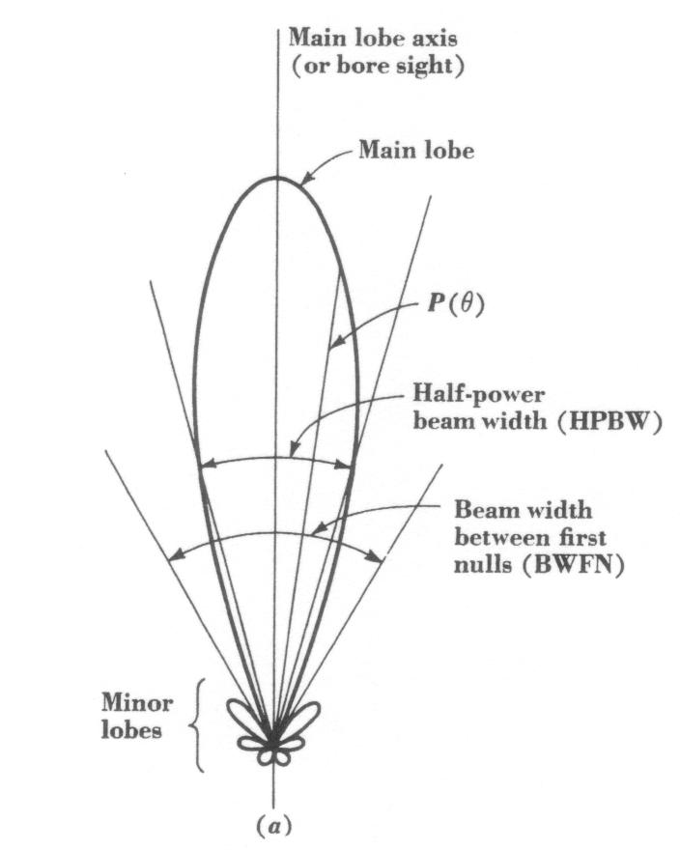
Basic Radio/mm Astronomy
The Beam
The antenna “beam” solid
angle on the sky is:
Telescope beams @ 345 GHz
D (m)
θ (“)
AST/RO
1.7
103
JCMT
15
15
LMT
50
4.5
SMA
508
0.35
Sidelobes
NB: rear lobes!
ALMA
15 000
0.012

Slide 12
Basic Radio/mm Astronomy
Sensitivity (Noise)
Unfortunately, the telescope system itself contributes noise to the the signal detected by the telescope, i.e.,
P_{out} = P_{A} + P_{sys} ➔ T_{out} = T_{A} + T_{sys}
The system temperature, T_{sys}, represents noise added by the system:
T_{sys} = T_{bg} + T_{sky} + T_{spill} + T_{loss} + T_{cal} + T_{rx}
T_{bg} = microwave and galactic background (3K, except below 1GHz)
T_{sky} = atmospheric emission (increases with frequency--dominant in mm)
T_{spill} = ground radiation (via sidelobes) (telescope design)
T_{loss} = losses in the feed and signal transmission system (design)
T_{cal} = injected calibrator signal (usually small)
T_{rx} = receiver system (often dominates at cm — a design challenge)
Note that T_{bg}, T_{sky}, and T_{spill} vary with sky position and T_{sky} is time variable

Slide 13
Basic Radio/mm Astronomy
Sensitivity (Noise)
In the mm/submm regime, T_{sky} is the challenge (especially at low elevations)
In general, T_{rx} is essentially at the quantum limit, and T_{rx} < T_{sky}
ALMA T_{rx}
GHz
T_{rx} (K)
Band 3
84-116
< 37
Band 6
211-275
< 83
Band 7
275-370
< 83
Band 9
602-720
< 175
“Wet” component: H₂O
“Dry” component: O₂

Slide 14
Basic Radio/mm Astronomy
Sensitivity (Noise)
Q: How can you detect T_{A} (signal) in the presence of T_{sys} (noise)?
A: The signal is correlated from one sample to the next but the noise is not
For bandwidth Δν, samples taken less than Δτ = 1/Δν are not independent
(Nyquist sampling theorem!)
Time τ contains independent samples
For Gaussian noise, total error for N samples is
that of single sample
Radiometer equation

Slide 15
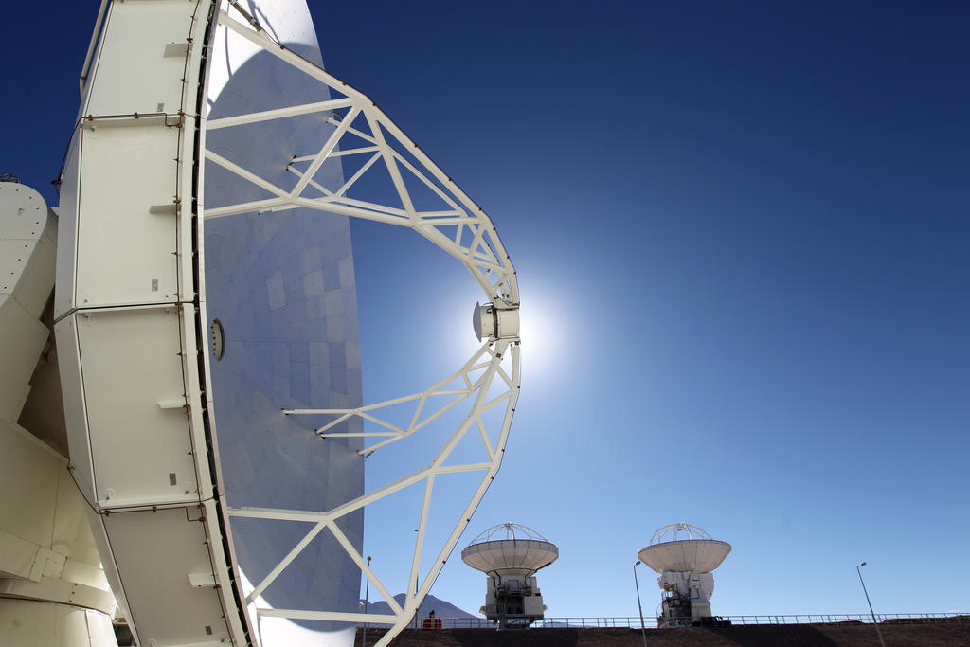
Next: Aperture Synthesis

