Slide 1

The VLA Sky Survey – data products and science results
Mark Lacy, NRAO

Slide 2
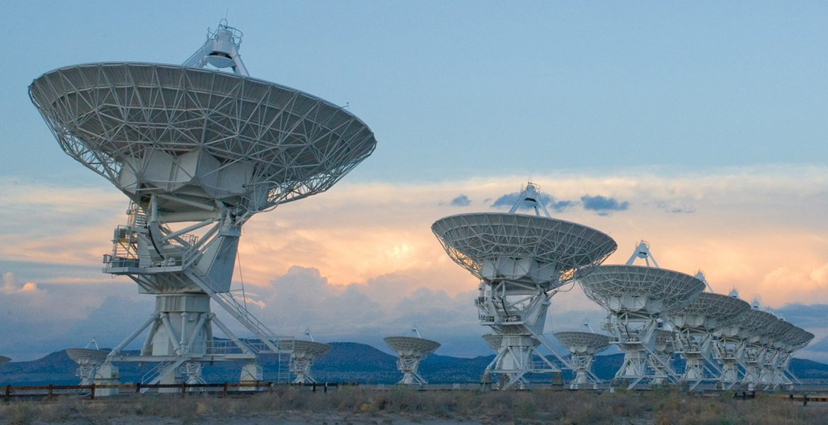
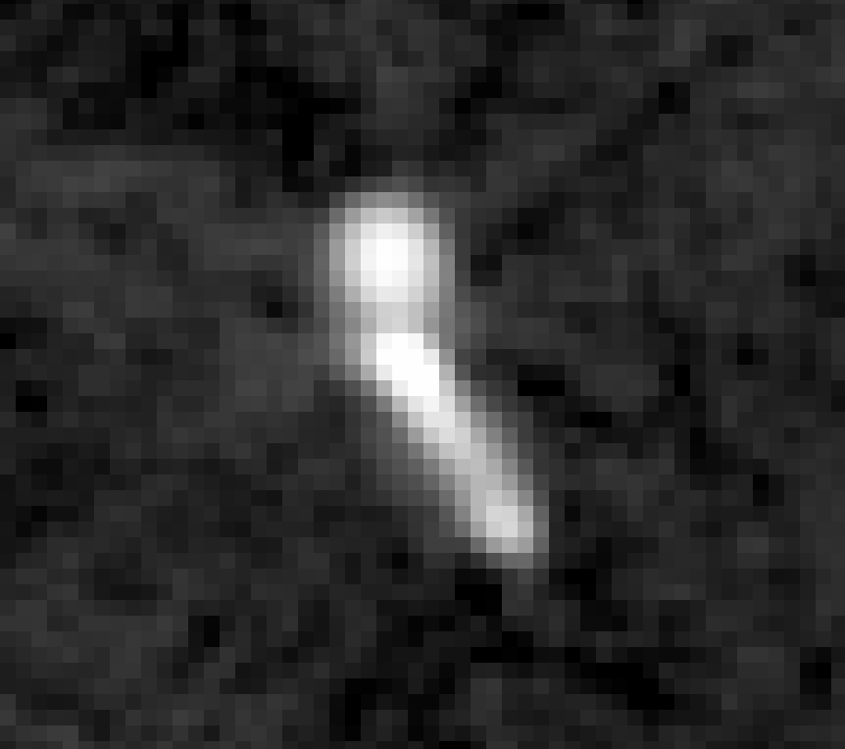
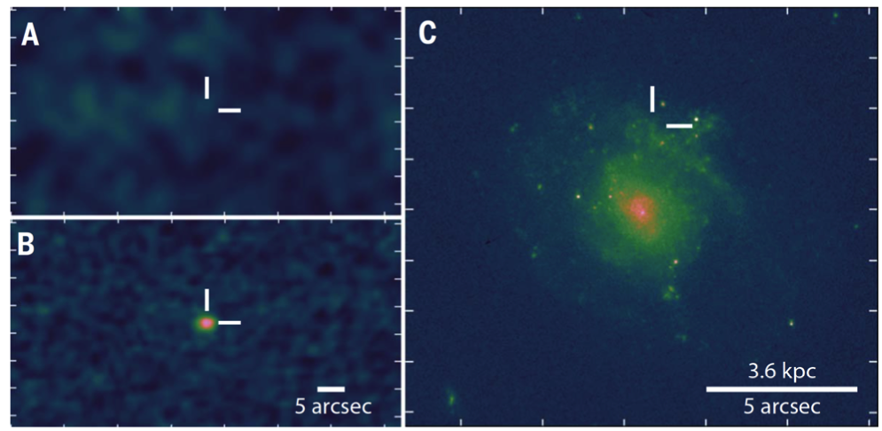
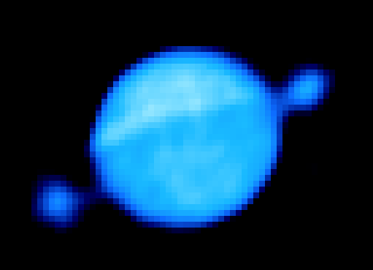
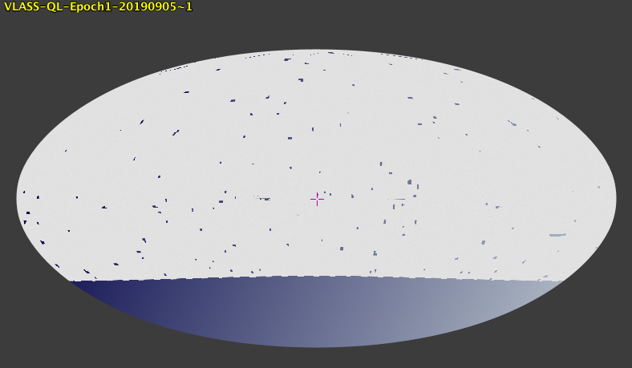
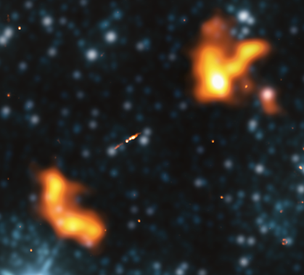
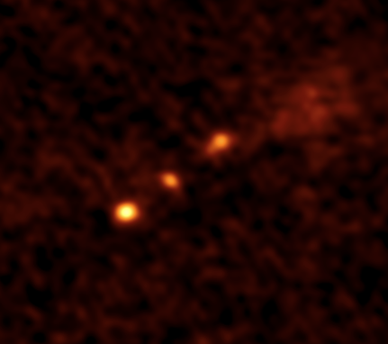
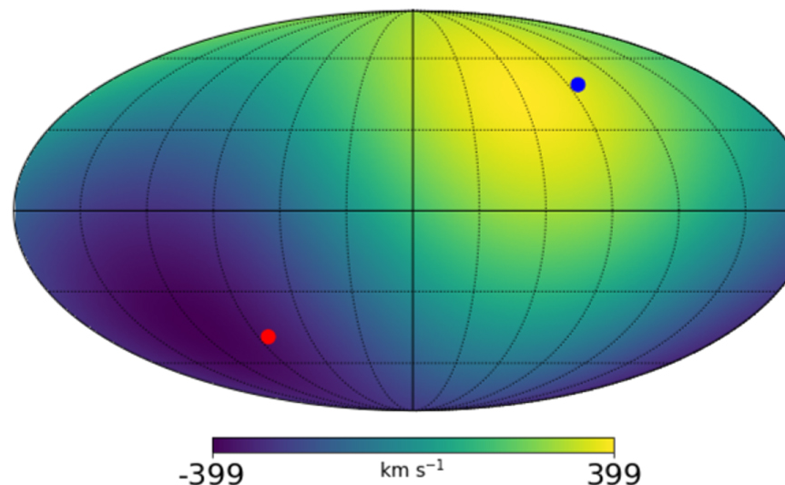
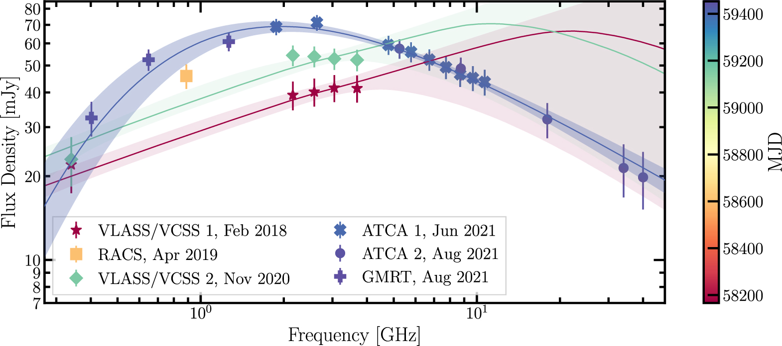
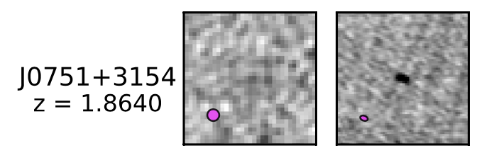
TXS 1433+205, the most distant gamma-ray AGN, resolved in VLASS (Paliya+23)
Jupiter as seen by VLASS
VT1210+4956: merger-driven supernova; Dong+21
Inner jet of a 5-Mpc giant (Oei+22)
The cosmic dipole signal from VLASS matches the Planck signal (Darling+22)
Quasars changing from radio-quiet to radio-loud; Nyland+20
VT0243-2840 radio TDE candidate (Somalwar+22)

Slide 3
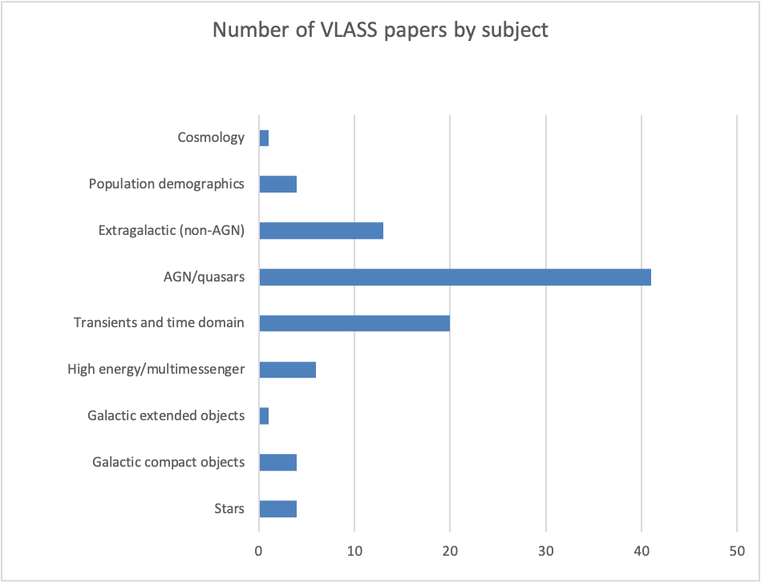
What are astronomers using VLASS for?
94 papers use VLASS (to end of April 2023).

Slide 4
VLASS data products
Quick Look (QL) images – produced 4-5 weeks after observations are made, using a simple mosaic gridder. Epochs 1 and 2 all online, epoch 3 being placed online as images are made.
Single Epoch (SE) continuum images – more refined versions of the QL images with self-calibration, better cleaning and in-band spectral index information.
  A work-in-progress – 1130 images from Epoch 2 currently available.
SE polarization cubes: 128MHz channel cubes in Stokes I, Q & U (also single plane combined V)
  Also in progress, 12 demonstration images available. Starting full production in the Fall.
Cumulative products – at the end of the project we coadd the data from all epochs.
Also commensal products from the VLITE survey at 365 MHz (VCSS) – catalog only right now, images available on request to NRL.

Slide 5
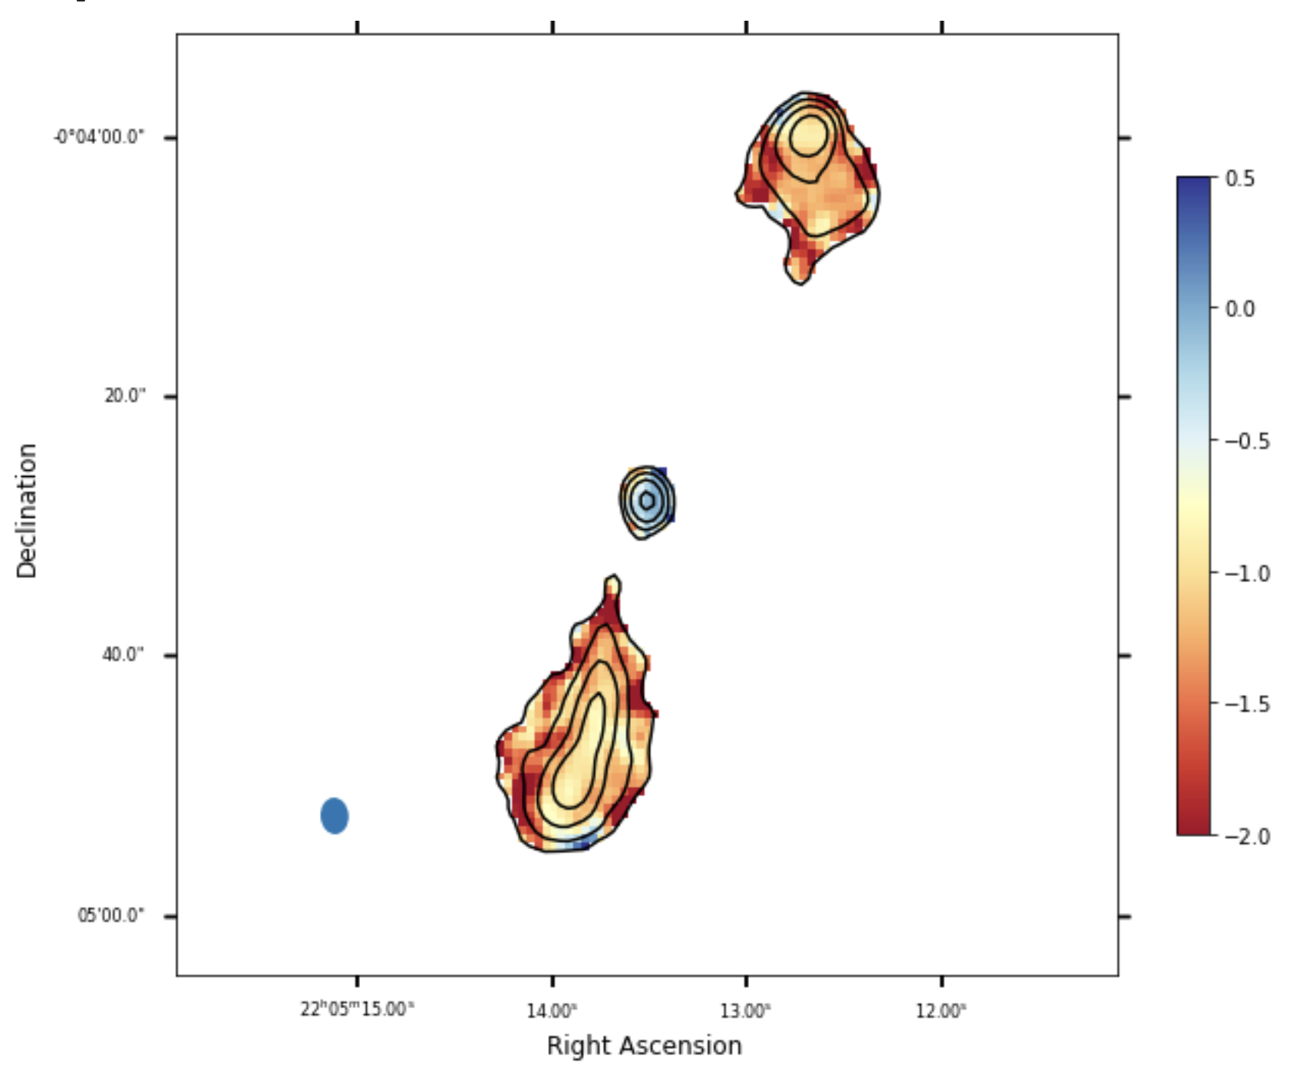
SE continuum – in-band spectral index
Improved compared to QL by using self-calibration and contain in-band spectral index information.
Main utility of the in-band spectral indices is for compact source spectral indices, for example, distinguishing cores from lobes.
SNR needed for +/-0.2 spectral index accuracy is ~30.
Sampling issues make extended source spectral indices unreliable, though they can still be used as a qualitative guide.

Slide 6
SE cubes
Stokes I,Q,U cubes (also frequency-averaged V-plane).
~10-16 128MHz channels (depending on RFI) in the 2-4 GHz range.
Designed for polarization studies, but can also be used for spectral indices.
For most purposes, the cubes will need to be regridded to a common center (there are small positional offsets as a function of frequency to compensate for the lack of w-terms in imaging) and convolved to a common (low resolution) beam.
CIRADA plan to produce high-level polarization products from VLASS data.

Slide 7
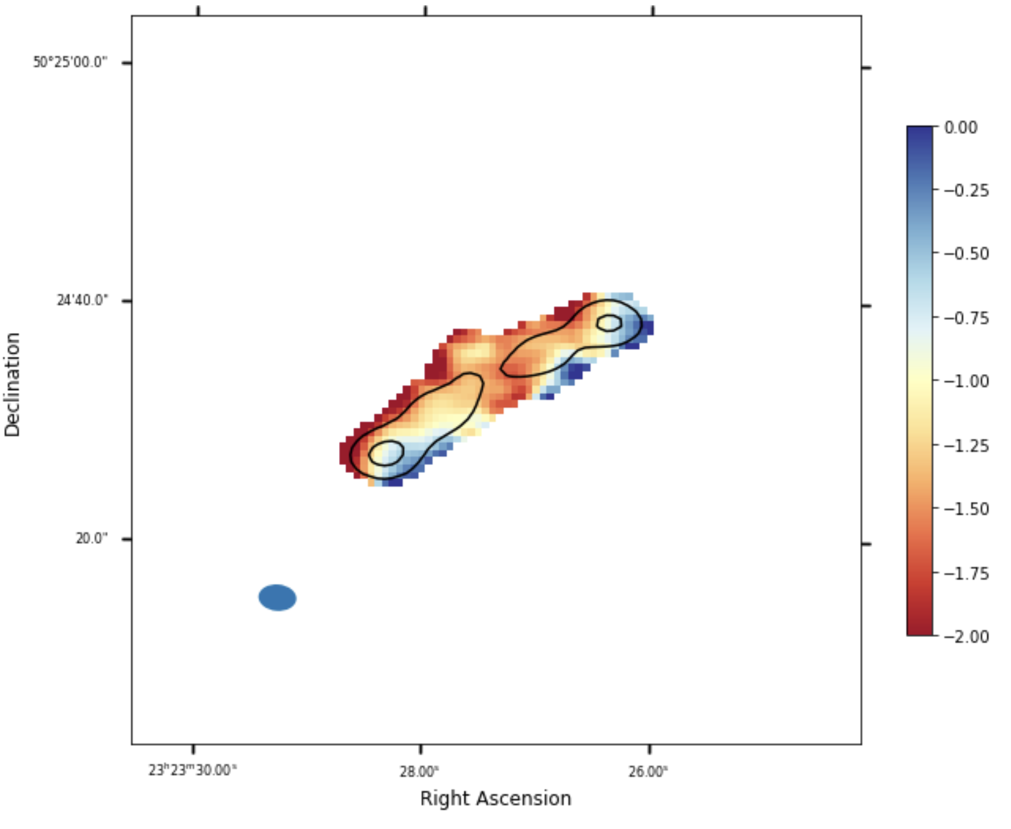
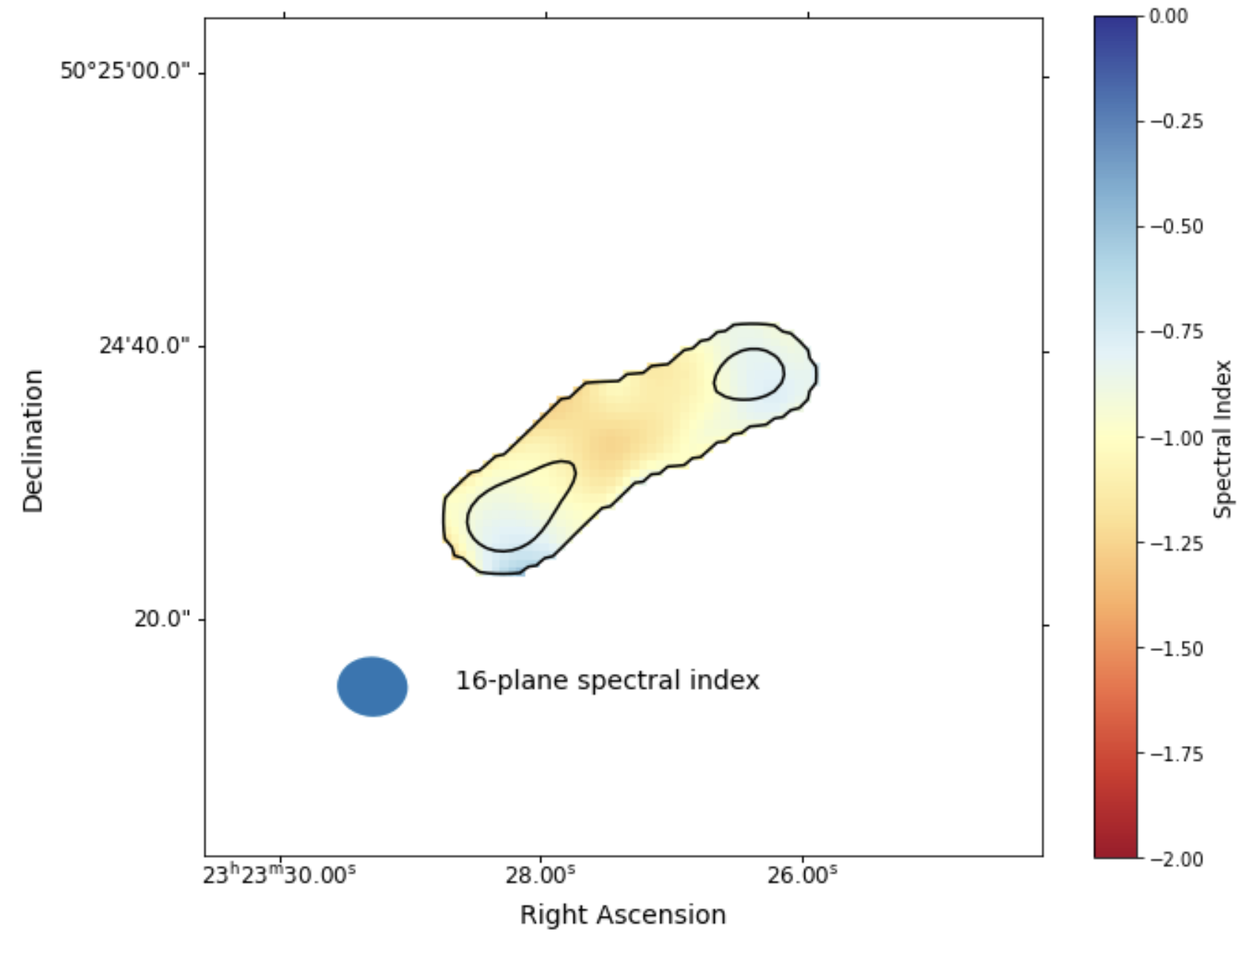
Spectral index comparison
From continuum
From cube

Slide 8
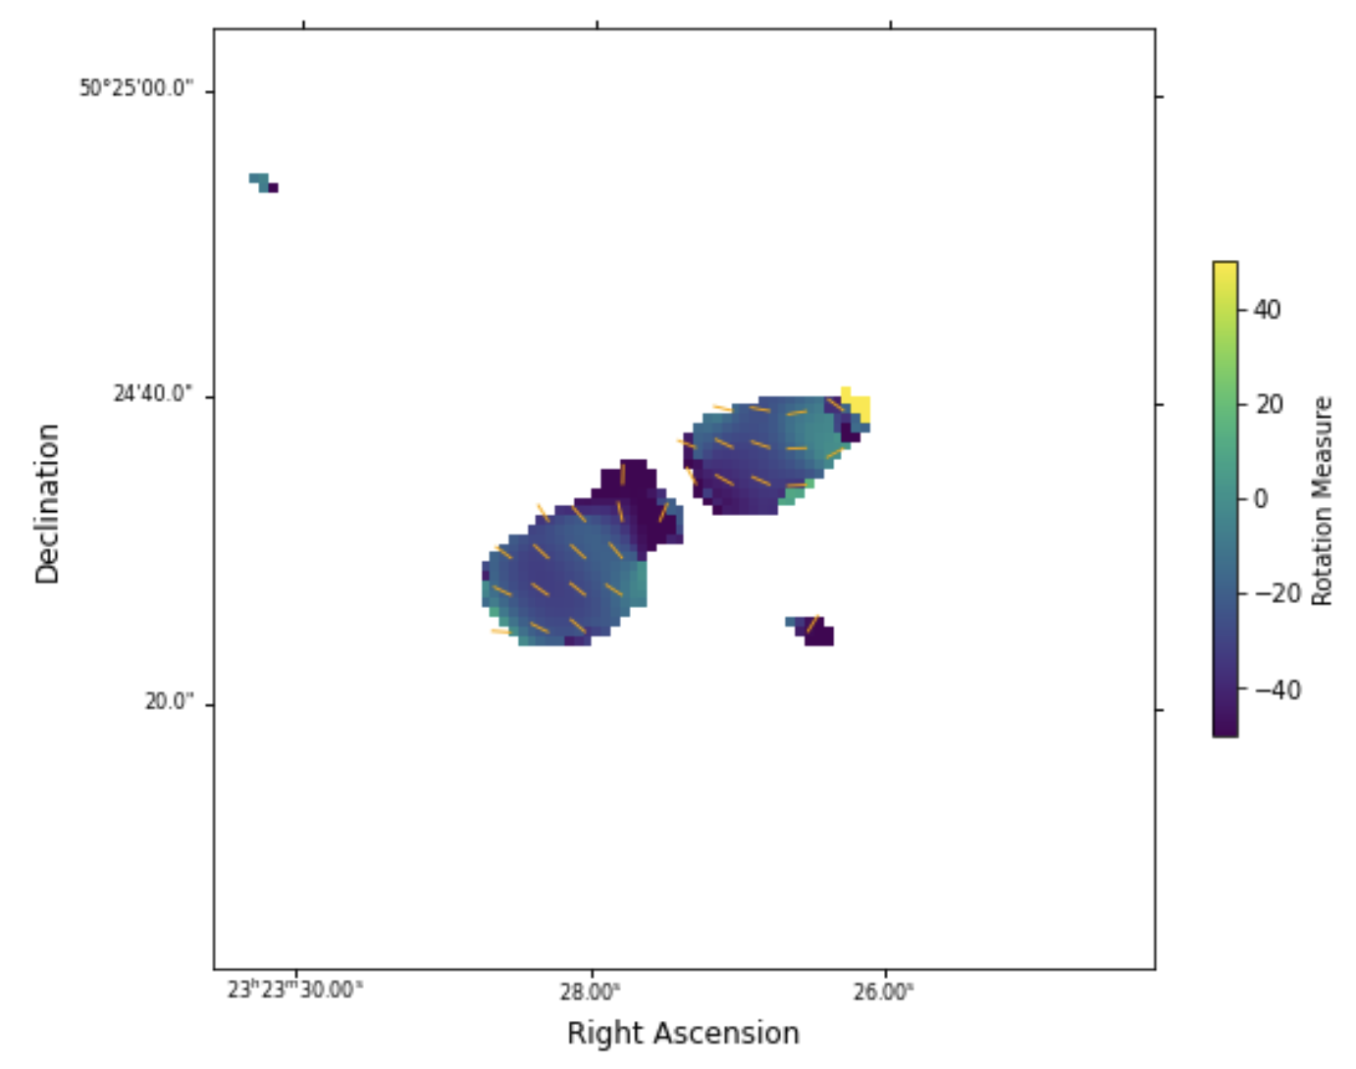
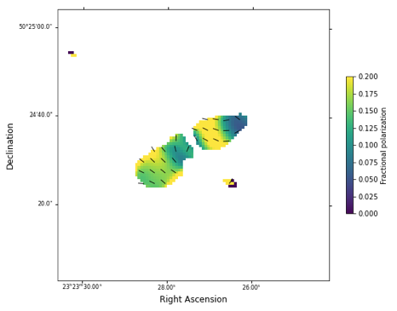
Polarimetry

Slide 9
How to get VLASS data
All VLASS data products are made available as soon as they pass quality assurance.
Several image download options:
  NRAO cache: https://archive-new.nrao.edu/vlass (QL, SE, QL HIPS images)
  NRAO archive (data.nrao.edu, QL only, note that epoch 1 images have small(~1”) position errors that are corrected in the cached products), can view images in CARTA
  CADC (VLASS collection)
    Cutout services at CADC and https://cutouts.cirada.ca
    VO Simple Image Access and SODA (cutout) service via CADC (see notebooks)
Catalogs from https://cirada.ca and CDS/Vizier (Ep 1 and VCSS only)

Slide 10

VLASS in the Virtual Observatory
The VO provides convenient scripted access to the VLASS image products stored at CADC, and the epoch 1 QL catalog at CDS.
TOPCAT provides an interactive tool to cross-match other catalogs to VLASS, and can communicate with other VO-enabled applications via SAMP.
HIPS allows the QL images to be browsed interactively (Steve’s talk).
pyVO helps to script VO queries, including image cutouts and downloads.

Slide 11
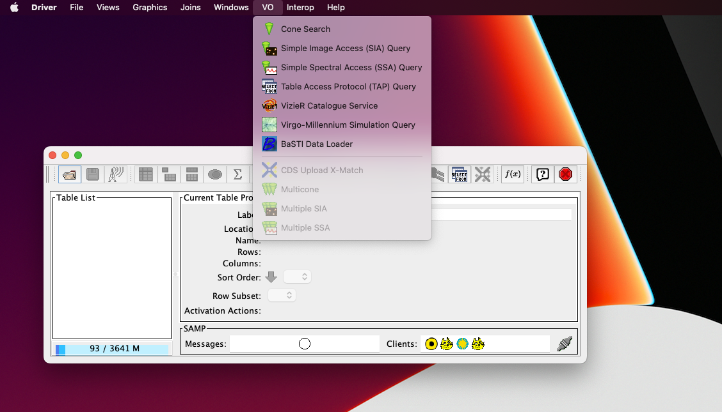
TOPCAT
Select “VO” then “Cone Search” from the main menu.
Or, with a table selected you can do a “MultiCone” search to match a whole input catalog
http://www.star.bris.ac.uk/~mbt/topcat/

Slide 12
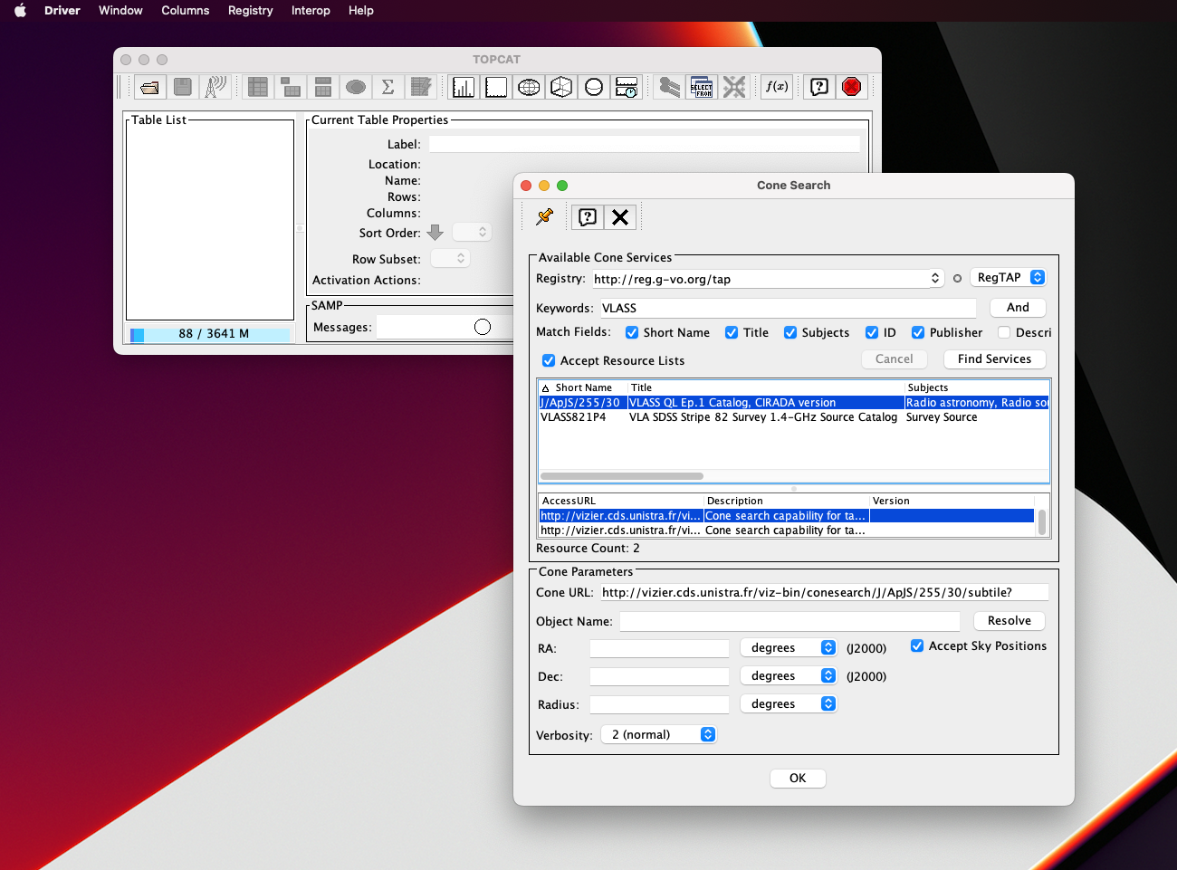
Search using keyword
“VLASS” to find cone
search services in the VO registry

Slide 13
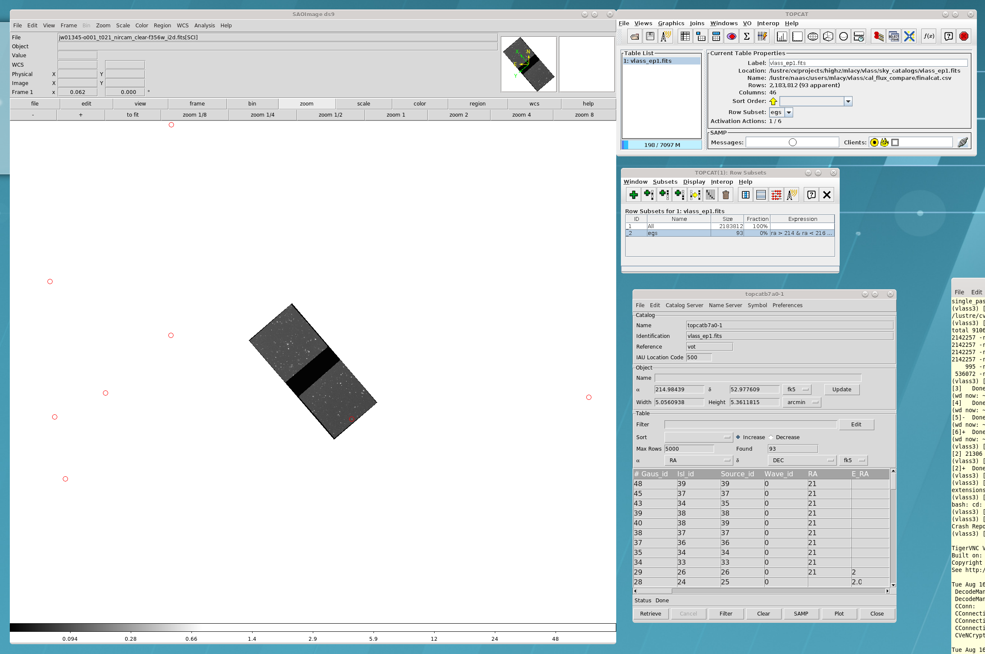
SAMP
Communicate e.g. between Topcat and ds9 – show VLASS sources on a JWST image

Slide 14
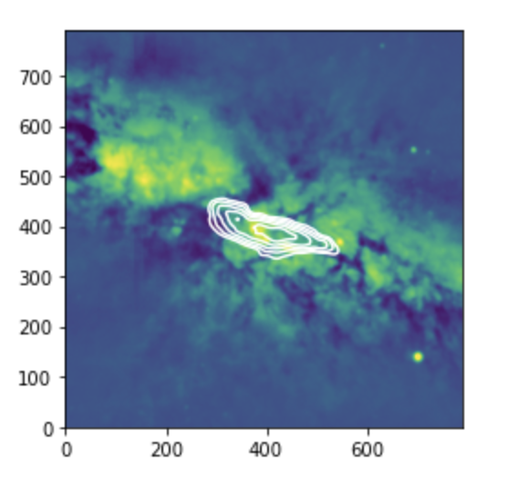
Scripted access
The pyVO python package can be used to make image and catalog searches, and also TAP queries
Example image notebook: VO_SIA_SODA_demo.ipynb.
  Runs SIA2 query at CADC (https://ws.cadc-ccda.hia-iha.nrc-cnrc.gc.ca/sia/v2query) for M82
  Uses Datalink to get a whole VLASS image, and SODA to get a cutout
  Also gets a CFHT MegaCAM optical cutout via SIA2 and SODA to match the VLASS one.
  Uses Scipy to interpolate the VLASS and CFHT images to the same grid and overplots VLASS contours on the optical image.
  All this is done via direct streaming – no awkward saving images to disk and reading them back in!

Slide 15
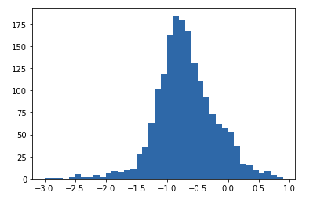
Scripted Queries – Cone search
Example image notebook: Cone_search_demo.ipynb
Extract a 4 degree radius cutout from the VLASS catalog of Gordon et al. held at CDS in France using SCS (http://vizier.cds.unistra.fr/viz-bin/conesearch/J/ApJS/255/30/comp?)
Use TAP to extract the same region from the RACS survey from the CASDA archive at CSIRO in Australia (https://casda.csiro.au/casda_vo_tools/tap).
Use astropy coordinates to match the VLASS and RACS sources and construct a spectral index distribution.

Slide 16

Summary
VLASS QL products available, SE products starting to come out.
Products available through both NRAO and CADC.
Interactive viewing via HIPS
QL catalogs: cirada.ca, also ep 1 at CDS.
Cutout service at cutouts.cirada.ca
Scripted image and cutout downloads using VO services via CADC.

Slide 17
Thanks to
VLASS Survey Science Group (past and present): Shami Chatterjee, Tracy Clark, Kristina Nyland, Heinz Andernach, Laurent Loinard, Adam Ginsburg, Gregg Hallinan, Greg Sivakoff, Amy Kimball, Eric Murphy, Jake Noel-Storr, Summer Ash, Larry Rudnick, Bryan Gaensler, Casey Law, Kunal Mooley, Shea Brown, Erik Rosolowsky, Russ Taylor, Rick White, Stefi Baum, Rachel Osten, Joseph Lazio, Dillon Dong, Kate Alexander, Brian Kent
, Nathan Bockisch, Daniel Nemergut

