Slide 1
VLASS Observing and Data Flow
Amy Kimball (NRAO)
for the VLA Sky Survey team and Survey Science Group

Slide 2
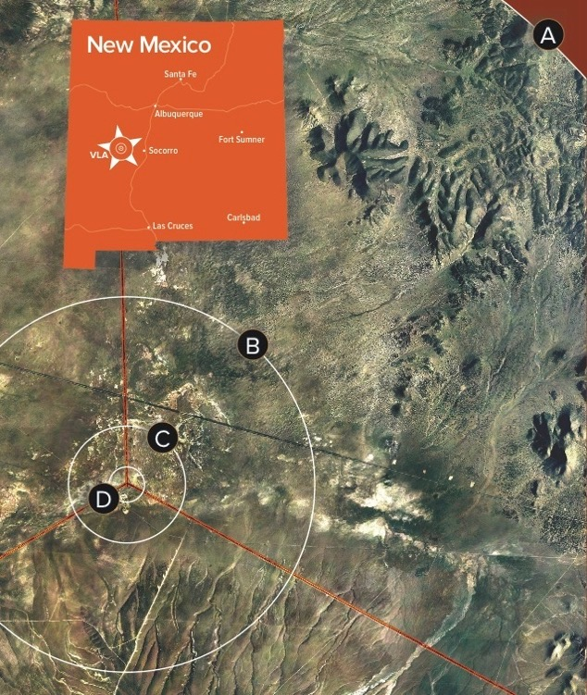
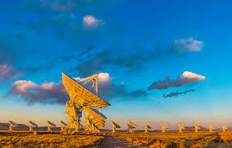
Karl G Jansky Very Large Array (VLA) configurations
A-configuration:
Best at spatial resolution, but can miss extended emission
D-configuration:
Lowest spatial resolution, but best at overall flux measurement
D-configuration

Slide 3
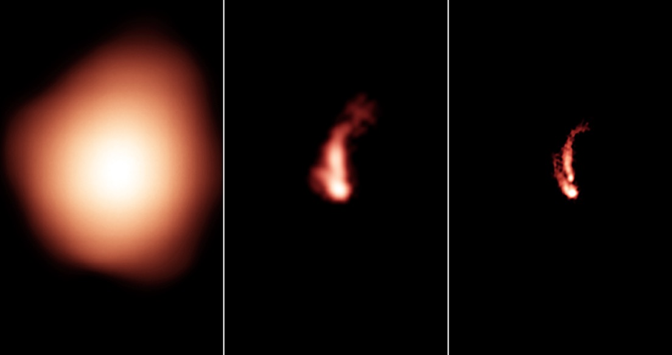
VLASS resolution advantage is key!
NVSS FIRST VLASS
1.4 GHz 1.4 GHz 3 GHz
D-config B-config B-config

Slide 4
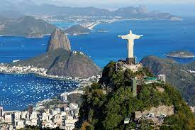
VLASS configurations
VLASS observes (mostly) in B-configuration to achieve 2.5"-resolution at a frequency of 3 GHz.

Slide 5
How to achieve reasonable resolution even very far to the south? (observing close to horizon)
Most of northern sky
South (≲ -14°)
B-config
BnA-config
(“hybrid”)
Projection to southern sky
Notes:
[Remove the figures on the right? Show some cartoon?]

Slide 6
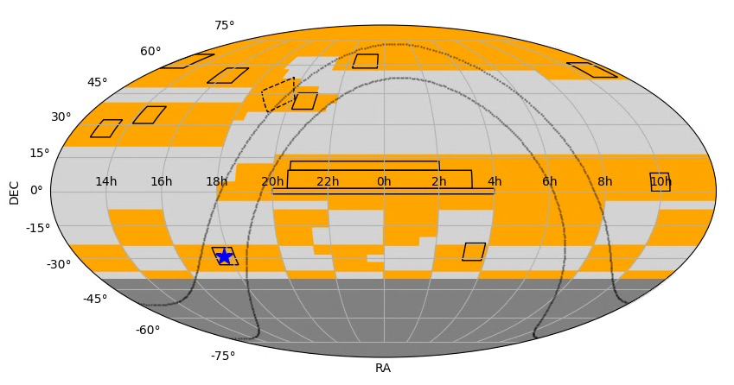
VLASS Sky Coverage: tessellated into 899 “tiles” (see VLASS memo #7)
Goal: constant RA observing pressure in each observing epoch
GOODS-N: re-observed each cycle
1st half of sky (Epoch X.1)
2nd half of sky (X.2)
BnA config
Pilot fields shown in black
Outside VLA visibility (< −40° decl.)

Slide 7
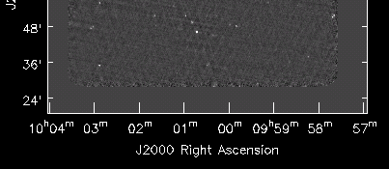
VLASS uses new “on-the-fly” (OTF) observing mode
instantaneous field-of-view
Antennas scan while taking data
Scan rate* 3.31′/s, 𝝙 decl. = 7.2′
Net survey speed* ~20 deg²/hr
Correlator dump 0.45s (1.5′/integ.)
Equivalent time-on-source: 5s*
* (slower scanning at low decl.)
×
×
×
×
Notes:
Scan rate changes to accommodate an integral number of phase-centers (2 ints per phasecenter) at each row. Scan rate is constant at each declination, across tiles.

Slide 8
VLASS uses new “on-the-fly” (OTF) observing mode
instantaneous field-of-view
Antennas scan while taking data
Scan rate* 3.31′/s, 𝝙 decl. = 7.2′
Net survey speed* ~20 deg²/hr
Correlator dump 0.45s (1.5′/integ.)
Equivalent time-on-source: 5s*
* (slower scanning at low decl.)
×
×
×
×
Two neighboring VLASS tiles on the sky
×
×
×
×
×
×
×
×
×
×
×
×
×
×
~ 40 deg² → 2 hours of OTF including calibration overheads
×
×
typically
4 deg
×
×
×
observe the complex gain calibrator every ~15 min
×
×
×
×
×
×
×
×
×
×
×
×
×
×
×
×
×
×
×
×
×
×
×
×
×
×
×
×
×
~ 10 deg
Notes:
Scan rate changes to accommodate an integral number of phase-centers (2 ints per phasecenter) at each row. Scan rate is constant at each declination, across tiles.

Slide 9
VLA observing in On-the-Fly Mosaicking mode
Notes:
Webcam at VLA capturing about 4 hours of VLASS observing.
..
Can see the telescope rastering back and forth, with a little jump about every 20 minutes to perform phase calibration.
..
After two hours, that chunk of sky is completed, and the telescope moves back to lower elevation to scan on another chunk that is starting to rise.

Slide 10
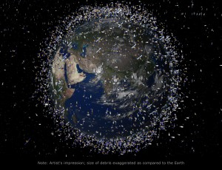
Challenge: Radio Frequency Interference (RFI)
Artist's impression based on real data

Slide 11
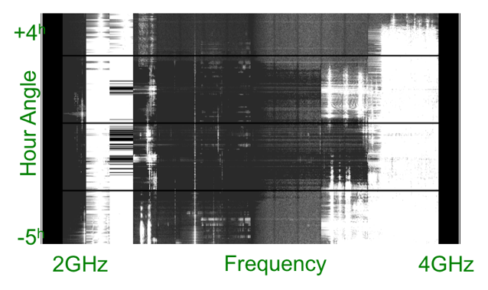
Challenge: Radio Frequency Interference (RFI)
Artist's impression based on real data
Results of RFI sweep

Slide 12
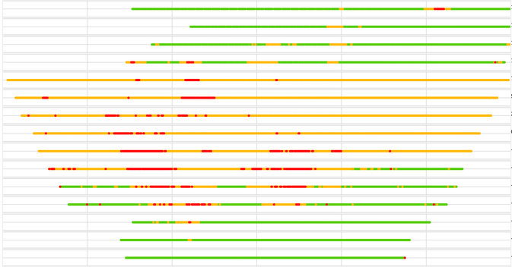
Challenge: Radio Frequency Interference (RFI)
Sirius/XM satellites
1-5 % compression
5-20 % compression
Artist's impression based on real data
>20 % compression
15°
Results of RFI sweep
10°
5°
Declination
0°
-5°
-10°
-15°
-6
-4
-2
0
+2
+4
+6
Hour Angle

Slide 13
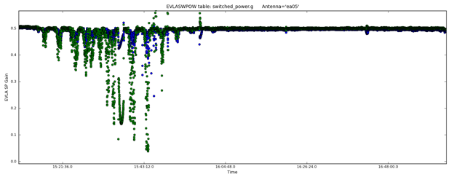
Challenge: Radio Frequency Interference (RFI)
Switched power gain
VLA switched power data shows gain compression
Time
Sirius/XM satellites
1-5 % compression
5-20 % compression
Artist's impression based on real data
>20 % compression
15°
Results of RFI sweep
10°
5°
Declination
0°
-5°
-10°
-15°
-6
-4
-2
0
+2
+4
+6
Hour Angle

Slide 14
VLASS calibration pipeline
Standard VLA calibration pipeline, with VLASS “recipe”
standard VLASS setup → some hard-coded options possible
switched-power application for gain compression
polarization calibration

Slide 15
VLASS calibration pipeline
Standard VLA calibration pipeline, with VLASS “recipe”
standard VLASS setup → some hard-coded options possible
switched-power application for gain compression
polarization calibration
Improvements to standard VLA pipeline from VLASS development:
“compression” fix by applying sys-power table
uv-ranges for calibrators (for non point-source cals)
improved RFI flagging heuristics

Slide 16
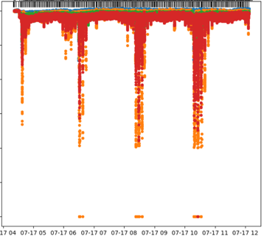
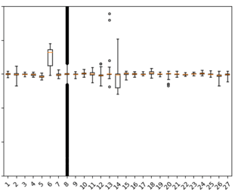
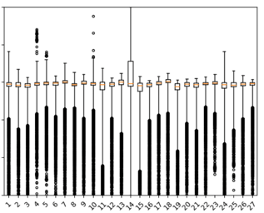
Correcting gain-compression in calibration pipeline
Determined by electronics signals internal to VLA system
Reliable correction results for compression ≲ 30%
Correction method (developed for VLASS) now in standard VLA pipeline
Examples from pipeline calibration weblog:
Compression vs time
Mostly good
Bad! compressed
1.00
1.2
1.2
0.90
1.0
1.0
Gain response
Gain response
0.80
0.8
0.8
0.70
Per VLA antenna
Per VLA antenna
Time of scan

Slide 17
VLASS Basic Data Products (status)
~1PB
Raw data 523 TB
Images 440 TB
Raw visibilities
timescale: immediate
served from NRAO data archive
✅
Notes:
***For single-epoch: re-evaluating the delivery schedule based on our developing experience with On-the-Fly-Mosaicking mode.
***We're producing them as quickly as we can now, and the SE Coarse Cubes will lag behind the SE continuum.

Slide 18
VLASS Basic Data Products (status)
~1PB
Raw data 523 TB
Images 440 TB
Raw visibilities
timescale: immediate
served from NRAO data archive
Calibrated data: standard VLA calibration pipeline, with VLASS “recipe”
timescale: days (pipeline+QA)
served from NRAO data archive
✅
✅
Notes:
***For single-epoch: re-evaluating the delivery schedule based on our developing experience with On-the-Fly-Mosaicking mode.
***We're producing them as quickly as we can now, and the SE Coarse Cubes will lag behind the SE continuum.

Slide 19
VLASS Basic Data Products (status)
~1PB
Raw data 523 TB
Images 440 TB
Raw visibilities
timescale: immediate
served from NRAO data archive
Calibrated data: standard VLA calibration pipeline, with VLASS “recipe”
timescale: days (pipeline+QA)
served from NRAO data archive
"QuickLook" Stokes I images: new VLA imaging pipeline, with VLASS “recipe”
timescale: days to weeks (pipeline+QA)
NRAO data archive** or https://science.nrao.edu/vlass/
✅
✅
✅
** Epoch 1 in archive lacks position correction updates
Notes:
***For single-epoch: re-evaluating the delivery schedule based on our developing experience with On-the-Fly-Mosaicking mode.
***We're producing them as quickly as we can now, and the SE Coarse Cubes will lag behind the SE continuum.

Slide 20
VLASS Basic Data Products (status)
~1PB
Raw data 523 TB
Images 440 TB
Raw visibilities
timescale: immediate
served from NRAO data archive
Calibrated data: standard VLA calibration pipeline, with VLASS “recipe”
timescale: days (pipeline+QA)
served from NRAO data archive
"QuickLook" Stokes I images: new VLA imaging pipeline, with VLASS “recipe”
timescale: days to weeks (pipeline+QA)
NRAO data archive** or https://science.nrao.edu/vlass/
"Single Epoch" products: higher-fidelity images, spectral/polarization cubes, catalogs
timescale: months to a year (producing as quickly as we can)
NRAO data archive or https://science.nrao.edu/vlass/
✅
✅
✅
** Epoch 1 in archive lacks position correction updates
⚠️
⇒ starting with Epoch 2.1, zenith distance < 45°
Notes:
***For single-epoch: re-evaluating the delivery schedule based on our developing experience with On-the-Fly-Mosaicking mode.
***We're producing them as quickly as we can now, and the SE Coarse Cubes will lag behind the SE continuum.

Slide 21
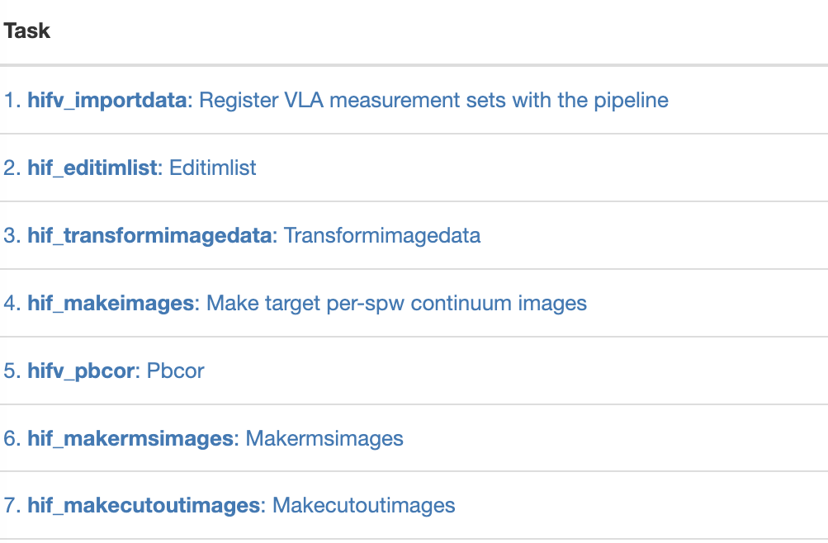
Quick Look image pipeline:
Basic imaging, for fast turnaround
Has automated quality checks
Re-imaging with different parameters or flagging if initial QA fails
Images are single plane, Stokes I continuum
Use of ‘mosaic’ gridder plus astrometric correction
Data products:
primary beam corrected images, rms images
Fast turnaround requires shortcuts in data processing…
The images still contain some deconvolution errors (sidelobes) for brighter sources
Phase errors from transfer of complex gain calibrator
No sophisticated clean regions
No direct w-term correction
Imaging pipeline steps (weblog):
Image definition
Image creation
Primary beam correction
RMS image creation

Slide 22
Quick Look image pipeline:
Basic imaging, for fast turnaround
Has automated quality checks
Re-imaging with different parameters or flagging if initial QA fails
Images are single plane, Stokes I continuum
Use of ‘mosaic’ gridder plus astrometric correction
Data products:
primary beam corrected images, rms images
Fast turnaround requires shortcuts in data processing…
The images still contain some deconvolution errors (sidelobes) for brighter sources
Phase errors from transfer of complex gain calibrator
No sophisticated clean regions
No direct w-term correction
Imaging pipeline steps (weblog):
Hear about the Quality Assurance QA procedures!
upcoming presentation by Sergio Garza (here, 1pm)
Quick Look imaging QA now well-automated!
poster tomorrow by Trent Seelig (5:30pm)
Image definition
Image creation
Primary beam correction
RMS image creation

Slide 23
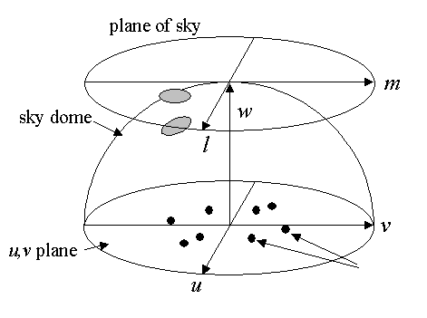
Quick Look image astrometric corrections:
The “mosaic” gridder in CASA’s tclean is fast, but does not correct for 3D w-term needed for sky curvature. Depends on zenith angle (Hour angle and declination).
We use an analytical function to correct images as a whole (using a reference pixel), based on offsets relative to GAIA and VLBA (VLASS memo #14)
AW-projection corrects for w-term effects directly, using a different gridding kernel, but it is much slower (also introduces a slight increase in noise)
VLASS - GAIA
Decl. offset (arcsec)
RA offset (arcsec)
Declination (deg)
VLASS - VLBI
Decl. offset (arcsec)
RA offset (arcsec)

Slide 24
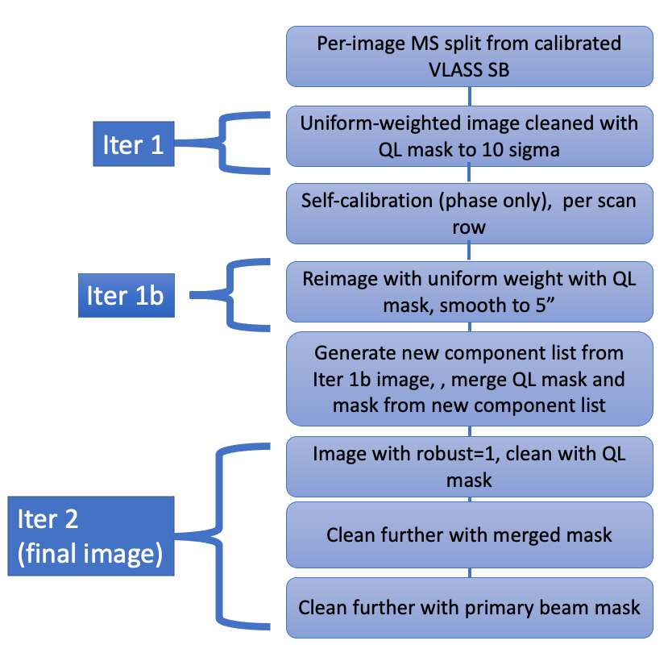
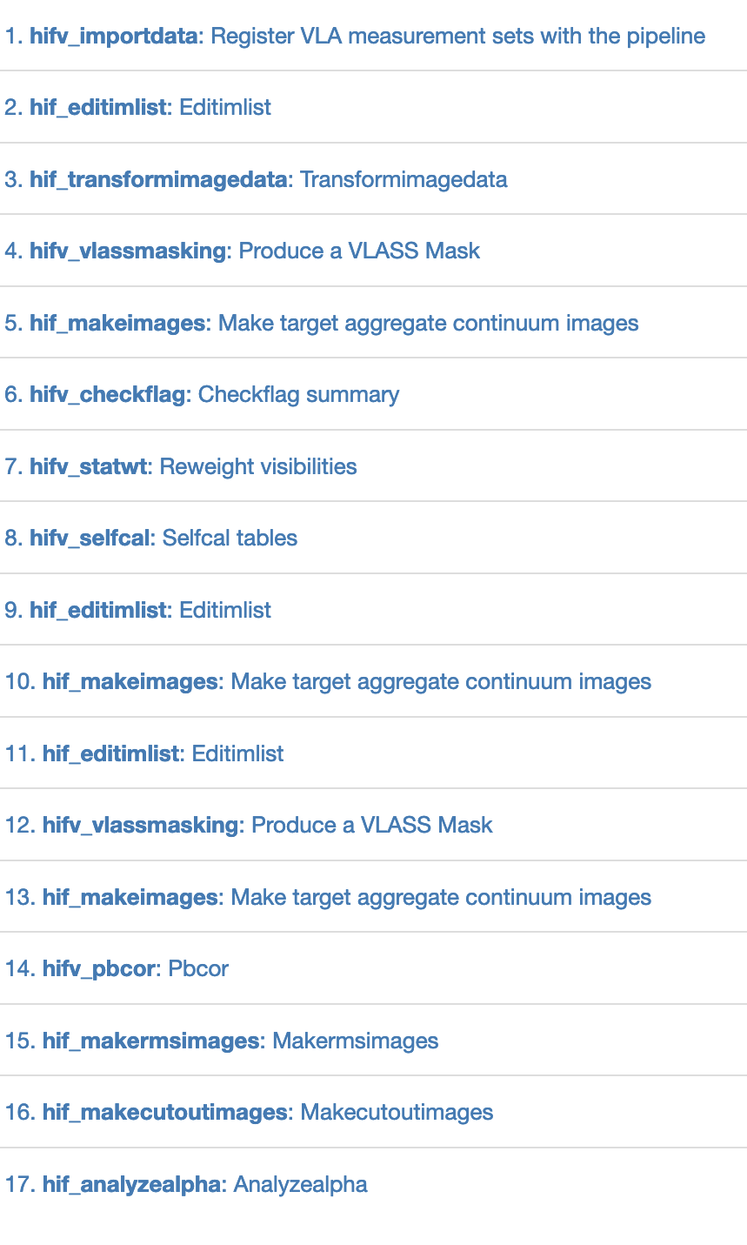
Single Epoch pipeline:
Better image quality, additional processing steps:
Initial clean with uniform weighting to fill model column
Self-calibration
Mask from QL + mask from the data themselves (iter 1)
Continuum data products are:
Stokes I image (tt0, tt1, alpha), primary beam corrected
RMS images
Region files/catalog
Currently using the “mosaic” gridder, limiting to zenith angle < 45°
Expect to use aw-project gridder for lower-declination / larger zenith angle images

Slide 25
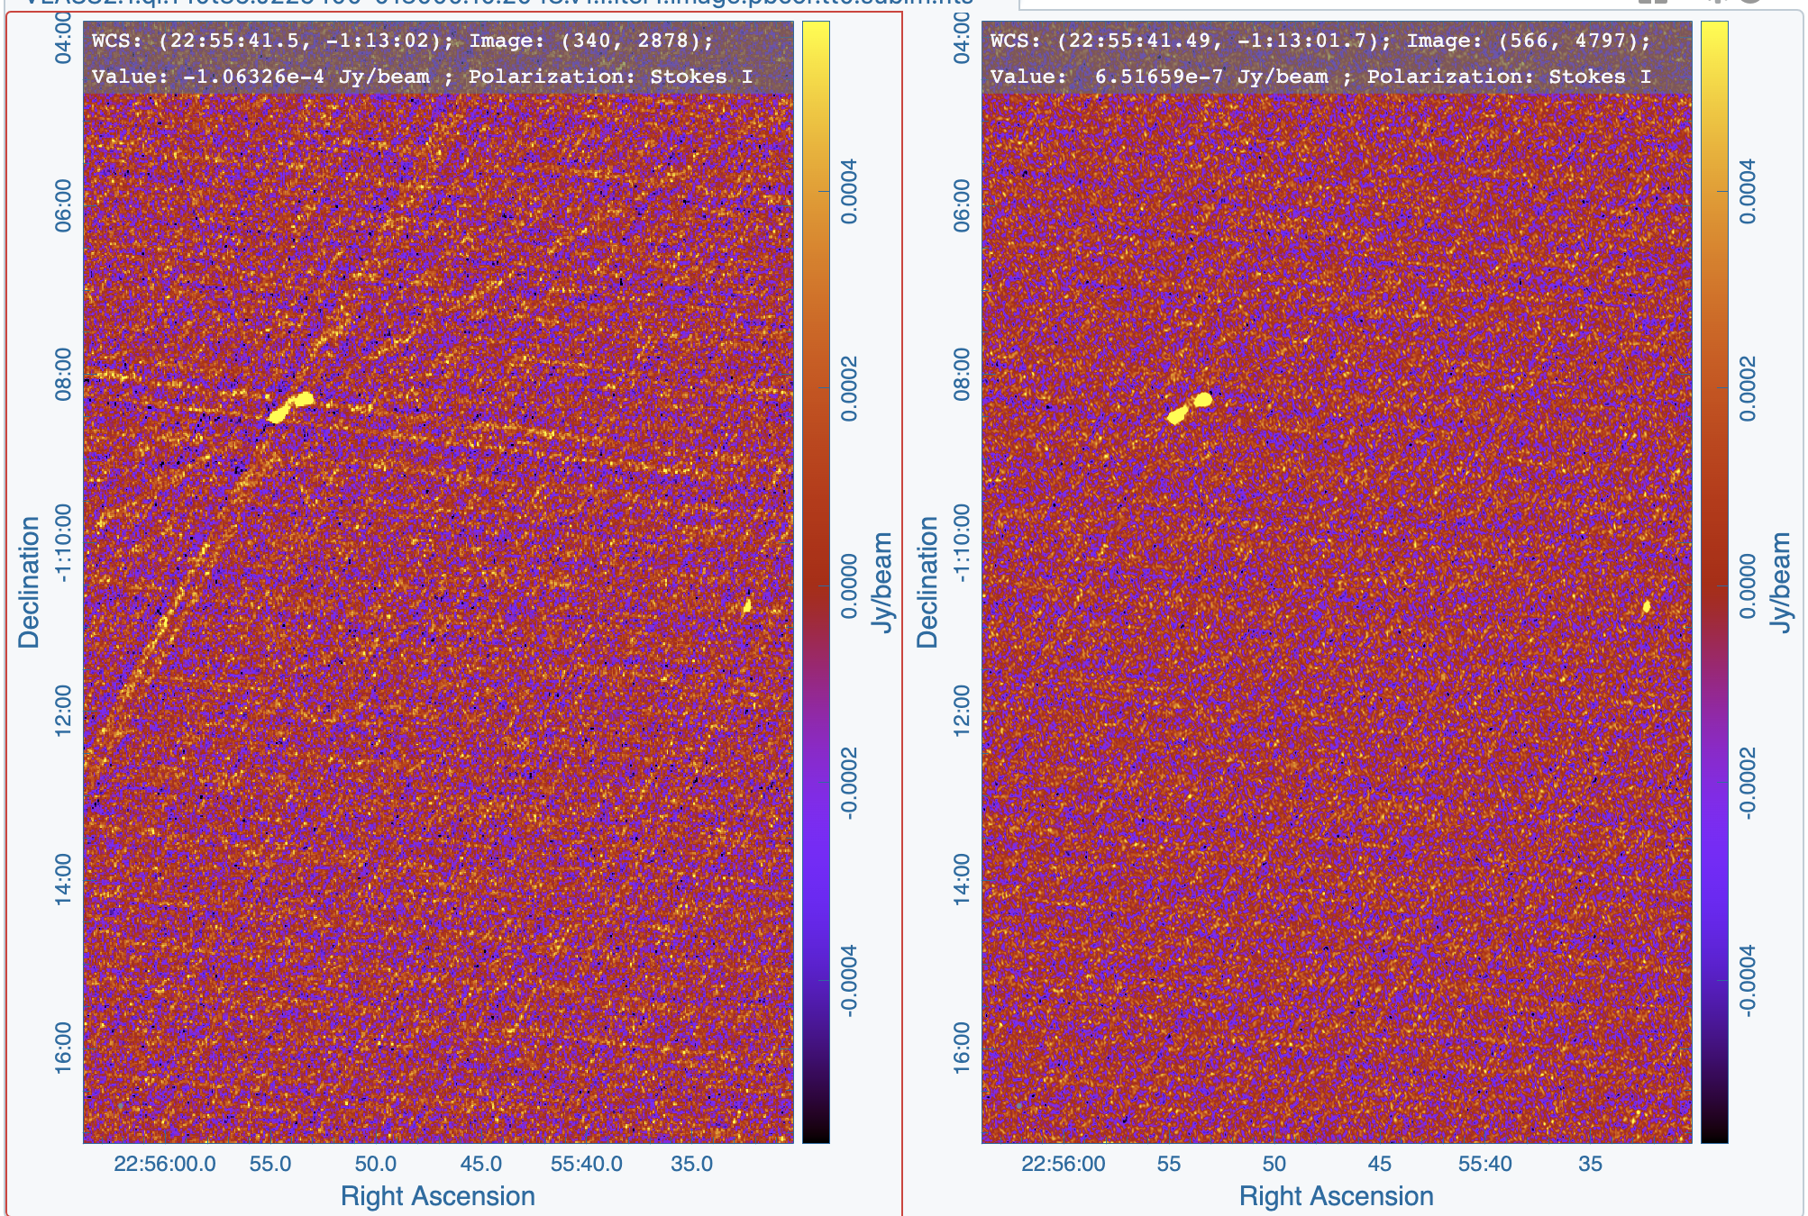
Quick Look Single Epoch
Image T10t35.J225400-013000
RMS ~ 180 𝛍Jy
RMS ~ 165 𝛍Jy
Notes:
RMS measured from full image; actually the MAD value
QL pipeline took 15.5 hours to run. SE pipeline took 3 days, 2.5 hours

Slide 26
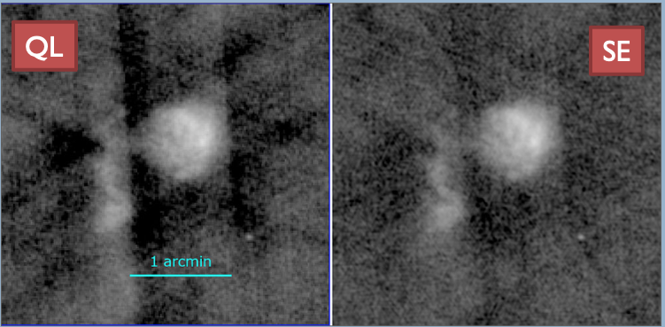
Improvement of Single Epoch (SE) over Quick Look (QL)
A protostar in Cygnus (image T21t21.J203427+413000)
RMS ~ 161 𝛍Jy
RMS ~ 137 𝛍Jy
Notes:
RMS measured 6 arcmin from the source
QL pipeline took 2 days, 18 hours to run. SE pipeline took 16 days, 9.5 hours to run

Slide 27
VLASS Computing challenges:
The NRAO cluster is powerful and designed for High Throughput Processing. We also have clusters at partner institutes (New Mexico Tech, RADIAL project).
Multicore processing speeds up the processing times, but will reduce the number of images being processed. For our purpose it is more efficient to run multiple datasets at once, each on a single core.
We produce 35,500 fields to image per epoch.
A Quick Look image takes about a day to run through the pipeline (longer for complex fields)
A Single Epoch continuum image with the mosaic gridder takes a few days (longer for complex fields)
AW-projection is needed for images/tiles at high zenith angle (southern declinations).
A possible speed-up will be a new GPU based gridder that is currently being developed and tested by the CASA group. First CASA tests in tclean show ~14 times improvement in processing speed for the imaging using the aw-projection. Tests for VLASS are planned once the gridder has been validated in CASA.

Slide 28
Imaging challenge: spectral index
Why the mosaic gridder has issues at high zenith angles:
Position offset scales as the square of the wavelength and the tangent of the Zenith Distance (ZD).
Thus the red end of the S-band has a larger displacement than the blue end.
The displacements are all small (<1” at 2 GHz) for ZD < 45 deg, and a simple correction works well.
At larger ZD, these chromatic effects start to become important on the scale of the 2.5-arcsec VLASS beam.
The main effect is on tt1, where the difference between the red and blue beams is being measured. This affects the spectral index (=tt1/tt0).
Zenith
Mean position correction
(applied in pipeline)
True position
Courtesy of Mark Lacy

Slide 29
VLASS status: observing ~2/3 completed
Pilot – Jun 2016 to Sep 2016 (observed)
Quick-Look processing only
VLASS 1.1 – Sep 2017 to Feb 2018 (observed)
QL calibrated, reimaging underway
VLASS 1.2 – Mar 2019 to Jul 2019 (observed)
QL calibrated, reimaging complete
VLASS 2.1 – Jun 2020 to Oct 2020 (observed)
QL complete & corrected; Single-Epoch calibration & imaging started
VLASS 2.2 – Oct 2021 to Mar 2022 (observed)
VLASS 3.1 – Jan 2023 to Jun 2023 (underway)
VLASS 3.2 – approximate May 2024 to Oct 2024

Slide 30
VLASS resources
Imaging products: archive-new.nrao.edu/vlass/
> 83,000 "QuickLook" images available
“Single Epoch” images in progress, starting with Epoch 2.1 (to pick up again after 3.2 observing)
Lacy et al. (2020, PASP, 132, 5001): The Karl G. Jansky Very Large Array Sky Survey (VLASS). Science Case and Survey Design
Survey science website: https://science.nrao.edu/vlass
VLASS memo series: https://library.nrao.edu/vlass.shtml
NRAO HelpDesk has a VLASS department! https://help.nrao.edu

